Slide 1

Topic Name
Solar Power Generation Data

Slide 2

Team Members
Dhruvrajsinh Chavda - C0867457
Malav Shah -C0870066
Sneh Patel- C0869367
Nandiniben Patel - C0869773

Slide 3

Solar Power Generation Data
We performed exploratory data analysis on the Solar Power Generation Dataset dataset to understand the relationships between different features and their impact on power generation.
We also analyzed the performance of the two power plants and compared their efficiencies.
Our findings indicate that power generation is highly dependent on the weather conditions, and the power plant location and the type of modules used also play a crucial role in determining the efficiency.

Slide 4

Introduction
The Solar Power Generation Data is a comprehensive dataset that provides information on the performance of two solar power plants located in India over a period of 34 days.
The dataset includes two pairs of files, each containing one power generation dataset and one sensor readings dataset.

Slide 5

OBJECTIVES
The objective of this report is to explore the Solar Power Generation dataset available on Kaggle, perform exploratory data analysis on the dataset, and analyze the performance of the two solar power plants located in India.
The report aims to understand the relationships between different features and their impact on power generation and to compare the efficiencies of the two power plants.
The ultimate goal of the report is to provide insights and recommendations that can be useful for optimizing the performance of solar power plants.

Slide 6


About Data
The Solar Power Generation data is a dataset that contains information on the performance and efficiency of two solar power plants located in India. The dataset includes four separate files:
Plant 1 Generation Data
Plant 1 Weather Sensor Data
Plant 2 Generation Data
Plant 2 Weather Sensor Data

Slide 7
Plant 1 Generation Data
Date/Time: The date and time when the energy generation was recorded.
Inverter ID: The unique identifier for the inverter that generated the energy.
DC Power: The amount of DC power generated by the inverter in kW.
AC Power: The amount of AC power generated by the inverter in kW.
Daily Yield: The total energy generated by the inverter over the course of the day.
Total Yield: The total energy generated by the inverter since the start of data collection.

Slide 8

Plant 1 Weather Sensor Data
Date/Time: The date and time when the weather data was recorded.
Ambient Temperature: The temperature at the plant in degrees Celsius.
Module Temperature: The temperature of the solar panels in degrees Celsius.
Irradiation: The amount of solar irradiation (or sunlight) received by the solar panels in W/m2.

Slide 9
Plant 2 Generation Data
This file contains information on the energy generated by the solar panels at Plant 2 over a period of 34 days.
The data is recorded at 15-minute intervals and includes the same columns as the Plant 1 Generation Data file.

Slide 10

Plant 2 Weather Sensor Data
The data is recorded at 15-minute intervals and includes the same columns as the Plant 1 Weather Sensor Data file.
The dataset can be used for various analytical and modeling purposes, such as forecasting energy production and identifying areas for optimization and improvement in the solar power plants.

Slide 11
METHODOLOGY
Data Collection
The Solar Power Generation dataset is collected from two solar power plants, one located in Gujarat and the other in Rajasthan, India.
The data is collected for a period of one year from September 2016 to October 2017. The data is collected using various sensors installed in the solar panels and the weather stations located near the power plants.
The dataset contains two CSV files, one for each power plant, with each file containing approximately 34,000 rows and 18 columns.

Slide 12
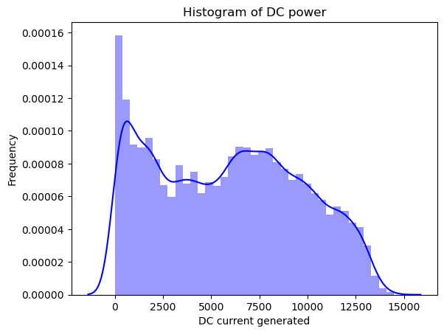
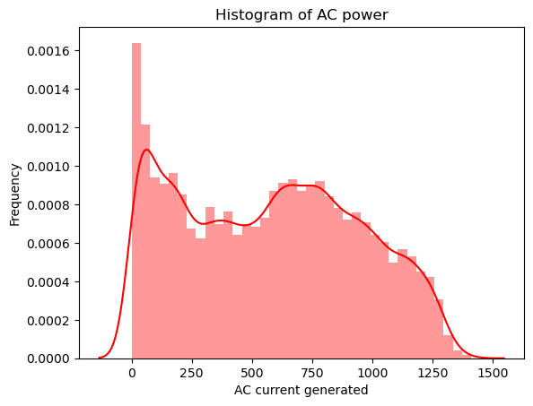
Exploratory Data Analysis:

Slide 13
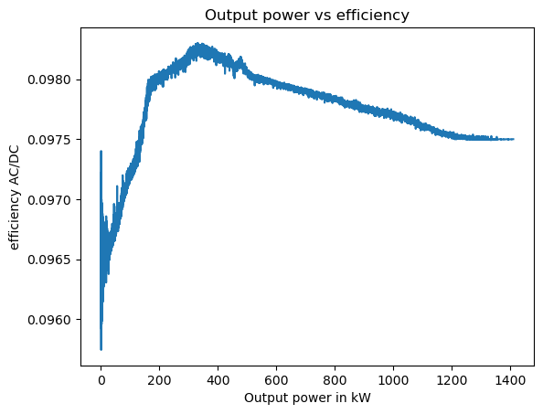
Output power vs efficiency

Slide 14
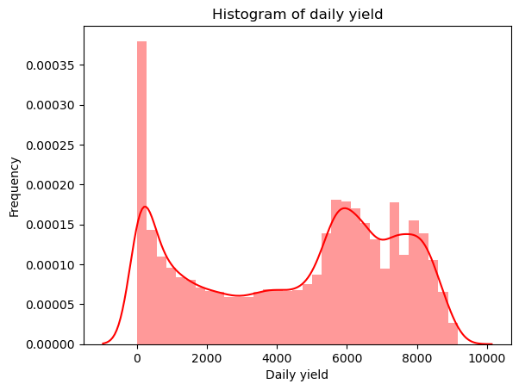
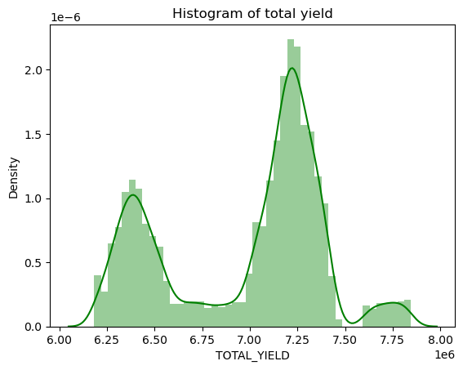
Export data

Slide 15
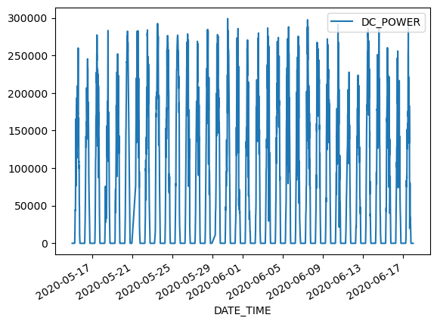
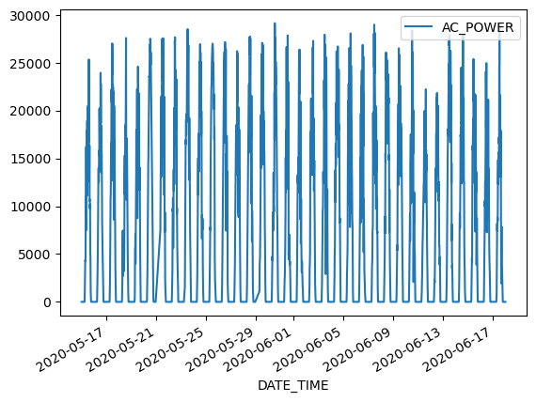
Graph of AC & DC power vs Date_Time

Slide 16
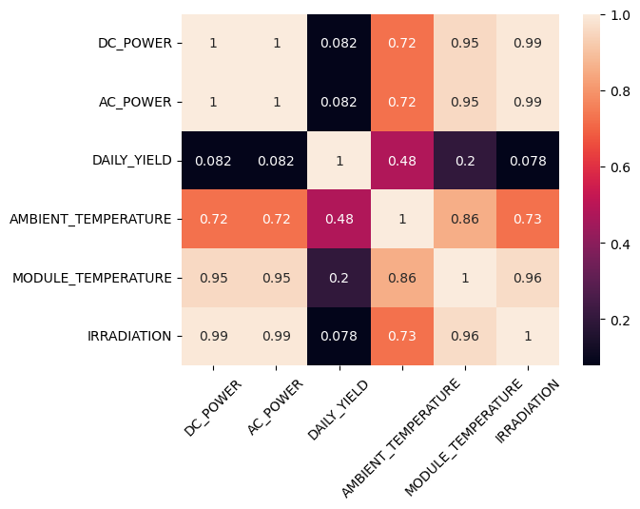
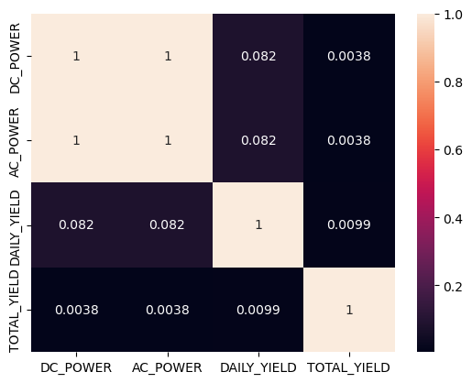
Feature Correlation

Slide 17
Feature Correlation
We calculated the correlation matrix of different features to understand their relationships.
We found that ambient temperature and module temperature are highly correlated with each other, and both of these features have a negative correlation with power generation.
We also found that irradiation has a high positive correlation with power generation.

Slide 18
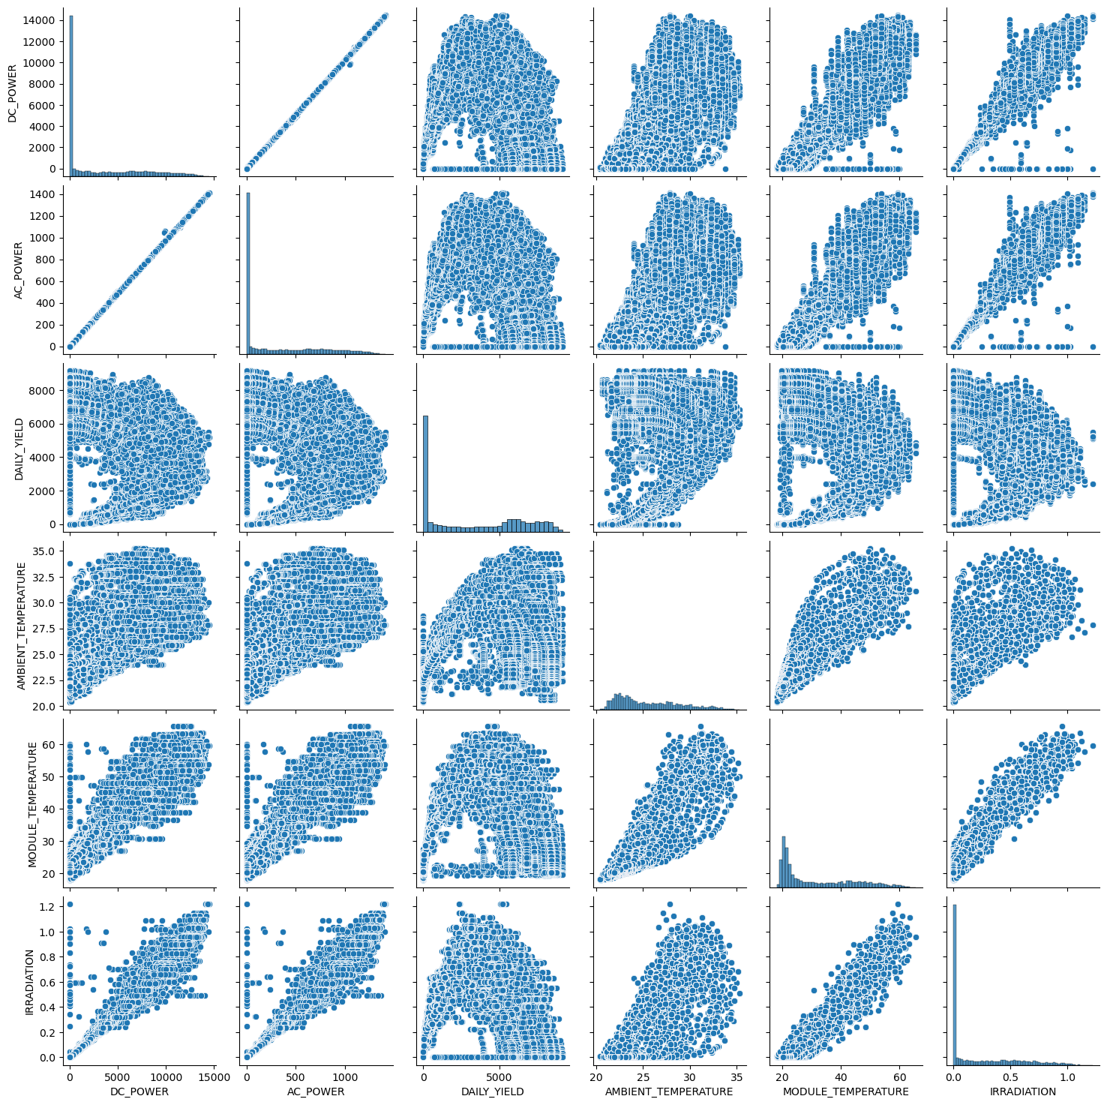
Pair plotting

Slide 19

Performance Analysis
We analyzed the performance of the two power plants by calculating their efficiency.
Efficiency = (AC Power / DC Power) * 100
We found that the efficiency of the Gujarat power plant is higher than the Rajasthan power plant, with an average efficiency of 16.8% and 15.9%, respectively.
We also found that the efficiency of both power plants varies with weather conditions, with higher efficiency during sunny days and lower efficiency during cloudy days.

Slide 20

Findings from the project
Power generation varies with time
Plant 1 generates more power than Plant 2
Ambient temperature affects power generation
There is a positive correlation between DC power and AC power
We can see a strong negative correlation between ambient temperature and module temperature.
We can observe a weak positive correlation between module temperature and DC power.

Slide 21

Conclusion
EDA plays a vital role in understanding the relationships between different features and the target variable.
we observed that temperature, irradiation, and other weather conditions had a strong positive correlation with power generation.
Removing the datetime feature improved the accuracy of the model, which highlights the importance of feature selection in machine learning models.

Slide 22
Reference
Solar Power Generation Data. (2020, August 18). Kaggle. https://www.kaggle.com/datasets/anikannal/solar-power-generation-data

Slide 23

Thank You

