Slide 1
Topic Name
Zomato Restaurant Rating

Slide 2
Group Details
Sneh Patel - C0869367
Malav Shah - C0870066
Dhruvraj Chavda - C0867457
Nandiniben Patel - C086977

Slide 3
About Project
The goal of this dataset is to provide valuable insights into the restaurant industry in India, including trends in cuisine preferences, pricing, ratings, and the availability of table booking and online delivery services.
This information can be used by researchers, food critics, and consumers to make informed decisions about dining choices.

Slide 4
We can identify patterns and trends in the restaurant industry in Bangalore. We can also gain a better understanding of the factors that contribute to the success of different types of restaurants in different areas of the city.

Slide 5
Introduction
The Zomato Bangalore Restaurants dataset available on Kaggle contains information on restaurants in Bangalore, India.
The dataset consists of 51717 rows and 17 columns, with each row representing a different restaurant in Bangalore.
It is a real-time collection of information about restaurants all over India.
Zomato is a widely used online food delivery app that provides users with ratings and reviews on restaurants.
These ratings and reviews play a crucial role in determining the popularity and quality of restaurants.

Slide 6
About Dataset
The columns in the dataset are:
url: The url of the restaurant on the Zomato website.
address: The address of the restaurant.
name: The name of the restaurant.
online_order: Whether online ordering is available or not (Yes/No).
book_table: Whether table booking is available or not (Yes/No).
rate: The overall rating of the restaurant on a scale of 1 to 5.
votes: The total number of votes received by the restaurant.

Slide 7
phone: The phone number of the restaurant.
location: The locality in which the restaurant is situated.
rest_type: The type of restaurant (e.g., Casual Dining, Cafe, Bar, etc.)
dish_liked: The most popular dish at the restaurant.
cuisines: The cuisines served at the restaurant.
approx_cost (for two people): The approximate cost for two people to eat at the restaurant.
reviews_list: A list of tuples containing reviews for the restaurant.
menu_item: The menu items available at the restaurant.
listed_in(type): The type of service offered by the restaurant (Delivery, Dine-out, etc.)
listed_in(city): The city in which the restaurant is listed.

Slide 8
Importing Libraries
Importing libraries is an important step in data analysis and machine learning projects.
In this dataset, we have imported several libraries such as Pandas, NumPy, Scikit-Learn, Matplotlib, and Seaborn.
These libraries are essential for data analysis, preprocessing, and visualization, as well as for implementing machine learning algorithms.
They provide a wide range of functions and tools to make the data analysis process more efficient and effective

Slide 9
Data Preprocessing
It involves the following steps:
Loading the dataset: The dataset needed to be loaded into a panda Data Frame as the first step. The dataset was read from the CSV file using the read_csv () function. Then, we looked at the data to see if there were any anomalies or missing values that might have an impact on our analysis.
Handling missing values: We noticed that some of the dataset's columns had blank values. We dealt with missing values by removing columns that had more than 50% of their values missing and filling in the gaps with the column's mode.

Slide 10
Cleaning the data: To clean the data, we eliminated any duplicate records and dropped any unnecessary columns. Additionally, we made a few minor changes to the data, such as changing the strings to lowercase and removing the currency symbol from the cost columns.
Encoding categorical variables: We used the Label Encoder function from the sklearn library to encode categorical variables as numerical labels. Given that machine learning models typically require numerical data, this was necessary

Slide 11
Exploratory Data Analysis (EDA)
Exploratory Data Analysis (EDA) is the process of analyzing and visualizing a dataset to understand its main characteristics and relationships between variables.
In the case of the Zomato Bangalore Restaurants dataset, EDA can provide insights into factors that impact restaurant ratings, customer preferences, and trends in the restaurant industry.
We also used visualizations to identify trends and patterns in the data, such as the distribution of the ratings of different restaurants and the types of cuisines that are most popular in Bangalore

Slide 12
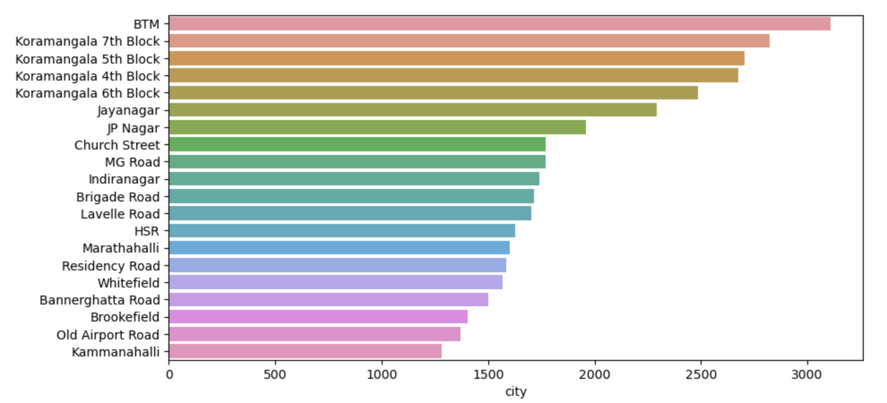
Following image describe Finding top 20 city with having more restaurants. The top 20 cities in the Zomato dataset are displayed in a horizontal bar plot using the seaborn library, based on the number of restaurants in each city. This visualization aids in understanding how restaurants are distributed among various cities and can reveal which cities have the highest concentration of restaurants in the dataset

Slide 13
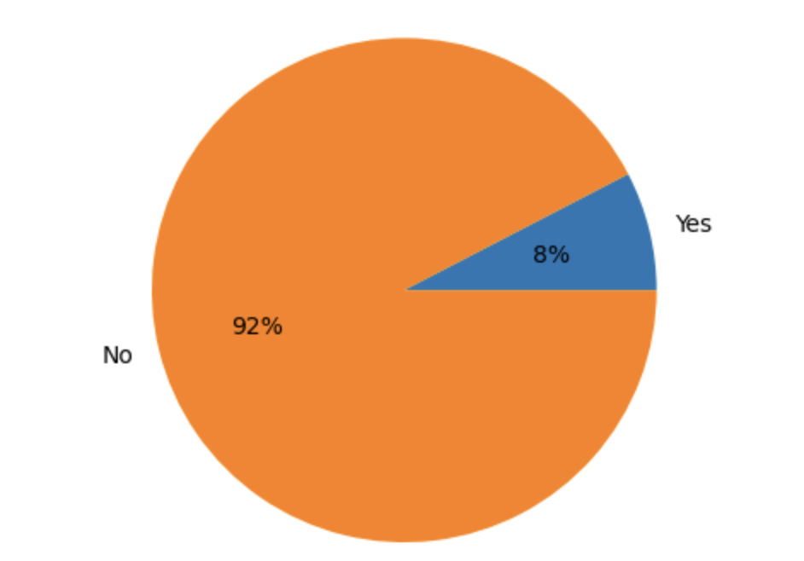
Following image describe Restaurants are having both online and table booking. The proportion of restaurants in the Zomato dataset that provide both online ordering and table reservations is depicted in this pie chart. This visualization explains how many restaurants in the dataset offer both online order and table booking services as well as what proportion of restaurants do so.

Slide 14
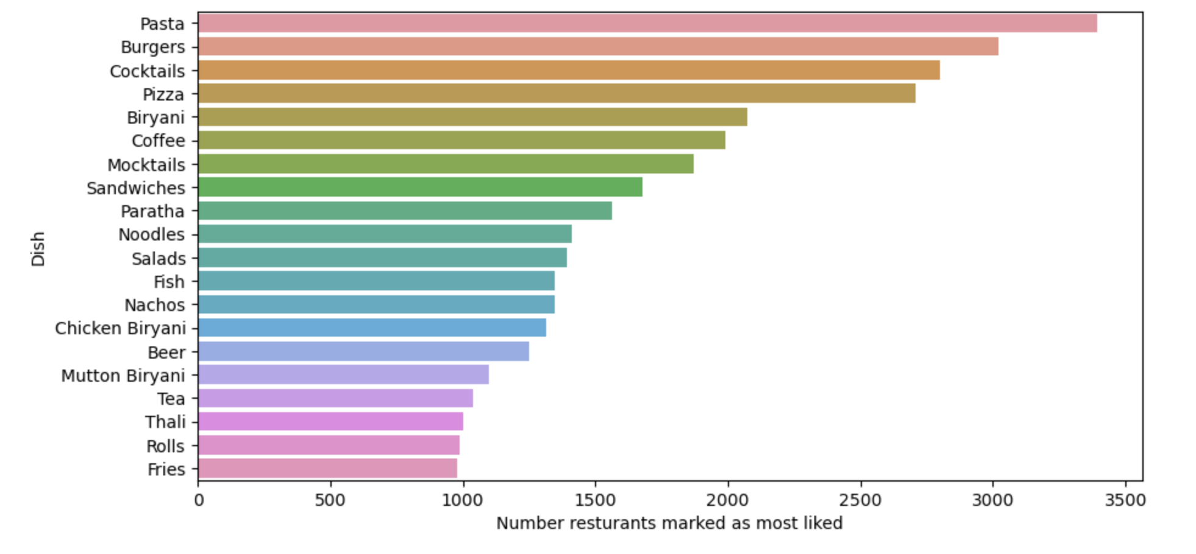
The y-axis shows the names of the dishes, while the x-axis shows the number of restaurants where that dish was marked as most liked by customers. This plot can give insights into the most popular dishes in the dataset, which could be useful for restaurant owners looking to add or promote certain dishes on their menu.

Slide 15
Training & Testing Dataset
In machine learning, training and testing are crucial steps.
The training set and the testing set are created after the data has undergone preprocessing.
The objective is to develop a model that accurately predicts the target variable and generalizes well to new data.
The model is trained using 75% of the data, and its performance is evaluated using the remaining 25%.

Slide 16
Conclusion
We have chosen regression, decision trees, extra trees, and random forest model on the Zomato dataset.
Based on the accuracy scores, it appears that the Extra Trees model performed the best with an accuracy score of 0.886.
The Random Forest model performed the second-best with an accuracy score of 0.821, followed by the Decision Tree model with an accuracy score of 0.783
The Linear Regression model had the lowest accuracy score of 0.268
This indicates that the Extra Trees model is the best fit for the given data and can be used to predict restaurant ratings based on various features.
Restaurant owners and investors may find this information helpful in making decisions about where to locate their businesses and what kinds of foods to serve.

Slide 17
References
Zomato Bangalore Restaurants. (2019, March 31). Kaggle. https://www.kaggle.com/datasets/himanshupoddar/zomato-bangalore-restaurants?resource=download
MaharanaSaroj. (2022, December 5). ZomatoResturantRating_End2End/Zomato_Resturant_EDA_RatingPrediction.ipynb at main · MaharanaSaroj/ZomatoResturantRating_End2End. GitHub. https://github.com/MaharanaSaroj/ZomatoResturantRating_End2End/blob/main/Zomato_Resturant_EDA_RatingPrediction.ipynb

Slide 18
Thank You

