Slide 1
Blockchain based E - Voting System
Professor - Dr. Sanjay Chaudhary
Teaching Assistant - Kaushal Patil
Dhruvil Panchamia - AU1940285
Jash Shah - AU1940286
Sarjil Patel - AU1940281

Slide 2
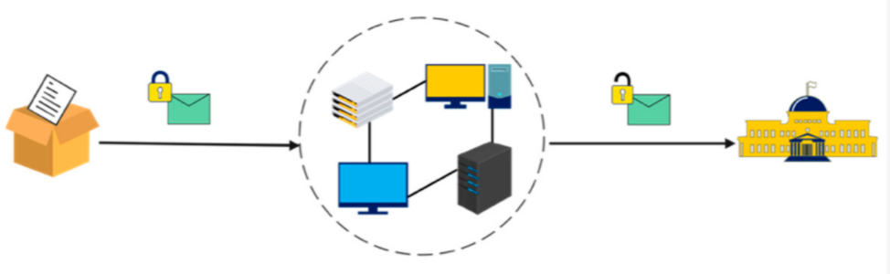
Problem Description
The purpose of Blockchain based Decentralized Voting System is to carry out election with transparency.
The voters will be verified and one voter will be able to vote only once.
Each vote will be stored on blockchain database so it cannot be tempered.
Only election commissions have access to the blockchain database which will help in conducting election fairly.

Slide 3
Stakeholders
Citizen (Voter)
Election Commision
Candidates
Smart Contracts
Election
Add Candidates
Validating Voter
Casting of Vote

Slide 4
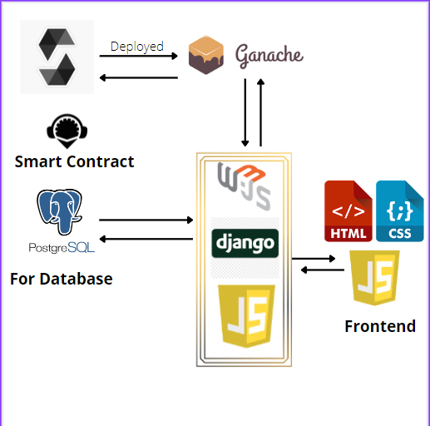
Architecture

Slide 5
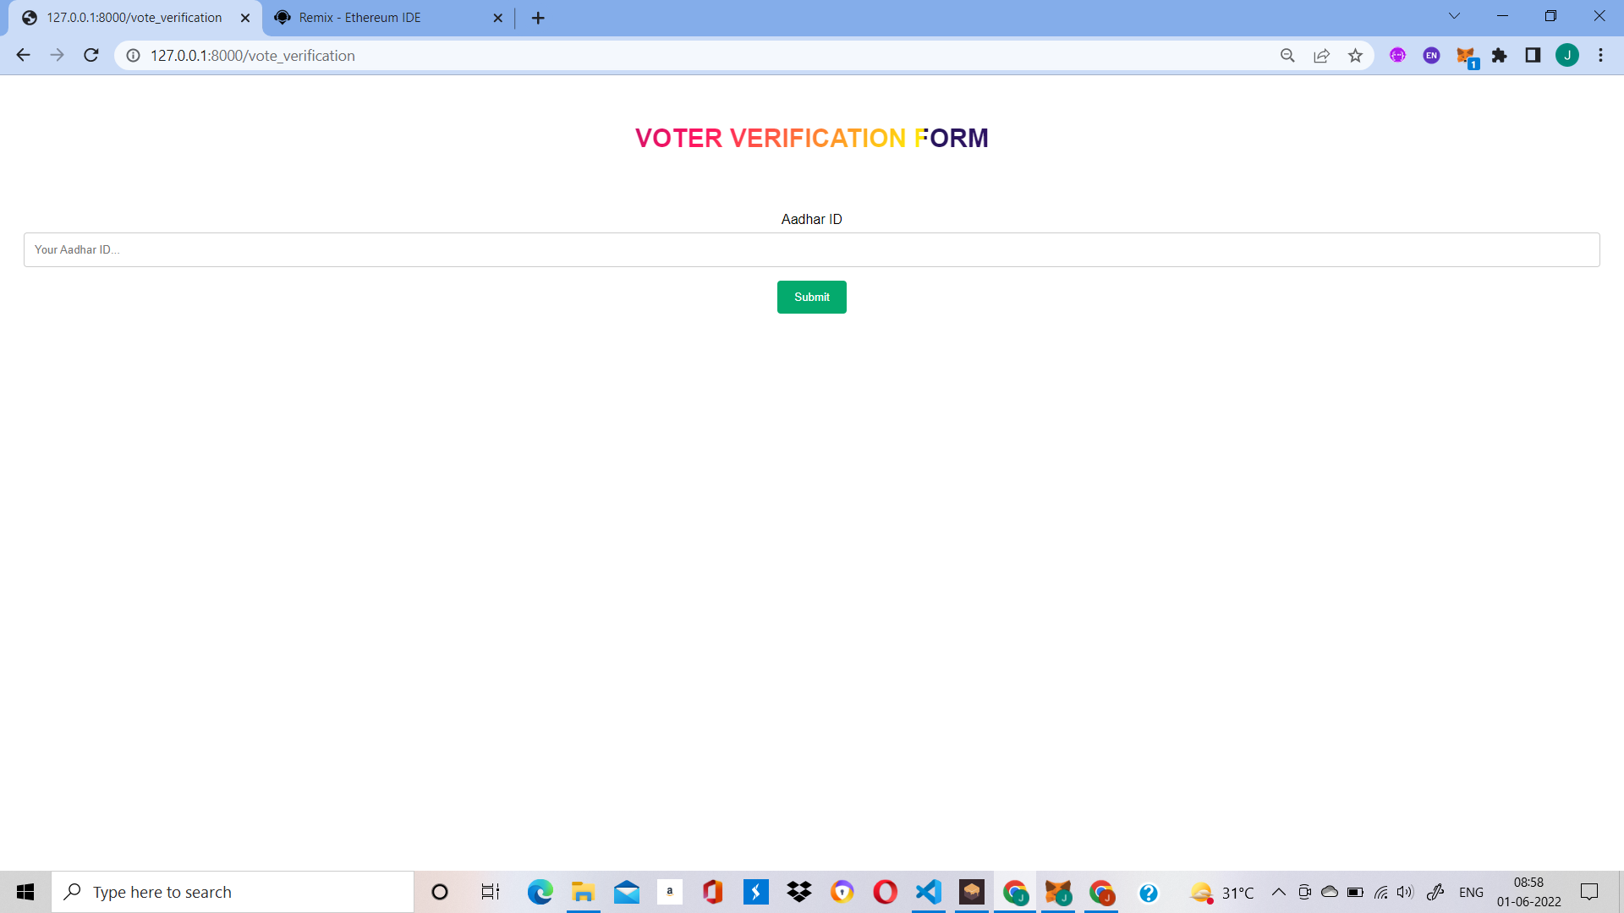
Voter Verification

Slide 6
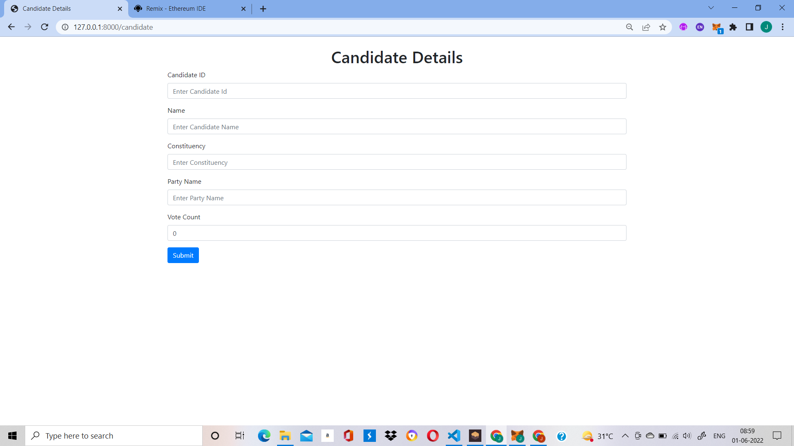
Candidate Form

Slide 7
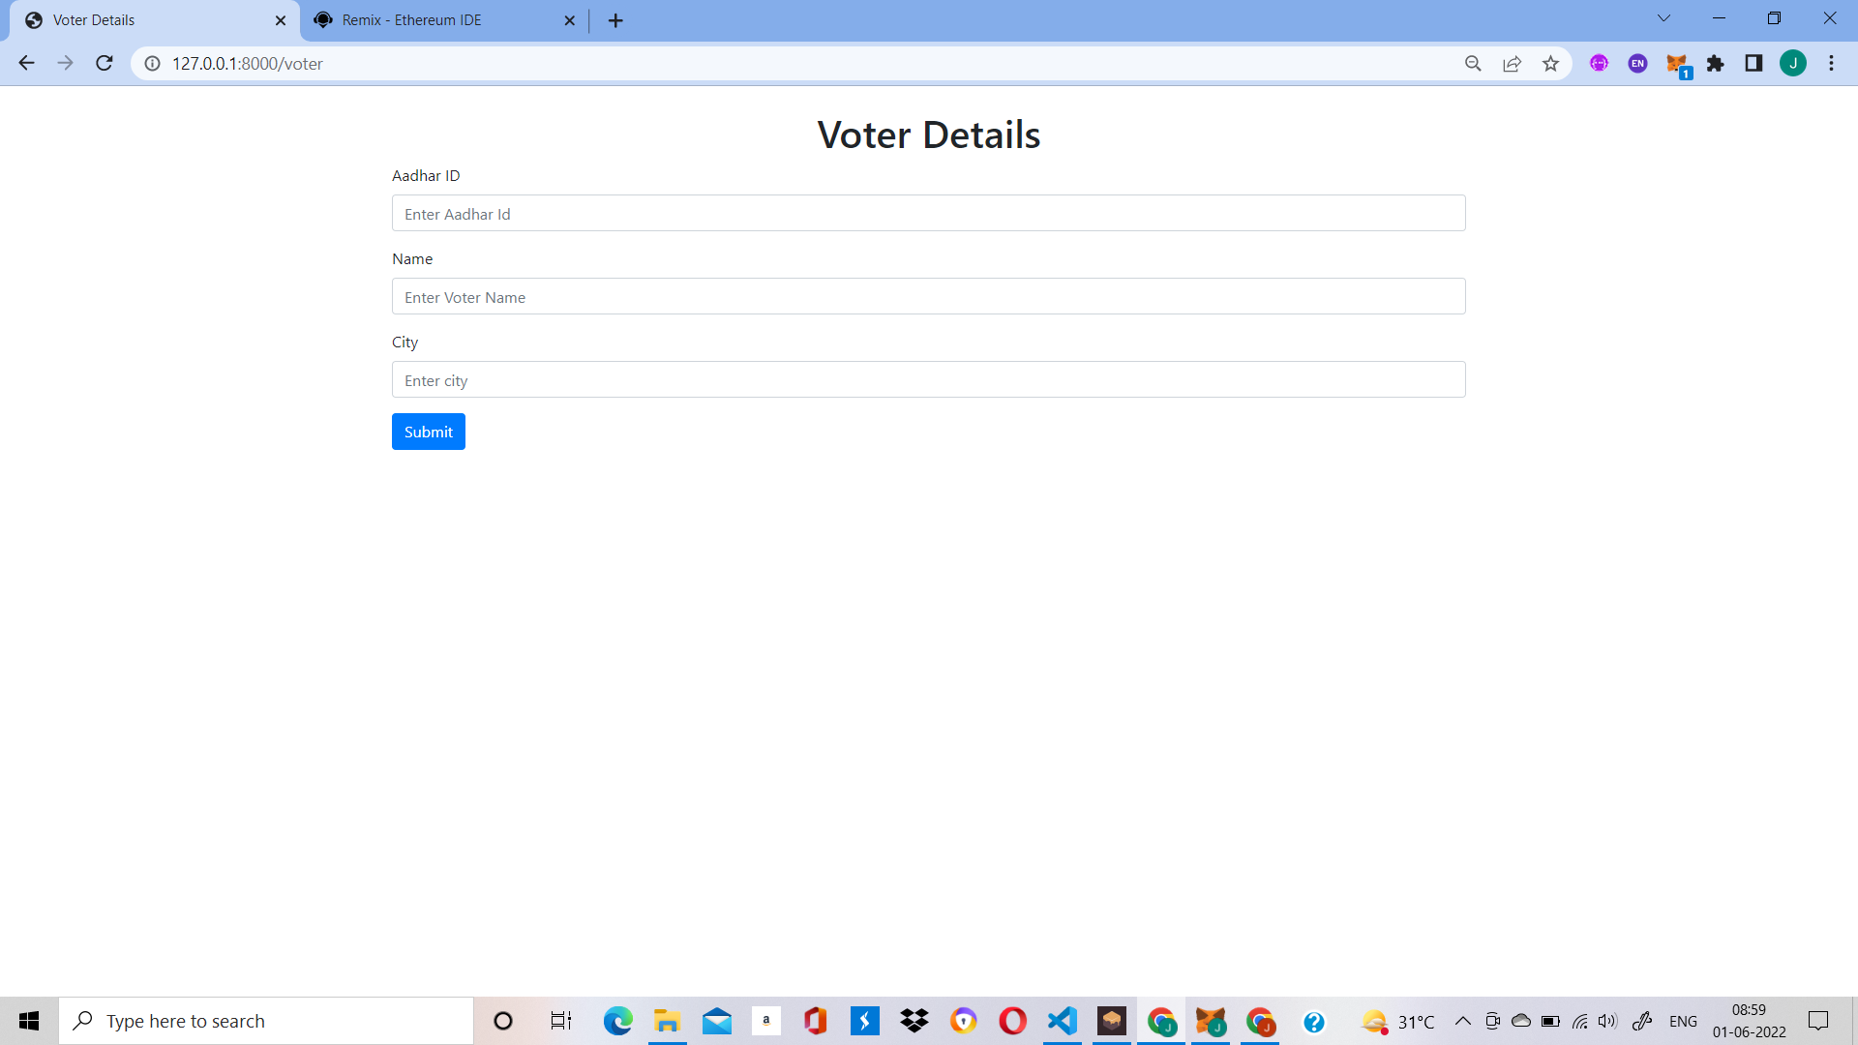
Voter Form

Slide 8
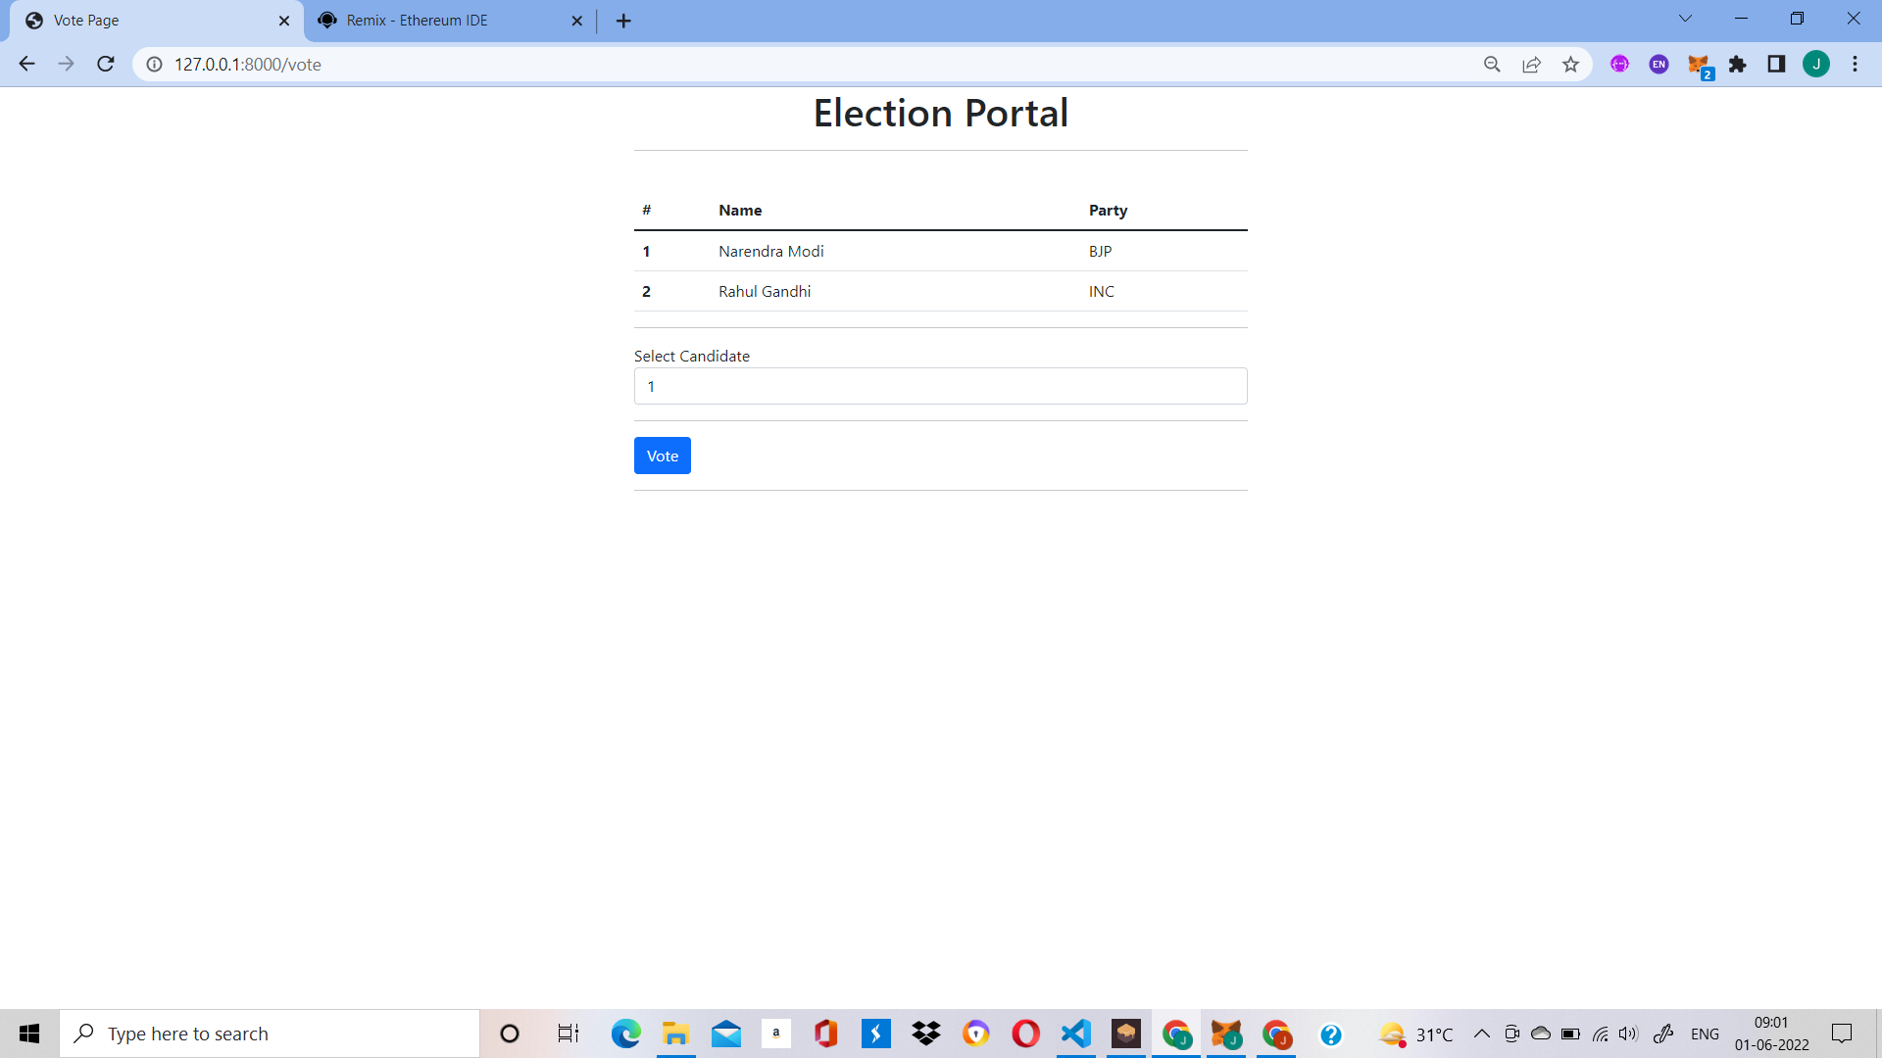
Election Portal

Slide 9
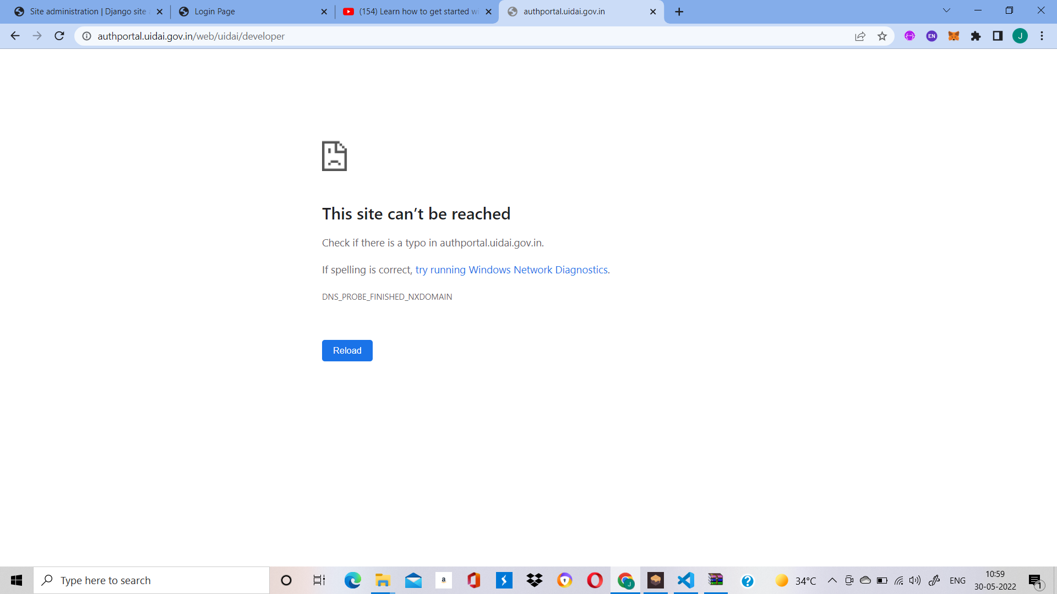
Aadhar API Error

Slide 10
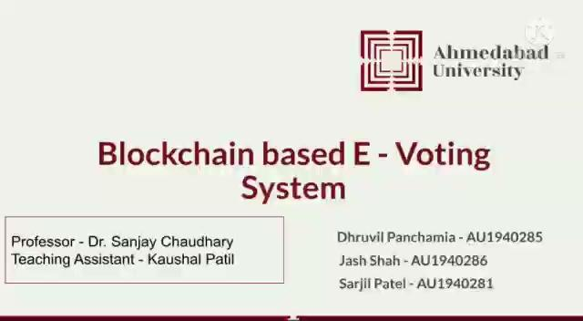
Implementation

Slide 11

Implementation

Slide 12
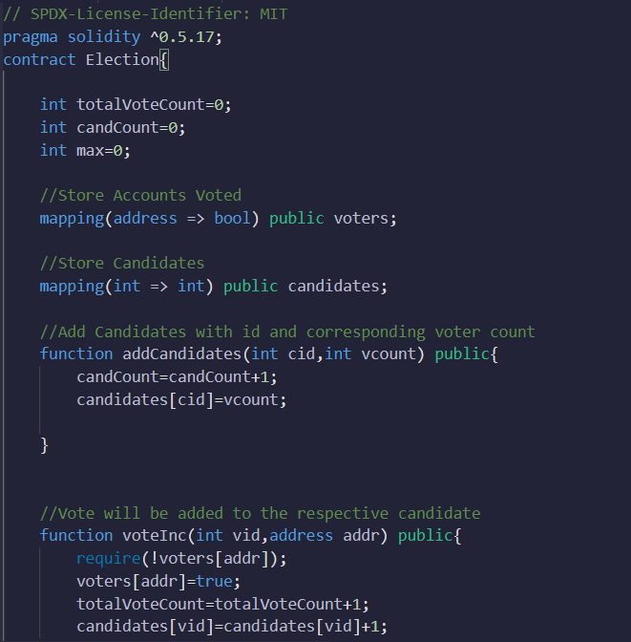
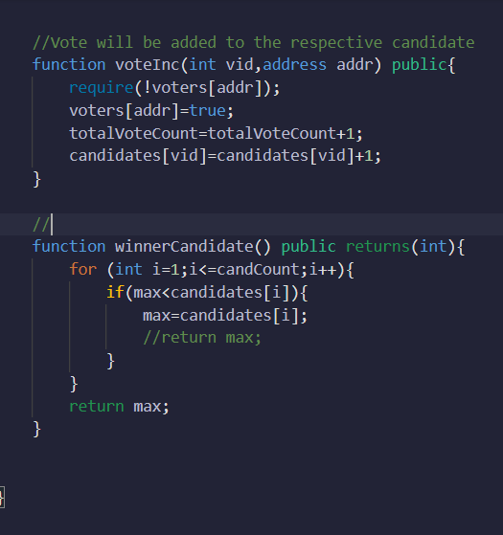
Some Snippets of Smart Contract

Slide 13
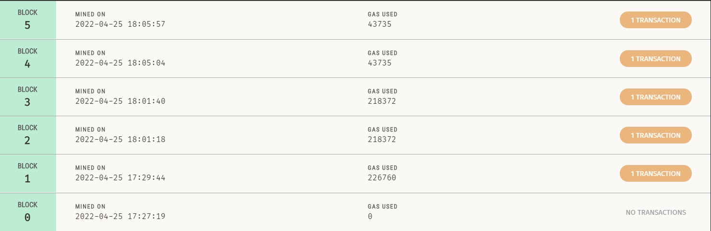
Blocks

Slide 14
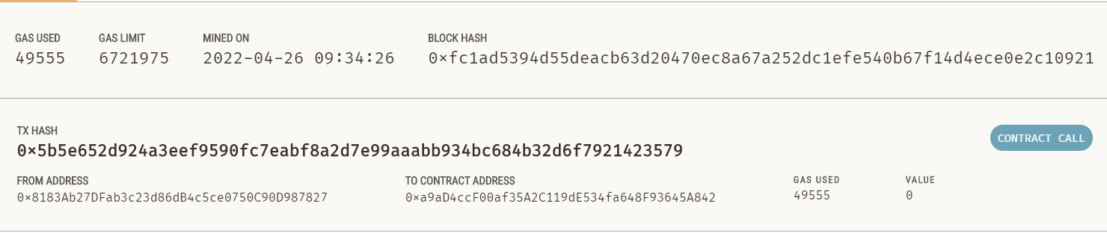
Block Details

Slide 15
THANK YOU!

