Slide 1
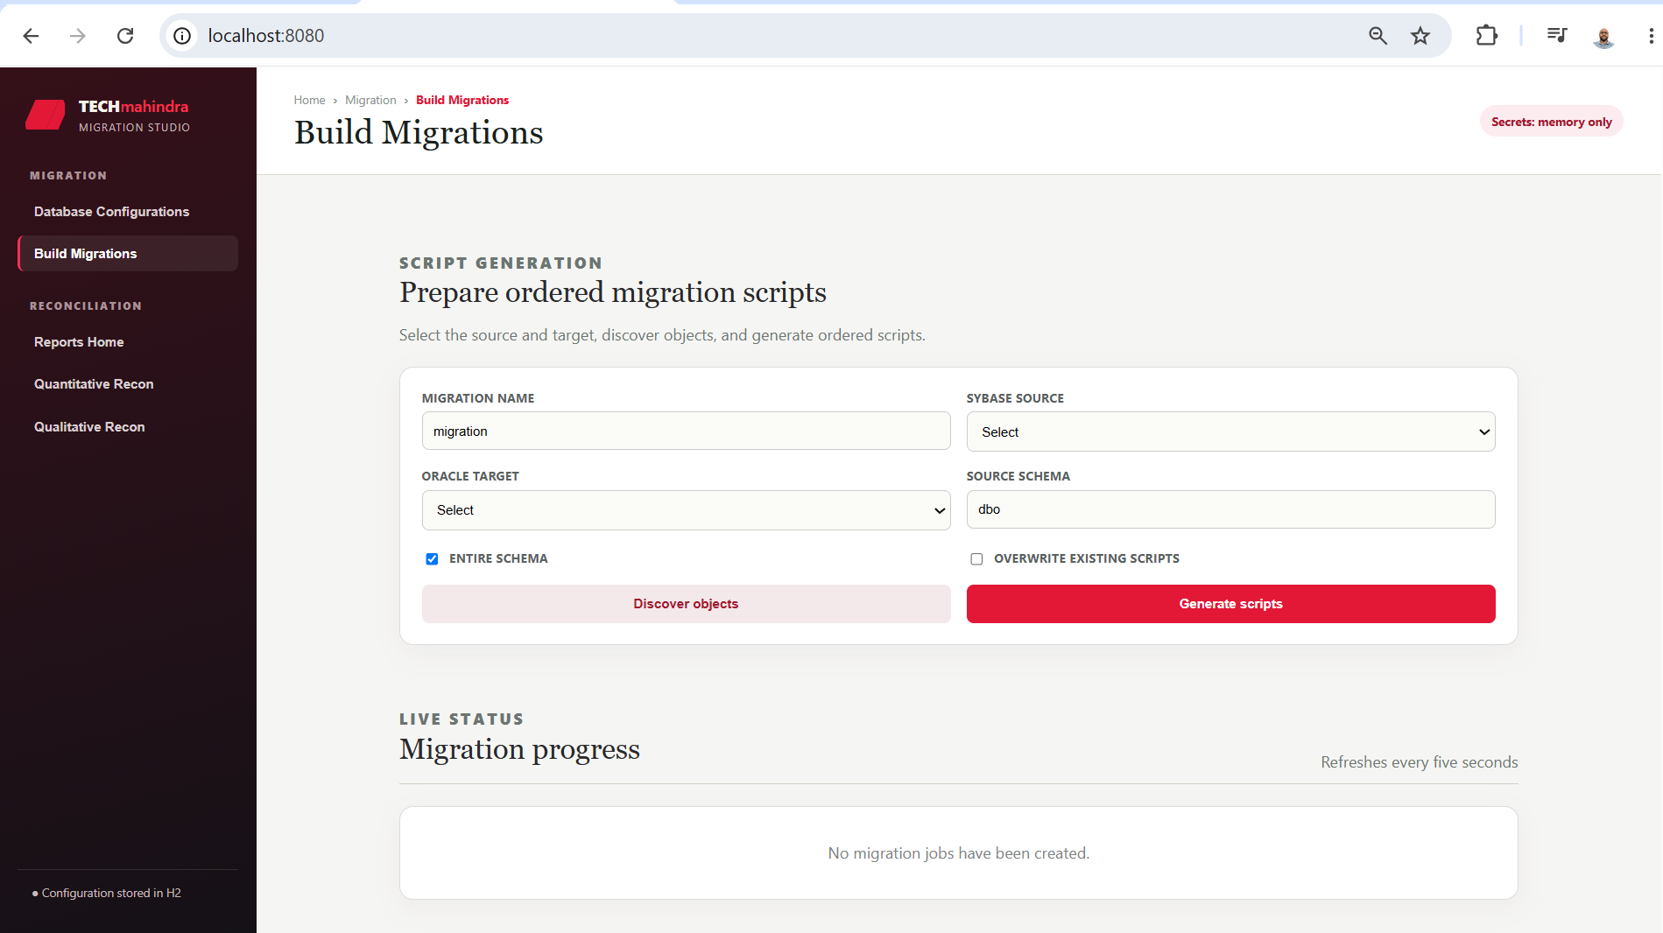
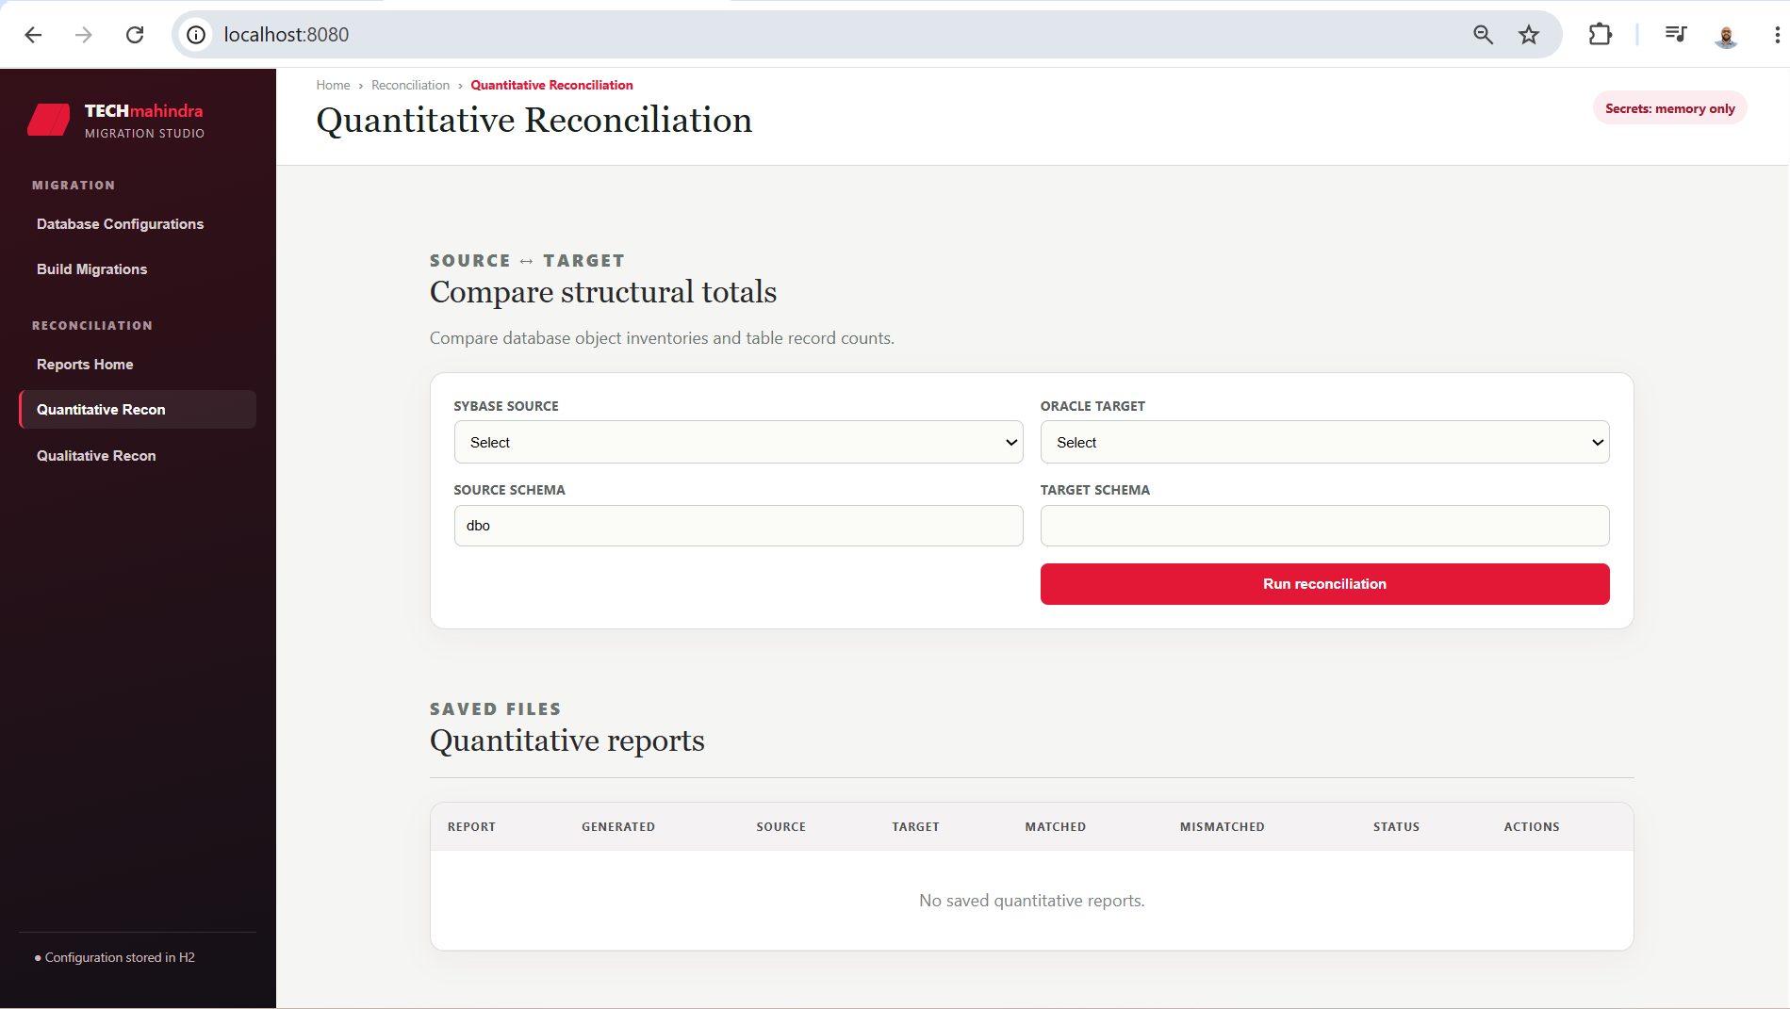
ORACLE
MIGRATION
MIGRATION STUDIO
A controlled path from SAP Sybase ASE metadata and data
to ordered Oracle migration scripts and evidence-based reconciliation.
SPRING BOOT 3 | ANGULAR 18 | JAVA 17
PRODUCT OVERVIEW / 2026
TECH MAHINDRA / MIGRATION STUDIO
01

Slide 2
THE JOB TO BE DONE
Make migration work visible, ordered, and recoverable.
The studio turns a high-risk database move into a sequence of inspectable decisions.
FROM
THROUGH
TO
Sybase ASE
metadata + data
Migration
Studio
Oracle
readiness
→
→
Reusable connection profiles
JDBC metadata discovery
Manual-review boundaries for complex objects
Generated scripts
Quantitative proof
Qualitative comparison
Ordered DDL / DML generation
Checkpointed async jobs
TECH MAHINDRA / MIGRATION STUDIO
02

Slide 3
ONE OPERATING MODEL
Configure once. Generate in phases. Reconcile with evidence.
Each stage leaves an artifact or checkpoint that supports the next decision.
01
02
03
04
CONFIGURE
→
DISCOVER
→
GENERATE
→
RECONCILE
Source + target
profiles
Schema objects
and selections
DDL, DML, keys
and indexes
Counts, mappings
and record proof
DESIGN PRINCIPLE
Keep credentials ephemeral, keep progress explicit, and keep mismatches actionable.
TECH MAHINDRA / MIGRATION STUDIO
03

Slide 4
MIGRATION FACTORY
Generate the right script at the right time.
Base DDL, data inserts, and deferred constraints are separated to protect execution order.
THE PHASED OUTPUT
01
Base DDL
Tables and views, without dependent keys or indexes.
02
DML inserts
Literal INSERT statements, checkpointed by table.
03
Deferred dependencies
Indexes, primary keys, and foreign keys after data.
The UI refreshes job data every five seconds and shows processed, failed, and completed units.
ASYNC JOBS
CHECKPOINTS
RESUME / RETRY
TECH MAHINDRA / MIGRATION STUDIO
04

Slide 5
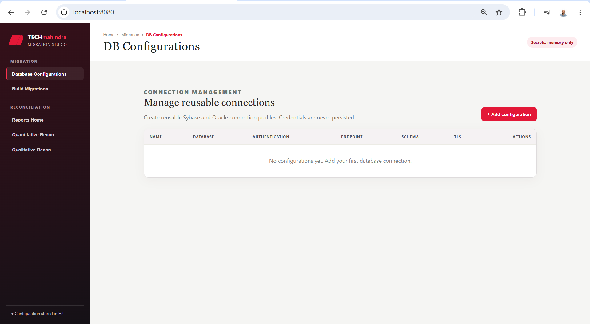
CONNECTION CONTROL
Reusable profiles without persistent passwords.
Connection metadata lives in file-based H2; database and keystore passwords stay in process memory.
SECURITY POSTURE
Profiles store endpoint, schema, TLS, and authentication selection.
Users do not enter JDBC URLs; the backend constructs them.
Passwords are never written to H2, logs, manifests, or scripts.
Operational implication: credentials must be re-entered after a JAR restart before resume, retry, or reconciliation.
TECH MAHINDRA / MIGRATION STUDIO
05

Slide 6
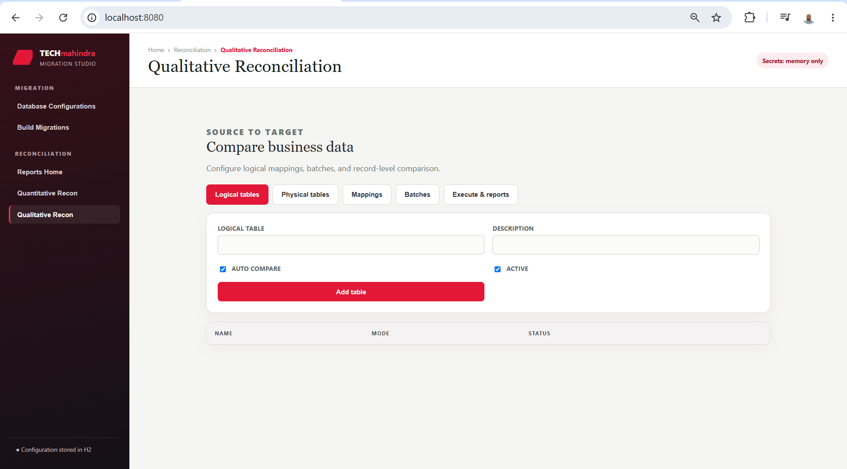
RECONCILIATION
Prove structure first. Then prove records.
Quantitative reports expose inventory and count mismatches; qualitative runs compare mapped business records.
QUANTITATIVE
Object inventory + COUNT(*)
QUALITATIVE
Mapped record-level comparison
TECH MAHINDRA / MIGRATION STUDIO
06

Slide 7
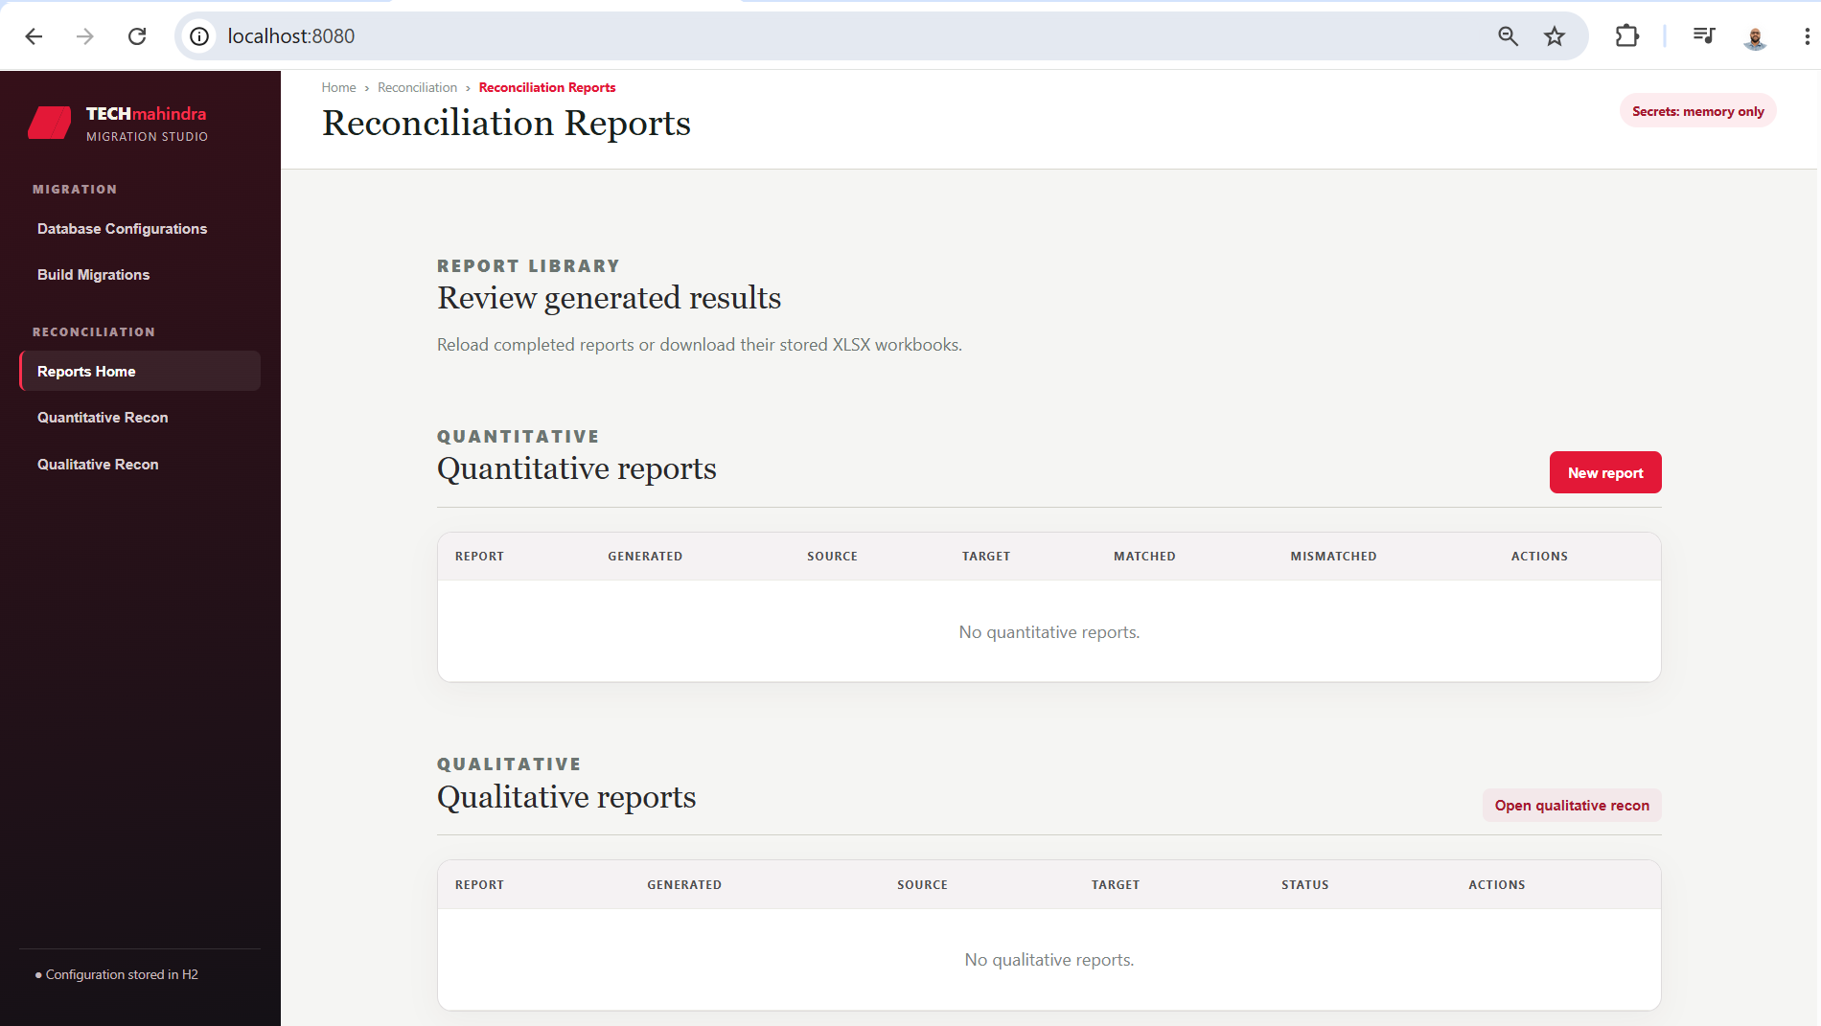
EVIDENCE LIBRARY
Reports remain reviewable after the run is over.
Immutable timestamped JSON and XLSX pairs make results reloadable, shareable, and auditable.
REPORT CONTENT
Summary and source / target header
Object counts and mismatch details
Record counts with pagination
Stored XLSX workbook for download
Reload reads existing JSON without querying either database.
TECH MAHINDRA / MIGRATION STUDIO
07

Slide 8
IMPLEMENTATION SHAPE
A focused application boundary with room to scale.
Angular owns the operator experience; Spring Boot owns orchestration, persistence, and filesystem artifacts.
OPERATOR EXPERIENCE
Angular 18 standalone UI · persistent side menu · five-second job refresh
↓
APPLICATION SERVICES
Spring Boot 3 · REST APIs · bounded worker pools · memory-only secrets
↓
PERSISTENCE + ARTIFACTS
Flyway-managed H2 · JSON / XLSX reports · generated DDL / DML directory tree
↓
CONNECTED SYSTEMS
SAP jConnect / Sybase ASE source ↔ Oracle target JDBC drivers
TECH MAHINDRA / MIGRATION STUDIO
08

Slide 9
DELIVERY REALITY
Strong foundation. Explicit next frontier.
The initial implementation is usable today, with clear manual-review boundaries for production hardening.
WORKING NOW
NEXT FRONTIER
Tables, columns, types, INSERTs
View bodies, sequences, triggers, procedures
Indexes, primary and foreign keys
Synonyms, grants, partitions, computed columns
Quantitative and qualitative reports
Bulk export and chunk-level restart
Resume, retry, pagination, XLSX export
Production-grade binary and LOB conversion
RECOMMENDED NEXT STEP
Validate against a representative ASE schema, then prioritize the manual-review object classes that matter to the first production wave.
TECH MAHINDRA / MIGRATION STUDIO
09

