Slide 1

CEIR Training - Calendar

Slide 2
Training Schedule

Slide 3
Training Schedule

Slide 4
Training Schedule

Slide 5
CEIR Product Training Manual

Slide 6

Product Overview
About CEIR
Stakeholder Overview
Feature Overview
Deployment Architecture
Integration Touchpoints

Slide 7
Product Overview
Key objective and functionality of CEIR is to block (or maintain black listing for blocking and grey listing for monitoring) the devices in multi operator’s environment homogeneously without any preference or selection for multiple reasons or objectives from using the network services like voice,SMS, GSMd data(not Wi-Fi data).
CEIR systems are also used for synchronizing the multiple EIRs from multiple network Operators in a country.
The only basis of blocking the GSM device is IMEI of the device
There are scenarios where a local EIR in Operator’s environment or Central EIR at CEIR authority can take precedence to execute or trigger the user data collection and barring action. It is completely a case depends on country, regulation and law.

Slide 8
Product – Integration
ETL for Operator CDR via FTP
Bulk Aggregator for sending SMS
Email Server for sending e-mails
PRTG for alerts
GSMA over HTTP(s) for blacklist/TAC details

Slide 9



High Level Solution Architecture
Manufacturer
Industry/
Importers
Customs
Retailer/Distributor
End User
Law Agency/TRC/Immigration/Manufacturer
TAC
Allocation Process
Secured API / Web Interface
(HTTPS)
CEIR (Hosted in DMC IT Network)
SMS‘s Network
DB
Web Client
SMS I/F
HTTP
Via
Bulk
SMS
Proivder
Set of Process(One set of each User Type)
API Interface
Set of GSMA
Process
DB
Set of
Operator Process
File Transfer Interface
…
Operator ‘s Network
Secured API
(HTTPS)
FTP
Via
ETL
Device Physical Flow
Device Physical Flow

Slide 10
Stakeholder Overview

Slide 11
CEIR Importer Training Manual

Slide 12
Product Overview
Importer
Assumption
Feature

Slide 13
Importer - Definition
An entity who interact with suppliers of Mobile devices or any SIM based devices and have business agreement with such suppliers to bring the SIM based devices in Cambodia for Cambodia based users to use. Importers may or may not have license for importing. Hence not necessary to have active interaction to Cambodian customs in applicable scenarios.
Importer is responsible for paying the Import duty to Cambodian customs. Here paying method could be direct or indirect to Customs.
Importer can be distributor or retailer as well.

Slide 14
Importer – Buy / Sell Scenario
Importer as Importer only
As importer - Sell device to other distributor or retailer
Importer as Importer and Distributor
As importer – Sell device to another distributor or retailer
As Distributor – Sell device to another retailer or distributor
As Distributor - Buy devices from other importer or other distributor
Importer as Importer and Retailer
As importer – Sell device to another distributor or retailer
As Retailer - Buy devices from other distributor or importer or retailer
As Retailer – Sell devices to other retailer
Importer as Importer, Distributor and Retailer
As importer - Sell device to another distributor or retailer
As Distributor - Buy devices from other distributor or importer
As Distributor – Sell devices to other distributor or retailer
As Retailer – Sell devices to other retailer
As Retailer – Buy devices from other importer or distributor or retailer

Slide 15
Assumption

Slide 16
Overview
Importer has to register using DMC Home Portal
As part of registration process, importer will receive the username and password which can be then used to login to the CEIR Portal
Once logged into the CEIR portal, importer can perform following operations
Consignment
Stock
Grievance
Profile Management
Importer can see the status of ongoing activity thru the Dashboard feature
Email Notification to keep track of the status of various operations

Slide 17
Dashboard – Importer

Slide 18
CEIR Consignment Feature -Training Manual

Slide 19
Consignment Feature
Feature
Stakeholder
State Diagram
UI Walk Thru
View All Consignment
View A Consignment
Register Consignment
Withdraw Consignment
Edit Consignment
View Consignment
Approve Consignment
Reject consignment
Clearance of a Consignment

Slide 20
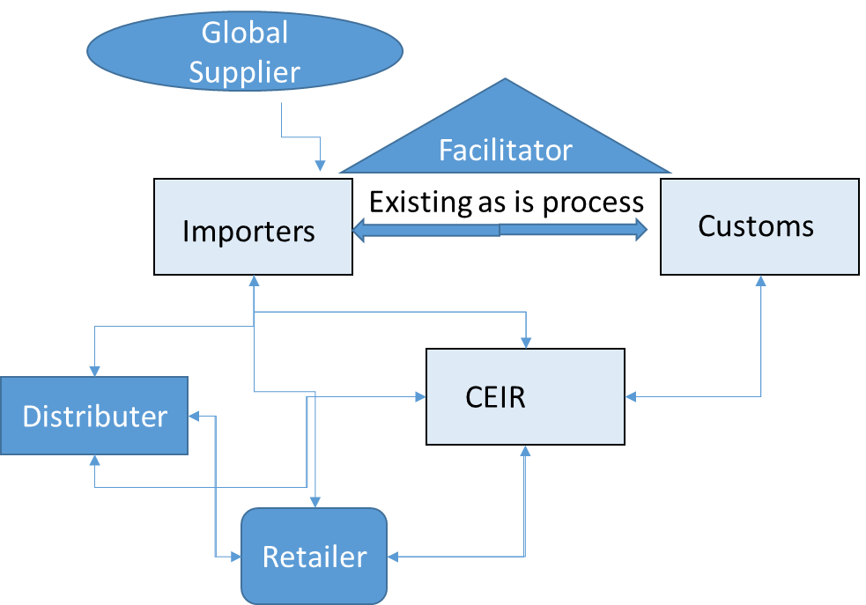
Feature Overview
Consignment Feature allow importer to register SIM based devices as ordered by supplier. The consignment details for device can be uploaded using this feature
Typical flow is as follows:
Importer Order a consignment
Get complete information from supplier
Register Consignment on CEIR Portal
CEIR Admin approve the consignment
Custom clear the consignment

Slide 21
Stakeholder Overview

Slide 22
State Transition – Overview - Consignment
Importer
System
CEIR Admin
Customs
INIT
PROCESSING
Pending for CEIR Approval
Pending For Clearance
Approved
Register
System
Process
System
Process
Approve
Clear
System
Process
Consignment State under various Stakeholder
Edit
Reject
Rejected by System
Edit by Importer
Edit
Rejected by
CEIR Admin
Reject
Edit by Importer
Rejected by
Custom
Device State under various Stakeholder
INIT
Pending
ACTIVE

Slide 23
State Transition - Overview

Slide 24
UI – Overview - Feature
View All Consignment
View A Consignment
Register Consignment
Withdraw Consignment
Edit Consignment
View Consignment
Approve Consignment
Reject consignment
Clear Consignment

Slide 25
UI – Overview - Feature

Slide 26
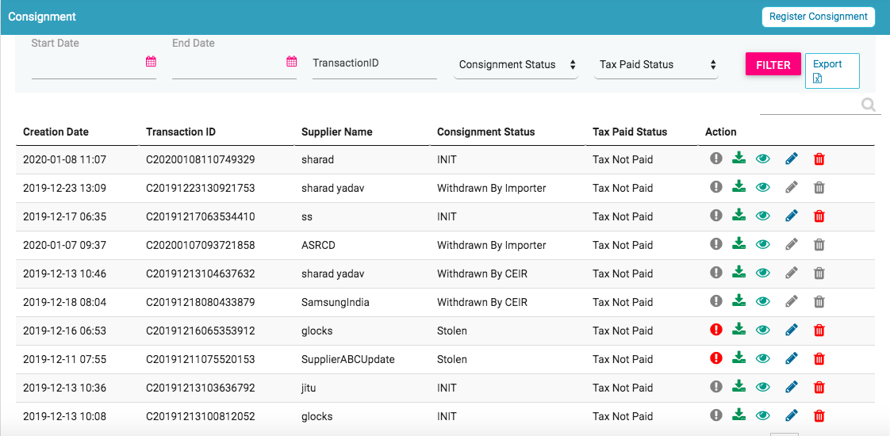
View All Consignment
Register
Filters
Export
View All Consignment
Action like View, Delete

Slide 27
Action List
Action are enabled / disabled based on the state of the consignment.

Slide 28
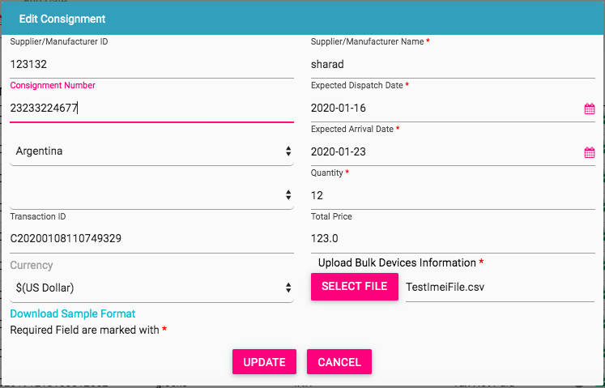
Register Consignment
Some Rules to Follow
Expected Dispatch date should be less than Expected arrival date
If price is filled, the currency
should also be filled
To upload the file, use the
format. For any confusion,
download the sample
format

Slide 29
Edit Consignment
Only allowed in rejected states
Rejected By System
Rejected By CEIR Admin
Rejected By Custom
Edit By Importer
INIT
What is Editable
Fields in the form
File that was initially uploaded.
Consignment moved back to INIT state

Slide 30
View Consignment

Slide 31
Approve Consignment

Slide 32
Reject Consignment

Slide 33
System Processing
All INIT consignment will be processed in FIFO order by the system
Once the processing starts, the status is changed to PROCESSING to indicate that Work is in progress
Once the processing is complete, the status is changed to either REJECTED_BY_SYSTEM or SUCCESS (PENDING_FOR_CEIR_APPROVAL)
Post processing a e-mail notification is sent to user in case of REJECTED_BY_SYSTEM and user and CEIR admin in case of SUCCESS

Slide 34
Clear Consignment

Slide 35
CEIR Stock Feature -Training Manual

Slide 36
Stock Feature
Feature
Stakeholder
State Diagram
UI Walk Thru
View All Stock
View A Stock
Upload Stock
Withdraw Stock
Edit Stock
Approve Stock
Reject Stock

Slide 37
State Transition – Overview - Stock
User
System
CEIR Admin
INIT
PROCESSING
Pending for CEIR Approval
Approved
Upload
System
Process
System
Process
Approve
Stock State under various Stakeholder
System
Process
Edit
Reject
Rejected by System
Edit by Importer
Edit
Rejected by
CEIR Admin
Device State under various Stakeholder
INIT
Pending
ACTIVR

Slide 38
CEIR Grievance Feature -Training Manual

Slide 39
Grievance Feature
Overview
Stakeholder
State Diagram
UI Walk Thru
View All Grievance
View A Grievances
Raise Grievance
Reply to Grievance

Slide 40
State Transition – Overview – Grievance
User
CEIR Admin
New
Close
Raise
Reply by CEIR Admin and Close
Grievance State under various Stakeholder
Reply by CEIR Admin
Reply by CEIR Admin and close
Reply by User
Pendiing
Wth CEIR Admin
Pending With
User
Reply by CEIR Admin

Slide 41
CEIR User Management Feature -Training Manual

Slide 42
User Management Feature
Feature
Stakeholder
State Diagram
Features
UI Walk Thru
Register
Account Management
Login/Logout
Password Management

Slide 43
User Management
This feature allow you to manage users and usertype (role) defined in the system
Using the feature, the system allows
Add a user
Manage User Profile
3) Management User Account
Delete a user
View all users/details about a particular user
Manage Passwords
Adding feature to users as per grace period

Slide 44
Stakeholders
The following stakeholder will register themselves in the system
Importers
Distributors
Retailers
Customs
Lawful Agency
Immigration Front Desk
Operators

Slide 45
Stakeholders
The following are the internal stakeholder who are configured at time of installation
System
To configure various user related parameters, policy etc
CEIR Admin
To be part of various work processes and approve / disapprove the consignment etc
There can only 1 CEIR administrator only 1 System Administrator

Slide 46
Registration – State Management
User
System
CEIR Admin
INIT
OTP Pending
Pending for CEIR Approval
Active
User disable the account
Deactive
Register
Request
Start
Request
Submitted
User
Validate
Email/Phone no.
Approve
User enable the account
No action
In ‘N’ days
Reject
Rejected by System
User deactivate the account
DeActivate
Rejected by
CEIR Admin

Slide 47
User Management - Features
CEIR provide self registration functionality so that user can register himself using the portal
Post successful registration, user can
Edit Profile
Deactivate account
Disable account
Enable Account
Change Password
Forget Password

Slide 48
System Feature
The following user types has been defined in the system
Importers
Distributors
Retailers
Customs
Lawful Agency
Immigration Front Desk
Operators
CEIR Admin
System

Slide 49
User to Feature Mapping
The following user types has been defined in the system
Importers
Distributors
Retailers
Customs
Lawful Agency
Immigration Front Desk
Operators
CEIR Admin
System

Slide 50
Stakeholder Overview

Slide 51
Password Management
The following policy is applicable for the password
Password should be minimum 8 chars with alphanumeric, with atleast 1 special character
Password would expire after 180 days (configurable)

Slide 52
Registration
DMC Home Portal would have a link to register new users.
There could be multiple type of users like importer, distributor, retailer
All type of users would be listed down in the drop down order
User select the type with which he/she wish to register
On selecting the user type, the user is redirected to CEIR Portal
On CEIR Portal, user fill the registration form. The form has few values specific to the type of user

Slide 53
Registration
Once the form is submitted, then the user is asked to verify contact number and email ID on phone and email
Once the email is verified, the request is sent to CEIR Authority for approval
Once CEIR Authority approve the user, the user account is active

Slide 54
Registration - Form
User Type
Importer
Distributor
Retailer
Custom
TRC
Operator
Manufacturer

Slide 55
Registration – Field
4 key areas
Type : Individual / Organization
Self Information
Address
Contact Information
Reporting Manager Information including contact information
For Individual
National ID
National ID Image
For company
Company name
VAT number
Security Related Questions

Slide 56
CEIR Stolen/Recovery Feature -Training Manual

Slide 57
Stolen / Recovery Feature
Feature
Stakeholder
State Diagram
UI Walk Thru
Single Stolen Case
Bulk Stolen Case
Single Recovery Case
With IMEI/Without IMEI (With MSISDN)
Bulk Recovery Case
Approve/disapprove by CEIR Admin
Rejection by System

Slide 58
Stolen – State Management
Lawful
System
CEIR Admin
INIT
Processing
Pending for CEIR Approval
Approved
Stolen
Request
Start
System Start
Processing
User
Validate
Email/Phone no.
Approve
No action
In ‘N’ days
Reject
Edit
Rejected by System
Edit
Rejected by
CEIR Admin
Device State under various Stakeholder
INIT/RECOVERED
STOLEN

Slide 59
Recovery – State Management
Lawful
Syste
CEIR Admin
Recovery
Single
Bulk
INIT
Processing
Pending for CEIR Approval
Approved
Stolen
Request
Start
System Start
Processing
User
Validate
Email/Phone no.
Approve
No action
In ‘N’ days
Reject
Edit
Rejected by System
Edit
Rejected by
CEIR Admin
Device State under various Stakeholder
STOLEN
RECOVERED

Slide 60
Stolen Cases
Individual
Single User has lost the device but know the IMEI
Single User has lost the device but does not know the IMEI
Company
Company has lost devices but should know the IMEI

Slide 61
Stolen Flow
Individual /Company representative go the lawful agency with the following information
ID card, device details, place of stolen as per stolen form
Lawful agency validates the information.
If satisfied, login in to the portal and report the stolen device.
All communication is 2 party only
Lawful agency and Individual/ Company Representative
Lawful Agency and CEIR admin
Communication is via Email only

Slide 62
Stolen – Key Feature
Can mark devices as stolen immediately, later or default period.

Slide 63
Recovery – State Management
Lawful
Syste
CEIR Admin
Recovery
Single
Bulk
INIT
Processing
Pending for CEIR Approval
Approved
Stolen
Request
Start
System Start
Processing
User
Validate
Email/Phone no.
Approve
No action
In ‘N’ days
Reject
Edit
Rejected by System
Edit
Rejected by
CEIR Admin
Device State under various Stakeholder
STOLEN
RECOVERED

Slide 64
Stolen – Mark Device as Stolen

Slide 65
Stolen – Mark Device as Stolen

Slide 66


Stolen and Recovery – Work Flow
Stolen/Recovery Request DB
Police Officer
Stolen DB
Grey DB
CEIR Portal
Usage/Duplicate DB
Black DB

Slide 67
CEIR Grey/Black List Feature -Training Manual

Slide 68
Grey/Black List Feature
Feature
Stakeholder
State Diagram
UI Walk Thru
Single Stolen Case
Bulk Stolen Case
Single Recovery Case
With IMEI/Without IMEI (With MSISDN)
Bulk Recovery Case
Approve/disapprove by CEIR Admin
Rejection by System

Slide 69
Grey list / Black List – Definition
Grey List contain the IMEI. Grey list is as per the definition of 3GPP GSMA where grey list are worth exploring to be monitored in operator network
Black-listed equipment is a equipment that has been reported stolen and has no permission to access a network (barred).
The black and grey lists are stored on a database for persistency.

Slide 70
Grey list / Black List – Feature
Full Dump for grey list which contain all the IMEI till date
Full Dump for black list which contain all the IMEI till date
Frequency to generate grey/black list is configurable.
All operator can download the grey/black list file using the web panel
Once downloaded, operator to upload the file in their EIR system
This grey/black list only contain numbers as per stolen/recovery flow.

Slide 71
Grey list / Black List Management
Add in Grey incremental List with flag = Add
Add in Black incremental List with Flag - Add
Add in Grey incremental List with Flag - Remove
Add in Grey Full List
Add in
Black Full
List
Remove from Grey Full list
Timer Expiry
Or as per user
flag
Stolen
Request
Processed
Timer Expiry
Or as per
User flag
Stolen
Request
Processed
Removed in Grey Full List if present
Removed from in Black Full List if present
Add in Grey incremental List with flag =Remove
Add in Black incremental List with Flag - Remove
Stolen
Request
Recovered
Stolen
Request
Recovered
FULL
Incremental

Slide 72
Grey / Black List Cases
When device is lost/stolen, the entry is added in the grey list
When device is recovered, the entry is deleted from grey/black list as applicable
When the timer expire for grey list or as per user defined option, the entry is deleted from the grey/black list as applicable

Slide 73
Grey / Black List – Operator Flow
One the file is available, operator should download files for further processing

Slide 74
Grey / Black List – GUI

