Slide 1

CEIR Consignment Feature -Training Manual

Slide 2

Consignment Feature
Feature
Stakeholder
State Diagram
UI Walk Thru
View All Consignment
View A Consignment
Register Consignment
Withdraw Consignment
Edit Consignment
View Consignment
Approve Consignment
Reject consignment
Clearance of a Consignment

Slide 3
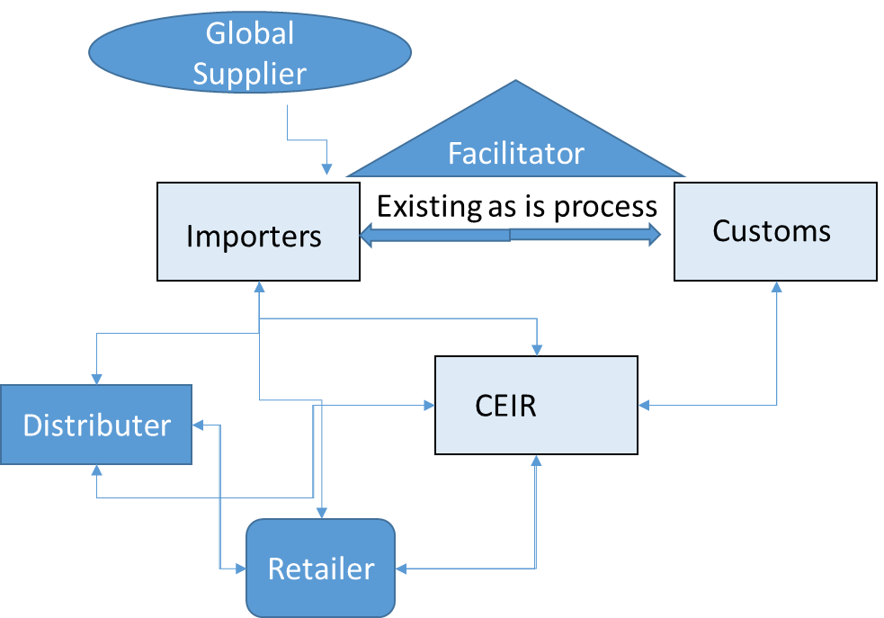
Feature Overview
Consignment Feature allows importer to register SIM based devices as ordered from supplier. The consignment details for device can be uploaded using this feature
Typical flow is as follows:
Importer orders a consignment
Get complete information from supplier
Register Consignment on CEIR Portal
CEIR Admin approves the consignment
Importer pays TAX for all the devices as per the consignment
Custom clears the consignment
Consignment is ready to be sold in the market

Slide 4
Feature Impact
Importance of this feature for the CEIR System
White list cannot be prepared
TAX paid information cannot be extracted
Price related information will be missing
Registration of Consignments by Importers is a mandatory step to be done in the CEIR System.
Sale/ Purchase of devices without TAX clearance will not be allowed in Cambodia.
Devices without a valid Type approval certificate will be blocked on the network.
Devices those violate the regulations will be blocked by the operators in CEIR System.

Slide 5
Stakeholder Overview

Slide 6
State Transition – Overview - Consignment
Importer
System
CEIR Admin
Customs
NEW
PROCESSING
Pending for CEIR Approval
Pending For Clearance
Approved
Register
System
Process
System
Process
Approve
Clear
System
Process
Consignment State under various Stakeholder
Edit
Reject
Rejected by System
Edit by Importer
Edit
Rejected by
CEIR Admin
Reject
Edit by Importer
Rejected by
Custom
Device State under various Stakeholder
INIT
Pending
ACTIVE

Slide 7
State Transition - Overview

Slide 8
UI – Overview - Feature
View All Consignment
View A Consignment
Register Consignment
Withdraw Consignment
Edit Consignment
View Consignment
Approve Consignment
Reject consignment
Clear Consignment
History of Consignment

Slide 9
UI – Overview - Feature

Slide 10
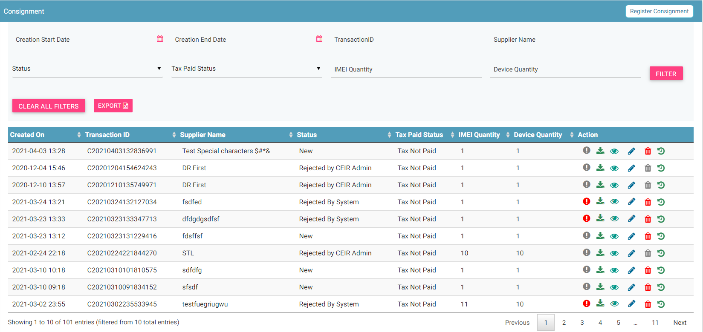
View All Consignment
Register
Filters
Clear all filters
Export
Action like View, Edit, Delete, History
View All Consignment

Slide 11
Action List
Action are enabled / disabled based on the state of the consignment.

Slide 12
Actions Enabled/ Disabled for Importer

Slide 13
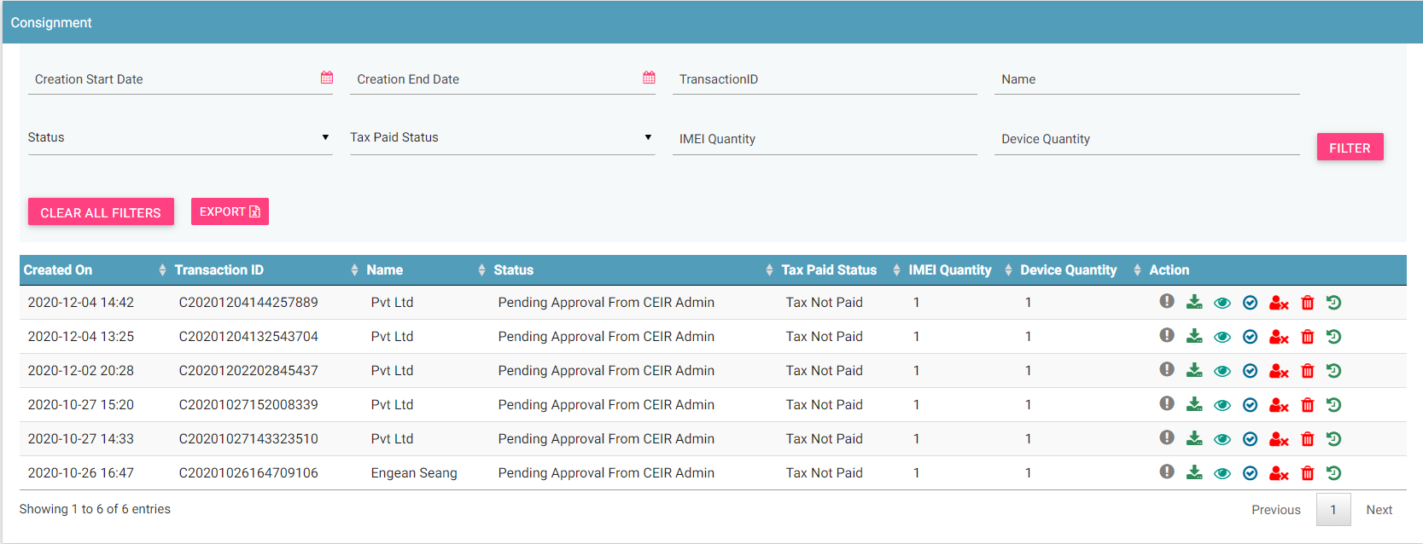
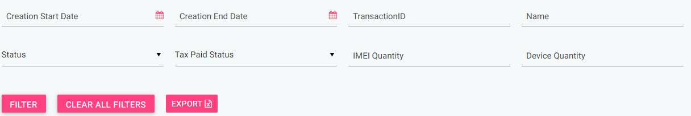
CEIR Admin Portal
By default, consignments with status “Pending approval from CEIR Admin” will be displayed in the CEIR Admin queue.
In case CEIR Admin wishes to view consignments in any other state, they can use the filter options to display the same.

Slide 14
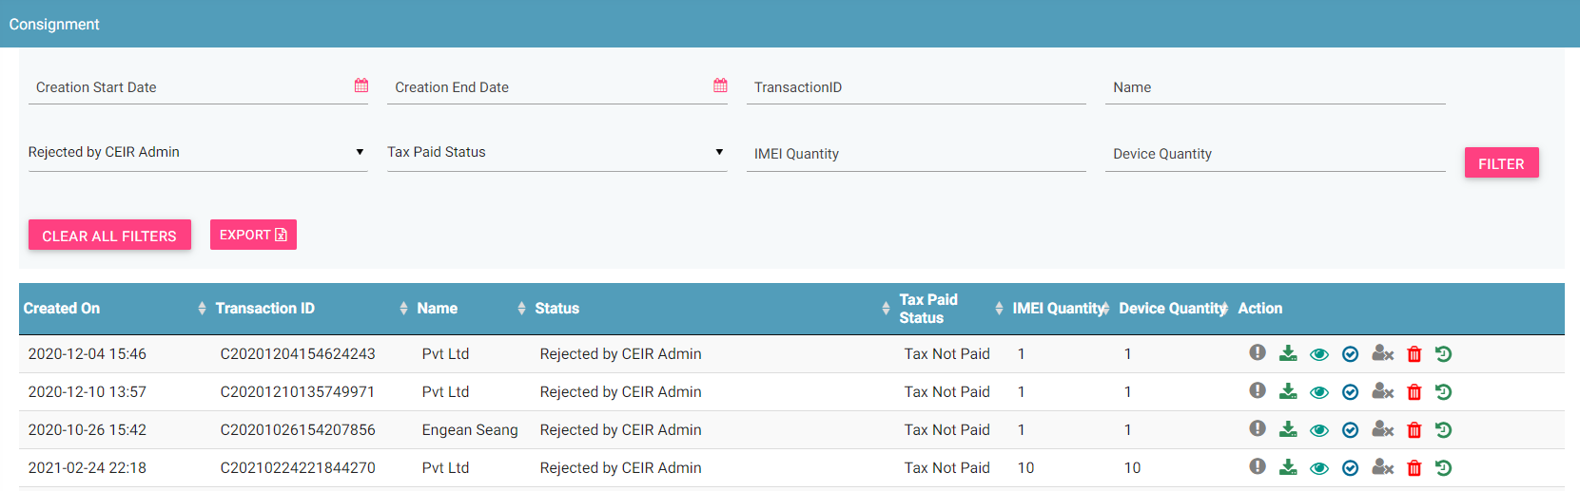
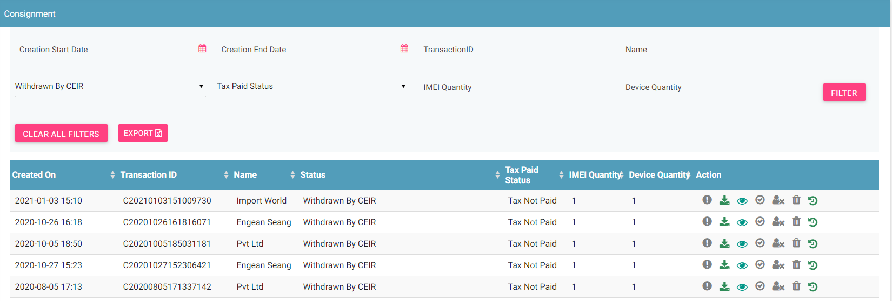
CEIR Admin Portal (contd.)
For consignment status PENDING APPROVAL FROM CEIR ADMIN, actions like View, Approve, Reject, Withdraw and History all will be enabled for CEIR Admin.
For consignment status REJECTED BY CEIR ADMIN , actions like View, Approve, History and Withdraw will be enabled for CEIR Admin.
For consignment status WITHDRAWN BY CEIR, only View and History option will be enabled for CEIR Admin.
All other states will have only View and History option enabled for CEIR Admin.

Slide 15
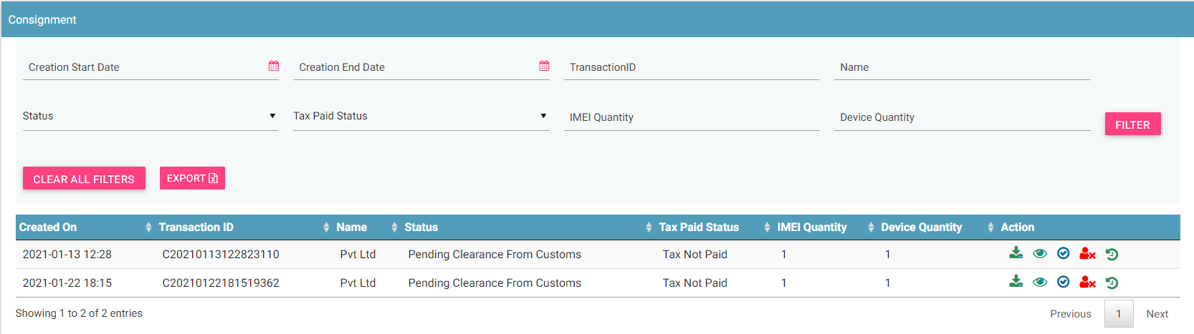
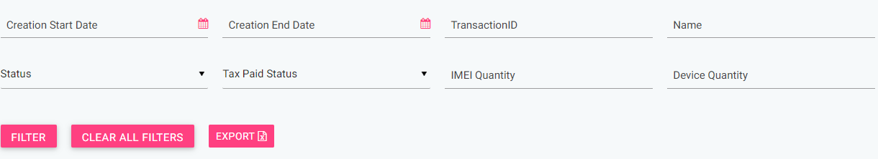
Custom Portal
By default, consignments with status “Pending clearance from Custom” will be displayed in the Custom queue.
In case Custom wishes to view consignments in any other state, they can use the filter options to display the same.

Slide 16
Custom Portal (Contd.)
For consignment status PENDING CLEARANCE FROM CUSTOM, actions like Download, View, Approve , Reject and History will be enabled for Custom.
For consignment status REJECTED BY CUSTOM, actions like Download, View, Approve and History will be enabled for Custom.
For consignment status APPROVED, actions like Download, View, Reject and History will be enabled for Custom.
All other states will have only View and History option available for Custom.

Slide 17
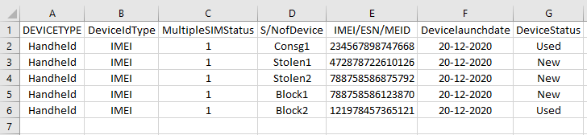
Consignment Flow
Importer registers a consignment.
In order to register a consignment, an Importer needs to furnish the following details:
→ Supplier / Manufacturer id, → Supplier / Manufacturer name,
→ Consignment number (if any), → Expected dispatch and arrival date for the consignment,
→ Expected arrival port → Device Originating Country,
→ Total price and quantity of the devices in consignment, → Bulk device information
A unique Transaction ID is generated for each new consignment which is registered. This transaction id can be used in future for raising grievance (if any) regarding the consignment. The transaction ID will be used for tracking the consignment at any state. Importer will pay tax with reference to the transaction ID. Status = NEW
System processing is being done at the backend. Status = PROCESSING
In case the consignment is rejected by system. Status = REJECTED BY SYSTEM
System rejects the consignment in case there is some issue with the format of the file uploaded or any policy violation is done. The format of the file is available for download on the register consignment screen.

Slide 18
Consignment Flow ( contd..)
After successful internal processing, the consignment is sent to the CEIR Admin queue for Approval/ Rejection. Status = PENDING APPROVAL FROM CEIR ADMIN.
CEIR Admin rejects the consignment. Status = REJECTED BY CEIR. Email is sent to Importer and CEIR Admin. Notifications is also displayed on the Importer dashboard.
CEIR Admin can also withdraw consignment. Status = WITHDRAWN BY CEIR. This can be done in scenarios like Importer didn’t turn up for claiming the consignment for more than allowed timelines and custom would want to auction the devices. Custom would then raise a request to CEIR Admin for Withdrawal of the consignment.
CEIR Authority approves the consignment. The consignment is sent to the custom queue for clearance by custom. Status = PENDING CLEARANCE BY CUSTOM. Email is sent to Importer and CEIR Admin. Notifications are also displayed on the Importer and CEIR Admin dashboard.
Custom clears the consignment. Status = APPROVED . Email is sent to Importer and CEIR Admin. Notifications are also displayed on the Importer and CEIR Admin dashboard.
Custom rejects the consignment. Status = REJECTED. Email is sent to Importer and CEIR Admin. Notifications are also displayed on the Importer and CEIR Admin dashboard.
Once the consignment is at CUSTOMs and CEIR system does not find the TAC information, the consignments will be REJECTED by the customs.
Importer can also withdraw consignment when it is in either NEW/ REJECTED BY SYSTEM state. Status = WITHDRAWN BY IMPORTER

Slide 19
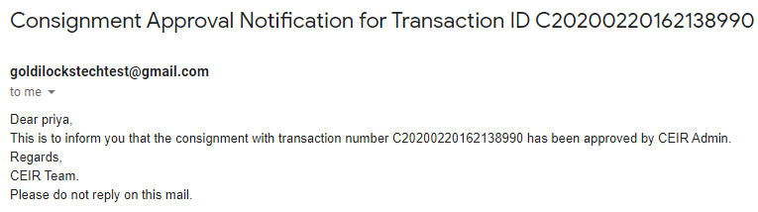
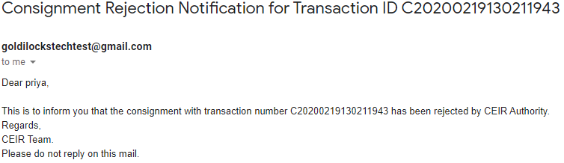
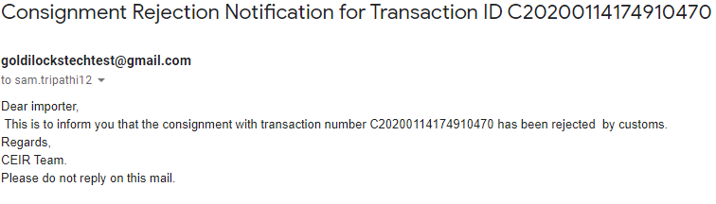
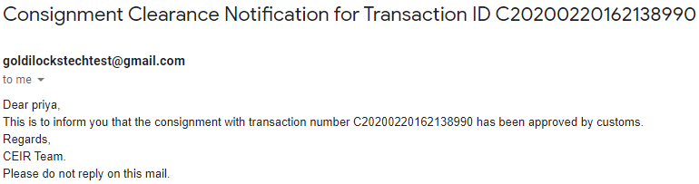
Email samples
Approved by CEIR
Rejected by CEIR
Rejected by Custom
Cleared by Custom
Email contents can be configured from the System Admin portal. This will be explained in detail in the system configuration training.

Slide 20
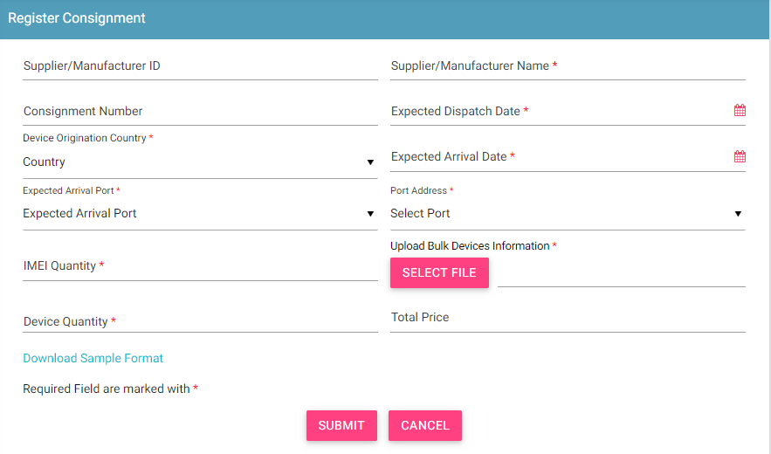
Register Consignment
Some Rules to Follow
Expected Dispatch date should be less than Expected arrival date.
If price is filled, the currency field will be displayed and it has to be filled.
To upload the file, use the system format. For any confusion, download the sample format.

Slide 21
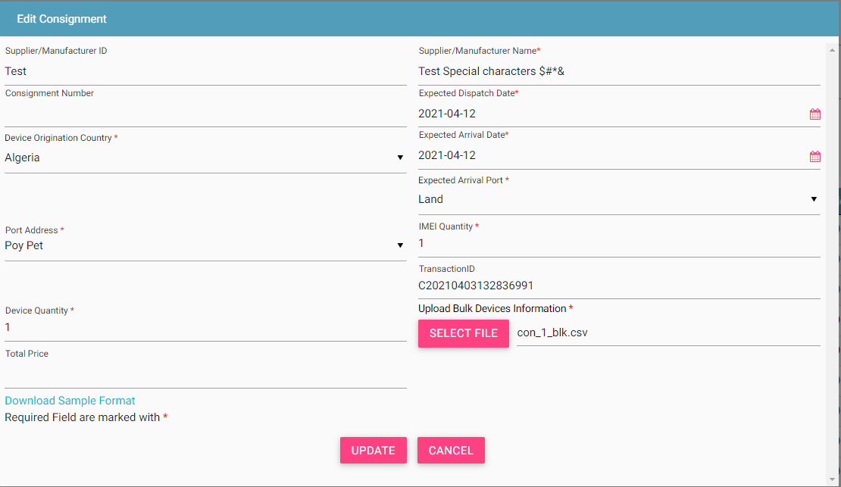
Edit Consignment
Only allowed in rejected states
Rejected By System
Rejected By CEIR Admin
Rejected By Custom
Edit By Importer
What is Editable
Fields in the form
File that was initially uploaded.
NEW
Consignment moved back to NEW state

Slide 22
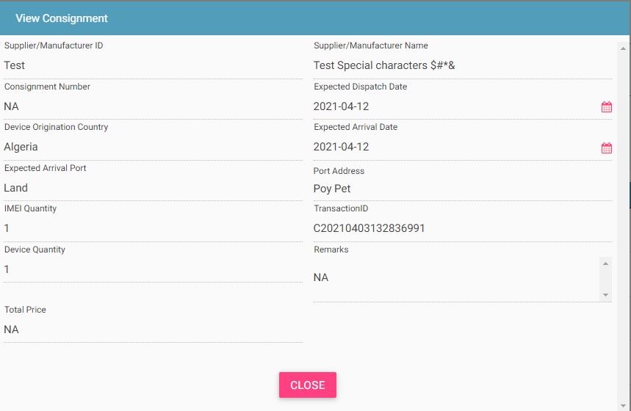
View Consignment
Who all can view the consignment?
Importer
CEIR Admin
Custom
This screen is not editable. This is just to view the details filled in by the Importer.

Slide 23
System Processing
All NEW consignment will be processed in FIFO order by the system
Once the processing starts, the status is changed to PROCESSING to indicate that Work is in progress
Once the processing is complete, the status is changed to either REJECTED_BY_SYSTEM or SUCCESS (PENDINGAPPROVAL_FROM_CEIR_ADMIN)
Post processing an e-mail notification is sent to Importer in case of REJECTED_BY_SYSTEM and in case of SUCCESS email is sent to both Importer and CEIR Admin.

Slide 24
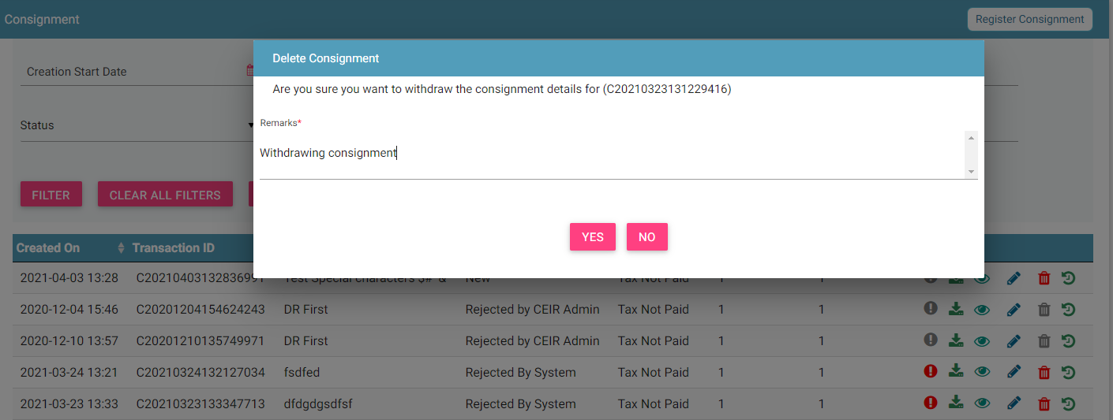
Consignment Withdrawn By Importer
Importer can withdraw consignments in two states only
New
Rejected by System

Slide 25
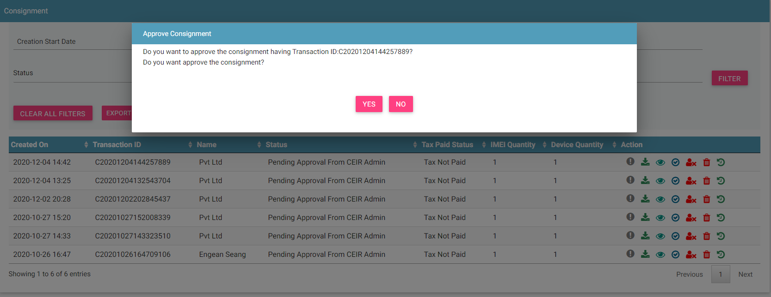
Consignment Approved by CEIR Admin
Consignments after successful processing are sent to the CEIR Admin queue for Approval / Rejection.
On Rejection, consignments are sent back to the Importer queue.

Slide 26
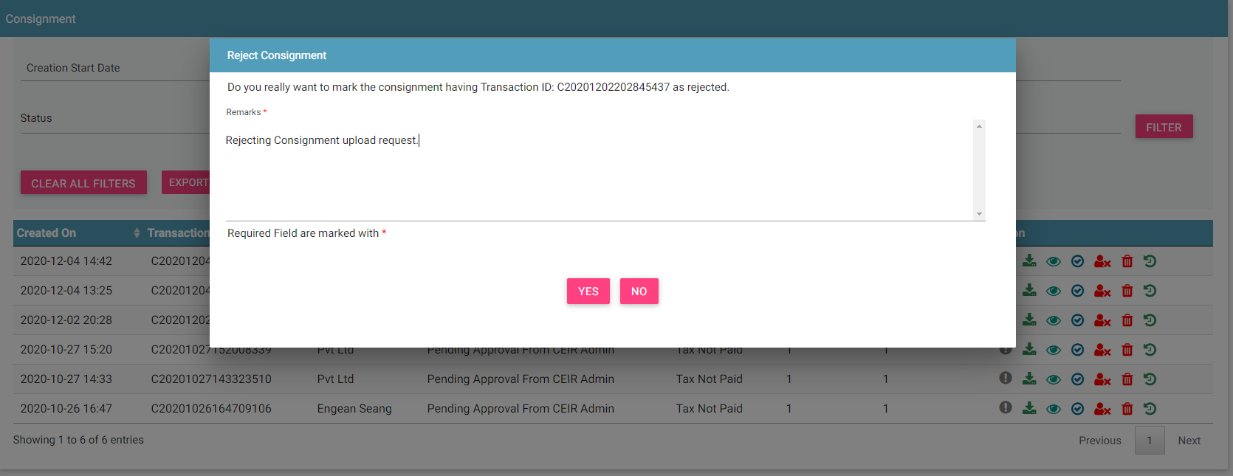
Consignment Rejected by CEIR Admin
CEIR Admin has the authority to reject any consignment. Remarks have to be updated for the same.

Slide 27
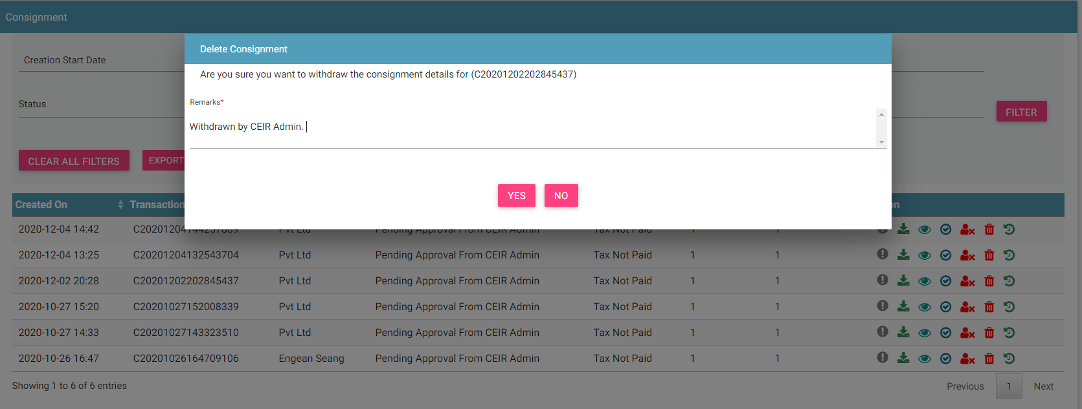
Consignment Withdrawn By CEIR Admin
CEIR Admin has the authority to withdraw any consignment. Remarks have to be updated for the same.

Slide 28
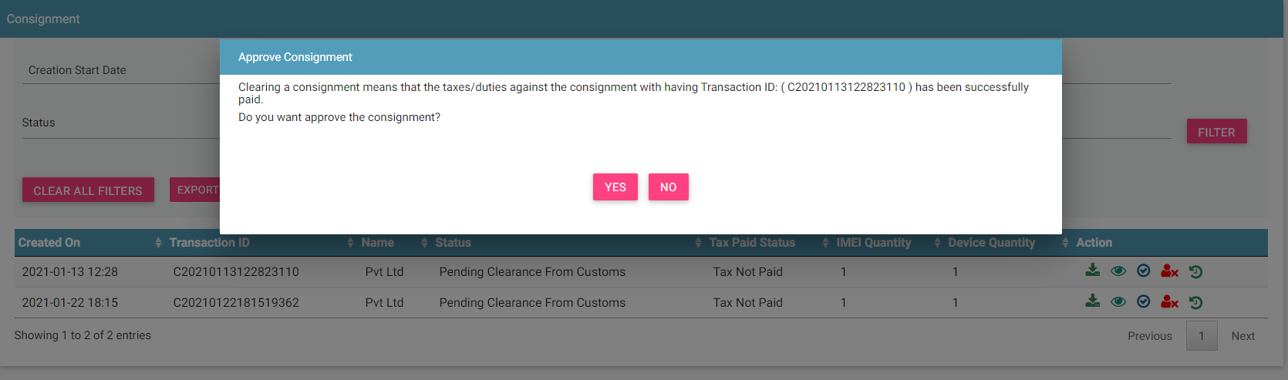
Consignment cleared by Custom
Consignments after approval by CEIR Admin are sent to the Customs queue for Clearance / Rejection.
On Rejection, consignments are sent back to the Importer queue.

Slide 29
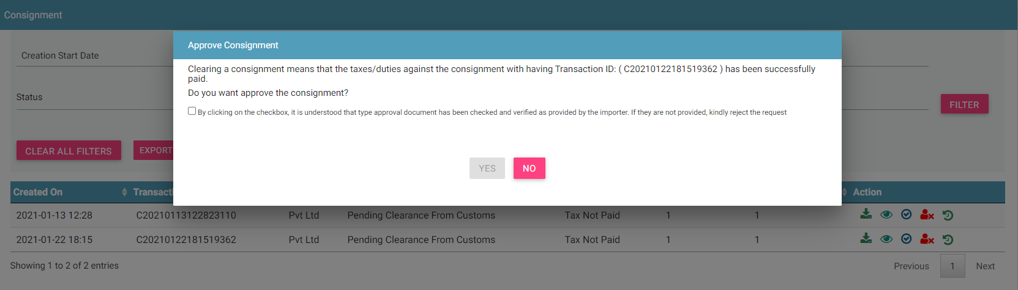
Consignment cleared by Custom ( Type Approval)
In case there are any devices whose TAC information is not present in the CEIR system, CUSTOM has to verify the TAC information at the time of clearance. They will be prompted for the same when they clear the consignment.

Slide 30
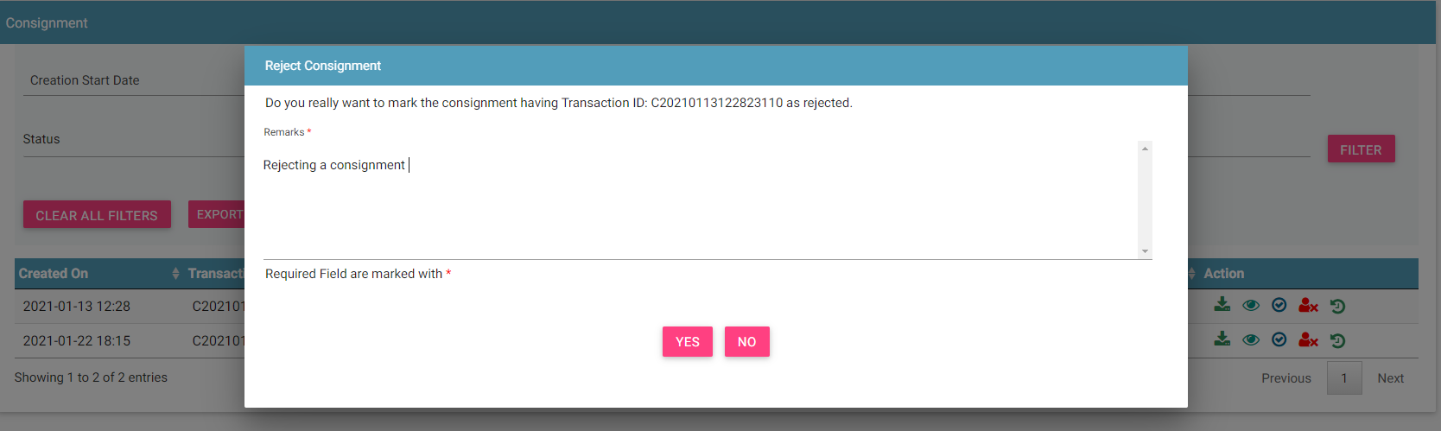
Consignment Rejected by Custom
Customs can reject consignment in case
Importer has not submitted Type approved certificate
Importer has not filled tax
After rejection the consignment does back to Importer queue. An email is sent to Importer and CEIR Admin to update about the rejection.

Slide 31
Filter Consignments
Consignments can be filtered on the basis of
Date filters, Transaction ID, Name, Consignment Status, TAX paid status, IMEI Quantity, Device Quantity
The User ( Importer/ CEIR Admin/ Custom) can also use a combination of more than one filters to filter the consignments.
Users can view old consignments using the date filter.
Clear All Filters can be used to clear filters and refresh the data table.
Export button will export the data based on the filters applied.

Slide 32
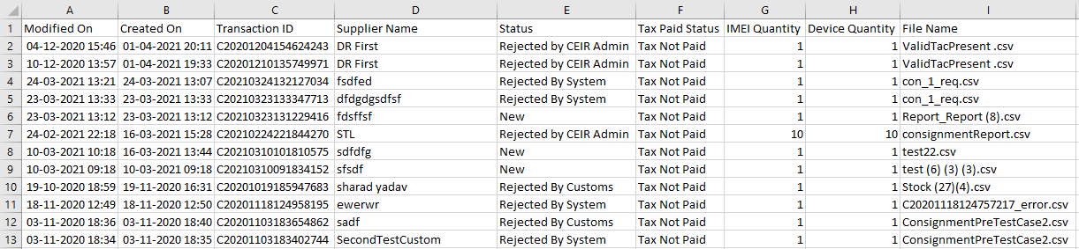
Export Consignments
Consignments can be exported in a .csv file using the export button.
User ( Importer/ CEIR Admin/Custom) can export all consignments assigned to the respective user.
User ( Importer/ CEIR Admin/Custom) can export filtered consignments.

Slide 33
Sorting of data
By default, the data displayed is sorted in descending order on last modified date.
Data can be sorted based on other fields by clicking the arrow buttons on the column headers. On first click, data will be sorted in ascending order. On second click, it will be sorted in descending order.

Slide 34
Policy
Policy for grace and post grace period will be same for registering consignment
In grace period, if any stakeholder (importer, distributor, retailer, and custom) want to whitelist the devices, “Stock Upload” feature can be used for same
Since importer consignment is one of the source of device information entering into country, it is desired that all rules should be in place to check the invalid devices at the entry point itself.
More details on same would be discussed in the “Policy Management” Training session

Slide 35
What next after Approval of Consignment?
Importer can sell this stock to Distributor/ Retailer.
Distributor/ Retailer can upload stock information in the CEIR system.

Slide 36
Queries

Slide 37
Thank You

