Slide 2
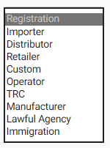
Registration – Importer

Slide 3
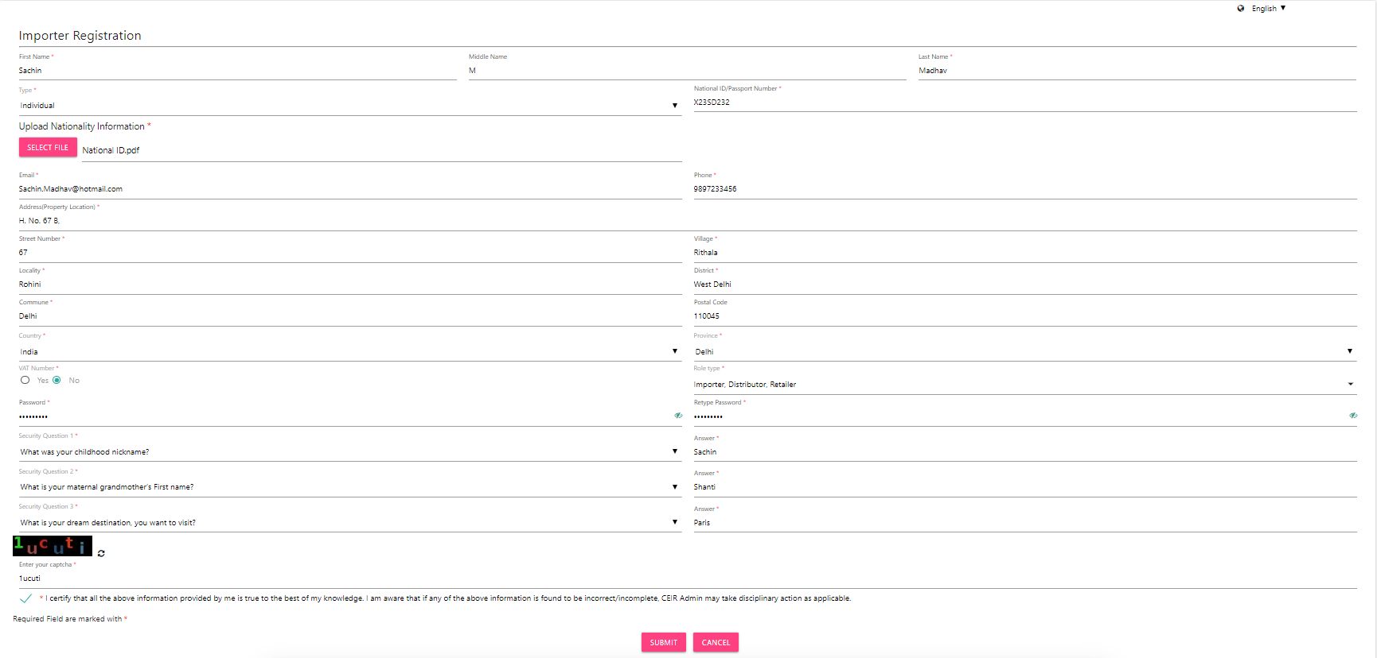
Registration – Importer (Form)

Slide 4


Registration – Importer

