Slide 1
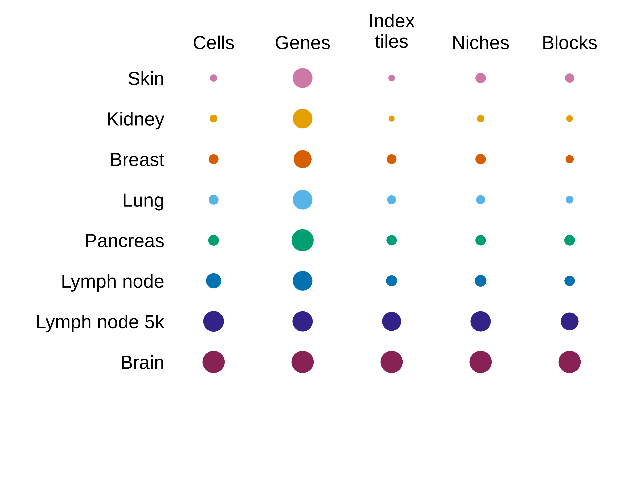
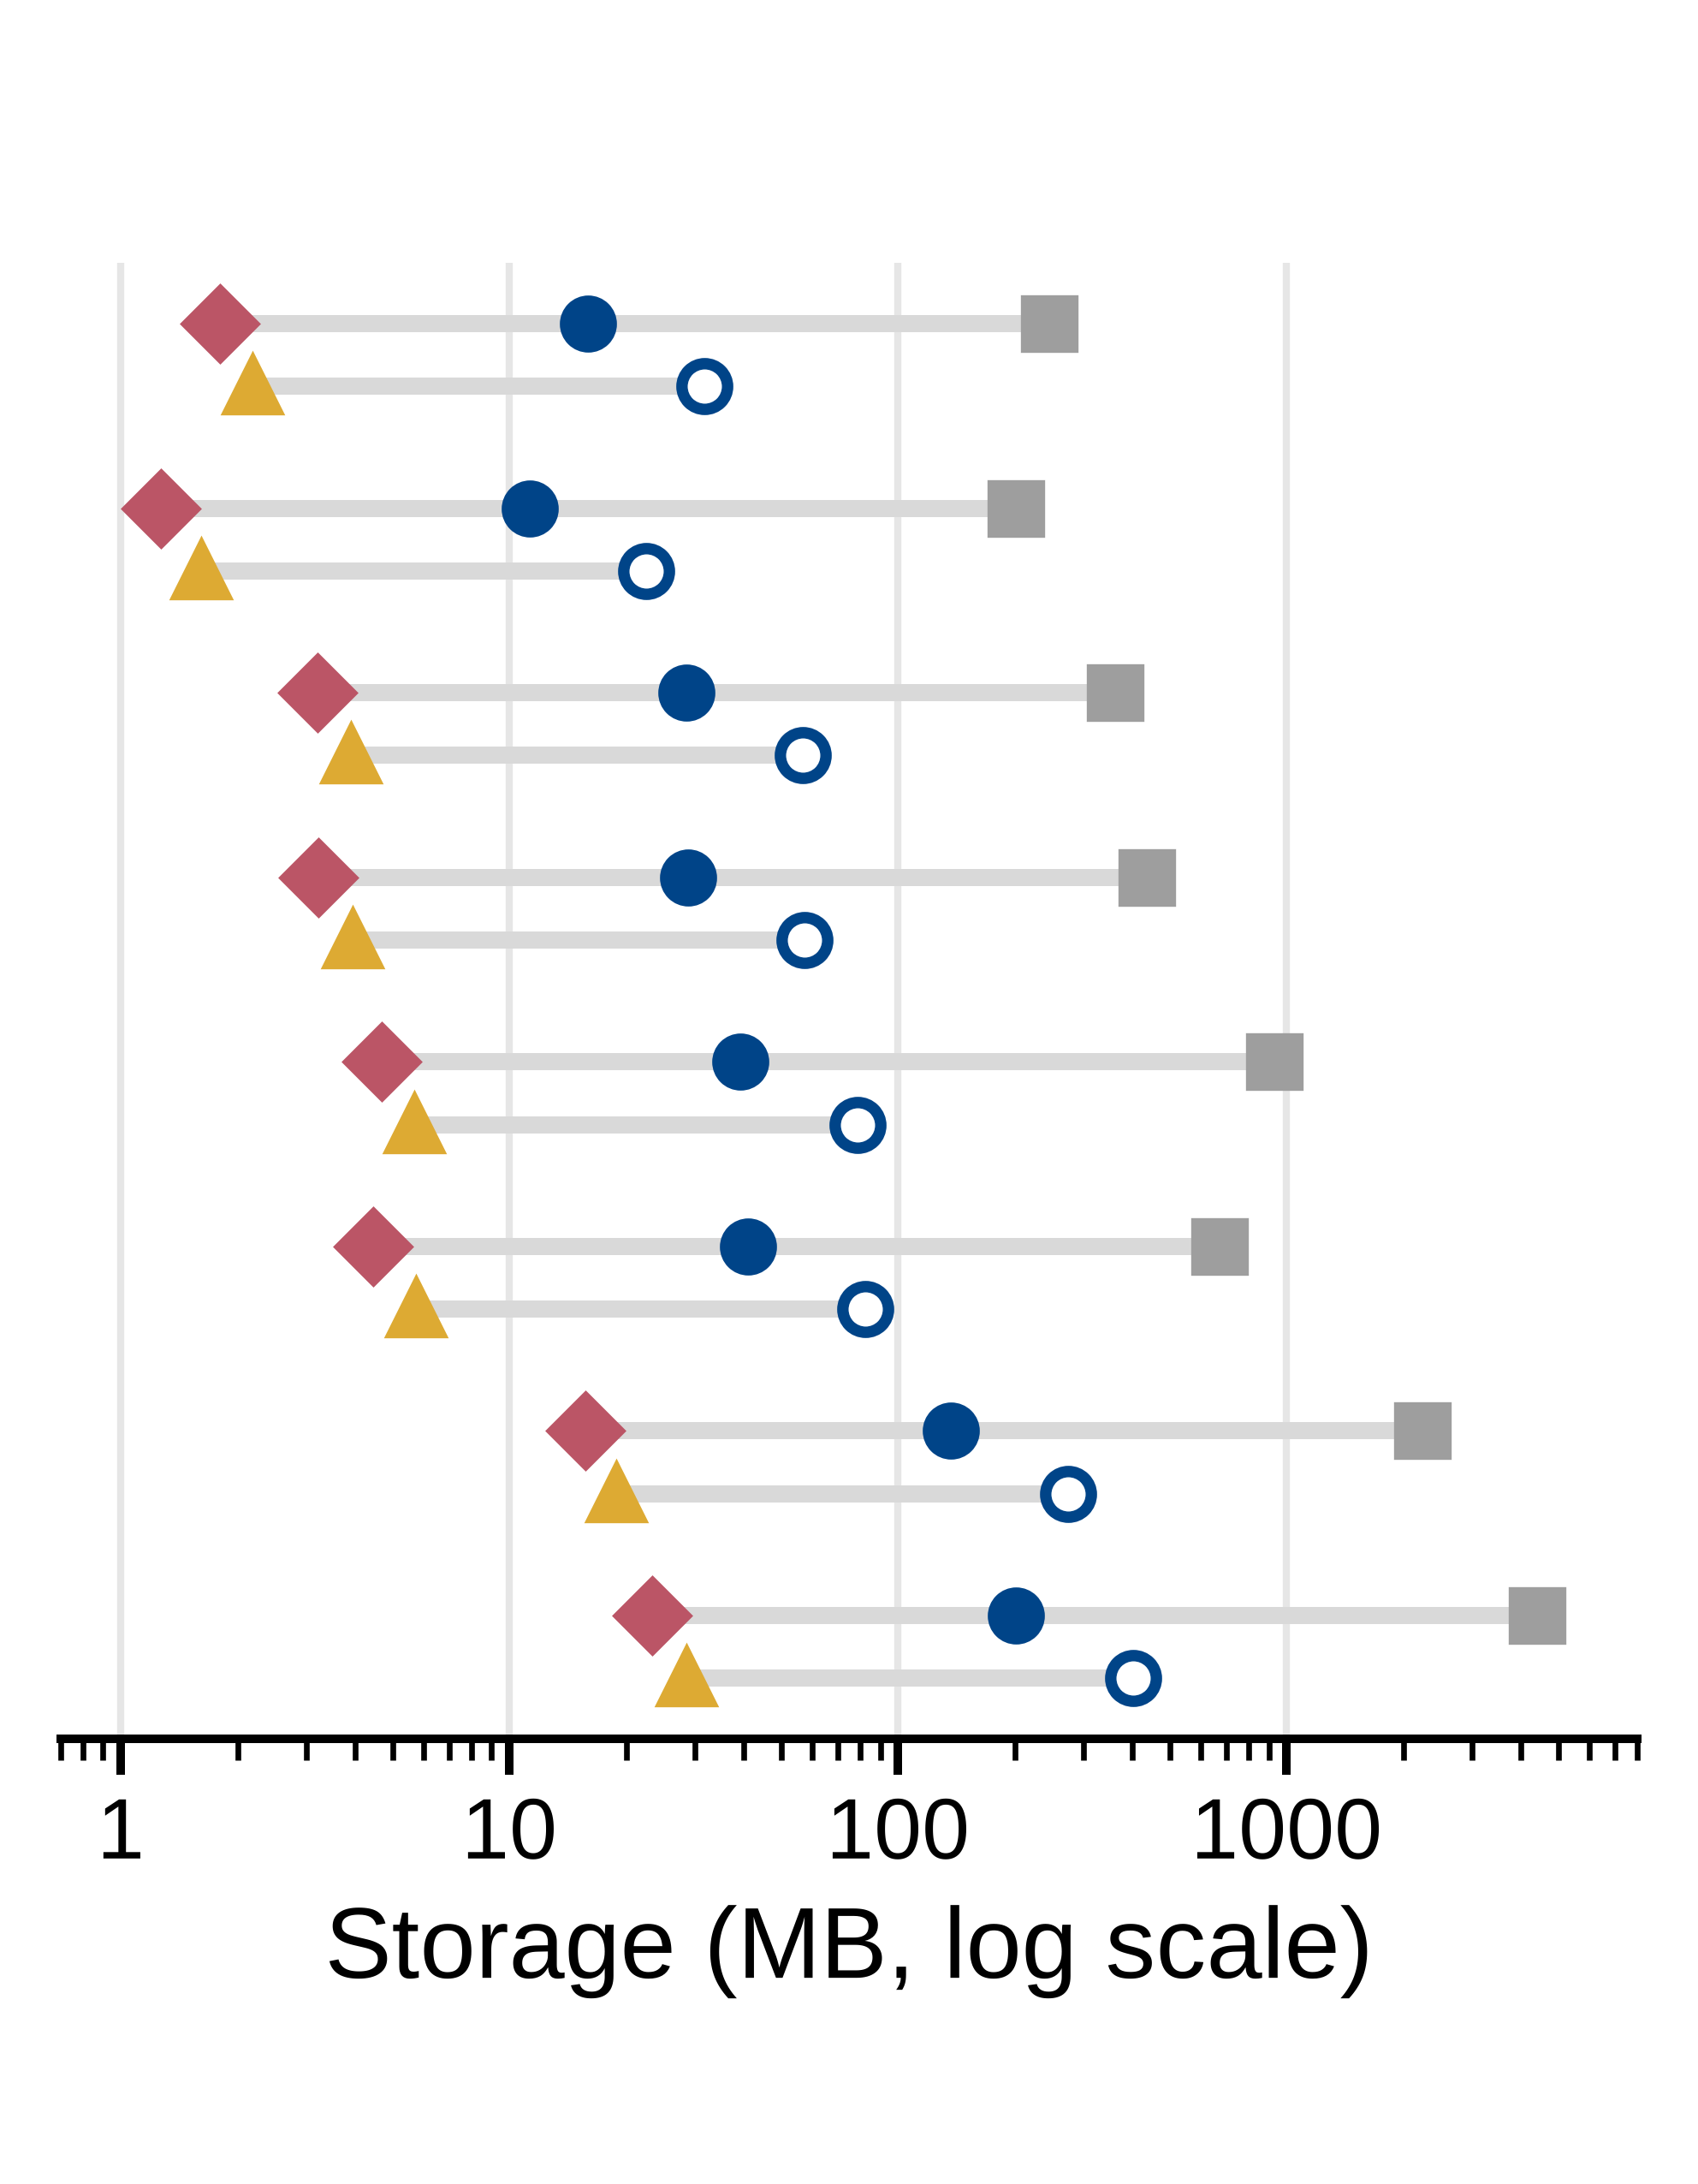
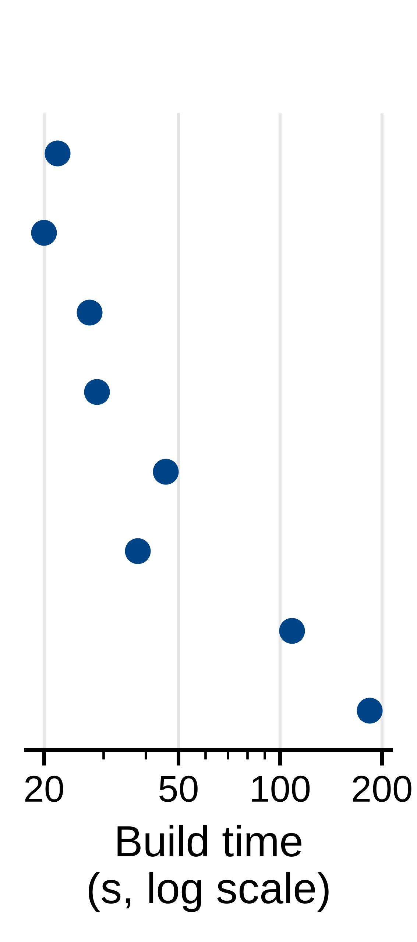
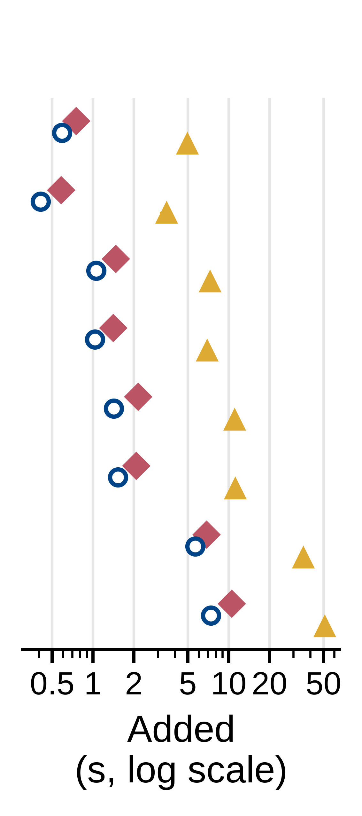
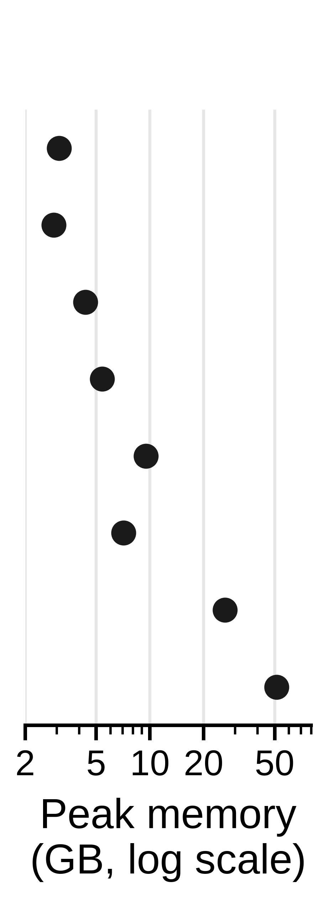
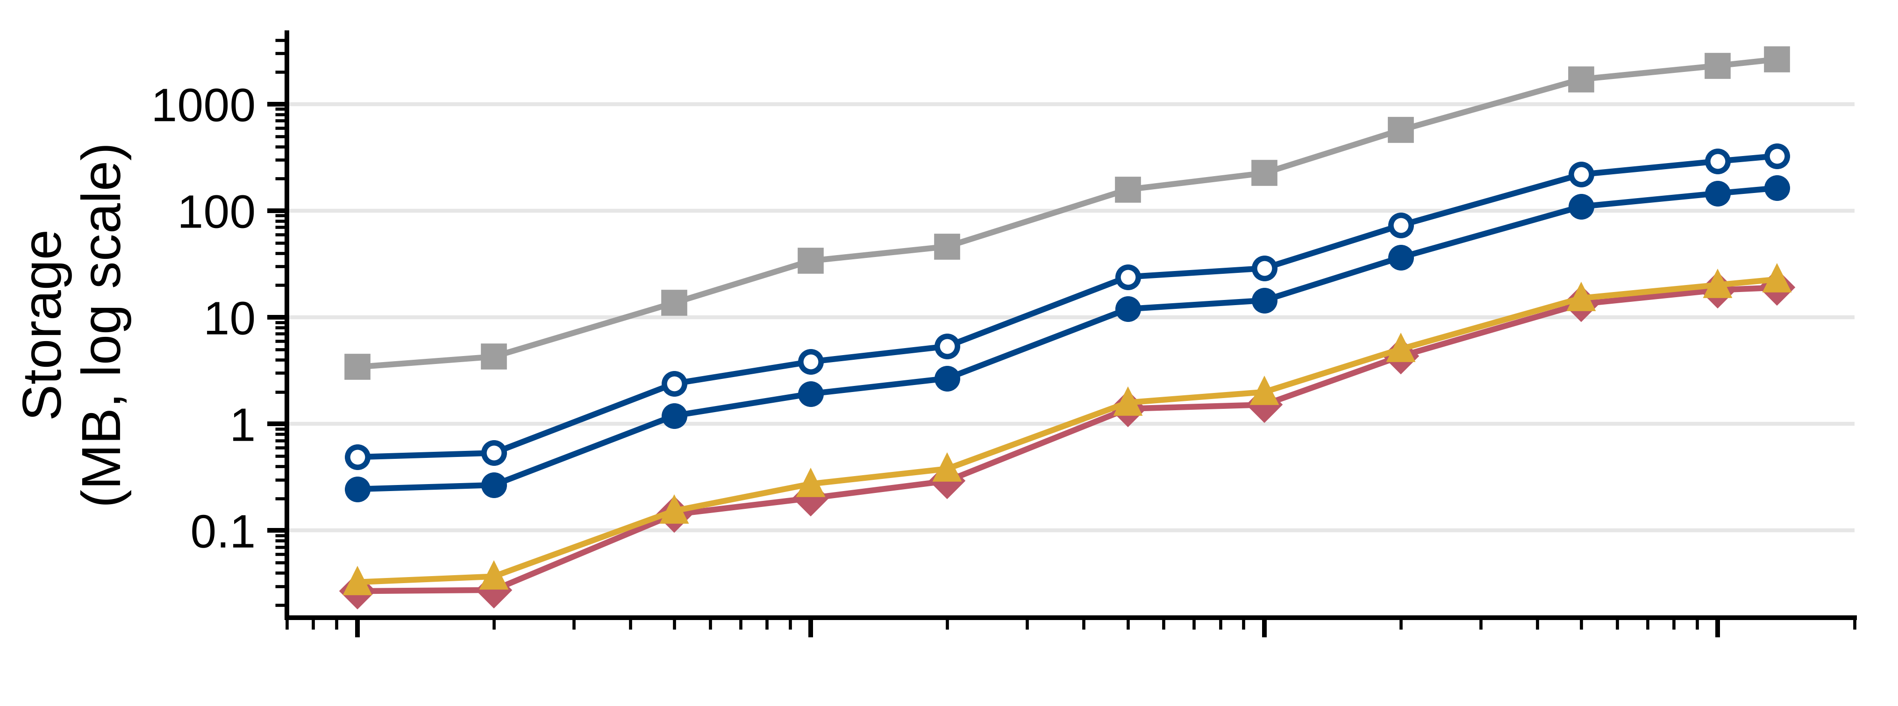
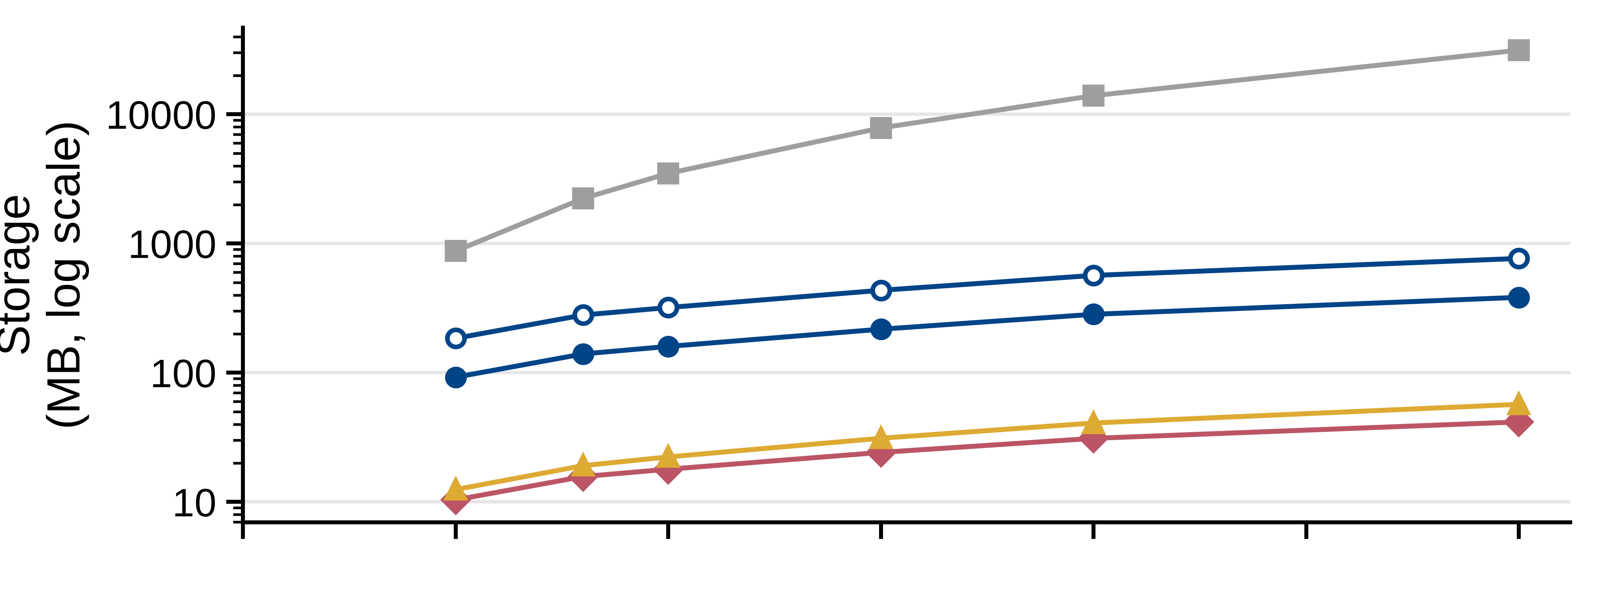
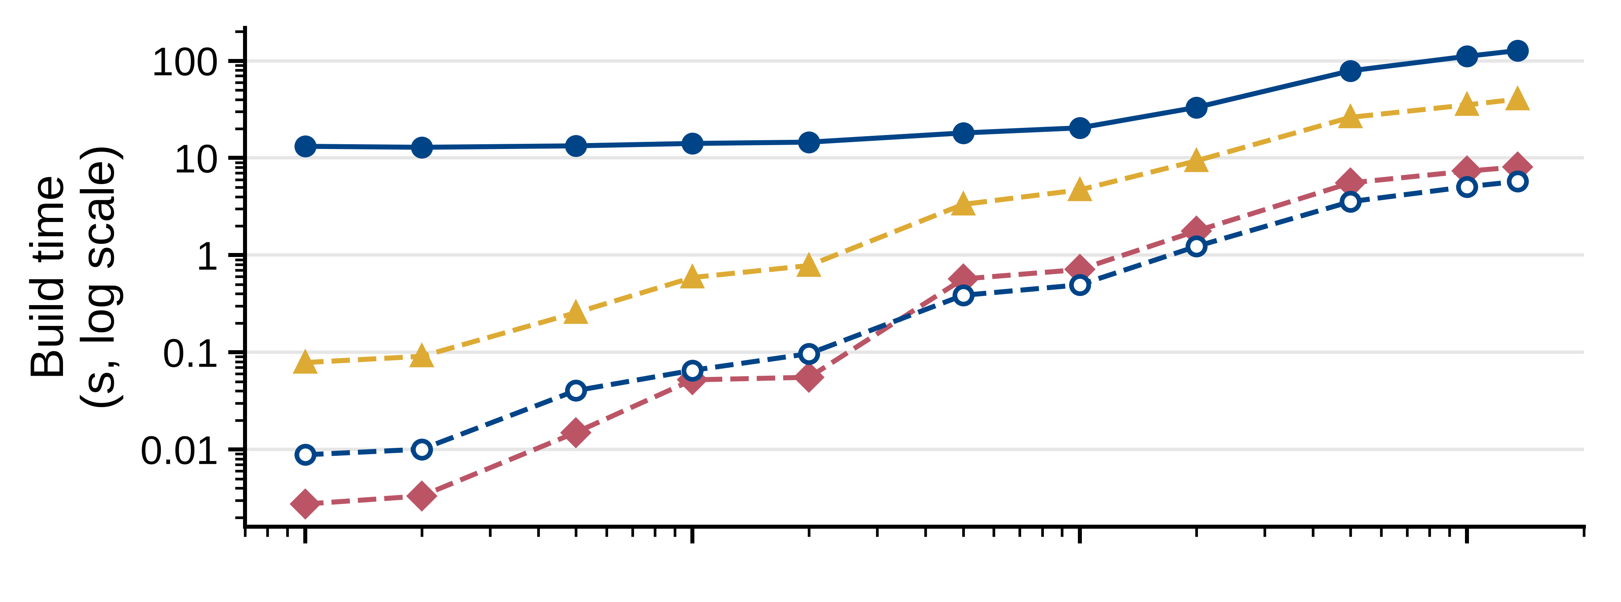
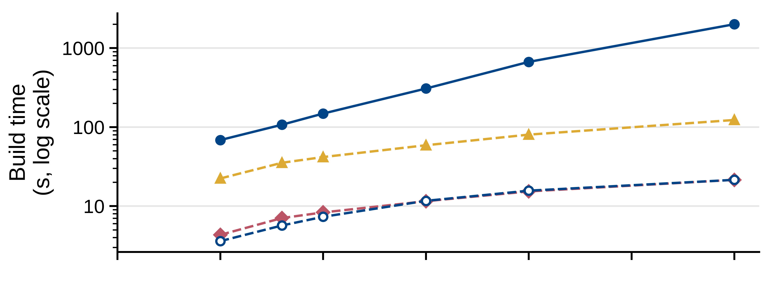
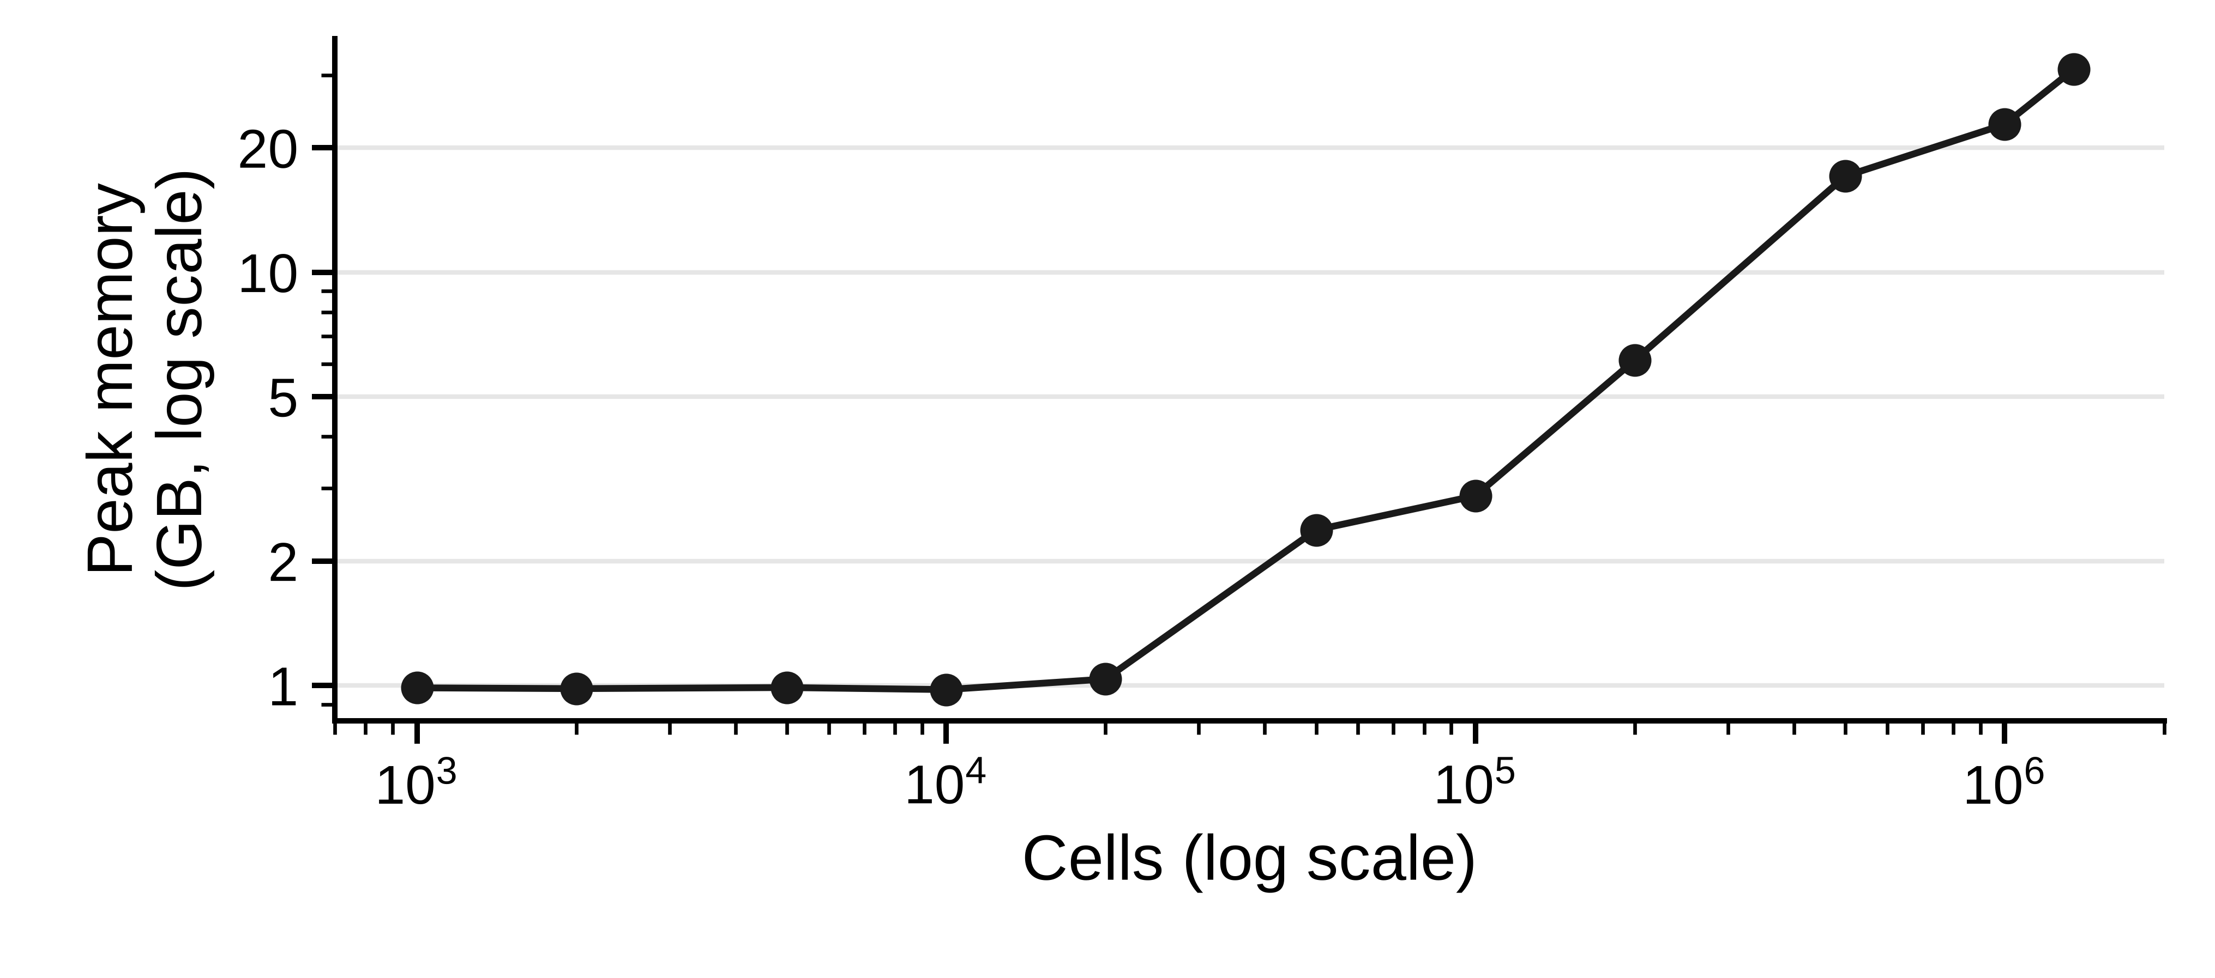
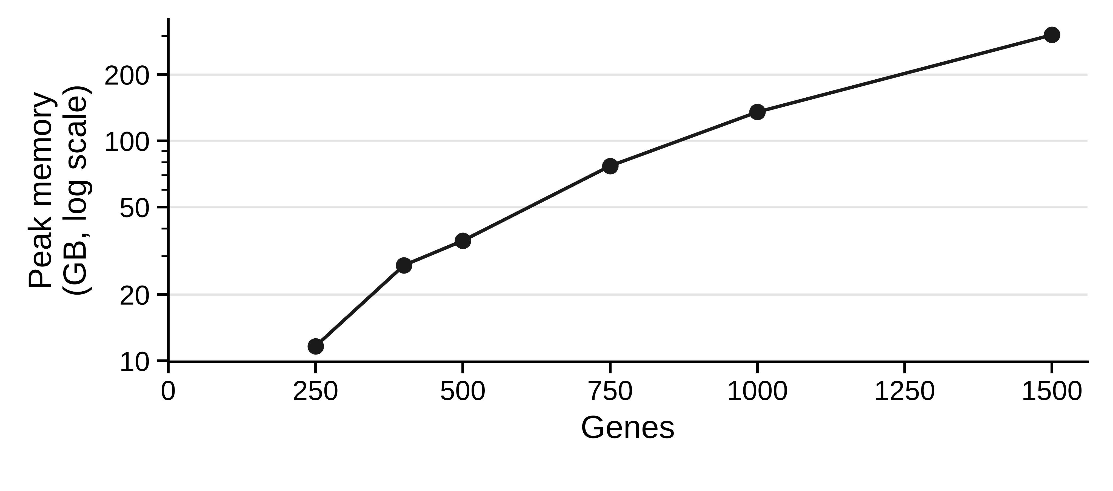
A
B
C
8.8×
15×
Spindle (full build)
added over Spindle
all four indexes
8.9×
18×
8.9×
13×
8.9×
15×
8.4×
24×
9.2×
16×
8.7×
16×
8.7×
22×
87k–817k
313–480
705–9,558
2–18
43–471
D
Tonsil, 1.35M cells, 377 genes, subsampled
E
Lymph node 5k, 6,972 index tiles

Slide 2
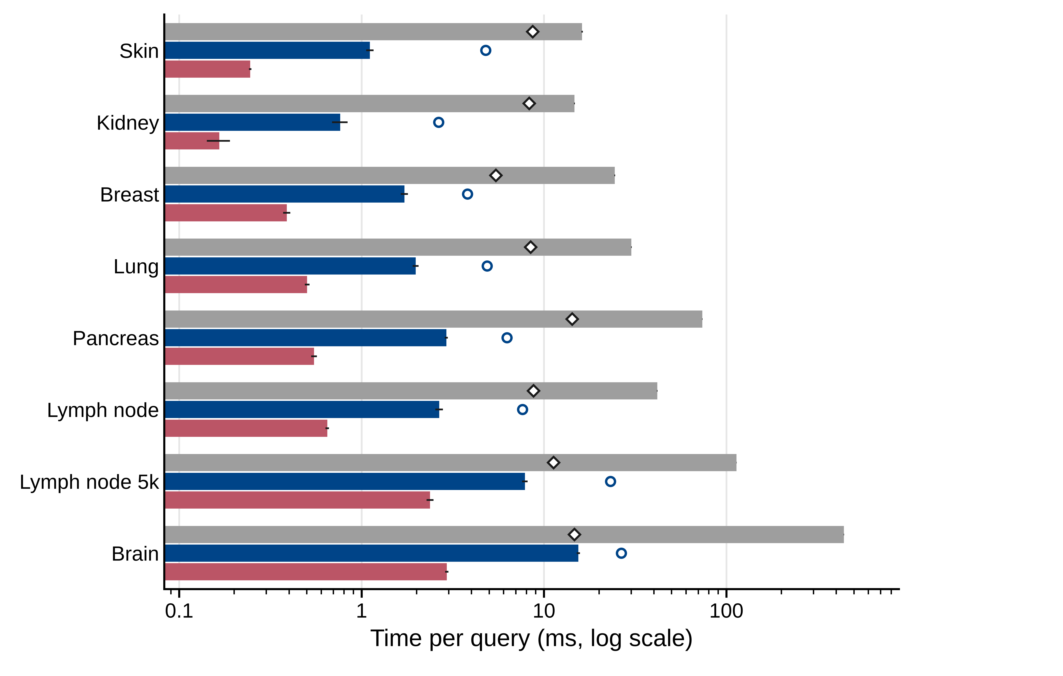
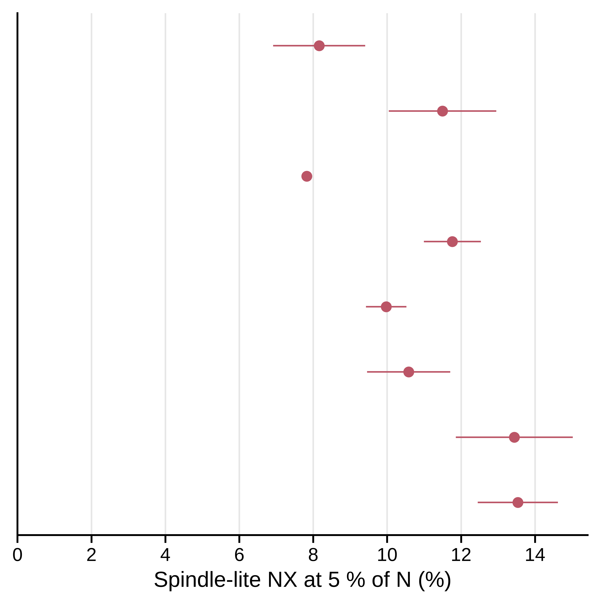
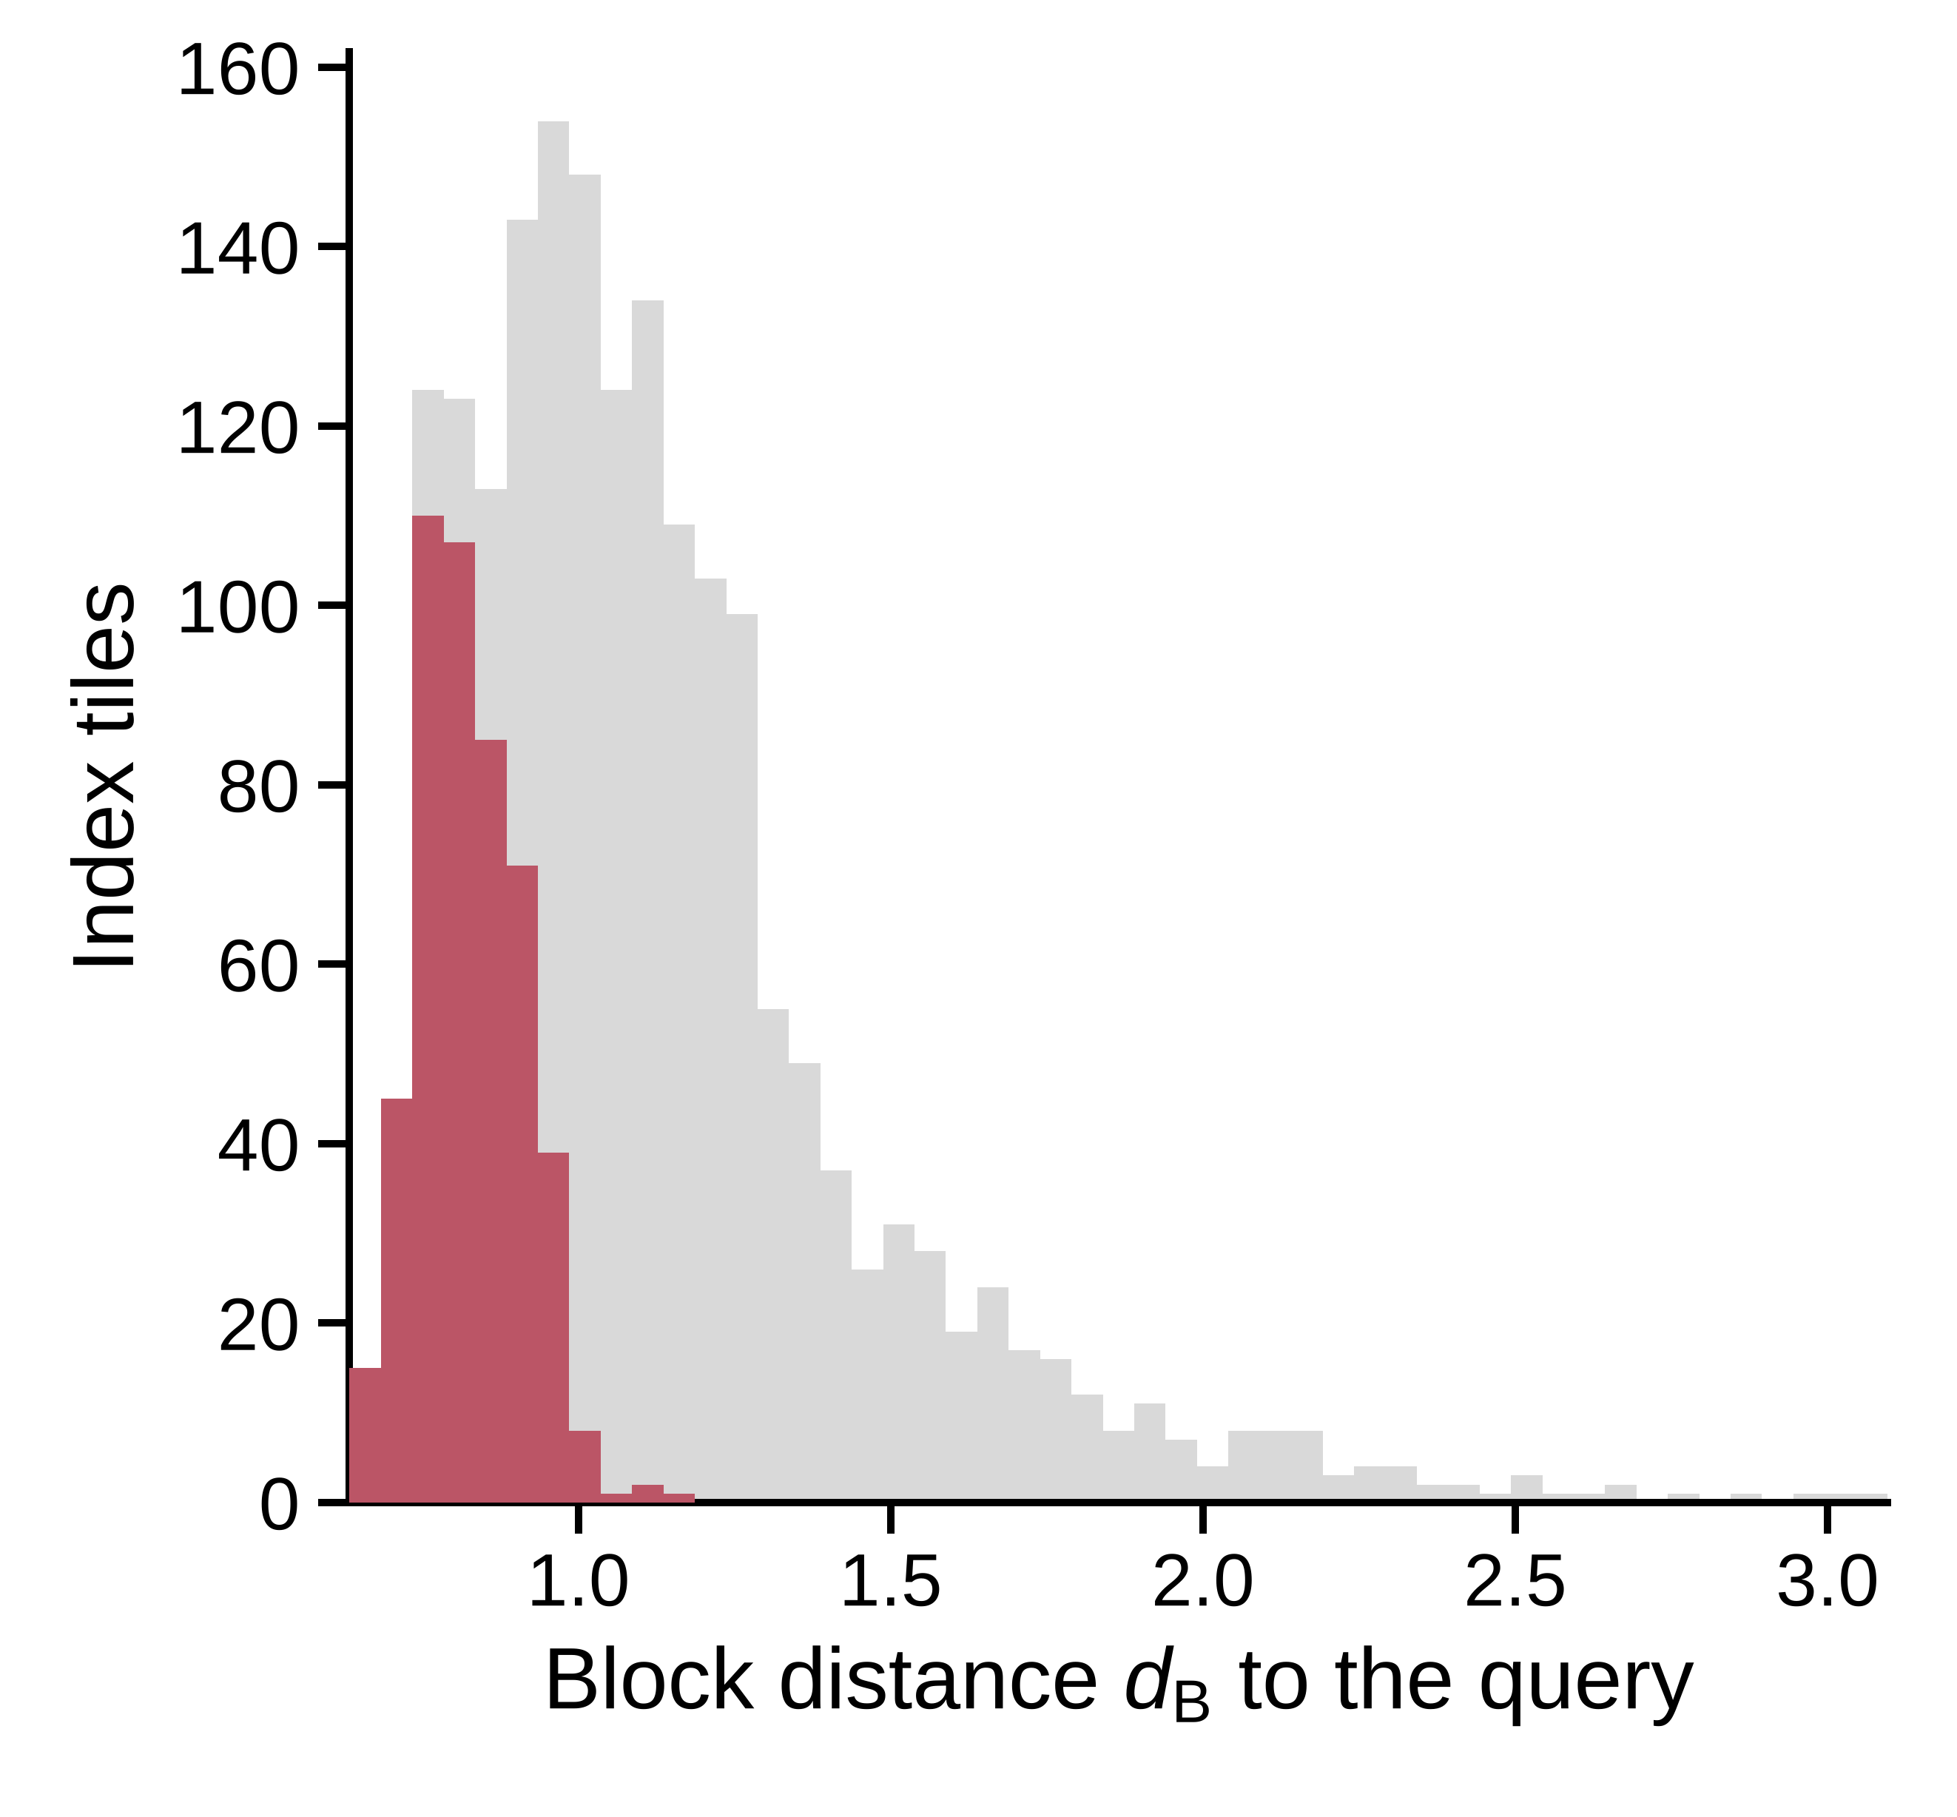
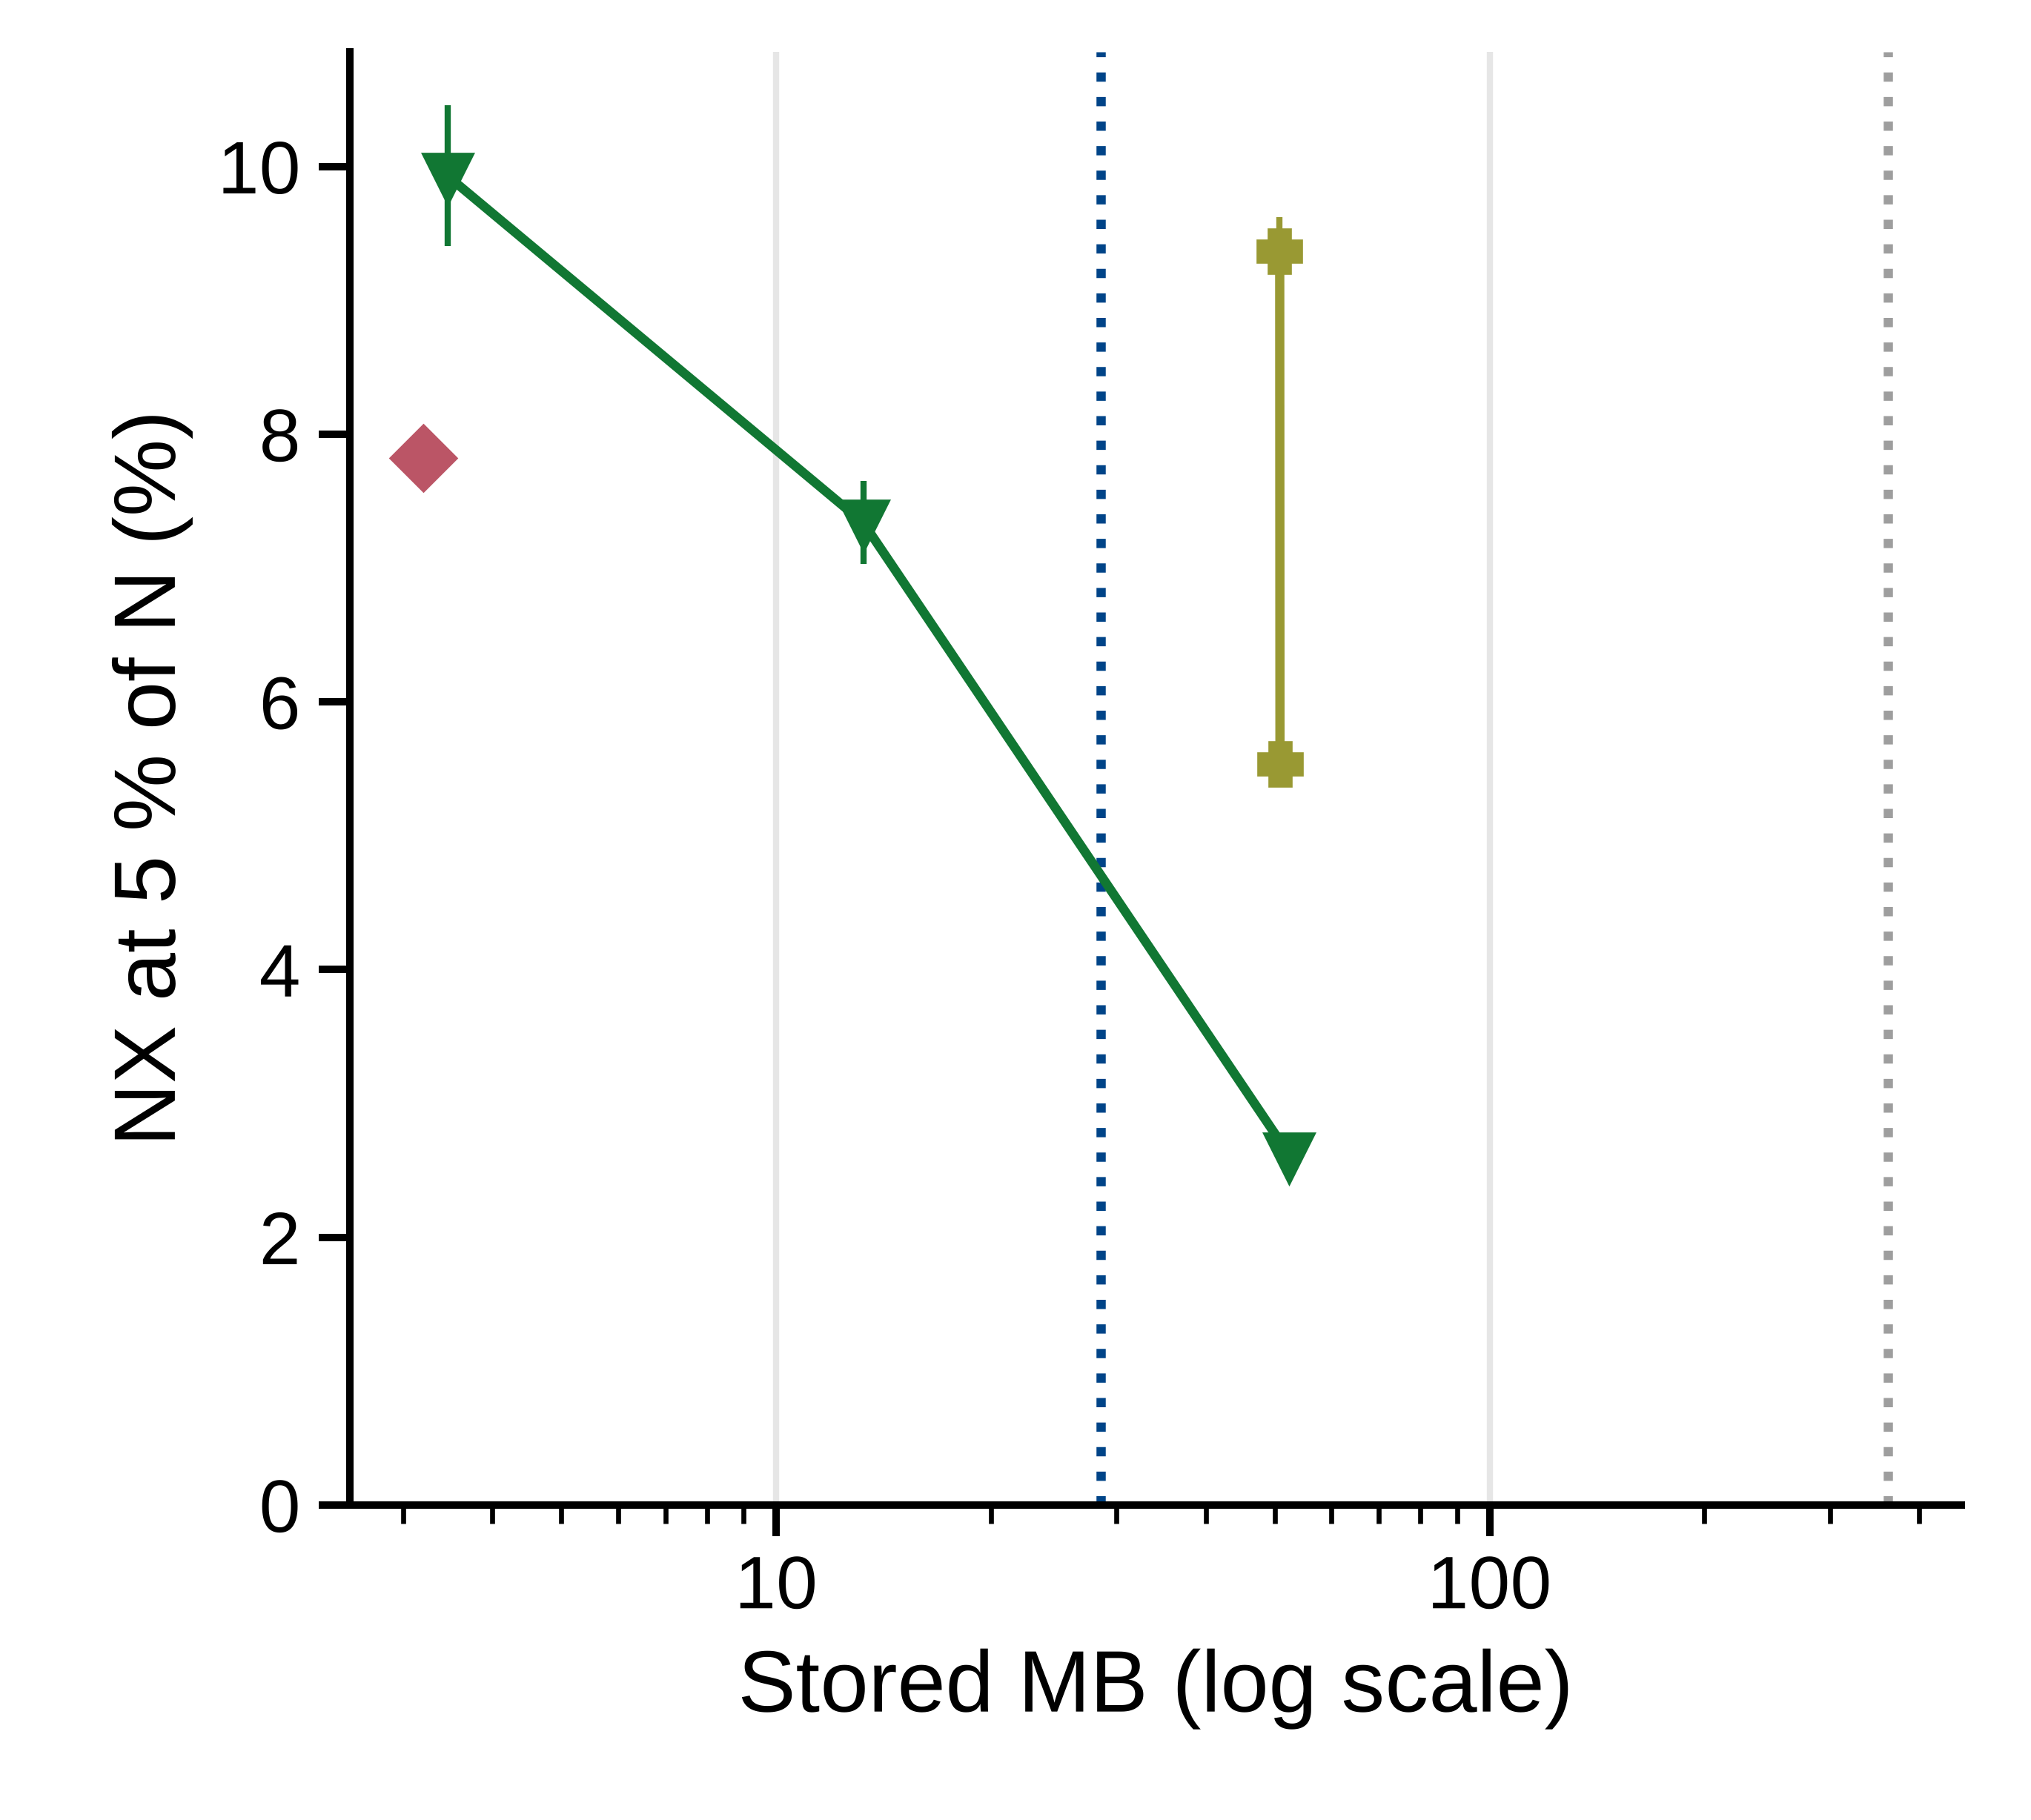
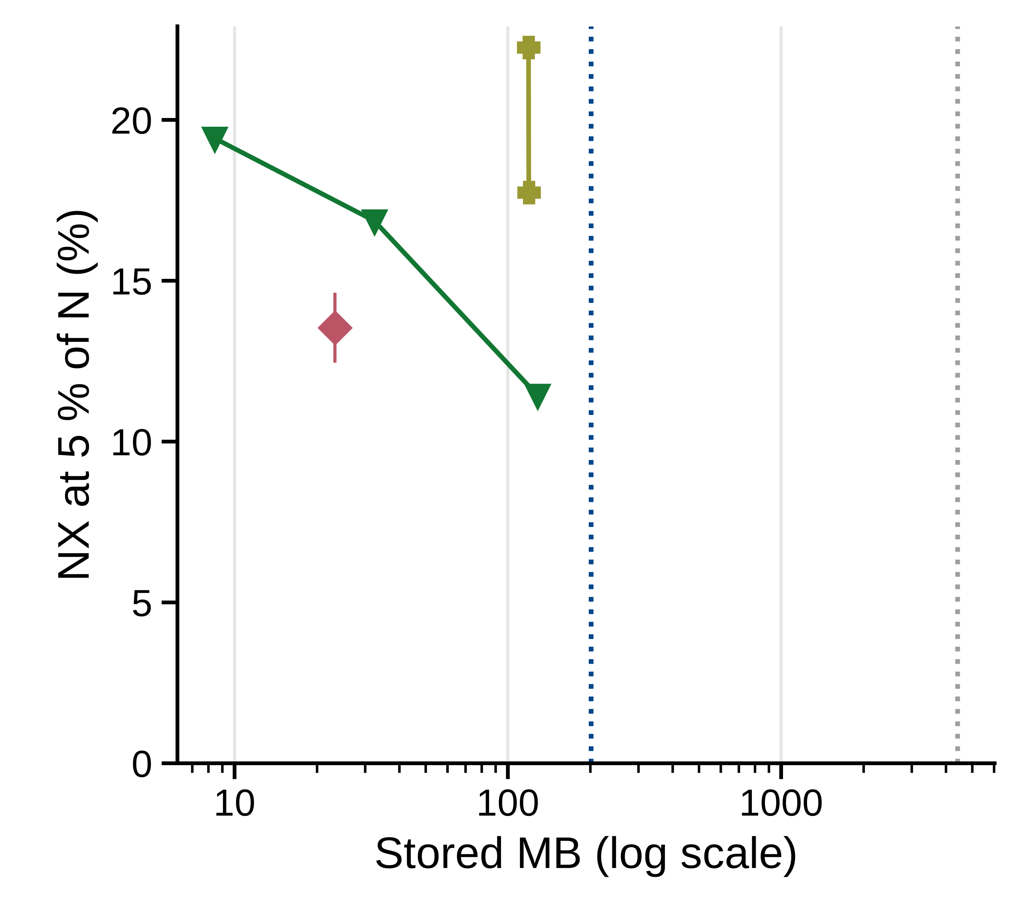
A
Speed-up
B
15×
4.5×
19×
4.6×
14×
4.4×
15×
3.9×
25×
5.3×
16×
4.1×
14×
3.3×
29×
5.3×
C
Breast, typical query
D
Breast
Brain
D = 16
m = 8
D = 16
m = 8
D = 64
D = 64
m = 32
m = 32
D = 256
D = 256

Slide 3
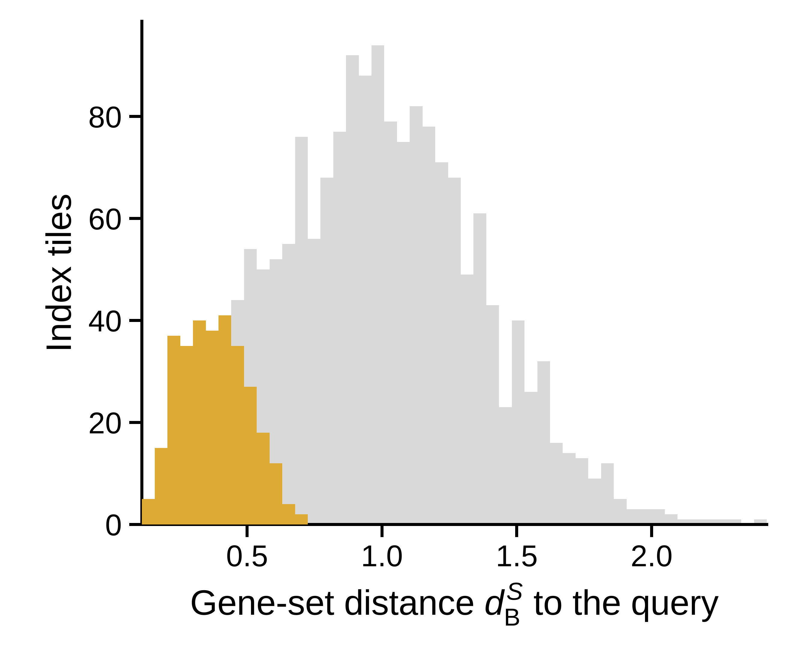
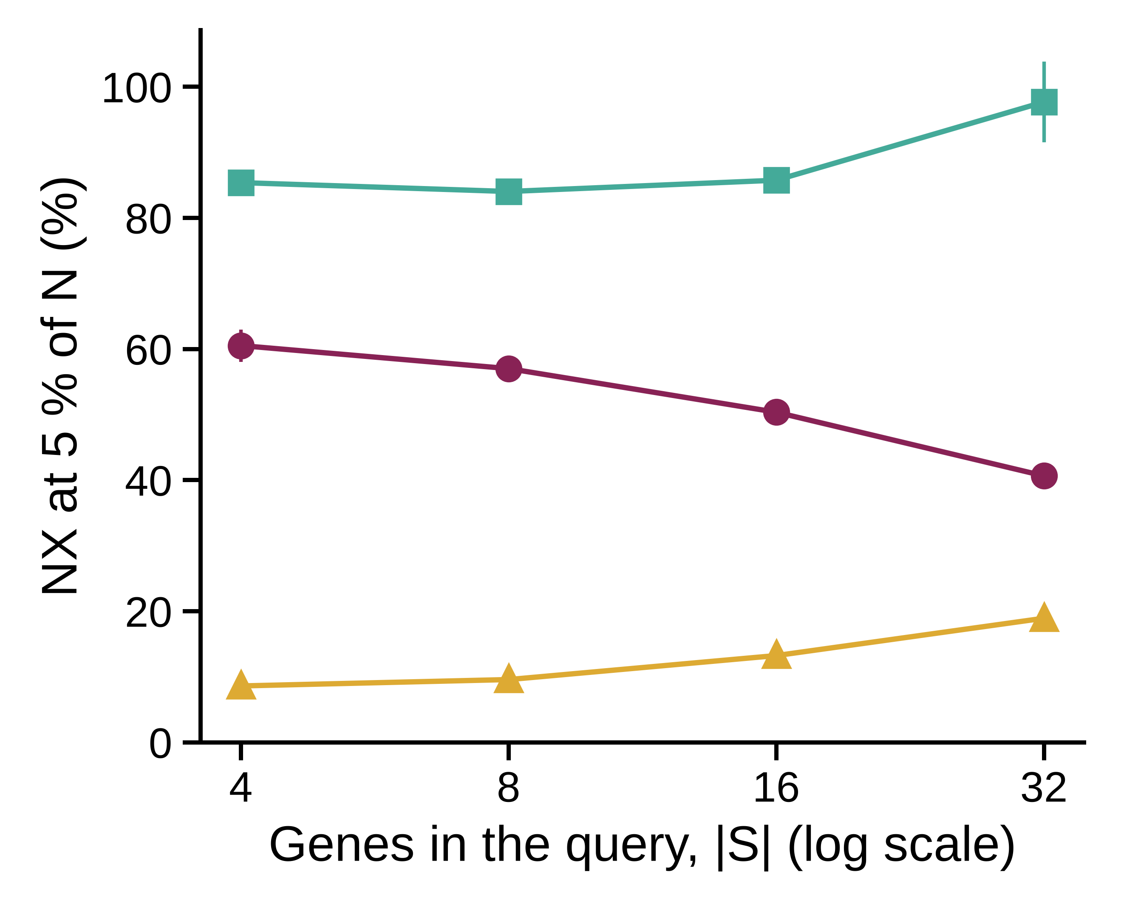
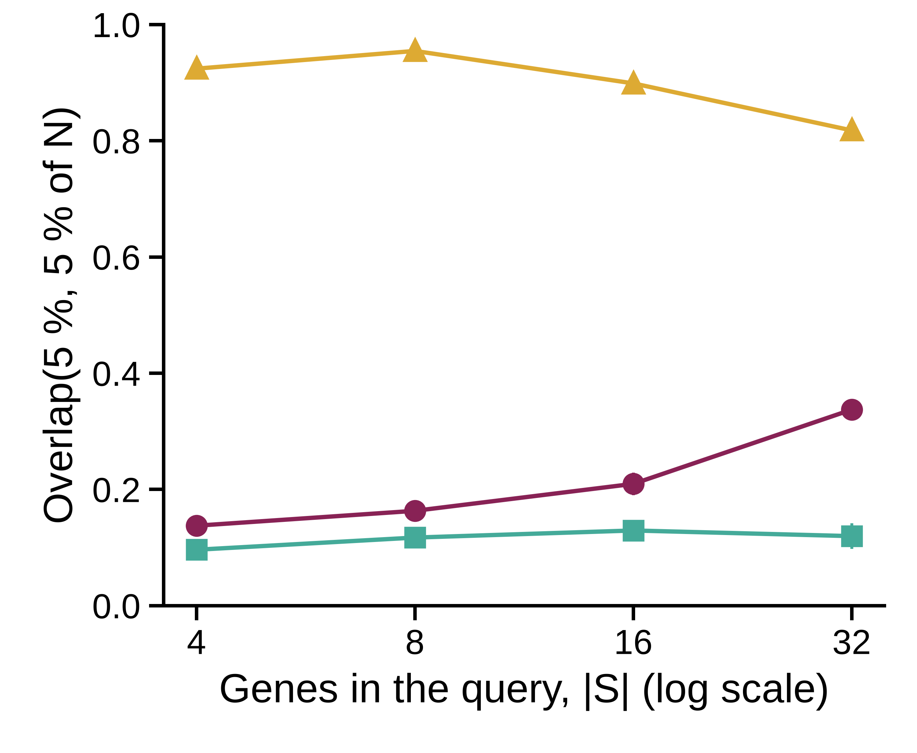
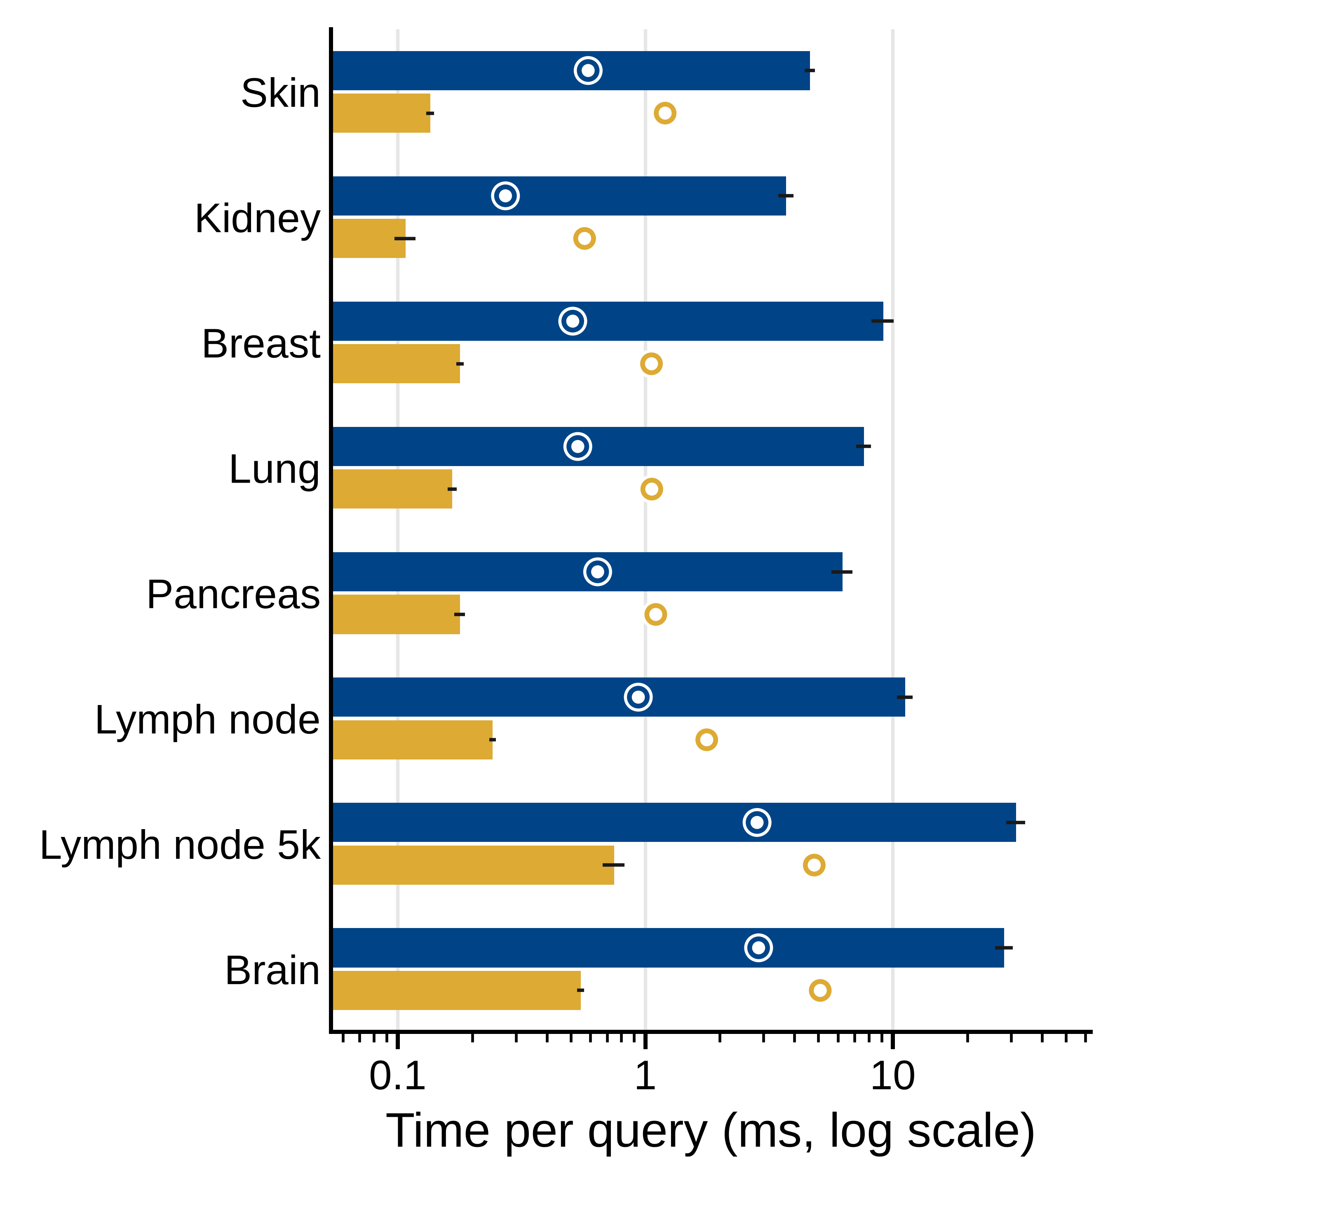
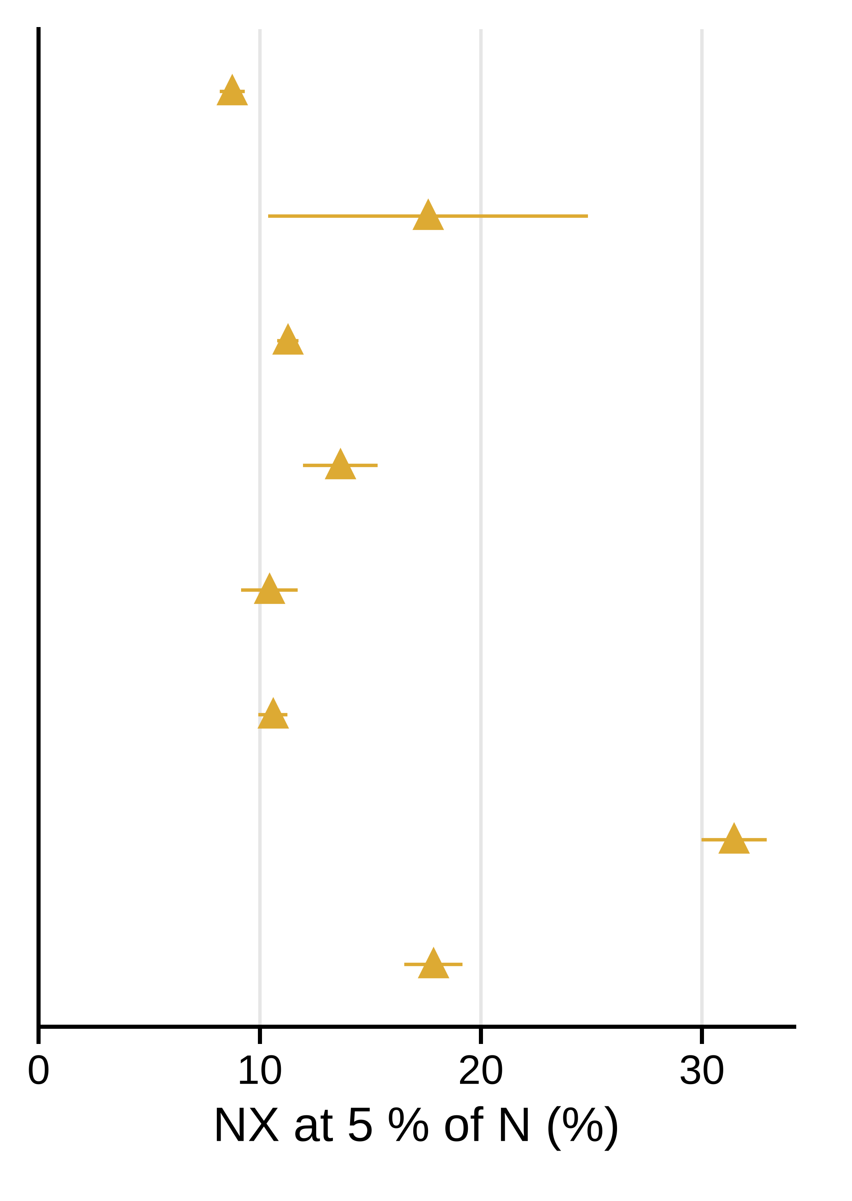
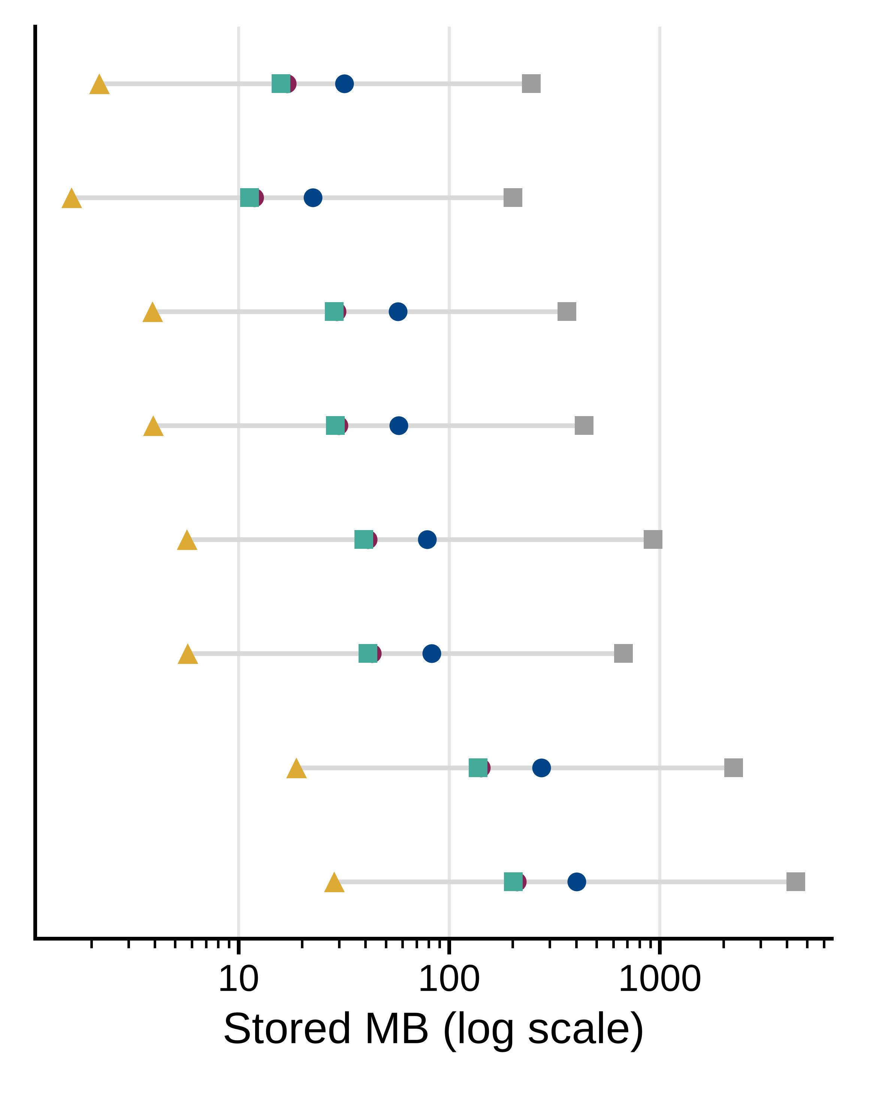

A
Breast, typical query, |S| = 16
B
C
D
Speed-up
E
F
34×
34×
51×
46×
35×
46×
42×
51×

Slide 4
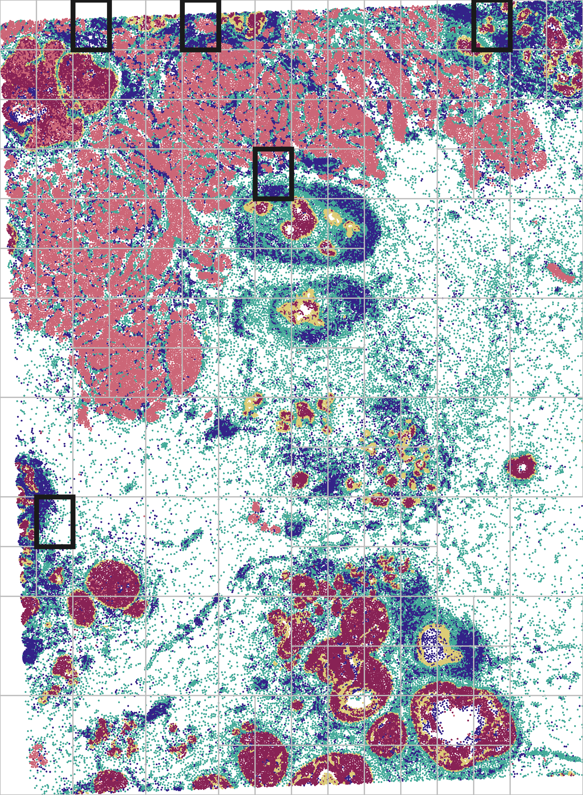
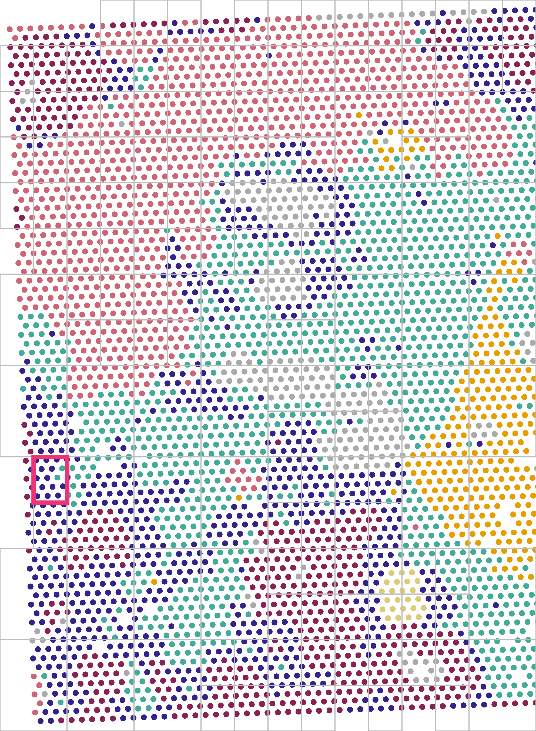
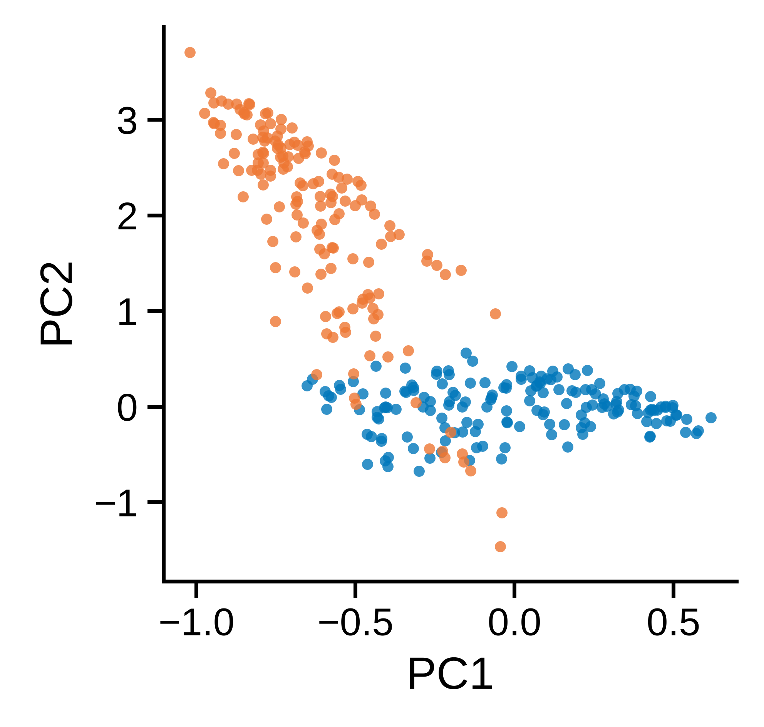

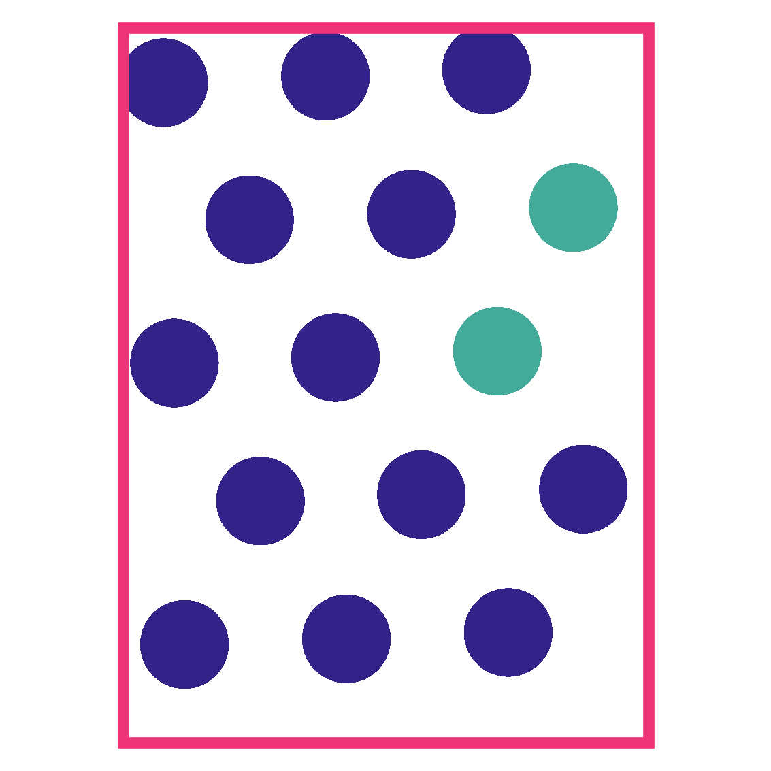
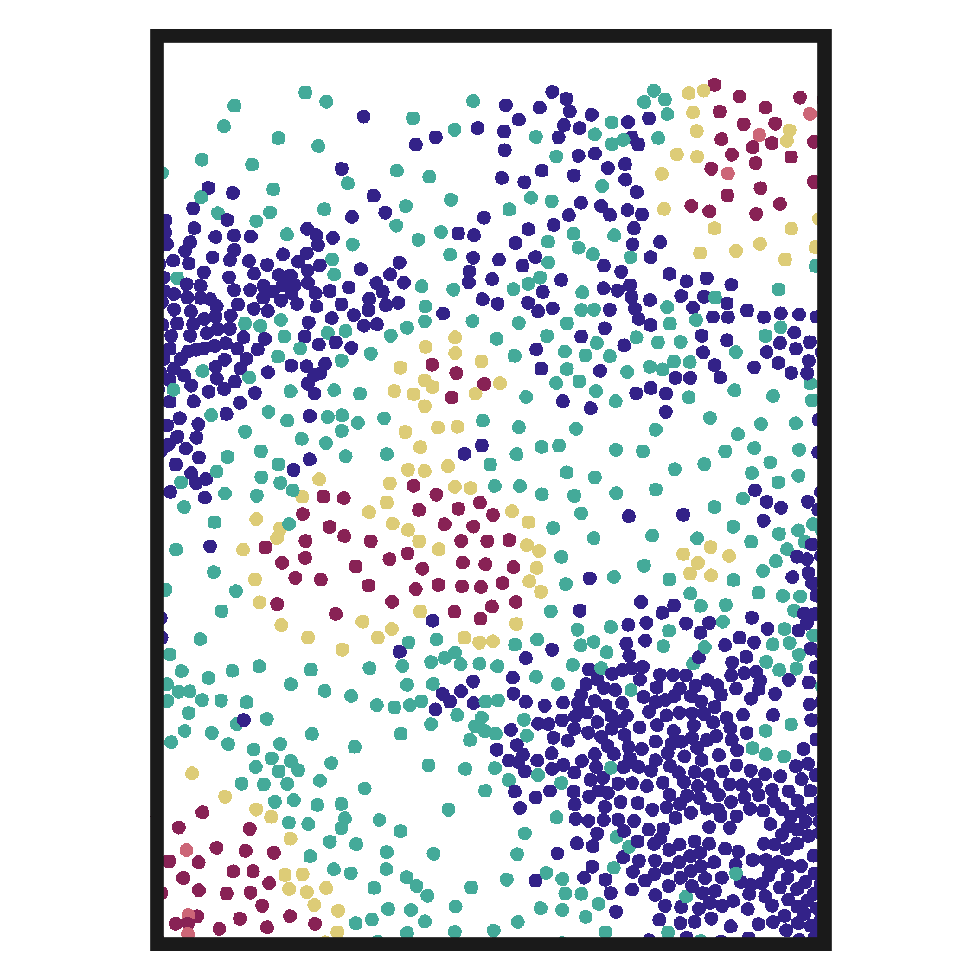
A
Xenium
Visium
B
Uncorrected
Global shift
C
D
E
Share of immune cells / spots (Xenium section: 22 %)
Query (Visium): 87 %
1: 53 %
2: 49 %
3: 63 %
4: 60 %
5 (co-located): 69 %

Slide 5
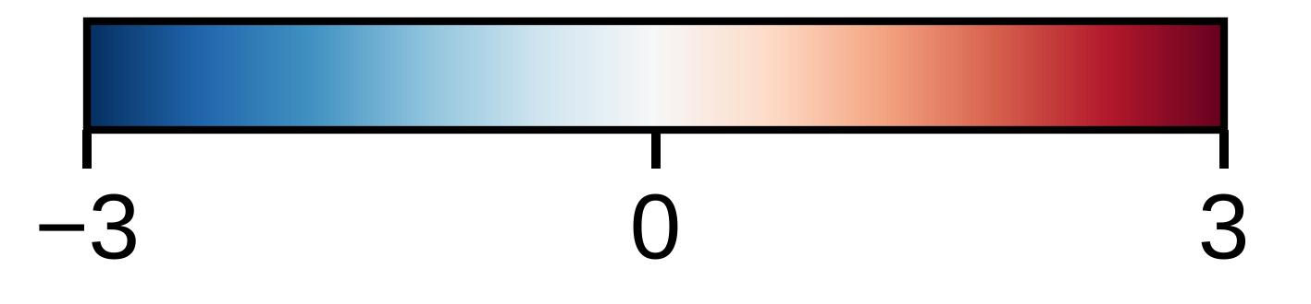
A
Niche
Section
B
r with ACTA2 (○ same block)
log2 enrichment over section
C
Niche 1, its blocks
Niche 2, in niche 1's order and blocks
Co-varying blocks: hub genes; term (FDR), its block genes
1 AQP1, PECAM1, VWF
2 CD3E, PTPRC, CCL5
Allograft Rejection (FDR 1e-02): IL2RG, GZMA, CD8A, CCL5, CD3E, PTPRC
3 APOC1, CXCL16, PDK4
Microglial Cell Activation (FDR 1e-02): CX3CR1, TYROBP, ITGAM, C1QA
4 FCER1G, LYZ, CD4
5 LUM, POSTN, CCDC80
Epithelial Mesenchymal Transition (FDR 8e-07): FSTL3, BASP1, LRRC15, SFRP4, FBLN1, CXCL12, …
6 KRT14, MYLK, KRT5
Intermediate Filament Organization (FDR 2e-03): KRT16, KRT15, KRT6B, KRT5, KRT14
7 TOP2A, RTKN2, PCLAF
G2-M Checkpoint (FDR 3e-04): MKI67, TOP2A, CENPF, HMGA1, SQLE
8 ERBB2, EPCAM, CEACAM6
Androgen Response (FDR 3e-02): SMS, TPD52, SCD, CCND1, KRT8
1
2
3
4
5
6
7
8
Correlation (niche mean)
D
Held-out query and its top 10
E
1
2
3
4
5
Query
6
7
8
9
10

Slide 6
A
Melanocyte (8 genes)
Keratinocyte (4 genes)
Immune (5 genes)
Signature score; Spindle-partial's 10 nearest tiles outlined
B
Held-out query and its top 10
1
2
3
4
5
6
7
8
9
10
Query
C
D
E

Slide 7
A
B
Myeloid
Breast
Lung
Brain
Skin
Pancreas
Stromal / perivascular
Pancreas
Farther
Nearer
Query correlation
Closeness to the query
C
D

