Slide 1
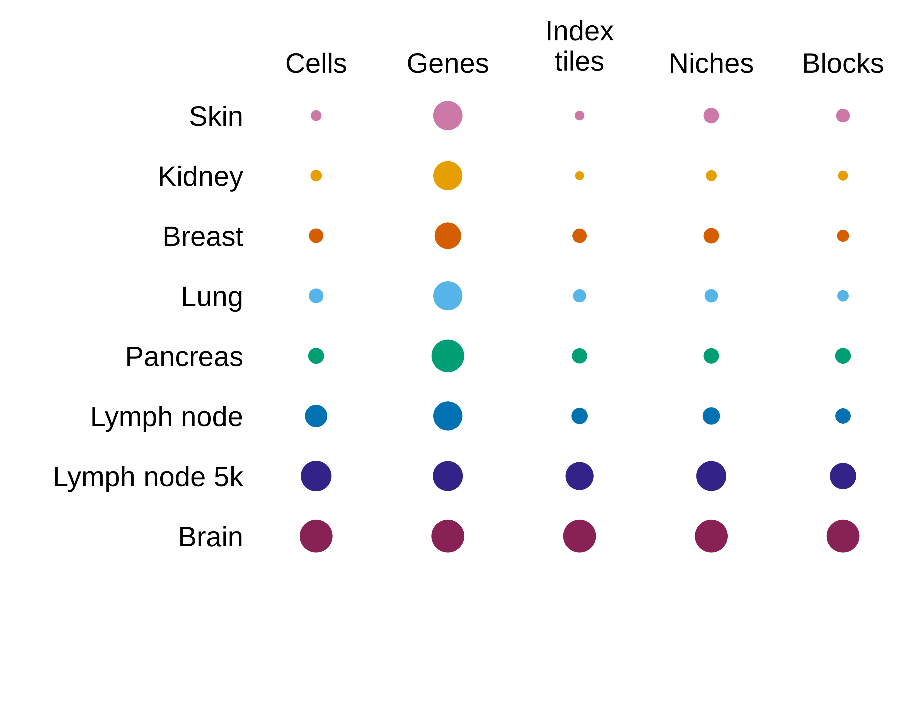
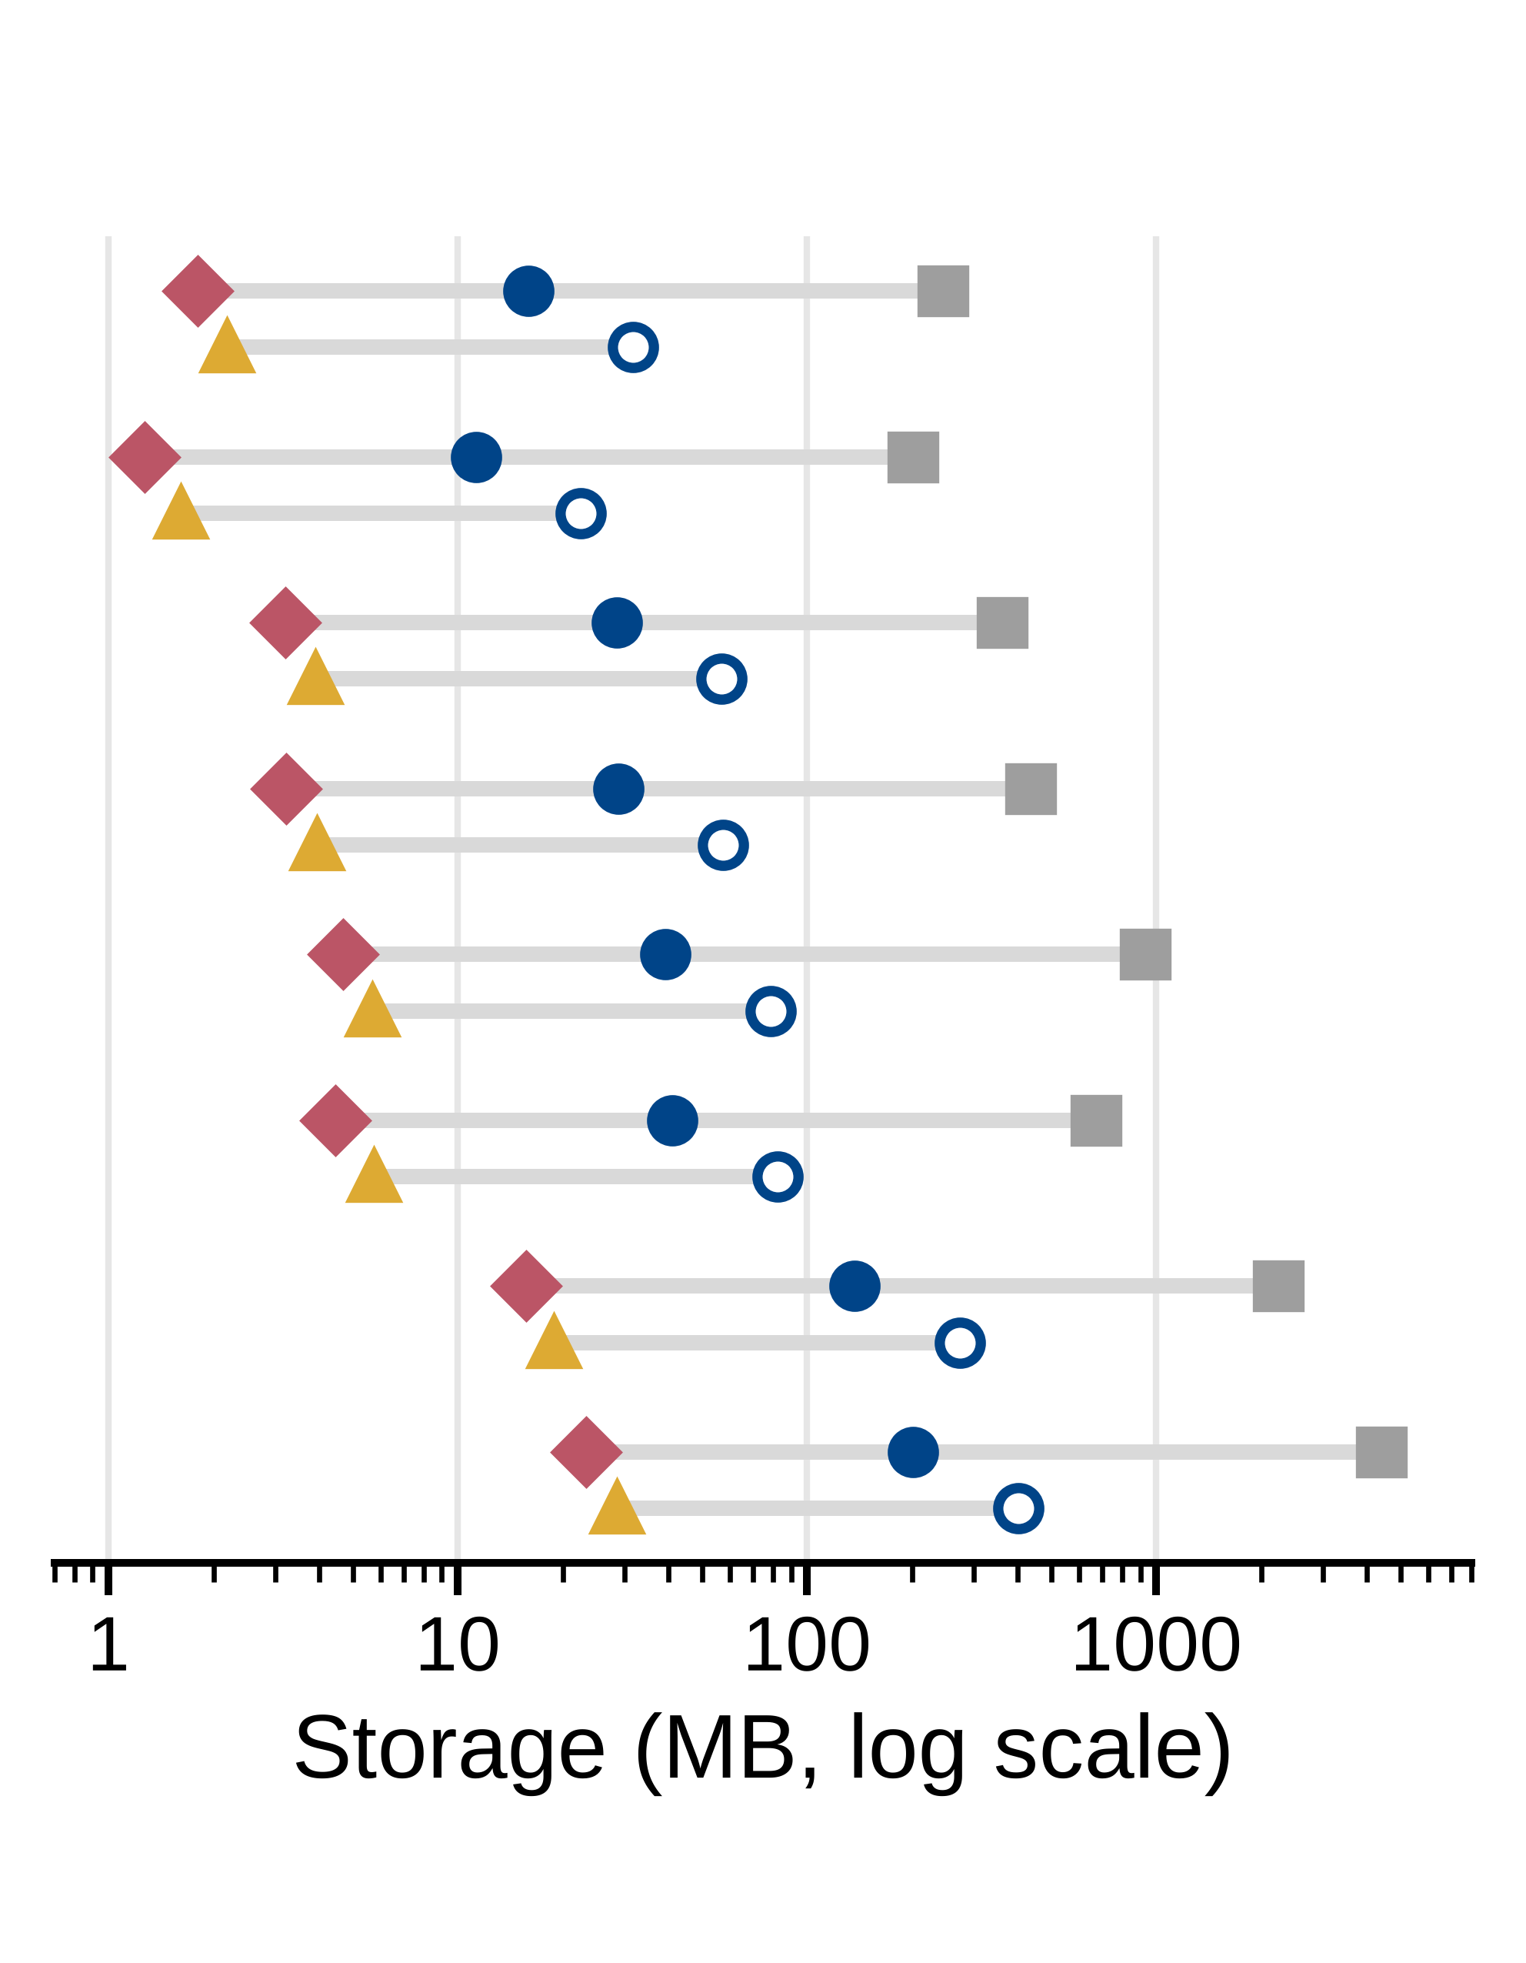
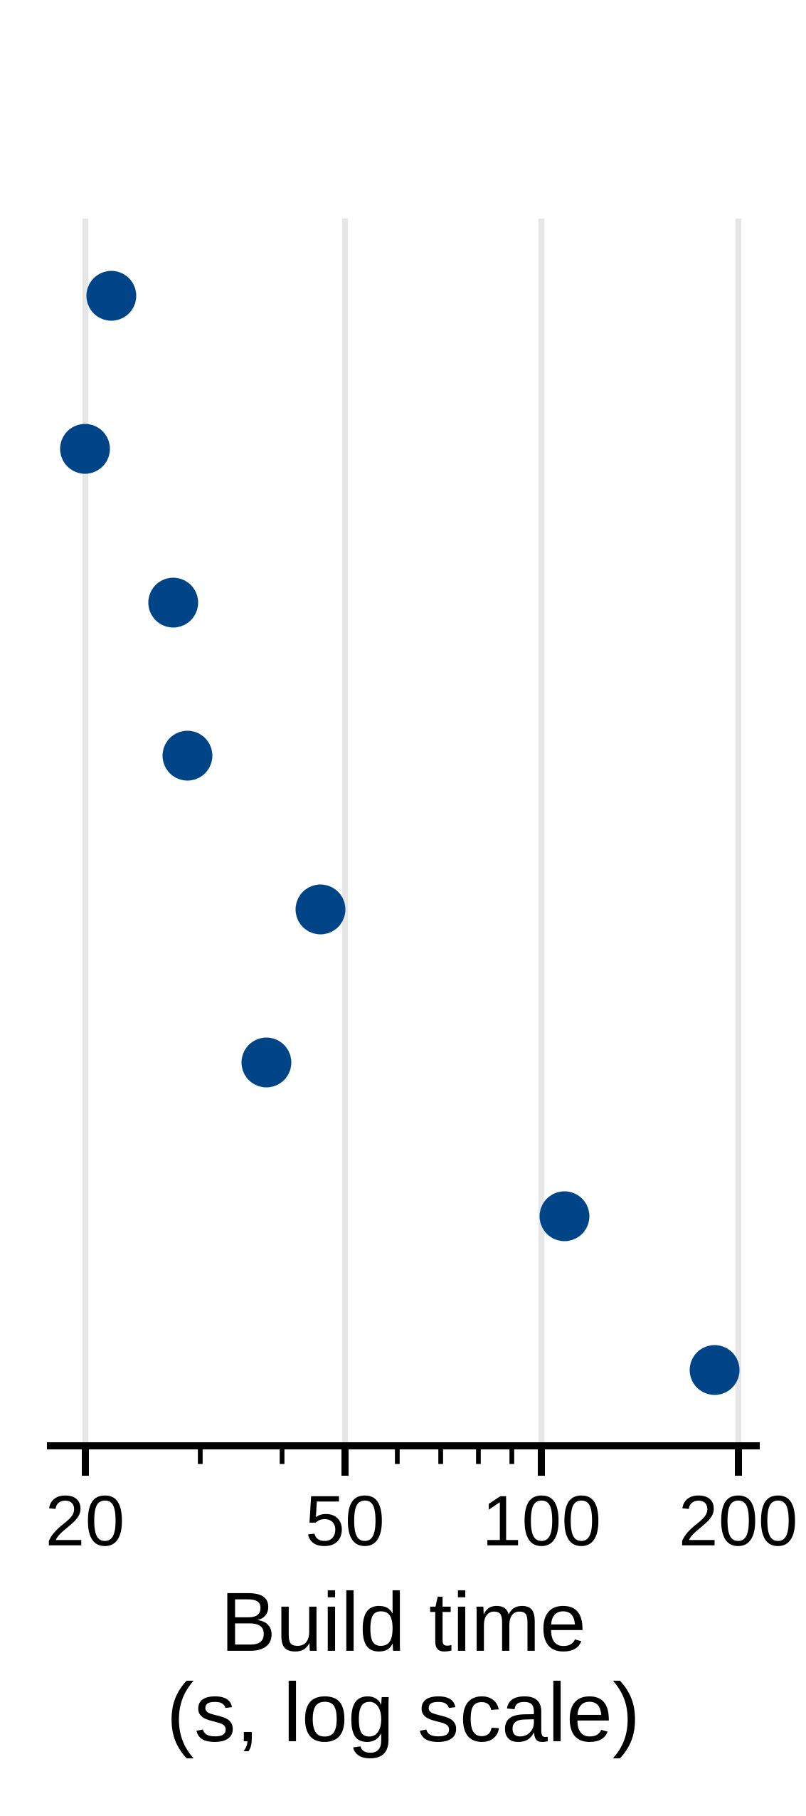
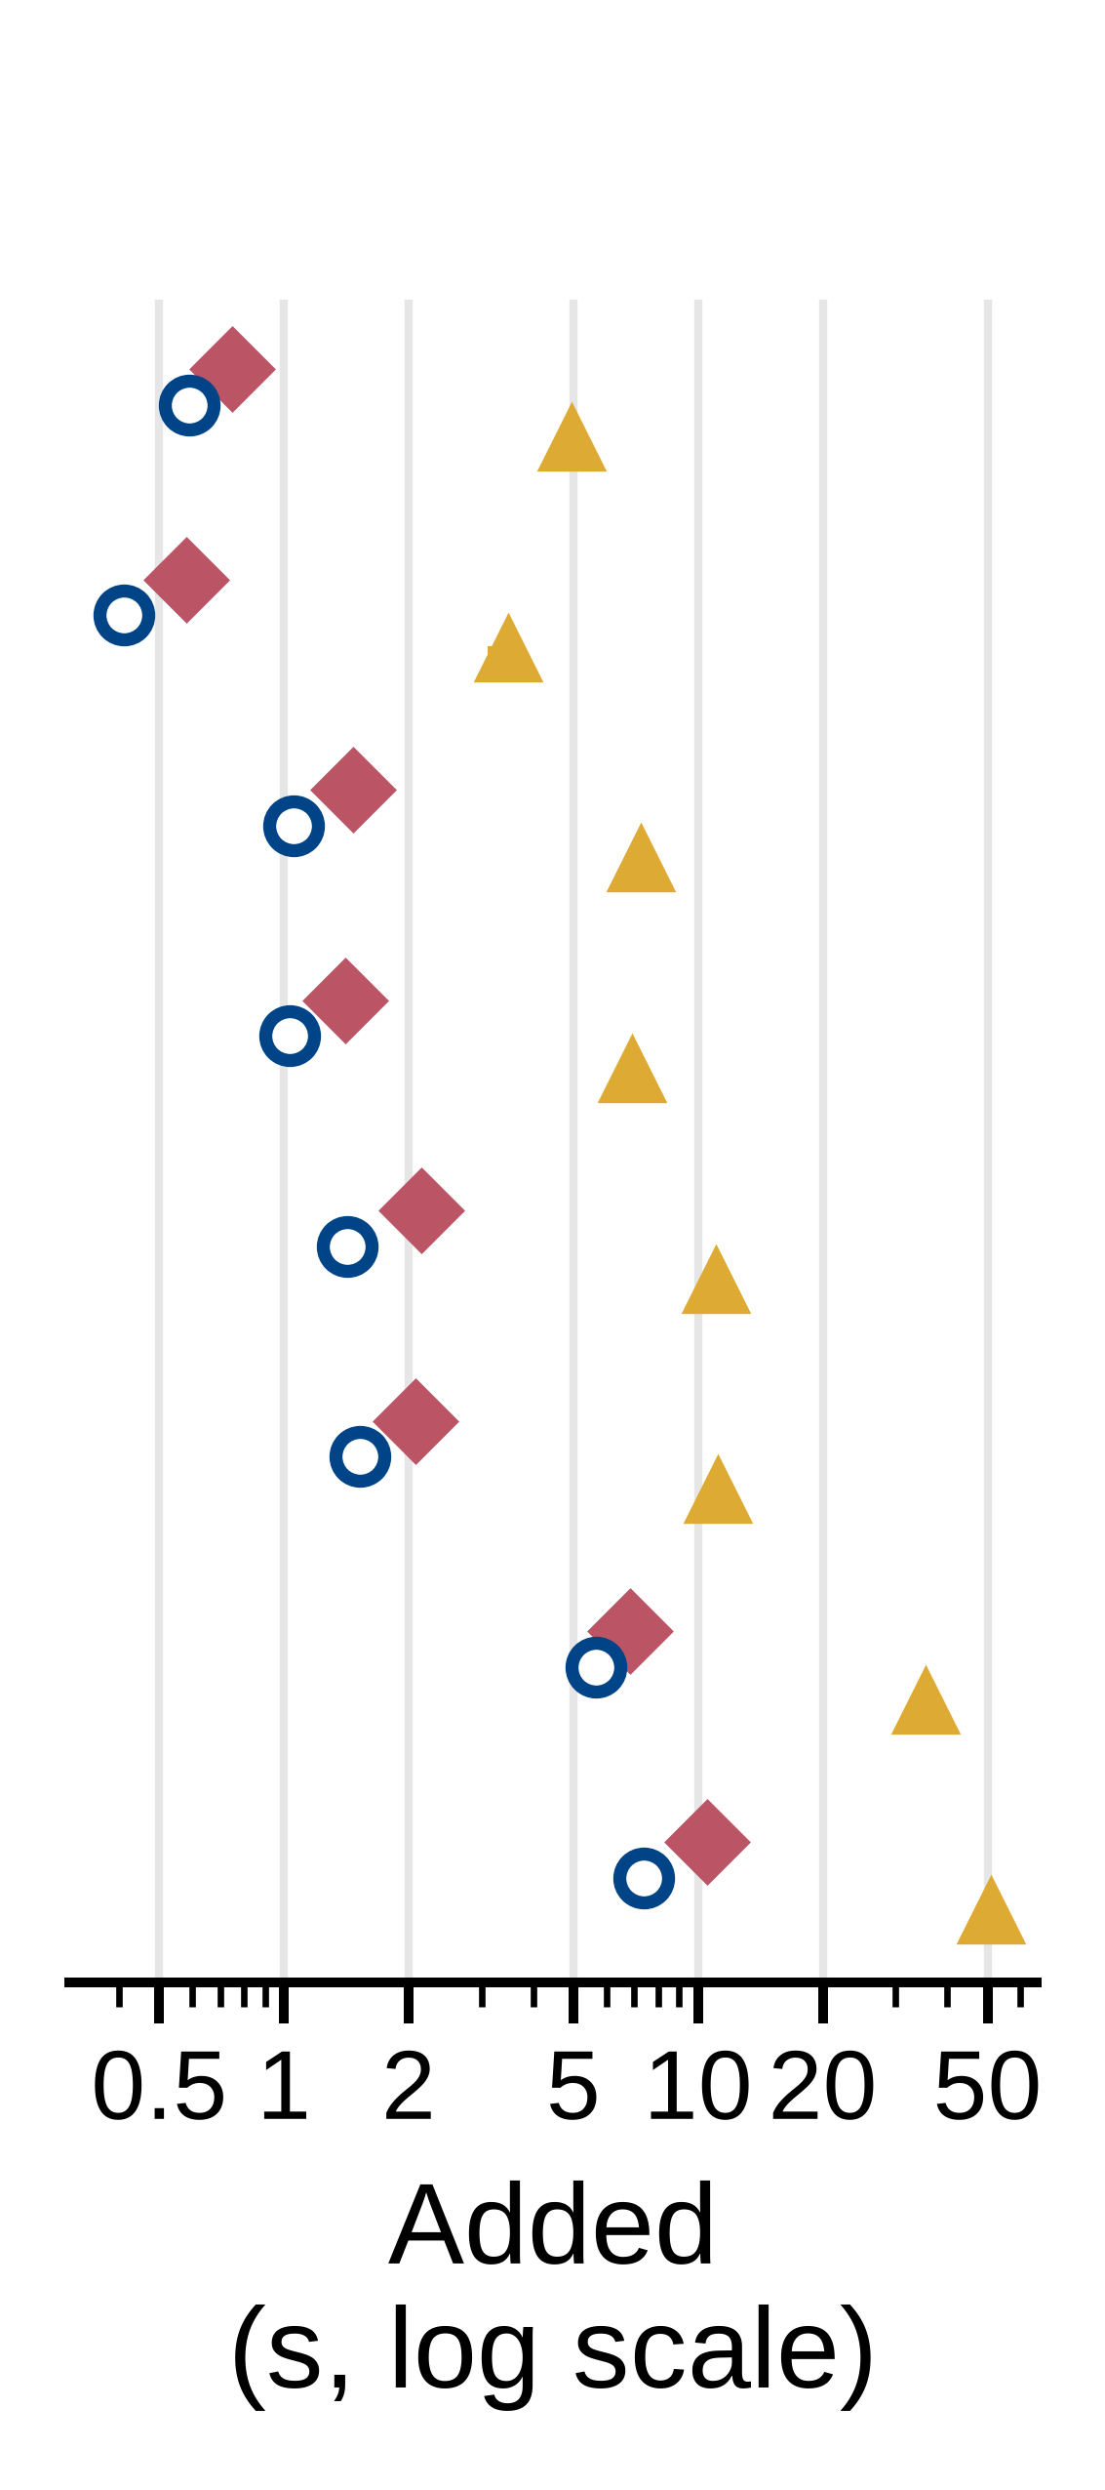
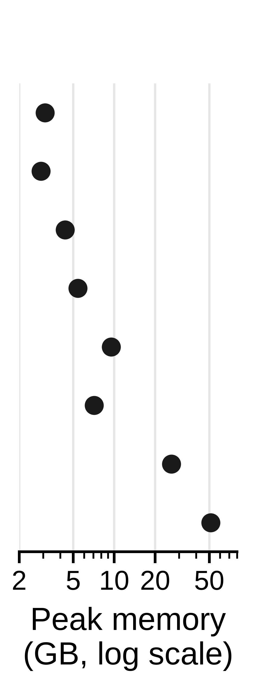
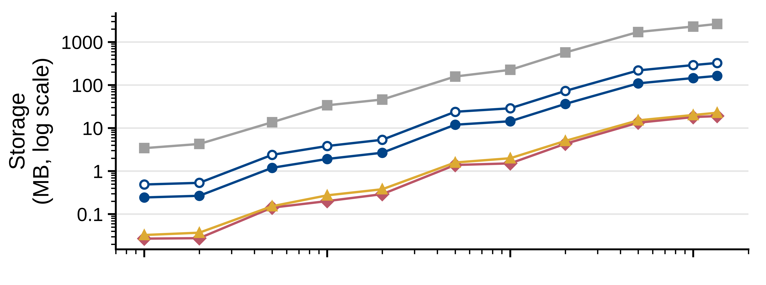
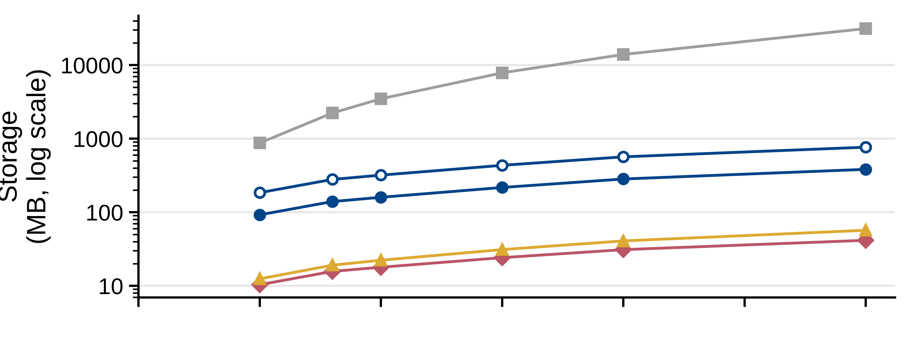
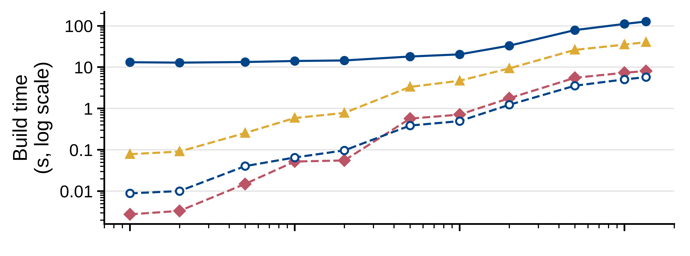
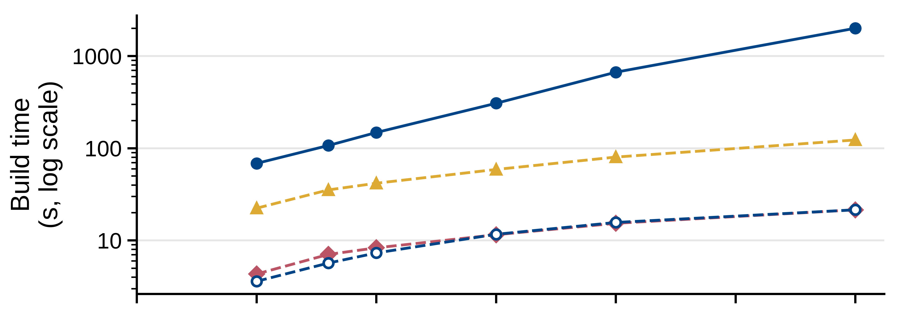
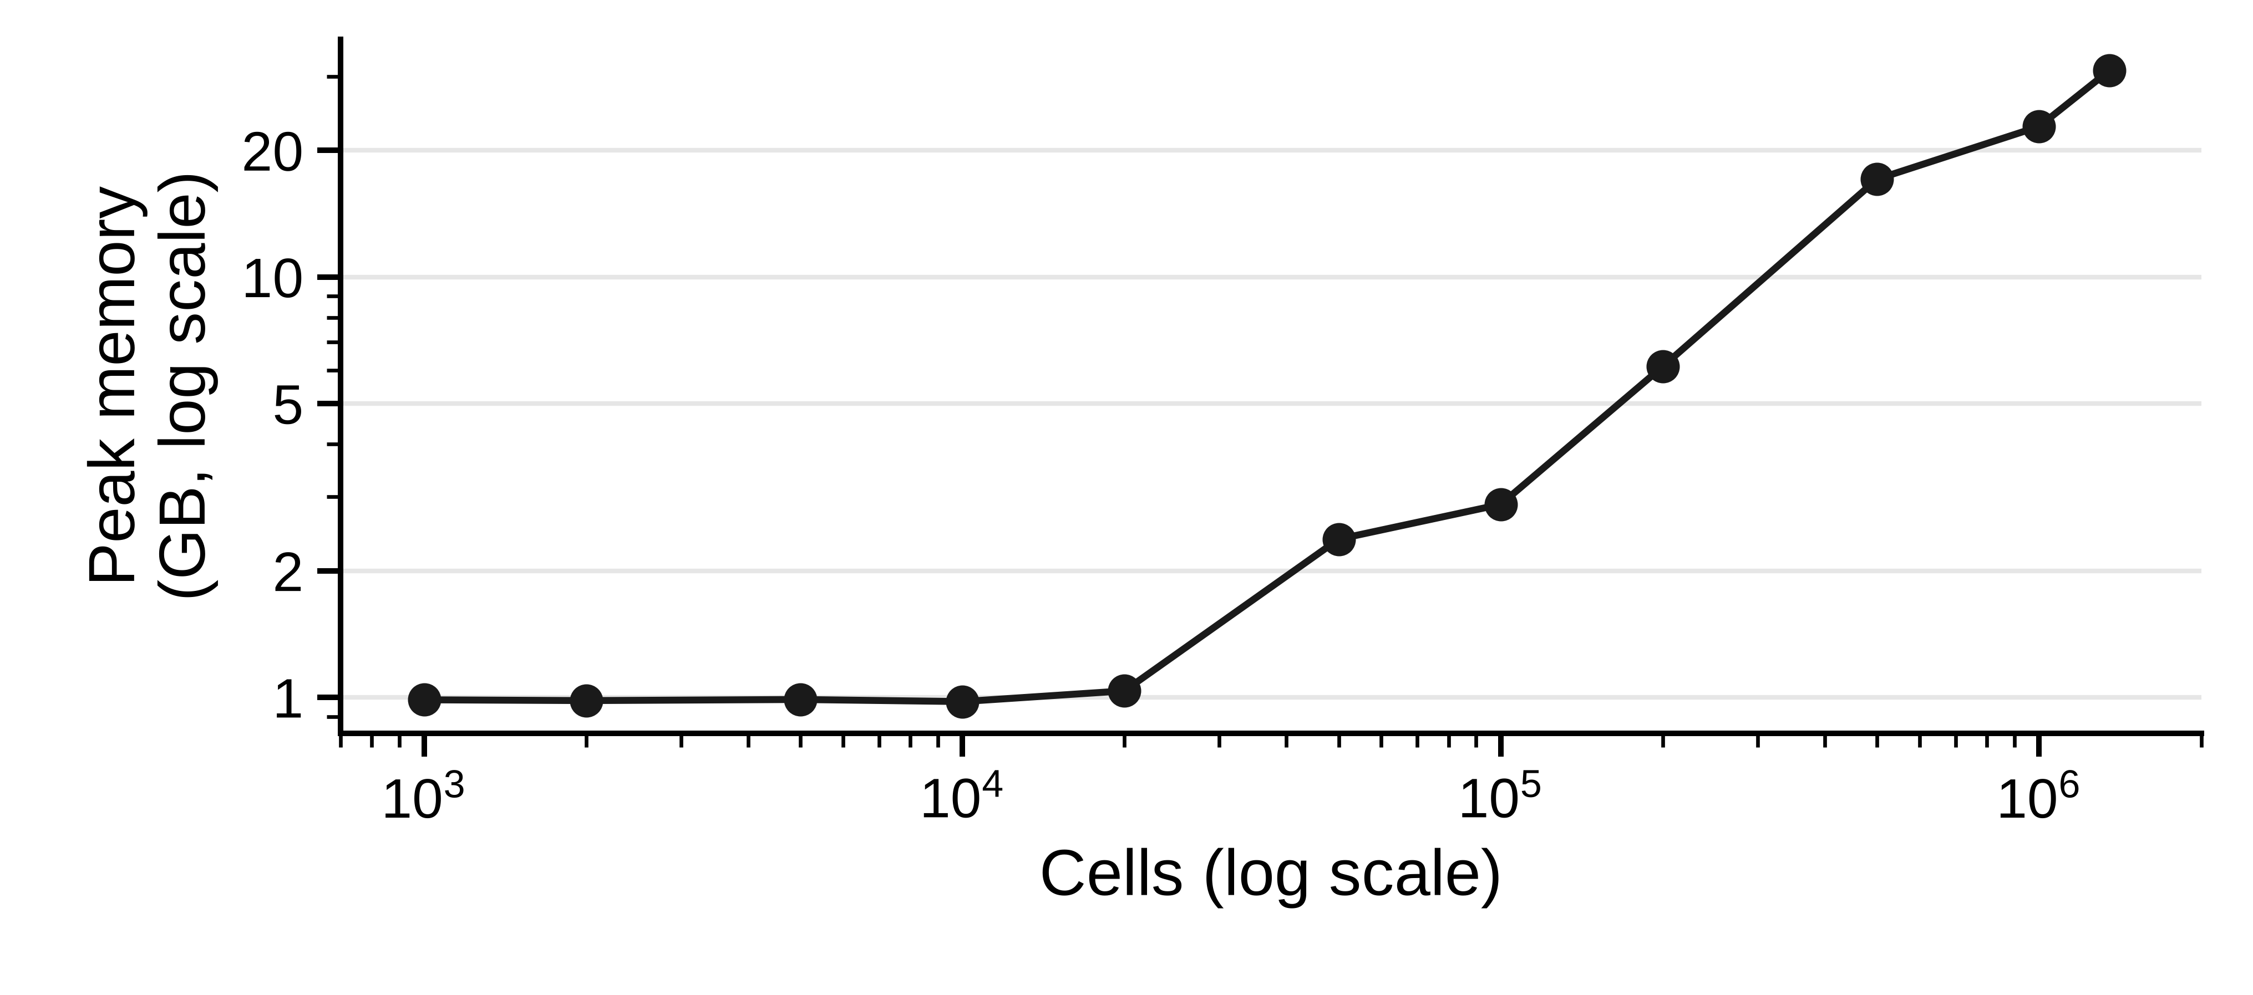
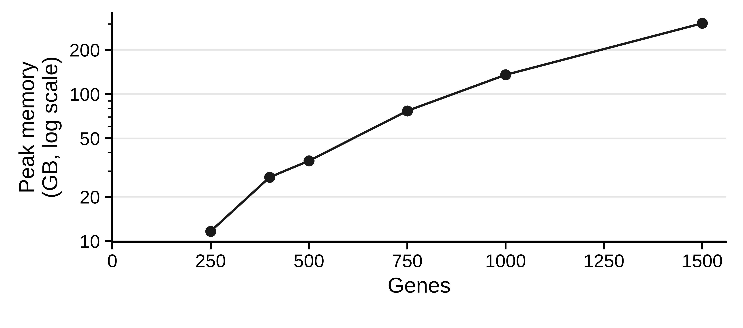
A
B
C
8.8×
15×
Spindle (full build)
added over Spindle
all four indexes
8.9×
18×
8.9×
13×
8.9×
15×
8.4×
24×
9.2×
16×
8.7×
16×
8.7×
22×
87k–817k
313–480
705–9,558
2–18
43–471
D
Tonsil, 1.35M cells, 377 genes, subsampled
E
Lymph node 5k, 6,972 index tiles

