Slide 1
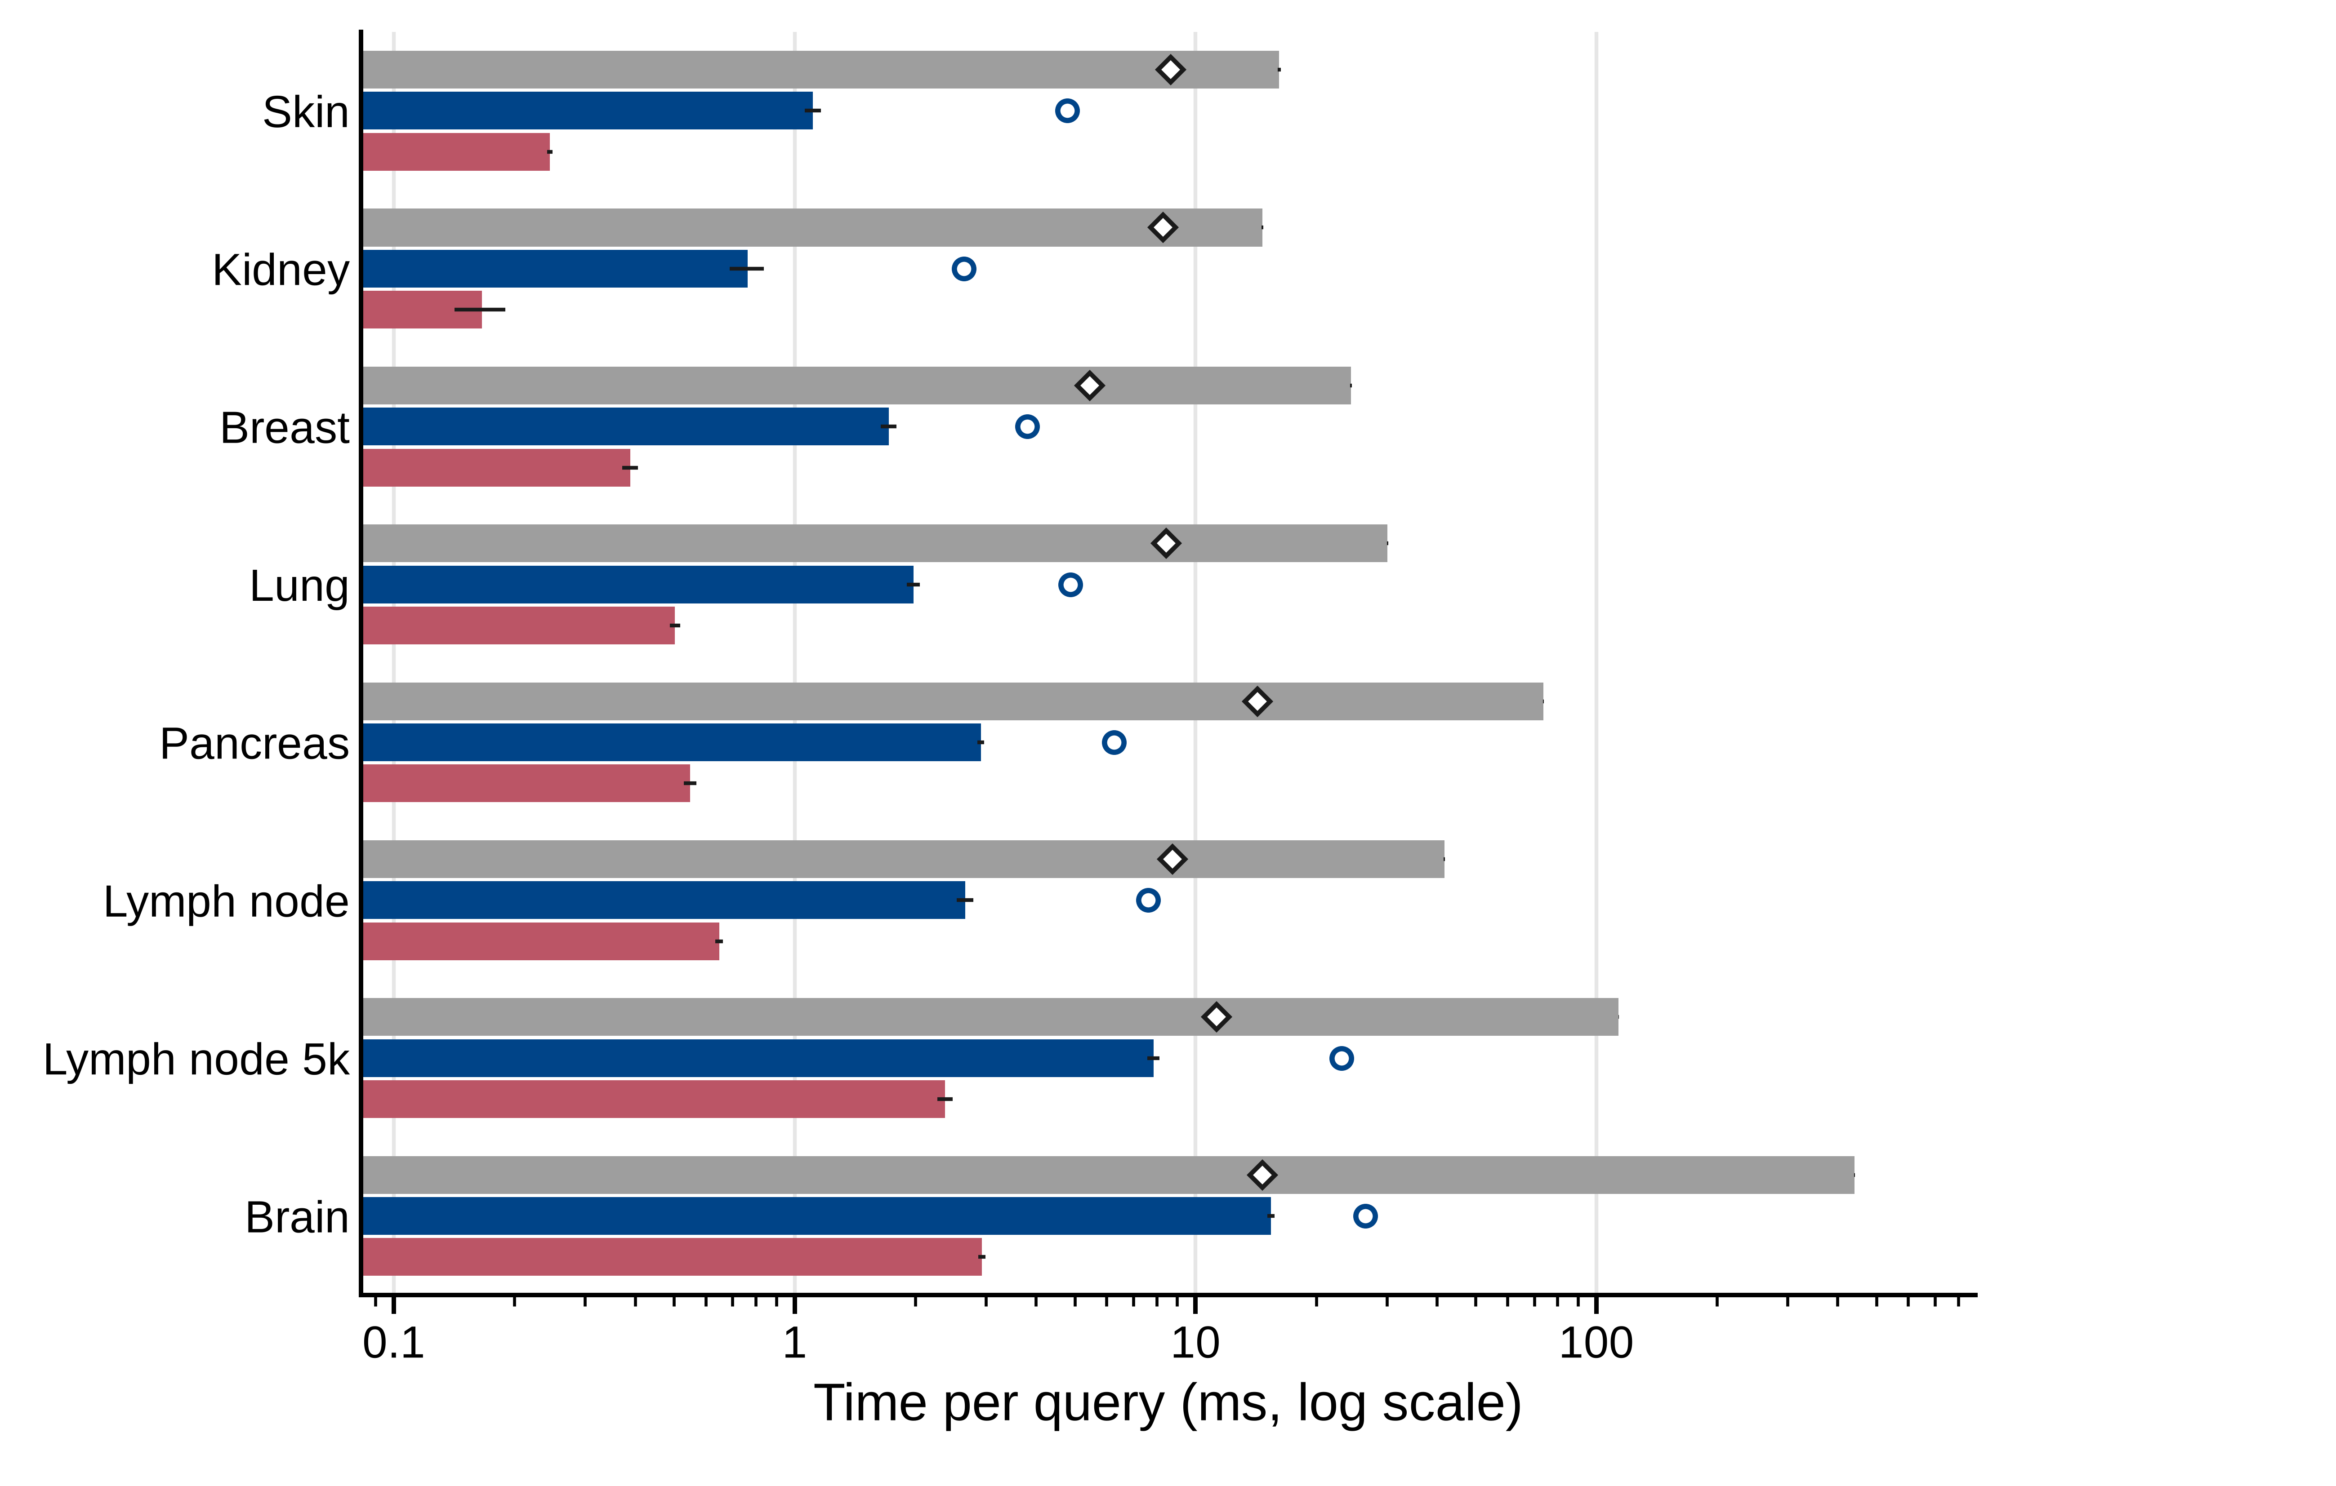
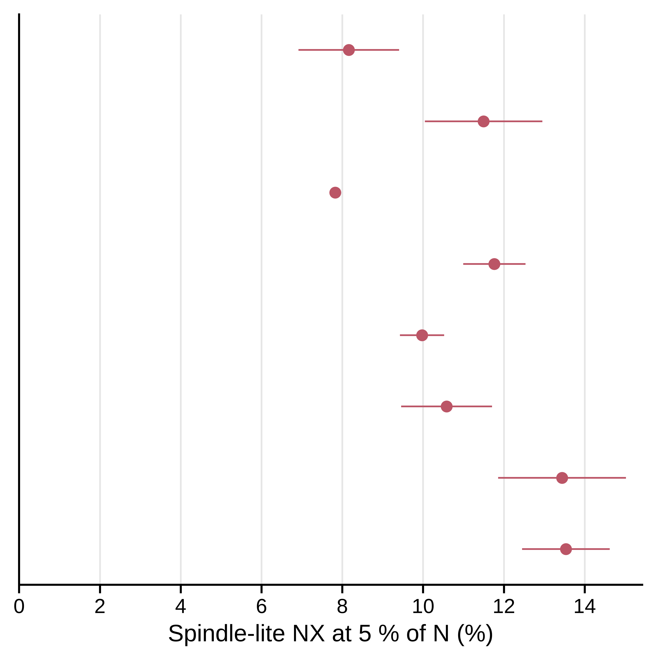
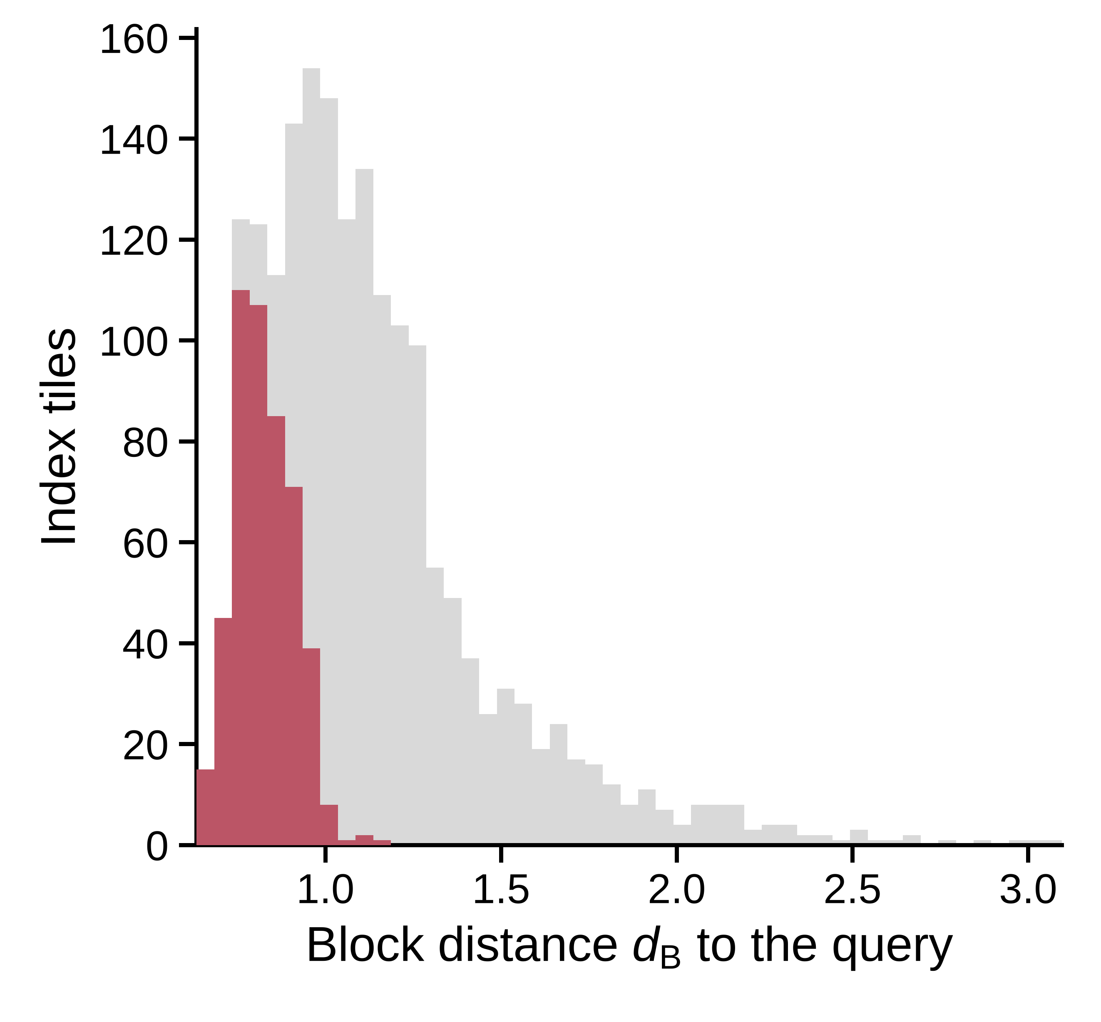
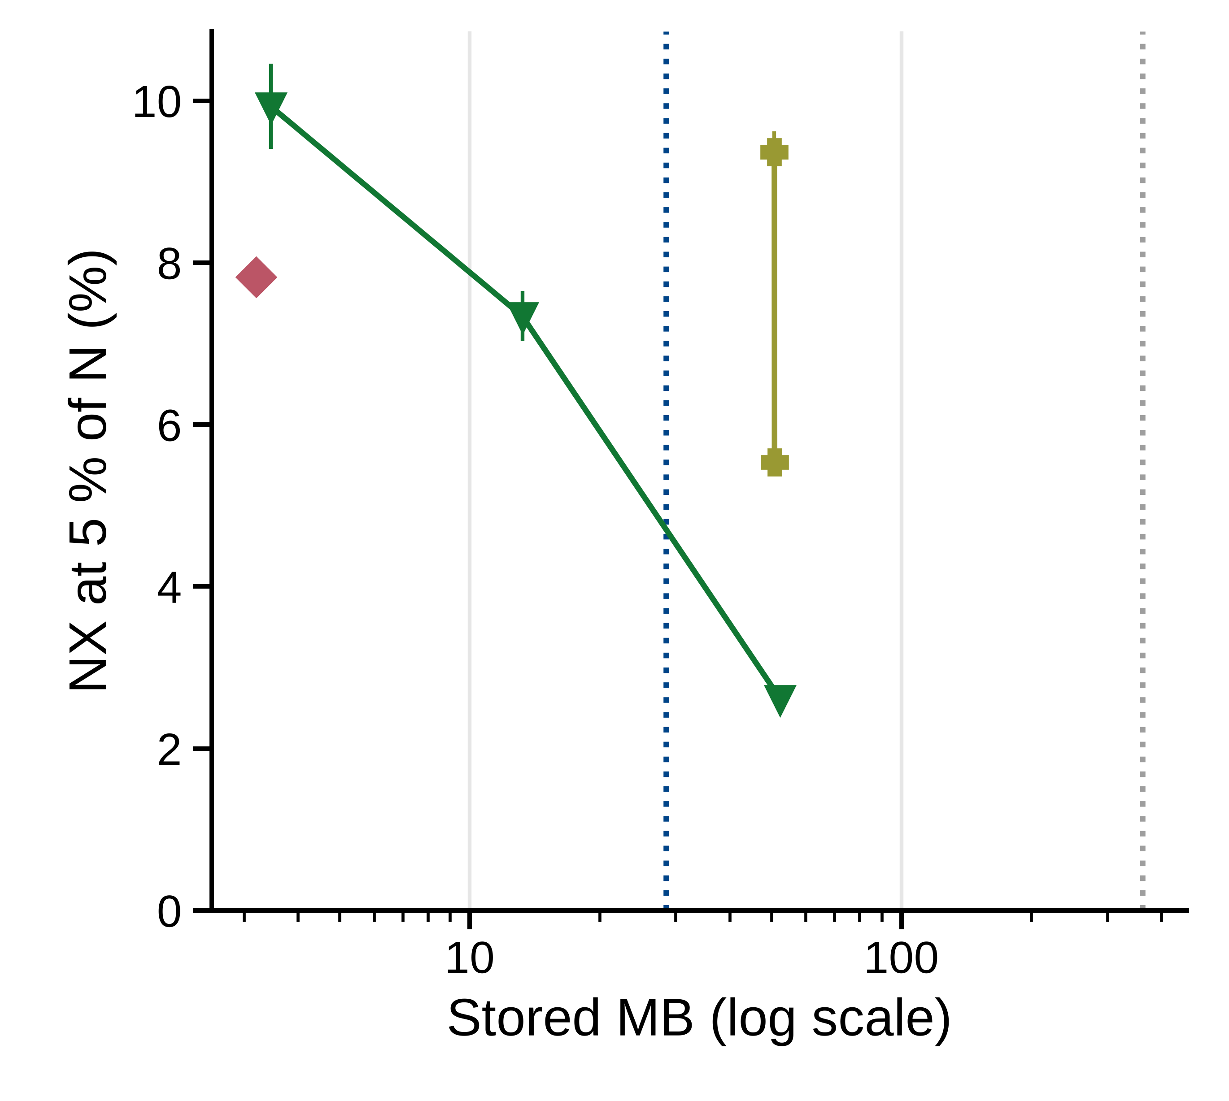
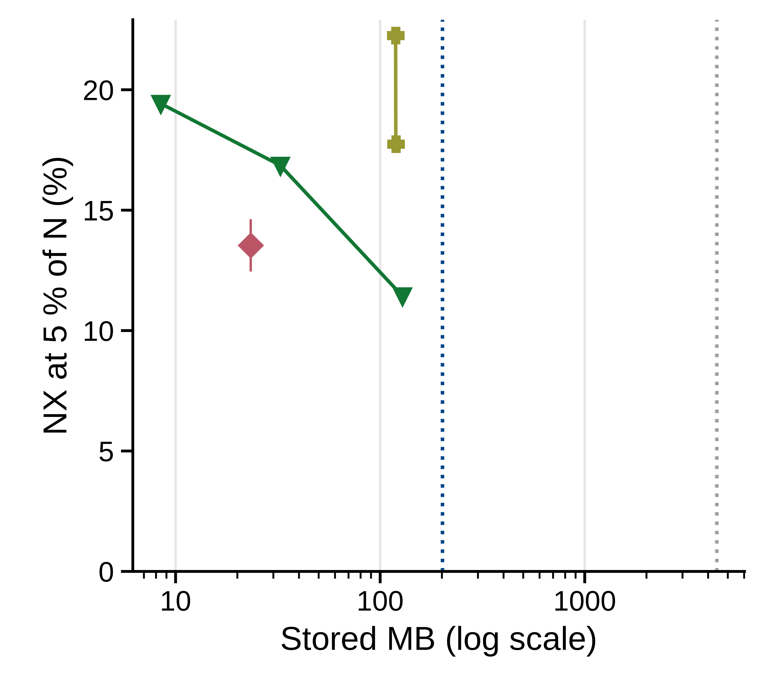
A
Speed-up
B
15×
4.5×
19×
4.6×
14×
4.4×
15×
3.9×
25×
5.3×
16×
4.1×
14×
3.3×
29×
5.3×
C
Breast, typical query
D
Breast
Brain
D = 16
m = 8
m = 8
D = 16
D = 64
m = 32
D = 64
m = 32
D = 256
D = 256

