Slide 1
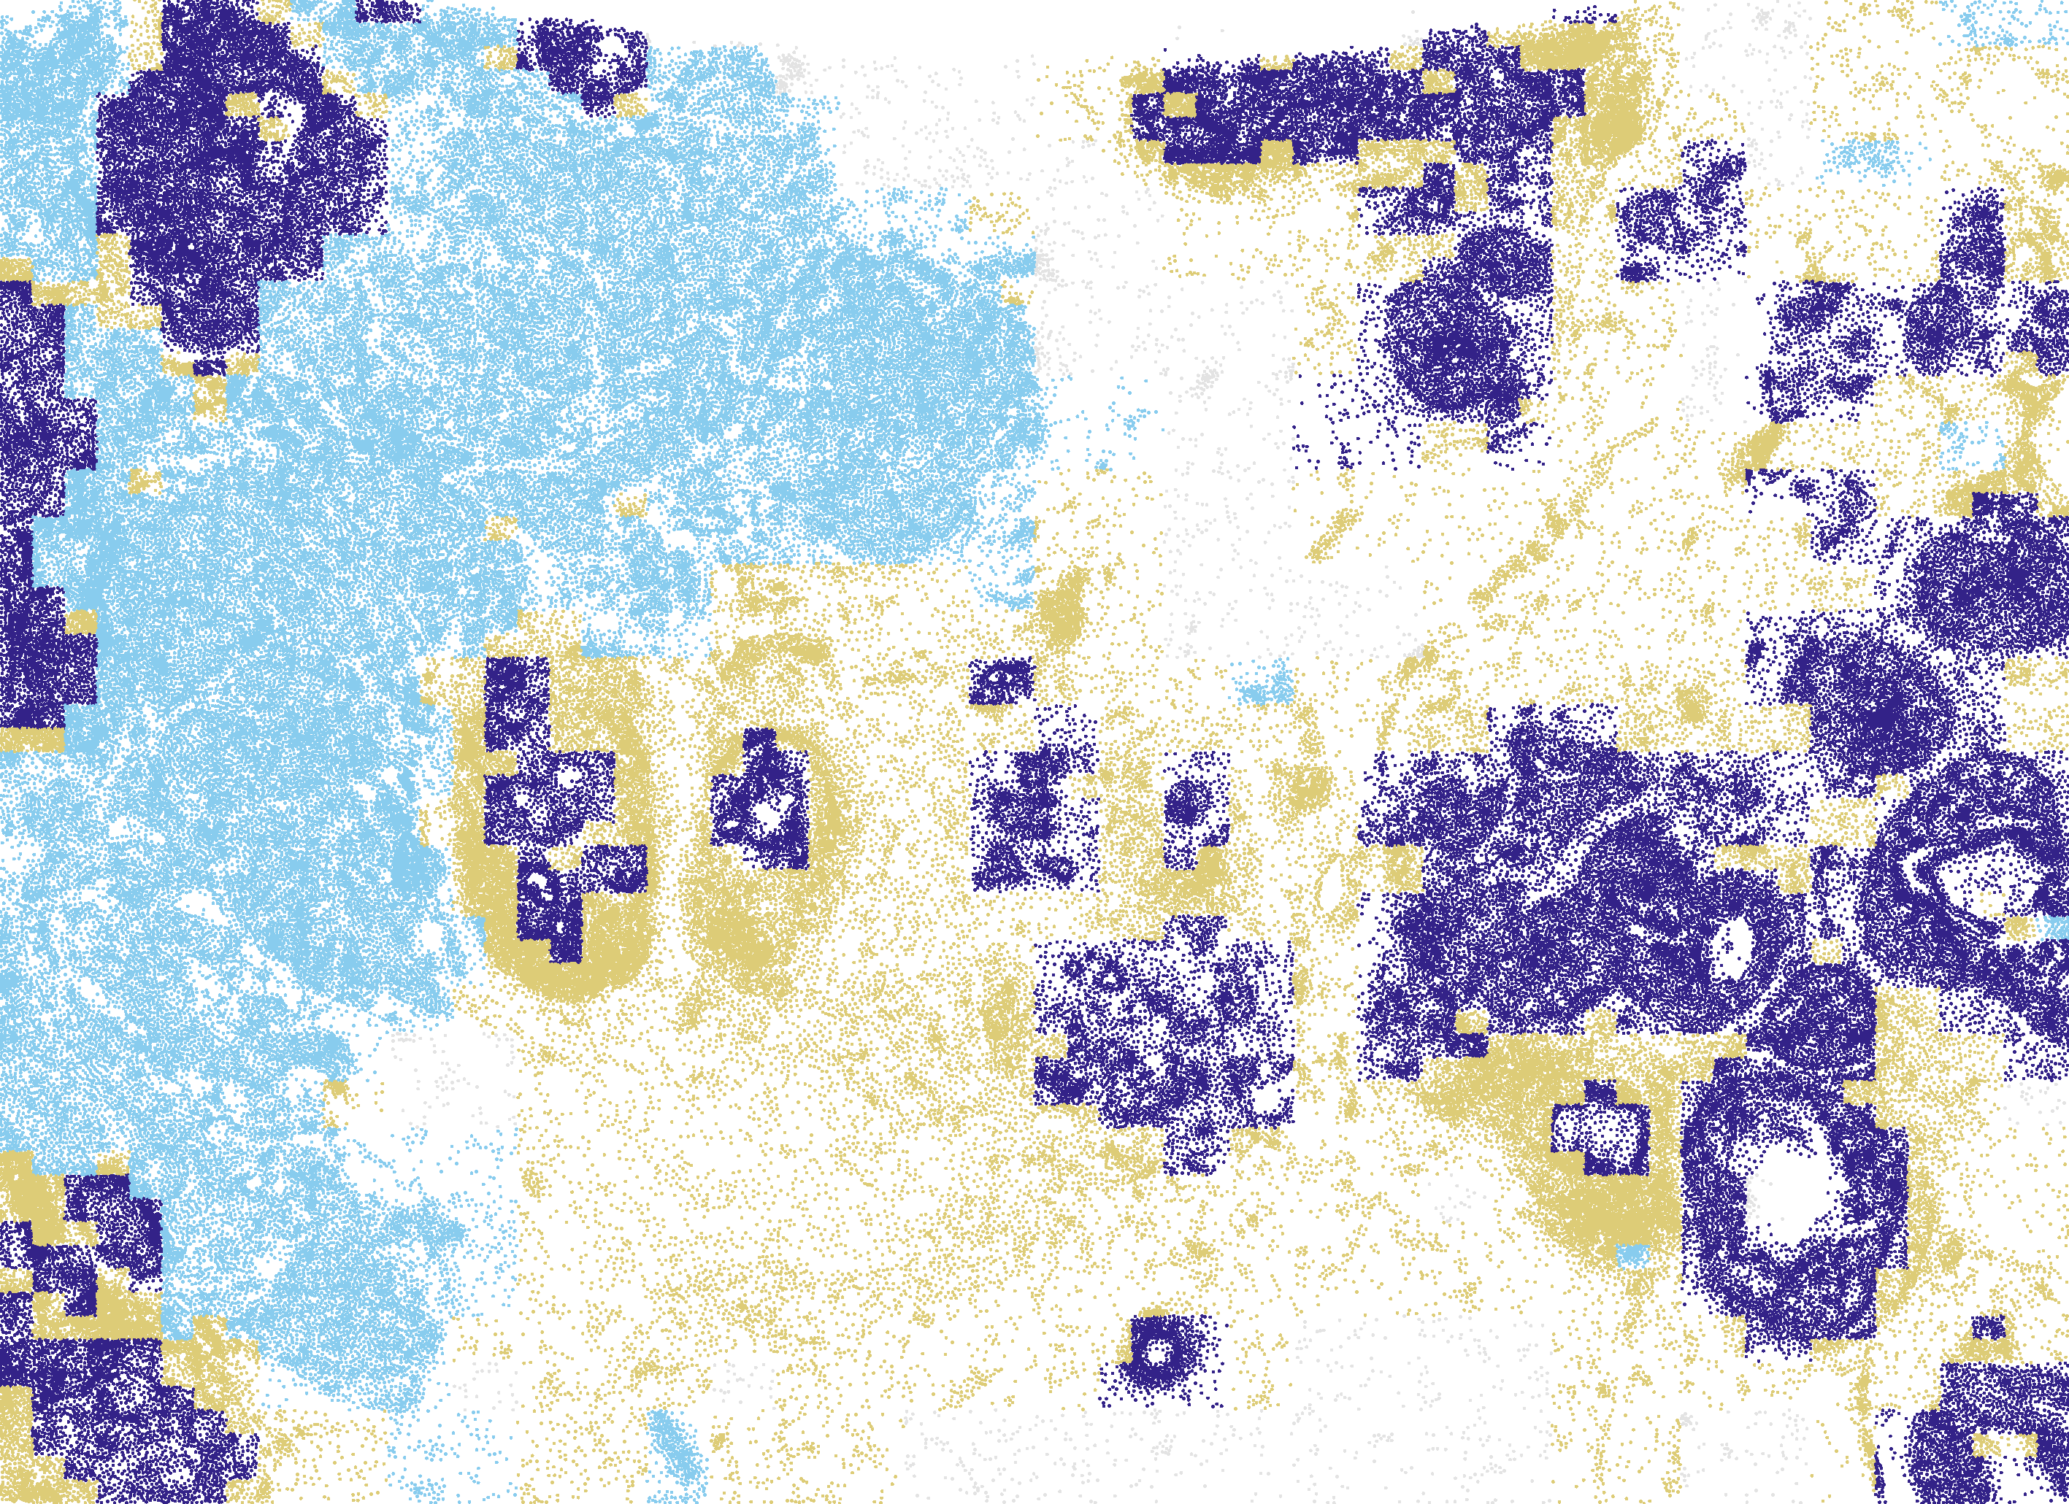
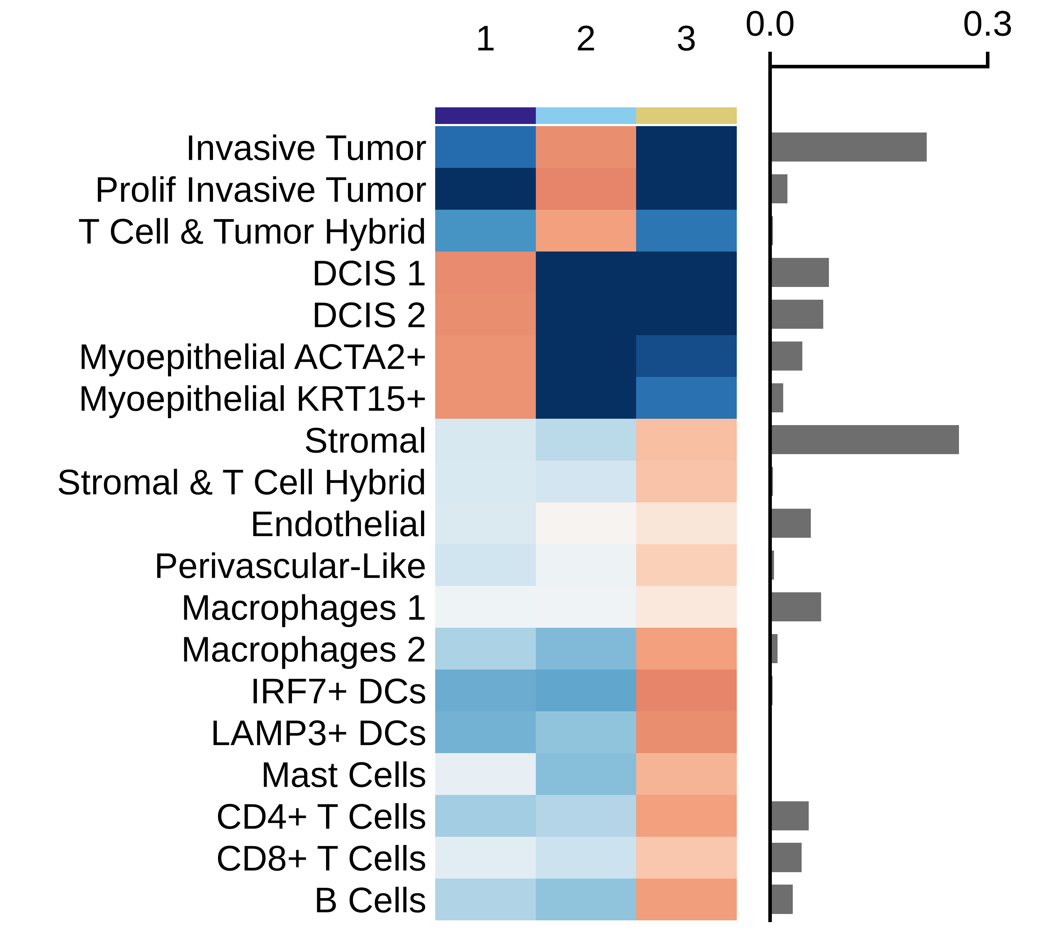
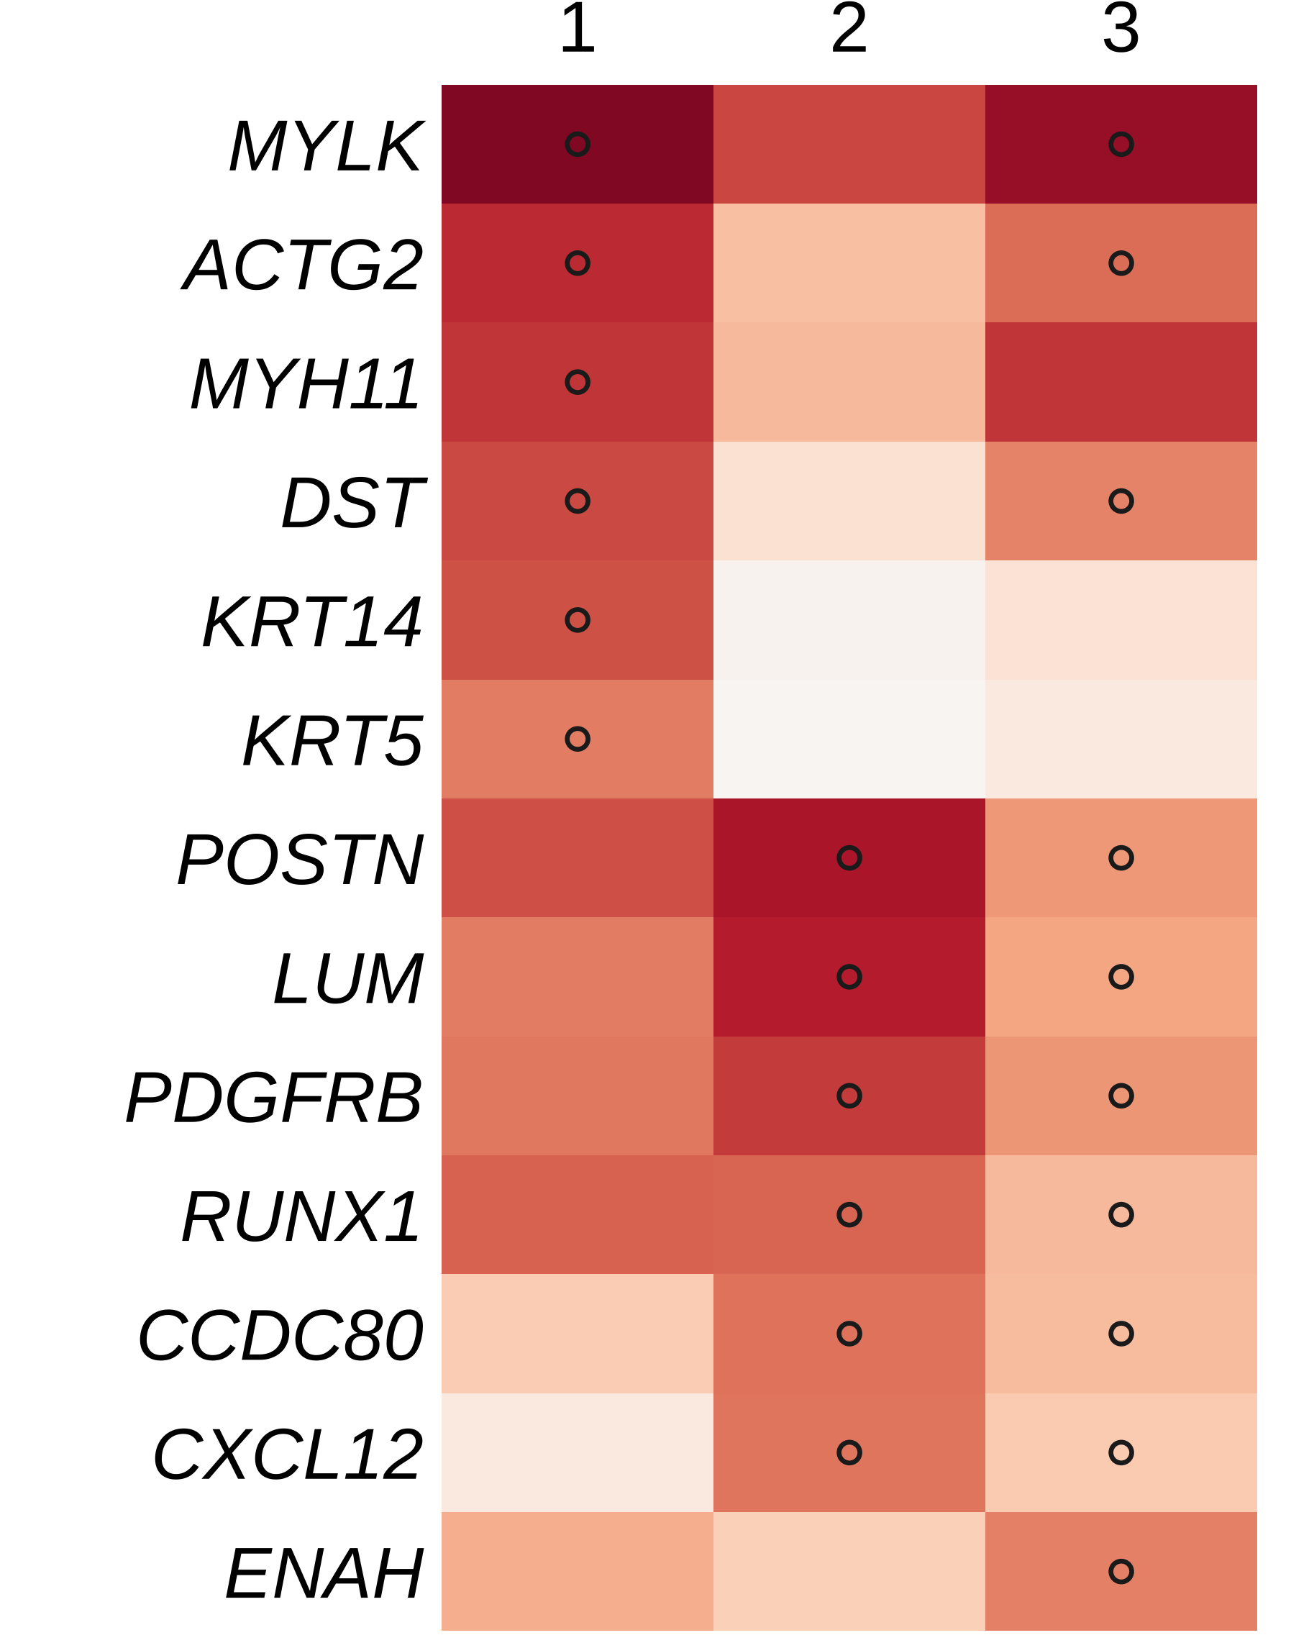
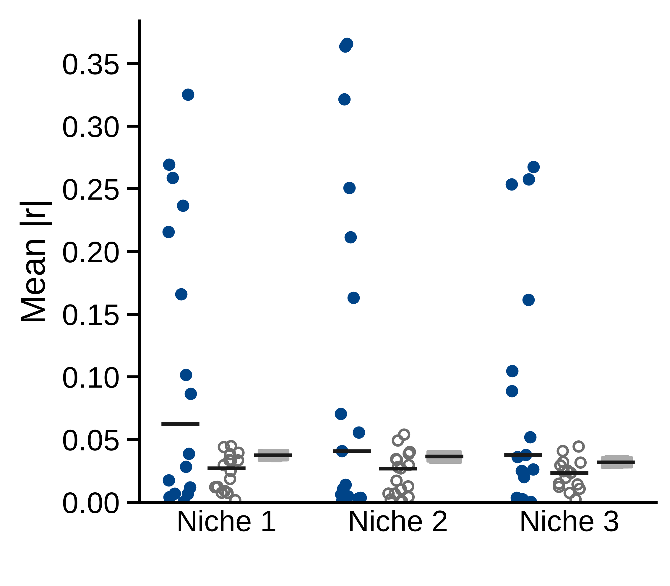
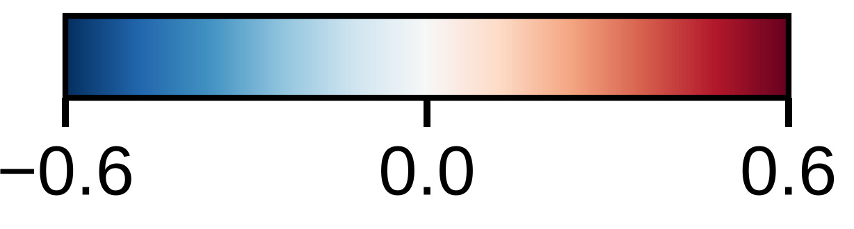

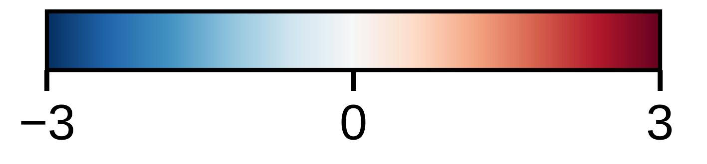
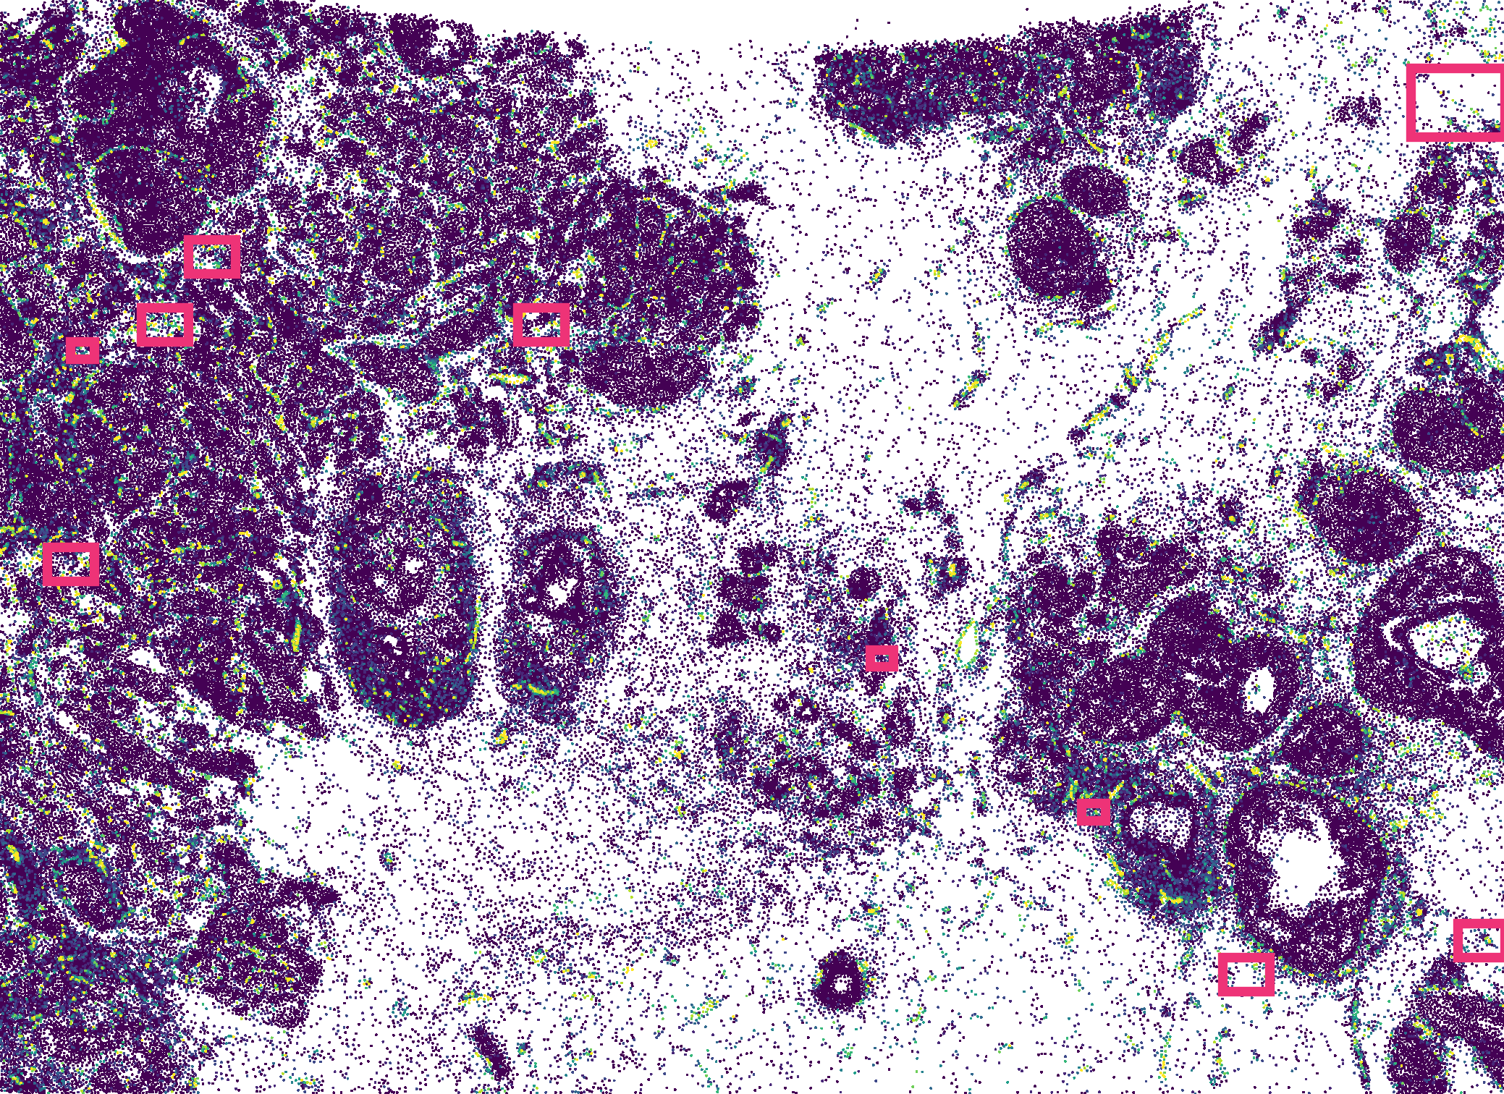
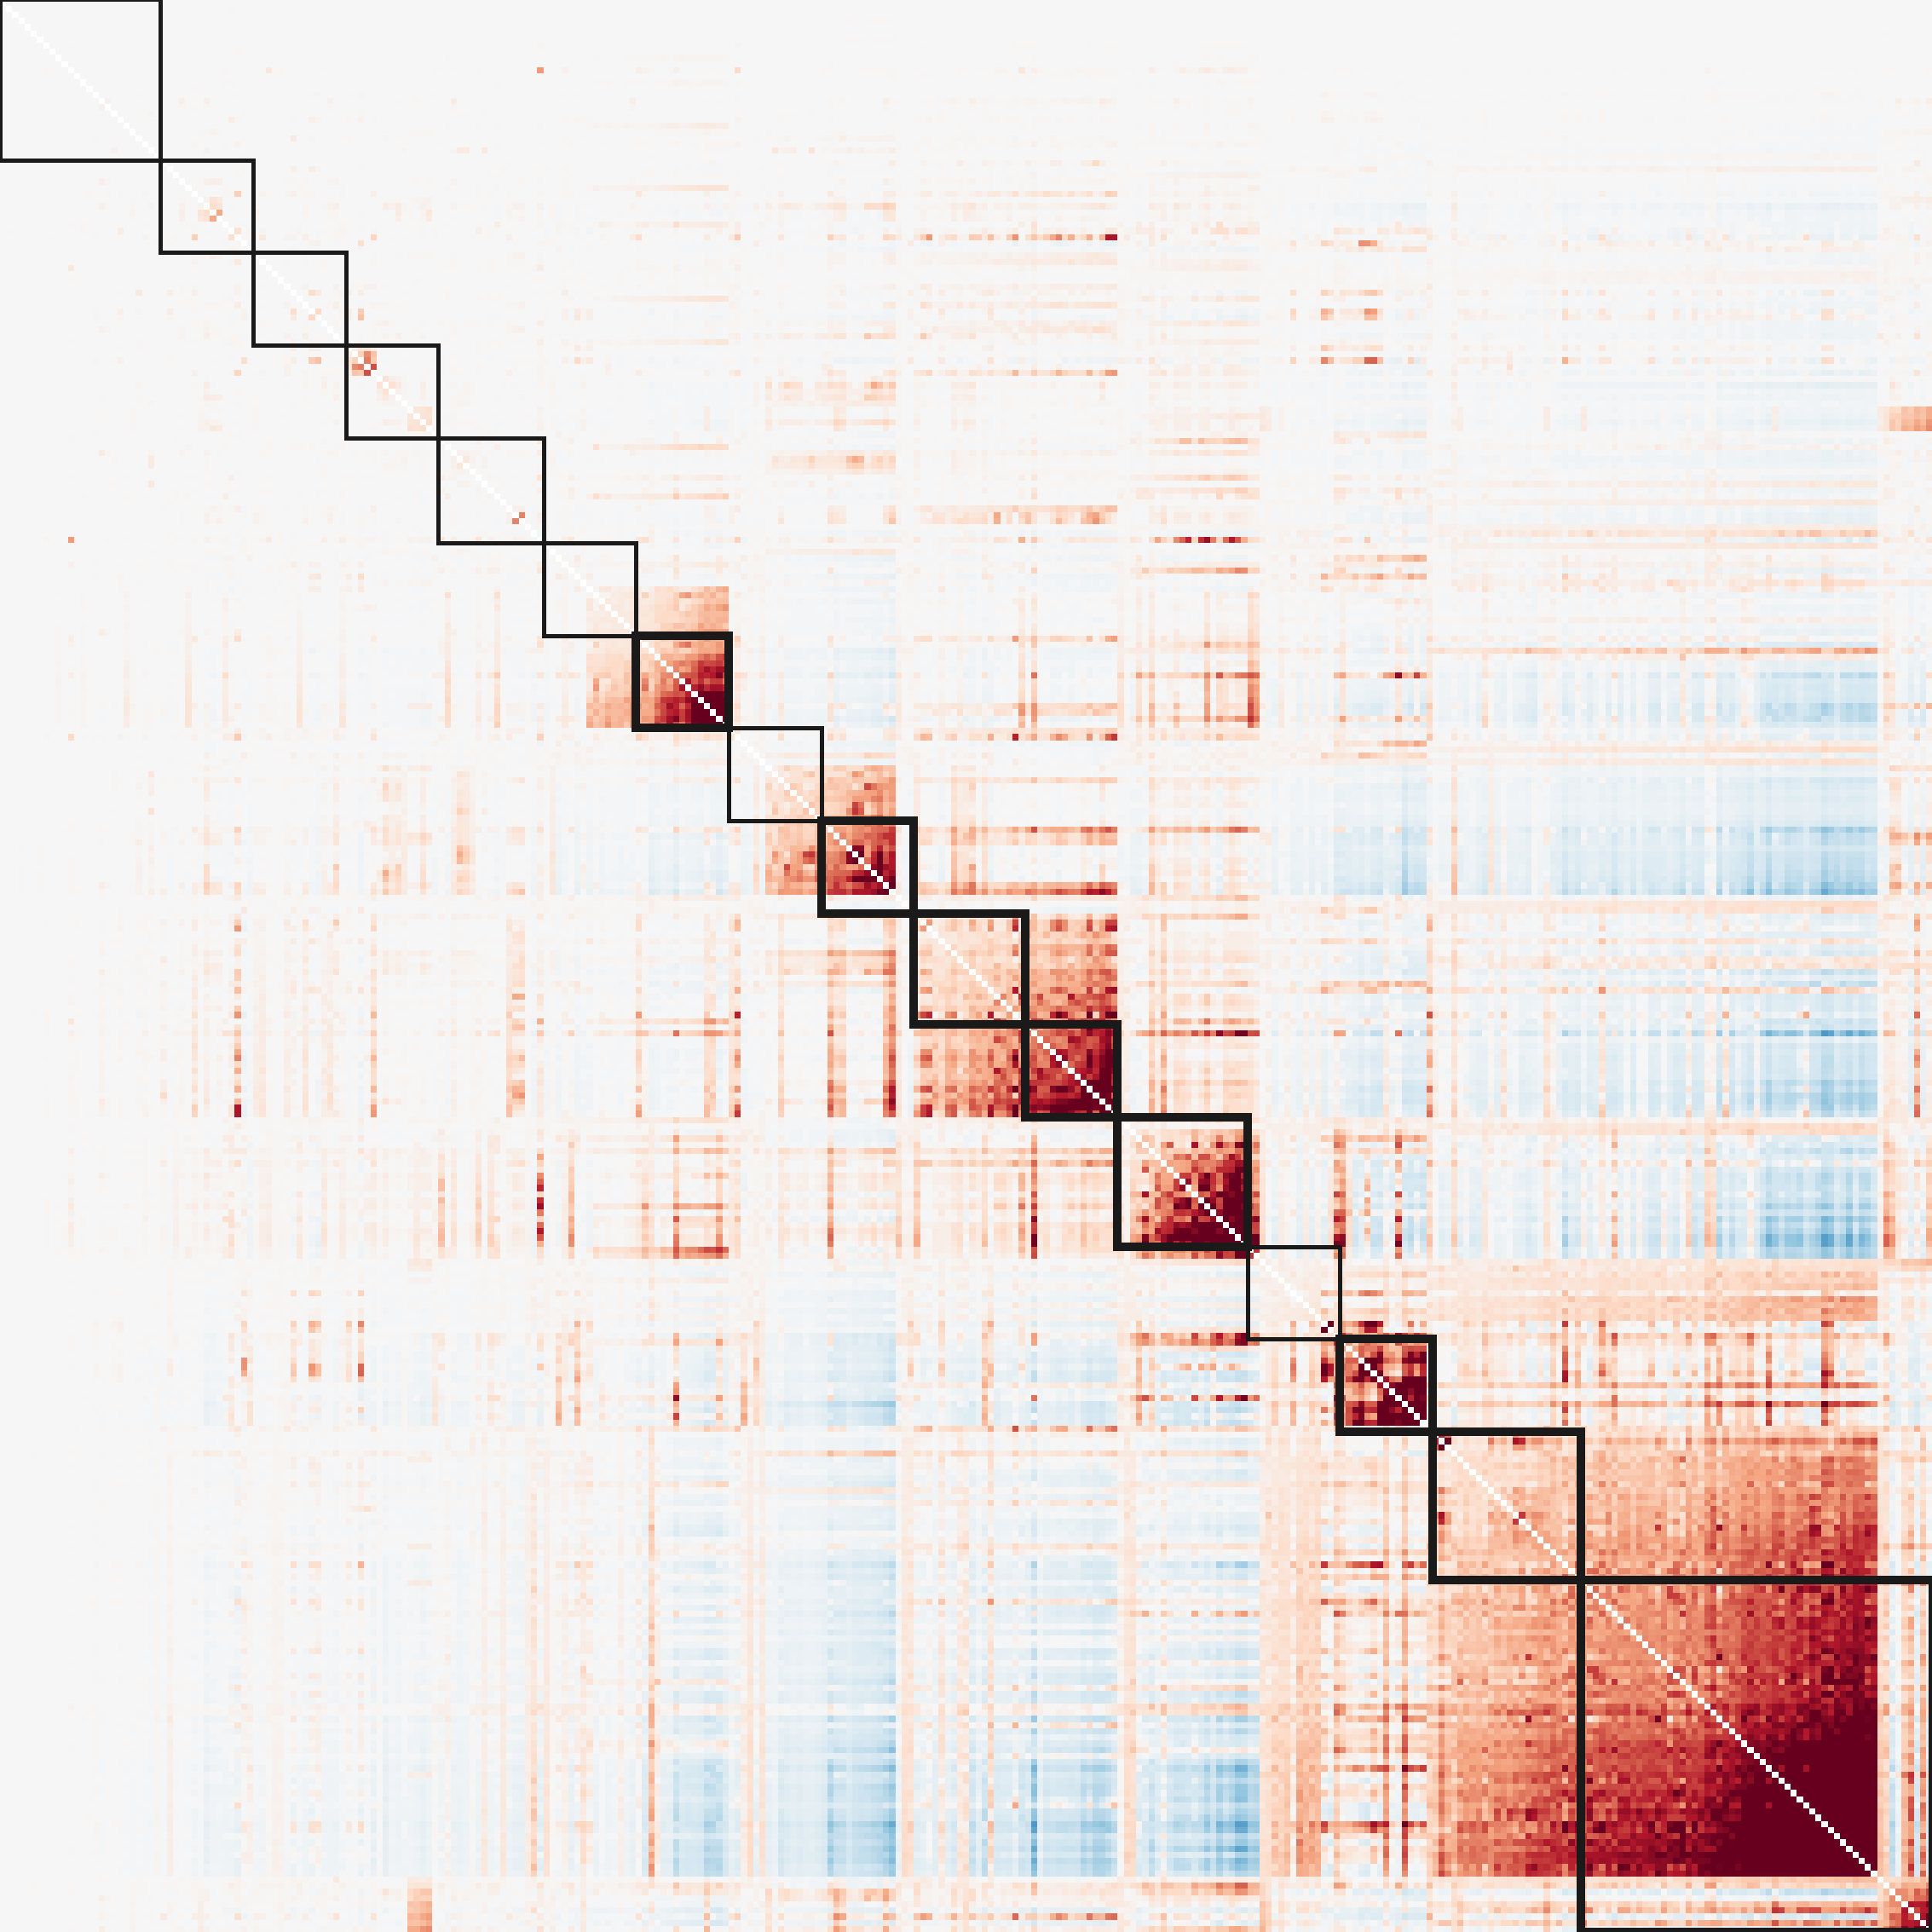
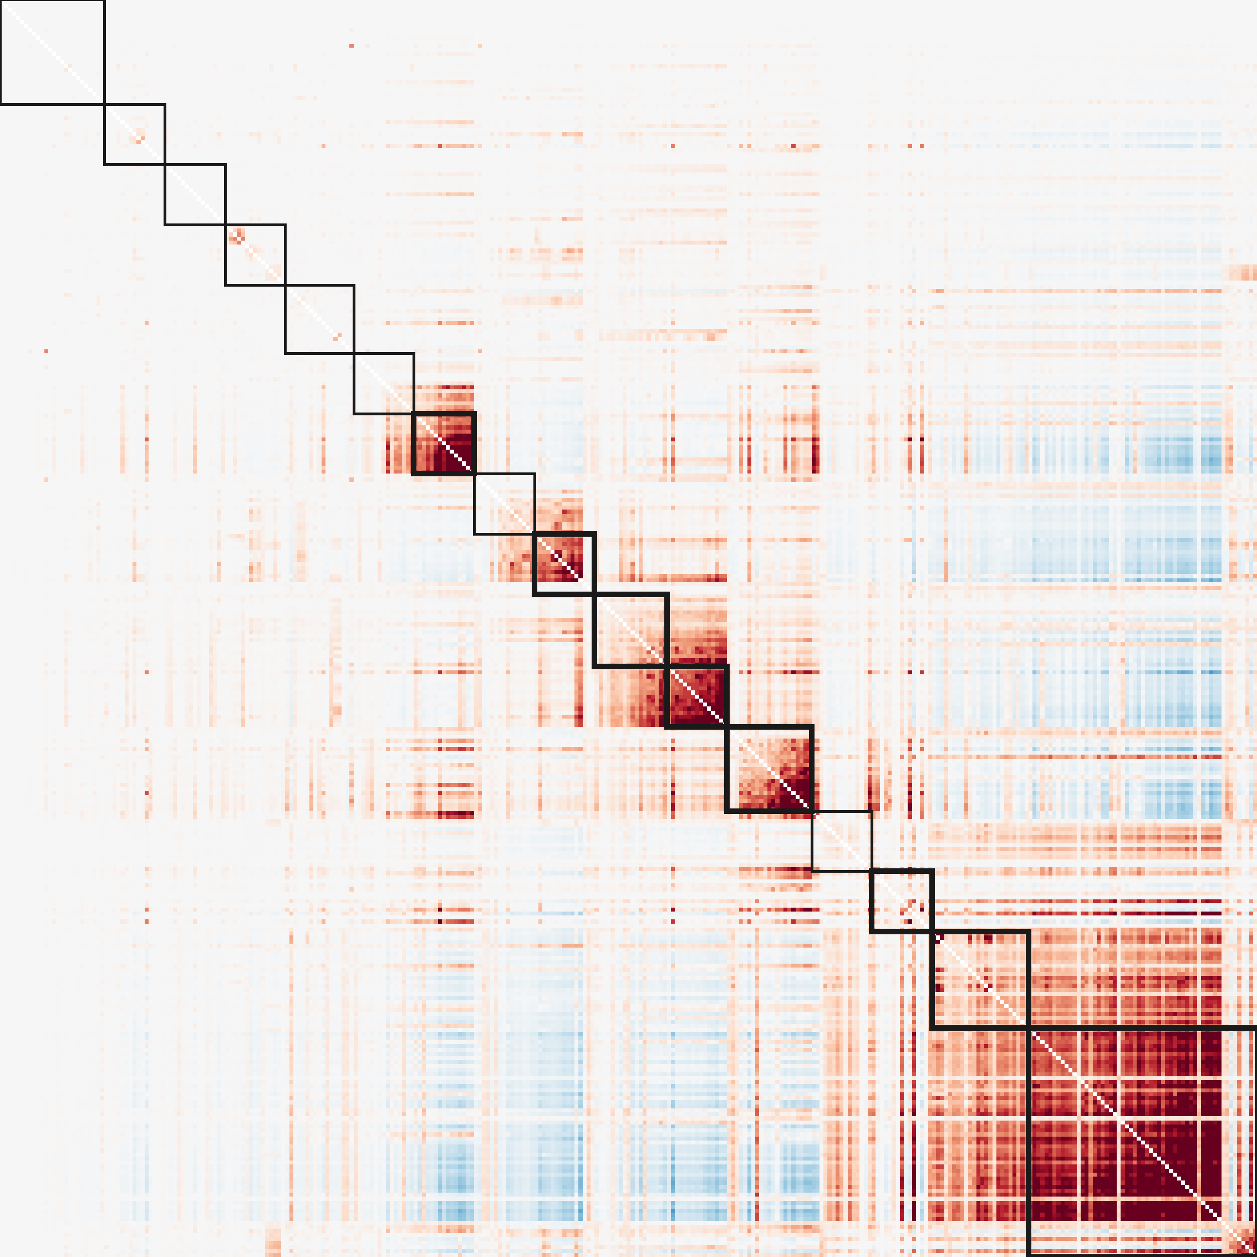
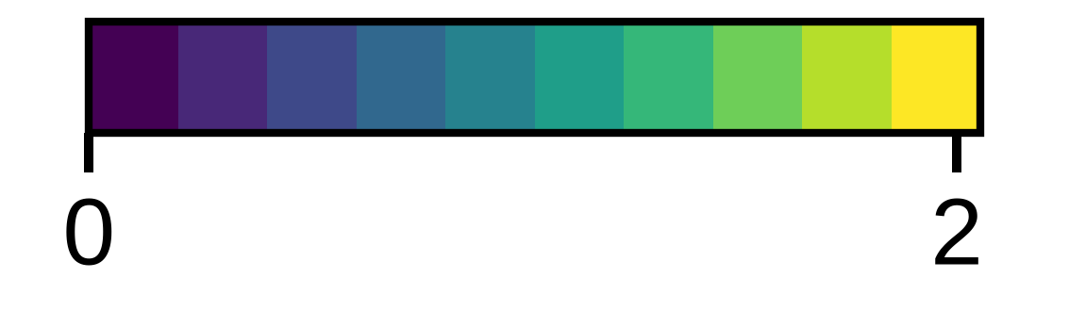
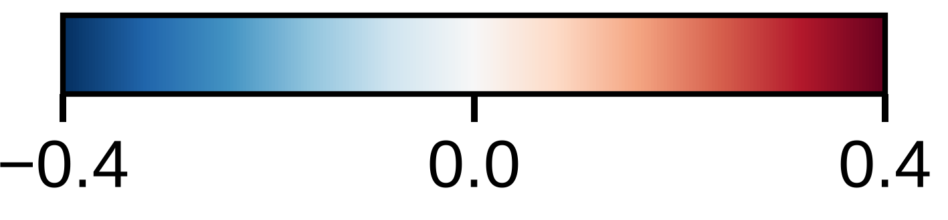
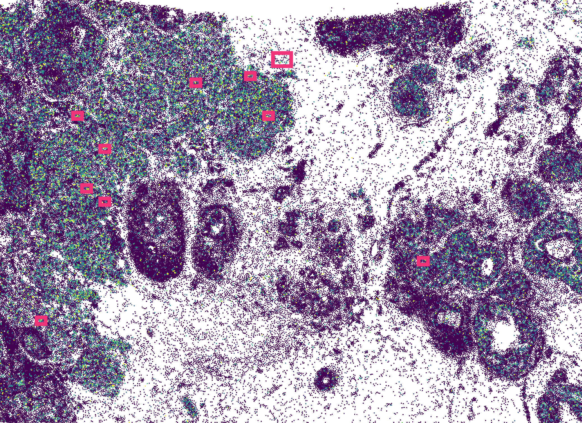
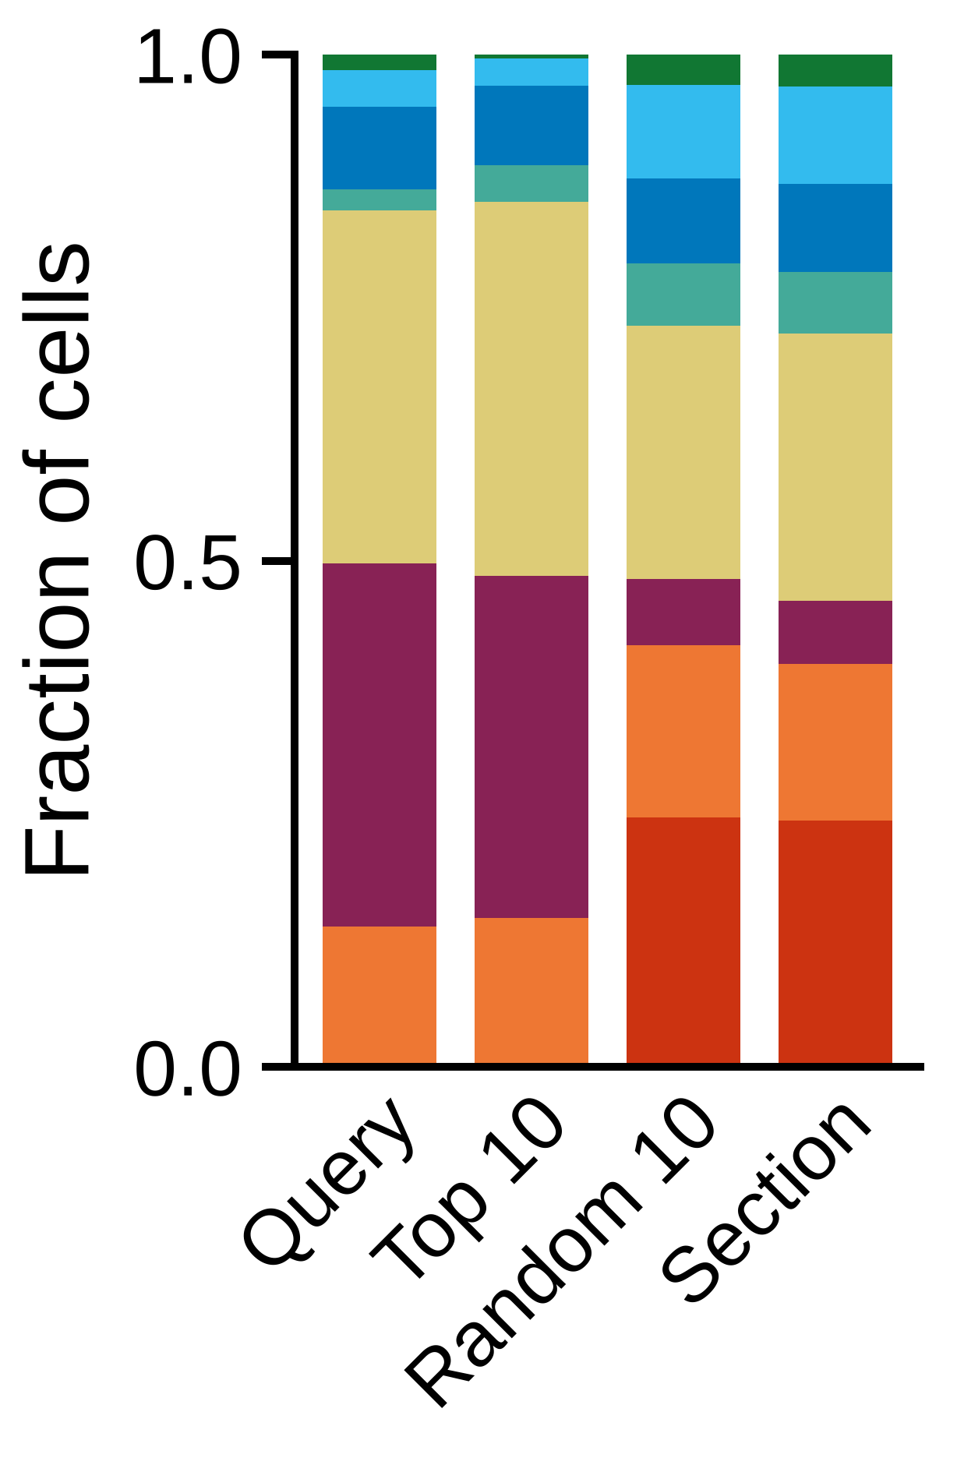
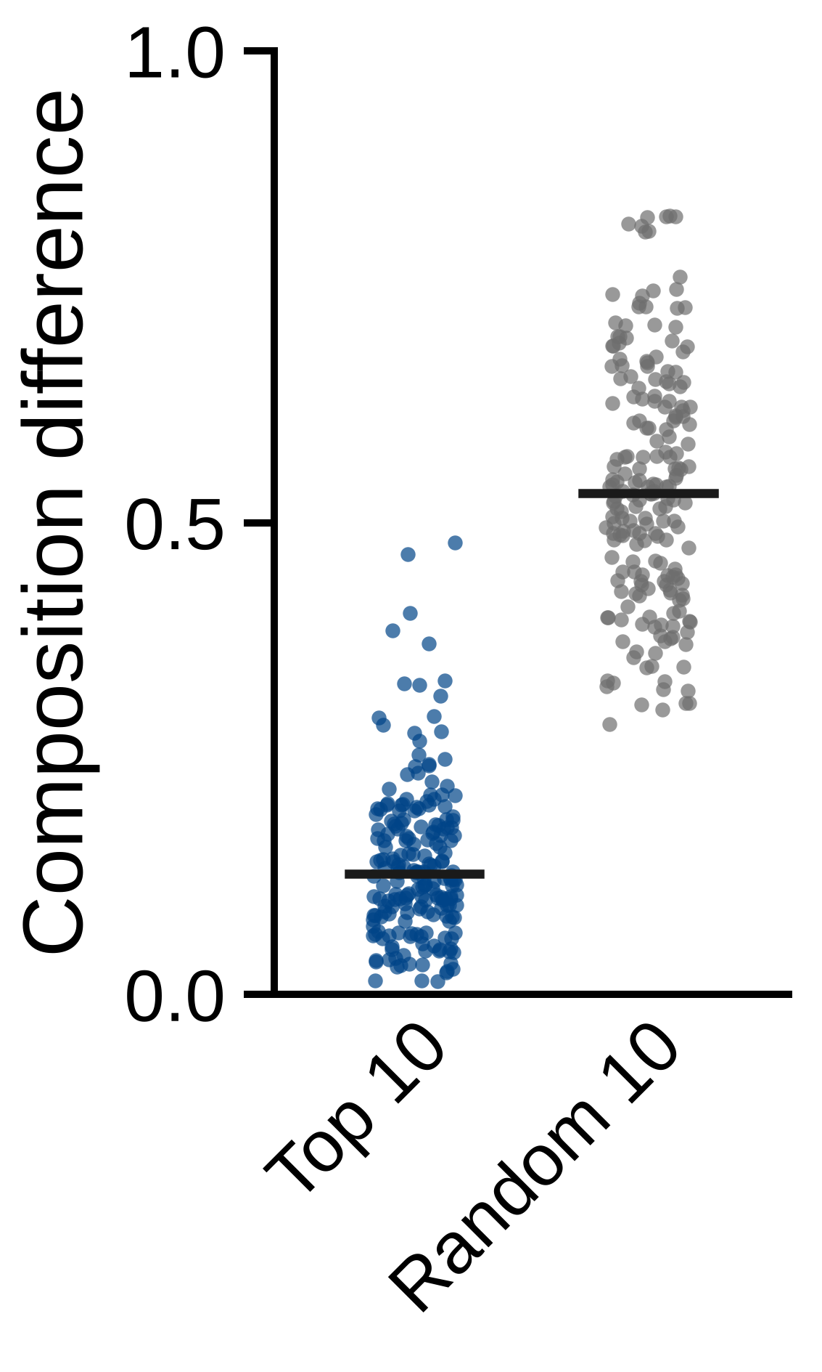
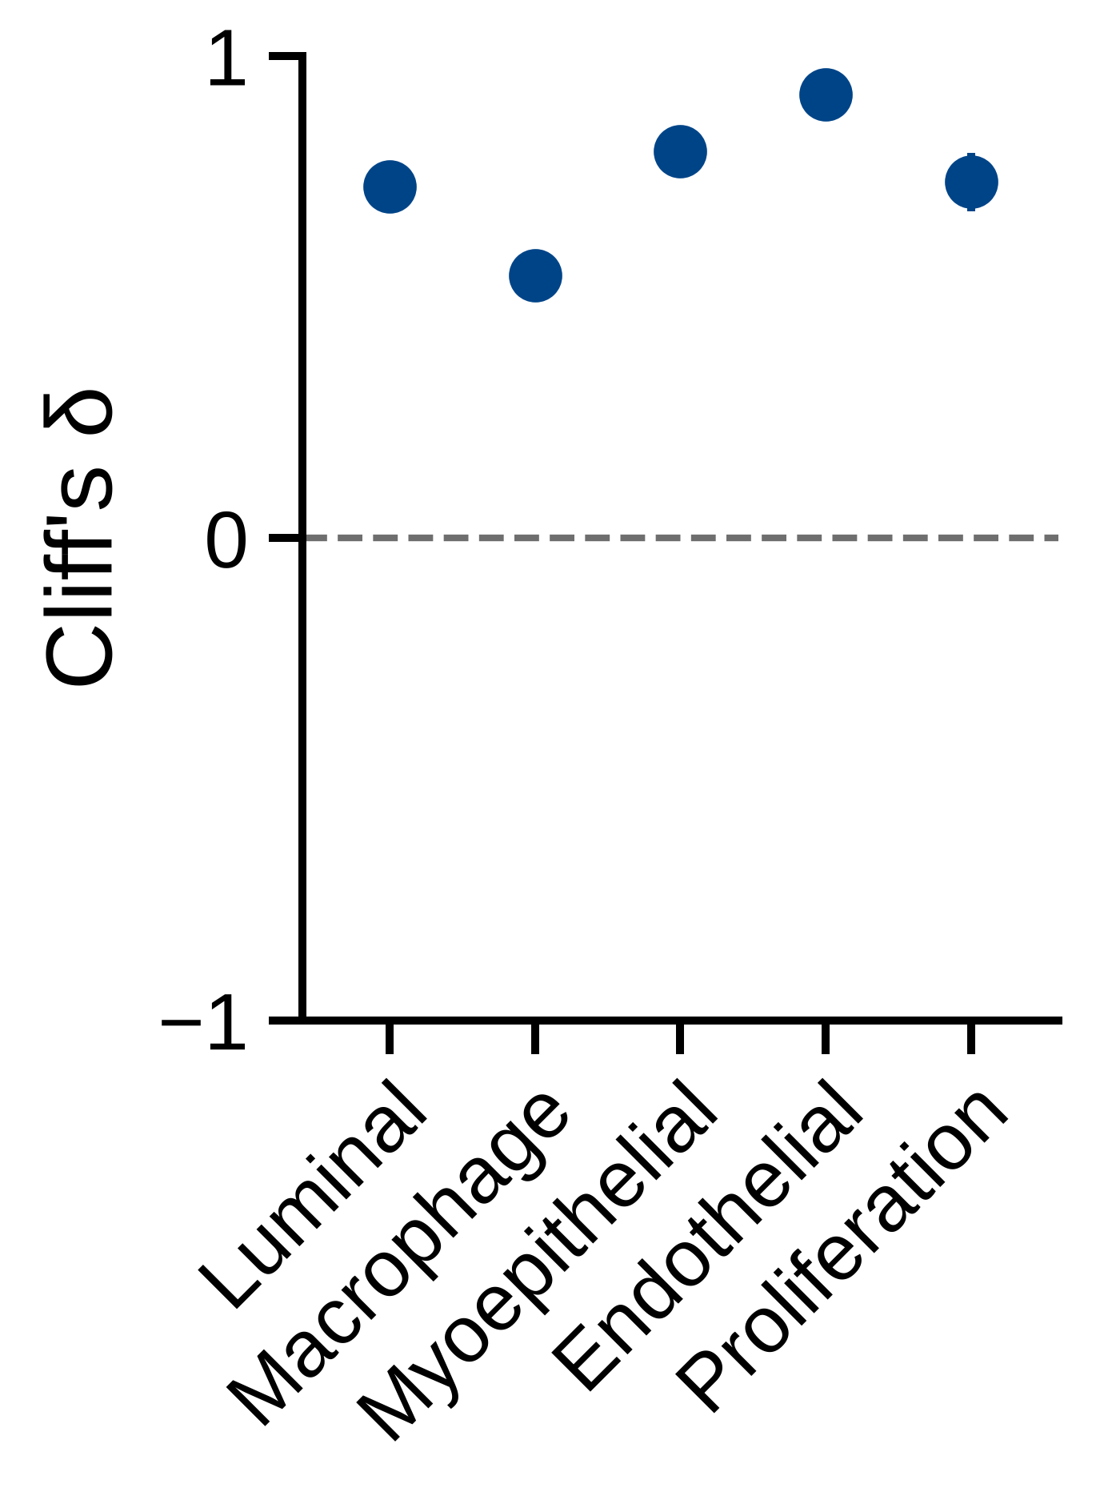
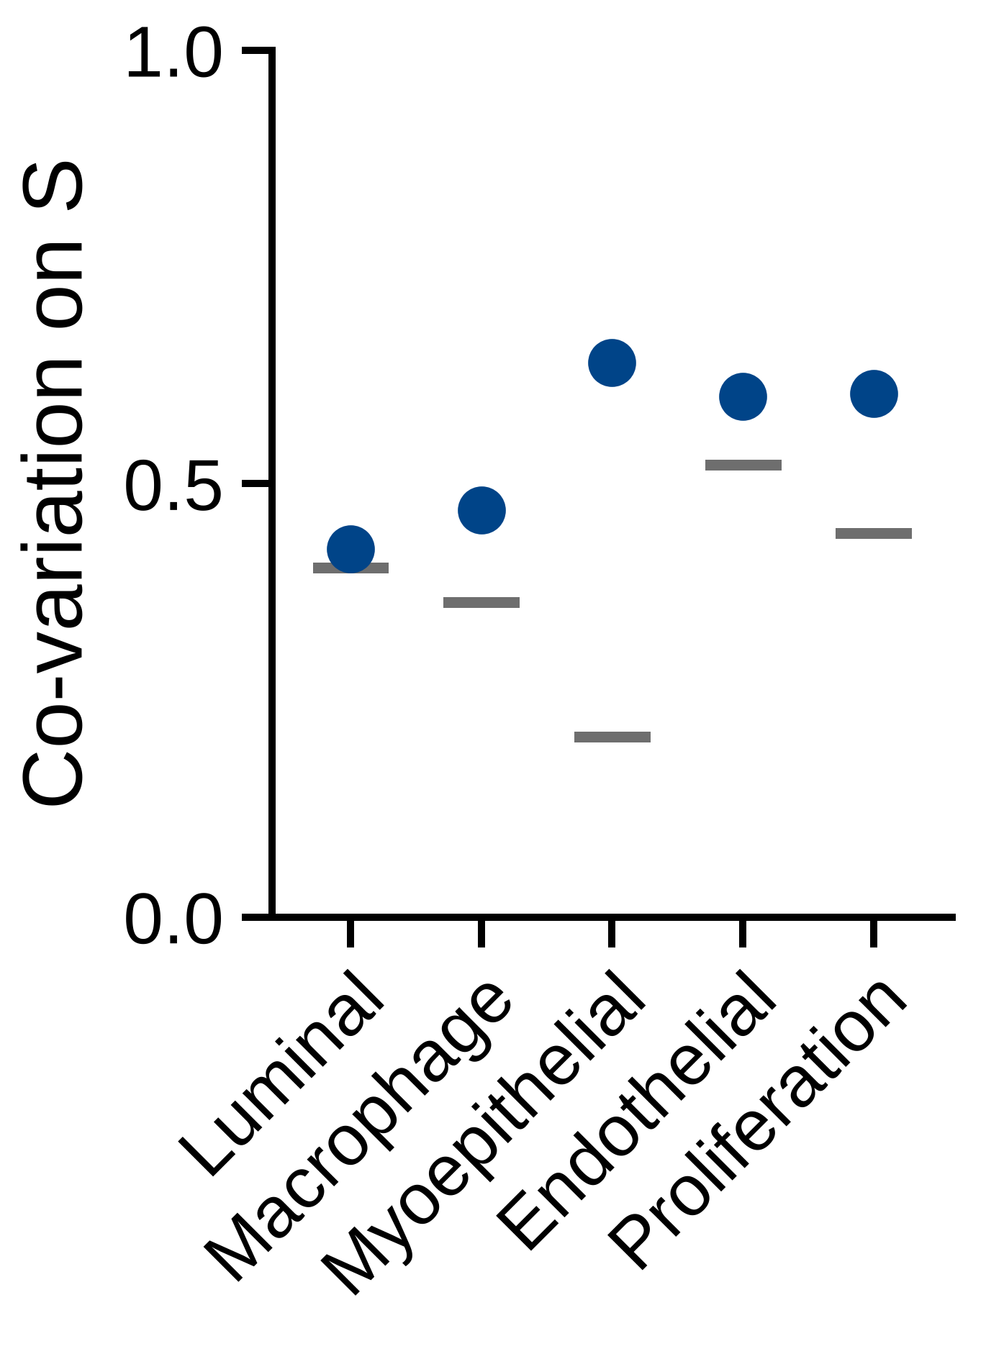
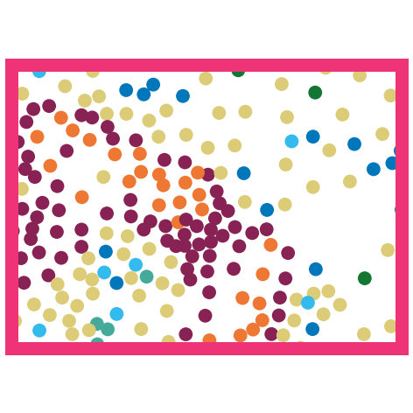

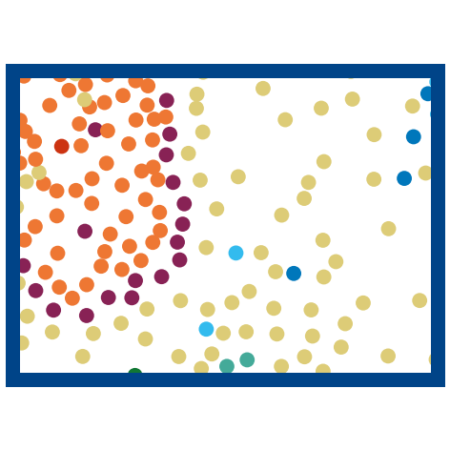

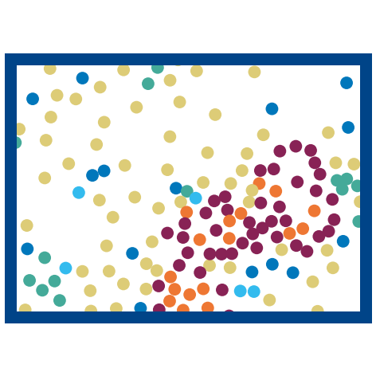




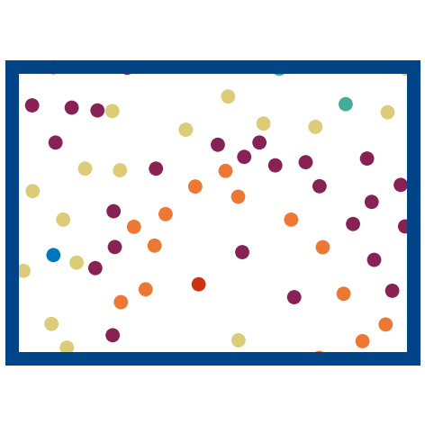
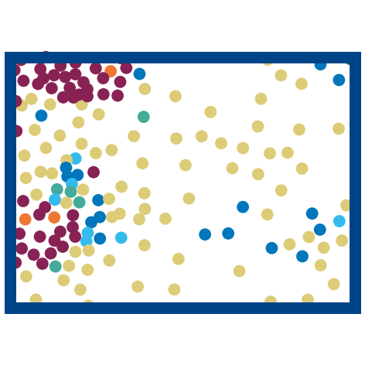
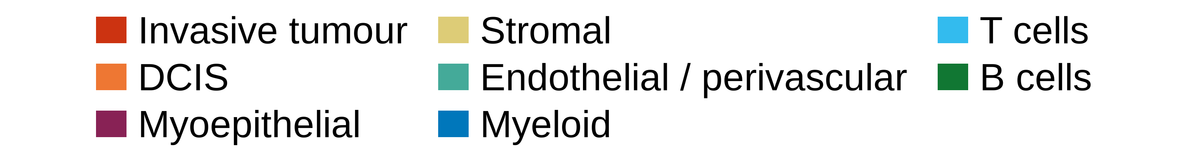
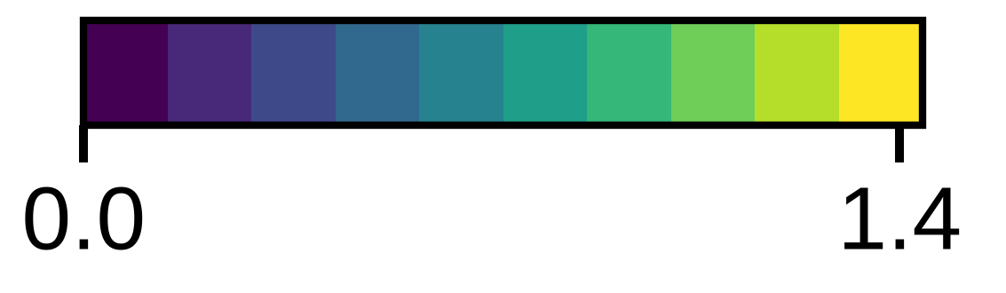
A
Niche
Section
B
r with ACTA2 (○ same block)
log2 enrichment over section
C
Niche 1, its blocks
Niche 2, in niche 1's order and blocks
Co-varying blocks: hub genes; term (FDR), its block genes
1 AQP1, PECAM1, VWF
2 CD3E, PTPRC, CCL5
Allograft Rejection (FDR 1e-02): IL2RG, GZMA, CD8A, CCL5, CD3E, PTPRC
3 APOC1, CXCL16, PDK4
Microglial Cell Activation (FDR 1e-02): CX3CR1, TYROBP, ITGAM, C1QA
4 FCER1G, LYZ, CD4
5 LUM, POSTN, CCDC80
Epithelial Mesenchymal Transition (FDR 8e-07): FSTL3, BASP1, LRRC15, SFRP4, FBLN1, CXCL12, …
6 KRT14, MYLK, KRT5
Intermediate Filament Organization (FDR 2e-03): KRT16, KRT15, KRT6B, KRT5, KRT14
7 TOP2A, RTKN2, PCLAF
G2-M Checkpoint (FDR 3e-04): MKI67, TOP2A, CENPF, HMGA1, SQLE
8 ERBB2, EPCAM, CEACAM6
Androgen Response (FDR 3e-02): SMS, TPD52, SCD, CCND1, KRT8
1
2
3
4
5
6
7
8
Correlation (niche mean)
D
Held-out query and its top 10
E
1
2
3
4
5
Query
6
7
8
9
10

