Slide 1
UNIVERSITY OF CALCUTTA Triple Security Message Cryption System Using Cryptography Ciphers & Steganography Techniques
Project Work
CMS-A-CC-6-14-P
Presented By:
Sayan Sarkar, Goutam Biswas & Rupam Das

Slide 2
ABSTRACT
This Project Work or Paper describes the designing and implementation of Triple Security Message Cryption. Sending Messages and Information has been and will always be of utmost importance, whether in times of Peace or War, Public use or Private use, Security purposes or Common purposes.
This paper focuses on encrypting data, information and messages to prevent security breach.
Messages were, are and will be the staple in every generation, and thus come the matter of privacy and security.
With the help of two different techniques, the data or information goes through a series of processes and modifies the data before data transfer and the recipient receives the encrypted data.
Then using the same Cryption system, recipient can decrypt it and obtain the message while ensuring the security of the message.

Slide 3
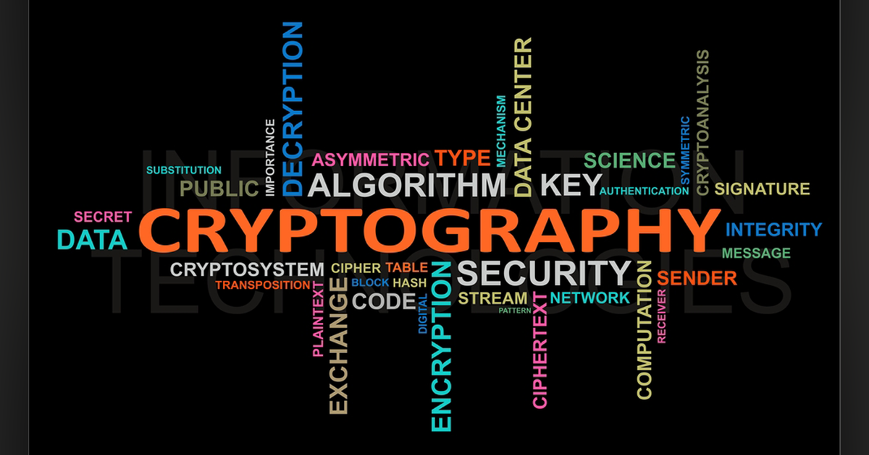
DOMAIN DESCRIPTION
Cryptography:“The discipline which embodies principles, means and methods for the transformation of data in order to hide its information content, prevent its undetected modification, or prevent its unauthorized use”.
It provides for secure communication in the presence of malicious third-parties—known as adversaries. Thus, preventing unauthorized access to information.

Slide 4
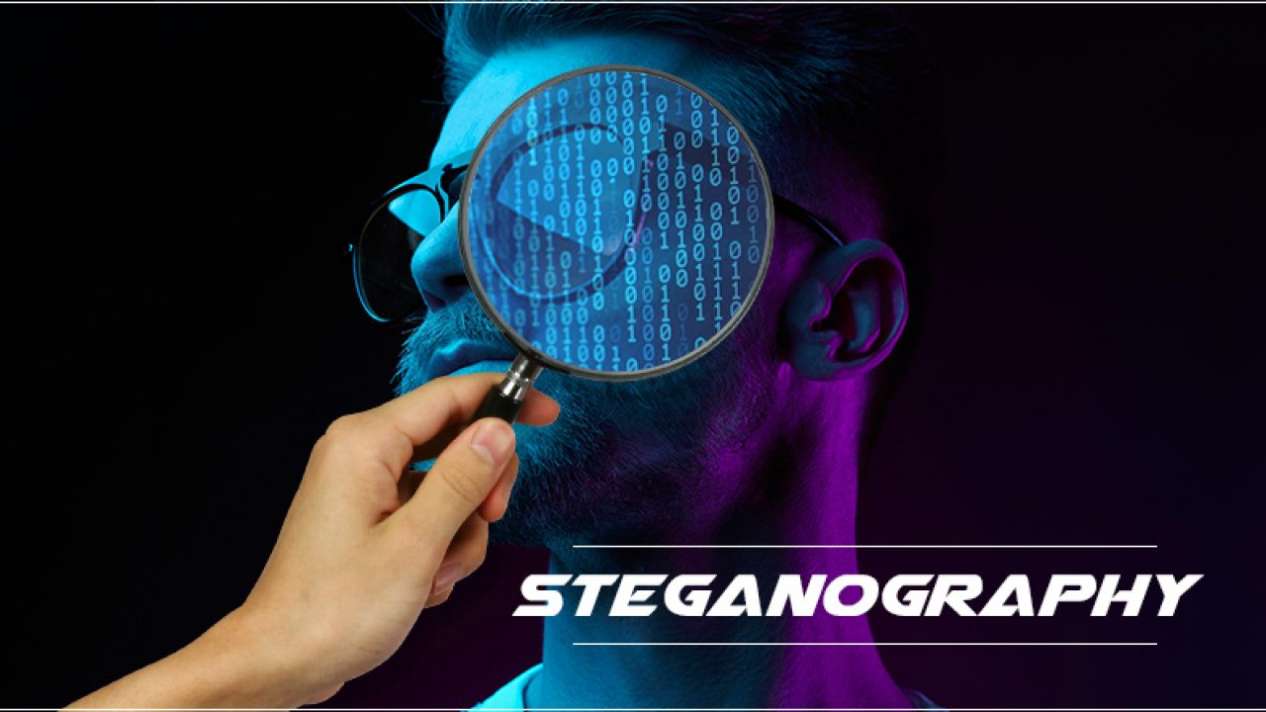
DOMAIN DESCRIPTION (contd.)
Steganography:“A method of hiding a secret message inside of other data.”
The purpose of Steganography is to conceal and deceive. It is a form of covert communication and can involve the use of any medium to hide messages.

Slide 5
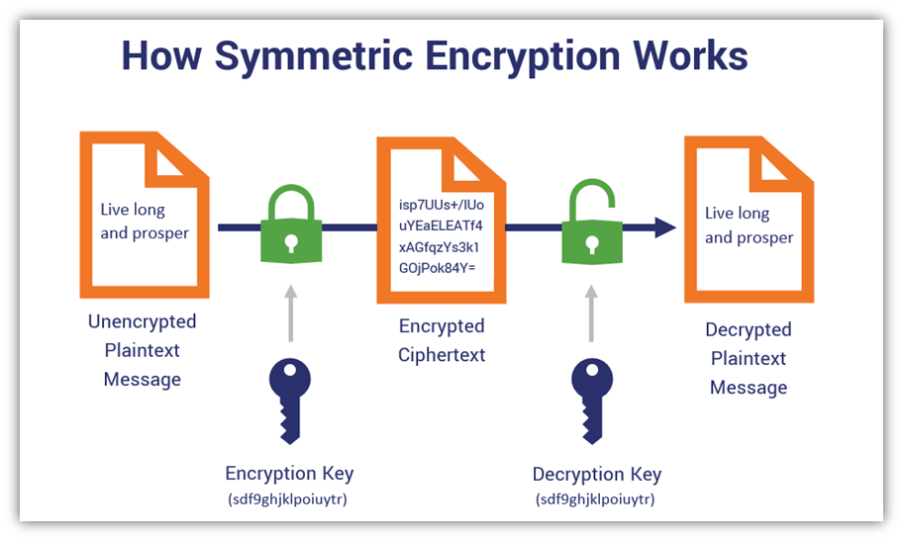
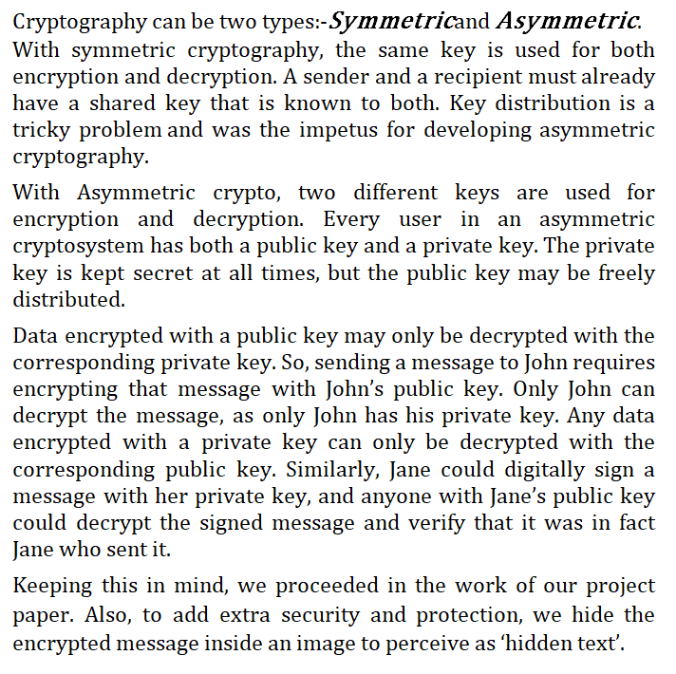
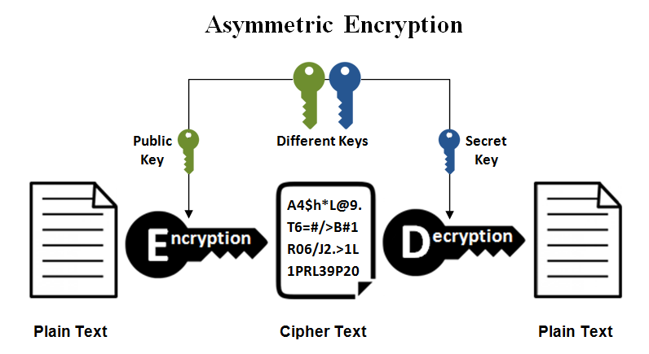
MOTIVATION

Slide 6
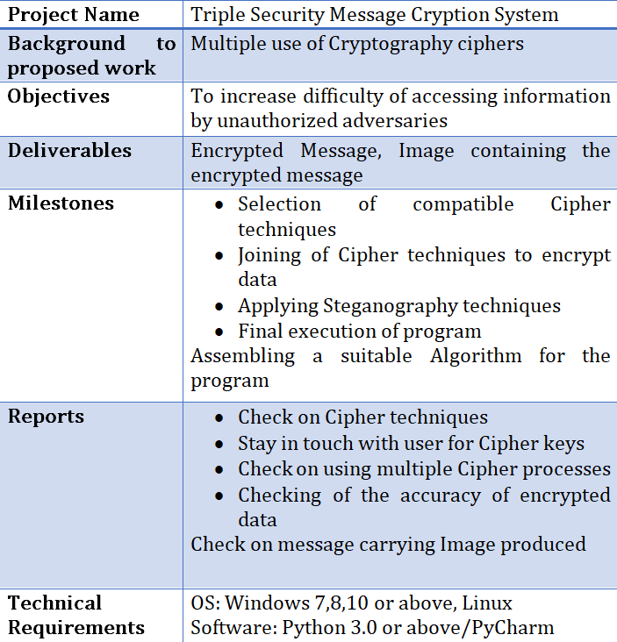
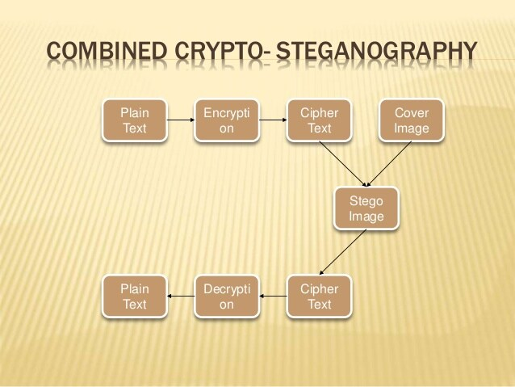
SCOPE OF THE WORK

Slide 7
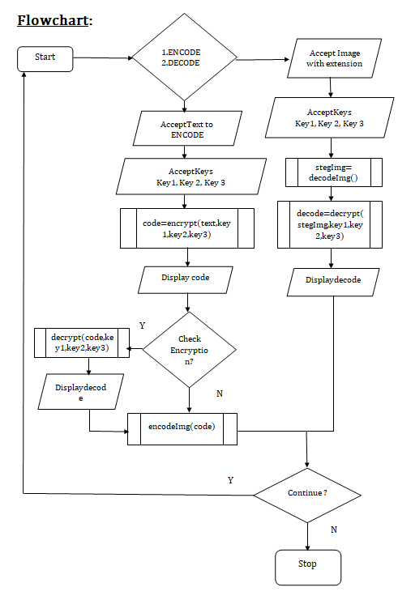
METHODOLOGY
Problem Formulation:
In this Section, we detail the general structure of three different ciphers focusing on Cryptography. We then describe how to encrypt and decrypt data and finally introduce the encoding and decoding of text into a given image.
Algorithm Description:
Write a suitable Algorithm to Encode and Decode a message into an Image, after Encrypting the input message thrice using separate Cipher techniques. Show the Decryption and Decoding as well to prove accuracy and viability.
Design Description:
Cryptography Ciphers used:
1. Onetime Pad Cipher
2. Substitution Caesar Cipher
3. Columnar Transposition Cipher
Steganography Process used: Image-based Encoding & Decoding

Slide 8
One Time Pad Cipher
One Time Pad algorithm is also known as Vernam Cipher. It is a method of encrypting alphabetic plain text. It is one of the Transposition techniques which converts plain text into ciphertext.
In this mechanism, we assign a number to each character of the Plain-Text.
The relation between the key and plain text: In this algorithm, the length of the key should be equal to that of plain text. [3]

Slide 9
One Time Pad Cipher (contd.)
Input: plain text - HELLO
Key - MONEY
Output: Cipher - TSYPM Message – HELLO
Input: plain text – SAVE
Key – LIFE
Output: Cipher – DIAI
Message – SAVE
[3]
Part 1 (plain text to cipher text)
Plain text — H E L L O → 7 4 11 11 14
Key — M O N E Y → 12 14 13 4 24
Plain text + key → 19 18 24 15 38
→ 19 18 24 15 12 (=38 – 26)
Cipher Text → T S Y P M
Part 2 (cipher text to Message)
Cipher Text — T S Y P M → 19 18 24 15 12
Key — M O N E Y→ 12 14 13 4 24
Cipher text – key → 7 4 11 11 -12
→ 7 4 11 11 14
Message → H E L L O

Slide 10
Substitution Caesar Cipher
The Substitution Caesar Cipher technique is one of the earliest and simplest method of encryption technique.
It is a type of mono-alphabetic substitution cipher where each letter of the plain text is shifted a fixed number of places down the alphabet.
For example, with a shift of 1, letter A would be replaced by letter B, letter B would be replaced by letter C, and so on.
Thus to cipher a given text we need an integer value, known as shift which indicates the number of position each letter of the text has been moved down. [3]

Slide 11
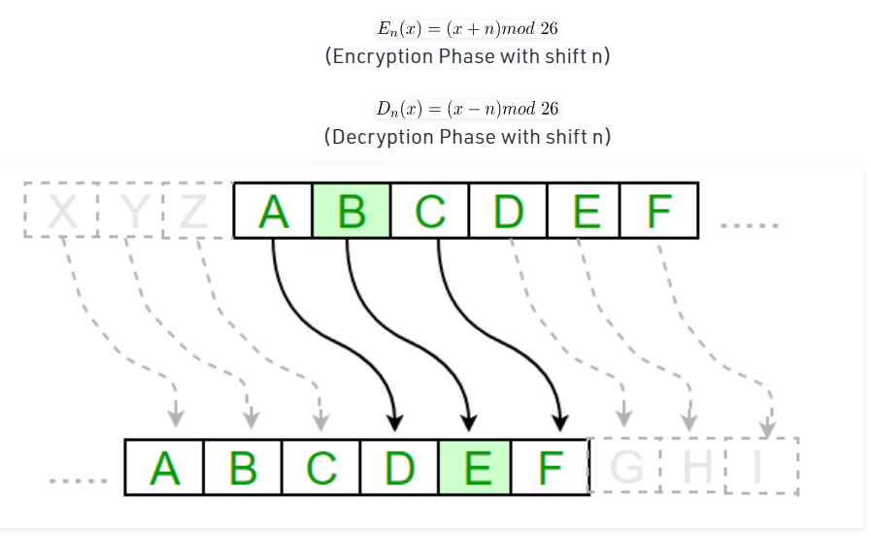
Substitution Caesar Cipher (contd.)
Plain Text: I am studying Data Encryption
Key: 4
Output: M eq wxyhCmrk Hexe IrgvCtxmsr
Plain Text: ABCDEFGHIJKLMNOPQRSTUVWXYZ
Key: 4
Output: EFGHIJKLMNOPQRSTUVWXYZabcd

Slide 12
Columnar Transposition Cipher
A transposition cipher is a method of encryption by which the positions held by units of plaintext (which are commonly characters or groups of characters) are shifted according to a regular system, so that the ciphertext constitutes a permutation of the plaintext.
In a Columnar transposition, the message is written out in rows of a fixed length, and then read out again column by column, and the columns are chosen in some scrambled order. Both the width of the rows and the permutation of the columns are usually defined by a keyword.
For example, the word HACK is of length 4 (so the rows are of length 4), and the permutation is defined by the alphabetical order of the letters in the keyword. In this case, the order would be “3 1 2 4”. [3]

Slide 13
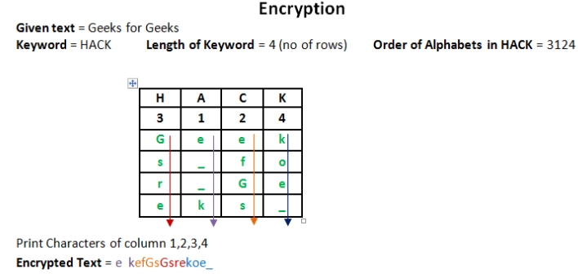
Columnar Transposition Cipher (contd.)
Encryption Input : Geeks for Geeks
Key = HACK
Output : e kefGsGsrekoe_
Decryption Input : e kefGsGsrekoe_
Key = HACK
Output : Geeks for Geeks
Encryption Input : Geeks on work
Key = HACK
Output : e w_eoo_Gs kknr_
Decryption Input : e w_eoo_Gs kknr_
Key = HACK
Output : Geeks on work

Slide 14
Image based Steganography
Steganography is the method of hiding secret data in any image/audio/video. In a nutshell, the main motive of steganography is to hide the intended information within any image/audio/video that doesn’t appear to be secret just by looking at it.
The idea behind image-based Steganography is very simple. Images are composed of digital data (pixels), which describes what’s inside the picture, usually the colors of all the pixels. Since we know every image is made up of pixels and every pixel contains 3-values (red, green, blue). [4]

Slide 15
Image based Steganography (contd.)
Encode the data :Every byte of data is converted to its 8-bit binary code using ASCII values.
Now pixels are read from left to right in a group of 3 containing a total of 9 values.
The first 8-values are used to store binary data. The value is made odd if 1 occurs and even if 0 occurs.
Decode the data :To decode, three pixels are read at a time, till the last value is odd, which means the message is over.
Every 3-pixels contain a binary data, which can be extracted by the same encoding logic.
If the value if odd the binary bit is 1 else 0. [4]

Slide 16
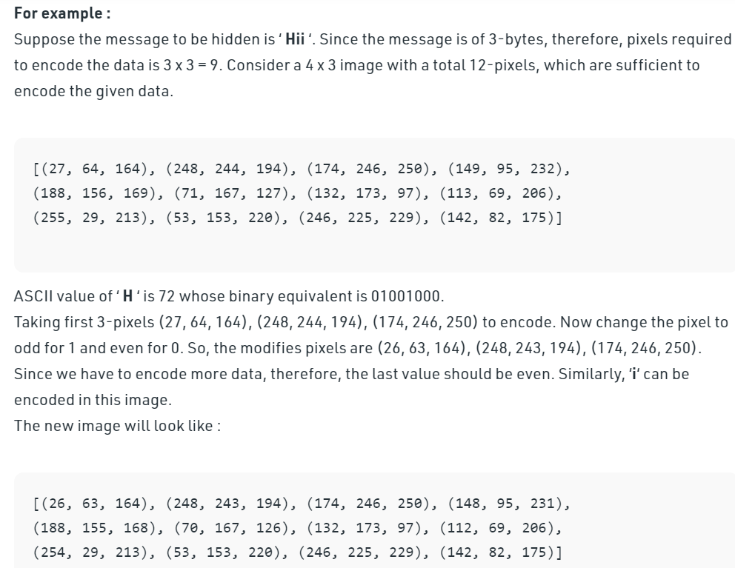
Image based Steganography (contd.)

Slide 17
IMPLEMENTATION (Main Algorithm)
Import required packages such as OneTimePad, String, Math and package Image from module PILLOW.
Define necessary processes in functions:
a)Subencrypt() b) Subdecrypt() c) transEncrypt() d) transDecrypt()
e) encrypt() f) decrypt() g) genData() h) modPix() i) encode_enc()
j) encodeImg() k) decodeImg()
Start a while loop to provide choice-based interaction with user.
If user chooses to encode, accept PlainText to encode. Also accept three respective keys for encryption.
“code=encrypt(PlainText, key1, key2, key3)”[code stores CipherText]
Display ‘code’ i.e. the CipherText.

Slide 18
IMPLEMENTATION (Main Algorithm)
To check whether Encrypted text is correct or not, use “decrypt(code, key1, key2, key3)” to decrypt. Proceed.
“encodeImg(code)” to encrypt CipherText into image. Image extension must be provided by user. Display suitable message.
If user chooses to decrypt, use “stegoImage=decodeImg()”. Provide image extension asked by the function.
Accept respective keys for decryption.
“decode=decrypt(stegoImage, key1, key2, key3)”
Display decoded text ‘decode’.
Close the while loop.

Slide 19
IMPLEMENTATION (Functions Used)
def Subencrypt(plain_text,key) : This function accepts a plain text and a key for Substitution Encryption.
Create a list of all the characters. Create a dictionary to store the subtitution for all characters.
For each character, transform the given character by adding Shift key value to Ascii value of the letters present in the text to create Cipher text. Use for loop to carry out this process.
Print the new string generated.
def Subdecrypt(cipher_text,key) : This function accepts a cipher text and a key for Substitution Decryption.
Create a list of all the characters. Create a dictionary to store the subtitution for all characters.
For each character, transform the given character by subtracting Shift key value to Ascii value of the letters present in the text to create Plain text. Use for loop to carry out this process.
Print the new string generated.

Slide 20
IMPLEMENTATION (Functions Used)
def transencrypt(text,key) : This function accepts a plain text and a key for Transposition Encryption.
The message is written out in rows of a fixed length, and then read out again column by column, and the columns are chosen in some scrambled order.
Width of the rows and the permutation of the columns are usually defined by a keyword.
Any spare spaces are filled with nulls or left blank or placed by a character (Example: _).
Finally, the message is read off in columns, in the order specified by the keyword.
def transdecrypt(cipher,key) : This function accepts a cipher text and a key for Transposition Decryption.
To decipher it, the recipient has to work out the column lengths by dividing the message length by the key length.
Then, write the message out in columns again, then re-order the columns by reforming the key word.

Slide 21
IMPLEMENTATION (Functions Used)
def encrypt(text, key1 ,key2 ,key3): This function accepts a plain text and keys for triple Encryption.
Use function Subencrypt() with plain text and Integer input key and store it in ‘cipher1’.
Use function transEncrypt() with ‘cipher1’ and String input key and store it in ‘cipher2’.
Use function onetimepad.encrypt( ) from OneTimePad package with ‘cipher2’ and String Input key as parameters and store it in ‘cipher3’.
Return ‘cipher3’,i.e. the triple Encrypted Cipher text.
def decrypt(cipher, key1 ,key2 ,key3): This function accepts a Cipher text and keys for triple Decryption.
1. Use function onetimepad.decrypt( ) from OneTimePad package with cipher text and Integer input key and store it in ‘cipher3’.
2. Use function transDecrypt() with ‘cipher3’ and String input key and store it in ‘cipher2’.
3. Use function Subdecrypt() with ‘cipher2’ and String Input key as parameters and store it in ‘cipher1’.
4. Return ‘cipher1’, i.e.the triple Decrypted Plain text.

Slide 22
IMPLEMENTATION (Functions Used)
def genData(data): This function accepts Encrypted Cipher text as data and returns the list of binary codes of given data.
Create a list to store binary codes of given data. Start a for loop.
Transform each character of data into Unicode first,and then format it to binary codes respectively and append them into the list. Use append(format(ord(i), ‘08b’) for this step.
Close for loop. Return the list.
def modPix(pix,data): This function accepts contents of the image as a sequence object containing pixel values as data and modifies the pixels according to the 8-bit binary data.
“datalist=genData(data)”. Get length of ‘datalist’. Access and store the input pixel values.
Start a for loop and extract 3-pixels at a time.
Start a for loop to change pixel value to odd for 1 and to even for 0.
Eighth pixel of every set tells whether to stop or read further. Start a nested if to check. 0 means keep reading, 1 means that message is over.
Use tuple to keep all changed pixel values together. [4]

Slide 23
IMPLEMENTATION (Functions Used)
def encode_enc(new_img, data): This function accepts image and Encrypted Cipher data to encode.
1. Calculate and store dimensions of the new image.
2. Start a for loop and use modPix() function to modify the pixels.
3. Put new modifies pixel values in the new image using putpixel() function from Image package.
def encodeImg(data): This function accepts Encrypted Cipher text as data and encodes the data into the Image.
Display a message to accept Image name to use with full extension. Store it.
Open image using Image.open() from Image package of PILLOW.
Copy the image into a new variable, possible ‘newimg’.
Encode the data using encode_enc() function with ‘newimg’ and data as the parameters.
Accept a new Image name and Extension for the ‘newimg’.
Save the ‘newimg’ with the new name and Extension.

Slide 24
IMPLEMENTATION (Functions Used)
def decodeImg(): This function decodes the Encrypted data from the Image.
Display a message to accept Image name to use with full extension. Store it.
Open image using Image.open() from Image package of PILLOW, and open it with read ‘r’ format.
Create a string variable to store the data.
Extract the pixel values of data and access it using ’iter(image.getdata())’.
Start a while loop with condition Boolean ‘true’.
To decode, read three pixels at a time till the last value is odd, which means the message is over. Every 3-pixels contain a binary data, which can be extracted by same encoding logic. If the value is odd, binary bit is 1 else 0.
Return the data.

Slide 25
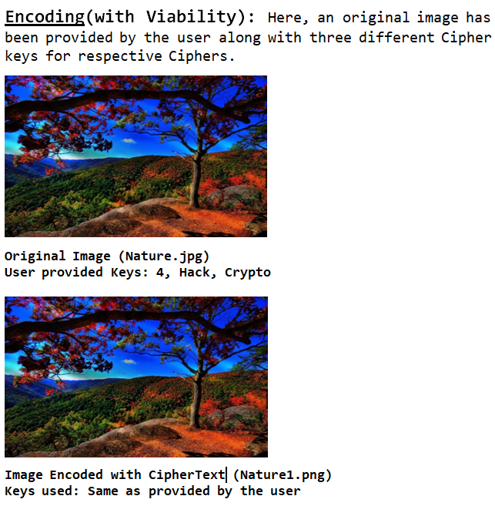
RESULTS & DISCUSSION
>>>
==== RESTART: C:/Users/HP/Desktop/Sixth Semester Project/ProjectCODE.py ====
Welcome To TriPLeSeCuriTy IMAGE EnCODER-DeCODER.
:: Welcome to Steganography ::
Choose:
1. Encode
2. Decode
1
Enter text to Encrypt:Good and Evil are just a matter of Perspective
Enter Three Keys for Encryption as followed:
Enter Key for Substitution Cipher(Input Shift Value):4
Enter Key for Transposition Cipher(Input String Value):Hack
Enter Key for OneTimePadCipher(Input String Value):Crypto
The Encoded Message :085259001d18630a0a191d15301730505417321b13061306300003151a4f260459070c302b1a14060d0a3b522d041930
Do You Want to DeCode the message to Check? Press Y or N:Y
The Decoded Message:Good and Evil are just a matter of Perspective

Slide 26
RESULTS & DISCUSSION (contd.)
Enter image name(with extension) : Nature.jpg
Enter the name of new image(with extension) : Nature1.png
Code has been Encrypted in the Provided Image.
DO YOU WISH TO CONTINUE? Y
:: Welcome to Steganography ::
Choose:
1. Encode
2. Decode
2
Enter image name(with extension) : Nature1.png
Enter Three Keys for Decryption as followed:
Enter Key for Substitution Cipher(Input Shift Value):4
Enter Key for Transposition Cipher(Input String Value):Hack
Enter Key for OneTimePadCipher(Input String Value):Crypto
The Decoded Message:Good and Evil are just a matter of Perspective
DO YOU WISH TO CONTINUE?N
THANK YOU FOR USING TriPLe-SeCuriTy EnCODER-DeCODER.
>>>

Slide 27
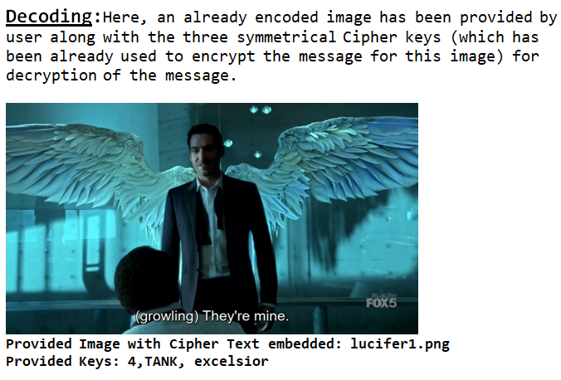
RESULTS & DISCUSSION (contd.)
>>>
==== RESTART: C:/Users/HP/Desktop/Sixth Semester Project/ProjectCODE.py ====
Welcome To TriPLeSeCuriTy IMAGE EnCODER-DeCODER.
:: Welcome to Steganography ::
Choose:
1. Encode
2. Decode
2
Enter image name(with extension) : lucifer1.png
Enter Three Keys for Decryption as followed:
Enter Key for Substitution Cipher(Input Shift Value):4
Enter Key for Transposition Cipher(Input String Value):TANK
Enter Key for OneTimePadCipher(Input String Value):excelsior
The Decoded Message: Calmness is the hallmark of those who are mighty.
DO YOU WISH TO CONTINUE?N
THANK YOU FOR USING TriPLe-SeCuriTy EnCODER-DeCODER.
>>>

Slide 28
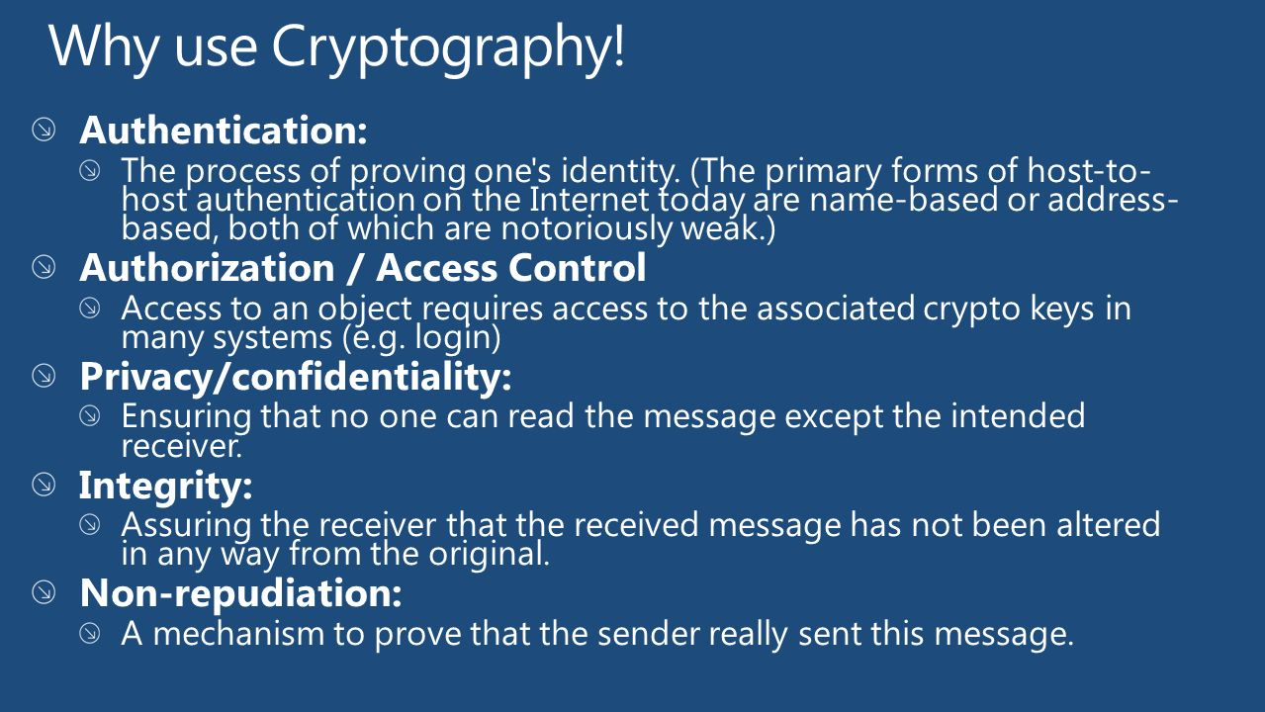
CONCLUSION
From a technical point of view, Cryptography is the solution to many of the Security Challenges that are present in the Internet. The technology exists to solve most of the problems. However, there are several issues that have obstructed the widespread use of cryptography in the Internet. First of all, cryptography, as a science, faces a difficult problem. Most of the algorithms cannot be proven secure. For this reason, there is suspicion around many of the cryptographic algorithms. Another aspect is related to the intellectual property associated with the algorithms. Most algorithms are patented, and only some companies have licensed them for use.

Slide 29
CONCLUSION (contd.)
Also, Cryptography can be used to harm society. Governments are concerned that encryption will make law enforcement and national security goals more difficult to achieve. For example, terrorists could communicate information over the Internet using encryption that law enforcement agencies could not decrypt. Therefore, some governments, such as the U.S., have regulated the export of software containing encryption algorithms. This is a topic of debate, pitting governments against the right to free speech. For example, U.S. export regulations can prevent the publication of cryptographic research.
For example, U.S. export regulations can prevent the publication of cryptographic research. In one court case, in March 1996, Phil Karn filed suite over whether he could export some source code from [SCHN96]. A District Court ruled that "export controls on encryption software are constitutional under the First Amendment" to the U.S. Constitution.
Steganography can protect data by hiding it but using it alone may not guarantee total protection. It is possible that by using a steganocryption technique, enemy detects presence of text message in the image file and then he/she may succeed in extracting information from the picture, which can be disastrous in real life situations.
This is same for plain encryption. In this case by seeing the meaningless appearing sequence of bits enemy can detect that some illegal message is being sent (unless he/she is a fool), and we may land-up in a problematic situation. However, if one uses both methods, this will lead to ‘security in depth’. The message should first be encoded using a strong encryption algorithm and then embedded into a carrier.

Slide 30
REFERENCES
Cryptography and Network Security by Atul Kahate, Tata McGraw Hill
Cryptography and Network Security by Behrouz A Forouzan & Debdeep Mukhopadhyay, Tata McGraw Hill
https://www.geeksforgeeks.org/cryptography-and-its-types/
https://www.geeksforgeeks.org/image-based-steganography-using-python/
Related Article: https://iopscience.iop.org/article/10.1088/1742-6596/1339/1/012061/pdf

Slide 31
THANK YOU

