Slide 1
Problem Statement : User Query on Stack Overflow
An application designed primarily to search the StackOverflow site using a query and obtain a specific number of relevant questions, and their most relevant answer using their public API.

Slide 2




Team Details :
Team Size: 4
Team members :
Aniruddha Silvia Sayan Kumar Subrata Sarkar Sultana Saha Paul

Slide 3
Role of Team Members
After finalizing the algorithm to solve the problem ,the tasks were divided as :
Aniruddha Sarkar : Core coding member , coding of some main functions like ranking of the questions using edit distance and graph , deploying the entire application as Flask-based application, presentation finalization, assimilation of the project idea into required docs.
Silvia Sultana : Coding of core functions that implement sentiment analysis on the comments to fetch the appropriate answers , code review , making of the entire presentation.
Sayan Kumar Saha : Coding of necessary basic functions like fetching query from StackOverflow API, creation of the video, presentation edits .
Subrata Paul : Coding of functions that would fetch the answers from StackAPI corresponding the question_ids, code review, presentation edits.

Slide 4
Overview
The application was designed primarily to search the StackOverflow site using a query, or a question, and obtain a specific number of relevant questions available online, and their most relevant answer, using their public API.
The application is written in Python and designed to be usable through a HTML-based User Interface, which is accessible through any web browser, and to run on various Cloud Platforms with minimum changes.
The application was designed as a micro-service, such that it can be integrated into a larger application, using the Flask Library.

Slide 5
Proposed Idea & Technologies used
The architecture of the application primarily comprises of 5 tasks :
Obtaining Keywords using IBM Watson Natural Language Understanding API
Obtaining questions using keywords of the query, using StackAPI
Graph and Edit Distance-based question ranking using NetworkX and NLTK
Sentiment analysis and ranking based answer picking, using IBM Watson Natural Language Understanding API
Deployment as a Flask-based Web Application.

Slide 6
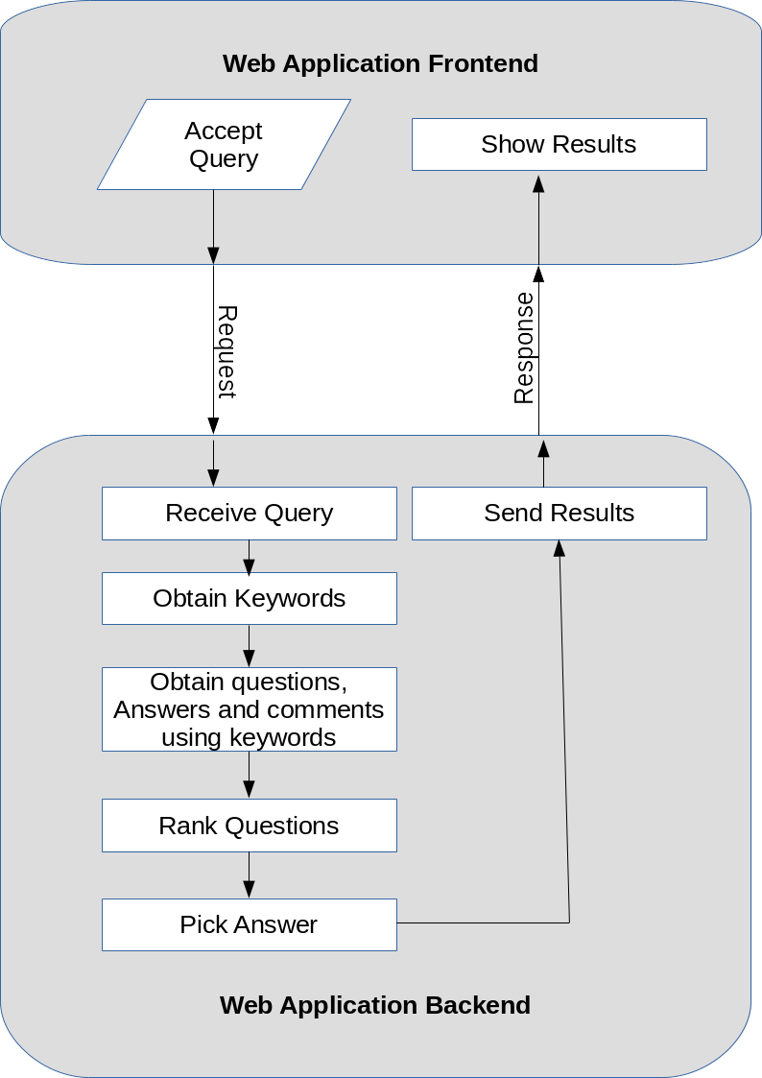
Flow Chart Describing Architecture

Slide 7
Tasks of this application
The scope of work of the application will include implementations of the following processes :
(a) Obtaining Keywords
(b) Obtaining questions using keywords of the query,
(c) Graph and Edit Distance-based question ranking,
(d) Sentiment analysis and ranking based answer picking,
(e) Deployment as a Web Application.

Slide 8
Proposed solution for task execution
Identification of relevant questions to a query – This has been achieved by extraction of keywords and then using them to query StackOverflow

Slide 9
Contd :
Identification of the matching tags and pick top relevant questions from stack overflow – This has been achieved by using Keyword Graph and Edit Distance based ranking.

Slide 10
Contd :
Identification of the top K-solutions of the problem – This has been achieved by ranking of answers based on the the result of sentiment analysis of the answer’s comments, the score of the answer received from StackOverflow and whether the answer has been accepted or not.

Slide 11
Frameworks/tools used for UI/UX design
HTML: HTML is used to create electronic documents (called pages) that are displayed on the World Wide Web. Every web page you see on the Internet is written using one version of HTML code or another.
CSS: CSS is a language that describes the style of an HTML document. CSS describes how HTML elements should be displayed on screen, paper, or in other media. It can control the layout of multiple web pages all at once
JavaScript: JavaScript is a dynamic computer programming language. It is lightweight and most commonly used as a part of web pages, whose implementations allow client-side script to interact with the user and make dynamic pages. It is the language of the web, it is used to make the web look alive by adding motion to it.
jQuery: jQuery is a small, light-weight and fast JavaScript library. It is cross-platform and supports different types of browsers. It is also referred as write less do more because it takes a lot of common tasks that requires many lines of JavaScript code to accomplish, and binds them into methods that can be called with a single line of code whenever needed. jQuery simplifies HTML document traversing, event handling, animating, and Ajax interactions for rapid web development. jQuery is a JavaScript toolkit designed to simplify various tasks by writing less code.

Slide 12
Business Goals
The application can potentially enrich the learning experience of the inexperienced developers, by picking efficient solutions from StackOverflow and thus contribute to business growth of any Information Technology services based organization, by saving time and energy of the new developers required to search StackOverflow.

Slide 13
THANK YOU

