Slide 1
Method-Trace Analyzer Presented by team- “BAPI”
IBM Hack Challenge
Video URL: https://www.youtube.com/watch?v=96nsZEiTkmQ

Slide 2
Problem Statement :
The problem statement is aimed at developing an application to assist developers in debugging code. Method tracing is one of the commonly used post-mortem diagnostic method to identify problems. It consists of timestamp of entry and exit points for each method invocation. They may also contain stack-trace for each invocation.

Slide 3




Team Members :
Aniruddha Sarkar
Riya Karan
Souhardya Mandal
Subhajit Bokshi

Slide 4
Role of team members
Application developer and lead- Aniruddha Sarkar
Code review and Video content creation- Riya Karan
Code review, Documentation and PPT- Souhardya Mandal & Subhajit Bokshi

Slide 5
technologies used
IBM Java 8 SE with the libraries - SQLite DB and Google's Diff Match Patch - and code from OpenJ9 Traceformat class, to perform various operations on the traces.

Slide 6
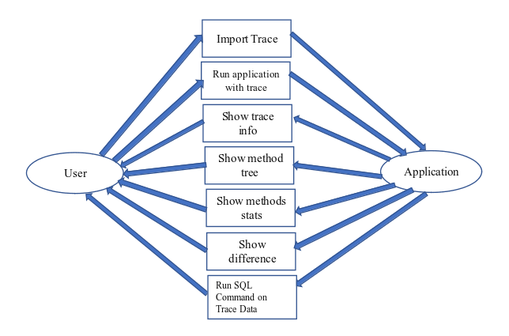
DATA FLOW DIAGRAM OF THE PROJECT

Slide 7
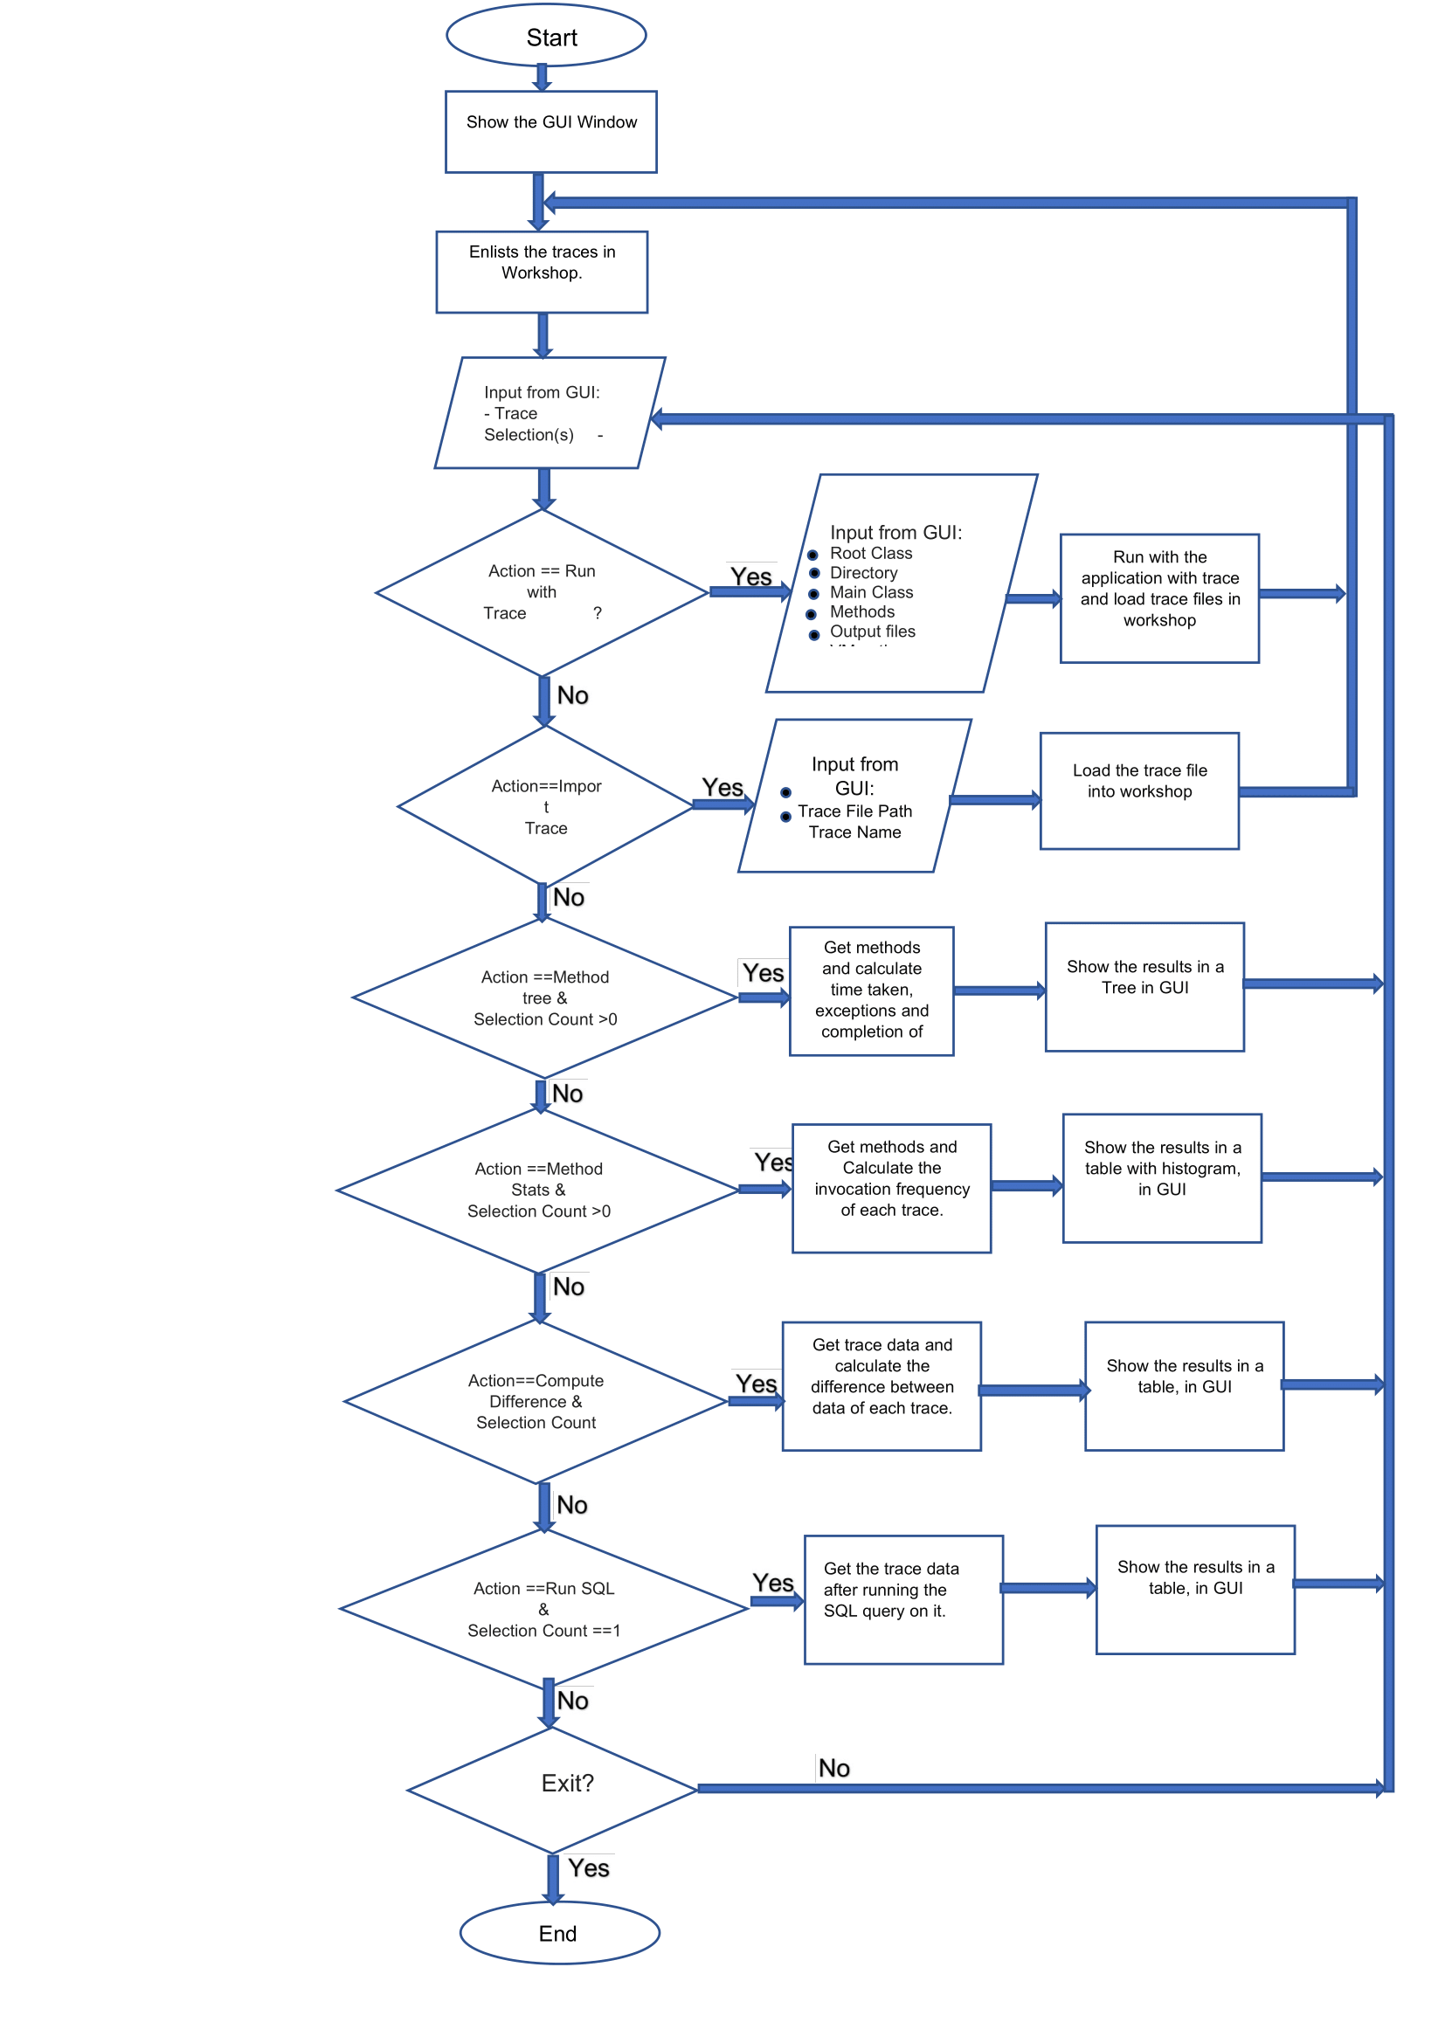
FLOW CHART of the project

Slide 8
LIBRARIES USED FOR UI/UX DESIGN
JAVA Swing Framework has been used for this project.
JAVA Swing Framework: Swing is a GUI widget toolkit for Java. It is part of Oracle's Java Foundation Classes (JFC) – an API for providing a graphical user interface (GUI) for Java programs.Swing provides a look and feel that emulates the look and feel of several platforms, and also supports a pluggable look and feel that allows applications to have a look and feel unrelated to the underlying platform. In addition to familiar components such as buttons, check boxes and labels, Swing provides several advanced components such as tabbed panel, scroll panes, trees, tables, and lists. Swing is a platform-independent because it is completely written in Java, "model-view-controller" GUI framework for Java, which follows a single-threaded programming model. Additionally, this framework provides a layer of abstraction between the code structure and graphic presentation of a Swing-based GUI. Besides, Swing is a component-based framework, whose components are all ultimately derived from the javax.swing.Jcomponent class. Swing objects asynchronously fire events, have bound properties, and respond to a documented set of methods specific to the component. Swing components are Java Beans components, compliant with the Java Beans Component Architecture specifications. Swing's heavy reliance on runtime mechanisms and indirect composition patterns allows it to respond at run time to fundamental changes in its settings.

