Slide 2
Autonomous Vehicle Control
Week 3
Adaptive cruise control

Slide 3
Recap
Last week, we learned about
Longitudinal Dynamic modelling
Linearization of nonlinear dynamic equations.
Controller design for a cruise control system which can maintain the vehicle velocity at desired input.

Slide 4
Table of Contents
Adaptive cruise control
Review of ACC systems
Study ACC boundary diagram
Mode manager and diagnostics
ACC algorithm
Controller implementation
Velocity control recap
Headway control design
Compensation for performance
Simulations and results

Slide 5
Adaptive Cruise Control

Slide 6
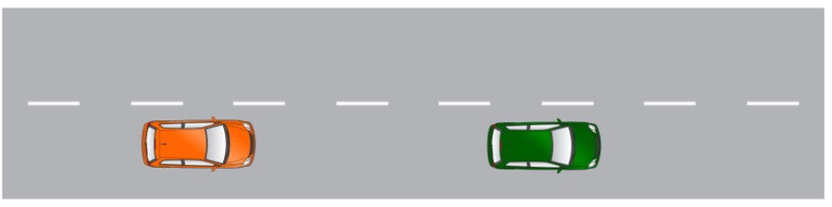
Adaptive cruise control
ACC is level 2 feature which controls the vehicle speed while maintaining a safe distance from a target vehicle.
Uses radar detection systems for target selection.
Has closed loop features and interfaces with powertrain, brake controls and steering control ECUs.
Can be enhanced to having automatic adaption to speed signs, stop and yield signs or various traffic scenarios
https://www.youtube.com/watch?v=GInSPWZRFRM
Notes:
Image 1: https://www.bosch-mobility-solutions.com/media/global/products-and-services/passenger-cars-and-light-commercial-vehicles/driver-assistance-systems/adaptive-cruise-control/adaptive_cruise_control_thumbnail.jpg
Image 2: https://icdn2.digitaltrends.com/image/digitaltrends/adaptive-cruise-control-rr.jpg

Slide 7
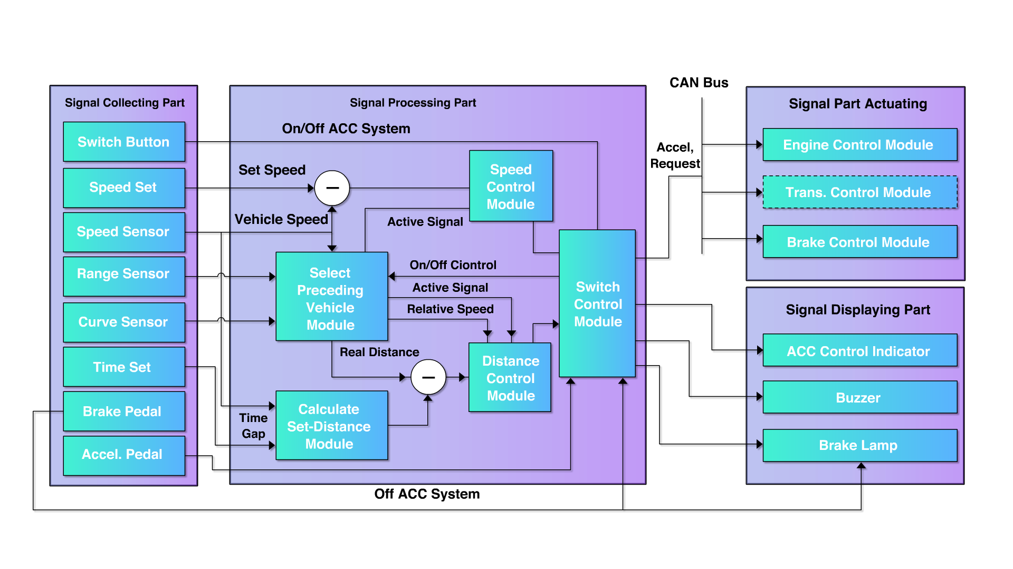
Adaptive cruise control boundary diagram
Notes:
Add Mode manager block between input signal to ADAS controller.
Inhibit block , plausibility check (check signal status)

Slide 8
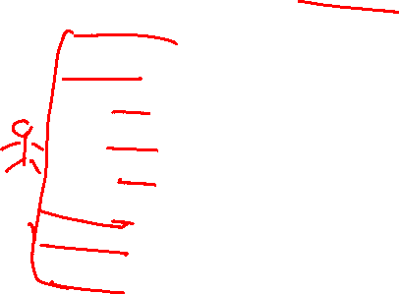
ACC Boundary diagram
Signal inputs : all input signals coming from the driver like steering switch requests for set speed, gap setting , feature On/Off. Brake pedal actuations to disable feature, acceleration requests to override

Slide 9
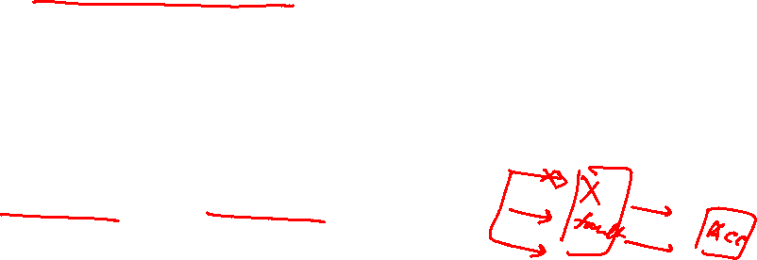
ACC Boundary diagram
Signal processing:
Sensor fusion : takes radar and camera inputs to select targets (preceding vehicles). Calculated range and range rate parameters for control calculations.
Mode manager & diagnostics : checks for various conditions to satisfy the enable conditions for the feature. Processes inputs such as set speed, gap setting and accel/brake pedal inputs to enable / disable feature.
ACC controller : control algorithm for ACC

Slide 10
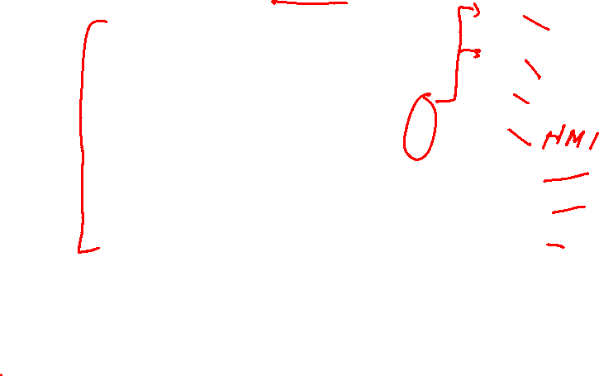
ACC Boundary diagram
Signal Actuation : Acceleration request sent to powertrain control module, brakes control module.
Signal display: HMI tell tale icons on cluster. Brake lamp lights when ACC is reducing speed by braking. Alarms or warning chimes to alert driver.

Slide 11
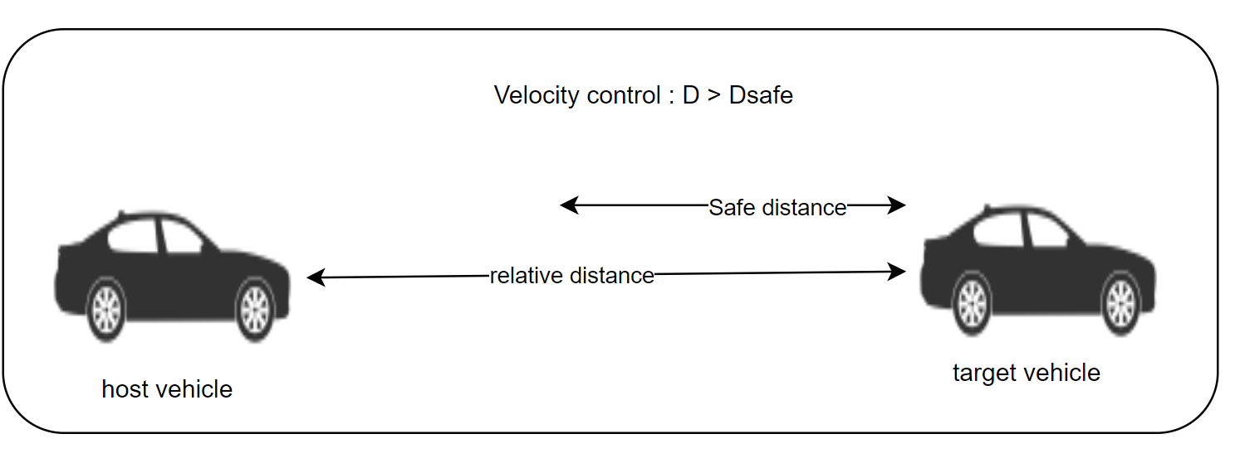
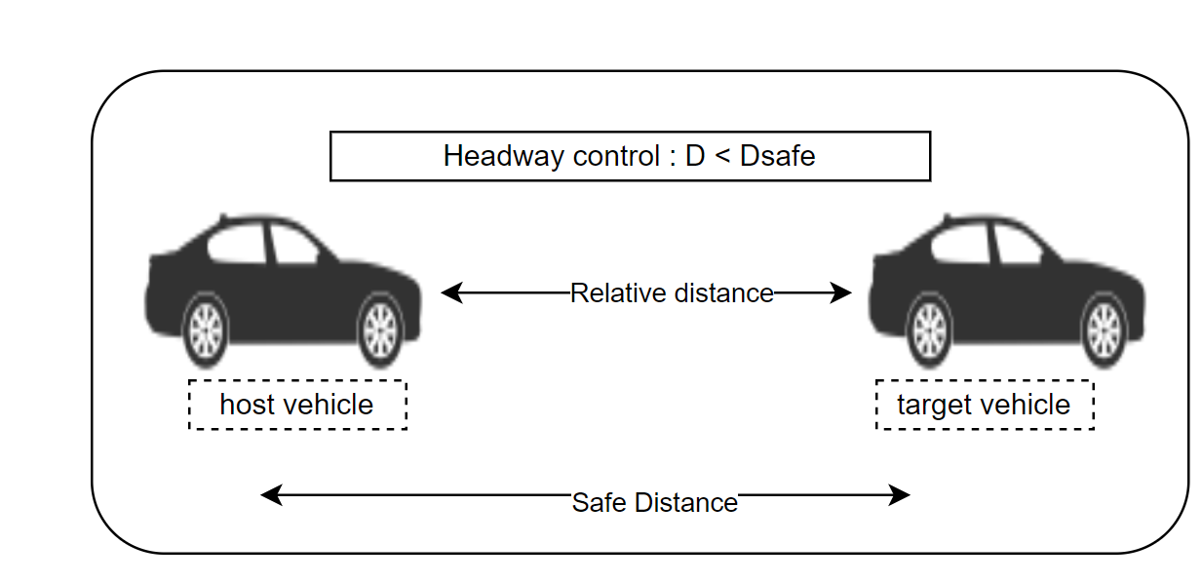
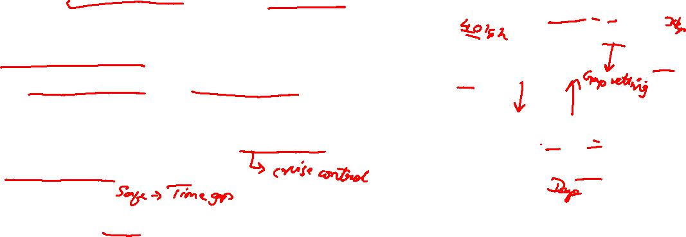
Adaptive Cruise control algorithm
The ACC model can be divided into two levels of control: lower-level control and higher-level control.
Lower-level control is resposible to calculate desired acceleration request based on the gap between vehicles & relative velocity
. There are 2 controllers _ Velocity control and Headway control.
Logic
If D >= Dsafe ⇒ Velocity control logic is active
If D < Dsafe ⇒ Headway control logic is active.
Notes:
Range and range rate use these terminology.
Images created by instructor

Slide 12
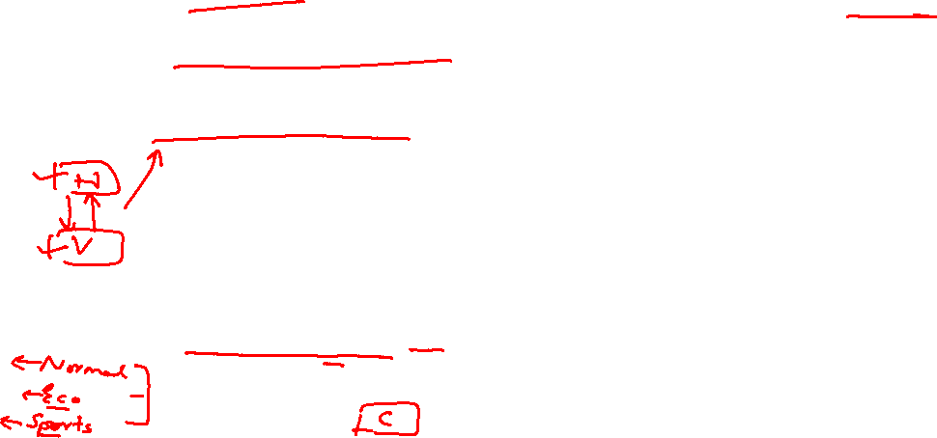
Adaptive Cruise control algorithm
The upper-level controller consists of mode manager logic and performance control logic.
Mode manager logic : This block will collect user input for set speed, gap setting , vehicle speed etc. and communicate to lower-level controller. This block will also monitor diagnostic signals and deny ACC when a denial condition is met.
ACC performance logic: A feed forward strategy to tune ACC to a more human like driving experience based on various drive scenarios

Slide 13
Lower level Controller implementation

Slide 14
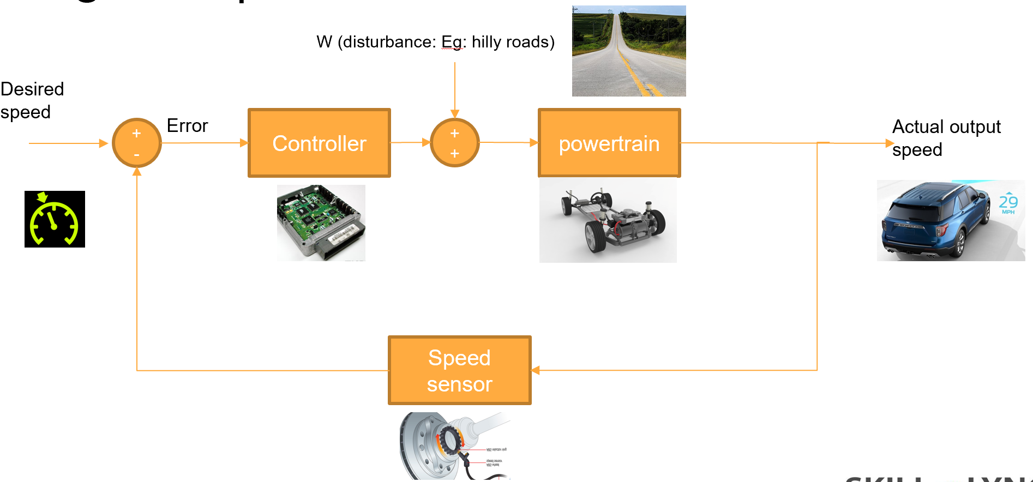
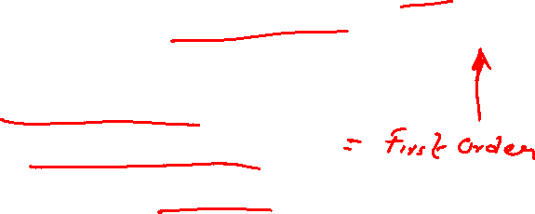
Velocity control recap
Steps to implement Velocity control
Develop the longitudinal plant model
Linearize the plant model to get a plant transfer function.
Implement a PI controller that would maintain vehicle speed
Tune the PI controller

Slide 15
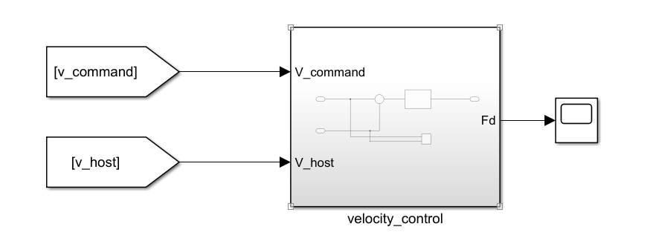
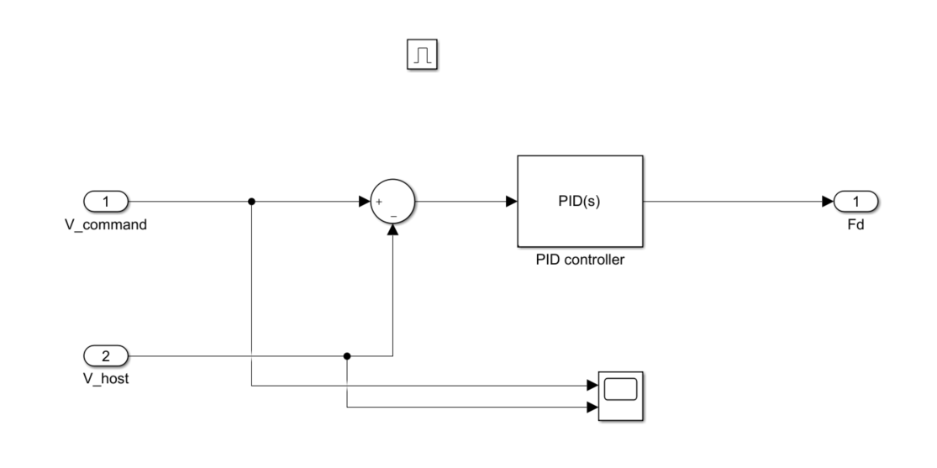
Velocity control implementation

Slide 16
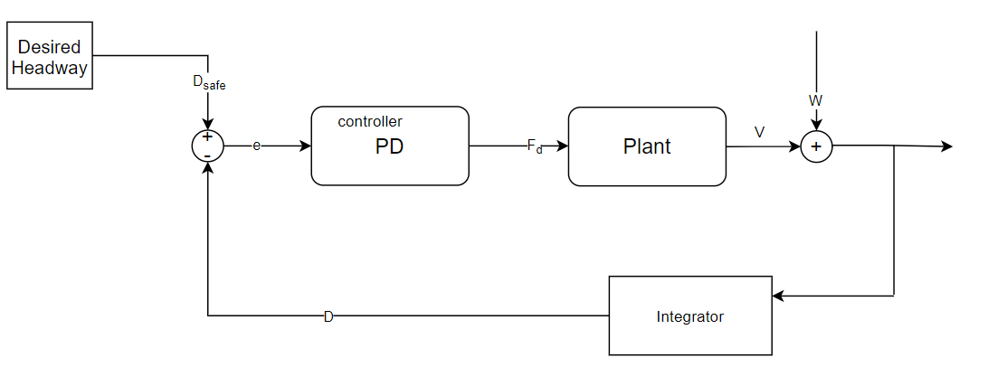
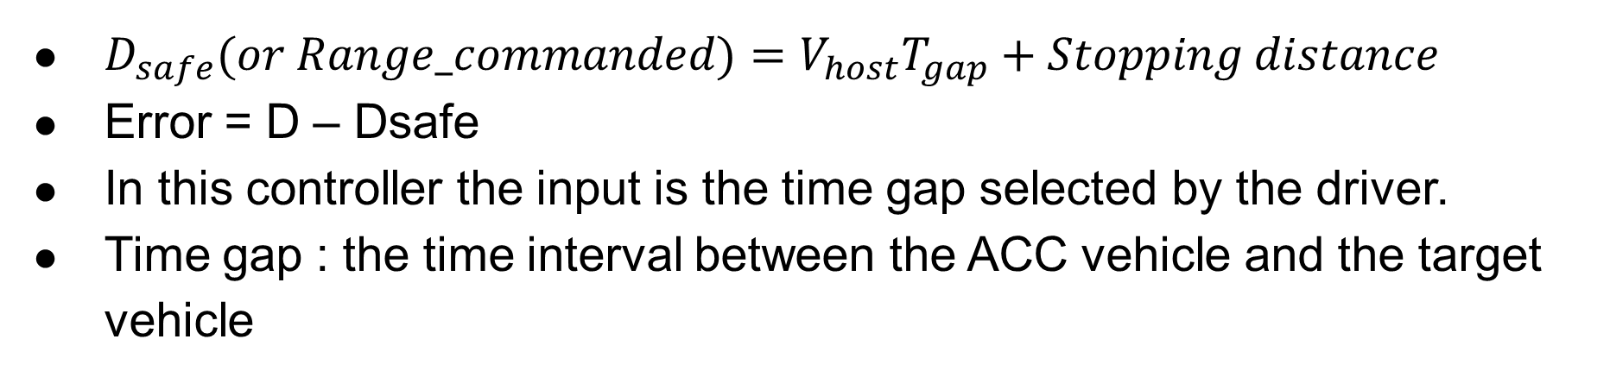
Headway control logic
$D_{safe}(or Range_commanded)=V_{host}T_{gap}+Stopping distance$
Error = D – Dsafe
In this controller the input is the time gap selected by the driver.
Time gap : the time interval between the ACC vehicle and the target vehicle
Notes:
Control block diagram,
Talk about hysteresis should be thought about when talking about switching control.

Slide 17
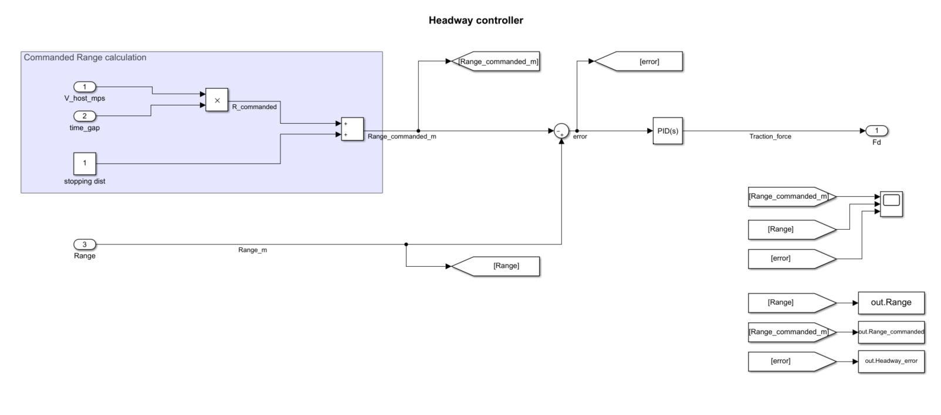
Headway control with PD control

Slide 18
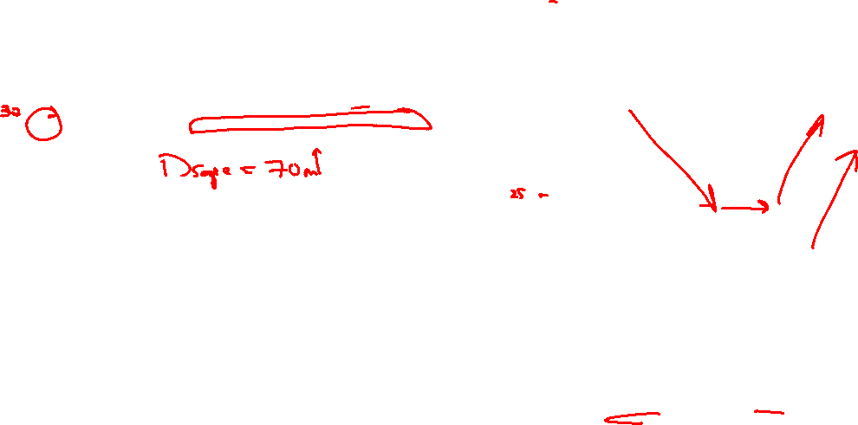
Testing Headway controller
Commanded time gap vs actual time gap
Target Velocity vs Host Velocity

Slide 19
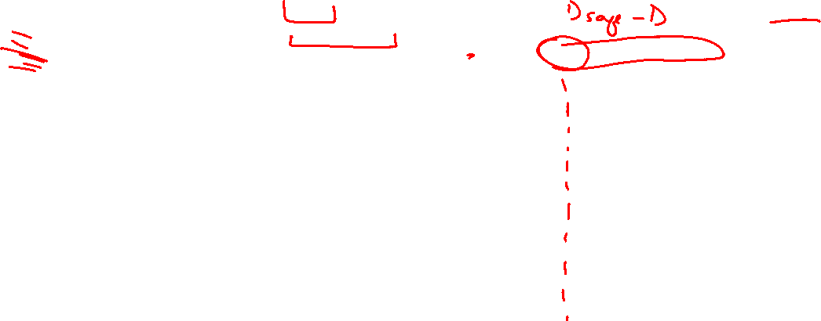
Testing Headway controller
Controller tracking performance
Controller error performance

Slide 20
ACC model integration

Slide 21
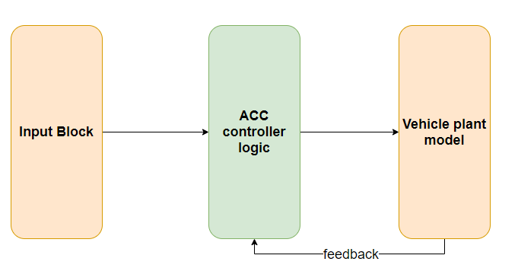
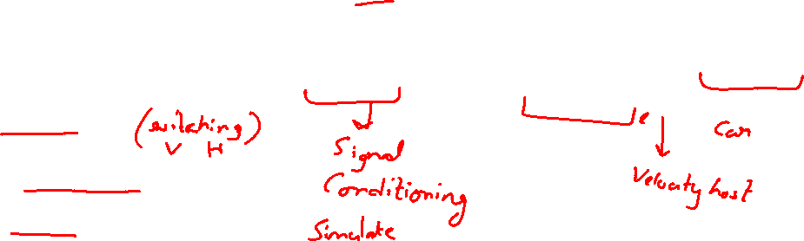
ACC feature model layout
Input Block: Input block will receive all the sensor signals and vehicle CAN signals
ACC controller: There are 3 components under ACC controller block.
ACC state manager
ACC headway and velocity control
ACC performance block
Vehicle plant model

Slide 22
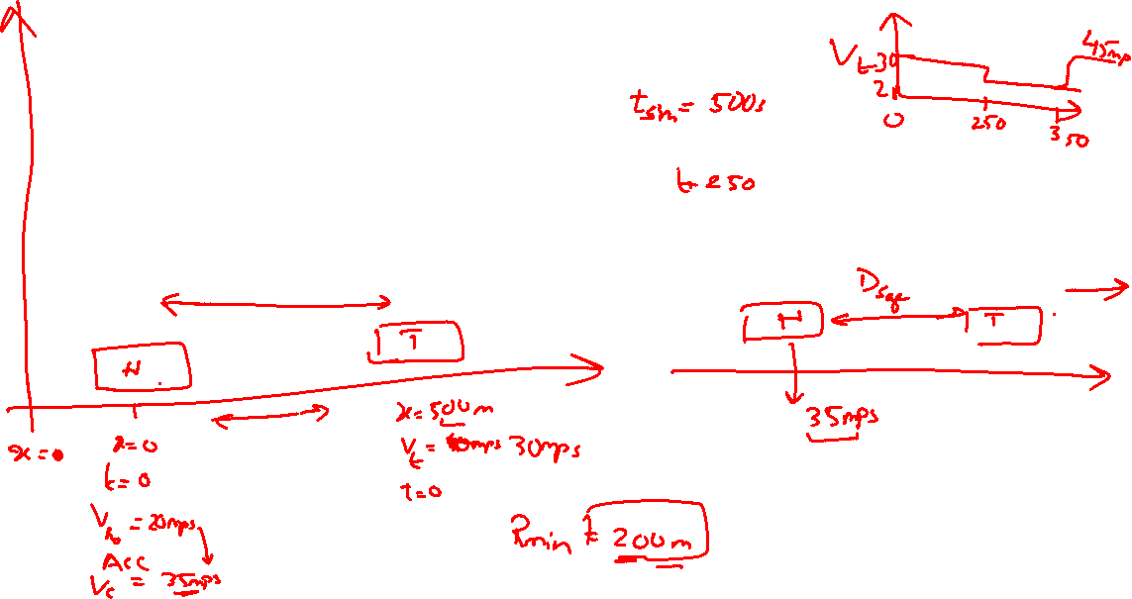
Scenario design

Slide 23
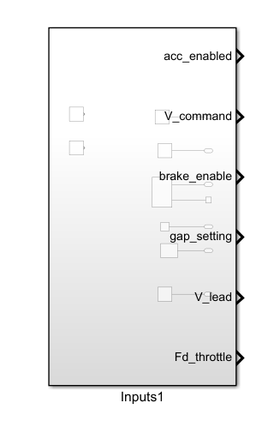
Input block implementation
Input Signal list
Acc enable request (acc_enable)
Set speed request (V_command)
Brake apply request (brake_enabled)
Gap setting (gap_setting)
Target vehicle velocity (v_lead)
Throttle request (Fd_throttle)

Slide 24
Radar input block
The radar is one of the important sensors used by ACC. It detects the targets and calculates the Range and Range rate.
Range : distance measured by the radar between target vehicle and host vehicle.
Range rate :it is the rate of change of range , also realized as the relative velocity of the target vehicle wrt host vehicle.
Target flag : If target vehicle not in range Target flag == 0 , else Target flag ==1

Slide 25
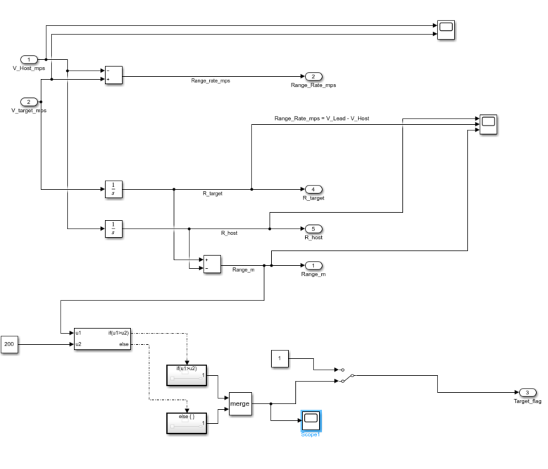
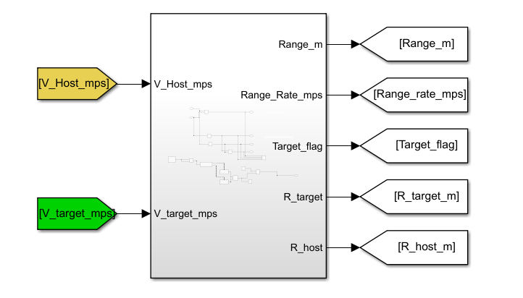
Radar input block

Slide 26
ACC controller block implementation
There will be 3 sections under the ACC controller block:
ACC state logic
Headway control & velocity control
Feedforward performance

Slide 27
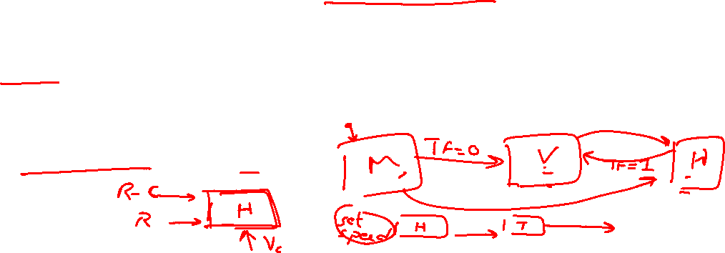
ACC state logic
There are 3 states in the ACC state logic : manual mode, velocity control mode, headway control mode.
To enter manual mode : ACC enable signal should be 0.
To enter velocity control : ACC should be enabled, Target flag ==0, or Vehicle current velocity is more that ACC set speed.
To enter headway control : ACC should be enabled, and Target flag should ==1.

Slide 29
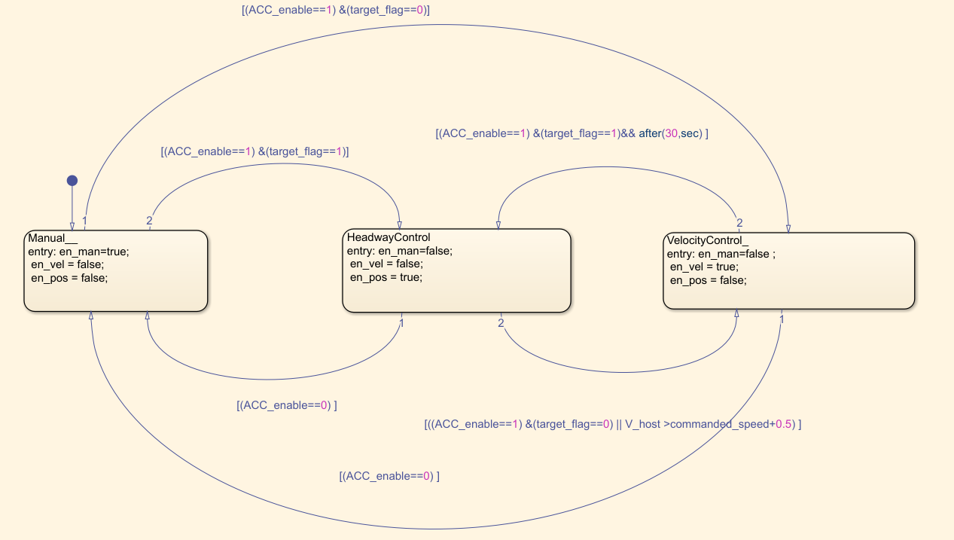
ACC state logic
When switching controls, transient will be experienced by the driver.
This can be avoided by adding different hysteresis for both the controllers during switching.

Slide 30
ACC state logic test
Notes:
Flag activation show with inputs

Slide 31
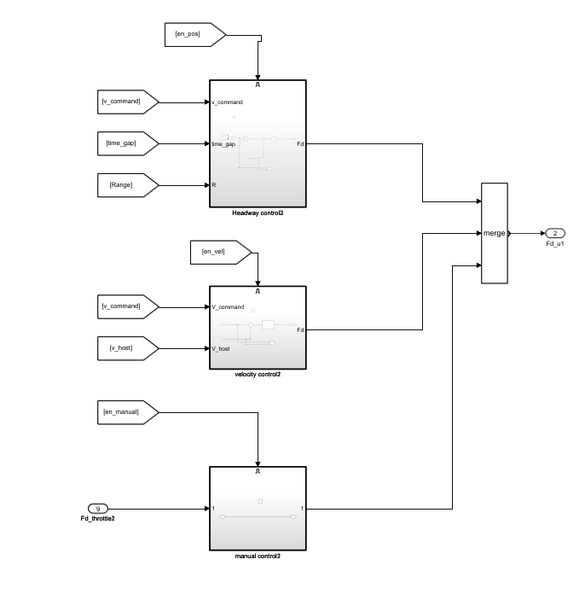
Headway & velocity control

Slide 32
ACC model integration

Slide 33
ACC scenario test.

Slide 34
ACC scenario test.

Slide 35
Performance susbsystem

Slide 36
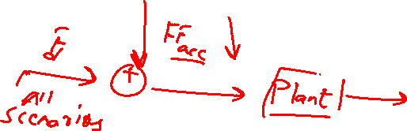
Feedforward performance logic
Till now we have seen a controller than can maintain a desired headway distance to a preceding vehicle while maintaining the corresponding set speed. However, this approach will not meet driver’s expectations in every driving scenario.
To understand the driver expectations from various driving scenarios we must categorize the various approaches in 4 parts.

Slide 37
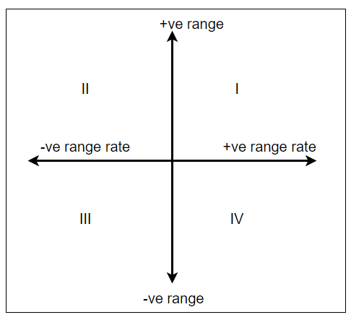
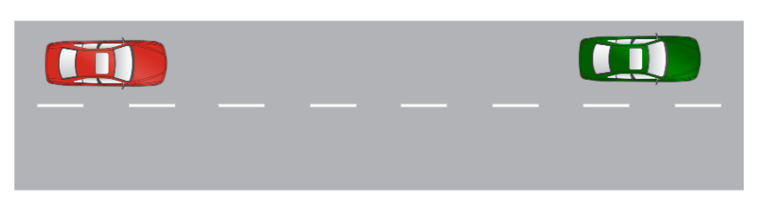
Range rate v/s range quadrants.
First quadrant : This quadrant corresponds to a situation where a preceding vehicle traveling at a faster speed than the ACC vehicle is present at a distance farther than the target headway distance. The ACC vehicle can accelerate within the speed range set by the driver. A faster response should be set here because there is an increasingly stronger perception that the preceding vehicle is pulling away from the ACC vehicle.
V_host = 40kph
V_target = 60kph

Slide 38
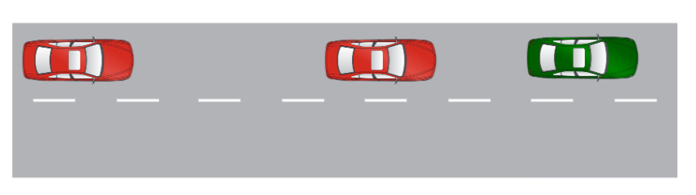
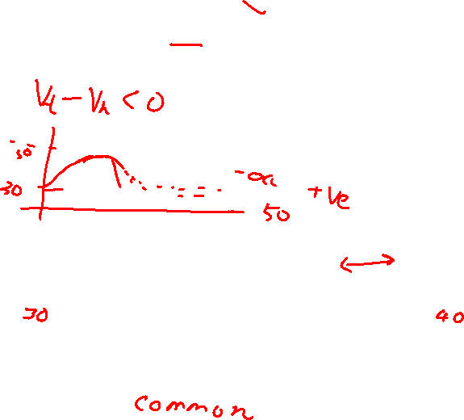
Range rate v/s range quadrants.
Second quadrant :This quadrant corresponds to a situation where a preceding vehicle traveling at a slower speed than the ACC vehicle & is present at a distance beyond the target headway distance. The ACC vehicle is decelerated to the speed of the preceding vehicle much smoothly . This quadrant represents one of the most typical ACC driving scenarios.

Slide 39
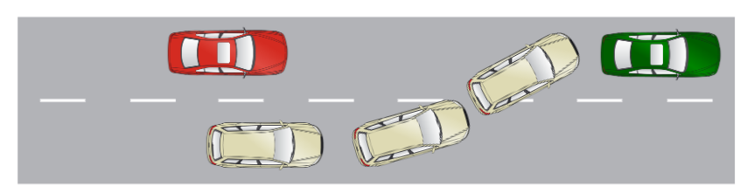
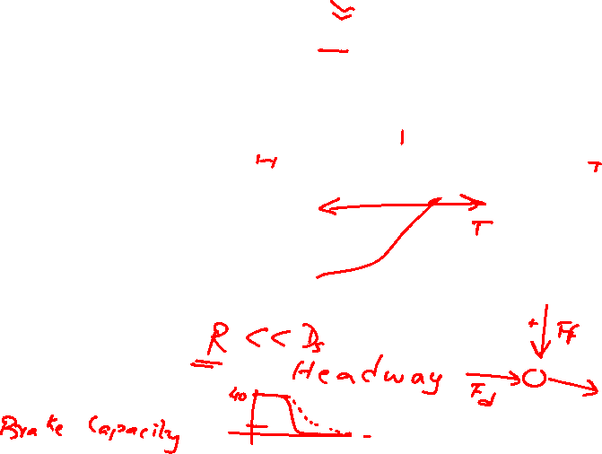
Range rate v/s range quadrants.
Third quadrant :This quadrant corresponds to a situation where a slower moving vehicle cuts in front of the ACC vehicle at a distance shorter than the target headway level while the latter is following a preceding vehicle. The ACC vehicle decelerates immediately to achieve the target headway distance. A fast response is set in this region because there is a risk of a rear-end collision with the vehicle that cuts in front.

Slide 40
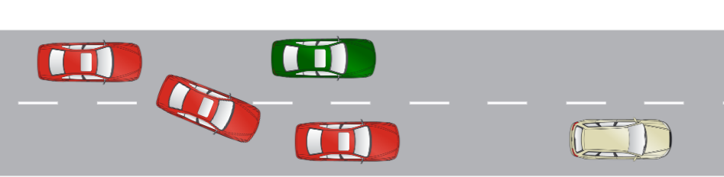
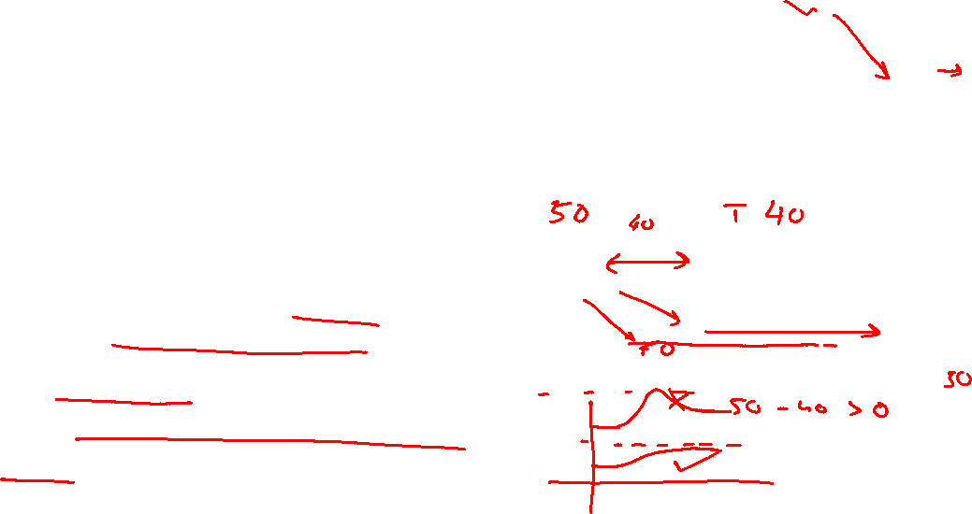
Range rate v/s range quadrants.
Fourth quadrant : corresponds to a situation where a preceding vehicle traveling at a faster speed than the ACC at a distance shorter than the target headway distance. This situation could occur when the ACC vehicle changes lanes. The ACC vehicle gradually accelerates until the target headway distance is reached. a gradual response characteristic is set to avoid unnecessary deceleration.

Slide 41
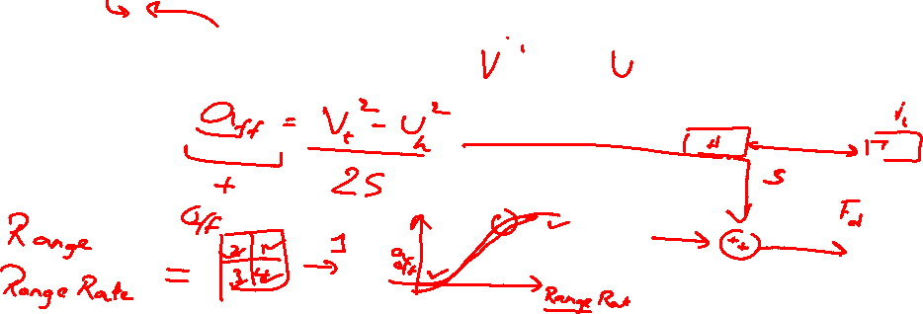
Feedforward compensator
Using kinematics formula, we can calculate the theoretical acceleration required
$a_{ff}= \frac{v^{2}−u^{2}}{2s}$ , where v is target vehicle velocity, u is host vehicle velocity and s is Dsafe.

Slide 42
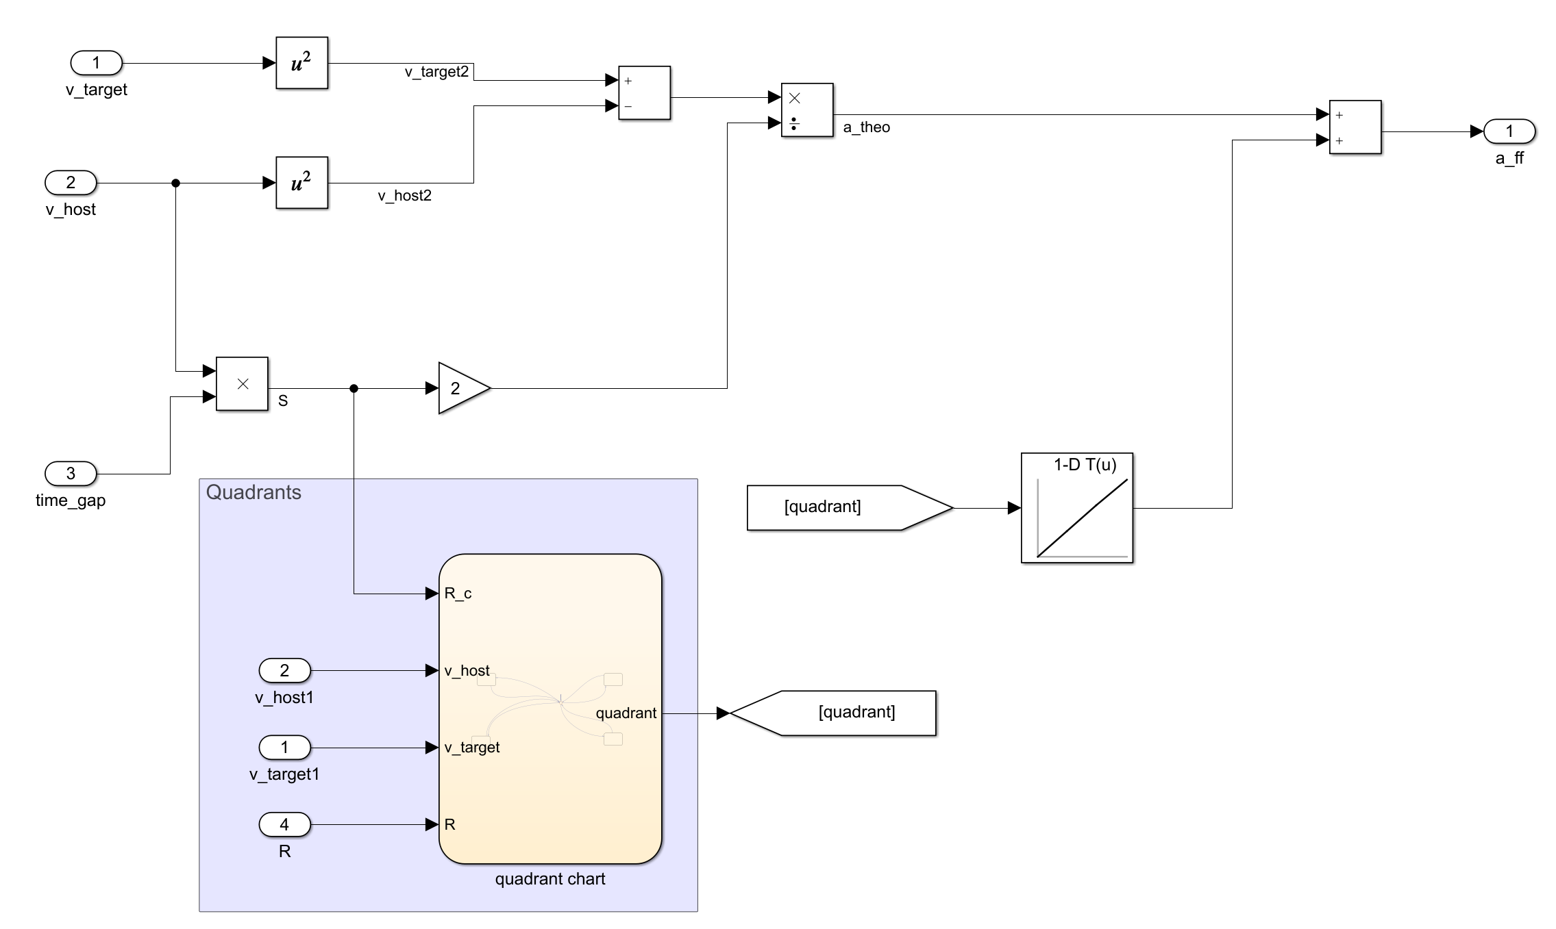
Adding a phase compensator for performance

Slide 43
ACC performance tuning
First quadrant :

Slide 44
Model integration

Slide 45
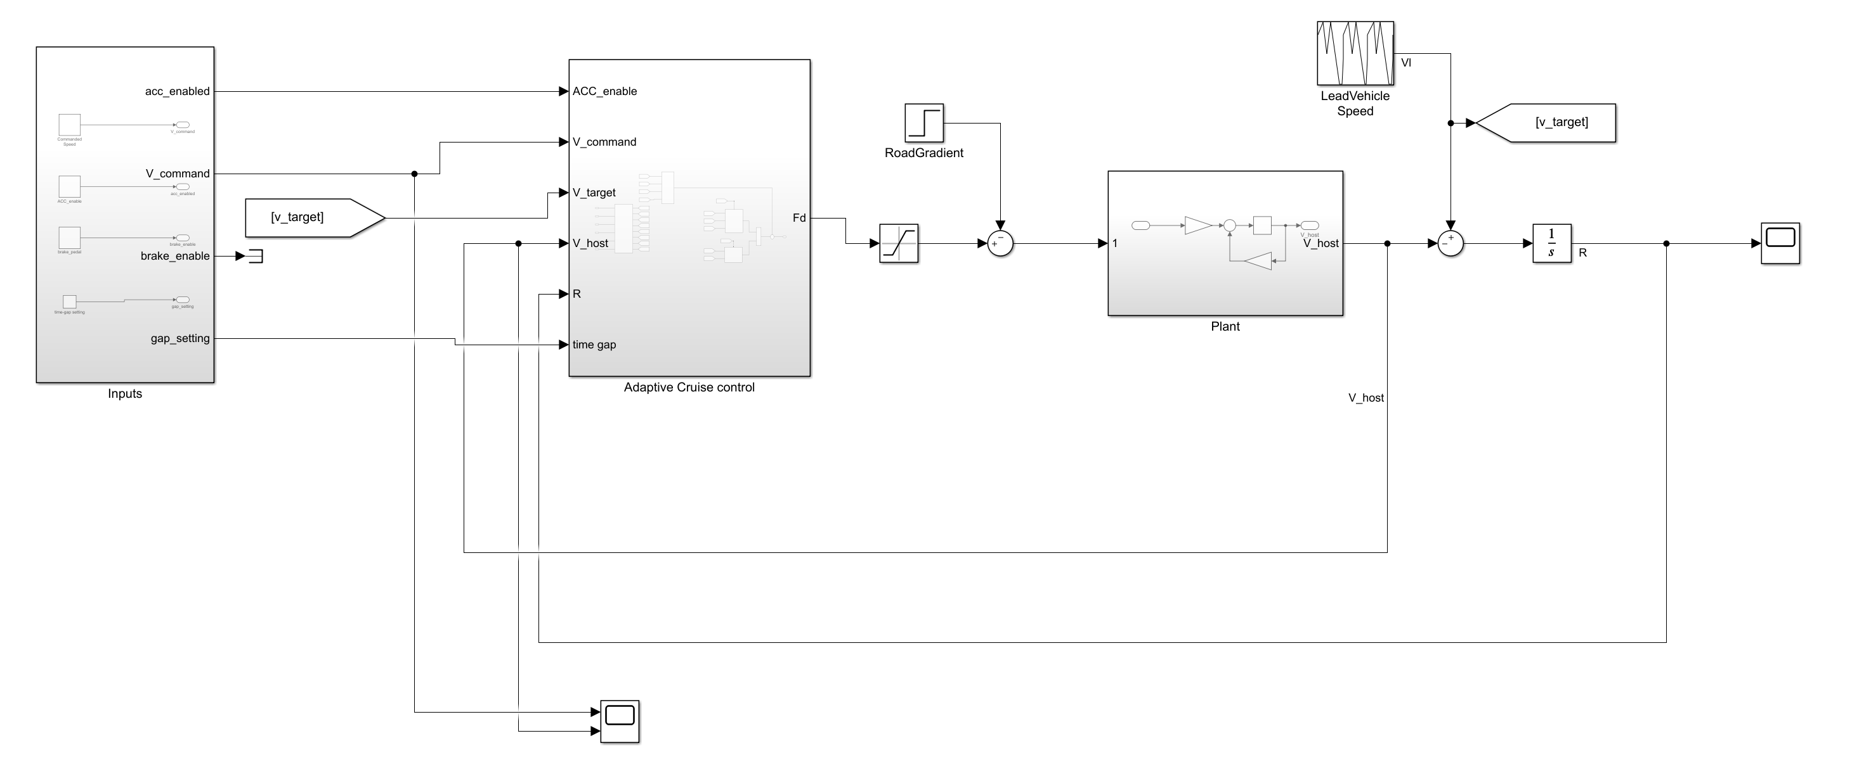
Simulink model with ACC

Slide 46
Simulation results

Slide 47

$$\begin{matrix}\begin{aligned}85 \\ 20\end{aligned} & \begin{aligned}25 \\ 30\end{aligned} & \begin{aligned}15 \\ 19\end{aligned} \\ −20 & −50 & −85 \\ 20 & 23 & 43\end{matrix}$$

Slide 48
Summary
This week, we learned about
Adaptive Cruise Control
Mathematical and Designing Aspects of Linear Quadratic Regulator

Slide 49
Image Credit
OSX, Public domain, via Wikimedia Commons

Slide 50
THANK YOU

