Slide 2
Autonomous Vehicle Controls
Week 4
Cooperative adaptive cruise control

Slide 3
Recap :
In the previous week we saw how to implement a level 2 adaptive cruise control (ACC) system ,also known as autonomous cruise control.
Implemented optimal control methods using LQR.
We also developed various levels of control which mimics actual production strategy.

Slide 4
Learning objectives for this week
This week we will
Try to improve the already built ACC system into an advance ACC system.
Learn about a new cooperative adaptive cruise control which uses additional sensor set to improve ACC performance
Implement this modified Adaptive cruise control into a simulation environment.

Slide 5
Table of Contents:
Introduction to CACC
Limitations of production ACC
How can CACC help?
Control strategy for CACC
Control strategy
Spacing policy formulation
CACC feed forward controller
Simulation and results
Notes:
Imge1 : https://www.fhwa.dot.gov/publications/research/operations/15032/index.cfm

Slide 6
Introduction to CACC

Slide 7
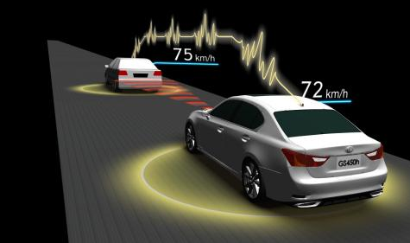
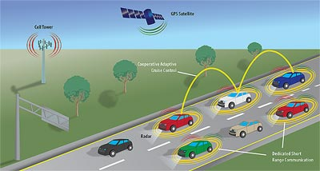
Introduction to CACC
Cooperative Adaptive Cruise Control (CACC) is a longitudinal control method where an ACC system is supported by a V2V (vehicle to vehicle communication system).
Notes:
Imag1 : https://www.eenewsautomotive.com/news/toyota-develops-its-own-automated-driving-technology
Imge2 : https://www.fhwa.dot.gov/publications/research/operations/15032/index.cfm

Slide 8
Introduction to CACC
In addition to the radar and camera sensors used by the vehicle for ACC. The CACC system uses a wireless communication system to receive data from other target vehicles.
This technique has been developed for platooning and string stability in high traffic. We shall discuss them in further detail in the upcoming slides.

Slide 9
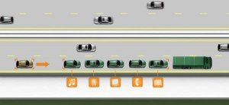
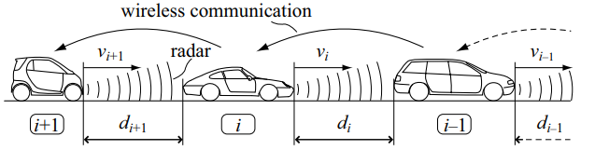
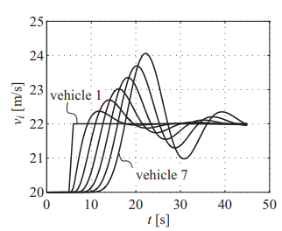
String Stability & platooning
A platoon is a group of vehicles that travel together very close to each other with minimal risk of collision even at high speeds.
String stability
It is the property of a string of vehicles by virtue of which the spacing error is guaranteed not to amplify as they propagate towards the end of the string.
Notes:
Image1 ; https://www.drivingtests.co.nz/resources/what-is-vehicle-platooning/
Image 2- need to be recreated, instructor will provide specific instructions
Image 3 - instructor will recreate the image on matlab.

Slide 10
String Stability & platooning
Eg: in a platoon of 6 cars. The error of spacing between the second and third cars do not amplify into an extremely large spacing error between the fifth and sixth car.

Slide 11
Limitations of Adaptive cruise control
Traditional ACC systems suffer from a significant trade off between ride quality & spacing accuracy due to noise range and range rate signals.
ACC cannot be implemented at low time headway values as it would result in rear end collisions in case of sudden speed changes in the traffic (shock waves).

Slide 12
Limitations of Adaptive cruise control
Due to radar / camera limitations, ACC does not do well in blind curves or hillcrest roads with target selection.
It is difficult to maintain string stability with traditional ACC if a constant spacing policy is used.

Slide 13
How can CACC help?
CACC can help maintain a low time headway value i.e. the vehicles in the platoon will travel at much closer distances without risk of collision due to loss of string stability.

Slide 14
How can CACC help?
Advantages
More traffic throughput which increases the capacity of the road.
With platooning there will be a reduction of air drag and prevention unnecessary acceleration & decelerations.
CACC can also improve performance in blind curves where radar cannot detect targets.

Slide 15
Control strategy for CACC

Slide 16
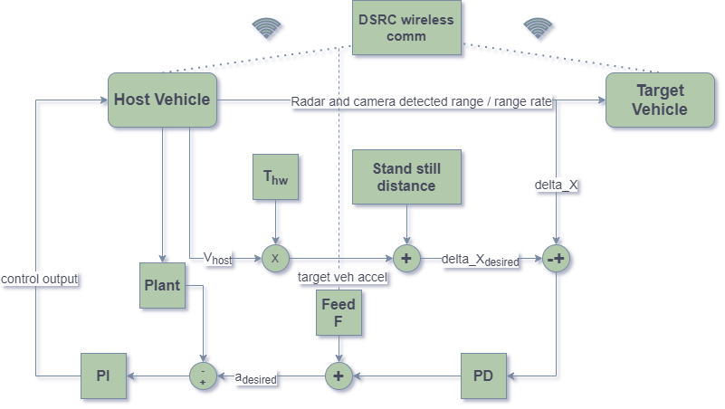
CACC control strategy block diagram
Notes:
Image created by instructor no modifications necessary

Slide 17
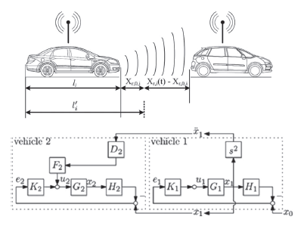
Spacing policy formulation
∆x_{desired}=V_{host} T_{hw}+standstill distance where, V_{host} is the host velocity , T_{hw} is desired time headway and standstill distance is the gap to be maintained while stationary.
∆x=x₁-x₂-l
e= ∆x - ∆x_{desired}

Slide 18
CACC feed forward controller
Feed forward formulation:
F=Q (τs+1)/(T_hw s+1)
Where 1/τ represents the desired closed loop bandwidth.

Slide 19
CACC controller implementation

Slide 20
Simulation for CACC vs ACC

Slide 21
Simulation results comparison between ACC and CACC

Slide 22
Summary
CACC is a longitudinal control method where an ACC system is supported by a V2V
String stability is the property of a string of vehicles in which the spacing error are guaranteed not to amplify as they propagate towards the end of the string
CACC can help maintain a low time headway value i.e. the vehicles in the platoon will travel a much closer distances without danger for losing string stability

Slide 23
THANK YOU

