Slide 2
Autonomous Vehicle Controls
Week 6
Lateral Vehicle Control
(Dynamic modeling with MPC)

Slide 3
Recap :
In the previous week we
Saw how to implement lateral vehicle control using geometrical methods.
Experimented with 2 different methods of geometric lateral control.
Saw the limitations of a geometric model and the issues introduced when dynamics are neglected.

Slide 4
Learning objectives for this week
This week we shall
Learn lateral vehicle control dynamics using dynamic modeling.
Overview dynamics model for lateral control
Experiment with MPC control strategies

Slide 5
Table of Contents:
Dynamic for lateral control
Control strategy
Introduction to MPC
Introduction to discrete modeling
Applying MPC to lateral control
Adaptive MPC and application to lateral control
Simulation and results

Slide 6
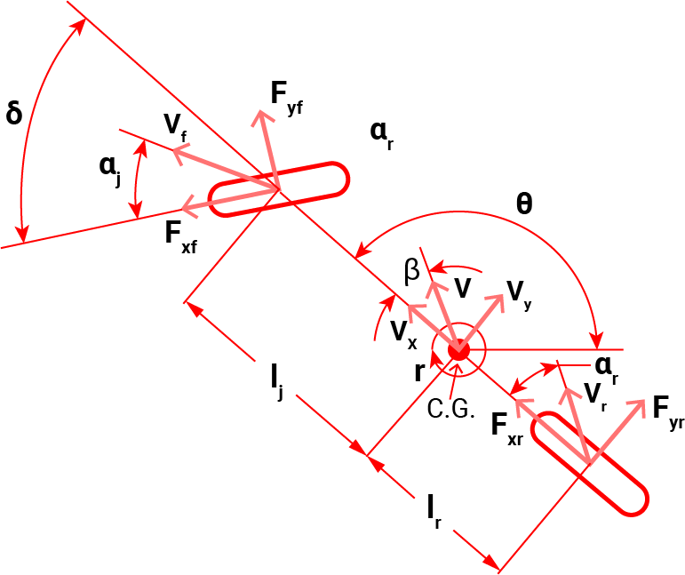
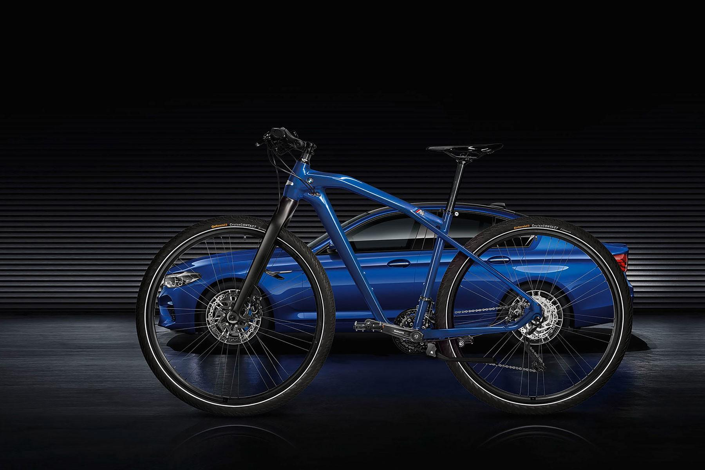
Introduction to Dynamic bi-cycle model
In the previous section we observed that neglecting vehicle dynamics has a negative impact on tracking performance.
As the speeds increase or the path curvature varies the geometric model is no longer suitable.
In this section we will see how to derive a simple lateral dynamics model that approximated the dynamic effects and helps us design a path tracking controller.
Bi- cycle representation

Slide 7
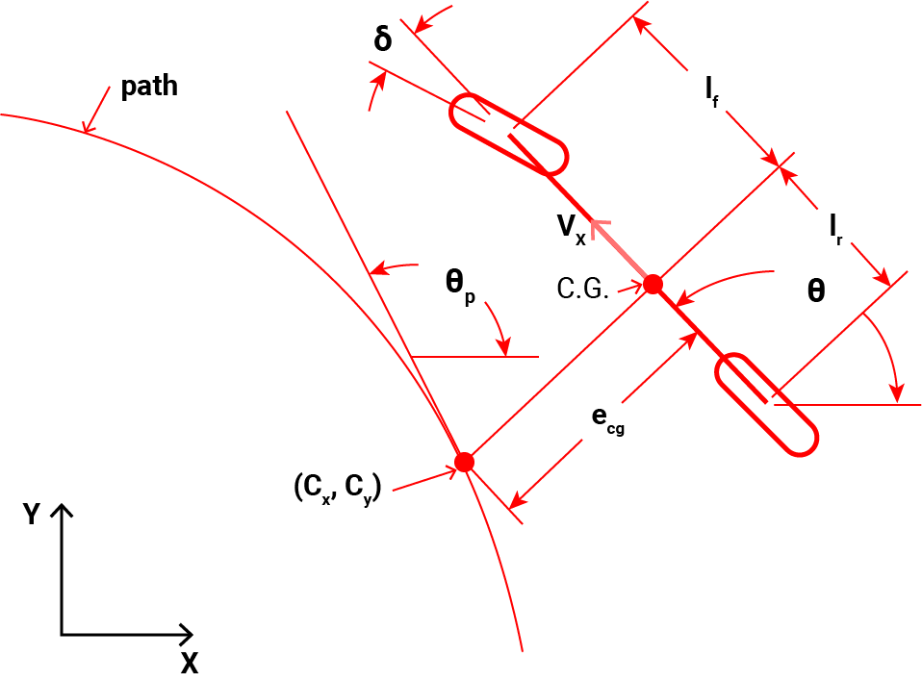
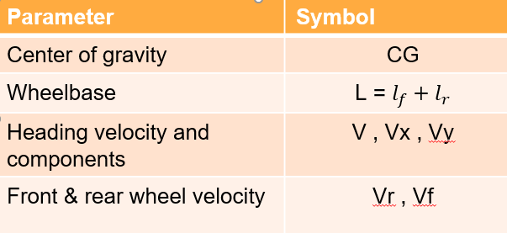
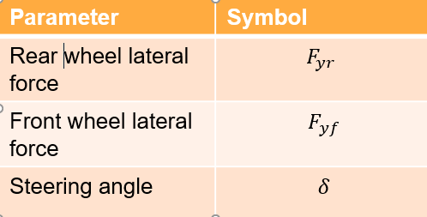
Dynamic vehicle model
The bicycle model in the last section is further included with lateral forces.
We assume that longitudinal velocity is controlled separately.
From the figure:
Dynamic Bicycle model

Slide 8
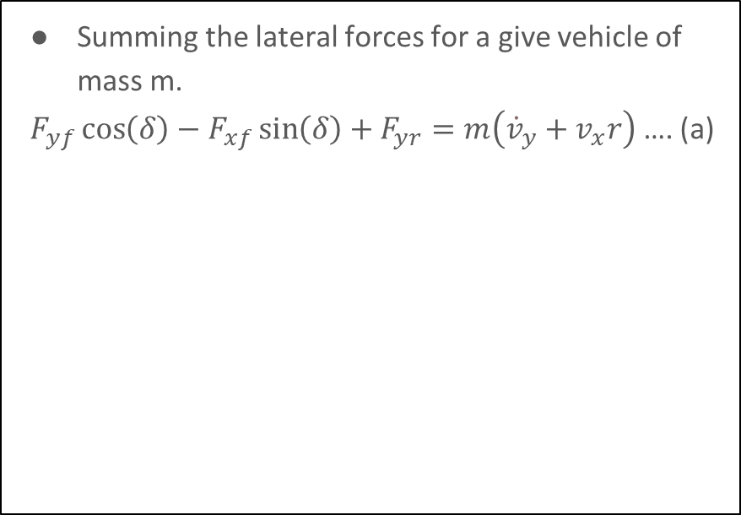
Dynamic vehicle model contd
Dynamic Bicycle model

Slide 9
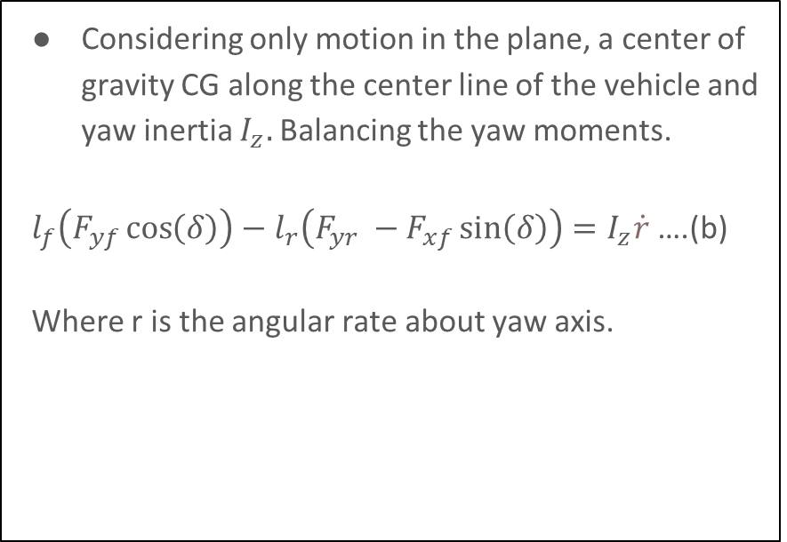
Dynamic vehicle model contd
Dynamic Bicycle model

Slide 10
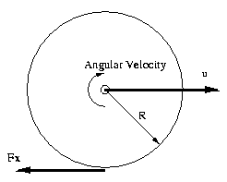
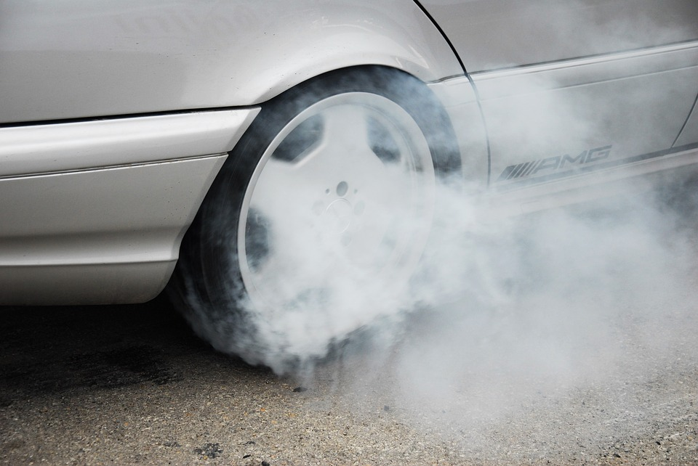
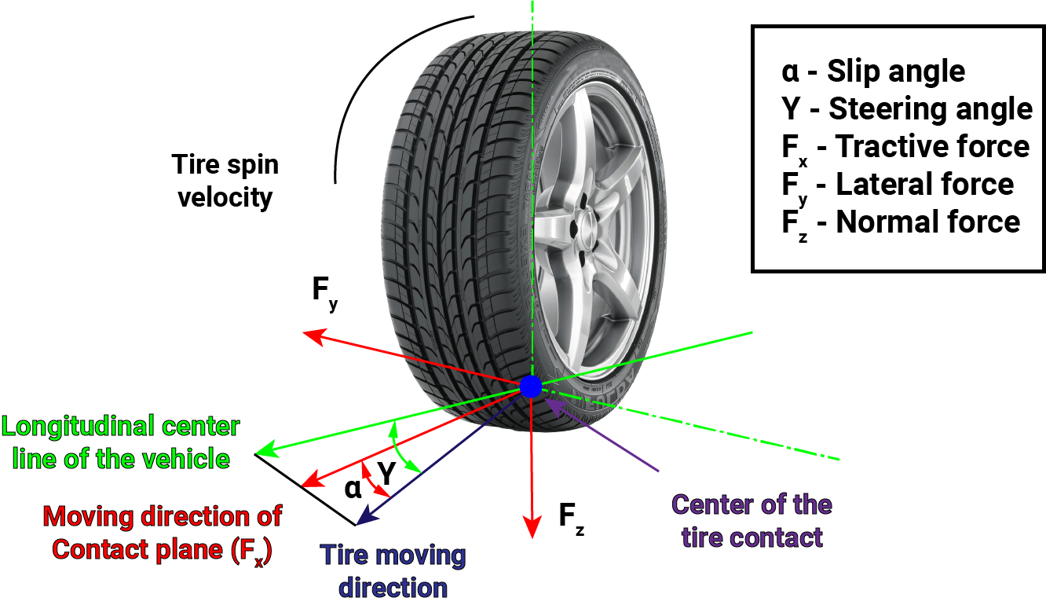
Longitudinal and lateral Slip
Longitudinal slip
Defined as the difference between the tire tangential speed and the speed of the axle relative to the road.
Lateral Slip
Slip angle or side slip angle is the angle between the direction a vehicle is traveling (heading) and the direction that the body of the vehicles is pointing (true heading).
source

Slide 11
Side Slip angle
Notes:
Introduce slip angle
Pictures or videos showing slip effect.
Differentiate lateral and longitudinal slip
Image source :

Slide 12
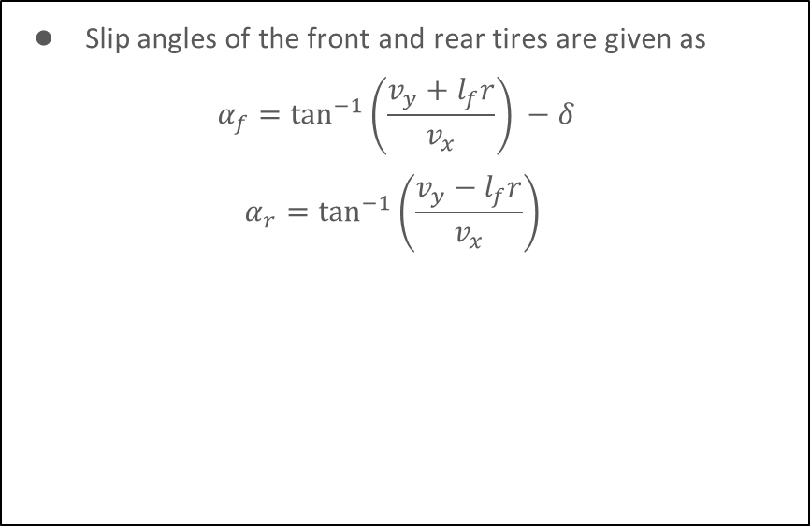
Dynamic vehicle model contd
Dynamic Bicycle model

Slide 13
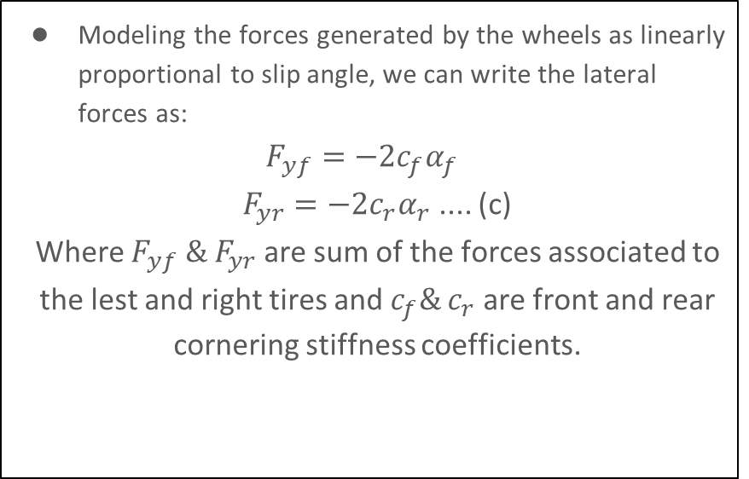
Dynamic vehicle model contd
Dynamic Bicycle model

Slide 14
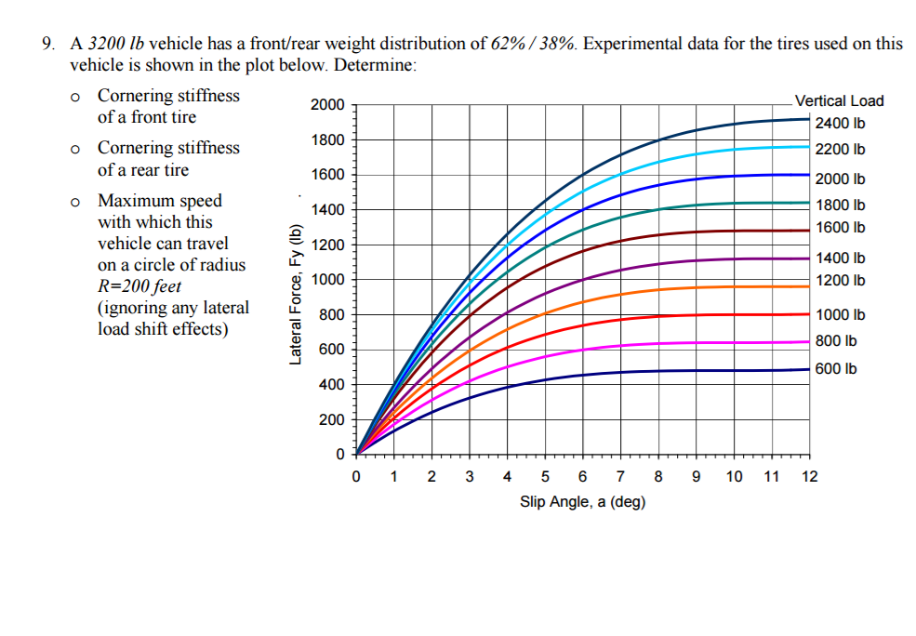
Cornering stiffness parameters
Cornering stiffness parameters cf and cr can be identified using tire cornering stiffness charts such as the one shown in the image.
Slip angle changes nonlinearly as lateral forces on the tire change & as normal force on tire varies.
A constant value describing the slope of the most linear region at a nominal force must be chosen.
Note since we are treating two tires as one in our bicycle model, we will double the values obtained from the data sheet.
Example of lateral force tire data

Slide 15
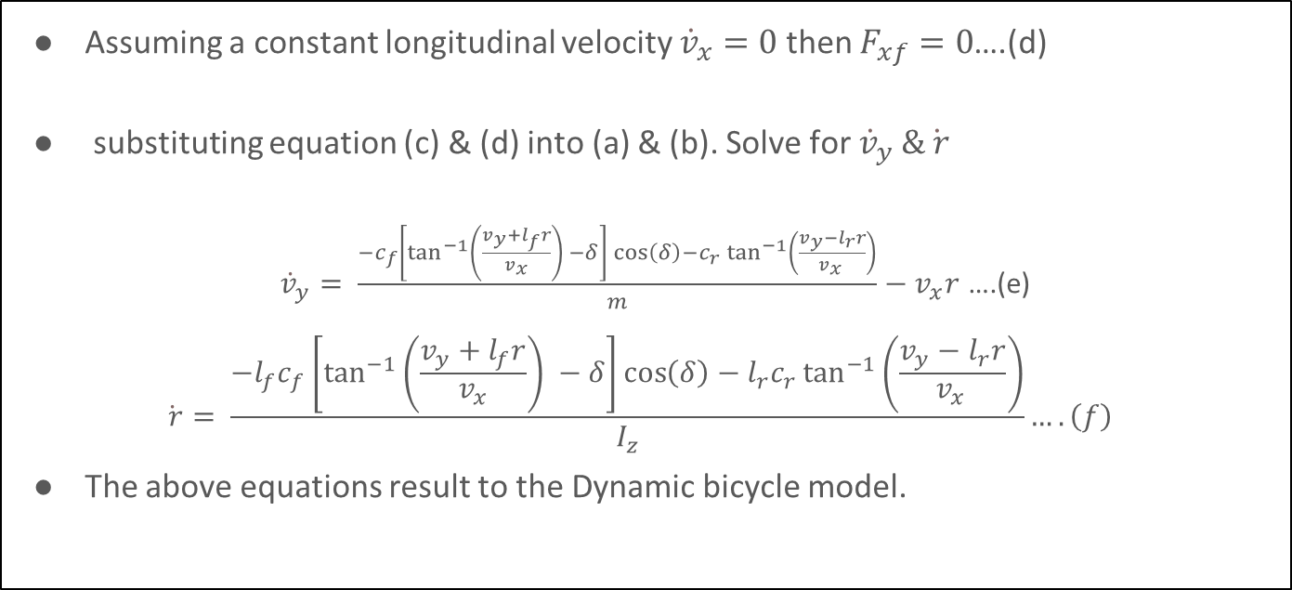

Dynamic vehicle model contd

Slide 16
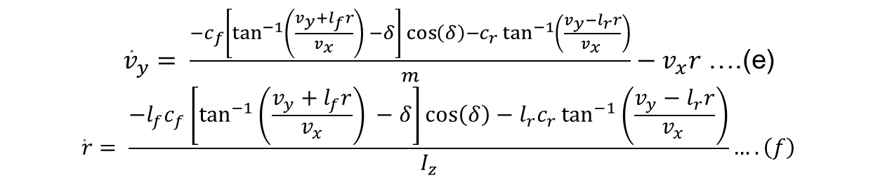
Linearizing the Dynamic bicycle model
Since we intent to apply linear control techniques to the dynamic bicycle model we must first linearize the model.
Notice that the non-linear term comes from the angle terms.

Slide 17
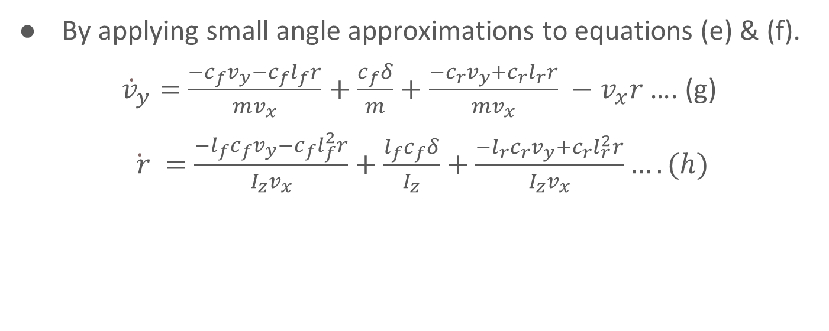

Linearizing the Dynamic bicycle model

Slide 18
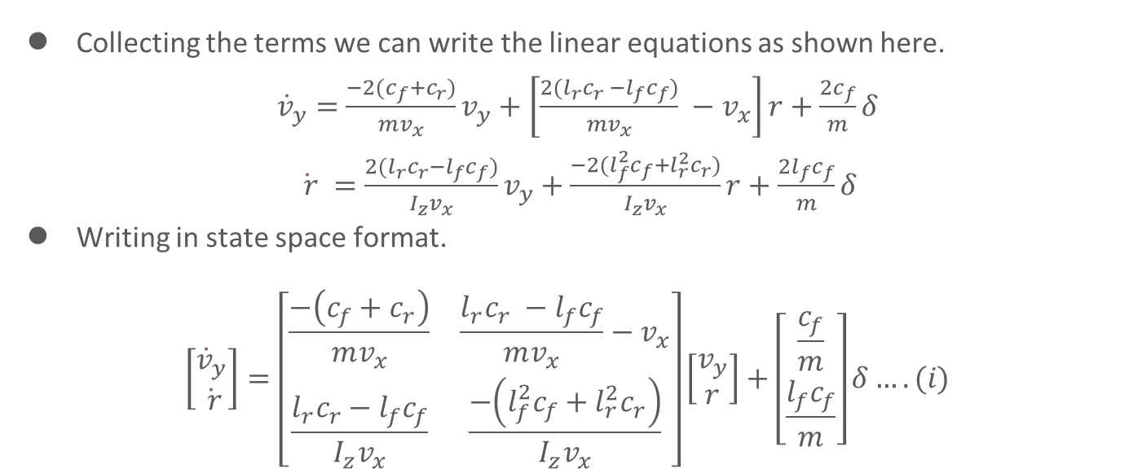
Linearized model in state space form

Slide 19
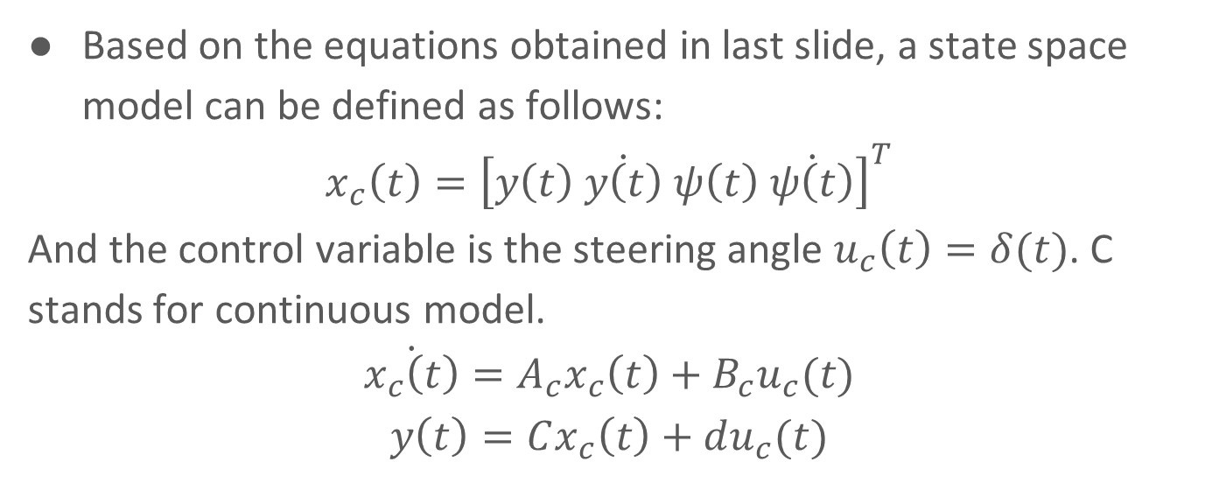
Linearized model in state space form
Notes:
C and D matrices missing
Explain yaw rate.

Slide 20
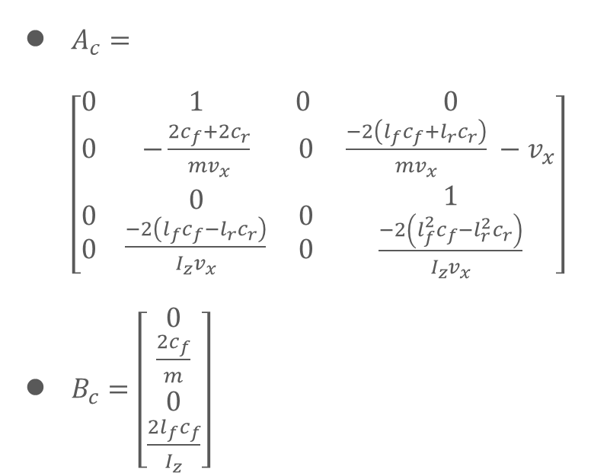


Extracting state matrices

Slide 21
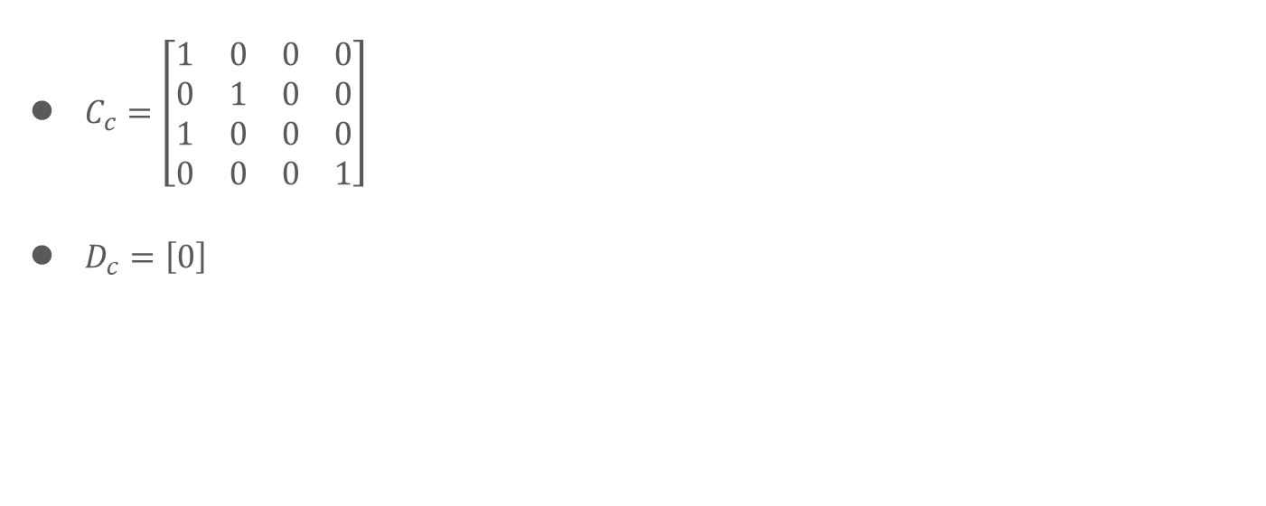
Extracting state matrices

Slide 22
Dynamics in path coordinate format
Why we need path coordinates?
Due to the nature of sensor information available from the car’s sensor we can easily determine the path coordinates and the rate of steering angle change. Which can be used as inputs to our feedback controller.
We shall assume constant longitudinal velocity.
Dynamic bicycle in path coordinate format

Slide 23
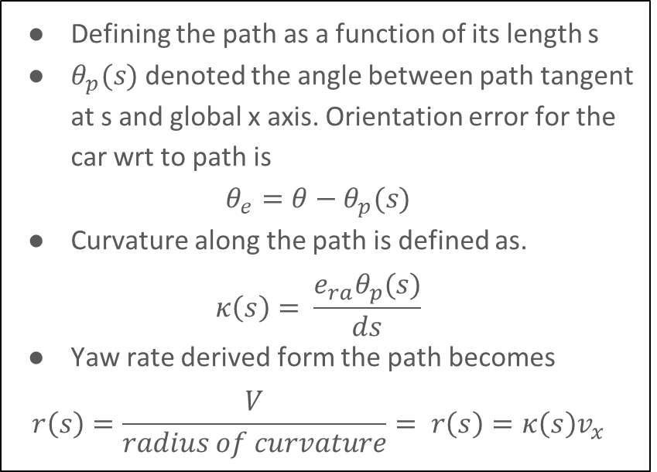
Path coordinate format contd
S
Dynamic bicycle in path coordinate format

Slide 24
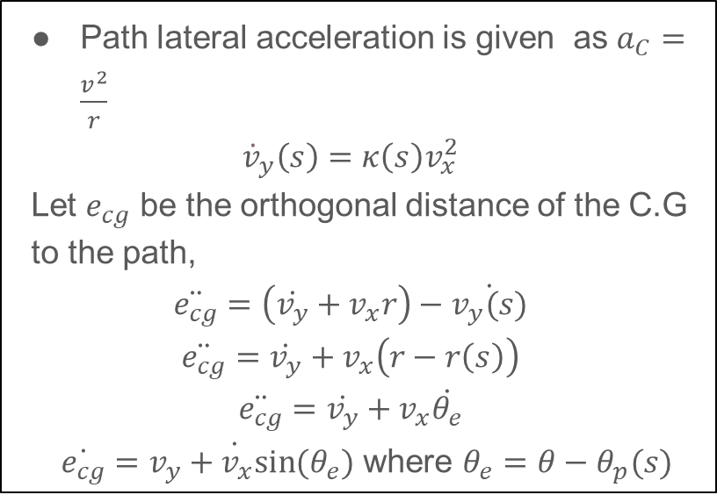
Path coordinate format contd
Dynamic bicycle in path coordinate format

Slide 25
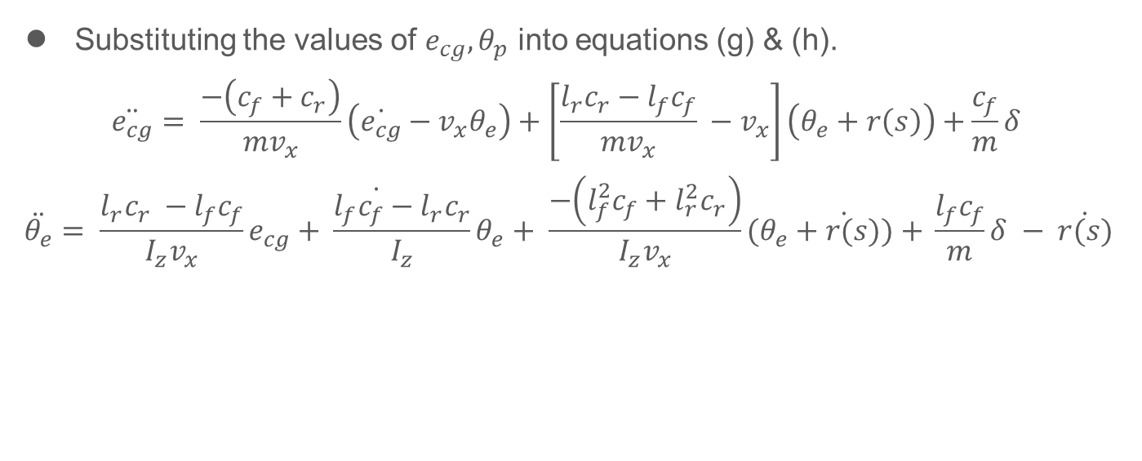
Path coordinate format contd

Slide 26
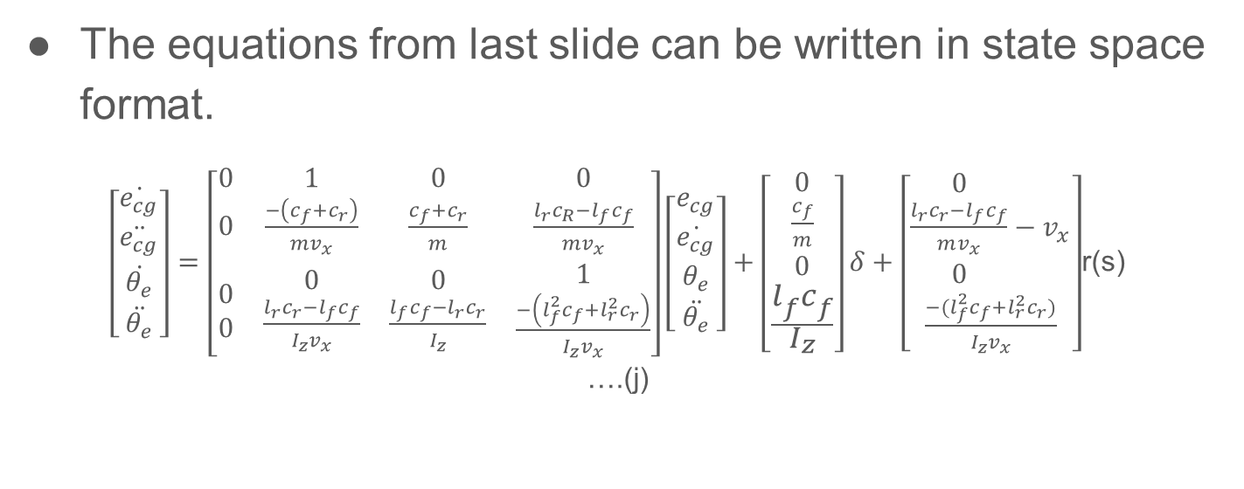
State space model in tracking error

Slide 27
Model dynamic model
Notes:
Open loop – demonstration
Input , ouput plots
Non linear model vs Linear model
Explain non linear model –
Linear model as assignment. And draw comparision

Slide 28
Lateral control methods with dynamic modeling
Linear feedback control using PID controllers: a PD control with feed-forward design can be implemented to reduce the error.
Linear feedback optimal control: We can implement a feedback controller and solve the gains using LQR offline.
Model predictive control
Notes:
Bridge slide on how to control

Slide 29
Introduction to model predictive control
In the world of control systems, the different methods can be divided into 2 categories : Model based controllers & Non- model-based controllers
Non-model-based controllers | Model based controllers
Does not consider dynamics. | Considers the vehicle dynamics of the plant during control law.
Low computational complexity. | Computationally expensive and complex.
Performance not met in certain scenarios leading to poor tracking , increased error. | Tailor the control outputs according to the dynamic situation, hence, ensures good performance in every scenario.
Examples: PID controllers, fuzzy logic controllers | Examples : Model predictive control, LQR etc.

Slide 30

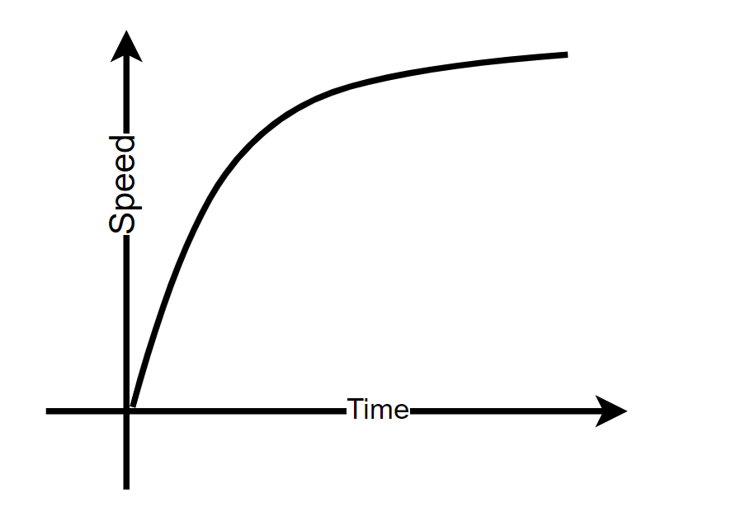


Introduction to model predictive control
Notes:
- Lane change explain in this example.

Slide 31
Why do we like MPC

Slide 32
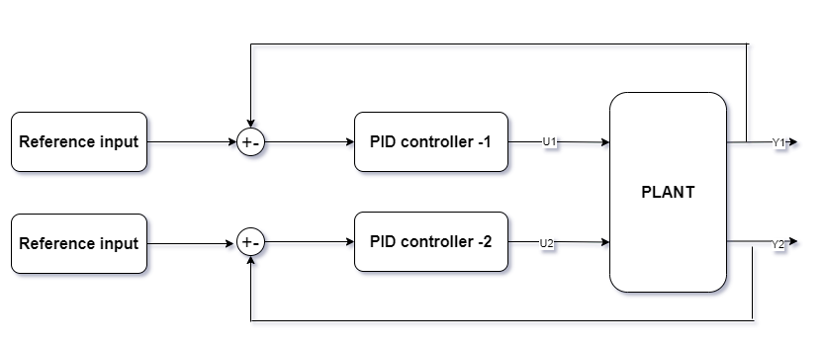
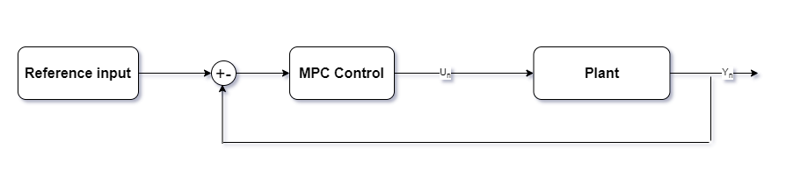
MPC can work with MIMO systems
PID feedback controllers
Both PIDs run individually and cannot influence each other’s output.
Model predictive controllers
MPC is multi-variable controller that can take into account all the system interactions between variables
Notes:
-Explain with examples : velocity + steering control example on a curve.

Slide 33

MPC can handle constraints
MPC can ensure constraints on control output.
Since it solves an online optimization problem, we can formulate constraints related to physical system.
Max : +60 deg
Max : -60 deg
Notes:
- Change the max min constraints- use a different example for constraints.

Slide 34
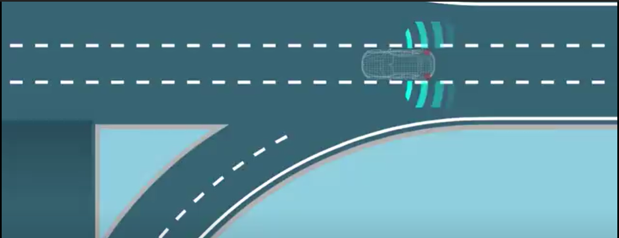
MPC has preview capability
A PID feedback system can only brake when the vehicle is at the curve. This can be uncomfortable.
MPC can preview ahead using the path planning info and brake early or prepare for lateral control ahead of the curve

Slide 35
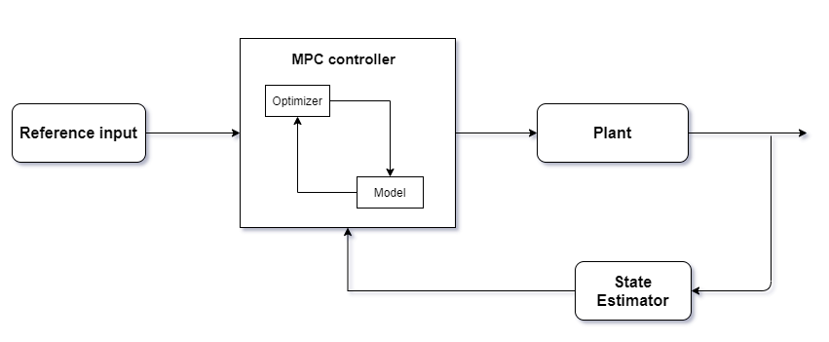
MPC High- level summary
MPC uses the plant model parameters to solve an online optimization problem at each time step.
It tries to determine the most optimal solution for a defined time horizon while maintaining constraints.
MPC requires powerful processor and memory for Realtime application.

Slide 36
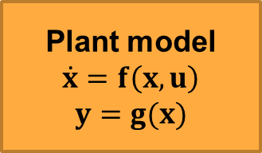
MPC formulation
MPC uses the dynamic model of the system to be controlled to predict its future behavior & adapt to the desired future reference.
It solves an online optimization problem at every time step to determine the optimal control U for a given time horizon.
In LQR we performed an offline optimization for the feedback system offline & used it for every scenario. Whereas MPC can run similar optimization at every time step.
u
y
Controller
MPC

Slide 37
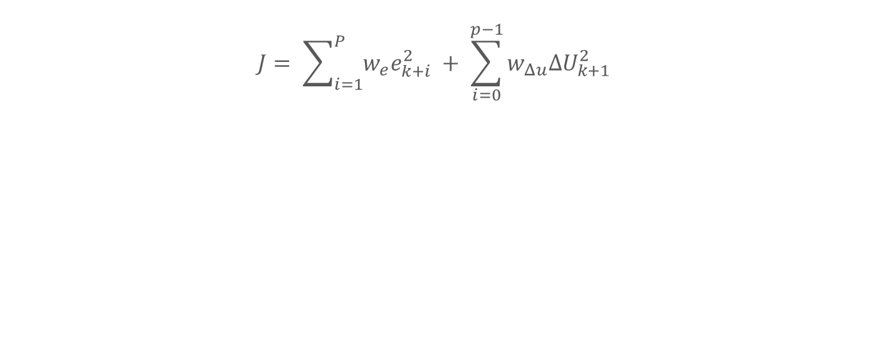

Example
Notes:
Explain lateral control example along
MPC will find the optimal path
Use the first control output
Calculate for future steps

Slide 38
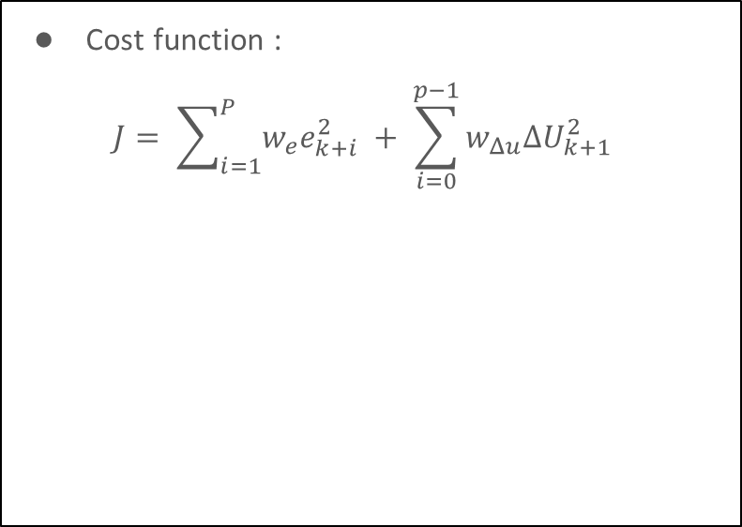
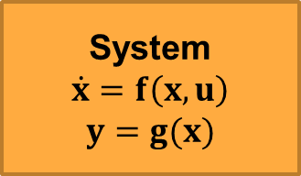
MPC formulation
u
y
Controller
MPC

Slide 39
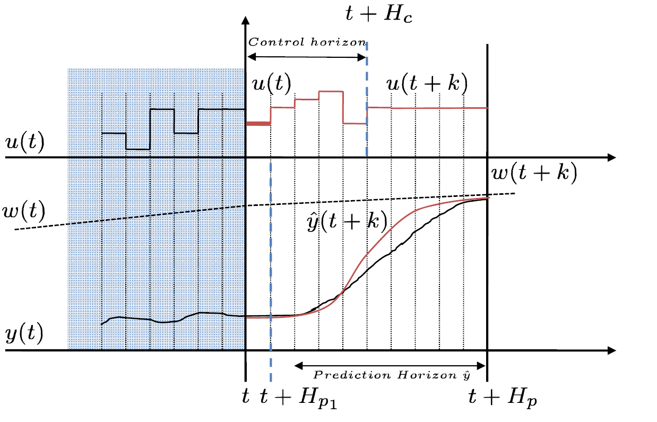
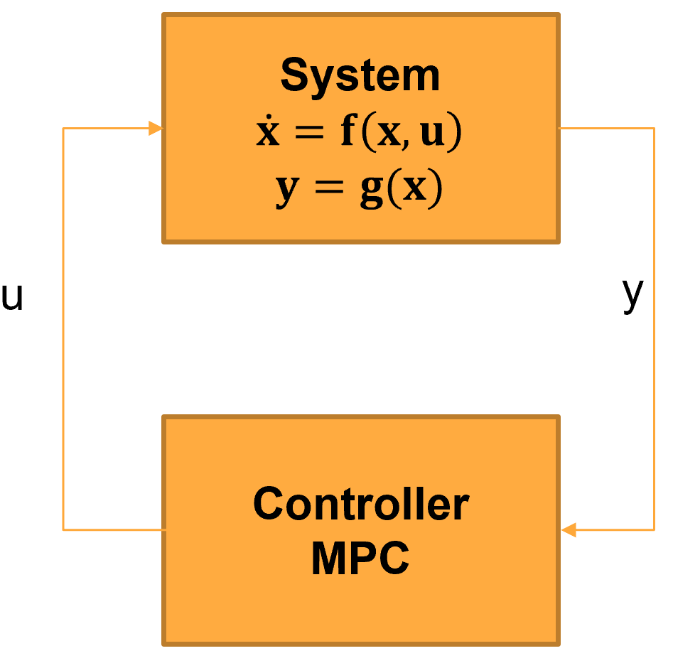

Slide 40
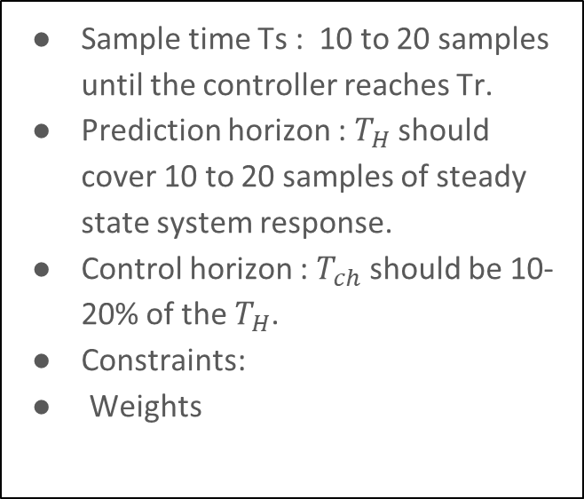
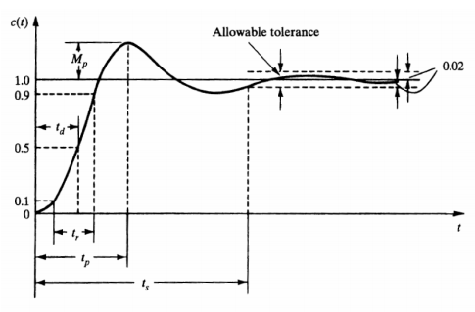
Designing a MPC controller

Slide 41
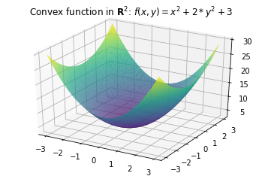
Types of MPC
Quadratic cost function will have a global minimum and can be solved with any convex optimization method
Linear Time invariant MPC:
Linear constraints
Linear system
Quadratic cost function
Linear time invariant MPC
Notes:
https://miro.medium.com/max/698/1*foMut_Sxoi6_kzNkExB0Gw.png

Slide 42
Types of MPC
2. Linear time variant MPC
Linear constraints
Non -Linear system
Quadratic cost function
Linear time variant MPC
Adaptive MPC
Gain Scheduled MPC

Slide 43
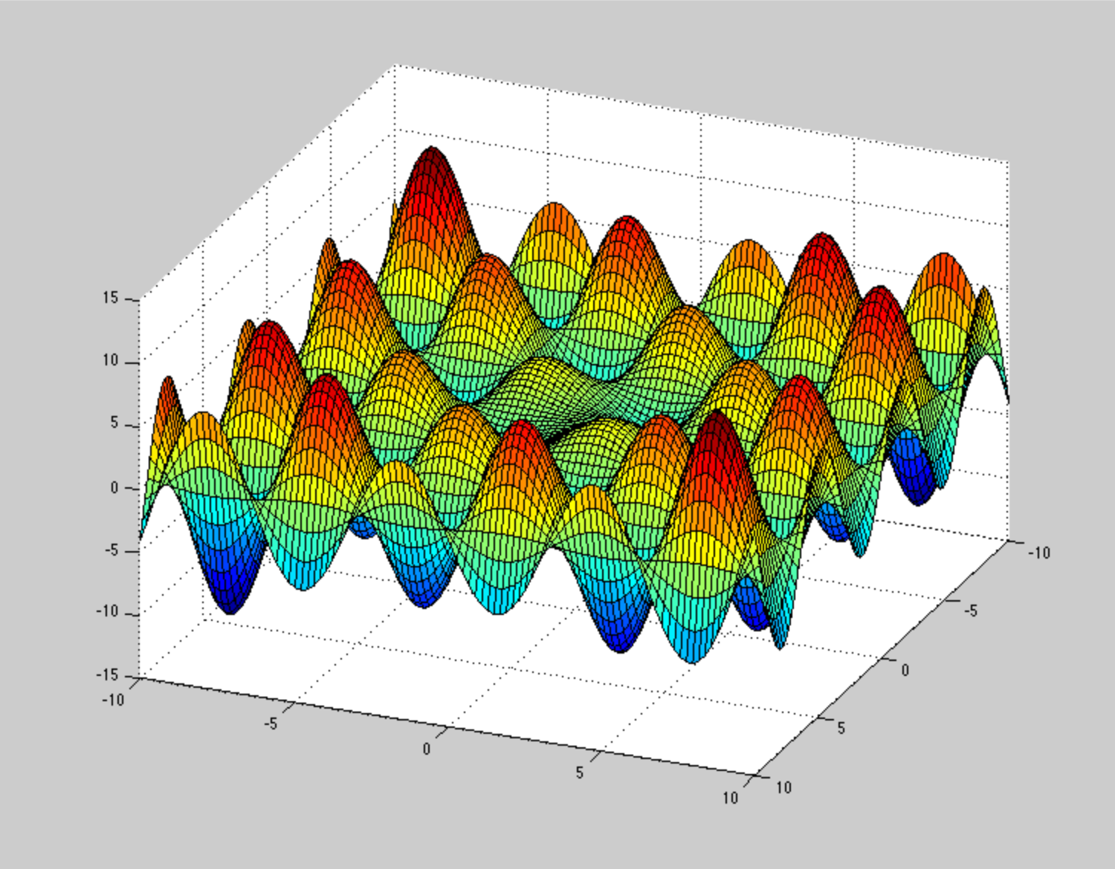
Types of MPC
3. Nonlinear MPC
Nonconvex optimization problem
Non-Linear constraints
Non -Linear system
Nonlinear cost function
Nonlinear MPC
Notes:
https://i.stack.imgur.com/T3A2w.png

Slide 44
Controller implementation

Slide 45
Path following control
Notes:
Path following control

Slide 46
Designing a MPC controller
Output variables
optimizer
Manipulated variables
reference
Plant
Plant
MPC
Estimated states
State estimator (ex: Kalman filters)
Notes:
Remove state estimator.

Slide 47
Simulation set up

Slide 48
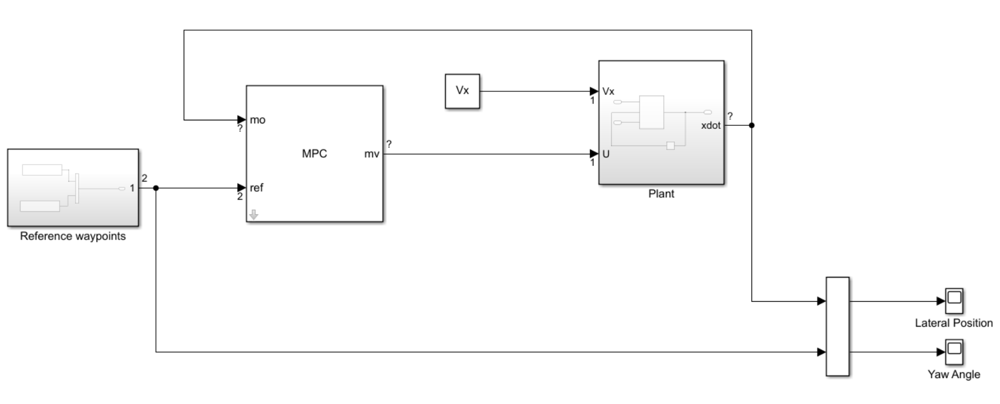
Notes:
Start with init script and define system
Create a mpc using mpc designer
Run all three scenarios lane change ,figure 8 , city road

Slide 49
Simulation results

Slide 50
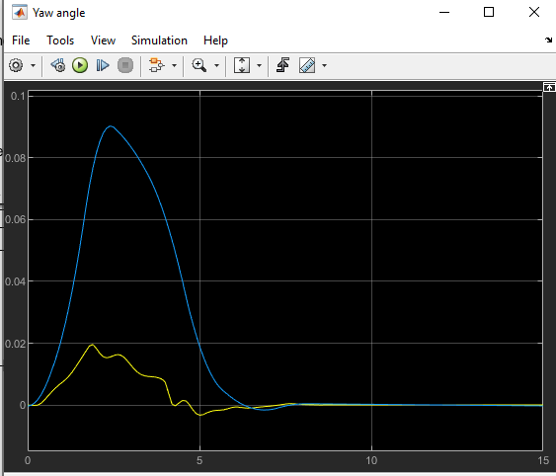
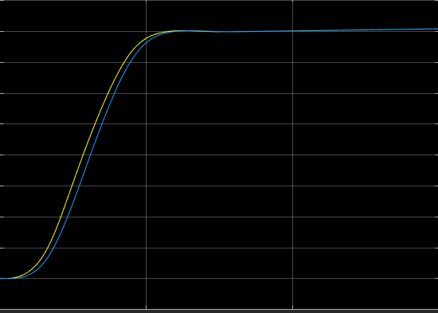
Notes:
- Change this according to the three courses .

Slide 51
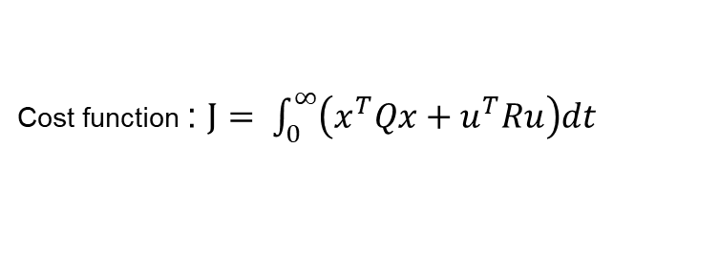
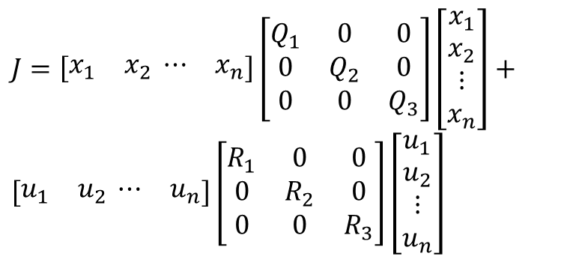
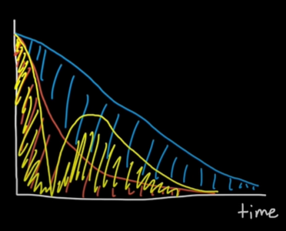
LQR refresher
In LQR we square the states so larger errors can be disproportionately punished than smaller ones.
LQR turns cost function into a quadratic function. Quadratic functions have a global minima.
Penalize actuator performance
Penalize bad performance

Slide 52
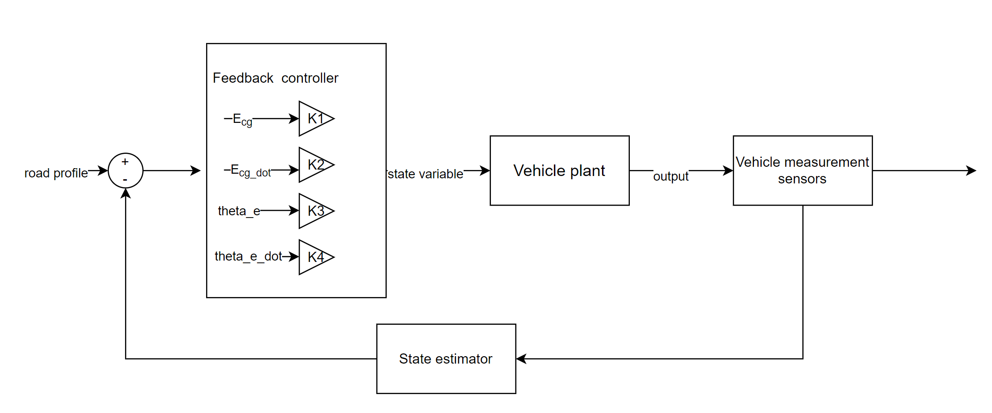
Feedback control system design

Slide 53
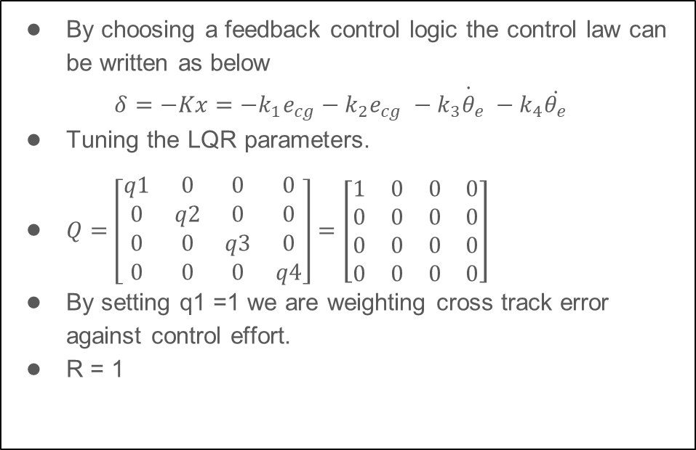
Feedback control system

Slide 54
Summary
This week, we learned about:
Dynamic lateral control for a bicycle
Control strategy

Slide 55
THANK YOU

