Slide 1

TechTrivia : The E-Learning Application
Submitted By :
ANKITA SARKAR RA2232241010016
Under The Guidence Of
Dr. J Anita Smiles

Slide 2
ABSTRACT
TechTrivia , is a web based interactive E – learning application designed to offer an interactive and educational learning experience. Developed using HTML, CSS, and JavaScript and PHP. This E- learning application provides a secure and user-friendly interface that includes user authentication, quiz selection, and a payment gateway for accessing premium quizzes, documents and videos.
Users are required to create an account and login to access the platform, ensuring security and personalization. Upon logging in, users can browse and select from a variety of quizzes available on the platform. Quizzes can be configured with time limits, and participants receive real-time scoring and performance feedback. The application offers premium gateway with advanced learning materials like well structured document and videos.
Our mission is to break down the barriers to learning by providing a user-friendly interface that allows you to explore, discover, and engage with a wealth of educational content. Unlock your potential, expand your horizons, and embark on a transformative learning experience with our e -learning website.

Slide 3
INTRODUCTION
OBJECTIVES :
The main objective of this E- learning based project is to provides a secure and user -friendly interface that includes user authentication, quiz selection, and a payment gateway for accessing premium quizzes, documents and videos. At our e-learning application , we've curated a vast repository of resources to ensure that you have access to a comprehensive learning experience. We understand that every learner is unique, and that's why we offer a diverse range of tools and materials to accommodate your learning style. From quizzes that test your knowledge and understanding to well-structured documents that serve as study guides, and from engaging videos that bring complex topics easily understandable , our platform has it all.

Slide 4
Purpose of the project :
The purpose of our website is to allow a student seeking to enhance their academic skills, a professional looking to upskill in your career, or simply a curious individual eager to explore new horizons, our platform is here to cater to educational needs.
Enhance the quality of learning and teaching. Meet the learning style or needs of students. Improve the efficiency and effectiveness. Improve user-accessibility and time flexibility to engage learners in the learning process.
These e – learning application gives you platform to practices your knowledge by giving quizzes that test your knowledge and understanding to well-structured documents that serve as study guides, and from engaging videos that bring complex topics easily understandable . These project provides a user-friendly interface that allows you to explore, discover, and engage with a wealth of educational content.

Slide 5
Project Scope :
Features
User registration and authentication
Access to a library of educational videos.
Downloadable documents for offline learning.
Interactive quizzes for self-assessment.
User engagement through contact us.
Supports individual learning styles and needs.

Slide 6
Existing System :
The existing system faces several challenges that need immediate attention. First and foremost, the reliance on paid quizzes may deter potential users. To attract a broader audience, offering some quizzes for free while maintaining premium options is advisable. Furthermore, there's a critical need for improved data security measures to safeguard user information, including robust encryption and compliance with data protection regulations. The content itself also requires enhancement, with a focus on making it more understandable through the use of plain language, clear explanations, and visuals. High premium course costs may also be discouraging potential users; a competitive pricing strategy or tiered options should be explored.

Slide 7
Proposed System :
The proposed system is designed to address the limitations of the current platform effectively. It introduces a range of improvements to enhance user experience and accessibility. Firstly, the implementation of free quizzes provides an opportunity for users to explore the content without financial constraints. The content itself is set to undergo a transformation, becoming well-structured, easily understandable, and focused on technology-related topics. Moreover, by offering premium courses at a lower cost, the system aims to make valuable educational content more affordable and accessible. The platform is being revamped to be user interactive, ensuring seamless navigation and a responsive design. Lastly, the inclusion of downloadable PDFs provides added convenience for users, allowing them to access content offline. Overall, these changes will contribute to a more user-centric, secure, and cost-effective educational platform.

Slide 8
System Requirements
Computers , Laptops
1 Gb processor
Software Requirements
Web Browser : Internet Explorer , Google Chrome
Code Editor : notepad , vs code
4 GB RAM
1 Gb hard free drive space
Operating System : Windows 7,8,9, 10

Slide 9
Technologies Used :
Front-end :-
HTML5
CSS3
JavaScript
Back-end :-
PHP
MYSQL
XAMPP SERVER

Slide 10
Module Description :
Home Module :
These Module is used to display the whole scenario of the application .
These page contain all the Modules present in application .
Login Module :
These Module is used to register a user .
Registered user details are saved in a database.
After login , user is directed directly to homepage.
Quizzes Module :
These module consists of several quizzes (C++ , HTML , Cloud computing).
Quizzes are time based and real time scoring .
Prices Module :
These module consists of premium plan (Basic , Standard )
In Basic Plan ,user will get downloadable content of related topic.
In Standard Plan ,user will get downloadable content and videos of related topic.
Contact Us module :
These module is used to interact with user queries , feedback.

Slide 11
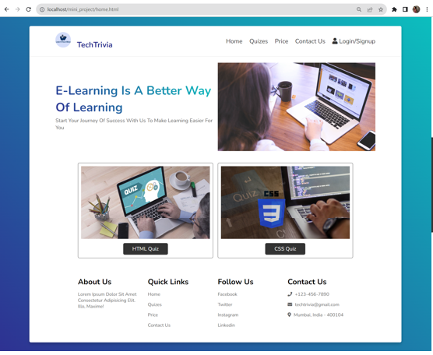
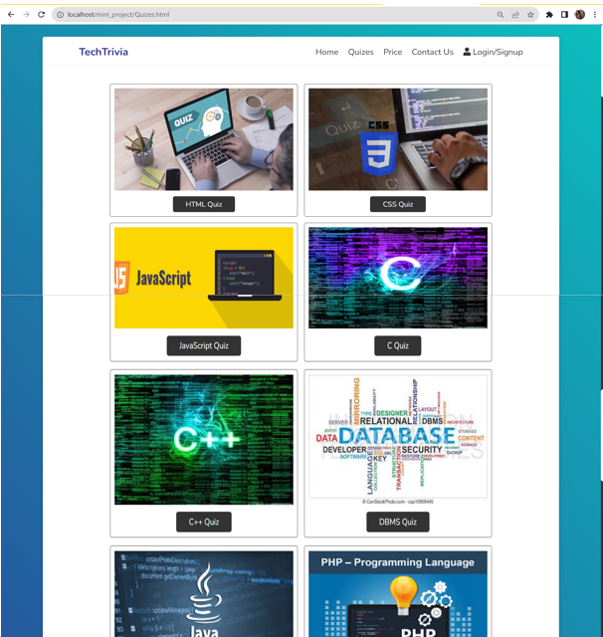
Screenshots :
Home.html
Quizes.html

Slide 12
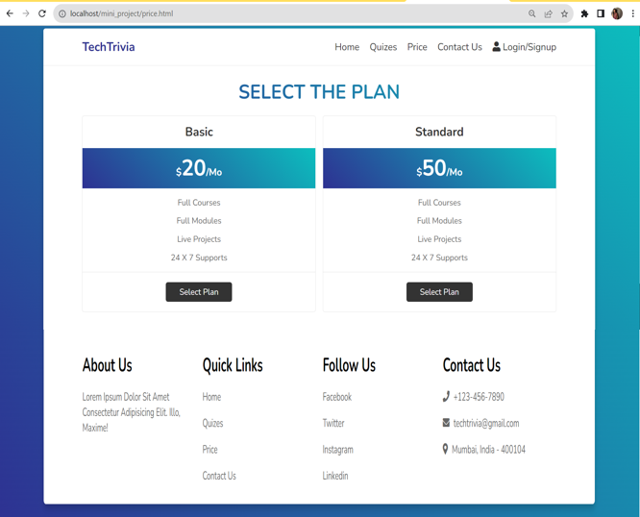
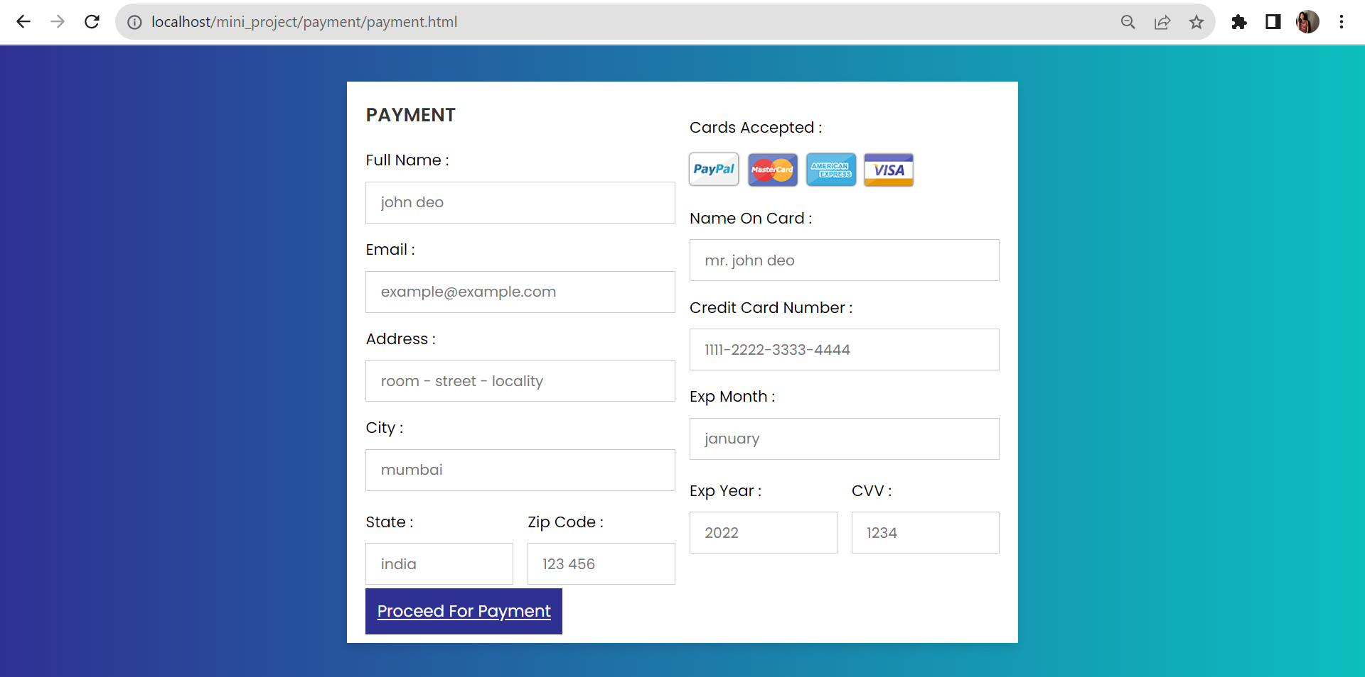
Price.html
Payment.html

Slide 13
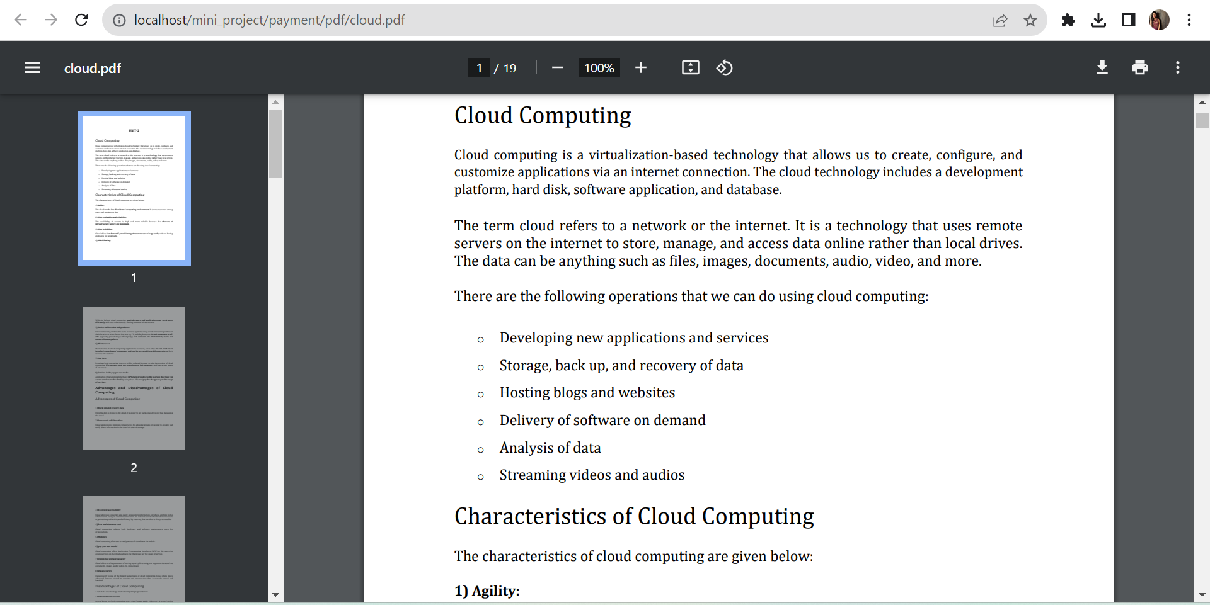
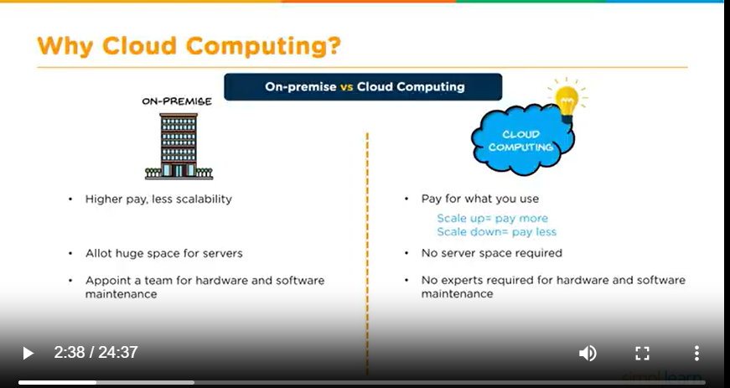
Pdf.html
Video.html

Slide 14
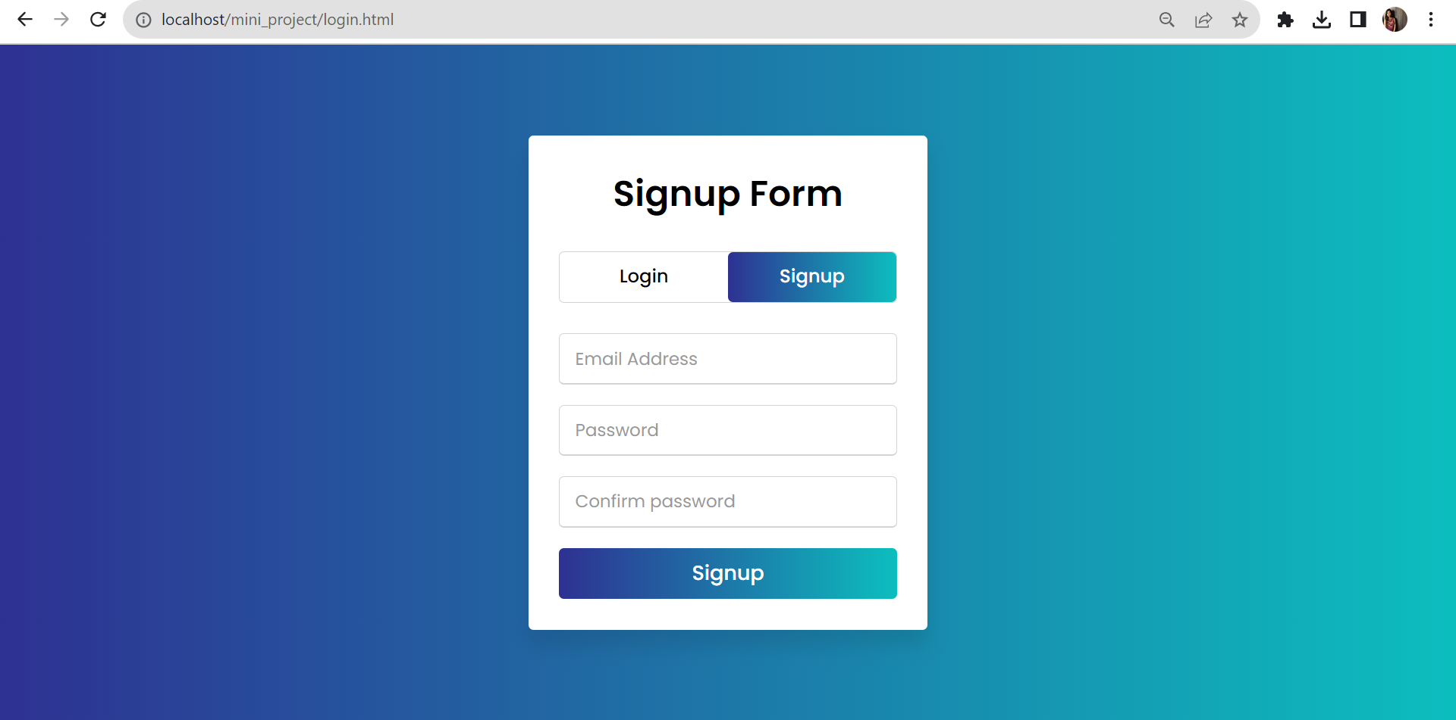
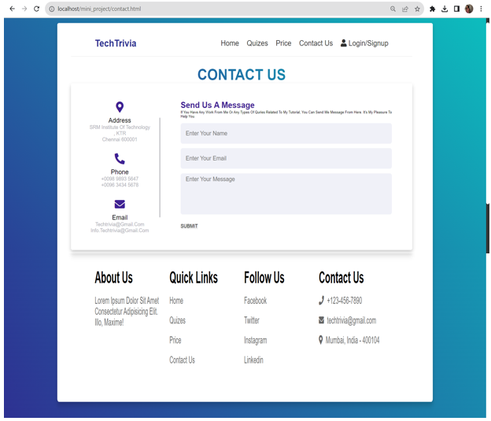
Login.html
Contact.html

Slide 15
CONCLUSION
In conclusion, the e-learning website we have developed is designed to provide a seamless and engaging learning experience for our users. By allowing user registration and providing a user-friendly login process, we aim to make it convenient for learners to access our platform and explore a wealth of educational resources.
The home page of our e-learning website serves as the central hub, where users can easily navigate to various educational topics, including quizzes, premium plans, and contact us for support and inquiries. This approach emphasizes accessibility and user-friendliness, making it easy for learners to find the content and resources they need.

Slide 16
THANK YOU !!

