Slide 1


The Future of IT Operations
An Introduction to ITOps and AIOps
Week-1/ Day-1
Transforming IT Operations with Intelligence and Automation

Slide 2

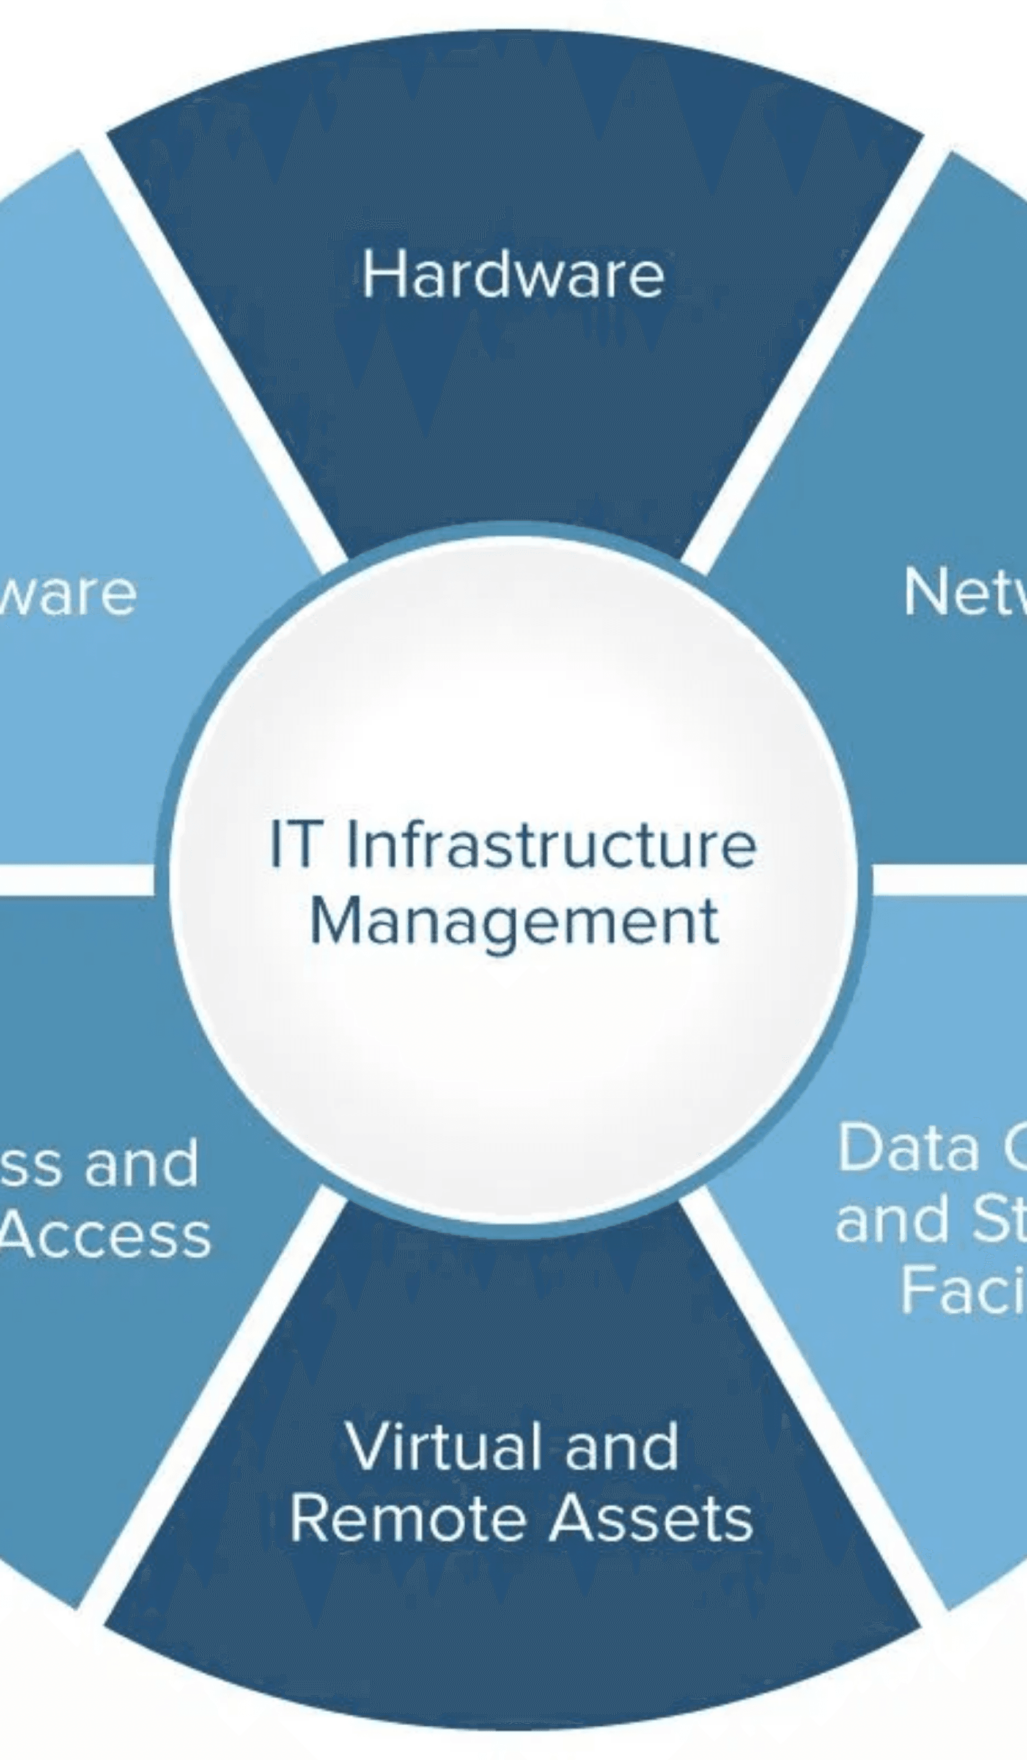
What is ITOps? The Engine of Your IT
IT Operations (ITOps) is the central nervous system of an organization's IT. It encompasses all the processes and services for managing, maintaining, and supporting the IT infrastructure. The primary goal of ITOps is to ensure the smooth and efficient operation of all IT systems and services, which are critical for business continuity and success.
▸
Resource Management:
Overseeing hardware, software, and network infrastructure.
▸
Infrastructure Optimization:
Enhancing performance and cost-efficiency.
▸
Application Performance:
Ensuring applications meet business expectations.
▸
Service Desk Support:
Providing timely technical assistance to users.
▸
Incident & Security Management:
Safeguarding the IT environment and ensuring rapid recovery.

Slide 3

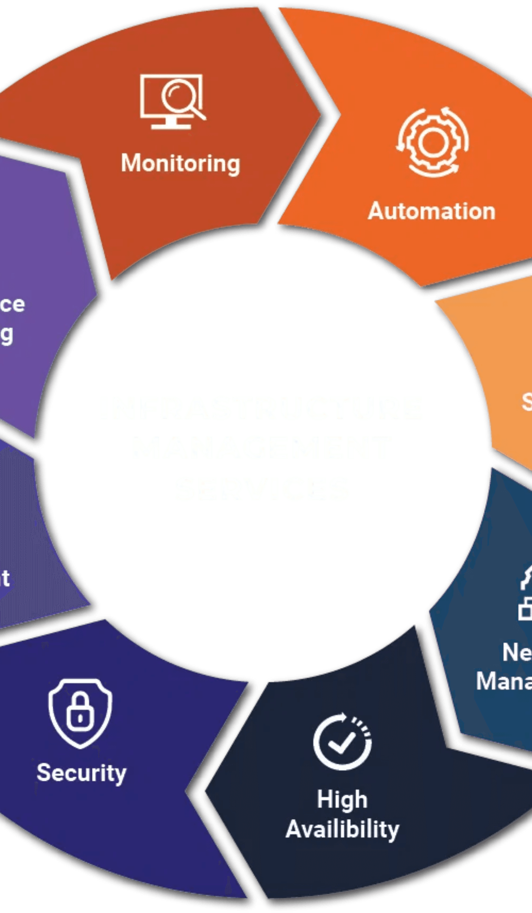
Core Functions of IT Operations
Function
Description
Ensures the availability, performance, and security of the organization's network infrastructure.
Network Management
Server & Device Management
Manages the lifecycle of physical and virtual servers, as well as end-user devices.
Guarantees that all software applications are available, reliable, and performing optimally.
Application Management
Acts as the single point of contact for users to report IT issues and request services.
Help Desk/Service Desk
Protects the organization's data and IT assets from internal and external threats.
Security Operations

Slide 4

ITOps Goals: Striving for Operational Excellence
Efficiency
Reliability
Productivity
Streamlining processes and automating tasks to reduce manual effort and operational costs.
Maximizing the uptime and availability of critical IT services to support business operations.
Empowering both IT staff and end-users with reliable and high-performing tools and systems.
Connecting to SLAs, SLOs, and SLIs
SLAs (Service Level Agreements)
Formal commitments made to end-users or customers about service performance.
SLOs (Service Level Objectives)
Specific, measurable targets that the IT team aims to achieve to meet the SLAs.
SLIs (Service Level Indicators)
The actual metrics used to measure performance against the SLOs (e.g., uptime, response time).

Slide 5

The Mounting Challenges in Modern ITOps
Challenge 01
Challenge 02
Challenge 03
Increasing Complexity
Data Overload
Tool Sprawl
Hybrid/multi-cloud, microservices and IoT create complex, dynamic ecosystems.
Exponential data growth makes manual analysis impractical.
Numerous disparate monitoring tools create data silos and fragmentation.
Challenge 04
Challenge 05
Pressure to Accelerate
Cybersecurity Threats
Demand for faster delivery increases pressure on ITOps to innovate.
Sophisticated attacks require continuous, proactive detection and response.
These challenges require a shift towards more intelligent and automated operational models.

Slide 6

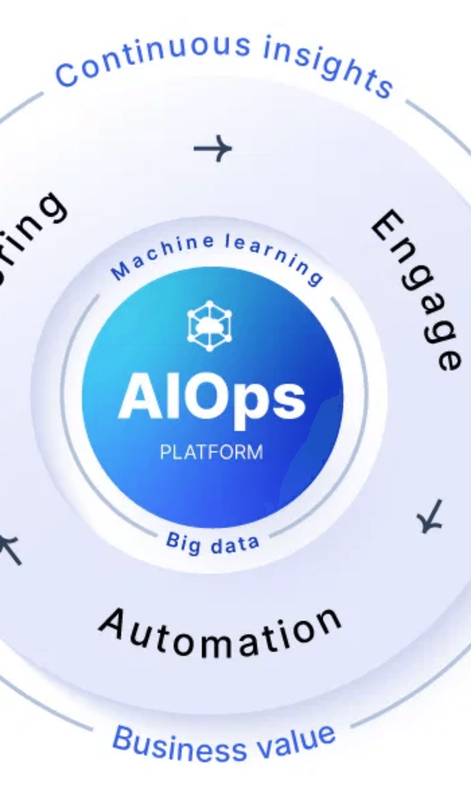
The Dawn of AIOps: Intelligence-Driven Operations
AIOps, or Artificial Intelligence for IT Operations, represents a paradigm shift in how IT operations are managed. By leveraging the power of AI and machine learning, AIOps enables a proactive, predictive, and automated approach to managing complex IT environments. It builds upon the foundations of Agile, DevOps, and ITOps to create a more intelligent and responsive operational model.
The AIOps Hierarchy:
counter(item)
ITOps:
The foundational layer responsible for IT service delivery.
counter(item)
Agile & DevOps:
Methodologies that promote collaboration and rapid, iterative delivery.
counter(item)
AIOps:
The intelligence layer that analyzes data from all underlying systems to provide actionable insights and automate responses.

Slide 7

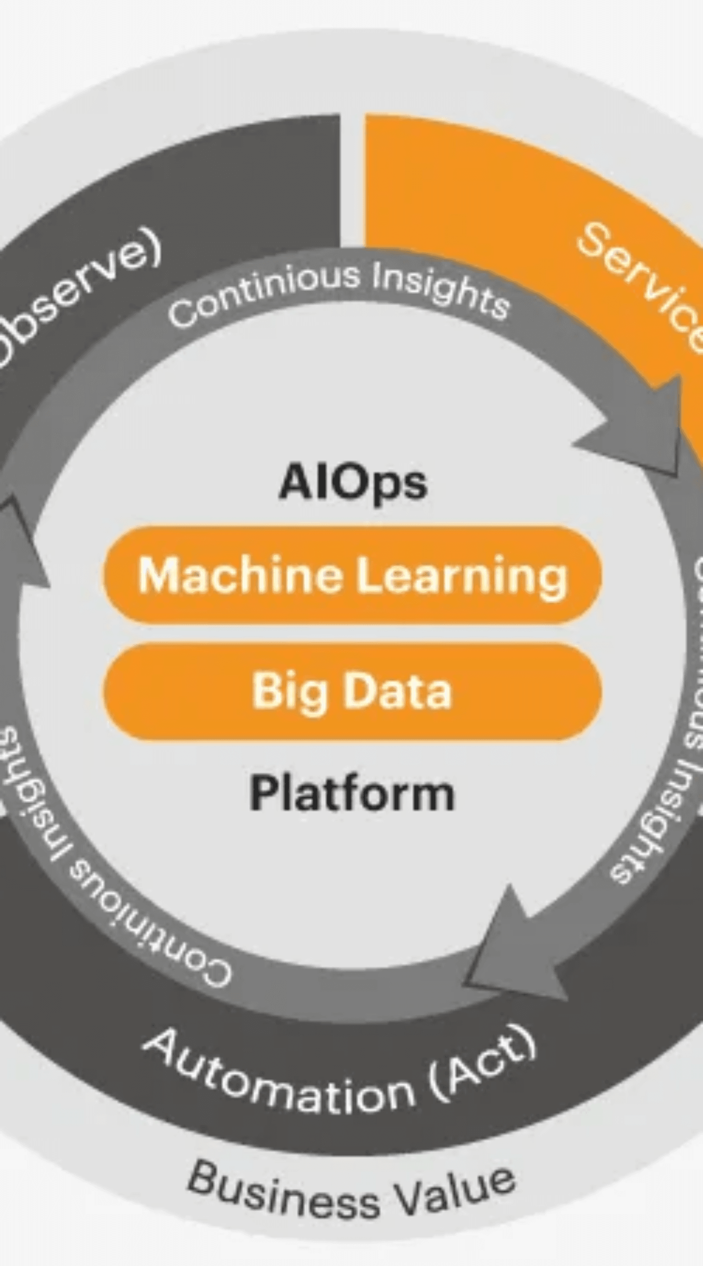
AIOps in Action: Transforming Key Operations
(A) Monitoring & Alerting
Enhanced Monitoring & Alerting
AIOps platforms analyze vast amounts of data in real-time to detect anomalies, correlate alerts to identify root causes, and reduce alert noise, allowing IT teams to focus on what matters most.
(B) Security & Compliance
Proactive Security & Compliance
By continuously monitoring for suspicious activities and potential threats, AIOps can identify and mitigate security risks before they impact the business and automate compliance checks.
(C) Problem Resolution
Accelerated Problem Resolution
AIOps automates root cause analysis, provides predictive insights into potential incidents, and can power self-service help desks to resolve common issues without human intervention.

Slide 8

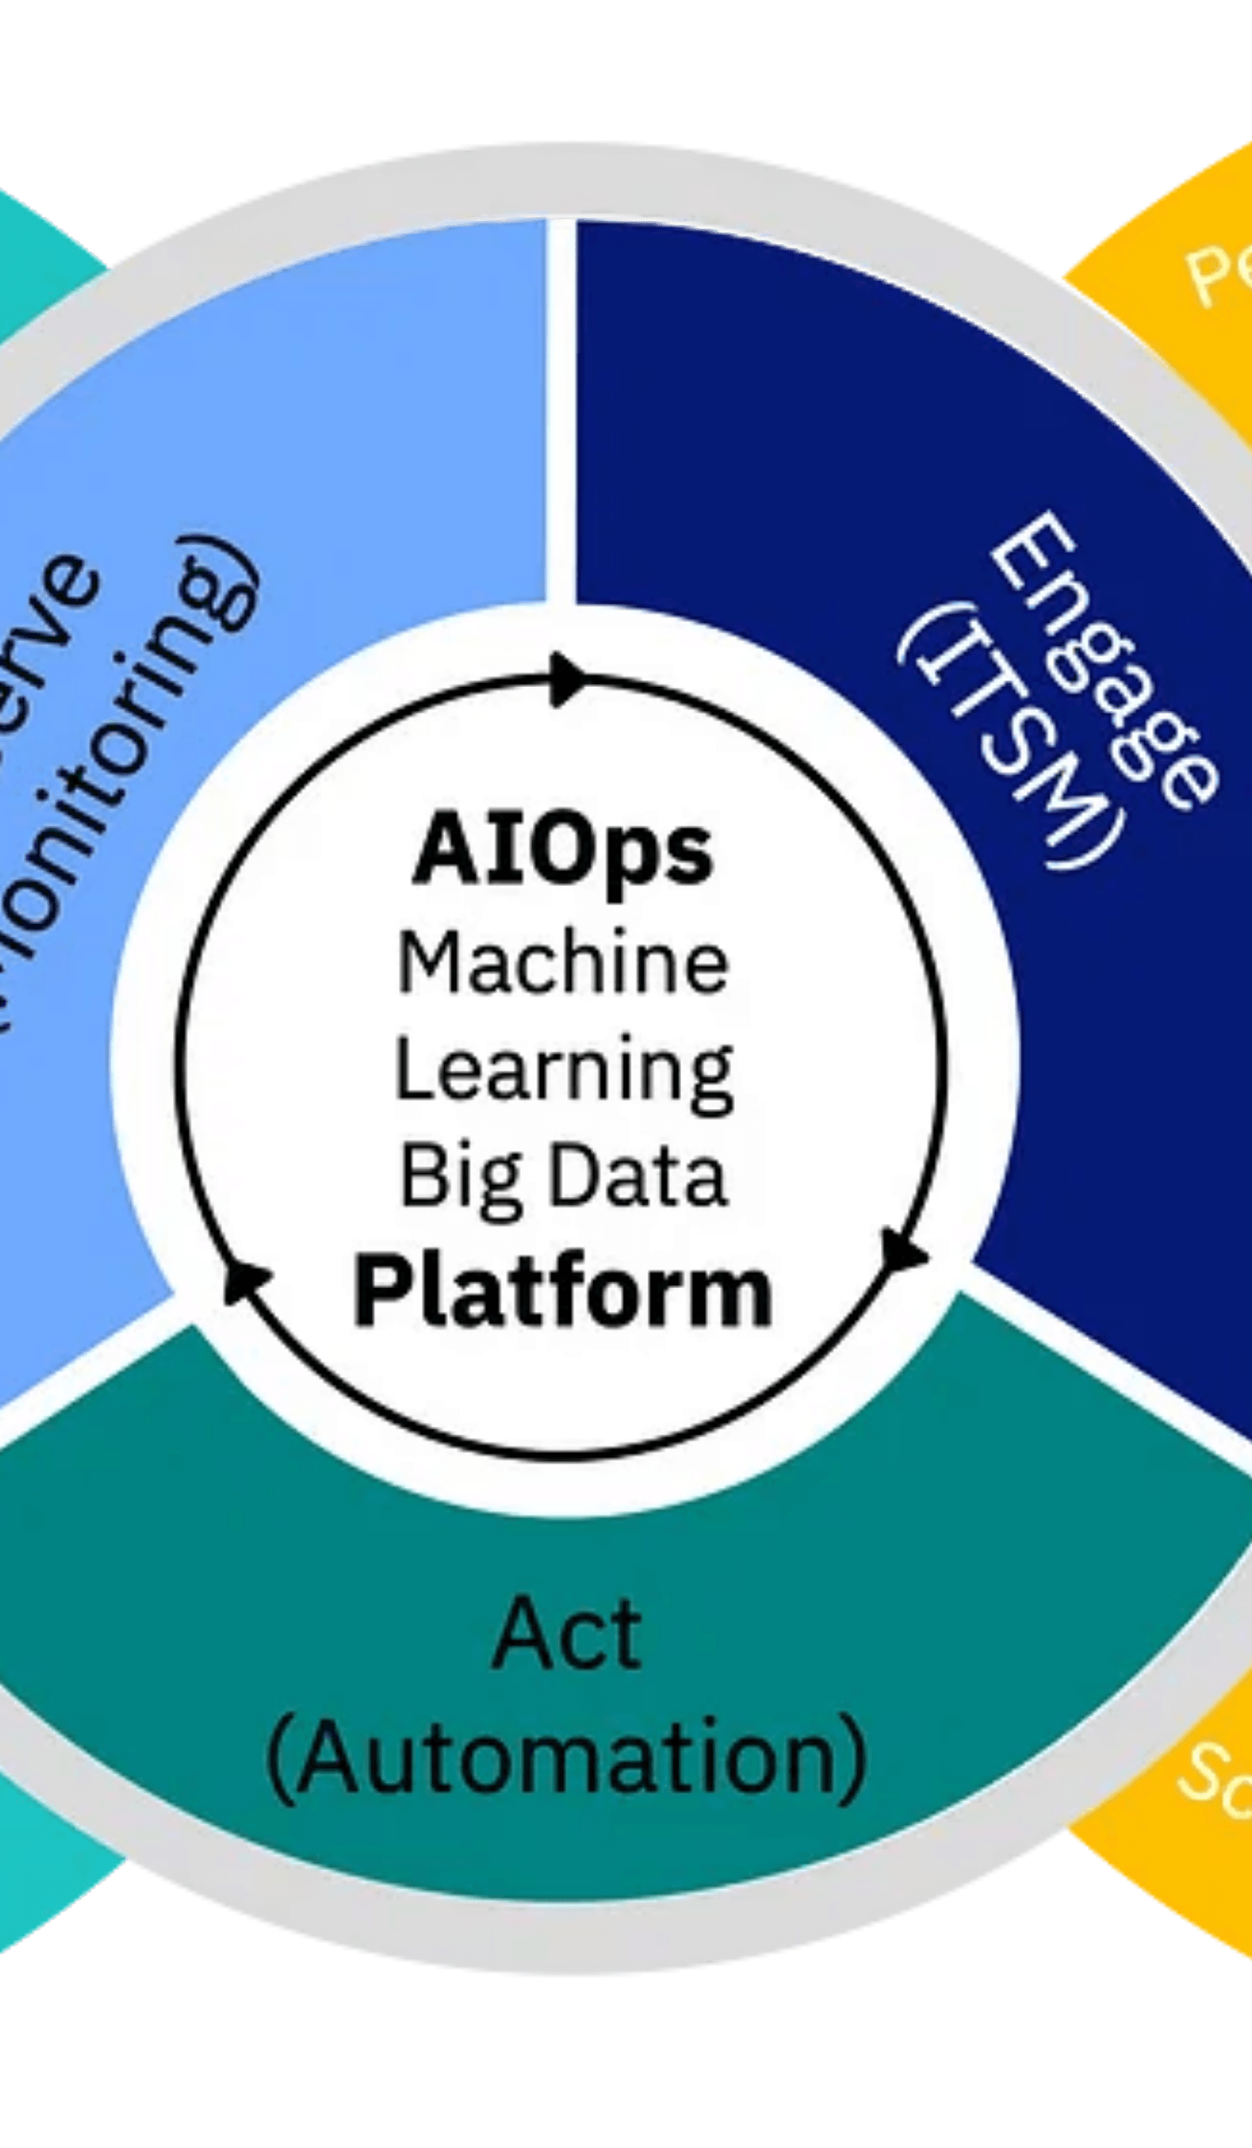
Expanding the Horizons of AIOps
(D) Intelligent Capacity Planning
AIOps can analyze historical data and trends to forecast future service load and predict potential service downtime, enabling proactive capacity planning and resource optimization.
(E) Smarter IT Help Desk
By automating incident categorization and routing, and providing intelligent knowledge bases, AIOps can significantly improve the efficiency and effectiveness of the IT help desk.
(F) Other Powerful Use Cases
The versatility of AIOps allows for a wide range of other applications, including automated incident root cause analysis, self-service help desks, service load forecasting, predictive service downtime, intrusion detection, spam classification, and incident categorization.

Slide 9


The Future is Autonomous: Your AIOps Journey Starts Now
For Consumers of IT
For Producers of IT
Improved Application Performance & Reliability
▸
Increased IT Predictability & Efficiency
▸
Better Customer Experience & Satisfaction
▸
Faster Problem Resolution
▸
Reduced Operational Costs
▸
Key Takeaways
ITOps is the backbone of your IT, but it's facing unprecedented challenges.
✓
AIOps is the key to overcoming these challenges and transforming IT operations.
✓
The benefits of AIOps are real and can be realized today.
✓
Start Your AIOps Journey Today

