Slide 1

Stock Market Analysis and Predictions
--Biswajit Sarkar(2101AI11)
--Yashveer(2101AI35)

Slide 2
Problem Statement
Building Robust Predictive Models for Stock Market Analysis

Slide 3
Purpose/Motivation
Investment Strategy Development: A model can help in determining the optimal allocation of funds across different stocks or assets to maximize returns while minimizing risk.
Automated Trading Systems: Models can be integrated into trading algorithms to execute buy/sell orders based on predefined criteria, allowing for faster and more precise trading.
Hedging Strategies: Companies may use stock prediction models to identify potential risks associated with their investments and implement hedging strategies to mitigate them.

Slide 4
Factors affecting stock market
Opening prices
Closing prices
High prices on a particular day
Low prices on a particular day
Adjusted close prices
Volume

Slide 5
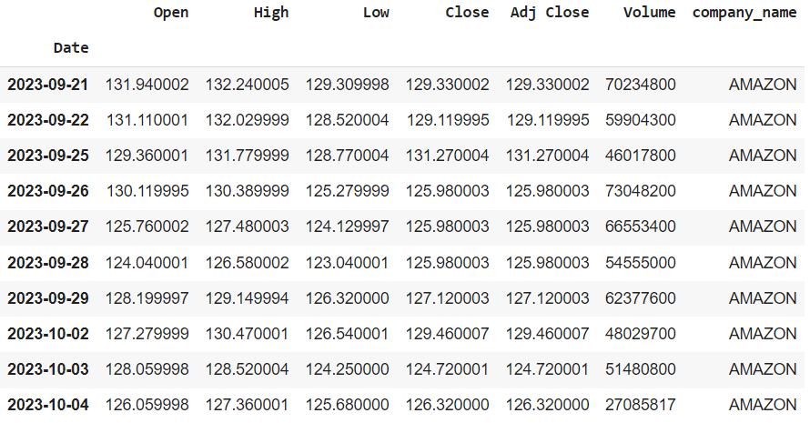

Slide 6
Moving average of stocks
A moving average in stock is a technical analysis tool that helps smooth out price trends by filtering out the noise from random short-term price fluctuations.
Moving average = Σ closing price over a specific period / number of periods
It is used by the investor to identify the trend direction. If stock crosses above its moving average, it can be a signal to buy the stock and if it crosses below then it can be a signal to sell the stock.

Slide 7
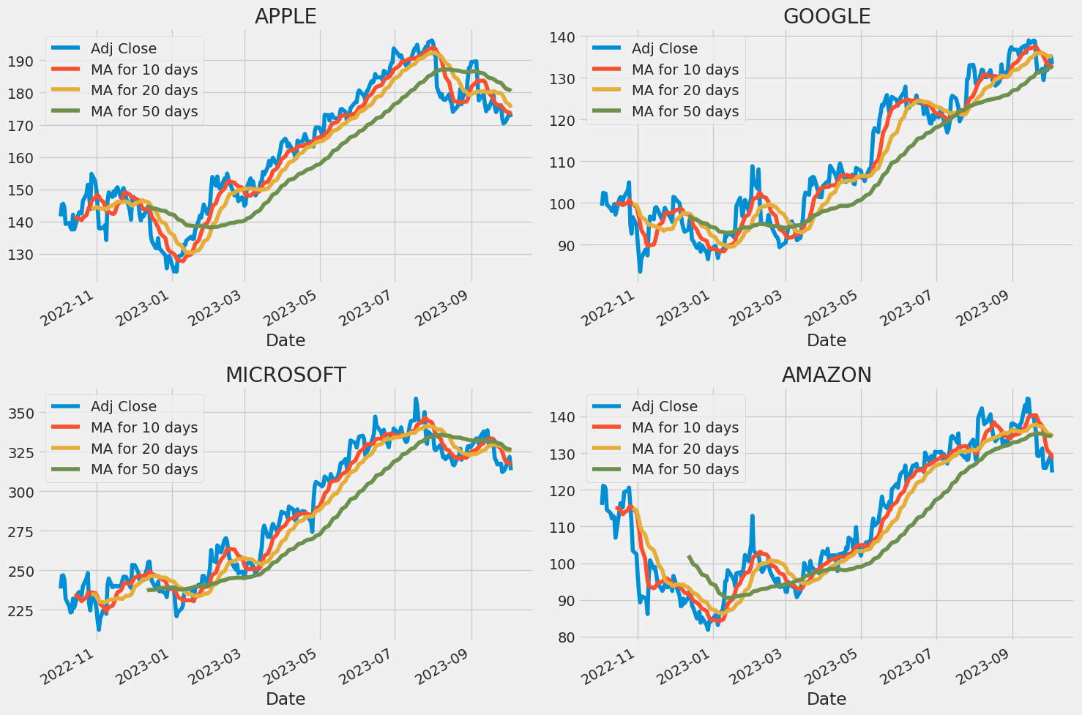

Slide 8
Predicting the closing stock price of Apple
In our model we are considering a dataset of apple that contains all the stock price data from 2012 to 2023(today).
For predicting closing price in our model, we are using -
LSTM Model (Long Short-Term Memory model)
Root Mean Squared Error for Loss calculation

Slide 9
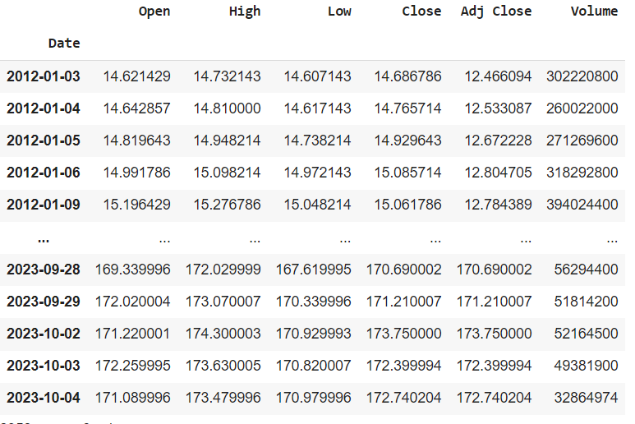

Slide 10
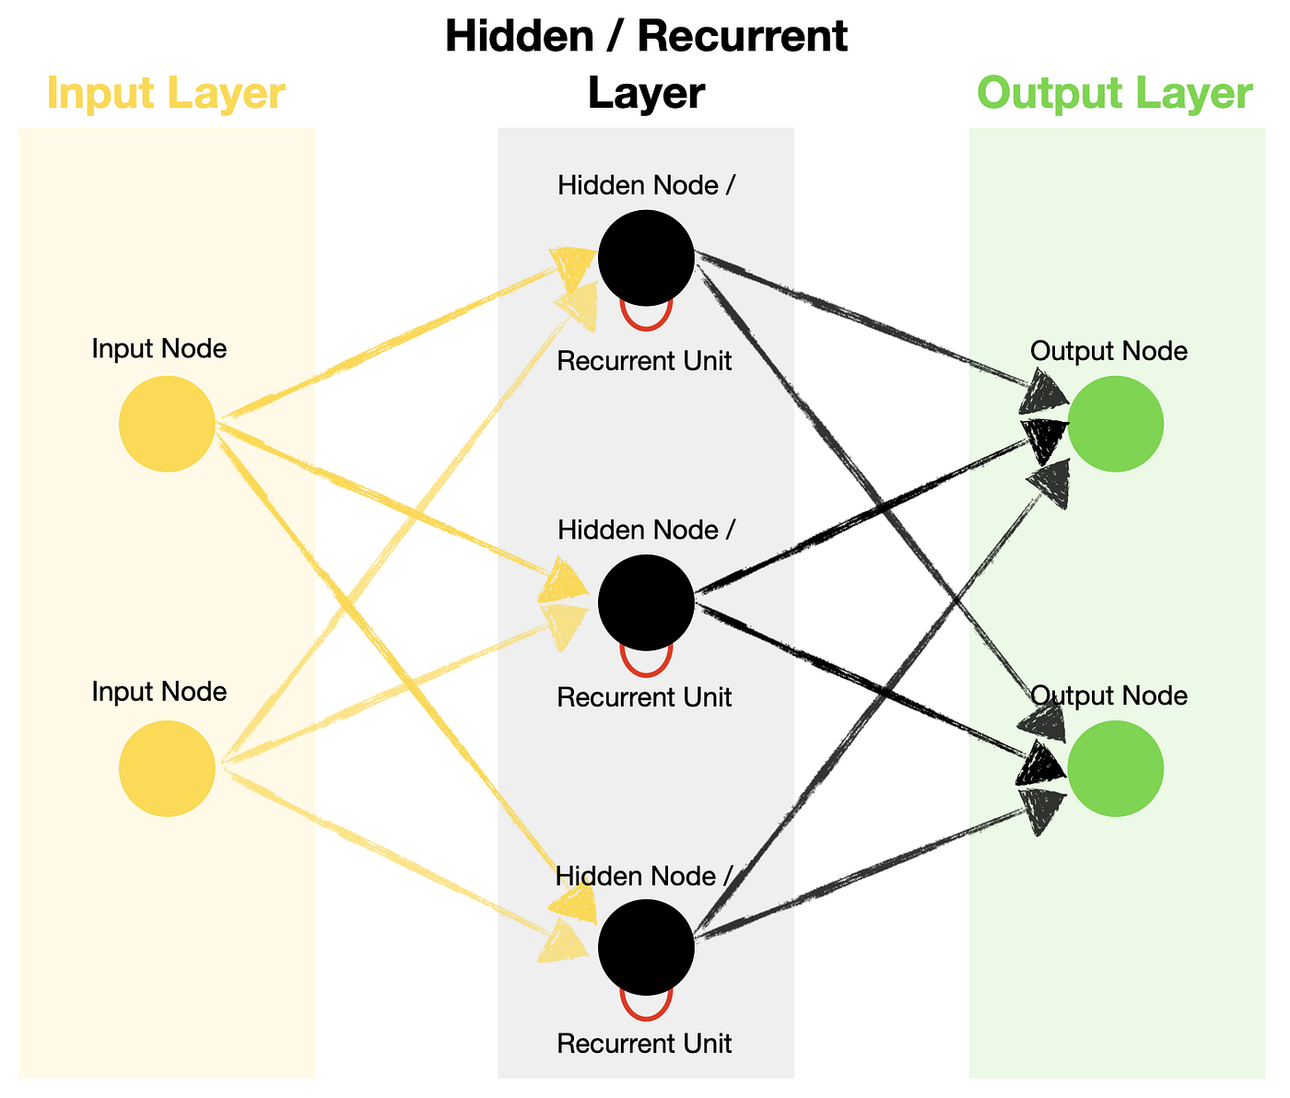
LTSM(Long Term-Short Memory) Model
Long Short-Term Memory (LSTM) is a type of recurrent neural network (RNN) well-suited for modeling sequential data.
Hidden layer consists of feedback loop with memory.

Slide 11
Why LTSM?
Non-Linear Relationships: Stock market data often exhibits non-linear patterns and dependencies. LSTMs, being a form of deep learning, are well-equipped to capture complex, non-linear relationships in the data.
Remembering Past Information: LSTMs have a memory cell that can store information over long sequences.

Slide 12
Progress
We have trained a basic LSTM model based on the training data, and then it makes predictions on the test data using mean square error only.

Slide 13
Our Model
Created a new data frame with only the 'Close' column.
Divided the dataset into training (95%) and test (5%) data.
Scaling the data using min-max scaler from sklearn.
scaled_value = (value - min_value) / (max_value - min_value)
Training the model by taking taking 100 days closing price into x_train and predicting the 101 th day price and then comparing
Build the LSTM model using keras -
Input -> LSTM(100, return_sequences=True) -> LSTM(50, return_sequences=False) -> Dense(25) -> Dense(1) -> Output

Slide 14
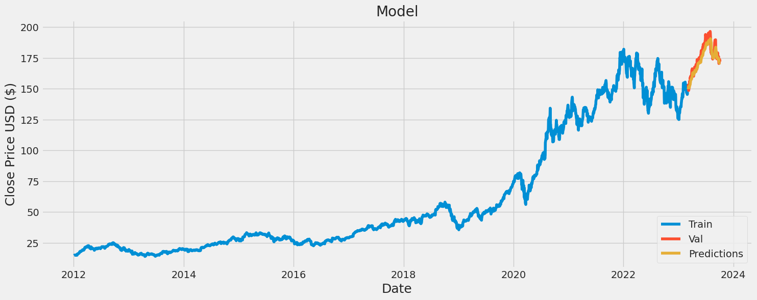
Our model's predictions

Slide 15
Future Plans
We have taken number of nodes randomly(100,50,25) so we are finding optimal number of nodes.
Addition of regularization to avoid overfitting and optimization to avoid local minima and fast learning.
Update our model to predict stock prices for upcoming 30 days.
A website where any user can access this stock prediction model.
User can access the history of various stocks.
Predicting Stock prices for various company for upcoming 30 days.
Predicting the best stock to purchase and rating all stocks.

Slide 16
Thank You

