Slide 1

Stock Market Analysis and Predictions
--Biswajit Sarkar(2101AI11)
--Yashveer(2101AI35)

Slide 2
Problem Statement
Building Robust Predictive Models for Stock Market Analysis

Slide 3
Purpose/Motivation
Investment Strategy Development: A model can help in determining the optimal allocation of funds across different stocks or assets to maximize returns while minimizing risk.
Automated Trading Systems: Models can be integrated into trading algorithms to execute buy/sell orders based on predefined criteria, allowing for faster and more precise trading.
Hedging Strategies: Companies may use stock prediction models to identify potential risks associated with their investments and implement hedging strategies to mitigate them.

Slide 4
Factors affecting stock market
Closing prices
Volume
Cash flow
Net income
News Headlines Labels

Slide 5
Predicting the closing stock price of Apple
In our model we are considering a dataset of apple that contains all the stock price data from 2012 to 2023.
For predicting closing price in our model, we are using -
LSTM Model (Long Short-Term Memory model)
Root Mean Squared Error for Loss calculation

Slide 6
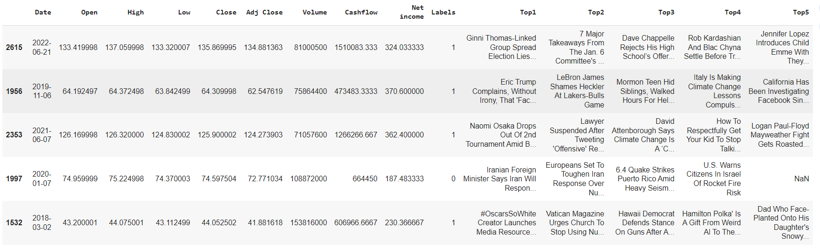

Slide 7
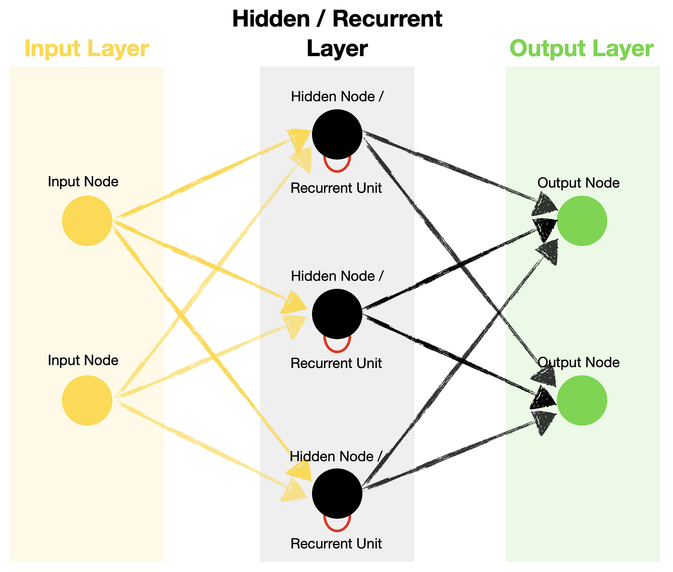
LTSM(Long Term-Short Memory) Model
Long Short-Term Memory (LSTM) is a type of recurrent neural network (RNN) well-suited for modeling sequential data.
Hidden layer consists of feedback loop with memory.

Slide 8
Why LTSM?
Non-Linear Relationships: Stock market data often exhibits non-linear patterns and dependencies. LSTMs, being a form of deep learning, are well-equipped to capture complex, non-linear relationships in the data.
Remembering Past Information: LSTMs have a memory cell that can store information over long sequences.

Slide 9
Our Model
Created a new data frame with only the 'Close','Cashflow','Volume','Net income','Labels'
column.
Divided the dataset into training (85%) and test (15%) data.
Scaling the data using min-max scaler from sklearn.
scaled_value = (value - min_value) / (max_value - min_value)
Training the model by taking taking 100 days closing price into x_train and predicting the 101 th day price and then comparing
Build the LSTM model using keras -
Input -> LSTM(100, return_sequences=True) -> LSTM(50, return_sequences=False) -> Dense(25) -> Dense(1) -> Output

Slide 10
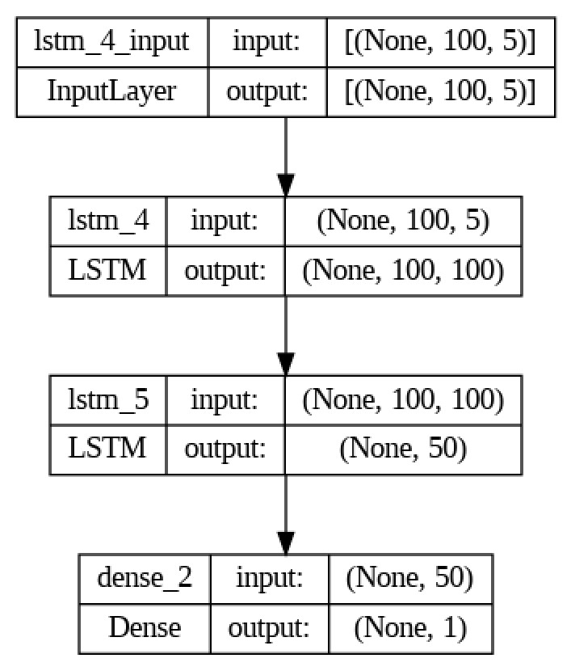
Model Architecture

Slide 11
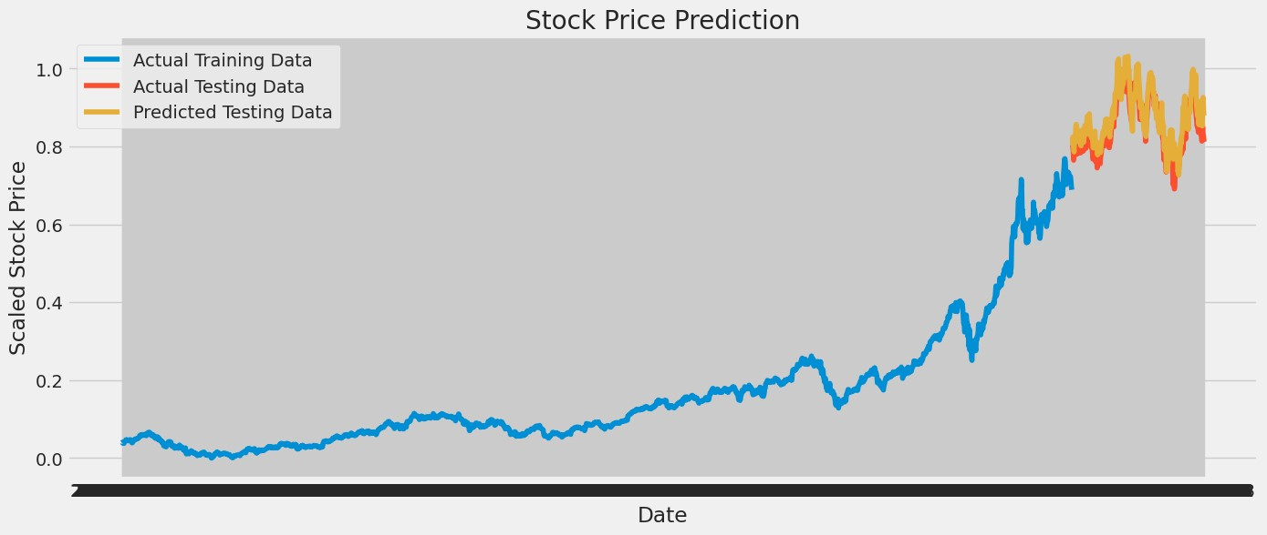
Our model's predictions

Slide 12
Thank You

