Slide 1
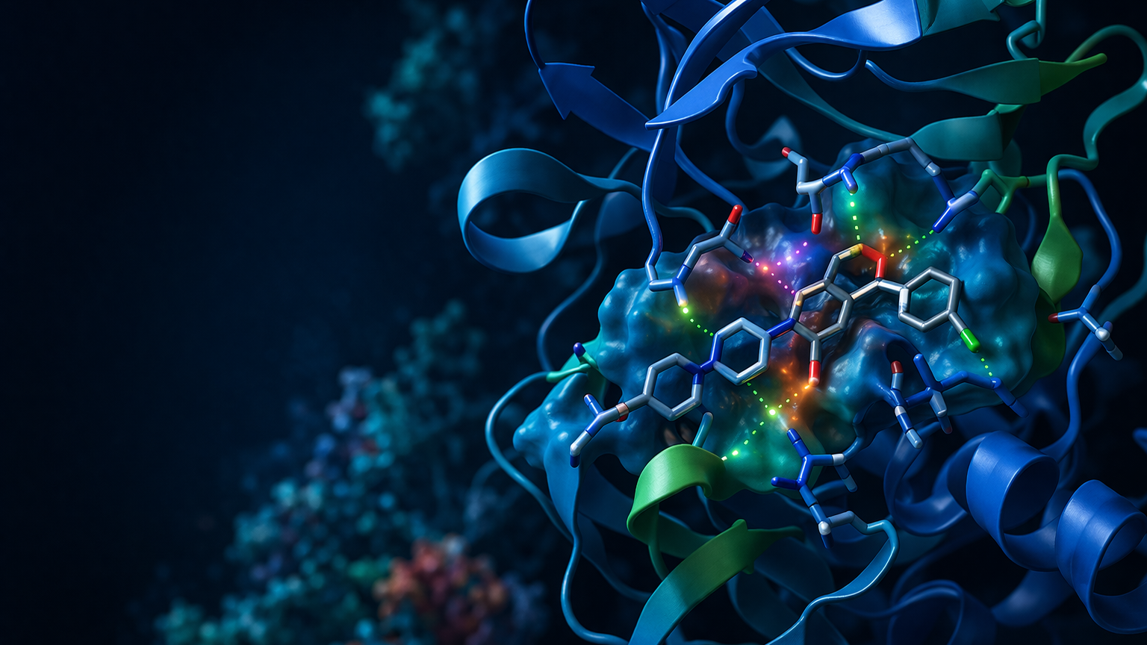
End-to-End
Drug Discovery Pipeline
Final major-project presentation with real AutoDock Vina parsing, PyMOL visualization workflow, live code demo steps, and viva-ready answers.
Disease model: EGFR-focused non-small cell lung cancer case study
Target -> Structure -> Docking -> ADMET -> Lead selection
20-minute final deck
Major project
Prepared from uploaded project guidelines, Session 10 planning notes, and course notes
Notes:
Open with the project title, disease model, and the fact that the deck now includes real Vina parsing, PyMOL rendering guidance, and a viva-ready code demo. Emphasize that the project matches the required end-to-end major-project workflow. [Sources] - Uploaded file: Minor & Major Project Guidelines PDF (major project title, workflow, deliverables) - Uploaded file: Session10.pdf (drug discovery pipeline idea and 20-minute presentation expectation) - Visual generated with OpenAI image generation based on project context

Slide 2
Drug Discovery Pipeline
Why this project fits the major-project brief
The course expects a 4-week, team-based, end-to-end workflow with multiple integrated tools, a complete pipeline, a 15-25 page report, and a 20-minute presentation. This project satisfies that brief directly.
Assessment focus
Technical execution, scientific rigor, code quality, report, and presentation
Phase 1: target identification and validation
Phase 2: structure acquisition and binding-site analysis
Phase 3: virtual screening, docking, and hit ranking
Phase 4: ADMET, integration, automation, and reporting
Week 1
Week 2
Week 3
Week 4
Planning
Target
Structure
Setup
Docking
Analysis
Report
Presentation
Major Project | Bioinformatics
2
Notes:
Explain that the project is intentionally aligned with the major-project rubric: end-to-end workflow, multiple tools, full documentation, and a 20-minute presentation. Mention that the deck follows the same four-phase timeline given in the course materials. [Sources] - Uploaded file: Session10.pdf (major project characteristics and deliverables) - Uploaded file: Minor & Major Project Guidelines PDF (weekly phases, assessment, documentation)

Slide 3
Drug Discovery Pipeline
Problem statement and project objectives
Problem statement
Objectives
Traditional drug discovery is slow and expensive. We need a reproducible computational workflow that can move from disease biology to virtual screening, docking, ADMET review, and evidence-based lead selection for a tractable protein target.
1
Select and justify a disease-associated target using literature and database evidence.
2
Acquire or model the structure and define the binding pocket.
3
Prepare a ligand set and perform docking with AutoDock Vina or PyRx.
Case study used here
• Disease: non-small cell lung cancer
• Target: EGFR kinase domain
• Rationale: clinically relevant, mutation-rich, druggable ATP pocket
4
Parse, rank, and visualize docking results in Python.
5
Filter top hits with ADMET logic and propose next experimental steps.
Major Project | Bioinformatics
3
Notes:
State the background, the gap, and the proposed solution exactly the way a project viva expects. Then walk through the five measurable objectives so the audience knows how success is defined. [Sources] - Uploaded file: Session10.pdf (problem statement framework and example objectives) - Uploaded file: Minor & Major Project Guidelines PDF (project phases and justification requirements)

Slide 4
Drug Discovery Pipeline
End-to-end workflow used in this project
Phase 1
Phase 2
Phase 3
Phase 4
Target
identification
Structure
and pocket
Docking
and ranking
ADMET
and reporting
Disease review
UniProt / PubMed
ClinVar / BLAST
PDB / AlphaFold
Pocket definition
PyMOL / ChimeraX
Compound library
AutoDock Vina
Pose selection
Lipinski / toxicity
Python outputs
Next steps
This is the same logic used later in the code: structured inputs -> docking evidence -> prioritized outputs.
Major Project | Bioinformatics
4
Notes:
Use this slide as the roadmap for the rest of the talk. Briefly preview the four phases, then tell the audience that the later code and result slides follow the same structure. [Sources] - Uploaded file: Minor & Major Project Guidelines PDF (phases 1-4) - Uploaded file: Course_Notes.pdf (drug discovery pipeline, docking process, ADMET workflow)

Slide 5
Drug Discovery Pipeline
Phase 1 - target identification and validation
Why EGFR?
Evidence used for validation
EGFR is a clinically relevant receptor tyrosine kinase in non-small cell lung cancer, with known disease mutations and an established druggable ATP-binding pocket.
PubMed
literature
UniProt
function
Validation logic used in the report
ClinVar /
COSMIC
BLAST
conservation
• Biological relevance: disease pathway and mutation evidence • Technical suitability: available structure and known inhibitors • Project fit: manageable scope for a 4-week academic workflow
All four evidence streams support EGFR as a suitable academic docking target.
Major Project | Bioinformatics
5
Notes:
Explain target selection as a scientific decision, not just a random protein choice. Mention literature support, functional annotation, mutation evidence, and conservation/druggability as the validation stack. [Sources] - Uploaded file: Minor & Major Project Guidelines PDF (target selection, mutation validation, BLAST conservation, druggability) - Uploaded file: Session10.pdf (disease-associated protein and target selection workflow)

Slide 6
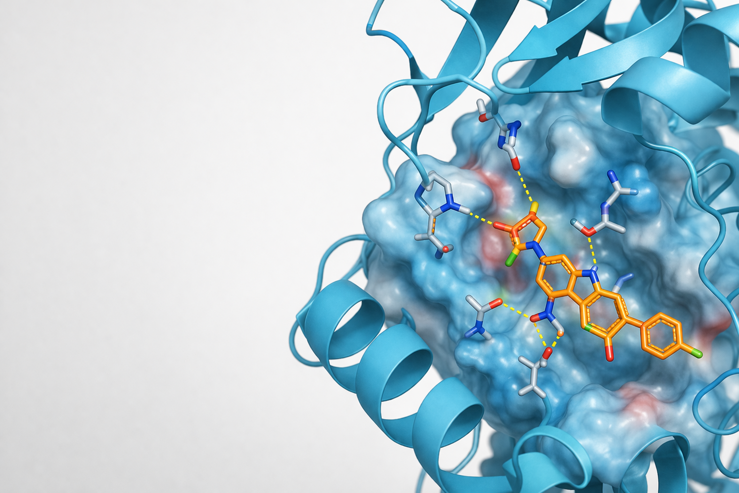
Drug Discovery Pipeline
Phase 2 - structure determination and binding-site analysis
Structure strategy
Acquire the receptor from PDB or AlphaFold DB.
Prepare the structure: remove non-essential molecules, add hydrogens, convert as needed.
Define the docking box around the active-site pocket.
Inspect the scene in PyMOL or ChimeraX before docking.
Key check before docking
The pocket should be chemically plausible, accessible to the ligand, and consistent with known biology.
Illustrative PyMOL-style active-site view
Major Project | Bioinformatics
6
Notes:
Describe where the structure comes from, how the pocket is defined, and why visual inspection matters before docking. Point to the illustrative active-site render on the right. [Sources] - Uploaded file: Minor & Major Project Guidelines PDF (structure acquisition, binding site identification, PyMOL/ChimeraX) - Uploaded file: Course_Notes.pdf (AlphaFold, PyMOL, docking preparation process) - Visual generated with OpenAI image generation based on project context

Slide 7
Drug Discovery Pipeline
Phase 3 - compound library and AutoDock Vina setup
Compound library logic
In the classroom-scale workflow, we keep the library manageable: known inhibitors plus candidate analogs from sources like ZINC, PubChem, or DrugBank. We then prepare ligands and dock them inside a fixed receptor box.
Input sources
ZINC, PubChem, DrugBank
Classroom scope
50-100 compounds
Typical docking settings shown in the final pipeline
Docking engine
AutoDock Vina / PyRx
1 vina --receptor egfr_receptor.pdbqt \ 2 --ligand lig4.pdbqt \ 3 --center_x 14.2 --center_y 8.5 --center_z 24.1 \ 4 --size_x 20 --size_y 20 --size_z 20 \ 5 --out lig4_out.pdbqt --log lig4_vina.txt
Outputs
Pose files + log files + scores
Why log files matter
The Vina log is the machine-readable source for pose mode, affinity, and RMSD. Our final pipeline parses these real outputs directly.
Major Project | Bioinformatics
7
Notes:
Walk through the ligand-library choices and then pause on the Vina command. Explain that real docking does not end at the terminal: the log file becomes an input to the Python ranking workflow. [Sources] - Uploaded file: Minor & Major Project Guidelines PDF (compound library, AutoDock Vina/PyRx, docking region, run docking) - Uploaded file: Course_Notes.pdf (compound sources, docking process, Vina software)

Slide 8
Drug Discovery Pipeline
Real AutoDock Vina output parsing in Python
The final pipeline no longer relies only on placeholder scores. It can parse the real Vina result table for each ligand, keep the best pose, merge metadata, and write ranked CSV outputs.
1 def parse_vina_log(log_path): 2 rows = [] 3 for line in log_path.read_text().splitlines(): 4 match = VINA_RESULT_RE.match(line) 5 if match: 6 rows.append({ 7 "mode": int(match.group("mode")), 8 "vina_affinity_kcal_mol": float(match.group("affinity")), 9 "rmsd_lb": float(match.group("rmsd_lb")), 10 "rmsd_ub": float(match.group("rmsd_ub")), 11 }) 12 return pd.DataFrame(rows).sort_values("vina_affinity_kcal_mol")
1 mode | affinity | rmsd l.b.| rmsd u.b. 2 -----+------------+----------+---------- 3 1 -11.0 0.000 0.000 4 2 -10.5 1.558 2.675 5 3 -9.8 3.744 5.001
What the parser gives us
• Best mode per ligand
• Affinity plus RMSD columns
• Merge with compound name and SMILES
• Ranked CSV + plots + JSON summary
Major Project | Bioinformatics
8
Notes:
This is the key upgrade slide. Make it clear that the pipeline reads authentic Vina log structure, extracts affinity and RMSD values, and transforms them into report-ready outputs. [Sources] - Internal project file: drug_discovery_pipeline_final.py - Uploaded file: Course_Notes.pdf (Vina scoring, pose generation, ranking workflow) - Internal sample data: data/vina_logs/*.txt

Slide 9
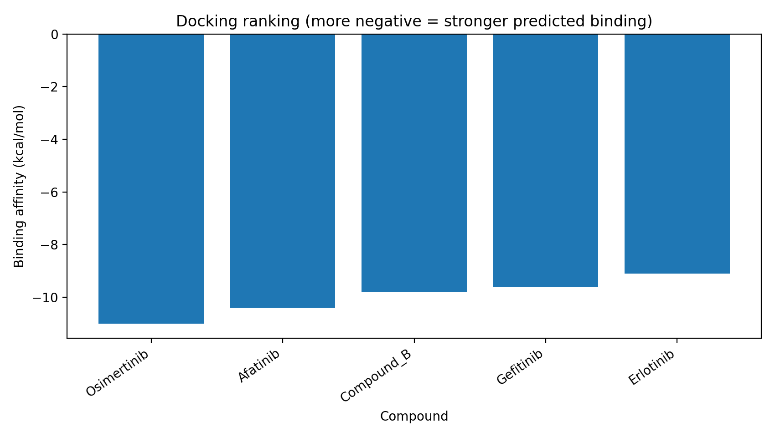
Drug Discovery Pipeline
Docking results: top-ranked compounds from parsed Vina logs
Compound
Score
Toxicity
Osimertinib
-11.0
Low
Afatinib
-10.4
Moderate
Compound_B
-9.8
Low
Gefitinib
-9.6
Moderate
Erlotinib
-9.1
Low
Interpretation
• More negative affinity suggests stronger predicted binding
• Top five hits all pass basic drug-likeness filters
• Osimertinib and Afatinib provide useful positive controls for the case study
Major Project | Bioinformatics
9
Notes:
Read the plot left-to-right: the most negative scores sit at the top of the ranking. Then use the table to summarize the strongest candidates and explain why known EGFR inhibitors help validate the workflow. [Sources] - Internal project output: outputs/vina_binding_plot.png - Internal project output: outputs/vina_top_hits.csv - Uploaded file: Course_Notes.pdf (interpretation of docking affinity and interactions)

Slide 10
Drug Discovery Pipeline
Interaction analysis with PyMOL
After ranking, the top pose is reviewed visually to check whether the ligand occupies the expected pocket and forms chemically sensible contacts.
What to inspect
• Hydrogen-bond-like contacts
• Hydrophobic packing in the pocket
• Aromatic stacking where applicable
• Unreasonable clashes or solvent-exposed poses
Important viva line
Docking score ranks candidates, but PyMOL helps judge whether the pose is structurally believable.
Major Project | Bioinformatics
10
Notes:
Use this slide to move from numbers to structural interpretation. Tell the audience that docking score alone is not enough; pose quality and interaction plausibility matter. [Sources] - Uploaded file: Minor & Major Project Guidelines PDF (interaction analysis and PyMOL / ChimeraX visualization) - Uploaded file: Course_Notes.pdf (hydrogen bonds, hydrophobic, electrostatic, pi-pi, van der Waals) - Visual generated with OpenAI image generation based on project context

Slide 11
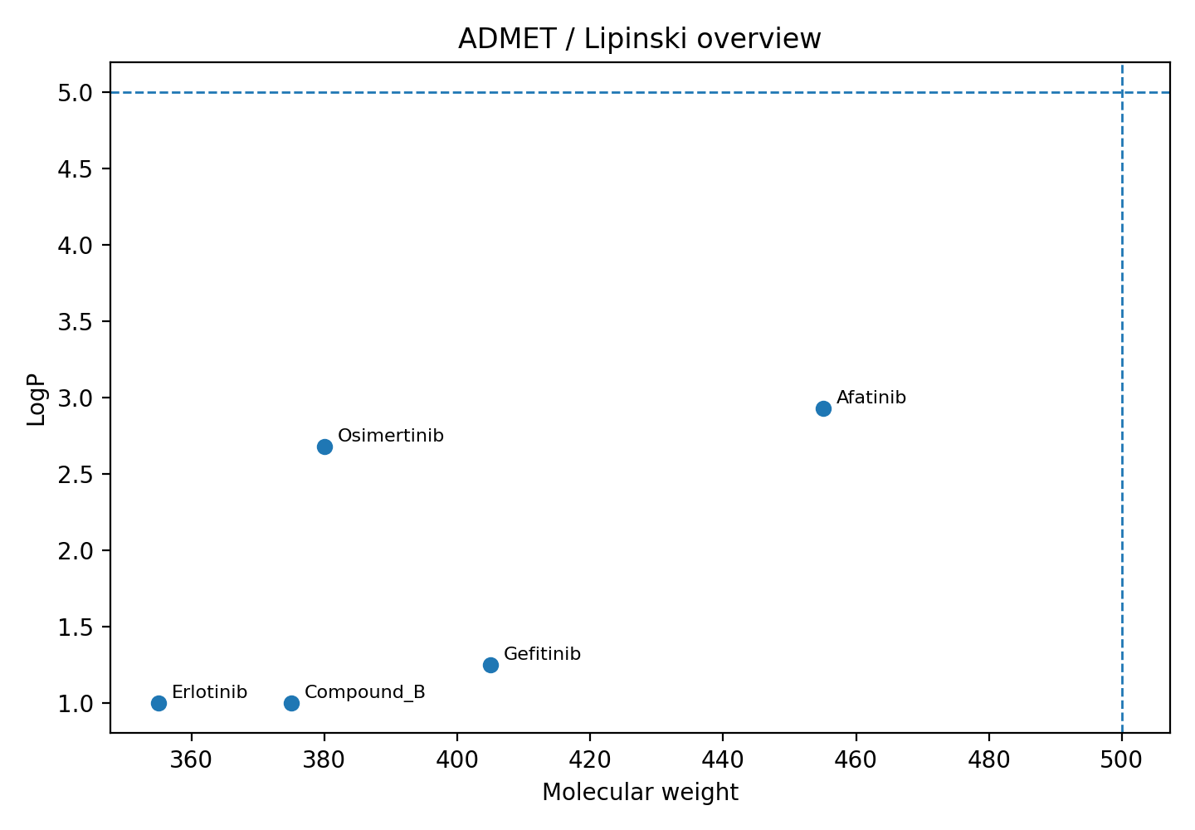
Drug Discovery Pipeline
ADMET and lead prioritization
Why ADMET matters
Good docking alone is not enough. A useful lead should also have acceptable molecular weight, lipophilicity, and toxicity risk.
Lipinski-like filters used for first-pass drug-likeness
Predicted toxicity kept as a prioritization penalty
Final score combines docking evidence with property filters
Outcome
Osimertinib, Afatinib, and Compound_B remain strong leads after combining affinity and property checks.
Major Project | Bioinformatics
11
Notes:
Explain that ADMET is a filter, not a replacement for docking. Use the plot thresholds to show how lead selection becomes more realistic once property balance is included. [Sources] - Internal project output: outputs/vina_admet_plot.png - Uploaded file: Course_Notes.pdf (Lipinski rule of five, ADMET categories and tools) - Uploaded file: Minor & Major Project Guidelines PDF (ADMET prediction and lead characterization)

Slide 12
Drug Discovery Pipeline
Final Python pipeline architecture
Inputs
compound CSV
Vina logs
receptor / pose files
demo-screen
rank + ADMET
CSV / JSON
report figures
prioritize hits
plots + summary
parse-vina
real log parser
make-pymol-script
render figure
Why this matters in viva: it proves the project is modular, reproducible, and ready for extension to larger screens or better ADMET services.
Major Project | Bioinformatics
12
Notes:
Use this slide to explain code structure at a systems level. The three important modules are screening, Vina parsing, and PyMOL script generation. [Sources] - Internal project file: drug_discovery_pipeline_final.py - Uploaded file: Minor & Major Project Guidelines PDF (automation with Python and structured outputs) - Uploaded file: Course_Notes.pdf (Python, pandas, matplotlib as recommended tools)

Slide 13
Drug Discovery Pipeline
Live code demo for viva: step-by-step
1
Show help menu to prove the CLI is structured.
1 cd drug_discovery_upgrade 2 python drug_discovery_pipeline_final.py -h 3 python drug_discovery_pipeline_final.py demo-screen \ 4 --compounds sample_compounds.csv --output-dir outputs --top-n 5 5 python drug_discovery_pipeline_final.py parse-vina \ 6 --log-dir data/vina_logs --metadata sample_compounds.csv \ 7 --output-dir outputs --top-n 5 8 python drug_discovery_pipeline_final.py make-pymol-script \ 9 --receptor data/receptor/egfr_receptor.pdb \ 10 --pose outputs/example_top_pose.pdbqt \ 11 --output outputs/render_docking_scene.pml
2
Run demo-screen to generate ranked hits and ADMET outputs.
3
Run parse-vina to read real docking logs and create CSV / plot outputs.
4
Run make-pymol-script to prepare the figure-generation script.
Major Project | Bioinformatics
13
Notes:
This is the exact demo flow to follow in front of the examiner. Speak slowly, explain each command, and point out the files that are created after each step. [Sources] - Internal project file: drug_discovery_pipeline_final.py - Internal project files: sample_compounds.csv, data/vina_logs, outputs/

Slide 14
Drug Discovery Pipeline
PyMOL actual image generation guide
If you want a true project figure instead of an illustrative visual, use the pipeline to write a PyMOL script and then run that script inside PyMOL.
1 reinitialize 2 load receptor.pdb, target 3 load top_pose.pdbqt, ligand 4 hide everything, all 5 show cartoon, target 6 show sticks, ligand 7 select pocket, byres (target within 5 of ligand) 8 show surface, pocket 9 dist hbonds, ligand, pocket and (elem n+o), mode=2 10 ray 2400, 1350 11 png docking_visual.png, dpi=300
1. Prepare receptor file and top docked pose.
2. Generate the script from Python.
3. Open PyMOL and run @render_docking_scene.pml
4. Ray trace and export PNG at 300 dpi.
Tip: if the pocket view is not ideal, rotate the model manually and repeat the ray + png commands.
Major Project | Bioinformatics
14
Notes:
Explain that the Python pipeline and PyMOL are connected: the pipeline prepares a script, and PyMOL turns the chosen pose into a publication-style image. [Sources] - Internal project file: outputs/render_docking_scene.pml - Uploaded file: Minor & Major Project Guidelines PDF (PyMOL/ChimeraX for visualization) - Uploaded file: Course_Notes.pdf (PyMOL as recommended visualization software)

Slide 15
Drug Discovery Pipeline
Limitations and next steps
Current limitations
Next steps
• Static receptor model
• Simplified scoring model
• Small academic ligand library
• First-pass ADMET heuristics
• No wet-lab validation in this project scope
• Expand library size and diversity
• Use experimentally solved receptor structures when available
• Add RDKit descriptors and better ADMET APIs
• Validate hits with molecular dynamics
• Compare with literature or assay data
This is the right answer if the examiner asks: “Can docking prove the drug works?”
Major Project | Bioinformatics
15
Notes:
Be explicit about limitations. This makes the project sound scientifically mature rather than over-claimed. Then show the natural upgrade path toward more serious validation. [Sources] - Uploaded file: Minor & Major Project Guidelines PDF (suggest next steps, estimate development process) - Uploaded file: Course_Notes.pdf (preclinical path after computational hit discovery) - Internal project design choices and scope limits

Slide 16
Drug Discovery Pipeline
Common viva questions and strong answers
Q. Why EGFR?
Q. Why PyMOL?
A. Clinically relevant target with known mutations and a druggable pocket.
A. It turns docking scores into structural interpretation and figure-ready visuals.
Q. Why Vina?
Q. Can docking prove activity?
A. Open source, fast, widely used, and good for academic virtual screening.
A. No. It only predicts plausible binding; experiments are still required.
Q. Why ADMET after docking?
Q. What would you improve?
A. Strong binding alone does not guarantee safety or bioavailability.
A. Bigger libraries, better receptor prep, MD simulation, stronger ADMET services.
Major Project | Bioinformatics
16
Notes:
Use this only if questions come up. Answer in a calm, concise way and avoid over-claiming what docking can prove. [Sources] - Internal companion document: Drug_Discovery_Viva_Guide.docx - Uploaded file: Session10.pdf (communication, Q&A handling, interview talking points) - Uploaded file: Course_Notes.pdf (docking, ADMET, PyMOL, pipeline concepts)

Slide 17
Final takeaway
This project delivers a complete, presentation-ready drug discovery workflow with real docking-output parsing, lead prioritization, visualization guidance, and a modular Python pipeline.
• End-to-end course-aligned workflow
• Real Vina log parsing and ranked outputs
• PyMOL figure-generation guide
• Viva-ready code demo and Q&A support
Questions?
Notes:
Close by repeating the end-to-end value of the project. Invite questions and, if needed, jump to the viva backup slide. [Sources] - Uploaded file: Minor & Major Project Guidelines PDF (complete workflow and deliverables) - Uploaded file: Session10.pdf (major-project outcomes and communication goals) - Visual generated with OpenAI image generation based on project context

