Slide 1





QUANTA-SIM: Quantum Circuit Framework
Simulating Photonic Interference & Linear Optical Transformations through Quantum Circuits
1/31

Slide 2



The Big Idea
Core Concept
Integrated Approach
Primary Objective
A specialized simulation framework designed for studying how individual photons evolve and interfere through complex optical systems.
Combines physical photonic interference with rigorous mathematical modeling and digital quantum-circuit simulation.
Allows users to construct small optical systems, simulate physical quantum behavior, and visually inspect output probability distributions.

Slide 3
Why This Project?
Intuitive Learning: Quantum interference is counter-intuitive and difficult to grasp using mathematical equations alone.
Hardware Accessibility: Real photonic quantum experiments demand expensive, specialized optical hardware and cleanroom setups.
Controlled Environment: A computational simulator enables flexible experiments by tuning parameters dynamically.
Academic Bridge: Connects core computer science skills directly with modern quantum optics and physics.

Slide 4







What Are We Studying?
Photons & Modes
Quantum Superposition
Complex Amplitudes
Tracking light quanta moving through distinct spatial or polarization optical paths.
Modeling photons simultaneously inhabiting multiple optical modes prior to measurement.
Computing complex probability amplitudes that determine quantum state evolution.
Interference Patterns
Unitary Matrices
Multi-Mode Networks
Analyzing constructive and destructive interference governing output probabilities.
Representing optical components mathematically as energy-conserving unitary operators.
Simulating complex linear optical circuits with interconnected beamsplitters and phase shifts.

Slide 5


What Is a Photonic Quantum System?
Quantum Information Carriers: Photons act as durable, low-noise qubits with long coherence times.
Optical Modes: Distinct physical paths, frequencies, or time bins are treated as individual quantum modes.
Linear Transformations: Passive components like beam splitters and phase shifters continuously transform the quantum state.
Photonic State Vector Space
Transforming continuous electromagnetic fields into discrete quantum state representations.
Measurement Collapse: Single-photon detectors collapse complex probability amplitudes into observable output count distributions.

Slide 6

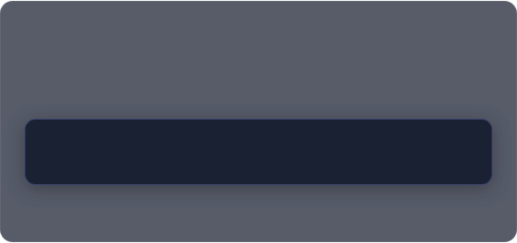



The Core Physics Behind QUANTA-SIM
Mathematical Formalism
Born's Probability Rule
A quantum state is mathematically represented as a normalized state vector within a Hilbert space.
Measurement probabilities are obtained directly from the squared magnitude of output state probability amplitudes:
Optical components map directly to unitary matrices where .
Ensures total probability across all detector outcomes sums strictly to 1.0.

Slide 7

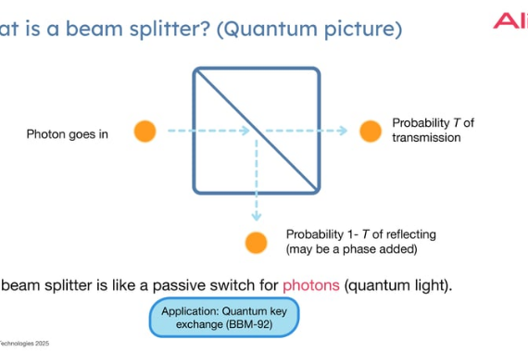

Beam Splitter Model
Mode Mixing: A beam splitter mixes two optical modes, creating spatial superposition.
50:50 Beam Splitter: Distributes a single photon's probability amplitude equally between two output paths.
Unitary Transformation: Parameterized by transmissivity angle .

Slide 8

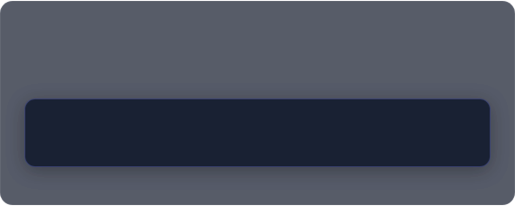

Phase Shifter Model
Physical Principle
Matrix Representation
A phase shifter adjusts the optical path length or refractive index, delaying the phase of a quantum probability amplitude relative to other modes without altering single-mode intensity.
Applies a complex phase factor to the target mode:
Essential for tuning constructive or destructive interference when modes recombine down the line.

Slide 9



Mach–Zehnder Interferometer
Combines two 50:50 beam splitters with an internal controllable phase shift to demonstrate optical interference.
STAGE 1
STAGE 2
STAGE 3
STAGE 4
Beam Splitter 1
Phase Shift (φ)
Beam Splitter 2
Measurement
Splits input photon into 2 paths
Applies relative phase delay
Recombines phase-shifted paths
Detects final output probabilities
Changing shifts output counts continuously between Detector 1 and Detector 2.

Slide 10










What Are We Simulating?
Single-Photon
Beam Splitters
Interference
Interferometry
Propagation through single optical paths and components.
50:50 and custom ratio mixing behaviors.
Phase-dependent fringe curves and visibility.
Complete Mach–Zehnder circuit simulations.
Multi-Mode
Two-Photon
Noise Models
Quantum Circuits
Optical networks with 2 to 4 distinct modes.
Basic Hong-Ou-Mandel style two-photon interference.
Phase drift and beam-splitter ratio imperfections.
Digital qubit analogue mappings in Qiskit.

Slide 11




Single-Photon Simulation Workflow
STEP 1
STEP 2
STEP 3
STEP 4
STEP 5
Initialization
Unitary Cascade
State Compute
Probabilities
Visualization
State vector input: |1,0›
Apply optical matrices in series
Compute final state |ψ_final›
P_i = |α_i|²
Plot output trends vs phase

Slide 12

Two-Photon Interference & Fock States
Occupation-Number (Fock) States: Represents photon counts per mode, e.g., (1 photon per mode).
Quantum Interference: Identical photons impinging on a 50:50 beam splitter bunch together due to quantum statistics.
Coincidence Probability Drops to 0
Output Configurations: Evaluates probability distribution across states , , and .
Fundamental proof of quantum indistinguishability simulated directly within QUANTA-SIM.

Slide 13




Optical Components to Math Models
How QUANTA-SIM cascades individual optical component matrices into a single global unitary operator.
Optical Circuit
Component Matrices
Total Unitary (U_total)
Final State Vector
Output Probabilities
Sequence of physical optical elements
Individual 2x2 or NxN unitary matrices
U_total = U_n · ... · U_2 · U_1
|ψ_out› = U_total |ψ_in›
P_i = |⟨i|ψ_out›|²

Slide 14



Multi-Mode Optical Interferometers
2–4 Mode Networks
Sub-Matrix Embedding
Complete System Unitary
Supports small-scale linear optical networks combining multiple beam splitters and phase shifters.
Embeds 2-mode localized component operations into larger N-mode global unitary space via tensor expansion.
Generates the complete transformation matrix representing the full multi-port interferometer network.

Slide 15




Photonic to Quantum Circuit Mapping
QUANTA-SIM maps continuous optical mode transformations into discrete gate-based qubit quantum circuits for educational comparison.
Optical System
Unitary Matrix
Circuit Analogue
Qiskit Simulation
Comparison
Modes, Beam Splitters, Phase Shifters
Continuous matrix representation
Qubit gates (Hadamard, RZ, CNOT)
Digital state vector & shots
Cross-validate output probabilities

Slide 16
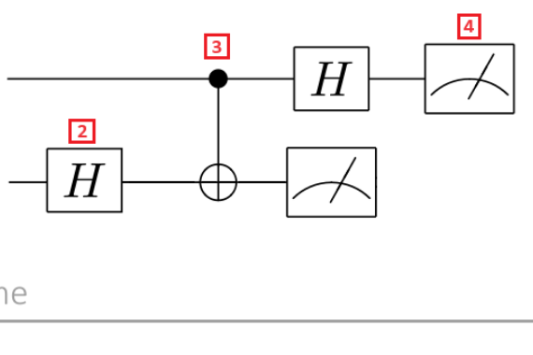
Quantum Circuit Simulation with Qiskit
Qiskit Integration: Builds equivalent quantum circuit analogues using standard gate primitives.
State Evolution: Simulates qubit state evolution under unitary quantum gates.
Circuit Visualization: Renders visual quantum circuit diagrams dynamically.
Probability Validation: Verifies digital quantum state probability outputs against exact optical models.

Slide 17

Optical vs Quantum Circuit Simulation
Feature / Metric | Optical Simulation Model | Digital Quantum Circuit Analogue
State Basis | Optical Spatial Modes & Photons | Qubit State Vectors (|0›, |1›)
Core Operator | Unitary Optical Matrices (BS, PS) | Quantum Gates (Hadamard, Phase RZ)
Circuit Metrics | Optical path depth & component count | Qubit count, gate depth, CNOT count
Simulation Target | Exact continuous complex amplitude math | Digital shot-based measurement sampling

Slide 18




Noise and Imperfections
Phase Noise
Beam-Splitter Parameter Error
Simulates optical phase drift and environmental phase fluctuations over time.
Models manufacturing tolerances and physical coupling ratio imperfections.
Impact Analysis: Enables direct comparison of ideal vs imperfect output distributions, measuring degradation in interference fringe visibility.

Slide 19

System Architecture
UI
BUILDER
ENGINE
SIMULATION
OUTPUT
User Input
Optical Builder
Unitary Model
Photon / Qiskit Engine
Visualization
Circuit setup & parameters
Constructs component list
Multiplies matrices
Runs optical & circuit math
Renders charts & graphs

Slide 20



Project Modules
Optical Components
Interferometer
Photon Simulation
Quantum Circuit
Beam splitters and phase shifters.
MZI and multi-mode networks.
Single and 2-photon states.
Selected Qiskit representations.
Noise Engine
Visualization
User Interface
Core Integration
Controlled parameter imperfections.
Graphs and probability plots.
Interactive Streamlit experiment GUI.
Unified data flow engine.

Slide 21






Software & Technologies
Python
NumPy & SciPy
Matplotlib
Main programming language powering the simulation core.
Complex matrix multiplication and advanced linear algebra routines.
High-quality plots for interference fringes and state counts.
Qiskit & Qiskit Aer
Streamlit
Tech Stack Synergy
Quantum circuit construction, synthesis, and execution.
Interactive Web UI for real-time parameter tweaking.
Seamless Python-native stack designed for rapid scientific computing.

Slide 22

Expected Visual Outputs
Probability Graphs
Interference Patterns
Distribution Charts
Phase vs output-probability curves demonstrating smooth interference.
Visual representation of constructive and destructive regions.
Histograms displaying single and multi-photon output counts.
Circuit Schematics
Unitary Heatmaps
Qiskit Circuit Diagrams
Clean schematic layouts of designed optical mode networks.
Color-coded heatmaps of complete system unitary matrices.
Generated digital quantum gate diagrams for comparison.

Slide 23
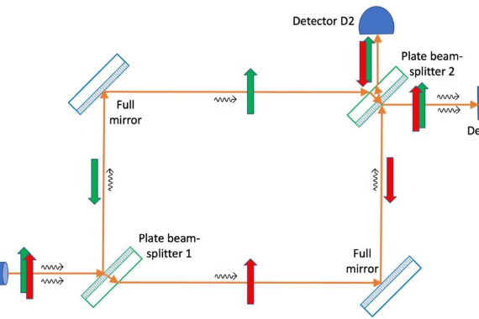
Example Experiment: MZI Interference
Step 1: Launch single photon into optical mode 0: .
Step 2: Sweep internal phase shift continuously from 0 to .
Step 3: Compute output probabilities at both detector ports.
Step 4: Plot detector probability as a function of phase angle .
Insight: Observe perfect sinusoidal fringes revealing constructive/destructive interference.

Slide 24


Example Experiment: Two-Photon Interference
Experimental Protocol
Prepare two-photon input Fock state: .
Direct photons simultaneously into a 50:50 beam splitter model.
|2,0› : |1,1› : |0,2› Output Ratio
Calculate exact quantum amplitudes for output states: , , and .
Quantum interference completely cancels the coincidence state .

Slide 25


Research Connection
Linear Optical Literature
Digital Circuit Bridge
Educational Adaptation
Based on foundational quantum optics literature studying linear optical networks via unitary transformations.
Motivated by modern efforts to map physical optical interferometers to gate-based quantum computers.
Distills complex quantum theoretical concepts into a lightweight, hands-on software prototype.

Slide 26


What Makes QUANTA-SIM Different?
Multidisciplinary
Visual Focus
Realistic Modeling
Combines physics, linear algebra, and computer science seamlessly into a unified suite.
Prioritizes intuitive visual understanding of complex optical quantum interference.
Supports both ideal analytical systems and noise-corrupted physical models.

Slide 27
Project Challenges
State Space Complexity: Efficiently representing multi-photon Fock state spaces as mode count grows.
Mapping Accuracy: Constructing accurate digital quantum circuit analogues for continuous optical transformations.
Numerical Precision: Preserving exact phase information with complex matrix math.
Scope Control: Maintaining precision while ensuring manageable scope for a beginner prototype.
Unitarity Preservation: Ensuring cascaded component transformations remain strictly unitary ( ).

Slide 28

Simulator Limitations
Mode & Photon Limits
Simplified Noise
Prototype focuses on small scale networks (2–4 optical modes, 1–2 photons).
Noise models use parameterized distributions rather than full experimental hardware dynamics.
Selected Mappings
Simulation Scope
Optical-to-quantum circuit mapping covers selected small systems rather than universal compilers.
Acts purely as a computational simulator and does not replace actual physical optical benches.

Slide 29
Future Scope & Roadmap
Scale & Boson Sampling
Matrix Decompositions
Loss & Hardware Hardware
Expand mode count and explore non-trivial Boson Sampling computational demonstrations.
Implement Reck and Clements algorithms for arbitrary optical interferometer synthesis.
Incorporate photon loss, detector dead-times, and execute circuits on cloud quantum hardware.

Slide 30

Final Expected Product
Interactive Application
Simulation & Analytics
Quantum Integration
Full-fledged Streamlit web application with configurable optical components.
Single & 2-photon simulation engine with visual probability outputs & noise analysis.
Direct visual comparison connecting linear optics with Qiskit quantum circuit representations.

Slide 31


Conclusion
QUANTA-SIM bridges the gap between quantum optics and digital quantum computing through intuitive computational simulation.
Enables users to construct, simulate, analyze, and visualize physical photonic quantum systems.
QUANTA-SIM Quantum Framework
Unifies quantum mechanics, linear algebra, Python software engineering, and Qiskit circuit modeling.

