Slide 1
International Islamic University Chittagong
Department of Computer Science & Engineering
Course Title : Artificial Intelligence Lab
Course Code : CSE-3636
Submitted To : Md Safayat Hossen
Assistant Lecturer, IIUC.
PROJECT: A virtual assistant like Jarvis in Python
Presented By:
Section & Semester: 6AM
1.C193018: Adnan Araf
2.C193035: Niloy Sarkar Babu
3.C181102: Mainuddin Hasan Manik

Slide 2
CONTENT OF virtual assistant like iron man Jarvis in Python
REQUIREMENTS
WORKING PROCESS
CONCLUSION
INTRODUCTION
METHODOLOGY

Slide 3
INTRODUCTION
VOICE ASSISTANCE JARVIS is a voice-recognition artificial intelligence application designed by me to perform tasks or services for an individual based on commands or questions. Voice assistants are devices/applications that utilize voice acknowledgment innovation, natural language processing and AI to answer people. The idea of virtual assistants in prior days is to depict the experts who offer subordinate types of assistance on the web.
For instance, product websites are increasingly implementing chat-bot assistants to answer frequently asked questions and common customer complaints.

Slide 4
REQUIREMENT FOR PROJECT
For this we need a code editor (IDE) for write all python programs. Example – VS Code.
Python Interpreter of any version for Complication of the code.
Stable Internet connection.
Microphone for input the voice command.

Slide 5
Features
Search on Wikipedia
Time Reporting
Performing google search
Searching on Wikipedia
Listen to jokes
To open YouTube site in browser
To play music
To open vs code program

Slide 6
Working Process
User asks a personal assistant to perform a task. Speak something (for e.g. “Hello”)
The natural language audio signal is converted into digital data that can be analyzed by the software.
Jarvis records the voice and match with available commands
If it is available then proper response is provided
And proper action is taken

Slide 7


Methodology
1. Installing speech recognition, pyttsx3 and pyaudio packages:
What is pyttsx3?
A python library that will help us to convert text to speech. In short, it is a text-to-speech library.
It works offline, and it is compatible with Python 2 as well as Python 3.
INSTALLATION
After successfully installing pyttsx3, import this module into your program.

Slide 8
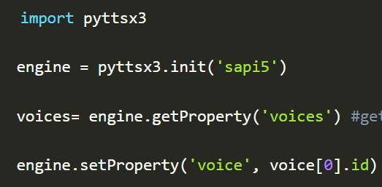
What is pyaudio ?
PyAudio provides Python bindings for PortAudio v19, the cross-platform audio I/O library. With PyAudio, you can easily use Python to play and record audio on a variety of platforms, such as GNU/Linux, Microsoft Windows, and Apple macOS.
PyAudio is distributed under the MIT License.
After successfully installing pyttsx3, import this module into your program.

Slide 9
What is sapi5?
Microsoft developed speech API.
Helps in synthesis and recognition of voice.
What Is VoiceId?
Voice id helps us to select different voices.
voice[0].id = Male voice
voice[1].id = Female voice
tt

Slide 10
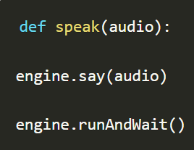
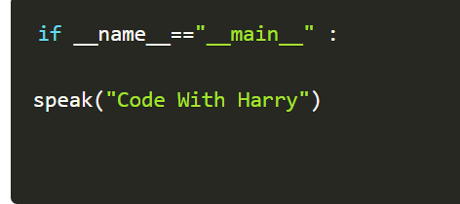
Writing Our speak() Function: We made a function called speak() at the starting of this tutorial. Now, we will write our speak() function to convert our text to speech.
Creating Our main() function:
We will create a main() function, and inside this main() Function, we will call our speak function.

Slide 11

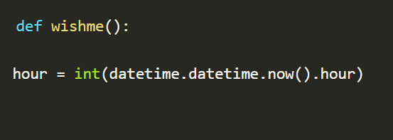
Whatever you will write inside this speak() function will be converted into speech. Congratulations! With this, our J.A.R.V.I.S. has its own voice, and it is ready to speak.
Defining Wish me Function :
Now, we will make a wishme() function that will make our J.A.R.V.I.S. wish or greet the user according to the time of computer or pc. To provide current or live time to A.I., we need to import a module called datetime. Import this module to your program by:
Now, let's start defining the wishme() function:

Slide 12

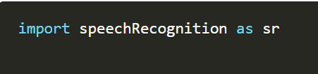
Here, we have stored the current hour or time integer value into a variable named hour.
Now, we will use this hour value inside an if-else loop.
Defining Take command Function :
The next most important thing for our A.I. assistant is that it should take command with the help of the microphone of the user's system. So, now we will make a takeCommand() function. With the help of the takeCommand() function, our A.I. assistant will return a string output by taking microphone input from the user.
Before defining the takeCommand() function, we need to install a module called speechRecognition. Install this module by:
After successfully installing this module, import this module into the program by writing an import statement.

Slide 13
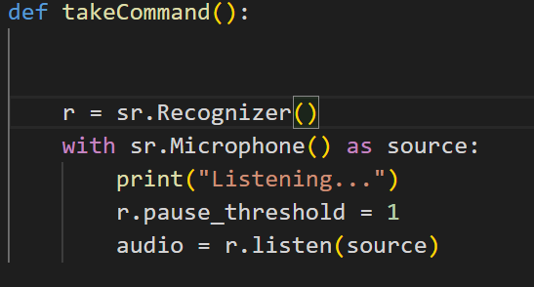
Let's start coding the take Command() function :
We have successfully created our take Command() function. Now we are going to add a try and except block to our program to handle errors effectively.

Slide 14
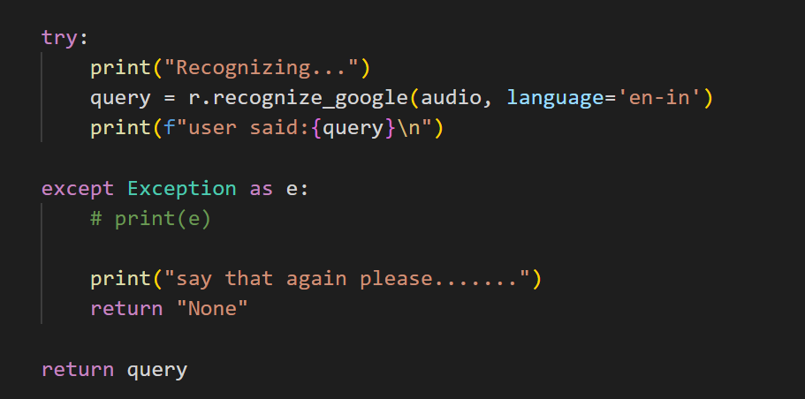

Slide 15

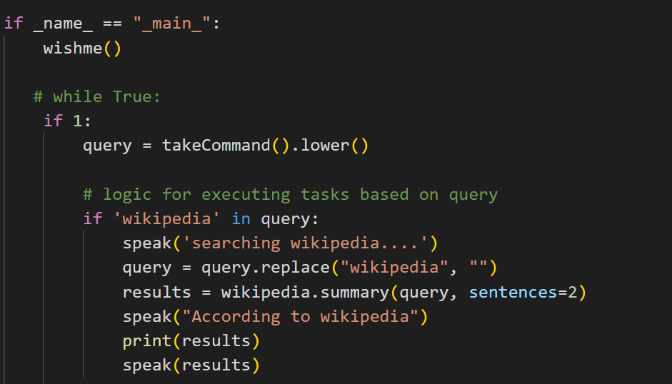
To search something on Wikipedia : To do Wikipedia searches, we need to install and
import the Wikipedia module into our program. Type the below command to install the
Wikipedia module :
After successfully installing the Wikipedia module, import it into the program by writing an import statement.

Slide 16

In the above code, we have used an if statement to check whether Wikipedia is in the
user's search query or not. If Wikipedia is found in the user's search query, then two
sentences from the summary of the Wikipedia page will be converted to speech with
the speak function's help.
To open YouTube site in a web-browser : To open any website, we need to import a module called web browser. It is an in-built module, and we do not need to install it with a pip statement; we can directly import it into our program by writing an import statement.
Code:
Here, we are using an elif loop to check whether Youtube is in the user's query. Let' suppose the user gives a command as "J.A.R.V.I.S., open youtube." So, open youtube will be in the user's query, and the elif condition will be true.

Slide 17
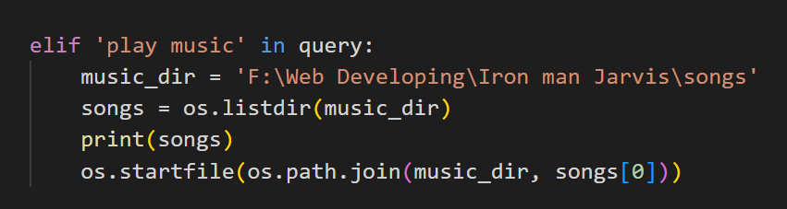
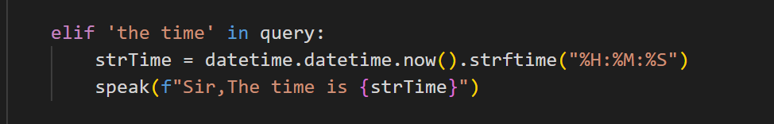
To play music: To play music, we need to import a module called os. Import this
module directly with an import statement.
To know the current time :
In the above, code we are using the datetime() function and storing the current or live system time into a variable called strTime. After storing the time in strTime, we are passing this variable as an argument in speak function. Now, the time string will be converted into speech.

Slide 18
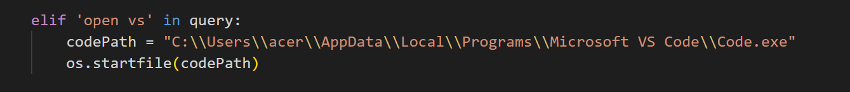

To open the VS Code Program :
To open the VS Code or any other application, we need the code path of the application.
Listen to Jokes: Python supports creation of random jokes using one of its libraries. Let us explore it a little more, Pyjokes is a python library that is used to create one-line jokes for programmers.
You can simply install it using pip with the following command:

Slide 19

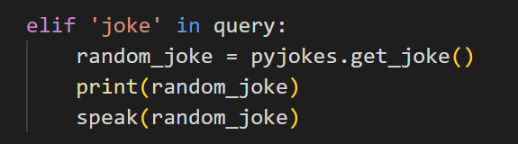
Now to use it, we need to import the installed library in our python Script using the following
command:
As the name suggests, this function is used to actually return a single joke from a certain category and in a particular language, (Categories and languages will be introduced later in this article

Slide 20



Taking Screenshot : To start, you’ll need to install the pyautogui package using the
following command (under Windows):
Begin with importing the pyautogui library:
Then call the .screenshot() method, which will return and Image object. And simply save it using any filename that works for you:

Slide 21
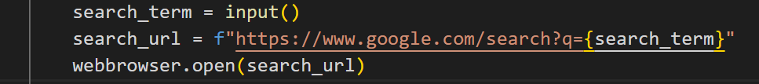
Performing Google Search : I want to search a text in Google using a python script and return the
name, description and URL for each result. I'm currently using this code:

Slide 22
Future work
Jarvis is a digital life assistant.
Based on the DOS language.
Solving math’s equations
Conversing
It is an open source software.
Jarvis assists with your daily life by acting as an
Alarm Clock
Informing you of the latest news headlines
The forecast of the weather for the upcoming days

Slide 23
Advantages and drawbacks
Advantages
Easy to operate
Can work with variety of commands
Custom commands
Secure
Helpful for disabled
Artificial Intelligent
Drawbacks
Limited language support
Costly
Expensive equipment's
It can’t work in noisy environment

Slide 24
CONCLUSION
→Jarvis is a digital and virtual assistant with artificial Intelligence.
Virtual Personal assistants are very effective way to organize you schedule. Now there are many smart personal digital assistant applications available in market for various device platforms.
It is very flexible and useful technology.
I provides a better interface to deal with it.
They also have lot of information than any assistant as they are connected with internet .

