Slide 1
Climate Change Analysis and Forecasting
Presented By – Sachin Sarkar

Slide 2
Objective
Analyze global temperature data to find trends, seasonality and autocorrelation patterns in it.
Explore the dataset and find out some meaningful insights on climatic conditions.
Develop and deploy a web UI based solution, that used to get analysis and forecasts for average temperatures per month.
The analysis and forecasts dependent on country and state selected.

Slide 3
About Data
For this project we used 3 csv file and 1 json. This are –
GlobalTemperatures.csv : For global average land temperatures.
GlobalLandTemperaturesByCountry.csv : For average temperatures group by countries.
GlobalLandTemperaturesByState.csv : For average temperatures group by states.
Countries.geo.json : Fo geographical locations of countries.
This data was collected from http://berkeleyearth.org/data/

Slide 4




Software and Tools
Python : used as the primary programming and scripting language.
Jupyter Notebook : For python scripting, data analysis and research.
Spyder : For application backend Programming.
Pandas : used for data frame manipulation.
NumPy : For array manipulation.
Plotly Express : for interactive plots.
Neural Prophet : For Deep Learning modelling and forecasting.
Streamlit : For frontend development.
Html / CSS : For frontend improvement.
Git : For project version control.

Slide 5
Project Flow
Import Data
Data Cleaning
Exploratory Data Analysis
Model Selection and Training
Model Validation
Frontend Development
Deployment
Data Preparation

Slide 6
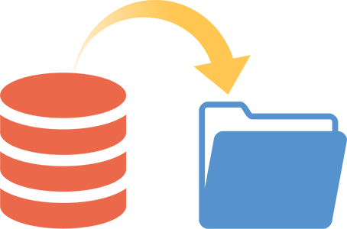
Import Data
All the csv and json files collected for this project stored inside a folder “datasets” in the repository.
Now load this csv files as pandas dataframe object into the python program to get access on this datasets.
The json file imported as json object using python in-built json library.

Slide 7
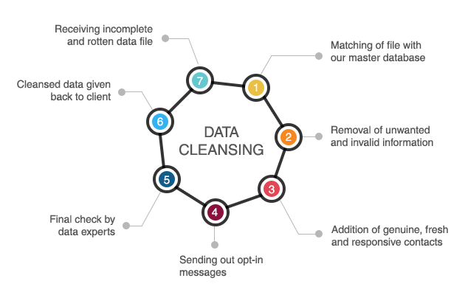
Data Cleaning
All the unnecessary features removed.
Missing Values imputed on monthly average data.

Slide 8
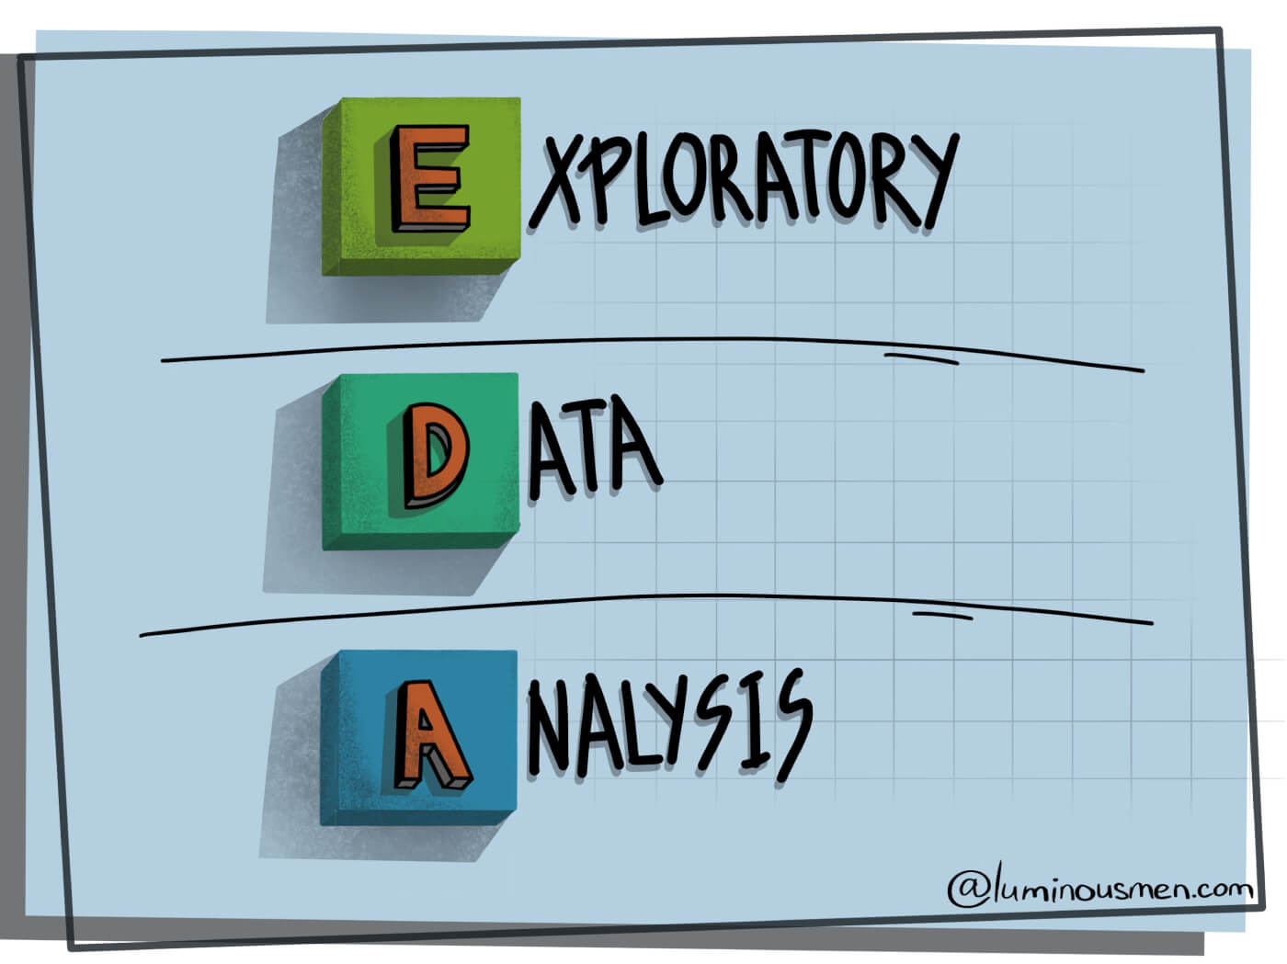
Exploratory Data Analysis
This Exploratory Data Analysis contains,
Lag Plot and Analysis
ACF or Autocorrelation plots and Analysis
Trend Plot and Analysis
Seasonal Plot and Analysis
Chloropleth Map of Average Temperature by Countries and Analysis

Slide 9
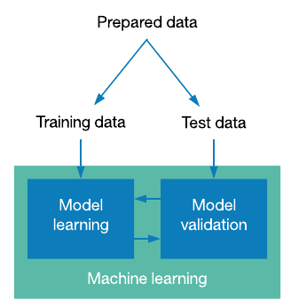
Data Preparation
Data prepared for training and validation.
First 80% of data used as training data for training.
Last 20% of data used as test data for validation.

Slide 10

Model Selection and Training
Choosing the best model and train it.
Meta’s state of art time series deep learning model Neuralprophet used.
This model is upgraded version of fbprophet.
This model built in pytorch.
Very fast and convenient API compare to tensorflow ANN, RNN etc.
Model trained on prepared training with 10 epochs.

Slide 11
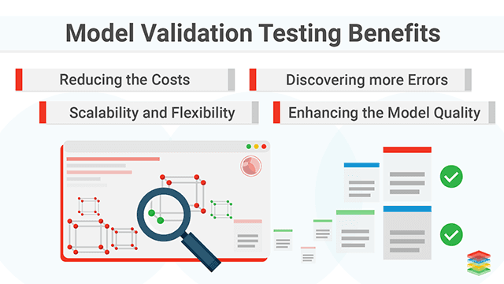
Model Validation
Analysis and plotting training per epochs loss and RMSE.
Validating model performance based on test data.
Evaluation metrices used : RMSE and R2 Score.
Demo forecasting for next 2 years.

Slide 12
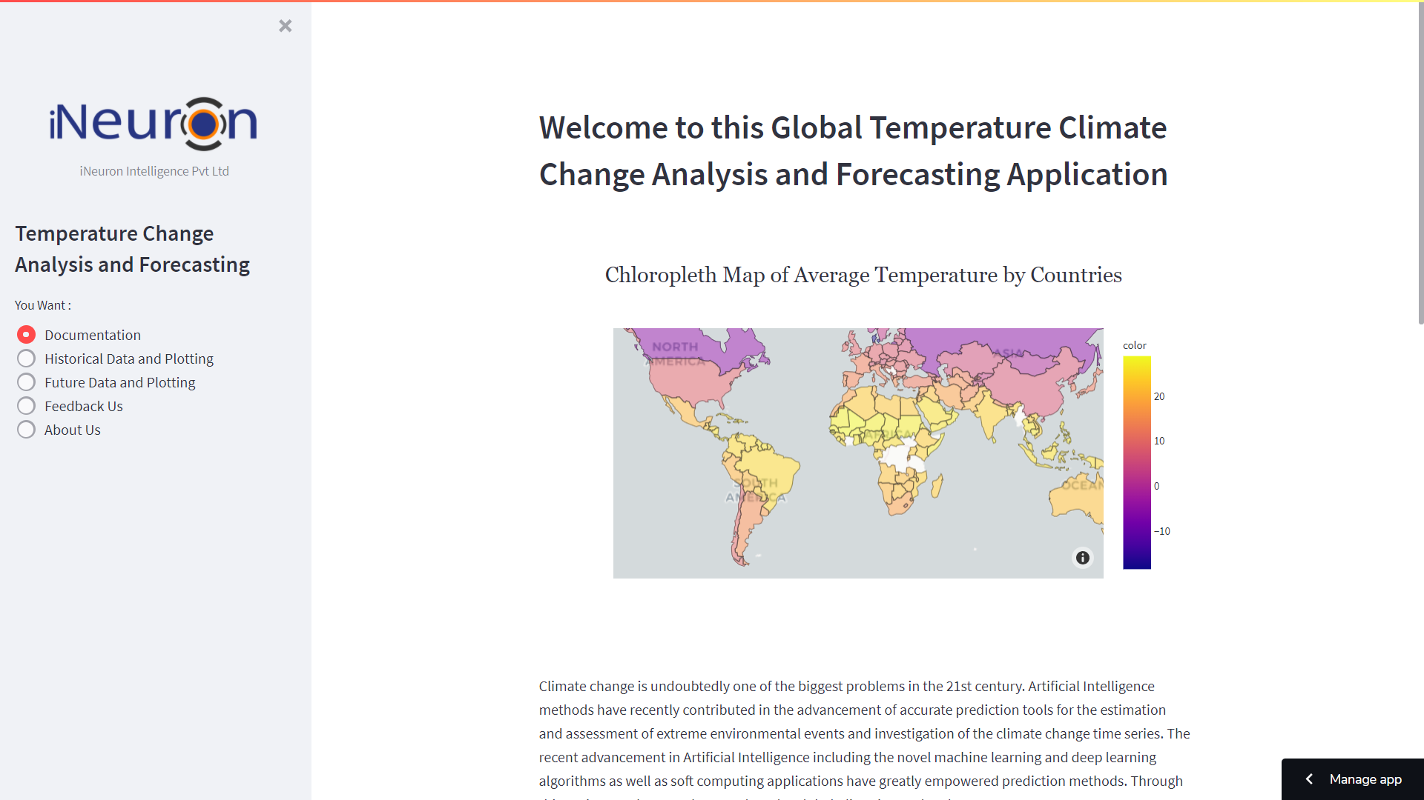
Frontend Development
Multi paged web based solution developed using streamlit to show plots, analysis and forecasts.
Here 5 different web pages developed inside the application. This are –
• Documentation
• Historical Data and Plotting
• Future Data and Plotting
• Feedback Us
• About Us

Slide 13
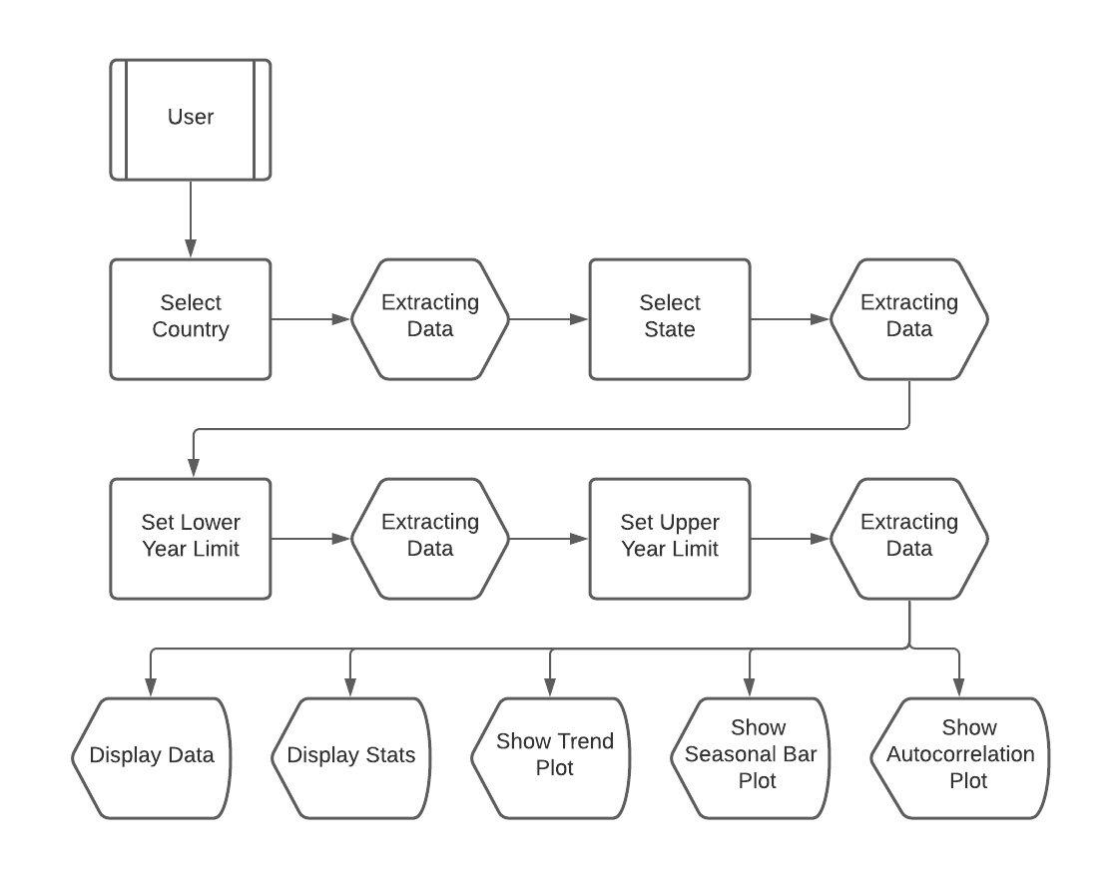
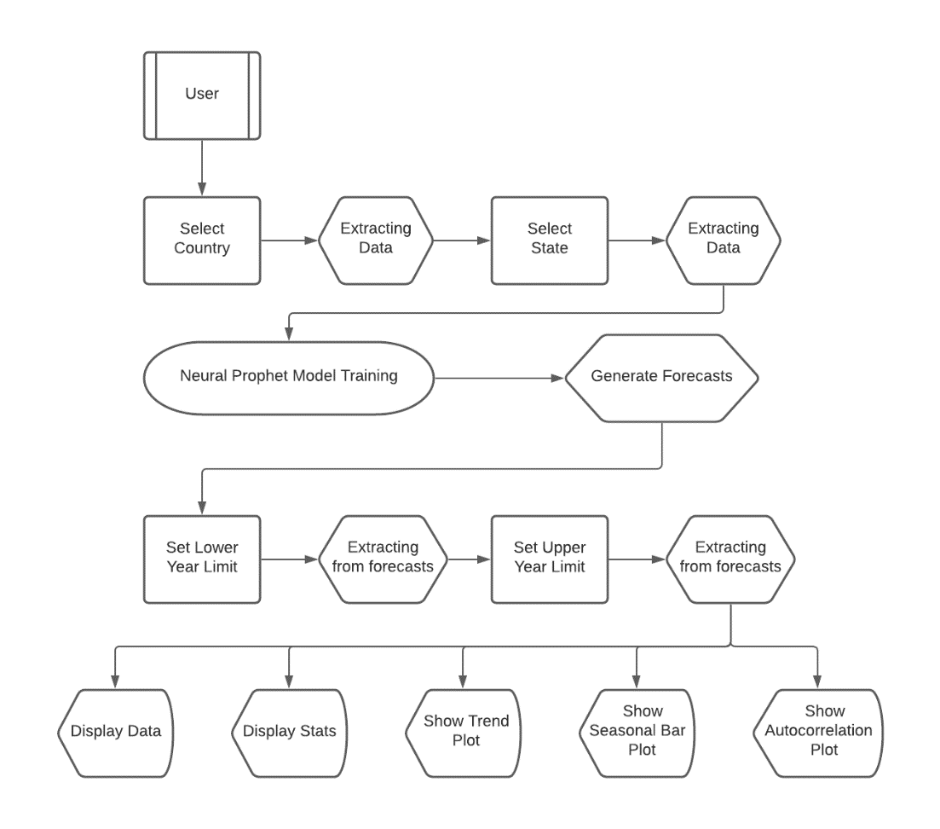
Architecture of this Application

Slide 14
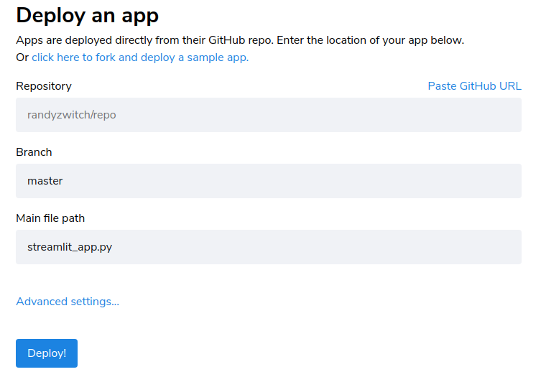
Deployment
The project successfully deployed through Streamlit Cloud.
The Github repository of the project needed to publish this application.
After deployment the website will automatically update on update of github repository.

Slide 15
Conclusion
Undoubtedly, this application will help users to analyze past and future climatic trends and changes. As well as users can get to know the monthly seasonality and autocorrelation. Users can able to filter this insights as per there choice of country, state and time range.

Slide 16


