Slide 1





(A)Intelligent
Digital Growth System™
Revitalise your digital efforts for better outcomes.
www.avocadotreedigital.com

Slide 2









The Value Proposition
Having a partner focused on growth, as keenly as you.
A true partner, not a vendor
One team owning it all
We sit on your side of the table. Your growth is the goal we are measured on, not billable hours.
Website, CRM, marketing and analytics run as one connected system, with a single team accountable for the result.
No agency mark-up
Experience that keeps you ahead
Direct access to senior talent and the right tools, without layers of reselling inflating the bill.
Proven expertise and AI put to real work, so you move faster than competitors still stuck experimenting.
(A)I GROWTH SYSTEM™
02

Slide 3





Comparison Matrix
How Do You Want to Run Your Digital Growth?
Criteria
In-House Team
Multiple Agencies
Ownership & Accountability
Single partner, full ownership
Fragmented
None / Finger-pointing
Agentic & Generative AI
Embedded, governed & strategic
Hard to build / Costly
Usually cosmetic / Bolt-on
Speed of Execution
Fast (Campaigns live 4wks)
Slow (Hiring/Training)
Very slow (Coordination)
Cost Structure
Efficient subscription
Very high (Salaries + Overhead)
High retainers + Hidden fees
Website Management
Fully Managed
Usually neglected / Dev resource
Often excluded / Separate
CRM & Automation
Included & Optimized
Requires specialists
Separate vendor needed
Marketing Performance
Integrated w/ CRM & AI
Hard to sync channels
Always siloed
Analytics & Intelligence
Unified growth intelligence
Fragmented data sources
Confusing / Disconnected
Result: In-house = expensive & slow. Multiple agencies = chaos. (A)Intelligent Digital Growth System™ = clarity, capability & performance.
(A)I GROWTH SYSTEM™
10

Slide 4

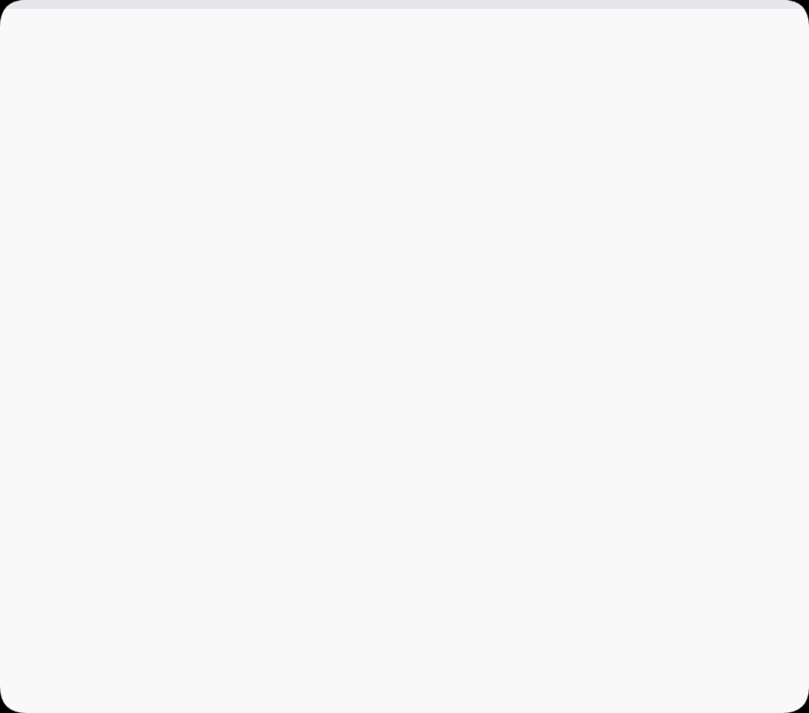



The Solution
(A)Intelligent Digital Growth System™
Not an Agency. Not a Tool. Two Intelligences, One Accountable Growth Department.
Artificial Intelligence
Human Intelligence
Committed Outcomes
AI agents, automation, and models running your marketing operations at machine speed. Always on, always measured, built to your workflows.
Strategists, growth leads, and analysts owning direction, creative judgment, and the decisions AI should never make alone.
Defined KPIs & deliverables each month. Performance guaranteed within scope. Monthly business reviews with complete transparency.
(A)I GROWTH SYSTEM™
03

Slide 5








THE COMPLETE ECOSYSTEM
Your complete growth stack
HUMAN INTELLIGENCE · STRATEGY & DIRECTION
Digital Strategy
Data Strategy
Content
Social Media Strategy & Review
A clear roadmap: where to play and how to win
Structure, quality and governance
Briefs, creative and campaign assets
Planned, run and reviewed with your in-house or hybrid team
REVENUE Every layer above and below is measured against it.
EXECUTION & ASSETS · DELIVERY
Digital Assets
Tools & Budget
Agentic & Generative AI
Analytics
Website management, media buying, CRM review and leads-quality management
Stack selection and spend allocation
Agents, models and marketing automation
Tracking, attribution and performance
One system. One partner. One set of numbers.

Slide 6











The Approach
Human + Artificial Intelligence
Human Intelligence
Artificial Intelligence
Digital Strategy
Agentic AI
A clear roadmap: where to play, how to win, in what order
Agents executing across the funnel
Data Strategy
Generative AI
Structure, quality, and governance
On-brand content production at scale
Content Direction
Predictive Analytics
Judgment, taste, and brand-level decisions
Forecasting trends and revenue outcomes
Growth & Governance
Marketing Automation
Owning the number, human-in-the-loop
Campaigns, nurture and workflows that run themselves
(A)I GROWTH SYSTEM™
05

Slide 7






Human Intelligence
Developing Your AI Digital Strategy
AI Maturity Assessment
Use Case Prioritisation
Data & Governance Readiness
Where you stand today across data, tooling, skills, and process readiness.
Every opportunity scored on business impact, effort, and risk, then sequenced.
Data quality, access, privacy, and the policies that keep AI use defensible.
Agent Architecture
Roadmap & Business Case
Adoption & Enablement
Which agents to build, what each one owns, and where humans stay in the loop.
A phased 12-month plan with costs, owners, and expected return.
Training, change management, and the operating rhythm that makes it stick.
"Strategy before software. We define the destination before we build a single agent."
(A)I GROWTH SYSTEM™
06

Slide 8






Rapid Deployment
Implementation: Ready in 4 Weeks
Week 1
Week 2
Week 3
Week 4 Onwards
Discovery & Blueprint
Stabilize & Modernize
Build & Launch
Continuous Growth
Deep systems audit (site, CRM, analytics)
Website technical fixes & UX
First marketing campaigns live
Weekly execution sprints
CRM structure & data cleanup
CRM automations active
Monthly optimization cycles
Growth gap analysis
Analytics framework setup
Dashboards live & reporting
Agent fleet expanding & tuned
Competitive benchmarking
Tool integration & agent architecture
First AI agents live & team trained
Bi-weekly performance reviews
AI maturity & use case mapping
Success metrics framework
Output: Systems Modernized
Output: Operations Live
Output: Compounding Growth
Output: Blueprint & AI Strategy
(A)I GROWTH SYSTEM™
08

Slide 9



THE ADVANTAGE
Why Avocado Tree Digital
One partner. Total accountability.
Machine speed, human judgment.
Replace six or more vendors with one. Clear KPIs, performance guaranteed within scope, and transparent monthly reviews so you always know where you stand.
Agents absorb the volume: production, monitoring and optimisation. Our strategists own the calls that move pipeline, conversion and revenue.
AI you can actually trust.
From idea to live in weeks.
Governed, agentic AI with defined scope, measurable output and a human in the loop on every critical action. Not "add AI to everything".
A four-week cycle: campaigns live, automations active and agents in production, with no waiting on vendor coordination.

Slide 10






Our Clients
Trusted by growth-driven teams
SGInnovate
HDFC Capital
XENI
360 degree digital strategy, tactical delivery and CRM implementation services
Brand strategy, web and social development
Digital Strategy and web services
SlurrpFarm
Museum of Art and Photography
Blair Road Capital
Digital Strategy, D2C and other services
Web development and brand repositioning
Digital strategy, event strategy and implementation
A selection of the brands who have grown with Avocado Tree Digital.
(A)I GROWTH SYSTEM™
11

Slide 11
PRICING & PACKAGING
One partner. Three levels of firepower.
Every plan includes an AI digital strategy, a 12-month roadmap and live agents from day one.
MOST POPULAR
Foundation Growth
Performance Growth
Growth Elite
For founder-led teams building traction.
For scale-ups chasing aggressive targets.
For enterprises that need the full engine.
$6,500 to $8,500 / month
$10,000 to $14,000 / month
$15,000 to $20,000 / month
+15% website conversion
+25% qualified pipeline
+30% YoY revenue growth
✓
AI digital strategy & 12-month roadmap
✓
Multi-channel digital strategy & execution
✓
Custom AI agent fleet & orchestration
✓
2 core AI agents deployed & managed
✓
6 AI agents across marketing & sales
✓
Enterprise AI strategy & governance
✓
Website management & marketing automation
✓
Full-funnel marketing automation
✓
Dedicated growth lead & proprietary models
✓
Monthly strategic check-ins
✓
Weekly execution sprints & reviews
✓
Board-level reporting & reviews
Custom plans available. See the next slide.

Slide 12




Tailored Engagement
Custom Plan
Fully Bespoke
Custom
Custom Plan
Built around your goals, stack and pace of growth
scoped to you
Core Deliverables
When a custom plan fits
Scope shaped to your priorities, not a fixed package
Multi-brand
Choose your channels, agents and level of automation
or multi-market growth programmes
Blend of strategy, services and AI matched to your team
Flexible commercial model: retainer, project or hybrid
Niche
Scales up or down as your needs change
sectors with specific compliance needs
One accountable partner, KPIs agreed up front
Blended
in-house plus Avocado delivery models
(A)I GROWTH SYSTEM™
13

Slide 13













Accountability Framework
Committed Deliverables & SLA Framework
Recurring Value
Operational Speed
Risk Management
Monthly Commitments
Performance SLAs
Escalation Protocol
Strategic roadmap updates
Response Time
< 24 Hours
If SLAs are missed, we trigger:
Refined strategy based on data
For non-critical requests
D1
Notification & Analysis
Performance reporting dashboard
Campaign Turnaround
5 Days
Immediate root cause identification
Live data transparency
Bug Fix Turnaround
48 Hours
Growth experiments (min 2)
D3
Executive Briefing
CRO & channel testing
Reporting Accuracy
99%+
Remediation plan presented
System Uptime
99.5%
W1
Make-good Plan
Agent performance audit
Service credit or extended service
Team training & enablement
M1
Post-Mortem Review
Prevention measures implemented
"Accountability is built into our contract. Not just our culture."
(A)I GROWTH SYSTEM™
14

Slide 14
Target Audience
Who This Is Built For
Growth-Driven SMEs
B2B & SaaS
Financial Services
Aggressive growth targets, frustrated with fragmented agency support.
Complex sales cycles needing unified lead management and attribution.
Regulated growth that demands trust, compliance and measurable results.
Travel Services
Real Estate
Healthcare
Seasonal demand and high-intent audiences needing sharp, timely campaigns.
High-value leads and long decision cycles that reward sharp targeting and follow-up.
Building reach and reputation with care, clarity and compliant messaging.
"If you have ambitious targets and are tired of managing chaos, we're built for you."
(A)I GROWTH SYSTEM™
15

Slide 15








Enterprise Clarity
Common Questions
Partnership & Operations
Technology & Impact
Do you replace our internal teams?
How deeply is AI embedded?
No, we partner with and extend them. Agents absorb the repetitive volume so your people work on judgment calls. Many clients consolidate 6+ agencies into one accountable partner.
Deeply, and deliberately. Every tier includes an AI digital strategy and live agents in production. What scales by tier is how many agents, how custom they are, and how much they own.
Is there a lock-in contract?
What tools do you work with?
Minimum 6 months is recommended to realize compounding benefits. After that, we offer month-to-month flexibility. Our results are designed to speak for themselves.
We are platform-agnostic, working with HubSpot, Salesforce, Zoho, Webflow, WordPress, Shopify, GA4, Meta, Google Ads, LinkedIn, plus 50+ other integrations.
What if we're not satisfied?
How fast do results show?
We offer a 30-day trial period. If we're not aligned, we part as friends. However, our SLAs and committed outcomes are contractual guarantees, not just promises.
You'll see stability and operational flow within 4 weeks. Meaningful growth momentum typically builds in 60-90 days, with compounding results accelerating from month 4 onwards.
(A)I GROWTH SYSTEM™
16

Slide 16


Stop Managing Chaos.
Start Compounding Growth.
Let's discuss how the (A)Intelligent Digital Growth System™ becomes your unfair advantage in the market.
Avocado Tree Digital © 2026 • (A)Intelligent Digital Growth System™

