Slide 1

Title page
Prospects of Windenergie in Bangladesh
Title of Seminar:
Prospects of Wind Energy in Bangladesh
Exam protocol of MNF-Eco-115 : Planning and Construction of a Wind Farm
Module Teacher:
Dr. Philipp Schmagold, Ebert Erneuerbare Energien Wind GmbH & Co. KG
Prepared by
Razeeb Sarker
MNF-Eco-116, Module Teacher: Dr. Philipp Schmagold, Seminar prepared by Razeeb Sarker

Slide 2
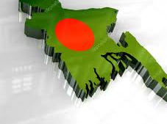
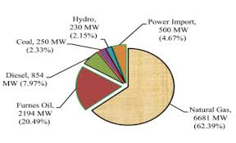
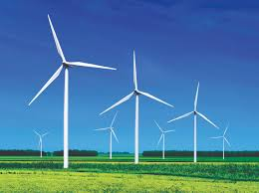


Outline
Prospects of Windenergie in Bangladesh
Study Area
Market Share
Wind energy
Challenges to Wind energy
Conclusion
MNF-Eco-116, Module Teacher: Dr. Philipp Schmagold, Seminar prepared by Razeeb Sarker

Slide 3
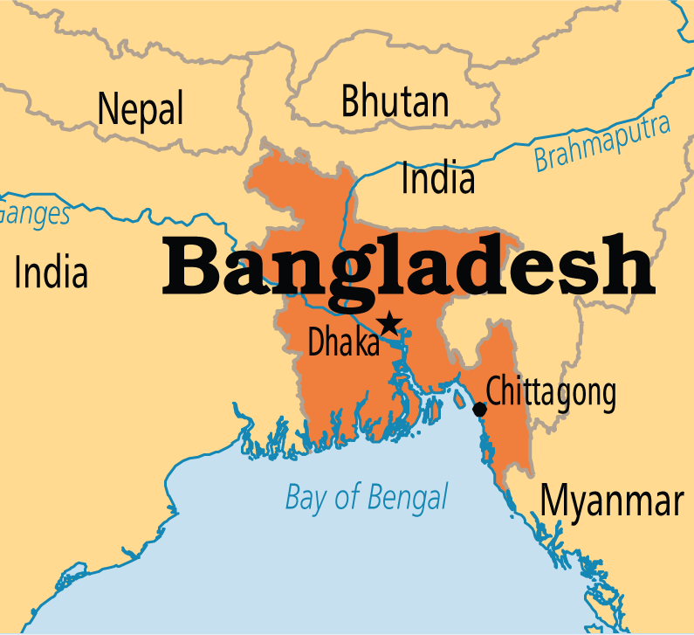
Study Area
Prospects of Windenergie in Bangladesh
Geographical Location:
Average Latitude: 23.5° N
Average Longitude: 90.5° E
Mountainous regions(India,Tibet, Nepal, Bhutan) to the North
See(Bay of Bengal) to the South
East and West are surrounded by India and Myanmar respectively.
MNF-Eco-116
Study Area
Market Share
Investment
Wind Energy
Conclusion

Slide 4
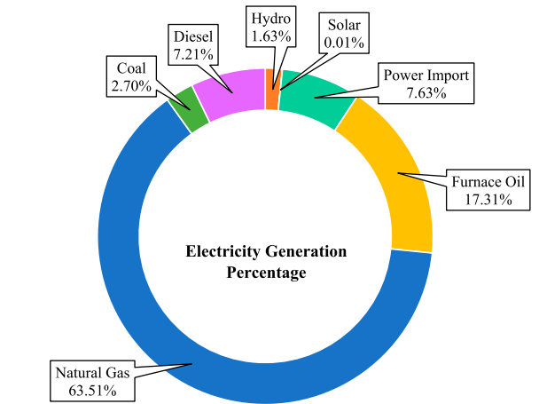
Market share
Prospects of Windenergie in Bangladesh
Energy production in Jan. 2021 is approx. 20000 MW
Mostly used by industries
BPDB, 2021
Masud et al, 2019
MNF-Eco-116
Study Area
Market Share
Investment
Wind Energy
Conclusion

Slide 5
Study Area
Prospects of Windenergie in Bangladesh
Wind Speed
Competition with Solar energy
Infrastructure insufficiency
Lack of suitable transfer grids
Land Scarcity
Cyclones
Corruption
Challenges to Wind Energy
MNF-Eco-116
Study Area
Market Share
Investment
Wind Energy
Conclusion

Slide 6
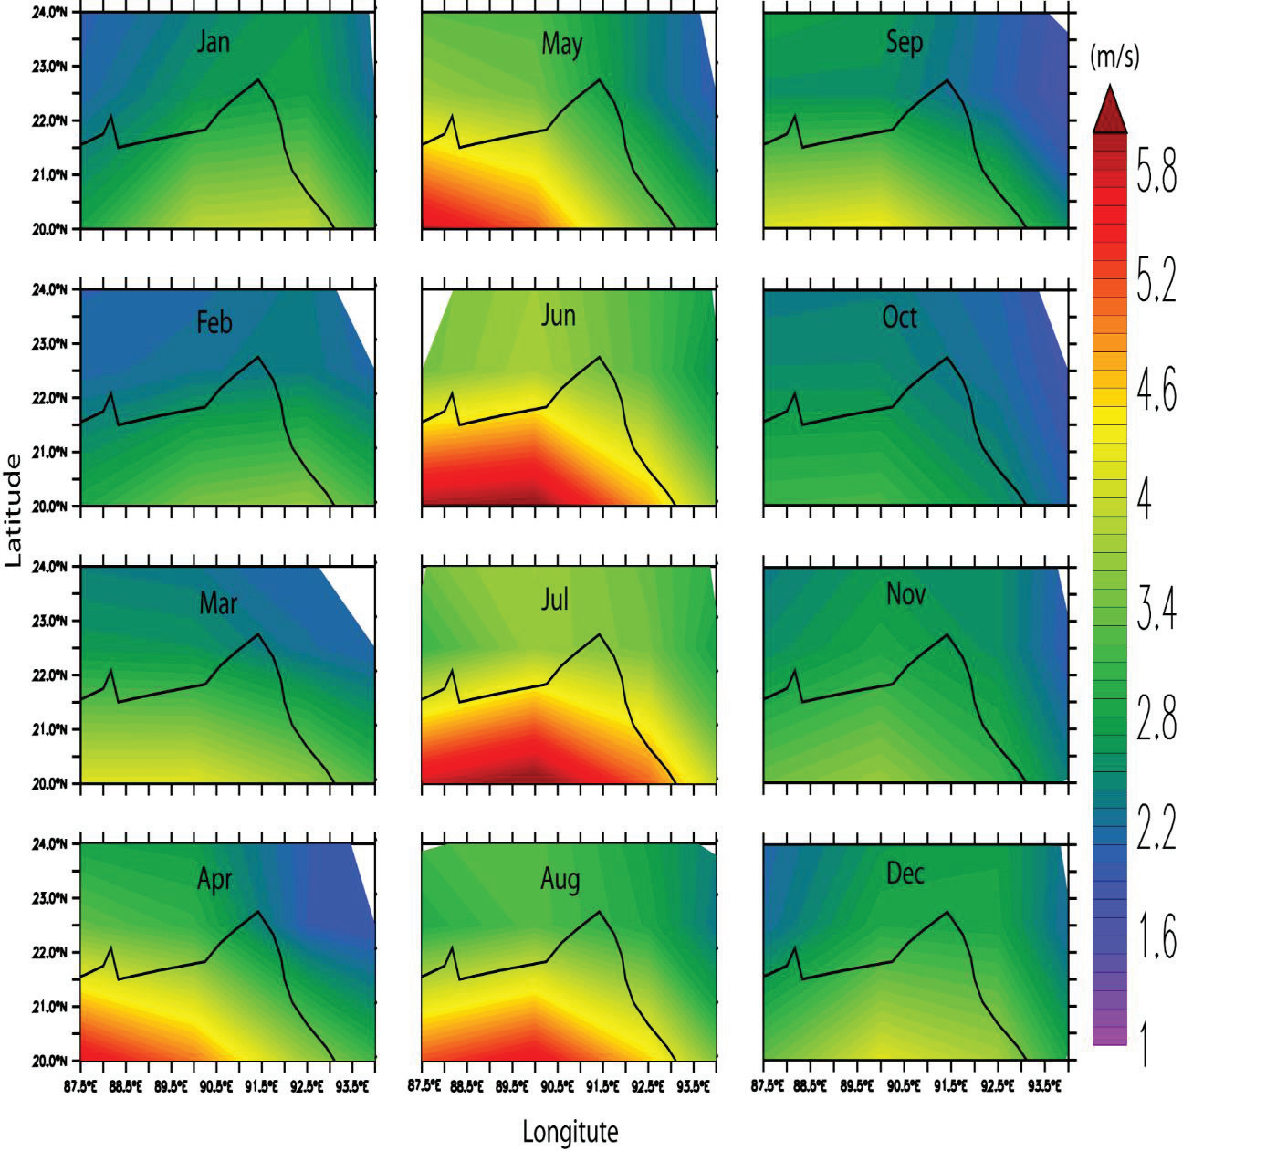
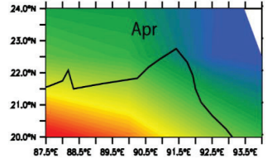
wind energy→ wind speed.
Prospects of Windenergie in Bangladesh
Monthly wind speed varies depending on the latitude and longitude. (from 1990 to 2016).
Speed < 5 m/s is considered as low(Baseline Study Wind Energy Bangladesh, 2017)
Sharif et al, 2017
MNF-Eco-116
Study Area
Market Share
Investment
Wind Energy
Conclusion

Slide 7
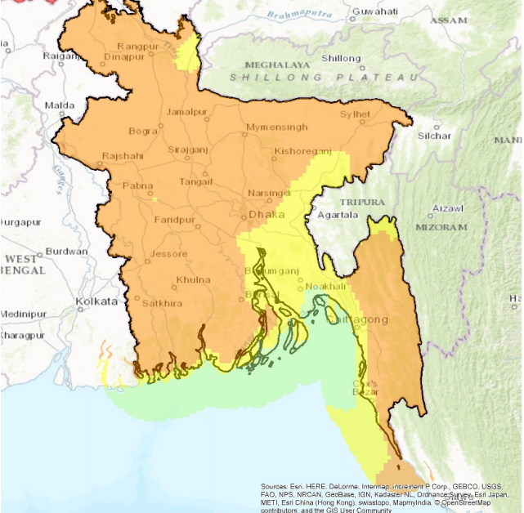
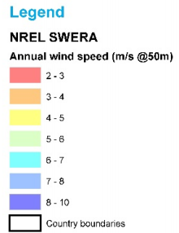
wind energy→ wind speed.
Prospects of Windenergie in Bangladesh
Baseline Study Wind Energy Bangladesh, 2017
MNF-Eco-116
Study Area
Market Share
Investment
Wind Energy
Conclusion

Slide 8
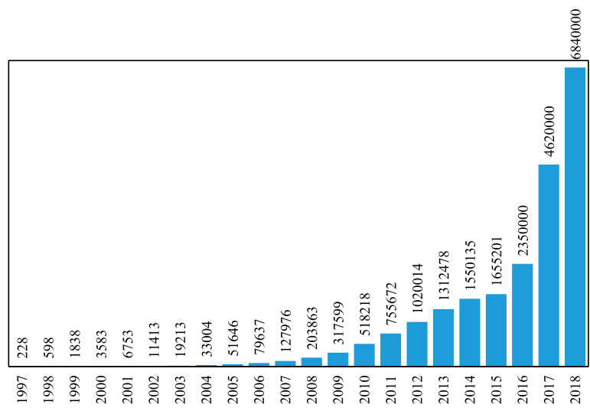
wind energy→ solar ene..
Prospects of Windenergie in Bangladesh
Approx. 18 million people are under with 7 million of Solar Home System
IDCOL,2019
MNF-Eco-116
Study Area
Market Share
Investment
Wind Energy
Conclusion

Slide 9
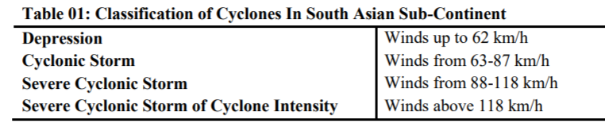
wind energy→ Cyclones
Prospects of Windenergie in Bangladesh
More than 50 cyclones hit Bangladesh since 1950 and 20% of them are categorized as severe.
Hossain & Mallik, 2020
MNF-Eco-116
Study Area
Market Share
Investment
Wind Energy
Conclusion

Slide 10
wind energy→ Land constraints
Prospects of Windenergie in Bangladesh
Wind turbine requires approx. 1 acre permanent and approx. 2 acres of temporary land use during installation and decommission per MW
Installing Wind turbine will be land consuming considering the limited arable land in Bangladesh
MNF-Eco-116
Study Area
Market Share
Investment
Wind Energy
Conclusion

Slide 11
wind energy→ solar ene..
Prospects of Windenergie in Bangladesh
MNF-Eco-116
Study Area
Market Share
Investment
Wind Energy
Conclusion

Slide 12
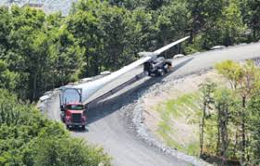
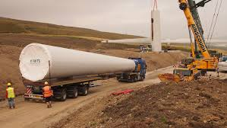
wind energy→ infrastruct.
Prospects of Windenergie in Bangladesh
Lack of sufficient roads in coastal areas for heavy machinery transport could be a problem. Making new roads will consume considerable amount of land area.
Forkers Ltd. Renewable Energy
MNF-Eco-116
Study Area
Market Share
Investment
Wind Energy
Conclusion

Slide 13
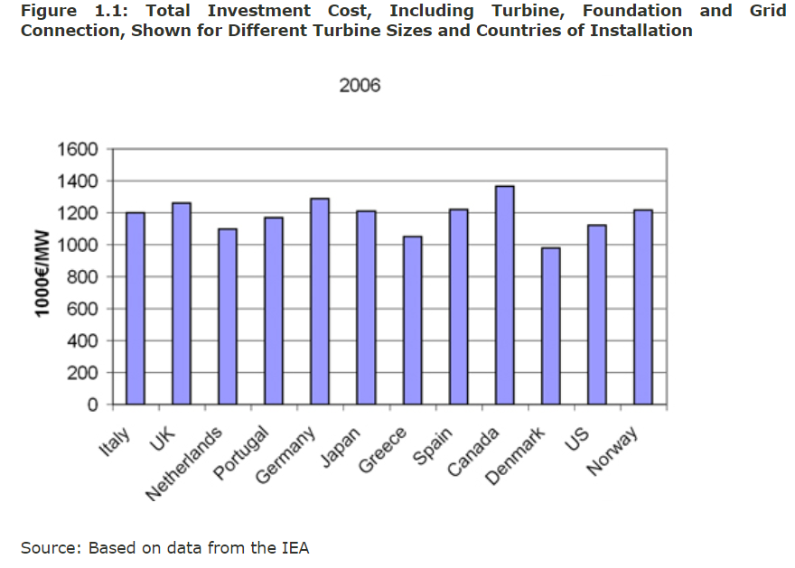
Title page
Prospects of Windenergie in Bangladesh
MNF-Eco-116, Module Teacher: Dr. Philipp Schmagold, Seminar prepared by Razeeb Sarker

Slide 14
wind energy→ already ins..
Prospects of Windenergie in Bangladesh
MNF-Eco-116
Study Area
Market Share
Investment
Wind Energy
Conclusion

Slide 15
wind energy→ approved projects.
Prospects of Windenergie in Bangladesh
MNF-Eco-116
Study Area
Market Share
Investment
Wind Energy
Conclusion

Slide 16
wind energy→Solution.
Prospects of Windenergie in Bangladesh
Is there any way? Yes!!
→ Small scale turbine
Overcome grid scarcity
→ Offshore Wind Farm
Overcome arable land scarcity
→ Hybrid Plant (combination of wind and PV)
Interchangeable options depending on the season
→ Planning for more robust solution
Long-term consideration for Big Offshore wind farm
MNF-Eco-116
Study Area
Market Share
Investment
Wind Energy
Conclusion

Slide 17
wind energy→ Conclusion.
Prospects of Windenergie in Bangladesh
MNF-Eco-116
Study Area
Market Share
Investment
Wind Energy
Conclusion

Slide 18
Prospects of Windenergie in Bangladesh
MNF-Eco-116, Module Teacher: Dr. Philipp Schmagold, Seminar prepared by Razeeb Sarker

Slide 19
Title page
Prospects of Windenergie in Bangladesh
MNF-Eco-116, Module Teacher: Dr. Philipp Schmagold, Seminar prepared by Razeeb Sarker

Slide 20
Title page
Prospects of Windenergie in Bangladesh
MNF-Eco-116, Module Teacher: Dr. Philipp Schmagold, Seminar prepared by Razeeb Sarker

Slide 21
links and infos:
Australia invested 760 m for 1.76 GW
Bangladesh has over 34,000MW of untapped wind power
https://www.youtube.com/watch?v=7j-aiUNUN4s
background color #e8f0ffff
Border color #674ea7ff
References:
bangladesh Image source

Slide 22
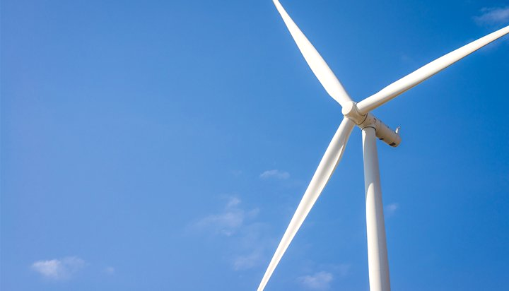
Title page
Prospects of Windenergie in Bangladesh
Study Area
Study Area
Geographical Location:
Average Latitude: 23.5° N
Average Longitude: 90.5° E
Mountainous regions(India,Tibet, Nepal, Bhutan) to the North
See(Bay of Bengal) to the South
East and West are surrounded by India and Myanmar respectively.
Market Share
Investment
Wind energy
Conclusion
Source: www.operationworld.org
MNF-Eco-116, Module Teacher: Dr. Philipp Schmagold, Seminar prepared by Razeeb Sarker

Slide 23
Title page
Prospects of Windenergie in Bangladesh
Study Area
Study Area
Geographical Location:
Average Latitude: 23.5° N
Average Longitude: 90.5° E
Mountainous regions(India,Tibet, Nepal, Bhutan) to the North
See(Bay of Bengal) to the South
East and West are surrounded by India and Myanmar respectively.
Market Share
Investment
Wind energy
Conclusion
Source: www.operationworld.org
MNF-Eco-116, Module Teacher: Dr. Philipp Schmagold, Seminar prepared by Razeeb Sarker

Slide 24
Title page
Prospects of Windenergie in Bangladesh
Study Area
Study Area
Energy production in 2018 is approx. 20000 MW
Mostly used by industries
Market Share
Investment
Wind energy
Masud et al, 2019
Conclusion
MNF-Eco-116, Module Teacher: Dr. Philipp Schmagold, Seminar prepared by Razeeb Sarker

Slide 25
Title page
Prospects of Windenergie in Bangladesh
Study Area
Study Area
Energy production in 2018 is approx. 20000 MW
Market Share
Investment
Wind energy
Conclusion
MNF-Eco-116, Module Teacher: Dr. Philipp Schmagold, Seminar prepared by Razeeb Sarker

Slide 26
Title page
Prospects of Windenergie in Bangladesh
Title of Seminar:
Prospects of Wind Energy in Bangladesh
Exam protocol of MNF-Eco-116 : Planning and Managing of a Wind Farm
Module Teacher:
Dr. Philipp Schmagold, Ebert Erneuerbare Energien Wind GmbH & Co. KG
Prepared by
Razeeb Sarker
MNF-Eco-116, Module Teacher: Dr. Philipp Schmagold, Seminar prepared by Razeeb Sarker

Slide 27
Title page
Prospects of Windenergie in Bangladesh
Outline:
Study area:
  Geographical Location
  Major weather traits/characteristics
Energy sources and market condition
  Source wise share
  Tariff
Investment in energy sector:
  State investment
  Private investment
  State-Private investment
  Running Mechanism
MNF-Eco-116, Module Teacher: Dr. Philipp Schmagold, Seminar prepared by Razeeb Sarker

