Slide 1
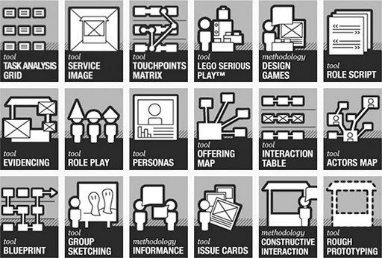
This is Service Design in 25 useful tools
Tijs Wilbrink
Methods from `this is service design thinking`

Slide 2
All service design methods in one overview
The profession of service design has lately been enriched with several methods and tools.
This is an overview of available methods and tools to design better customer experiences.
This document is best used with a problem of opportunity in mind, and select your best next step from the variety of available methods.

Slide 3
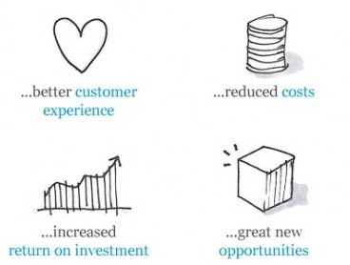
Why do we, or should we use service design?

Slide 4
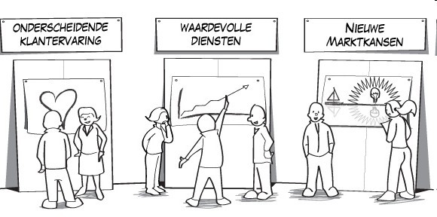
Using service design tools for exploration
Chapter 1 of 3
Distinctive customer experience
Valuable services
New market opportunities

Slide 5
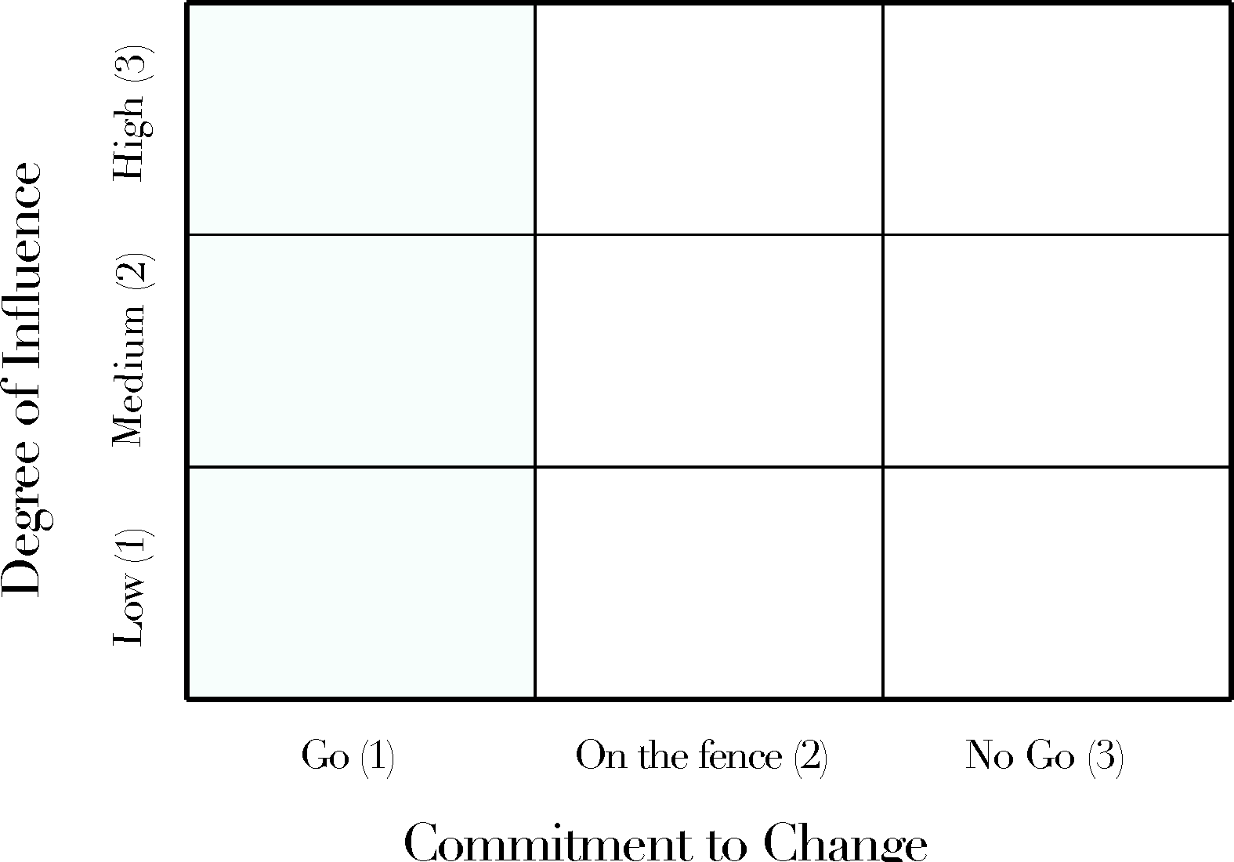
#1 Stakeholder mapping to plan for influence and change
Tools for Exploration
Visual representation of stakeholders to analyse and plan upon.

Slide 6

#2 Go on a service safari out into the wild and experience
Tools for Exploration

Slide 7
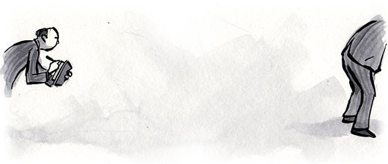
#3 Use contextual interviews to observe behaviour
Tools for Exploration

Slide 8

#4 Use mobile ethnography to observe from the outside
Tools for Exploration

Slide 9
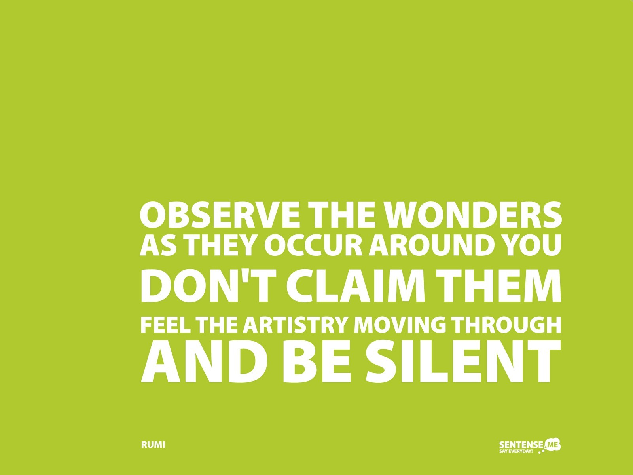

#5 Or use shadowing to observe while mingling in.
Tools for Exploration

Slide 10
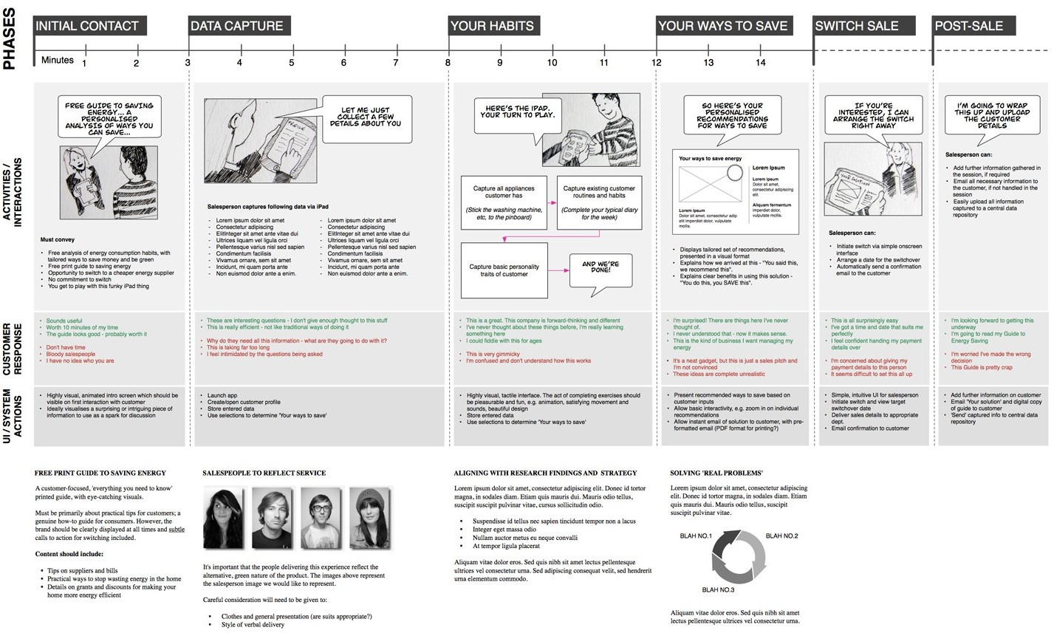
#6 Use customer journeys to structure your processes
Tools for Exploration

Slide 11
#7 Or the 5 why’s to get down to the core of the problem
Tools for Exploration
Training
Car won’t start

Slide 12
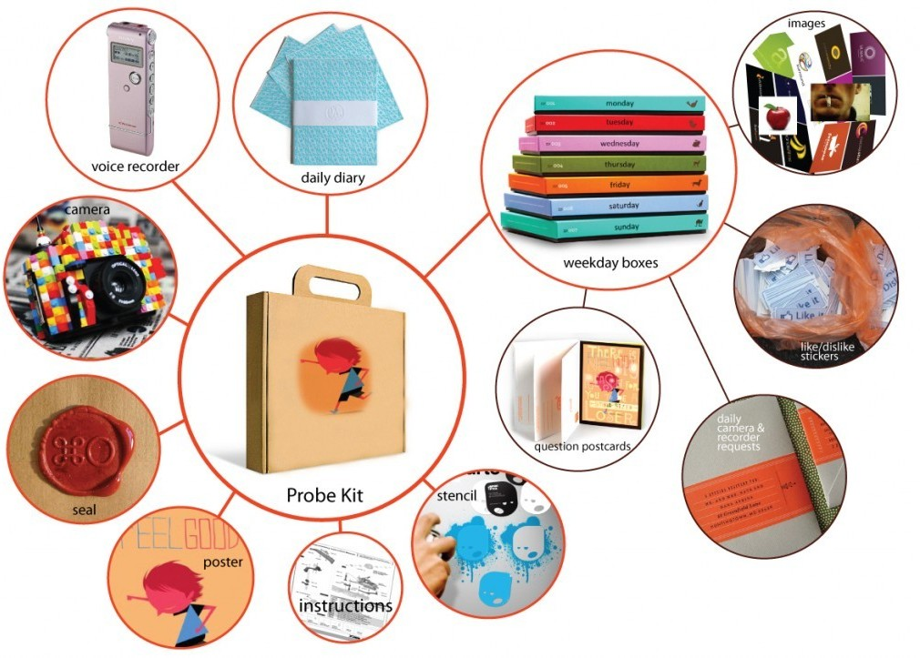
#8 Cultural probes to gather more information
Tools for Exploration

Slide 13
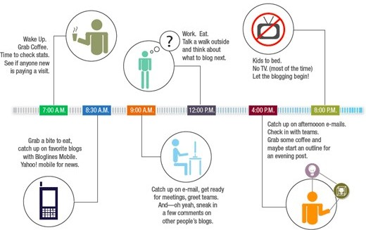
#9 Use ‘a day in the life of’ for a complete customer view
Tools for Exploration

Slide 14

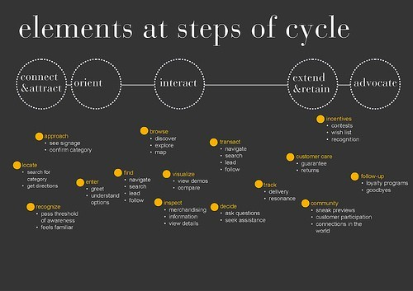
#10 Map customer expectations
Tools for Exploration

Slide 15
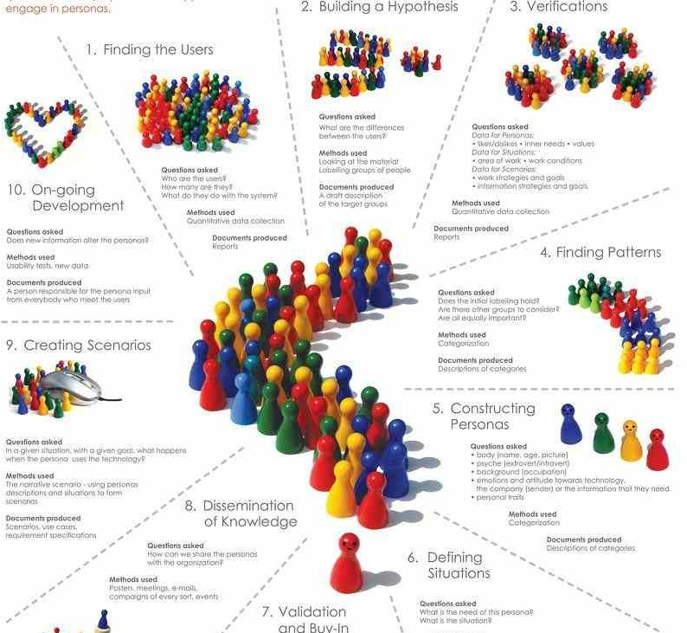
#11 Use personas for stress tests on customer segments
Tools for Exploration

Slide 16

Using service design tools to create and reflect
Chapter 2 of 3

Slide 17

#12 Use idea generation to create ideas
Tools to Create and Reflect

Slide 18

#13 Ask “what if”-questions to provoke thinking
Tools to Create and Reflect

Slide 19
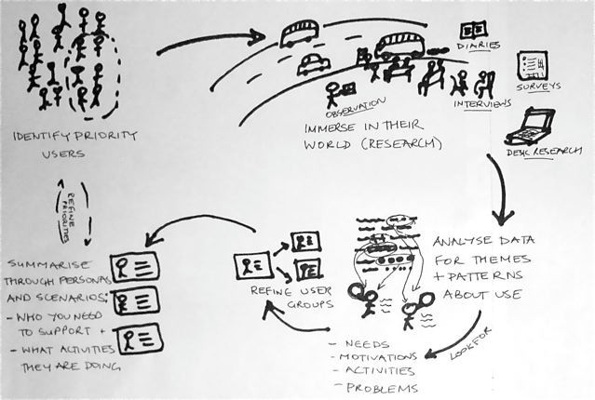
#14 Design scenarios as alternative futures
Tools to Create and Reflect

Slide 20
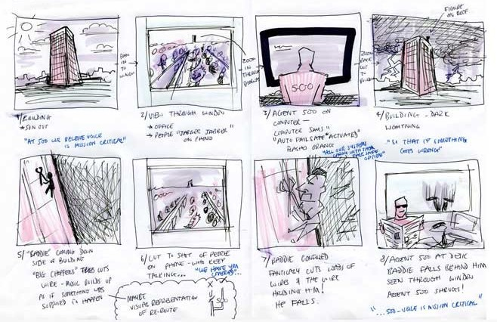
#15 Leverage storyboards for visualisation
Tools to Create and Reflect

Slide 21
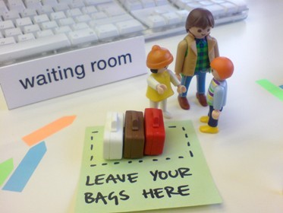
#16 Play with desktop walkthroughs to make it visible
Tools to Create and Reflect

Slide 22

#17 Prototype your services and simulate
Tools to Create and Reflect

Slide 23

#18 Create a safe environment with service staging
Tools to Create and Reflect

Slide 24
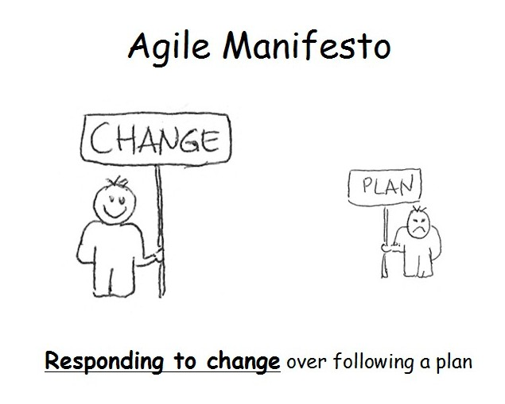
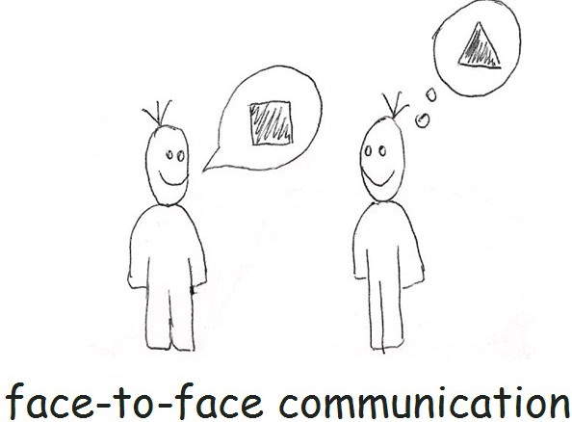
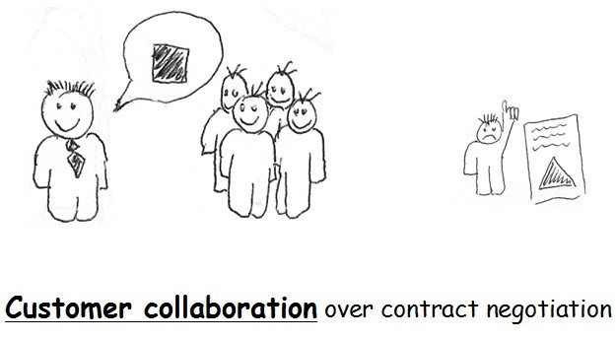
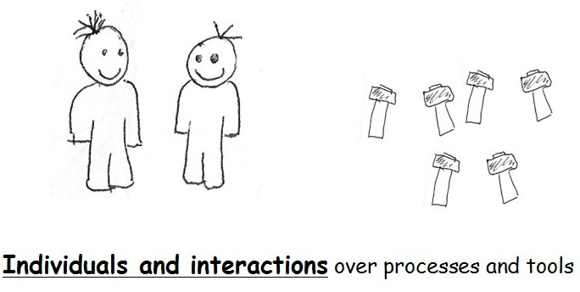
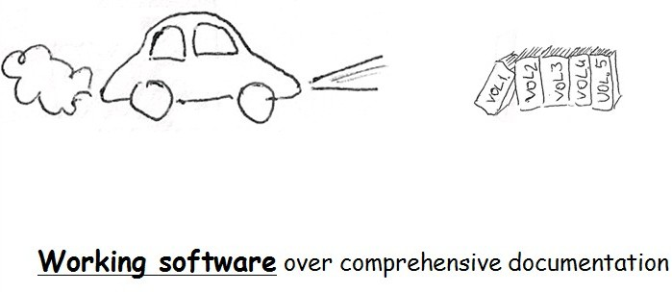
#19 Develop fast and responsive with agile methods
Tools to Create and Reflect

Slide 25
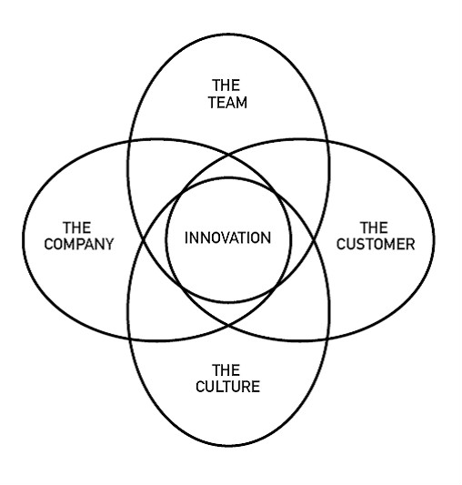
#20 Use co-creation to involve other stakeholders
Tools to Create and Reflect

Slide 26
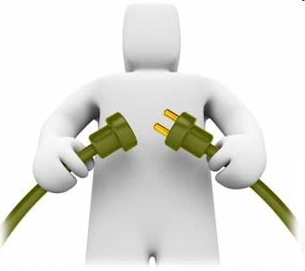
Using service design tools for implementation
Chapter 3 of 3

Slide 27

#21 Use storytelling for better comprehension
Tools for Implementation

Slide 28
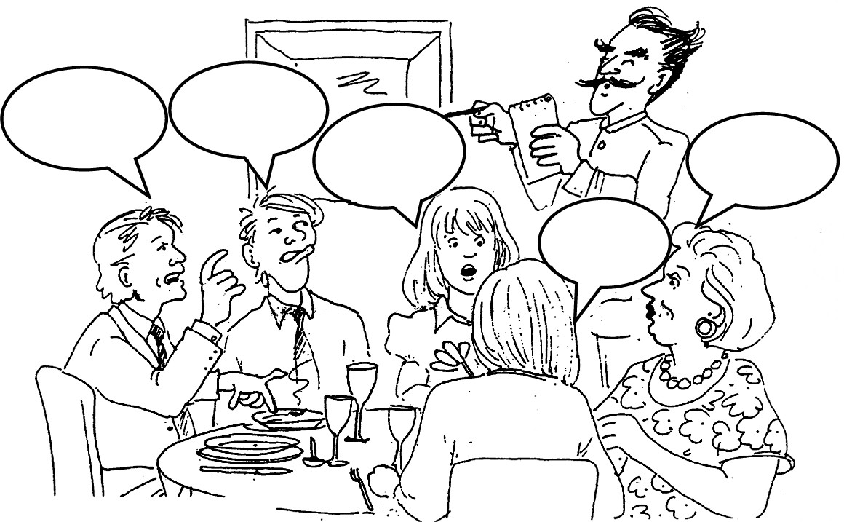
#22 Interact with your staff through service roleplay
Tools for Implementation

Slide 29
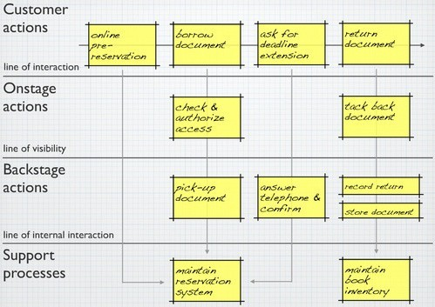
#23 Link journeys to process with service blueprints
Tools for Implementation

Slide 30
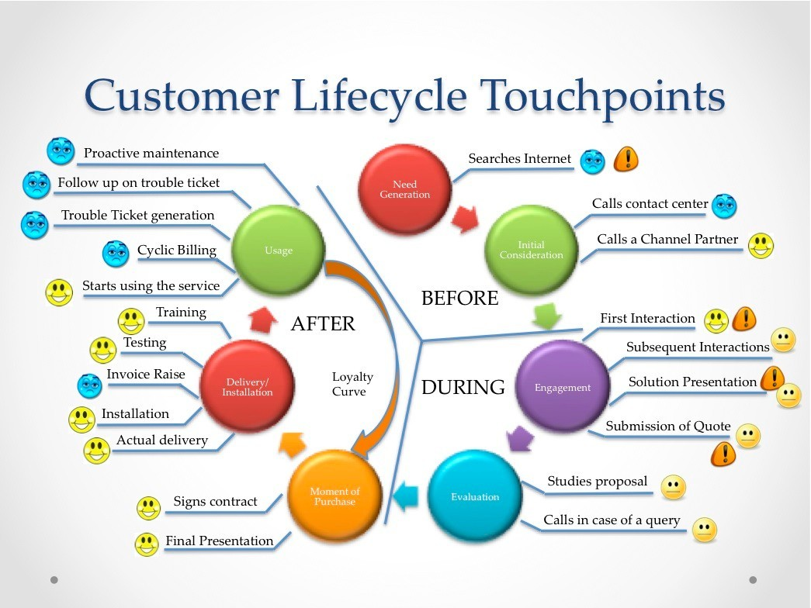
#24 Gain insight with customer lifecycle maps
Tools for Implementation

Slide 31
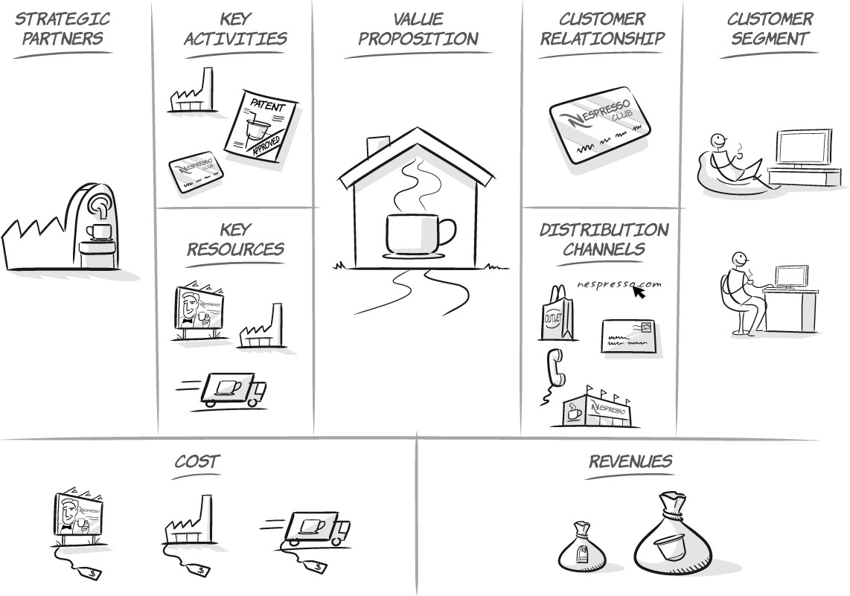
#25 Create your new business model using the canvas
Tools for Implementation

Slide 32

Get out there and get it going
End

