Slide 1
E-Commerce Website A/B Testing
Sarkis M Gonzalez Moujalli
Western Governors University

Slide 2
Does the new website perform better?
Conversion Rate
Sales
Notes:
SLIDE 2
SOURCE OF DATASET (MYSELF)
Their research comes from the need of the organization to make data-driven decisions to implement decisions that aim to increase sales, therefore mitigating risks. The research question I answered with this analysis is: Is the conversion rate (customers that buy a product) greater for the version of the website than the old version? This question was answered through A/B testing, and it determined if deploying the new website is the best choice.
SLIDE 3

Slide 3
Solution Overview
Jupyter Notebooks
Python
Pandas
Matplotlib
Notes:
The methodology used for this project was Waterfall. Given the size of the project and the clean condition of the data, a linear approach and planning from the beginning was sufficient. Another reason to choose the Waterfall methodology is the low chance that the project scope or objectives would change during the process.
Step 1: Defining Objectives. This was documented using the Project Approval form and this document.
Step 2: Data Understanding. In this step, data was gathered, requirements were defined, and an initial exploration of the data available was performed.
Step 3: Data Preparation. Data was gathered from Kaggle and imported using Jupyter Notebooks and Python. Cleaning and data wrangling was be performed.
Step 4: Exploratory Analysis and Modeling. In this step, a more thorough data exploration was performed. Variables for the analysis were determined, and the A/B testing was performed.
Step 5: Validation. Results were evaluated and reviewed, and a regression model was used to validate them.
Step 6: Visualization and Presentation: The project was uploaded to GitHub for peer review, and a presentation containing data visualizations was created to present the analysis results.
Anaconda Conda was used as an environment manager. Within this environment, Python, git, and Jupyter notebooks was installed to perform the analysis. Jupyter notebooks used my local environment, and Python was used to gather, analyze, and create visuals. The Python Libraries used were: Pandas, Numpy, statsmodel and matplotlib.

Slide 4
Technique and Methods
A/B Testing
Logistic Regression
Notes:
SLIDE 4
This project used diagnostic statistics to uncover what happened in the past. This was done by analyzing the results of an experiment conducted over the treatment and control groups and determining the cause and effect between page version and conversions. The analytical technique used to complete this diagnosis was A/B testing. The A/B test is a type of Hypothesis testing used to compare the difference in performance in one metric between two groups. In this case, this performance is measured using conversion rate. A/B testing is highly recommended and frequently used to compare the performance of two pages regarding conversion rates. This technique provides quantifiable results and a likelihood through p-value that the results are due to chance, providing strong confidence.
In addition, a logistic regression model was also used. However, this model was only used to validate the results of the A/B test, so it was not the focus of this analysis. In this project, both models had a similar result, therefore the validation was successful.

Slide 5
Demonstration
Functionality of the code

Slide 6
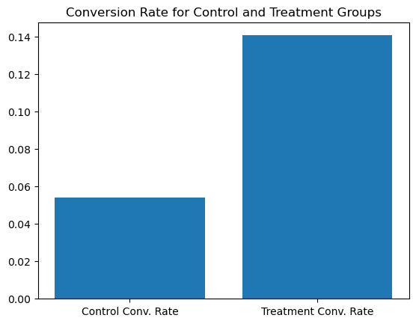
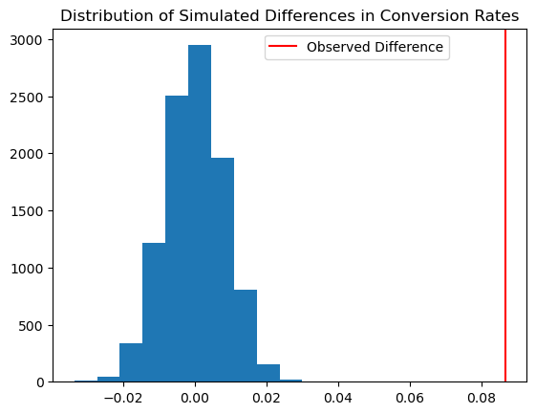
Findings
Notes:
Slide 6
The second visual shows the results of the test. By displaying the distribution of simulated differences in conversion rates, we can see all the possible differences that we should observe if there would not be difference between the two groups. In addition, this visual shows the observed difference. This provides a lot of insight, as we can see that the observe difference is by very far higher than the simulated differences. What this means is that there is a 0% probability that the observed difference is due to chance. This then provides a visual way to observe the results, which can be much more compelling than a p-value.

Slide 7
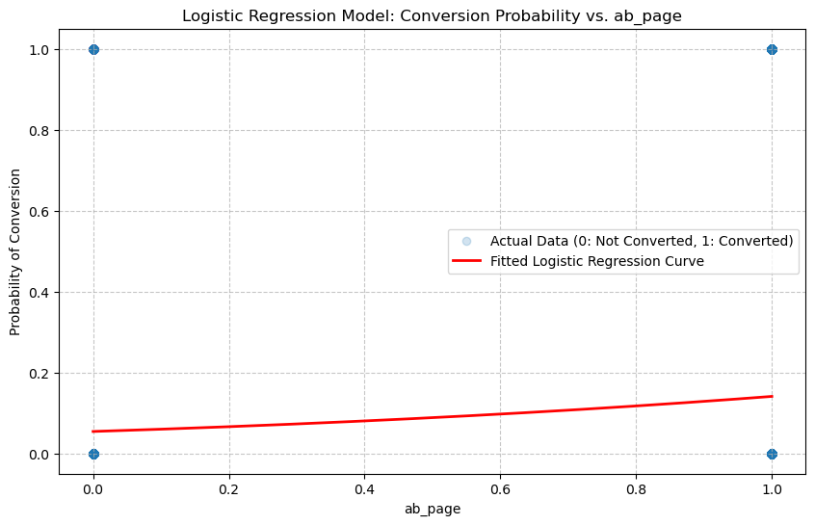
Findings
Notes:
SLIDE 7
Lastly, we plotted the logistic regression model used to validate the A/B test results. This graphical representation effectively supports storytelling in an A/B test by offering a clear, intuitive visual narrative of the experiment's outcome. The scattered points immediately show the raw reality: that users either converted or didn't. Overlaying the logistic regression curve then demonstrates how the model captures the subtle shift in conversion probability between the old and new pages. It moves beyond just a "yes or no" answer, allowing stakeholders to see that while the absolute conversion rate might still be low for both groups, the new page demonstrably pushes that probability upward.

Slide 8
Implications and Recommendations
Implement New Website
Investigation and improvement
Notes:
SLIDE 8
The results of the analysis shows that the new page would increase the conversion rate from about 5.54% to 14%. The results are both practically and statistically significant. This leads us to provide the following recommendations to the decision makers:
Implement the new version of the website as soon as possible. The new version of the website could lead to sales 2.6 times higher than the original page. The implementation should consider change management, but it should be done fast given that the opportunity cost of not implementing it now is significantly high.
The stunning difference in performance between the two pages illustrates how low performance the original page was. We recommend doing an investigation on why the original page was implemented in the first place to avoid making such mistakes in future websites developed by the e-commerce.

