Slide 1

Ansible Knowledge Sharing
Date: Feb/10/2016

Slide 2
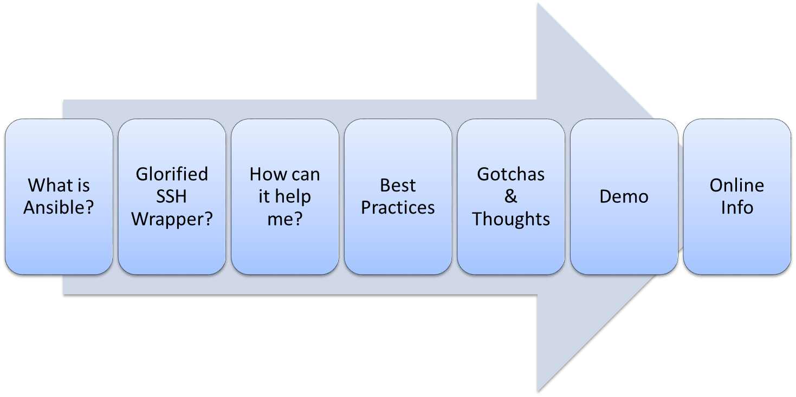
Agenda

Slide 3
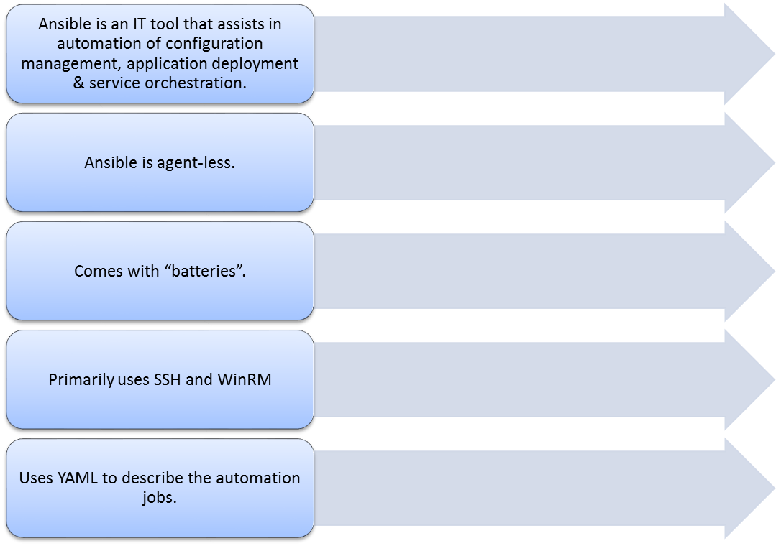
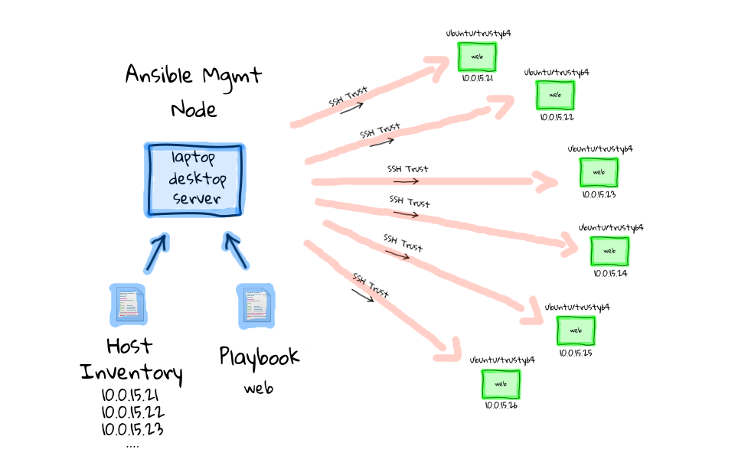
What is Ansible?
Image Source: https://sysadmincasts.com

Slide 4
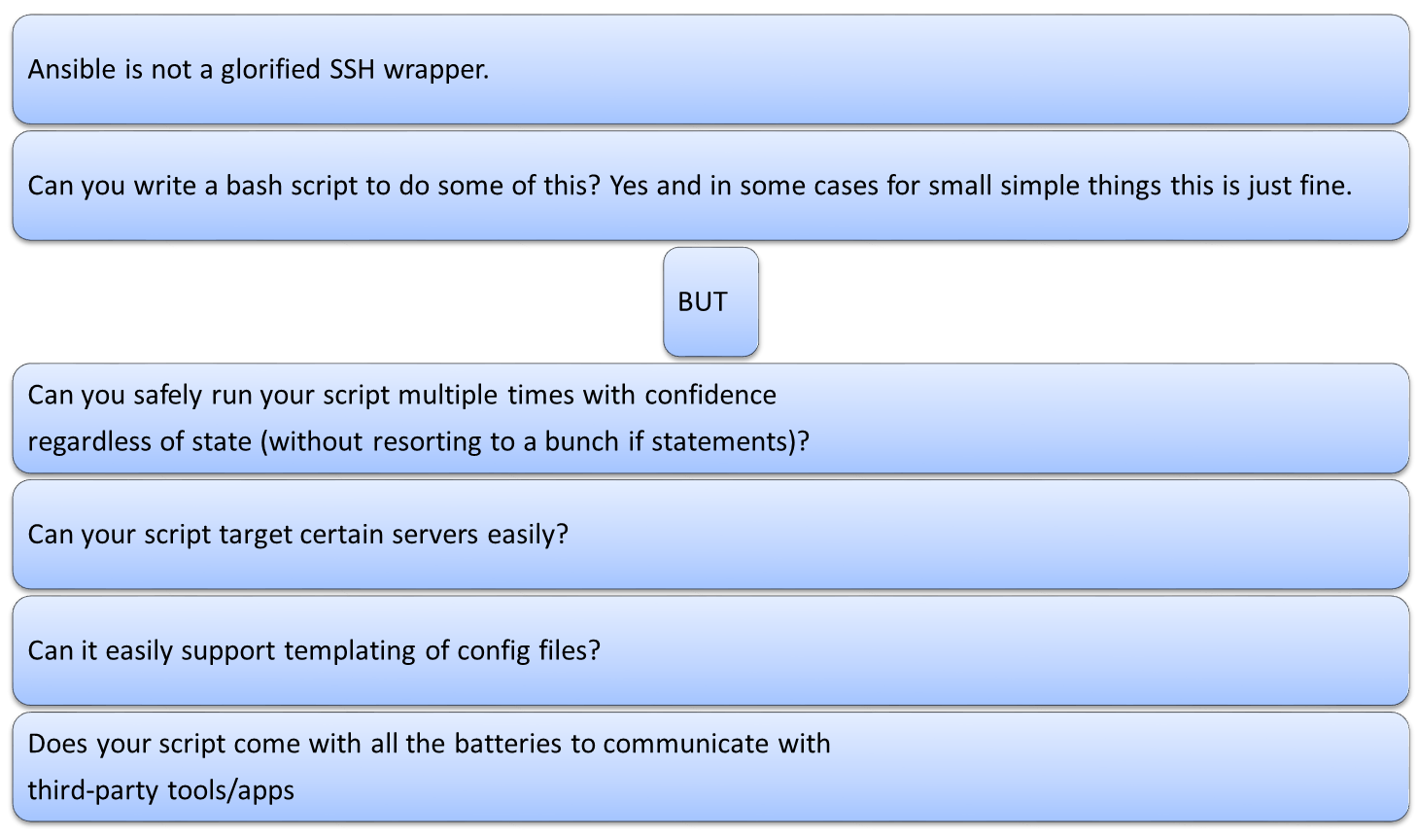
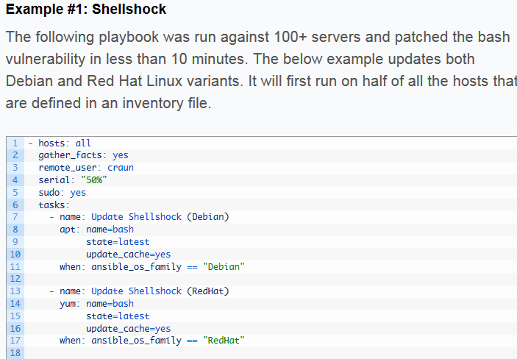
Glorified SSH Wrapper?

Slide 5
How can it help me?
Ansible can help automate some of those repetitive tasks that can become annoying
Ansible can help decrease Frankenstein environments often found with manual configuration
Through Ansible roles you can share common installation & configuration tasks amongst team members.
Security and Standards checking periodically configuration/state and reporting differences or reverting
There are many Ansible modules to assist with integration with third party tools, such as Vsphere tasks, F5 tasks, AWS tasks etc…

Slide 6
How can it help me?
An example process taken from an Ansible forum in regards to RHEL provisioning:
We enter the server's information into our custom database (MySQL) that we use to track our inventory. We also use this table to create our dynamic inventory for Ansible. The table contains the server's name, IP and other server specific information.
2. We kick off an Ansible playbook that does the following
Checks to see if the VM has already been created
Creates the VM using the vsphere_guest module. The VM is setup to boot on a network with DHCP.
Collects facts about the VM. We need this in order to get the MAC address of the newly created VM.
Updates our database with the MAC of the new VM.
Powers on the new VM.
The server is powered on with a custom RHEL ISO attached. The custom ISO is pointing to web service that will dynamically build our kickstart file. (http://kickstart.example.com/ws/ks.php). The custom ISO also has the inst.ks.sendmac, ks.sendmac and kssendmac parameters set on the kernel line. This will send the VM's MAC address to the web service which allow it to figure out the VM's IP information.
The kickstart script installs base packages, subscribes the VM with Satellite, installs VM tools and adds the server to our AD domain. The last thing the script does is send a web call to a web service that will change the VM's network from the DHCP network to the network that the VM is supposed to be on.
5. Once the VM is up it is ready to have our standard Ansible plays ran on it.

Slide 7
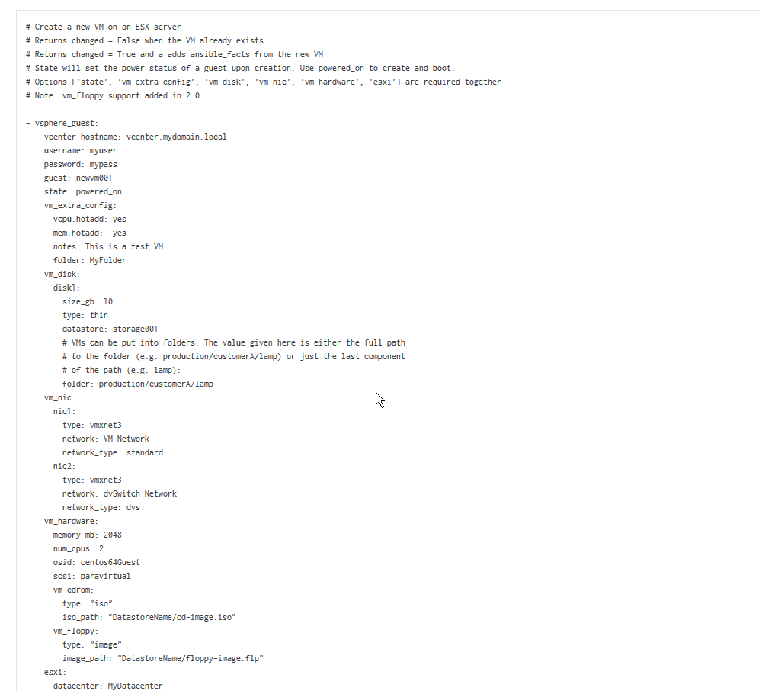
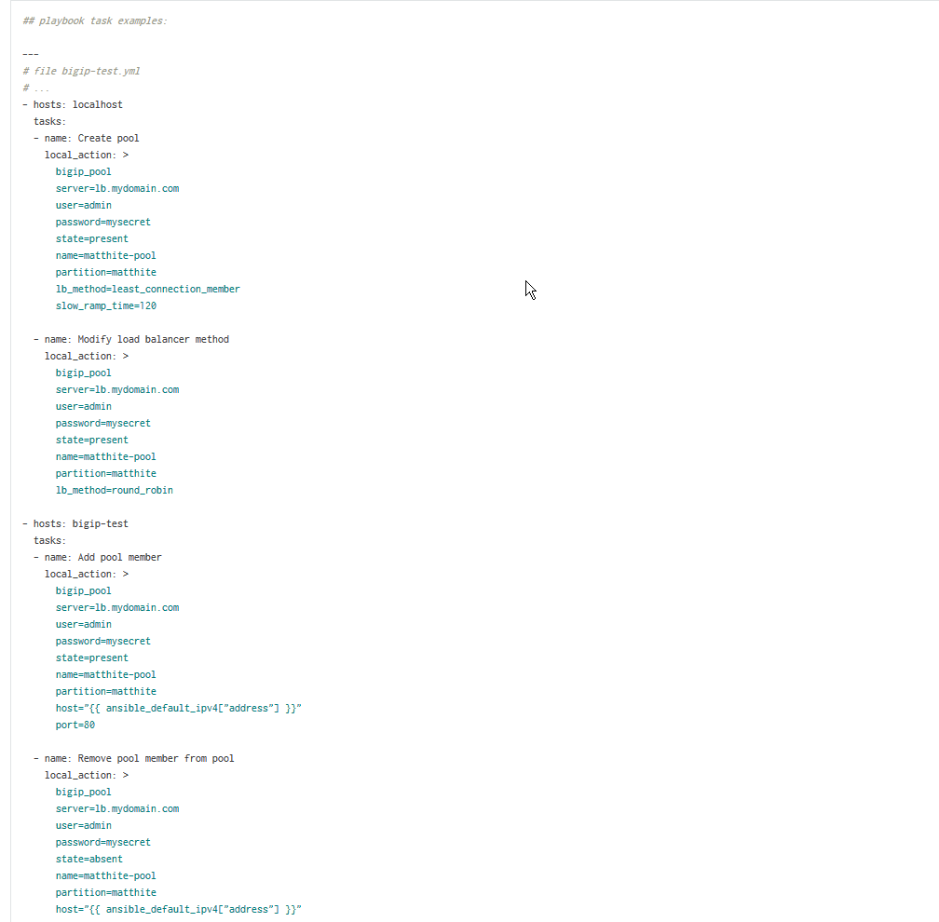
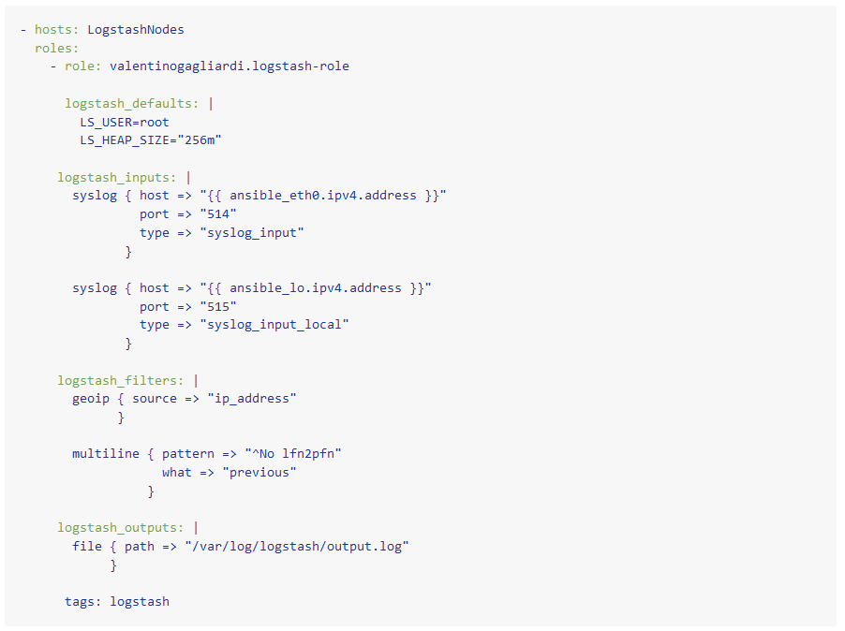
How can it help me?

Slide 8
Best Practices
Use Ansible Modules where you can
Use Roles and pick up an existing one if available OR at least includes
- roles build on the idea of include files and combine them to form a clean & reusable abstraction and are automation around “includes” and search path handling.
Version roles in a VCS (git) with tags
Think reusability
Ansible Galaxy (website & command-line tool)
- cli tool provides role templates
- cli tool can pull roles from galaxy or private git

Slide 9
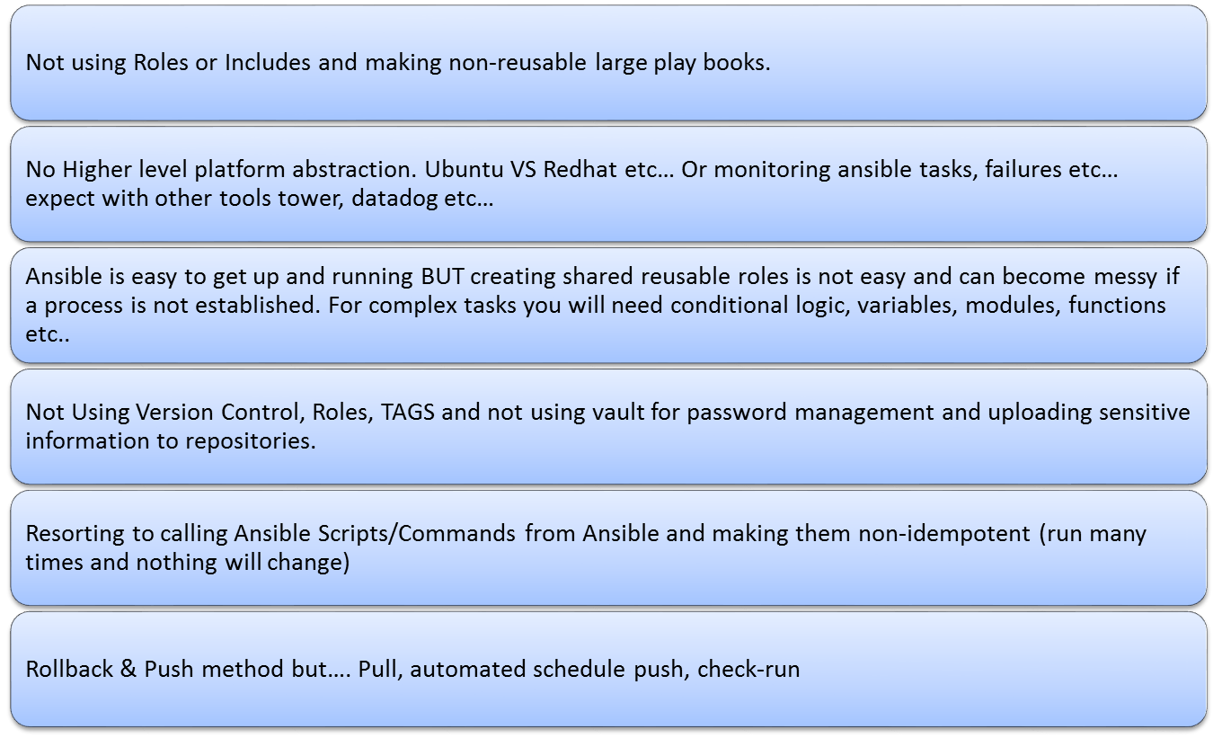
Gotchas

Slide 10
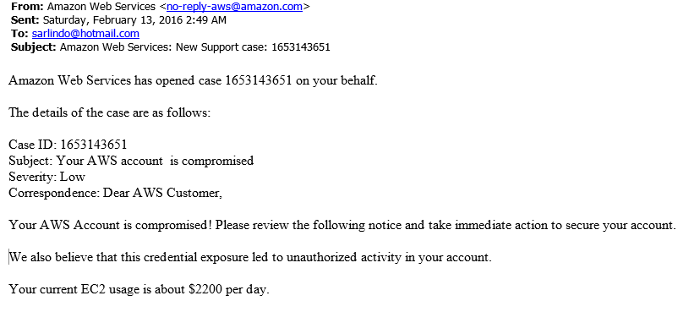
Gotchas

Slide 11
Some Thoughts….
To keep the barrier of entry small, disregard some of the best practices
  Don’t worry too much about reuse and duplication and versions
  Don’t worry too much about Ansible Galaxy command line
  Start with the open source command line Ansible and when complex use cases arise, then look at refactoring and/or additional add-ons such as Tower
  Even if Ansible is not the tool for TMX, falling back to existing processes would be minimal
  Initially no need for third-party Redhat support

Slide 12
Some Thoughts….
Deployment VS Provisioning VS Orchestration VS Config Management
  Dev View
    Probably means preparing everything from servers, middleware and finally deploying the application.
  Ops View
    “Provisioning” preparing servers for use by app (install os, connect to network, AD, storage etc…)
    “Middleware Provisioning” prepare middleware above the o/s required by the app to run (web servers, app servers, caching, libraries, databases, brokers, messaging etc…)
    “Application Deployment” would be to deploy the application into the environment along with it’s state with “Configuration management”.
    “Orchestration” would be to allow for a tool to perform these tasks in coordinated manner.

Slide 13
Some Thoughts….
I find myself struggling on how to best organize the Ansible playbooks given the various teams and subject matter experts and how to organize the git repos
Maybe a POC of an end-to-end automated Ansible deployment & provision process of an application would help flush this out. Outside ad-hoc plays.
  Ansible\Infrastructure\OS\provision-rhel-vsphere.yml
  Ansible\Infrastructure\Network\F5\f5-add-app-pool.yml
  Ansible\Platform\roles\nginx
  Ansible\Platform\roles\httpd, jboss, etc…
  Ansible\App\Equity\provision-equity.yml ← Responsible for stringing together and orchestrating all this?
  Ansible\App\Equity\deploy-equity.yml

Slide 14
Demo
One off ansible commands
Simple playbook & tags
Playbook with roles
Galaxy Git & Role Reuse
A full Ansible Orchestrated AWS/RDS Oracle/Windows/App

Slide 15
Online Info
Ansible tutorial
https://sysadmincasts.com/episodes/43-19-minutes-with-ansible-part-1-4
How Twitter Uses Ansible (Guy is funny)
https://www.youtube.com/watch?v=fwGrKXzocg4
Playbook Best Practices
http://docs.ansible.com/ansible/playbooks_best_practices.html

