Slide 1

Ansible Knowledge Sharing
Date: Feb/10/2016

Slide 2
Agenda
What is Ansible?
Glorified SSH Wrapper?
How can it help me?
Best Practices
Gotchas
Demo
Great Online Tutorial

Slide 3
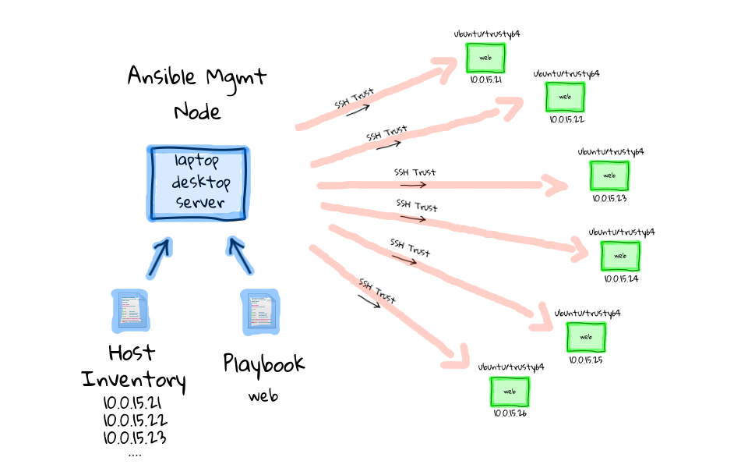
What is Ansible?
Ansible is an IT tool that assists in automation of configuration management, application deployment & service orchestration.
Ansible is agent-less.
Comes with “batteries”.
Primarily uses SSH and WinRM
Uses YAML to describe the automation jobs.
Image Source: https://sysadmincasts.com

Slide 4
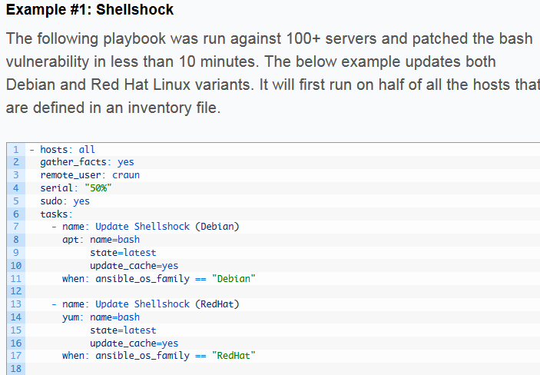
Glorified SSH Wrapper?
Ansible is not a glorified SSH wrapper.
Can you write a bash script to do some of this? Yes and in some cases for small simple things this is just fine.
BUT
Can you safely run your script multiple times with confidence
regardless of state (without resorting to a bunch if statements)?
Can your script target certain servers easily?
Can it easily support templating of config files?
Does your script come with all the batteries to communicate with
third-party tools/apps

Slide 5
How can it help me?
Ansible can help automate some of those repetitive tasks that can become annoying
Ansible can help decrease Frankenstein environments often found with manual configuration
Through Ansible roles you can share common installation & configuration tasks amongst team members.
There are many Ansible modules to assist with integration with third party tools, such as Vsphere tasks, F5 tasks, AWS tasks etc…

Slide 6
How can it help me?
An example process taken from an Ansible forum in regards to RHEL setup:
We enter the server's information into our custom database (MySQL) that we use to track our inventory. We also use this table to create our dynamic inventory for Ansible. The table contains the server's name, IP and other server specific information.
2. We kick off an Ansible playbook that does the following
Checks to see if the VM has already been created
Creates the VM using the vsphere_guest module. The VM is setup to boot on a network with DHCP.
Collects facts about the VM. We need this in order to get the MAC address of the newly created VM.
Updates our database with the MAC of the new VM.
Powers on the new VM.
The server is powered on with a custom RHEL ISO attached. The custom ISO is pointing to web service that will dynamically build our kickstart file. (http://kickstart.example.com/ws/ks.php). The custom ISO also has the inst.ks.sendmac, ks.sendmac and kssendmac parameters set on the kernel line. This will send the VM's MAC address to the web service which allow it to figure out the VM's IP information.
The kickstart script installs base packages, subscribes the VM with Satellite, installs VM tools and adds the server to our AD domain. The last thing the script does is send a web call to a web service that will change the VM's network from the DHCP network to the network that the VM is supposed to be on.
5. Once the VM is up it is ready to have our standard Ansible plays ran on it.

Slide 7
Best Practices
Use Ansible Modules where you can
Use Roles and pick up an existing one if available
Version roles in a VCS (git) with tags
Think reusability
Ansible Galaxy (website & command-line tool)
- cli tool provides role templates
- cli tool can pull roles from galaxy or private git
http://docs.ansible.com/ansible/playbooks_best_practices.html

Slide 8
Gotchas
Not using Roles and making non-reusable large play books.
No Higher level platform abstraction. Ubuntu VS Redhat etc…
Ansible is easy to get up and running BUT creating shared reusable roles is not easy and can become messy if a process is not established.
Not Using Version Control, Roles, TAGS and not using vault for password management and uploading sensitive information to repositories.
Resorting to calling Ansible Scripts/Commands from Ansible and making them non-idempotent (run many times and nothing will change)

Slide 9
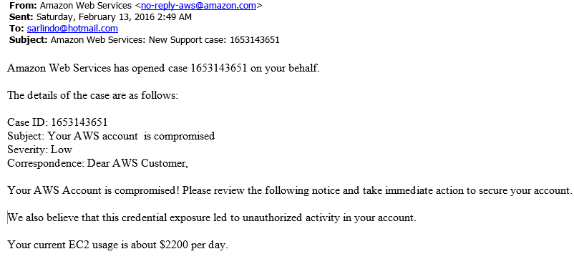
Gotchas

Slide 10
Demo

Slide 11
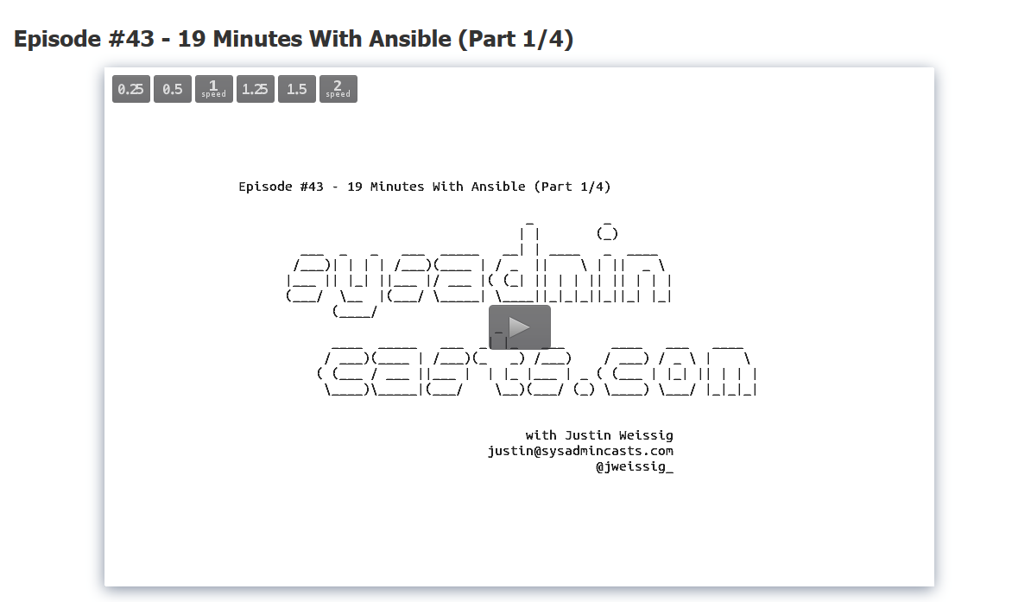
Great Online Tutorial
https://sysadmincasts.com/episodes/43-19-minutes-with-ansible-part-1-4

