Slide 1
Formulate: Intelligent Multi‑Agent Automated System for Form Processing
Team Members: Ubaid, Bilal, Sarmad
Supervisor: Dr. Omer Usman
Department of Computer Science, FAST‑NUCES Peshawar
Date: 3-Nov-2025

Slide 2
Last Discussion
Segmentation
Why agents? Maybe modules or some other name
Form extraction agent?

Slide 3

Decision Summary
Object Detection
Segmentation
Our dataset is annotated using instance segmentation and model is using object detection to improve detection performance

Slide 4

Progress Overview
Questions
Dataset?
Model Training?
Tool used?
Data collection results
Challenges and Hurdles ( Labeling )
Struggles

Slide 5

Dataset?
Canva – 50%
Google – 40%
Word / Docs – 5%
Pinterest – 5%
Model Training?
Roboflow
Tool Evaluation
Roboflow
LabelImg (paid)
Label Studio
Makesense.ai

Slide 6
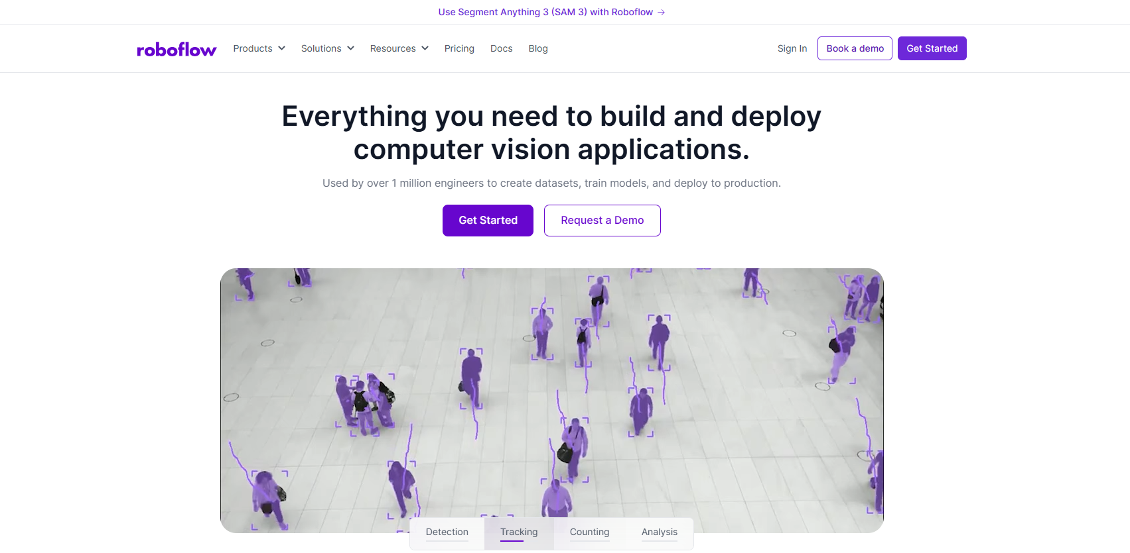
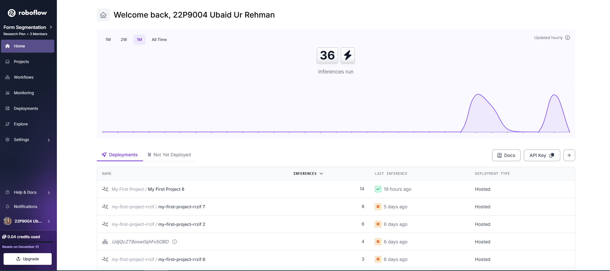
Roboflow

Slide 7


Slide 8
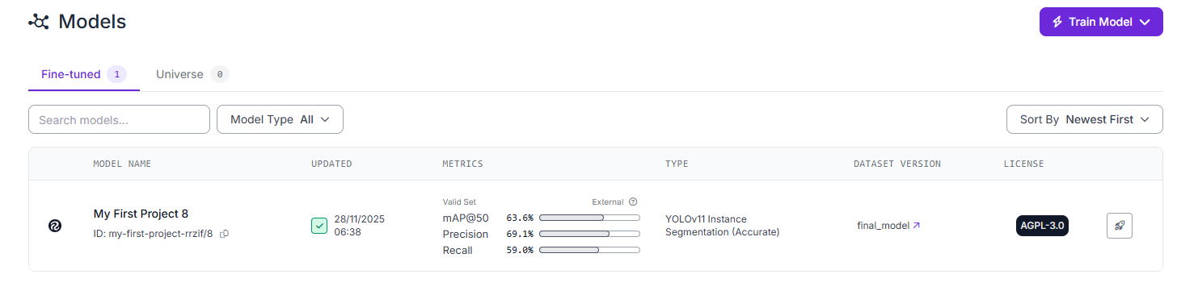
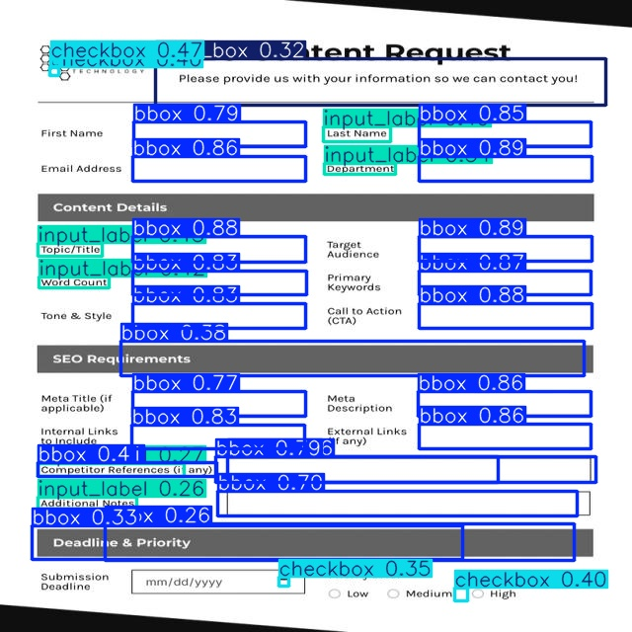
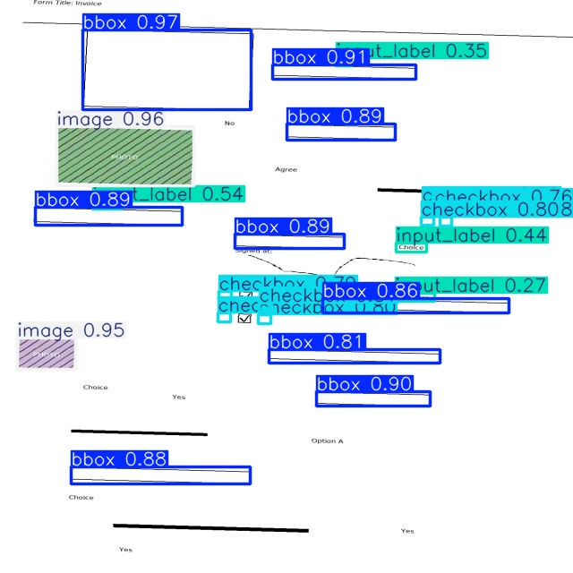
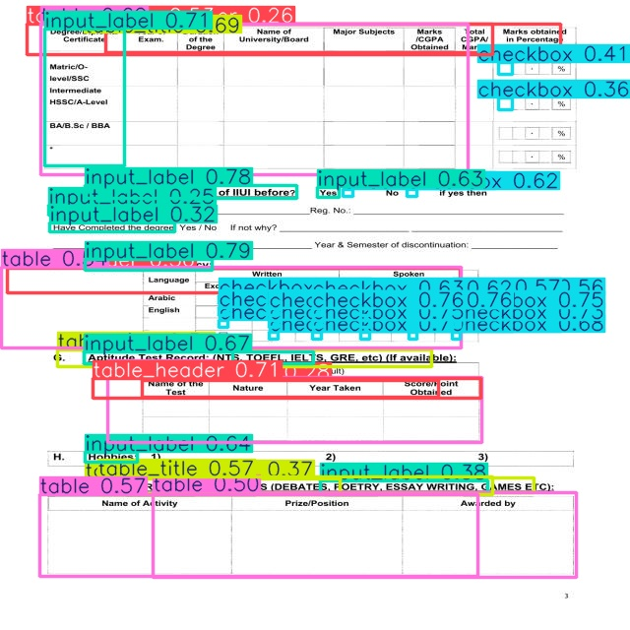

Slide 9
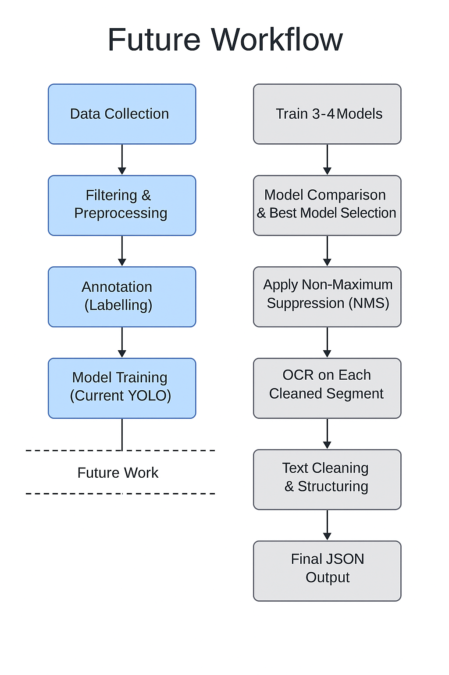
Future Workflow

Slide 10
Q/A?

