Slide 1
Formulate: Intelligent Multi‑Agent Automated System for Form Processing
Team Members: Ubaid, Bilal, Sarmad
Supervisor: Dr. Omer Usman
Department of Computer Science, FAST‑NUCES Peshawar
Date: 22-Oct-2025

Slide 2
Motivation & Problem Statement
Manual form submissions cause delays, errors, and administrative overhead.
Existing portals manage data but lack intelligent validation and routing.
Need for intelligent automation combining OCR, validation, and adaptive learning.
Research Objectives
Automate academic form workflows from submission to approval.
Integrate hierarchical routing (Student → Advisor → HOD → Director).
Implement a modular multi‑agent architecture for scalability and efficiency.
Survey of Existing Solutions
Commercial systems handle data but lack intelligent workflow automation.
Use OCR tool to extract text but lack contextual understanding.
No existing academic systems apply multi‑agent automation to form handling.

Slide 3
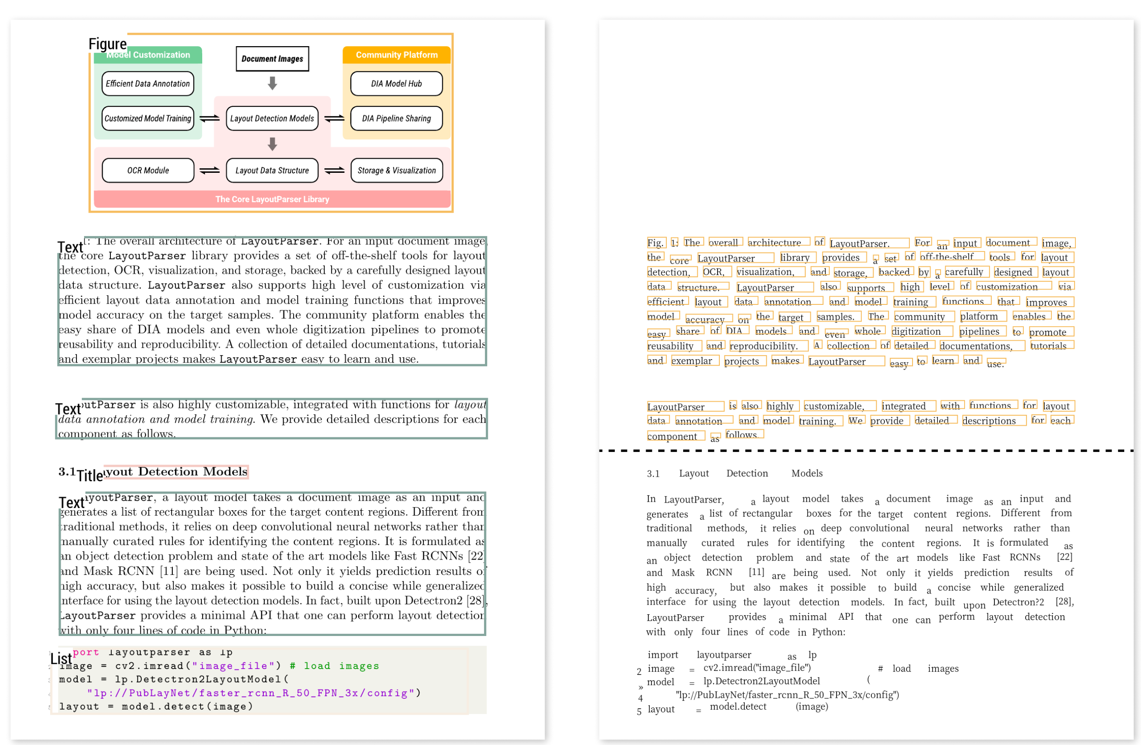
<- Paddle OCR
Layout Parser ->

Slide 4
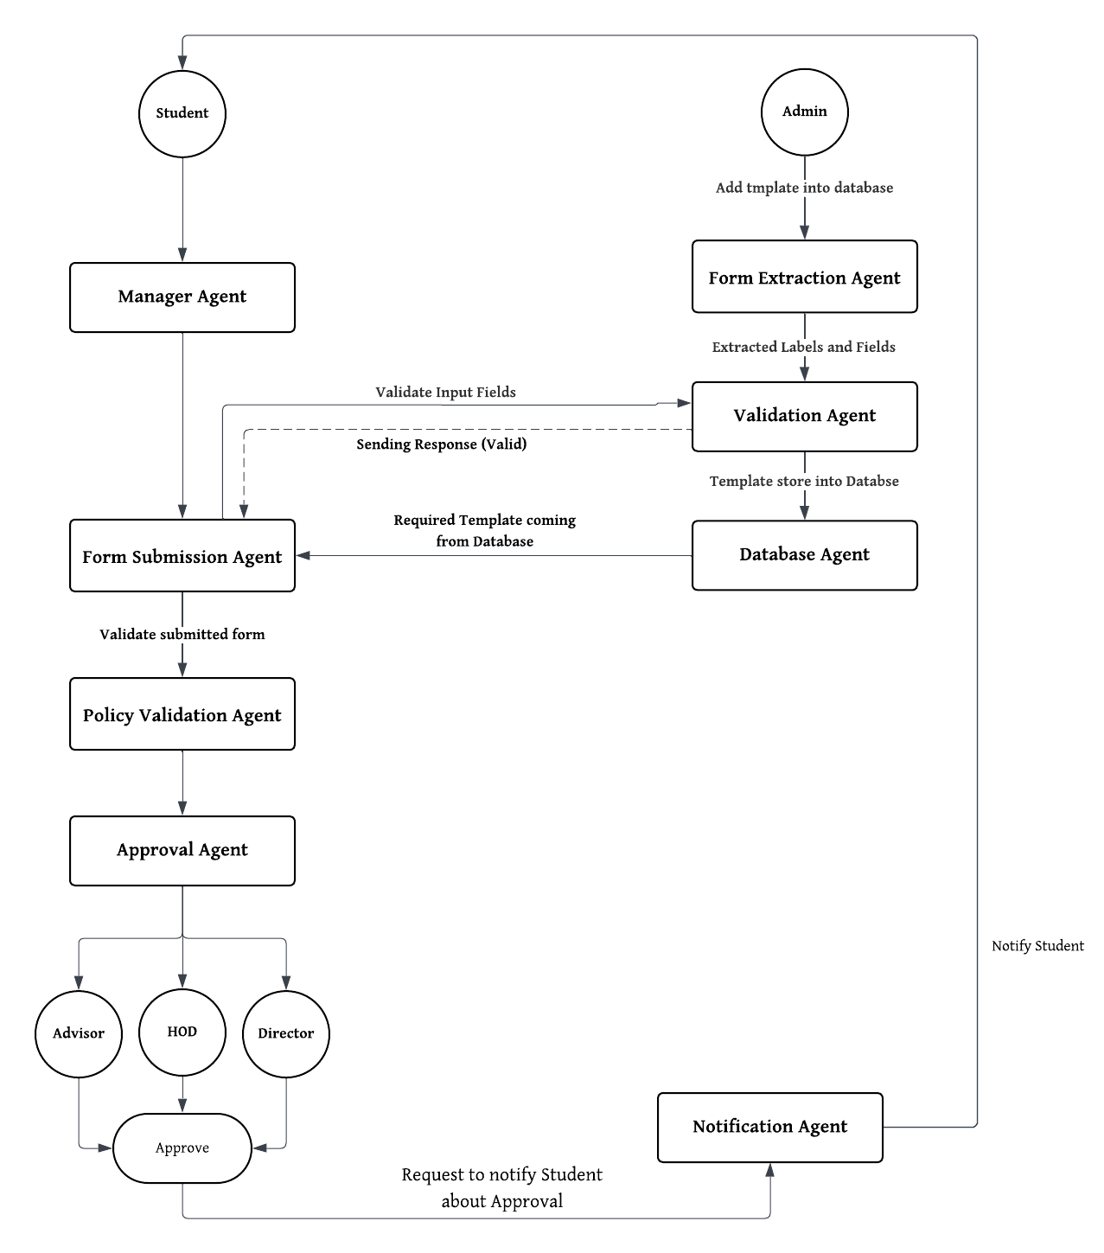
Proposed System Architecture

Slide 5
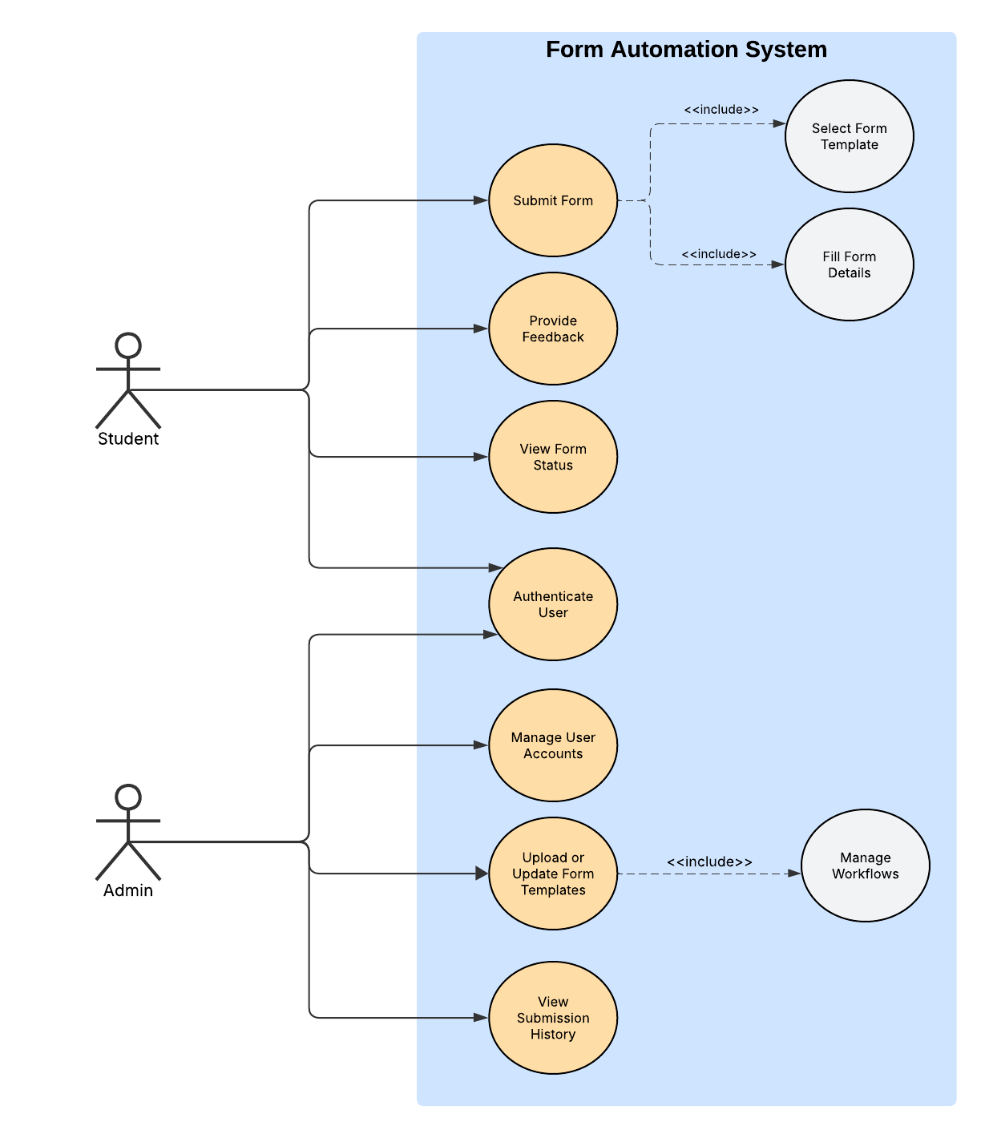
Use Case Diagram

Slide 6
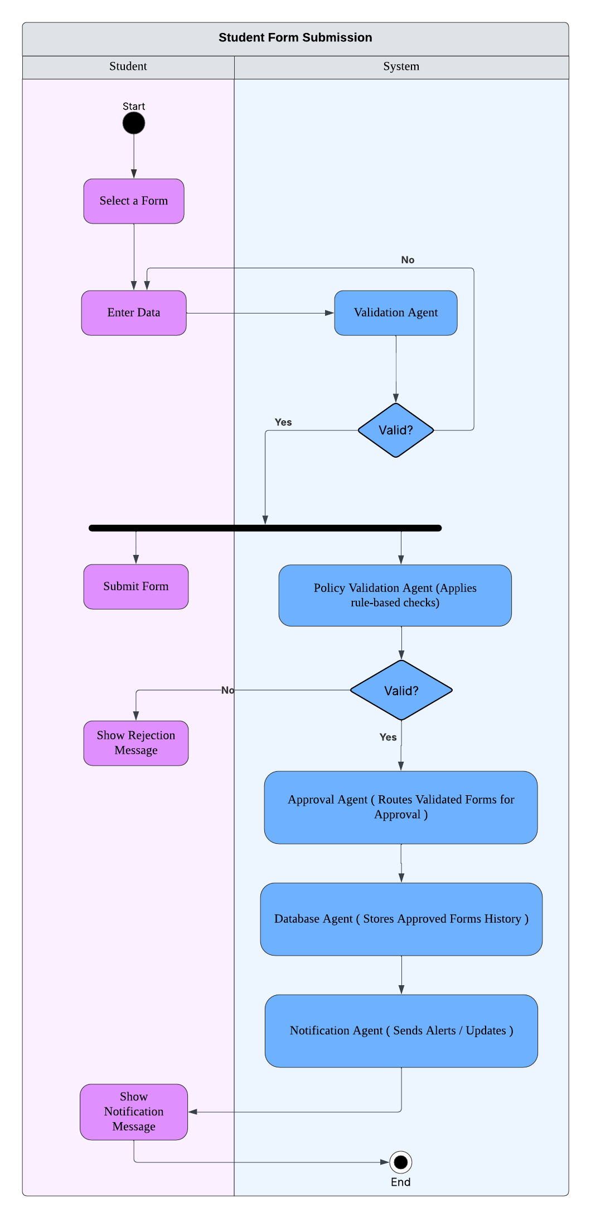
Activity Diagram (I)

Slide 7
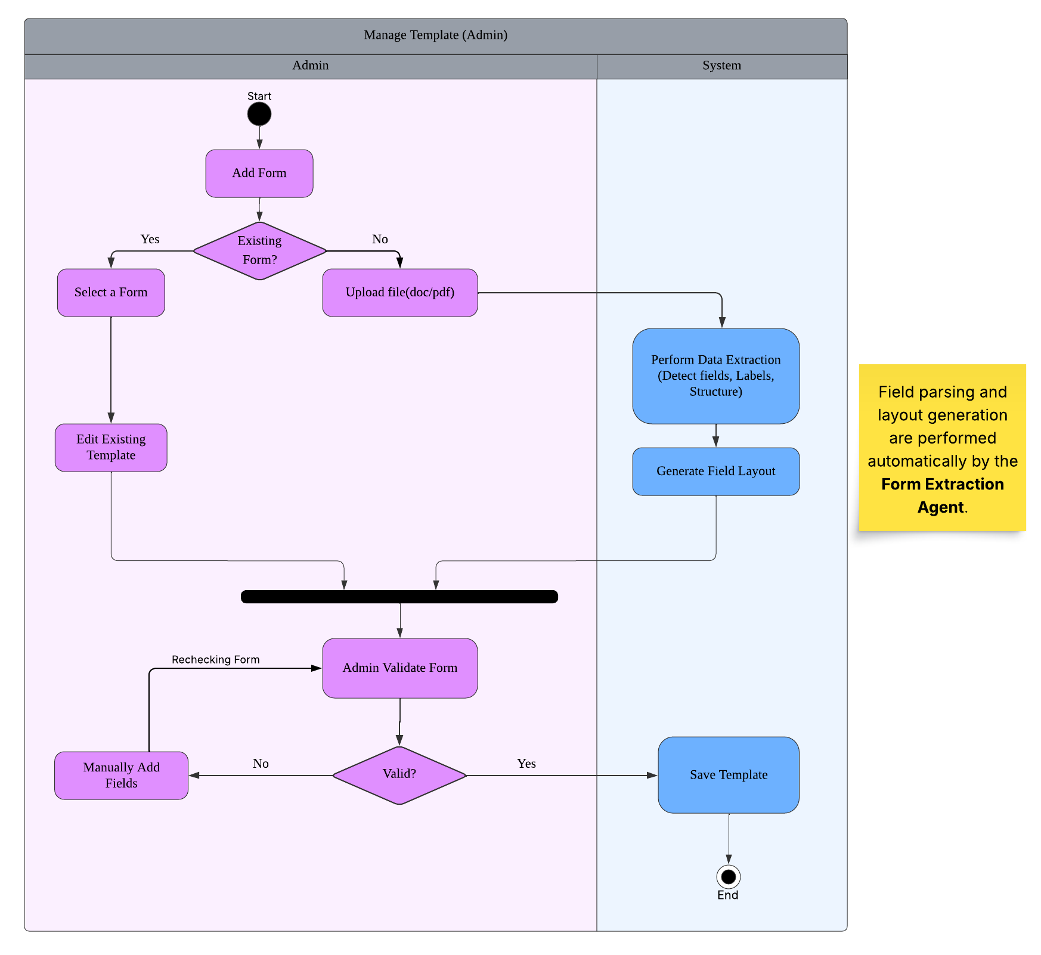
Activity Diagram (II)

Slide 8
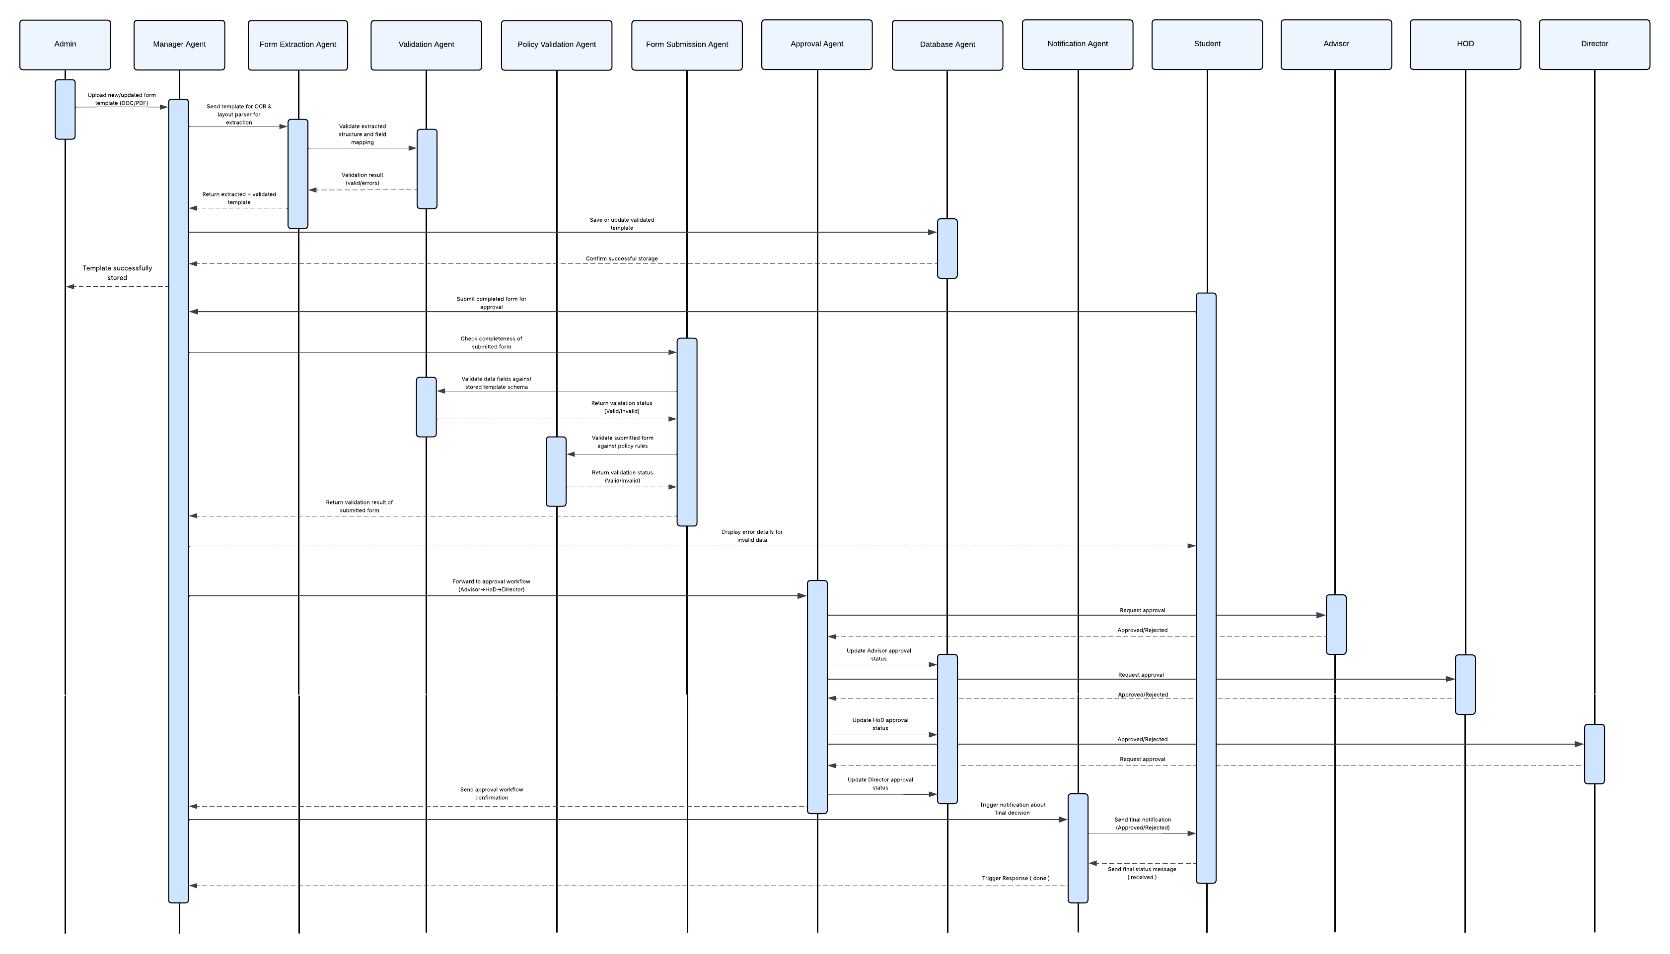
Sequence Diagram (Whole System)

Slide 9
Test Cases
Valid Form Submission
Given- Student submits form with complete details (reason + signature etc)
When- Validation agent check fields
Then- Status: Valid, Forward -> Policy Agent
Missing Course Field
Given- Course Field Empty
When- Validation agent start validation
Then- Status: Invalid, Manager -> Rejected
Duplicate Submission
Given- A student submits a form identical to one they submitted earlier.
When- The Validation Agent detects a matching record within a recent timeframe
Then- The system flags it as a temporary duplicate and notifies the student
Otherwise- If the prior submission is old or closed, it’s treated as a new valid request.
Cross-Agent Conflict Resolution
Given- The Validation agent marks a form “valid” but manager detects policy agent says “e.g Course already dropped before”
When- Both agents return conflicting returns.
Then- Manager override the form with “review required” and send form to Admin for manual approval.
Role Based Data Access Violation
Given- A student form contains restricted fields (e.g advisor comments)
When- A low agent rather than validation agent try to access fields
Then- Access is denied

Slide 10
Research Papers & Citations
Multi-Agent System: A Survey [1]
Foundations of Agentic AI and AI Agent [2]
Consequences in Multi Agent System [3]
Talk Structurally Act Hierarchically [4]
Managing Distributed Parallel Workflow Systems [5]
[1]
Dorri, A., Kanhere, S.S. and Jurdak, R., 2018. Multi-agent systems: A survey. Ieee Access, 6, pp.28573-28593.
[2]
Sapkota, R., Roumeliotis, K.I. and Karkee, M., 2025. Ai agents vs. agentic ai: A conceptual taxonomy, applications and challenges. arXiv preprint arXiv:2505.10468.
[3]
Amirkhani, A. and Barshooi, A.H., 2022. Consensus in multi-agent systems: a review. Artificial Intelligence Review, 55(5), pp.3897-3935.
[4]
Wang, Z., Moriyama, S., Wang, W.Y., Gangopadhyay, B. and Takamatsu, S., 2025. Talk structurally, act hierarchically: A collaborative framework for llm multi-agent systems. arXiv preprint arXiv:2502.11098.
[5]
Aknine, S. and Pinson, S., 2003. Managing Distributed Parallel Workflow Systems Using a Multi-agent Method. In Agent Supported Cooperative Work (pp. 177-203). Boston, MA: Springer US.

