Slide 1
ChurnModelling
File created on: 2019-12-30 6:50:35 PM

Slide 2
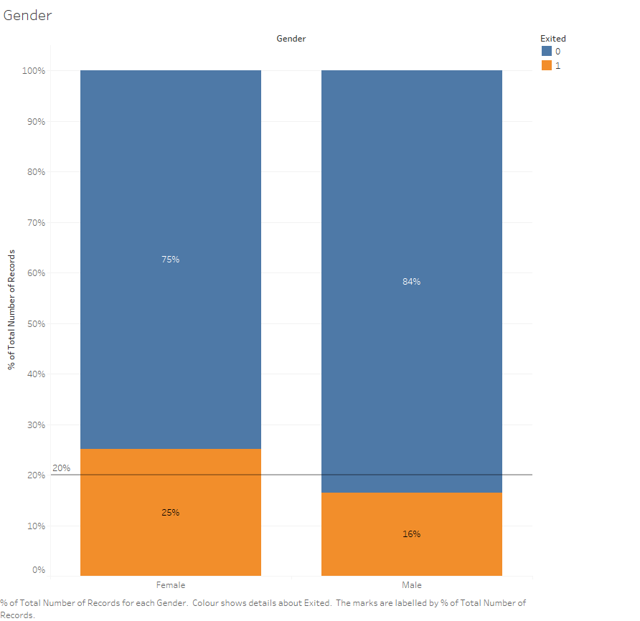

Slide 3
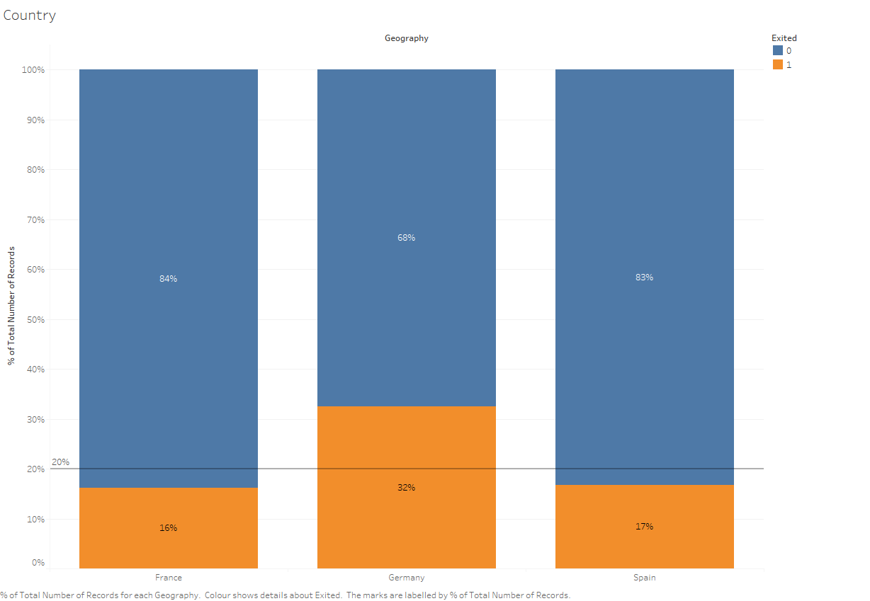

Slide 4
