Slide 1
ChurnModelling
File created on: 2020-01-02 10:27:38 AM

Slide 2
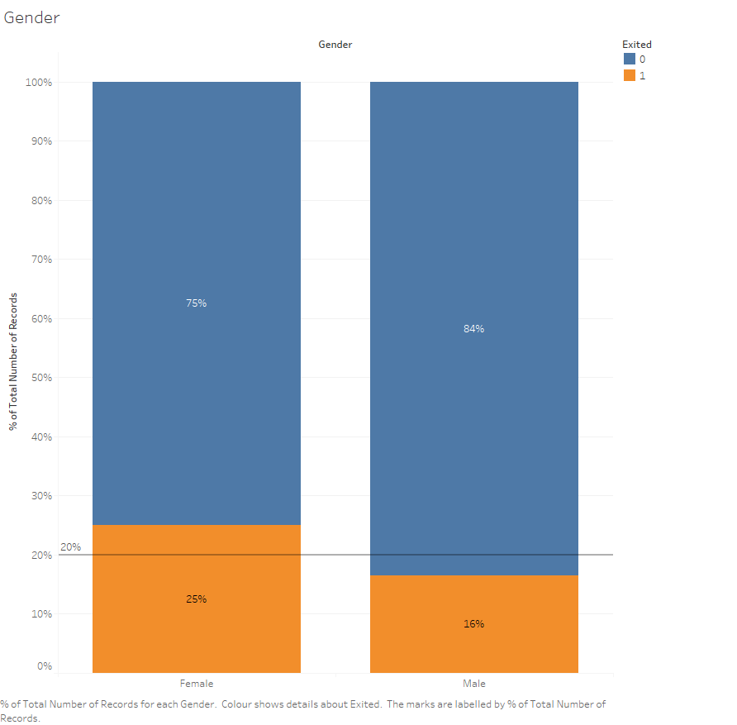

Slide 3
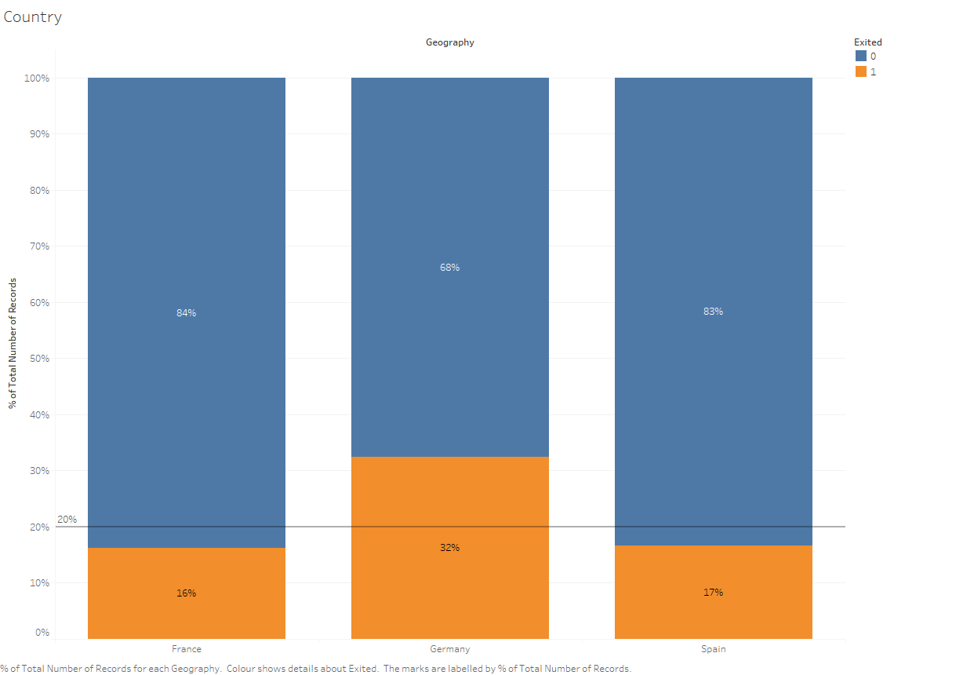

Slide 4
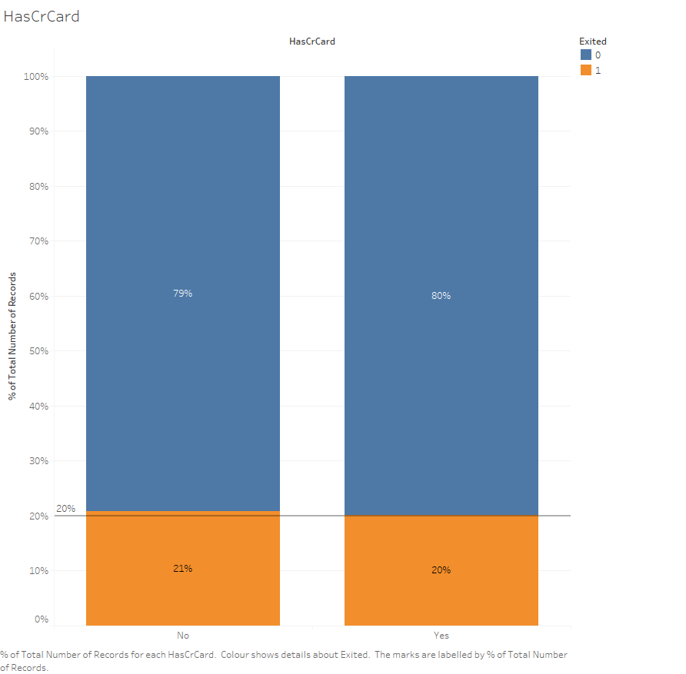

Slide 5
