Slide 1
Food Customization
Sandwich team
Template Version 1.0
Version 2.0
Nov, 11, 2019
Ammar Reslan, Tameem Alshomari , Naief Bitar,
Mohammed Ibrahim, Vitalii Naumov

Slide 2
Project Title
Key Motivation and Key Description
Gate
1
2
3
Slide required
✓
✓
✓
Motivation
Scope and Goals :
We are providing an unique service via our restaurant with delivery
  Food customization
  Calories count
  Calories tracking
  Saving the time of cooking
  New food experience
Our motivation:
  Once we stacked with apsence of the possibility to choose ingridients, we decided to get rid of it by creating a brand new service and a restaurant
Description
Deliverables of the project:
  Website
  Mobile app
  Restaurant
  We will provide two main options as solution for the problem we stacked with. First, if the customer up to go outside or just does not want to wait or the delivery, he might just come over to our restaurant to get his meal instant. Second, our customer might want to get all the ingridients he wants to see in his meal to be delivered right to his door.
Business Development Lab: Stage Gate Process Project Outline

Slide 3
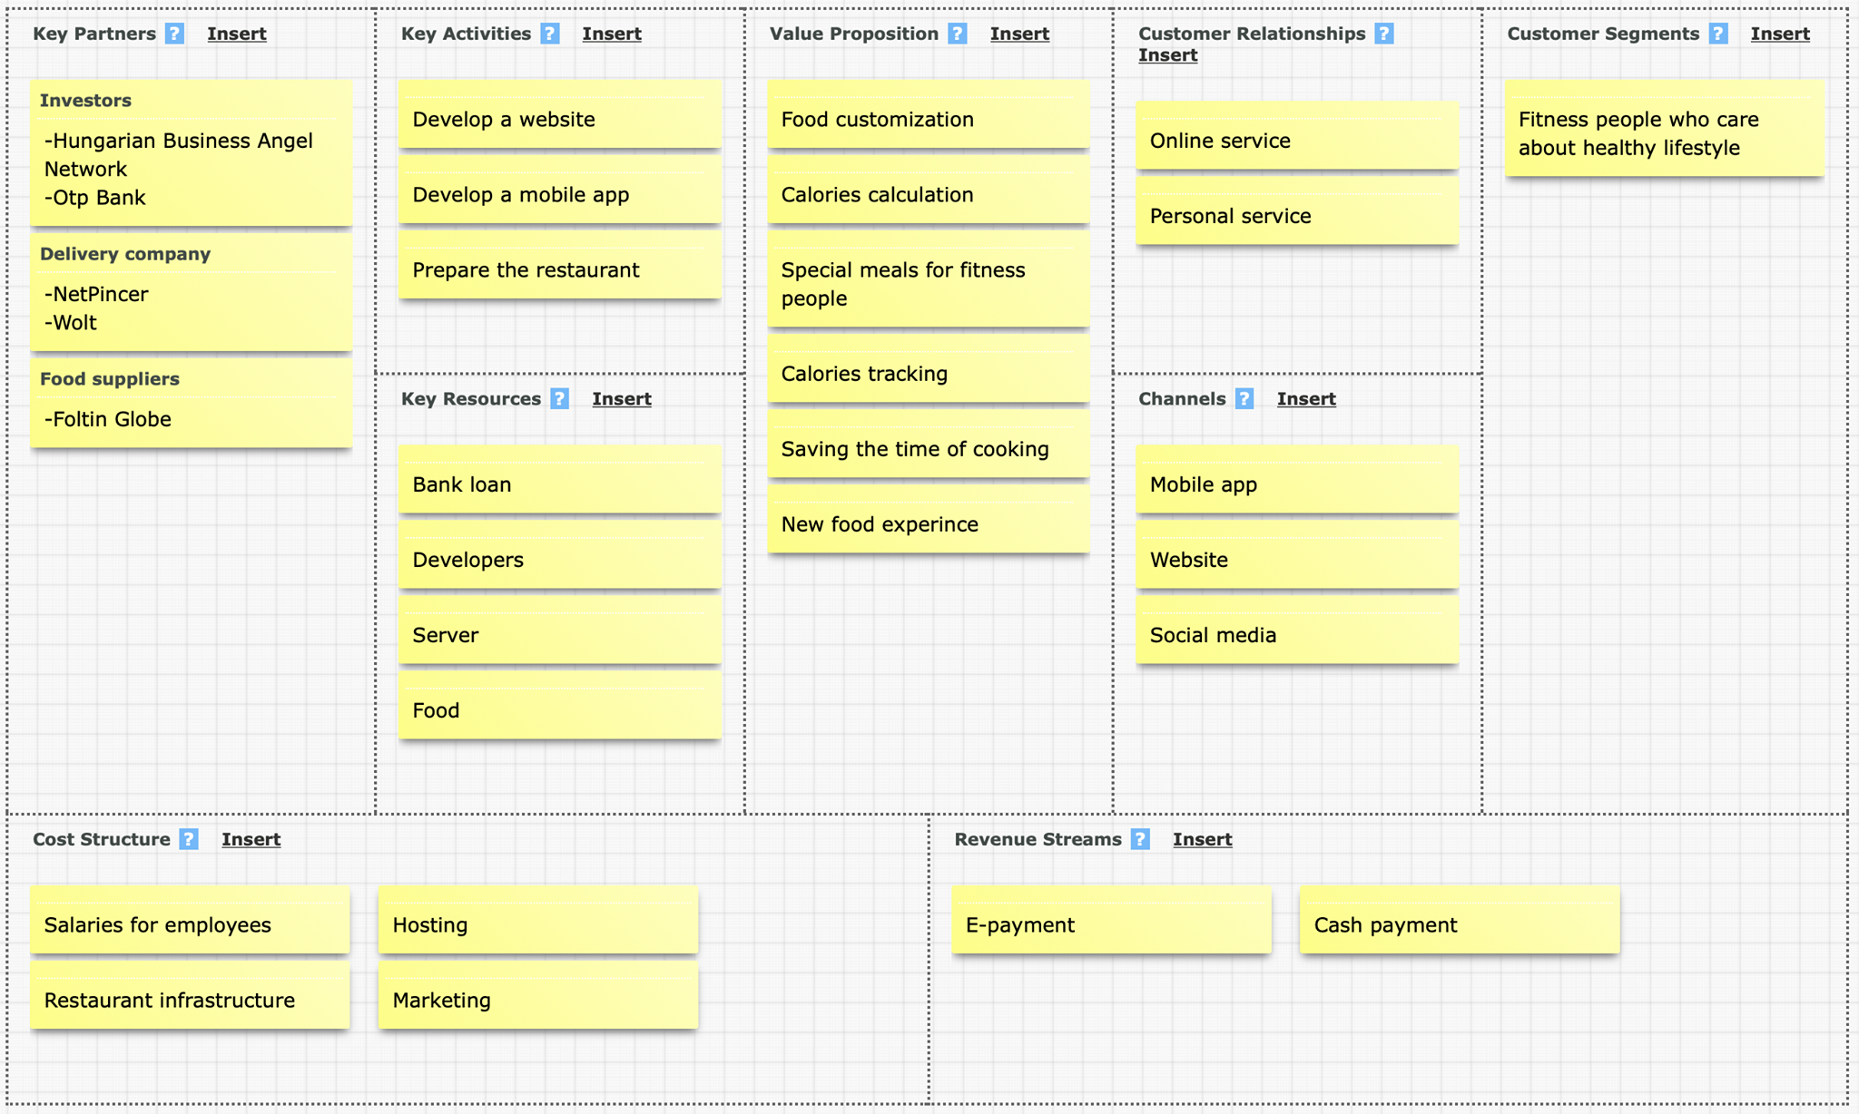
Project Title
Business Model Canvas
Gate
1
2
3
Slide required
✓
✓
✓
Business Development Lab: Stage Gate Process Project Outline

Slide 4
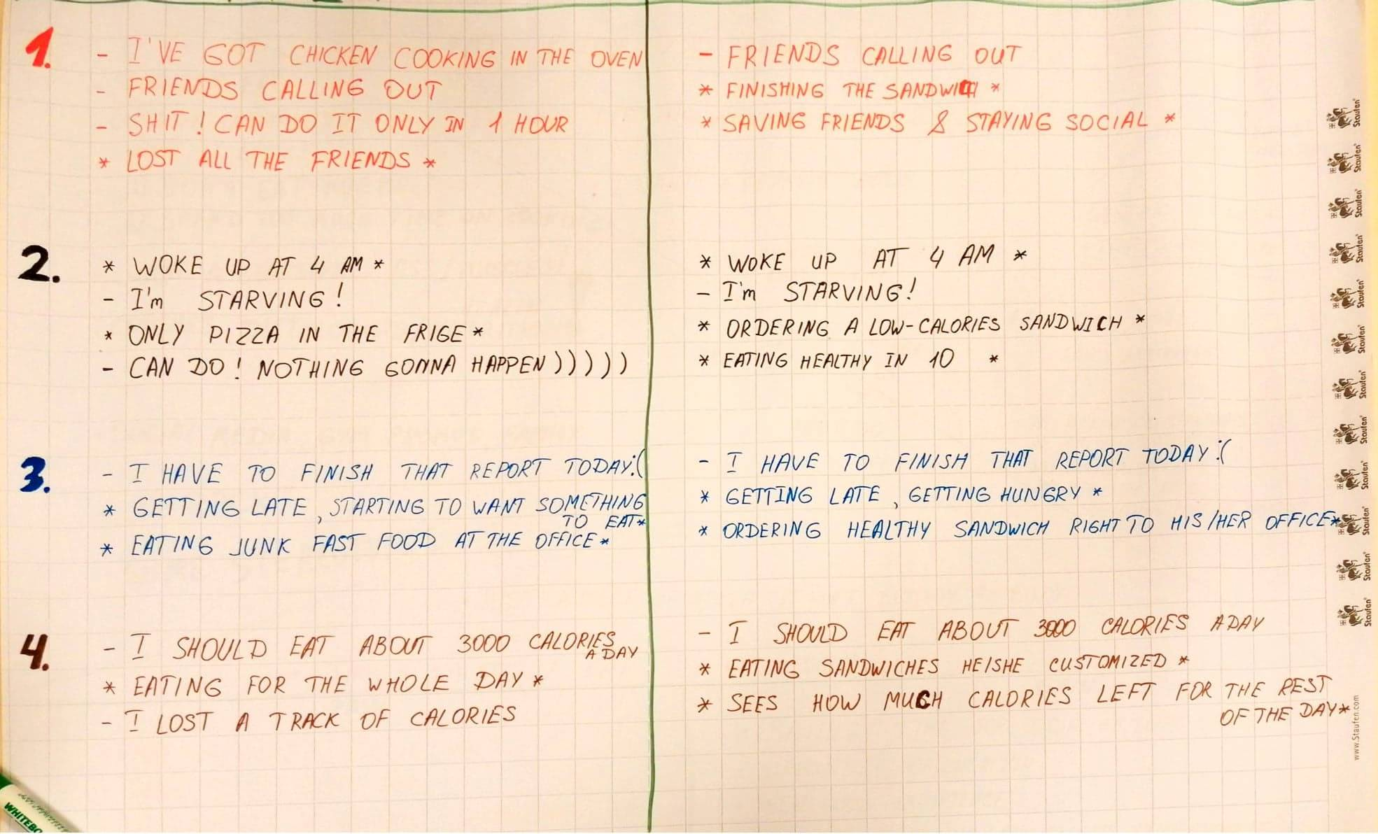
Project Title
Introduction
Gate
1
2
3
Slide required
-
✓
✓
contents of the project:
  a restaurant that serve the fitness people who can order their meals in person or using our app, so through this app he can customize his food order it and save it for another order and know the calories count of it and has his profile where he can set his calories limit.
actual problem:
  the absence of the possibility to choose some ingredients to his food (sandwich)
stories & solutions:
Business Development Lab: Stage Gate Process Project Outline

Slide 5
Project Title
Project Objectives
Gate
1
2
3
Slide required
-
✓
✓
Objectives
goals of the project:
  Food customization
  Calories count
  Calories tracking
  Saving the time of cooking
  New food experience
Business Development Lab: Stage Gate Process Project Outline

Slide 6
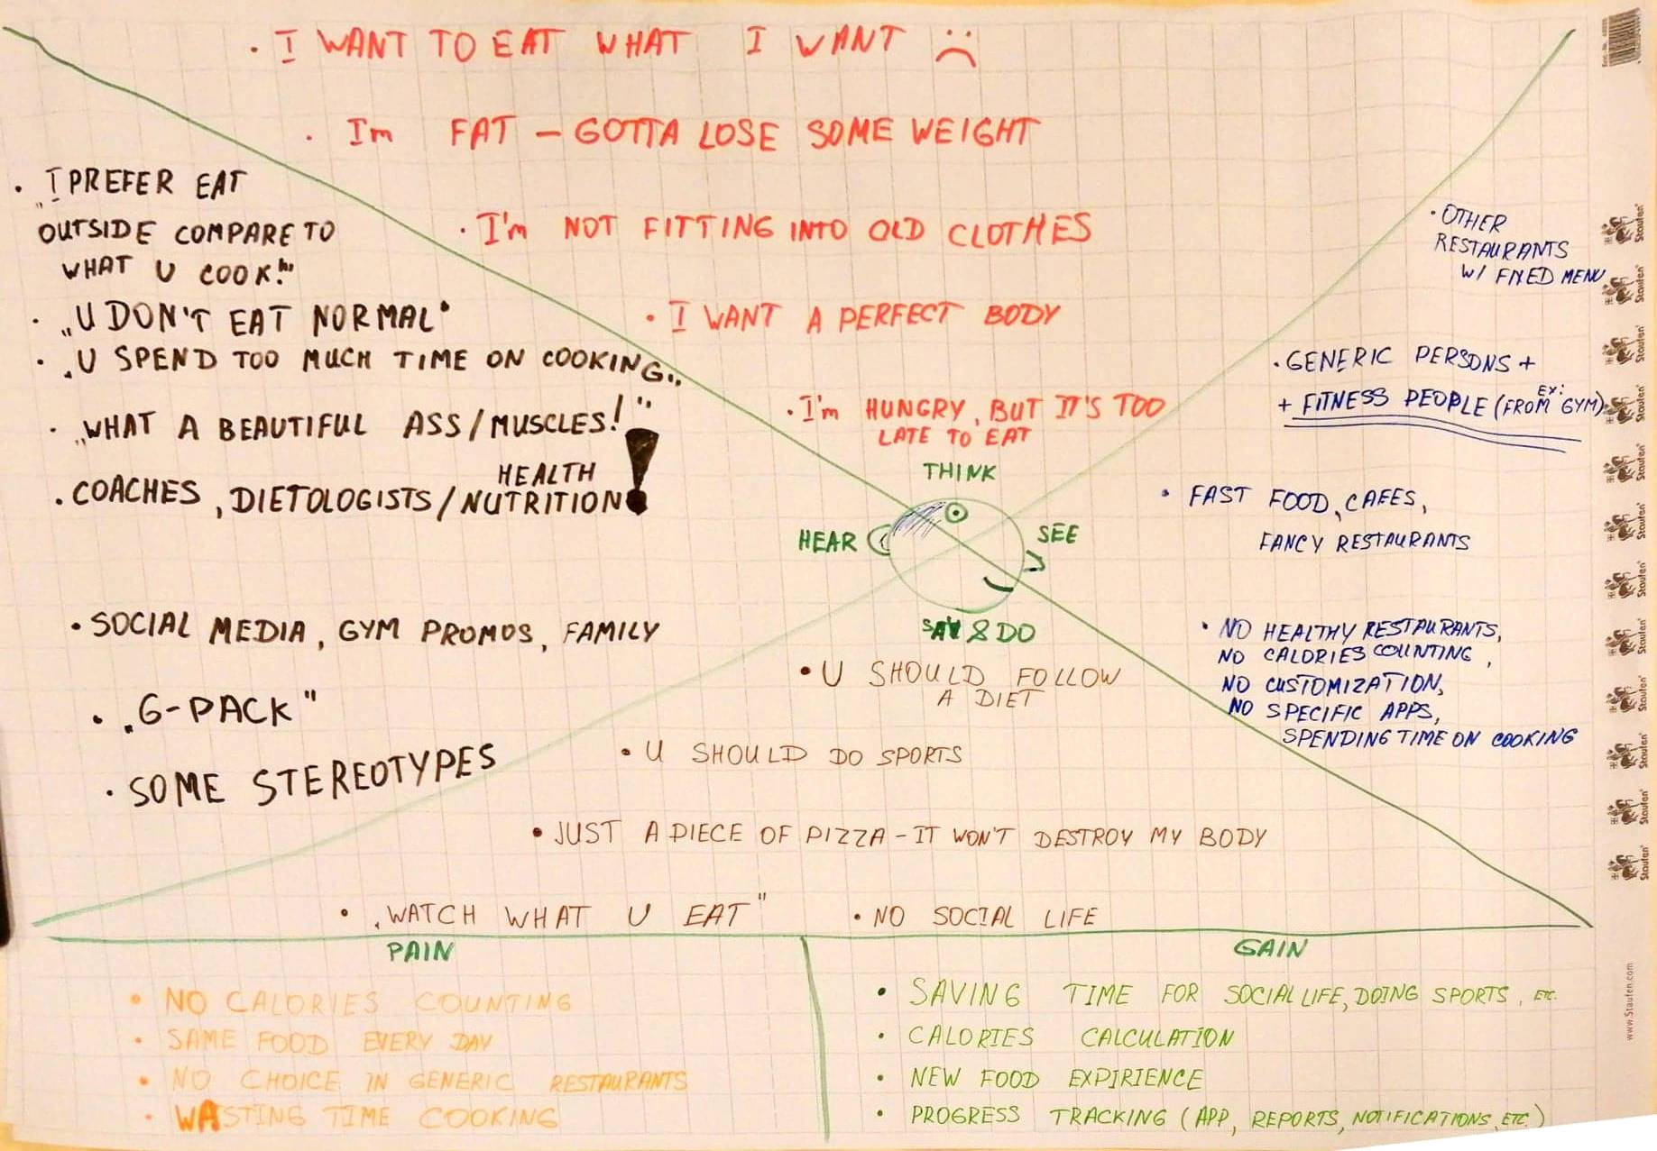
PAIN ➔ GAIN
Business Development Lab: Stage Gate Process Project Outline

Slide 7
Project Title
Project Scope
Gate
1
2
3
Slide required
-
✓
✓
In
scope
Fitness People:
People who care to be phisycally fit and healthy by follwoing a diet and counting calories.
Out of
scope
Allergic people
International students
Families
Business Development Lab: Stage Gate Process Project Outline

Slide 8
Project Title
Key Questions and Key Deliverables
Gate
1
2
3
Slide required
-
✓
✓
Key
questions
5 whys
Key
deliverables
Presentation
Mockup
MVP
Website (Prototype)
Mobile App
Business Development Lab: Stage Gate Process Project Outline

Slide 9
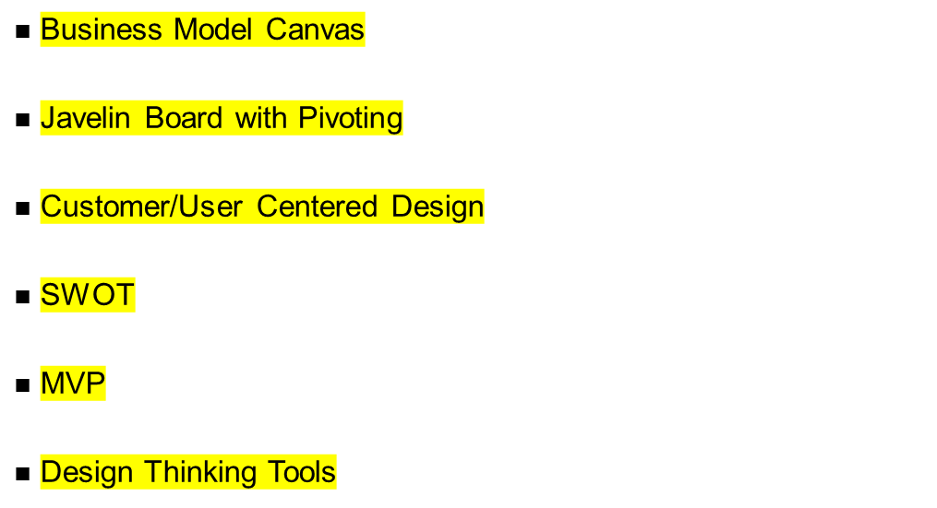
Project Title
BD Labs Methods & Tools to be used.
Gate
1
2
3
Slide required
-
✓
✓
Tools
Business Development Lab: Stage Gate Process Project Outline

Slide 10
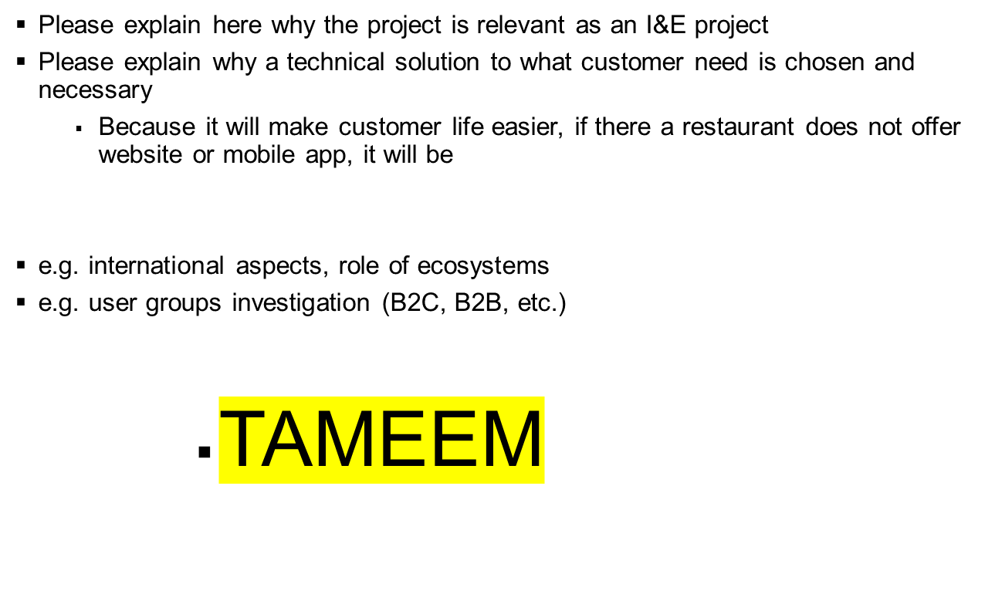
Project Title
Relevance for Innovation & Entrepreneurship
Gate
1
2
3
Slide required
-
✓
✓
Business Development Lab: Stage Gate Process Project Outline

Slide 11
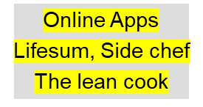
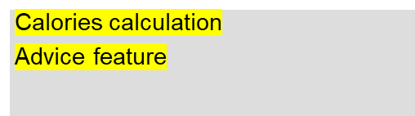
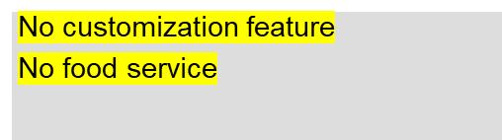
Project Title
Competitive Analysis
Gate
1
2
3
Slide required
-
✓
✓
Product / Activity /
Patent
Focus
Differentiation of new project
Subway
Customize cold sandwiches only
No customize any meal or sandwich
No targeting fitness people
No calories calculation
KFC, McDonalds
Fast food
Fast service
No customization feature
No calories calculation
Business Development Lab: Stage Gate Process Project Outline

Slide 12
Project Title
Business Rationale: Key statement on targeted market and first quantifications.
Gate
1
2
3
Slide required
-
✓
✓
e.g. MVP (Minimum Viable Product)
e.g. targeted market and customer/user
Please also quantify the project outcome (cost savings, new revenues) and make a business case calculation
(You can use graphical as well as textual objects and calculation sheets here)
(If necessary use multiple pages)
…
Business Development Lab: Stage Gate Process Project Outline

Slide 13
Project Title
Technology Impact
Gate
1
2
3
Slide required
-
✓
✓
To what extent are development efforts necessary?
  Digital world, Competitors (Technology is the most powerful tool to enter the market and be a competitor)
Please describe here the development effort and the technologies to be used and / or technology deployment roadmaps
  We need developers with full stack experience to work on parrallel on website and mobile app.
  Used technologies:
    PHP, HTML, CSS, JAVASCRIPT
    Android, IOS
    Tools for making diagrams (UML)
  Deployment roadmap:
    Analysis (Market, customer, Plan)
    Design (Mockup)
    Development
    Testing (alph beta testing)
    Deployment (Server)
Business Development Lab: Stage Gate Process Project Outline

Slide 14
Tameem: I & E
Vitali Naeif: Compare with other mobile apps
Ammar: Presentaion
Tomorrow: Mockup
Business Development Lab: Stage Gate Process Project Outline

Slide 15
Project Title
Prototype Description
Gate
1
2
3
Slide required
-
-
✓
Choice of / Combination of
Paper prototype, Drawing, Creativity Box, etc.
Webpage (reduced functionality, klick-prototype, etc.)
GUI prototype (Laptop), etc.
Mobile App
Hardware prototype
  Adruino
  Raspberry Pi
  etc.
etc.
Remark: Demonstration of prototype is part part of presentation
Business Development Lab: Stage Gate Process Project Outline

Slide 16
Project Title
Project Structure
Gate
1
2
3
Slide required
-
-
✓
Project
Name
WP 1: …
WP 2: …
WP 3: …
WP x: …
WP 1.1: …
WP 2.1: …
WP 3.1: …
WP x.1: …
WP 1.2: …
WP 2.2: …
WP3.2: …
WP x.2: …
WP 1.3: …
WP 2.3: …
WP 3.3: …
WP x.3: …
WP1.x: …
WP 2.x: …
WP 3.x: …
WP x.x: …
Business Development Lab: Stage Gate Process Project Outline
WP: Work Package

Slide 17
Project Title
Description of Work Packages WP 1.1: …
Gate
1
2
3
Slide required
-
-
✓
Activities
Deliverables
WP 1.1:
xxx
yyy
…
WP 1.2:
xxx
yyy
…
WP 1.3:
xxx
yyy
…
WP 1.x:
xxx
yyy
…
xxx
yyy
…
Methodology
xxx
yyy
…
Responsibility
xxx
yyy
…
Business Development Lab: Stage Gate Process Project Outline

Slide 18
Project Title
Project Risks and Counter Measures
Gate
1
2
3
Slide required
-
-
✓
Project risks
Counter measures
xxx
yyy
…
xxx
yyy
…
xxx
yyy
…
xxx
yyy
…
xxx
yyy
…
xxx
yyy
…
Business Development Lab: Stage Gate Process Project Outline

Slide 19
Project Title
Project Organization
Gate
1
2
3
Slide required
-
-.
✓
Project
Steering
Committee
N.N. (Company)
N.N. (Company)
N.N. (Company)
N.N. (Company)
Project Manager
N.N. (Company)
Project
Core Team
N.N. (Company)
N.N. (Company)
N.N. (Company)
N.N. (Company)
Project
Extended Team
N.N. (Company)
N.N. (Company)
N.N. (Company)
N.N. (Company)
Business Development Lab: Stage Gate Process Project Outline

Slide 20
Project Title
Project Resources
Gate
1
2
3
Slide required
-
-
✓
Workpackage
Contractor
Resources
1.1: …
…
FTE/TEUR
WP 1
1.2: …
…
FTE/TEUR
1.3: …
…
FTE/TEUR
1.x: …
…
FTE/TEUR
2.1: …
…
FTE/TEUR
WP 2
2.2: …
…
FTE/TEUR
2.3: …
…
FTE/TEUR
2.x: …
…
FTE/TEUR
3.1: …
…
FTE/TEUR
WP 3
3.2: …
…
FTE/TEUR
3.3: …
…
FTE/TEUR
3.x: …
…
FTE/TEUR
x.1: …
…
FTE/TEUR
WP x
x.2: …
…
FTE/TEUR
x.3: …
…
FTE/TEUR
x.x: …
…
FTE/TEUR
Sum
…
FTE/TEUR
Business Development Lab: Stage Gate Process Project Outline

Slide 21
Project Title
Project Budget Plan / Funding
Gate
1
2
3
Slide required
-
-
✓
Please give here a detailed budget plan
The budget plan should be structured to self-contained project phases
It should include expenditures for the transfer of the project results in the SBUs, too
(If necessary use multiple pages)
…
Business Development Lab: Stage Gate Process Project Outline

Slide 22
Project Title
Time Schedule (Gantt Chart)
Gate
1
2
3
Slide required
-
-
✓
Q1 / 2017
Q2 / 2017
Q3 / 2017
Q4 / 2017
Jan
Feb
Mar
Apr
May
Jun
Jul
Aug
Sep
Oct
Nov
Dec
Phase 1: ...
Phase 2: ...
WP 1.1
WP 1
WP 1.2
WP 1.3
WP 1.x
MS 1: …
WP 2.1
WP 2
WP 2.2
WP 2.3
WP 2.x
MS 2: …
WP 3.1
WP 3
WP 3.2
WP 3.3
WP 3.x
MS 3: …
WP x.1
WP x
WP x.2
WP x.3
WP x.x
MS x: …
Business Development Lab: Stage Gate Process Project Outline
MS: Milestone

Slide 23
Project Title
Project Outline History
Date
Version
Comment
Nov 11, 2016
1.0
Udo Bub: Template created based on T-Labs Stage Gate Process and adaptations to Business Development Labs
Business Development Lab: Stage Gate Process Project Outline

