Slide 1
PRO-SCAN RADAR System v2
Ultrasonic Object Detection & Visualization
Advanced Engineering Team

Slide 2
Hardware Components
• Arduino Uno R3 Control Center
• HC-SR04 Ultrasonic Sensor (150° Sweep)
• SG90 Micro Servo (Precision Drive)
• 16x2 Parallel LCD (Status Feedback)
• Active Buzzer & Red LED (Alert System)

Slide 3
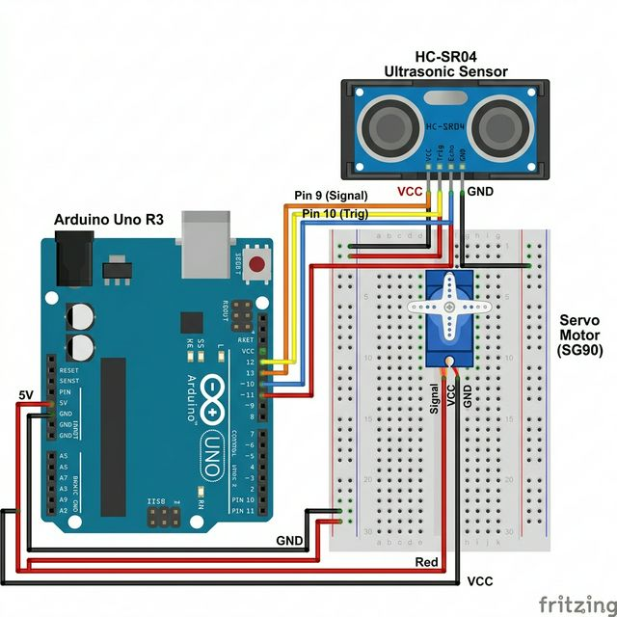
System Wiring Schematic

Slide 4
Software & Visualization
• Arduino: 9600 Baud Data Stream
• Python: Matplotlib Polar Transformation
• Alpha Filter for noise rejection (70/30)
• Real-time distance-weighted color alerts

