Slide 1
PRO RADAR: RADAR PRO: Advanced Detection System
Ultrasonic Sweep & Real-time Visualization
Doctor Gemini & Professional Engineering Team

Slide 2
Precision Wiring Schematic
HC-SR04: Trig=10, Echo=11 (5V Supply)
Servo: Signal=9 (PWM), VCC=5V, GND=GND
LCD 16x2: RS=2, E=3, D4-D7=4, 5, 6, 7
Buzzer: Pin 8 | Red LED: Pin A5
Final optimized professional layout.

Slide 3
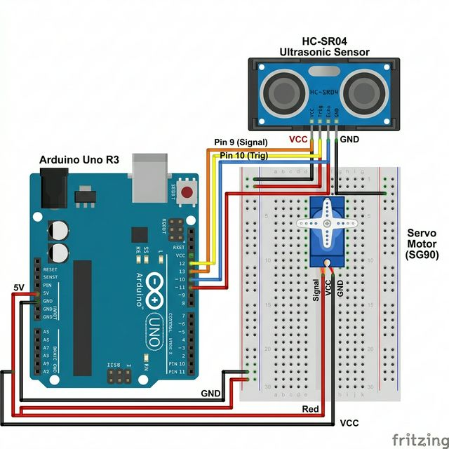
Visual Hardware Layout

Slide 4
Detection Algorithm
Speed of Sound Math: (duration * 0.034) / 2
Alpha Filter: 70% New Data / 30% Previous History
Auto-Alert: Any valid echo (1-400cm) triggers buzzer.
Smooth Sweep: 30ms delay per degree for stabilization.

