Slide 1
Speed Trap System GOLDEN v2
Dual-Sensor Velocity Enforcement
Advanced Traffic Engineering

Slide 2
Hardware Components
• Arduino Uno R3 High-Speed Processor
• Dual HC-SR04 Precision Gates (20cm Apart)
• 16x2 LCD Local Display (m/s and km/h)
• OVERSPEED Alert: Buzzer + Red LED

Slide 3
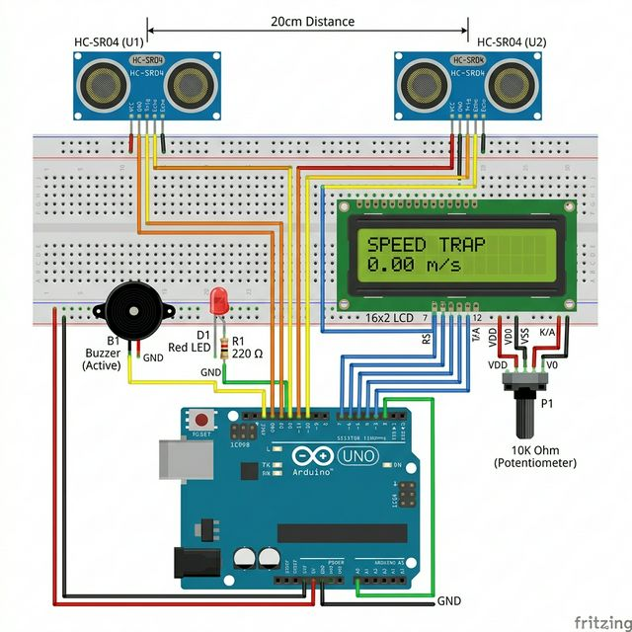
System Wiring Schematic

Slide 4
Speed Calculation Logic
• Formula: Speed = Distance (0.2m) / ΔTime
• Microsecond precision timing using micros()
• Double-confirmation logic to prevent false triggers
• Auto-timeout after 4 seconds of inactivity

