Slide 1
SPEED PRO: SPEED TRAP PRO: High-Velocity Enforcement
Dual-Gate Velocity Logic & Web Dashboard
Doctor Gemini & Professional Engineering Team

Slide 2
Gate & Logic Wiring
Sensor 1 (Entry): Pins 3, 4
Sensor 2 (Exit): Pins 5, 6
Gap Distance: Flexible (Calibrated to 13cm)
LCD: 7, 8, 9, 10, 11, 12 (Parallel 4-bit)
Alert: Buzzer=A0, Red LED=A1

Slide 3
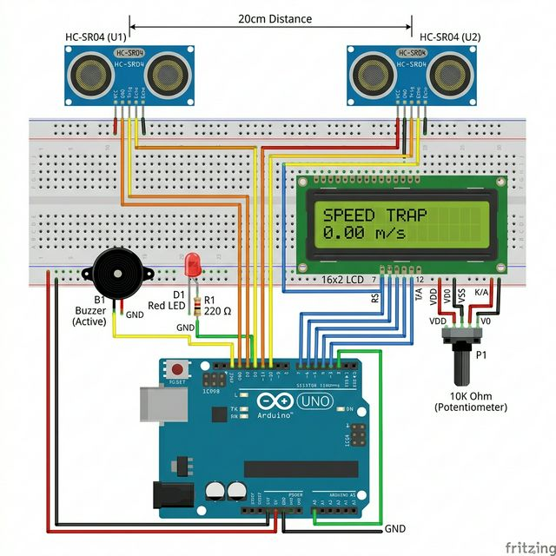
Hardware Interconnect

Slide 4
Math & Logic Deep Dive
Speed = 0.2 meters / (t2 - t1) in seconds
Microsecond precision using micros()
Double-Confirmation logic to prevent false starts
Auto-Relock/Wait timeout after 4 seconds
Threshold Alert: Fires if KM/H > 5.0

