Slide 1

An Academic Regression Analysis Project by Devin Sarnataro

Slide 2
Table of Contents
Introduction
Three Models
Features and Results
Future Investigations

Slide 3
Introduction
Dependent Variable
Predictors
Target
Independent Variable(s)
Features
Intercept
Percent Change
Numerical
Categorical

Slide 4
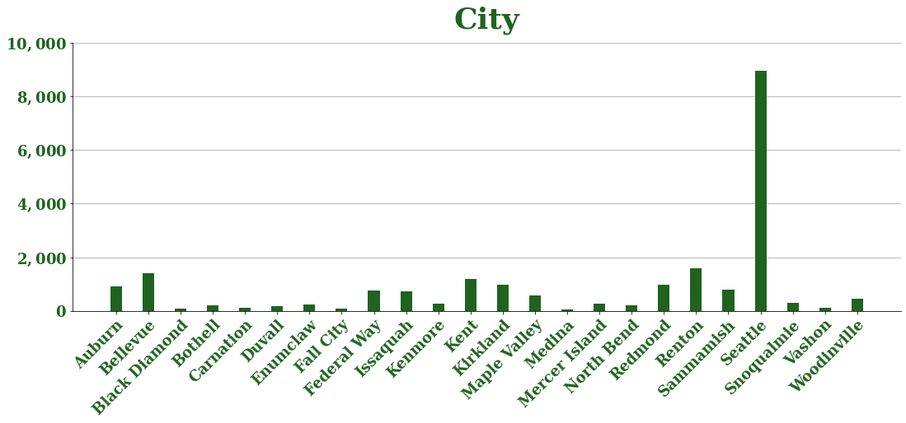
Three Models
All King County Model
Seattle Model
Outside Seattle Model
City

Slide 5
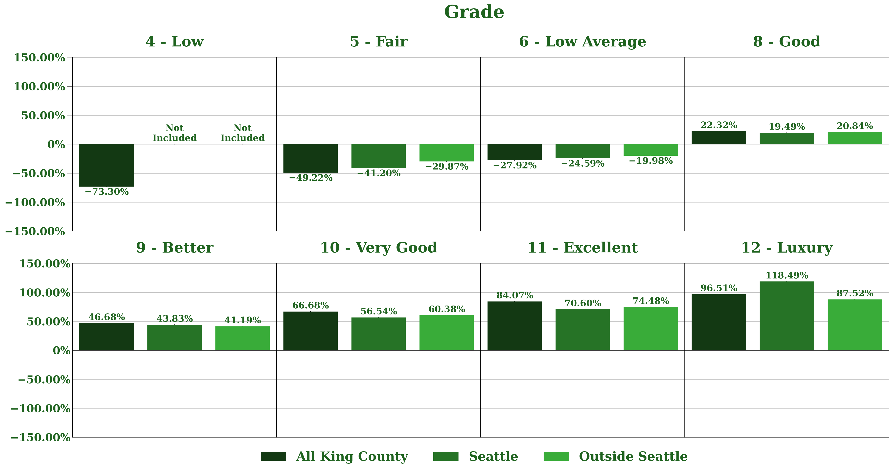
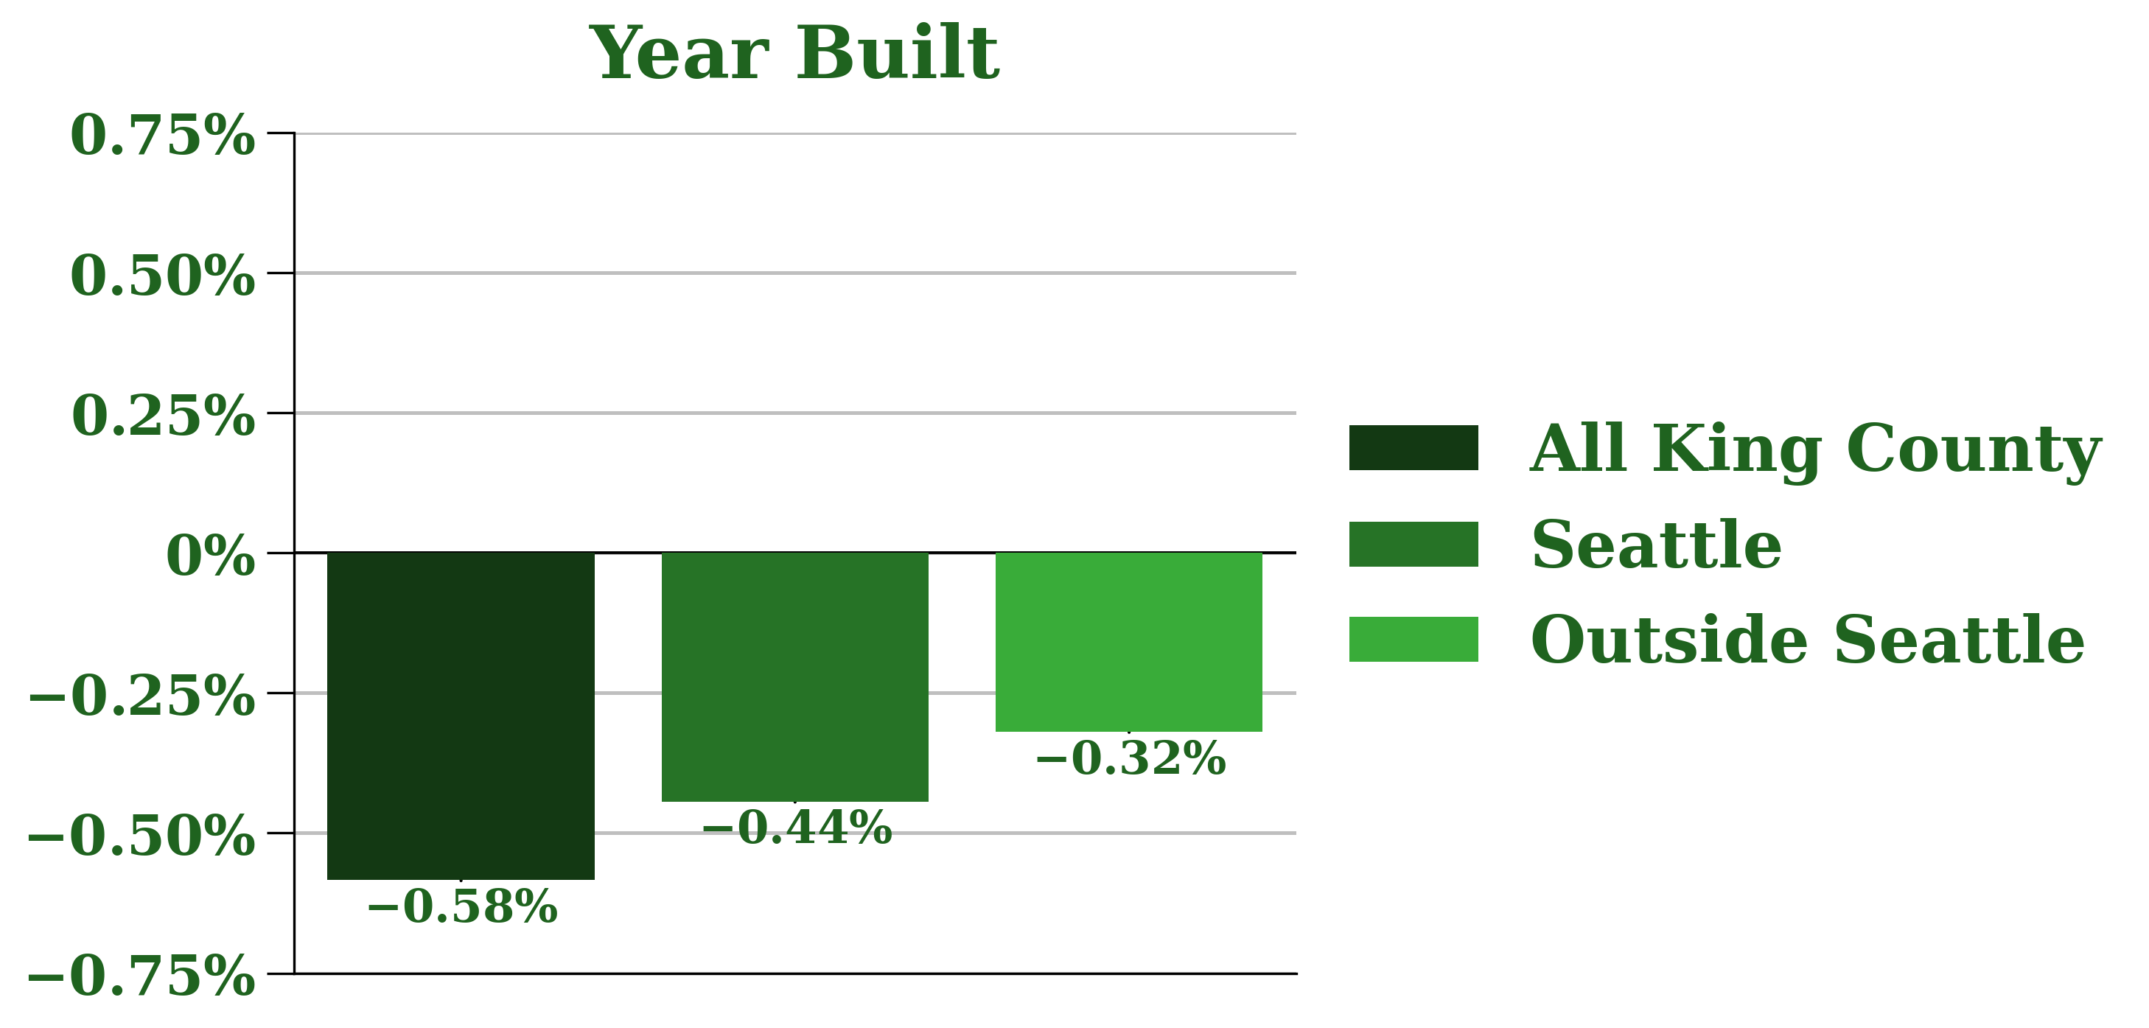
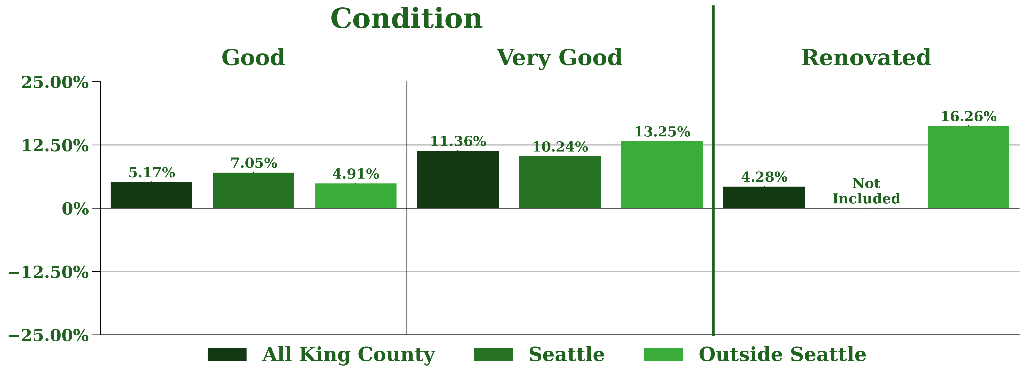
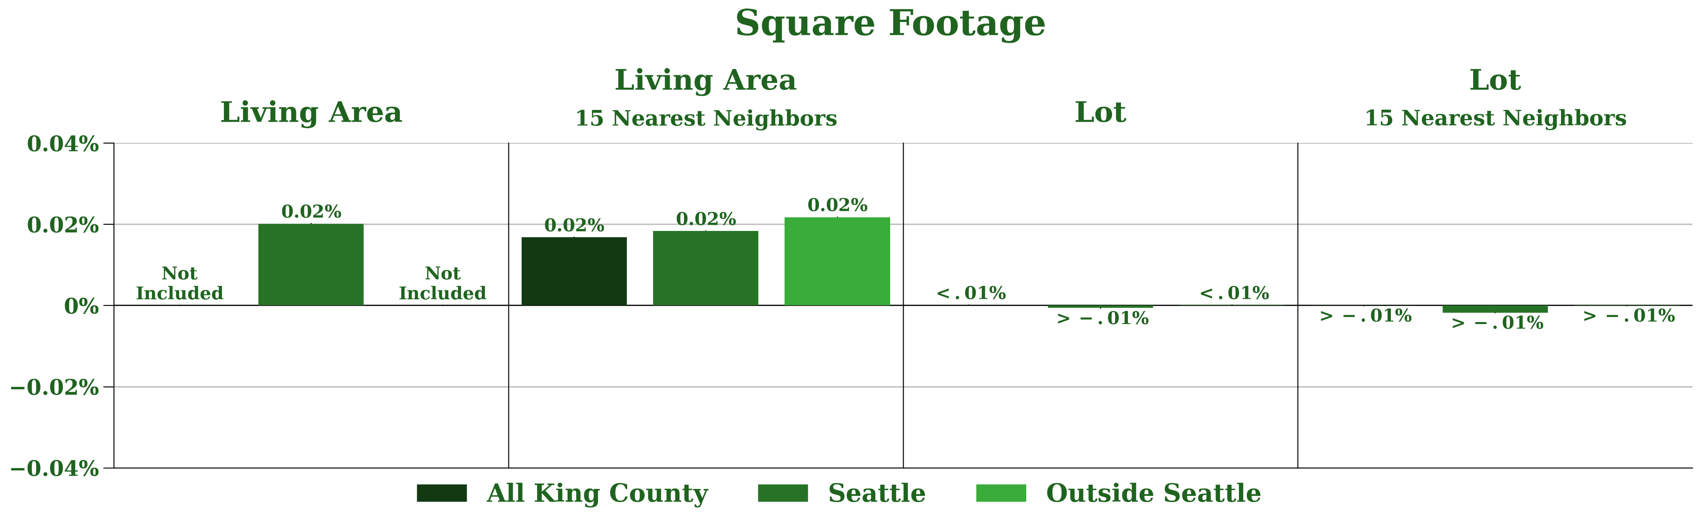
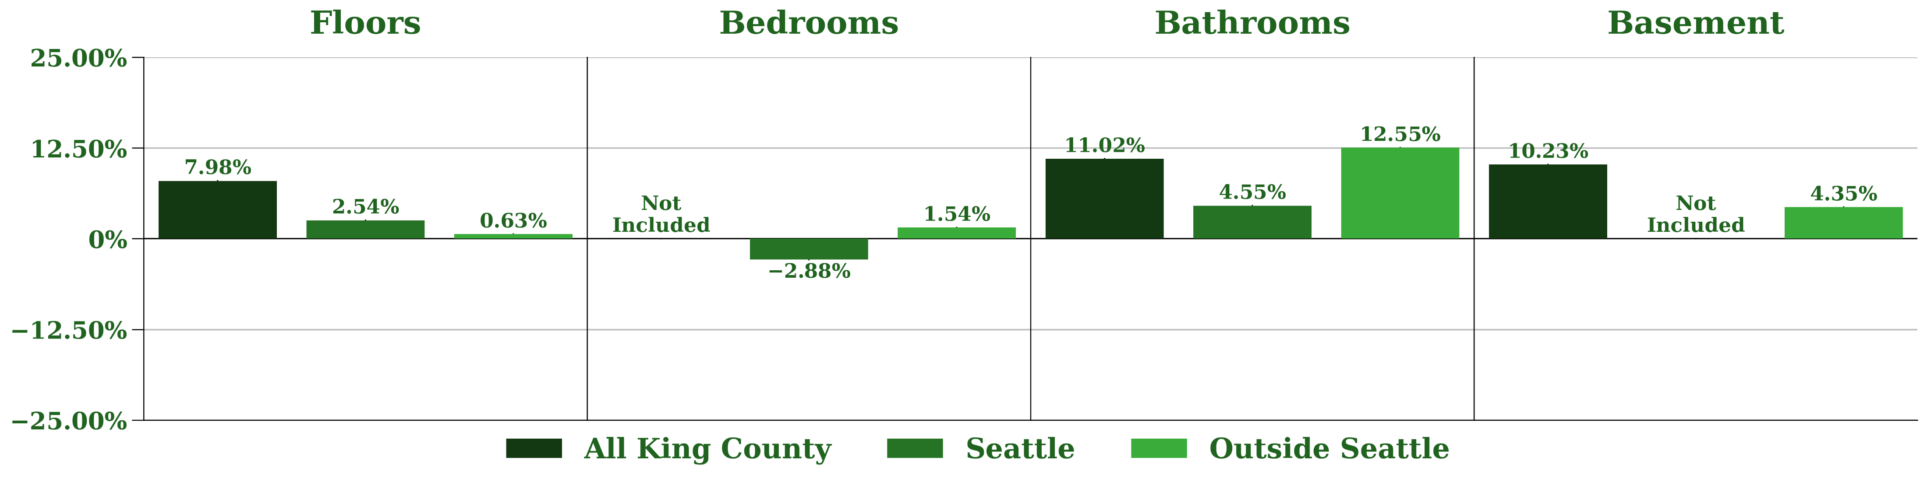
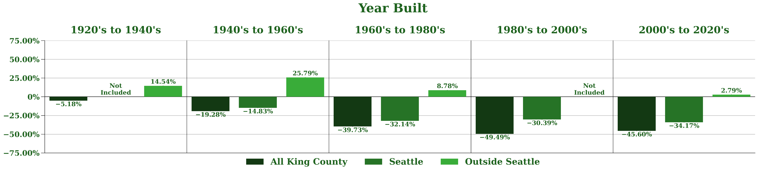
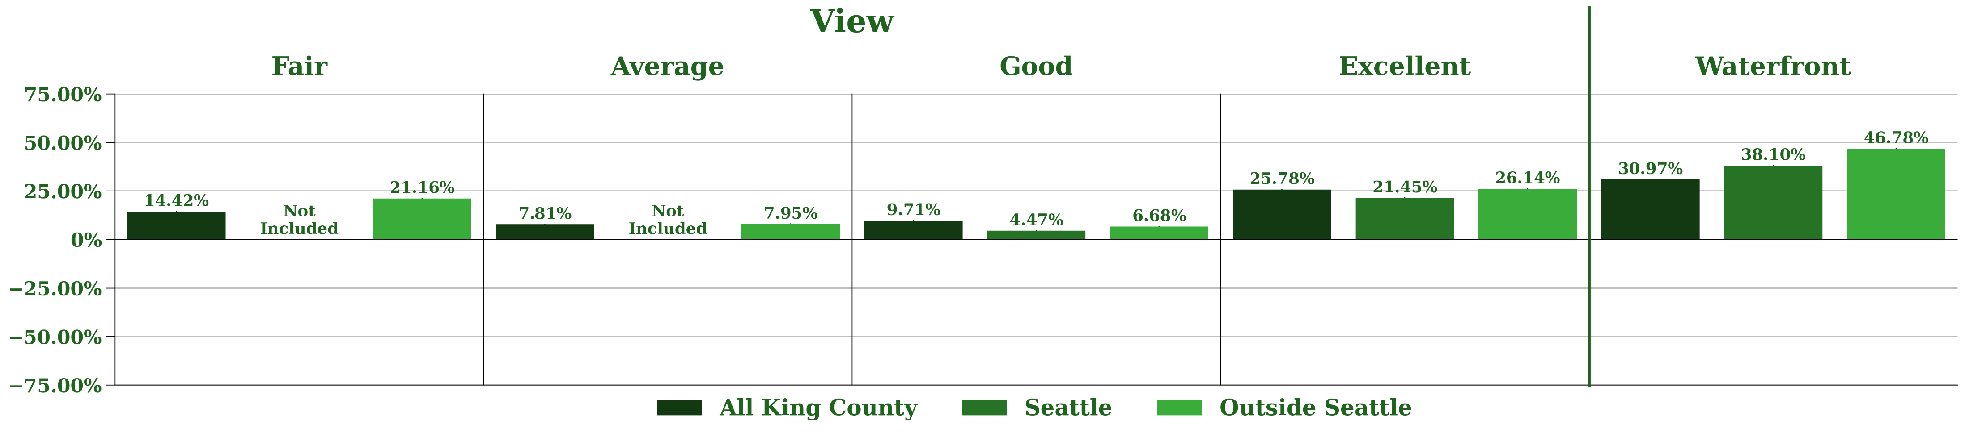
Features and Results
Square Footage Features
Intercepts
Grade
All King County Model
Seattle Model
Outside Seattle Model
Year Built
Condition and Renovated
View and Waterfront
Floors
Bedrooms
Baths
Basement
$262 K
$288 K
$149 K

Slide 6
Future Investigations
Picture Databases
Grade, View, and Condition Features
King County Records
Data on more than one year’s worth of property sales
Data on commercial property sales as well
Separate models for each city / ZIP code in King County
Identify changes over time
Identify areas with high potential
Identify the important features for each area
Interactive Maps for each City / ZIP Code
Zoning Districts
Heatmap of an Area’s Potential

Slide 7



Thank You
GMail
devin.sarnataro@gmail.com
LinkedIn
www.linkedin.com/in/devin-sarnataro-0b639b148
My Analysis
https://github.com/sarnadpy32/king_county_development

