Slide 1

An Academic Regression Analysis Project by Devin Sarnataro

Slide 2
Table of Contents
Introduction
Three Models
Results & Recommendations
Future Investigations

Slide 3
Introduction
Dependent Variable
Target
Percent Change
Sales Price
Independent Variable(s)
Predictors • Features
Numerical • Categorical
Intercept

Slide 4
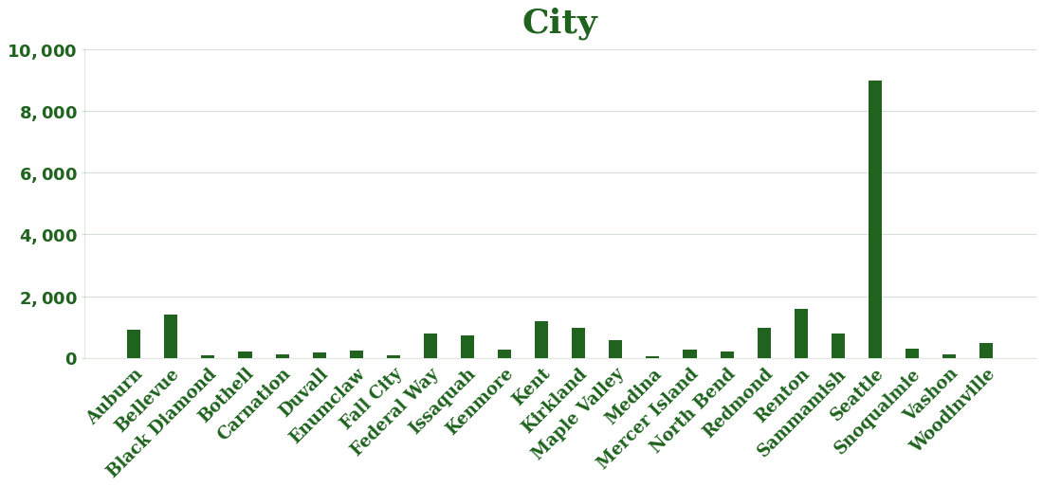
Three Models
All King County Model
Seattle Model
Outside Seattle Model
City

Slide 5
Results & Recommendations

Slide 6
Intercepts
All King County Model:
Seattle Model:
Outside Seattle Model:
$247 K
$266 K
$221 K

Slide 7
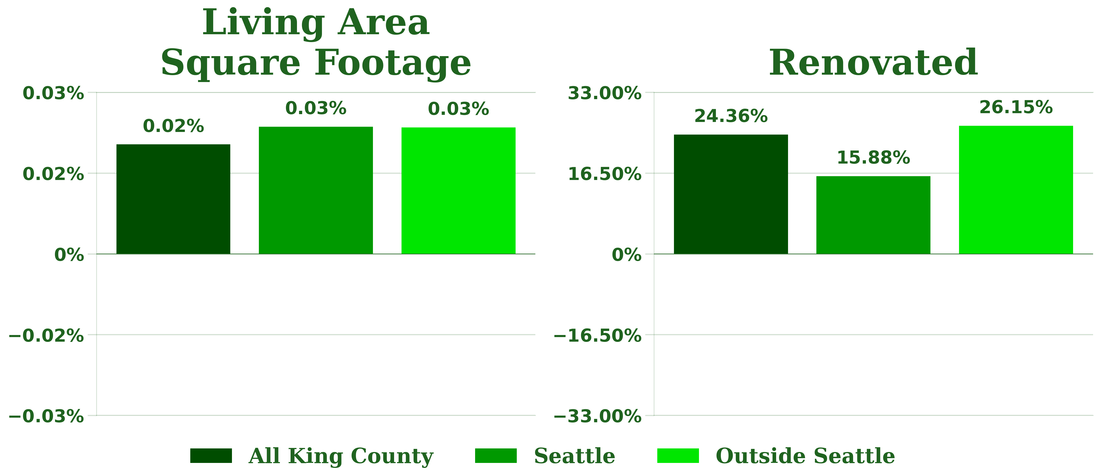
Living Area Square Footage & Renovated

Slide 8
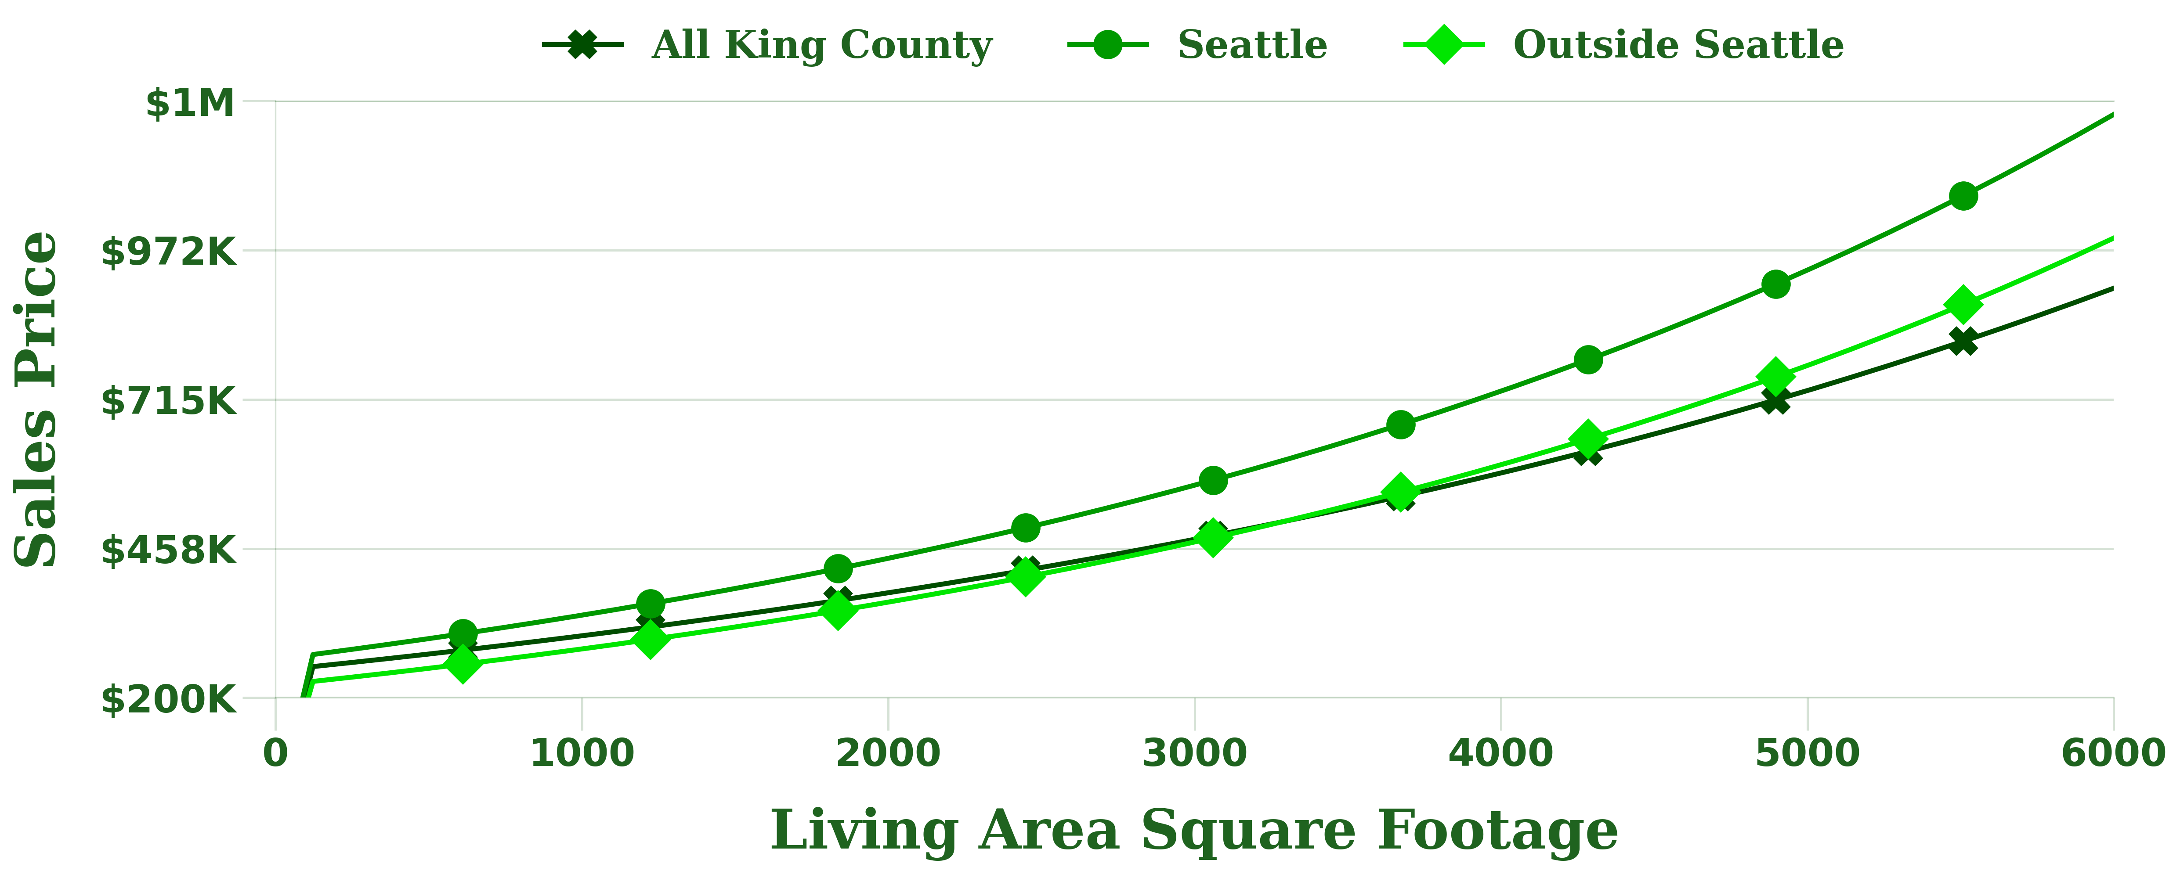
Sales Price vs. Living Area Square Footage

Slide 9
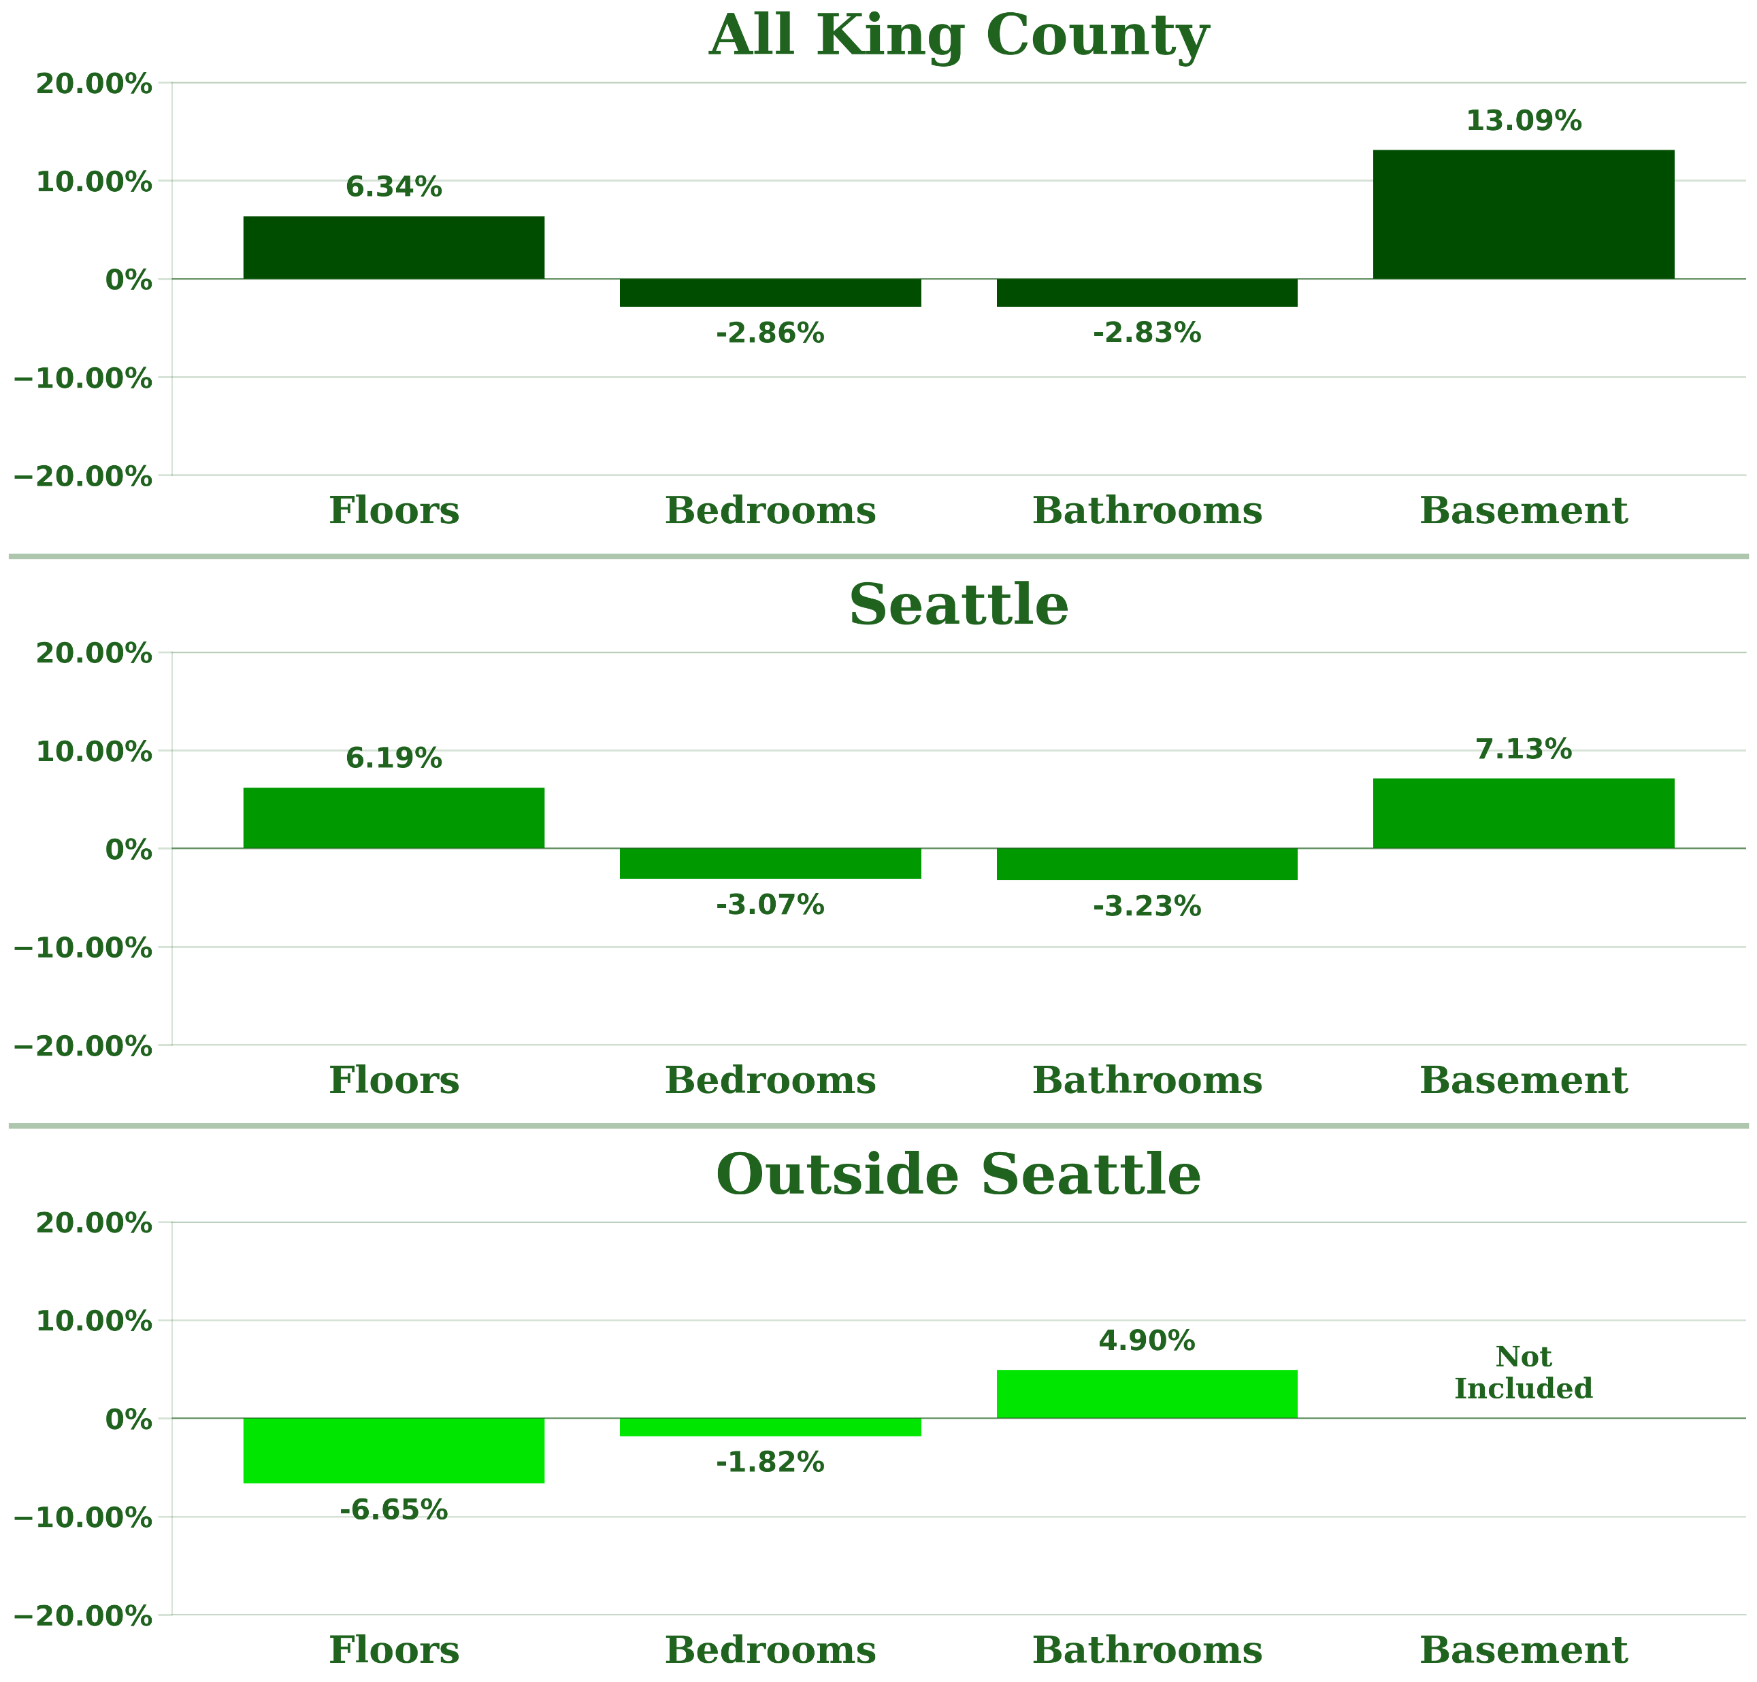


Floors, Bedrooms, Bathrooms & Basement

Slide 10
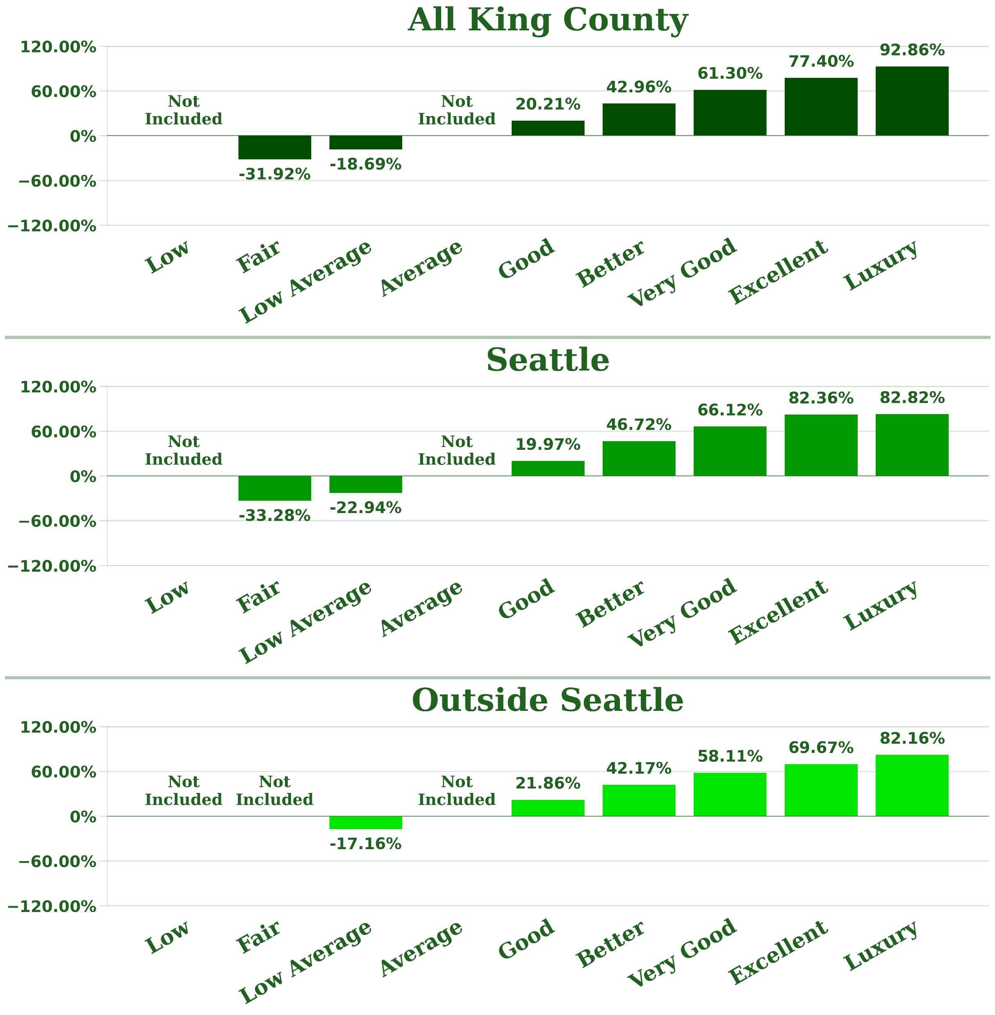
Grade

Slide 11
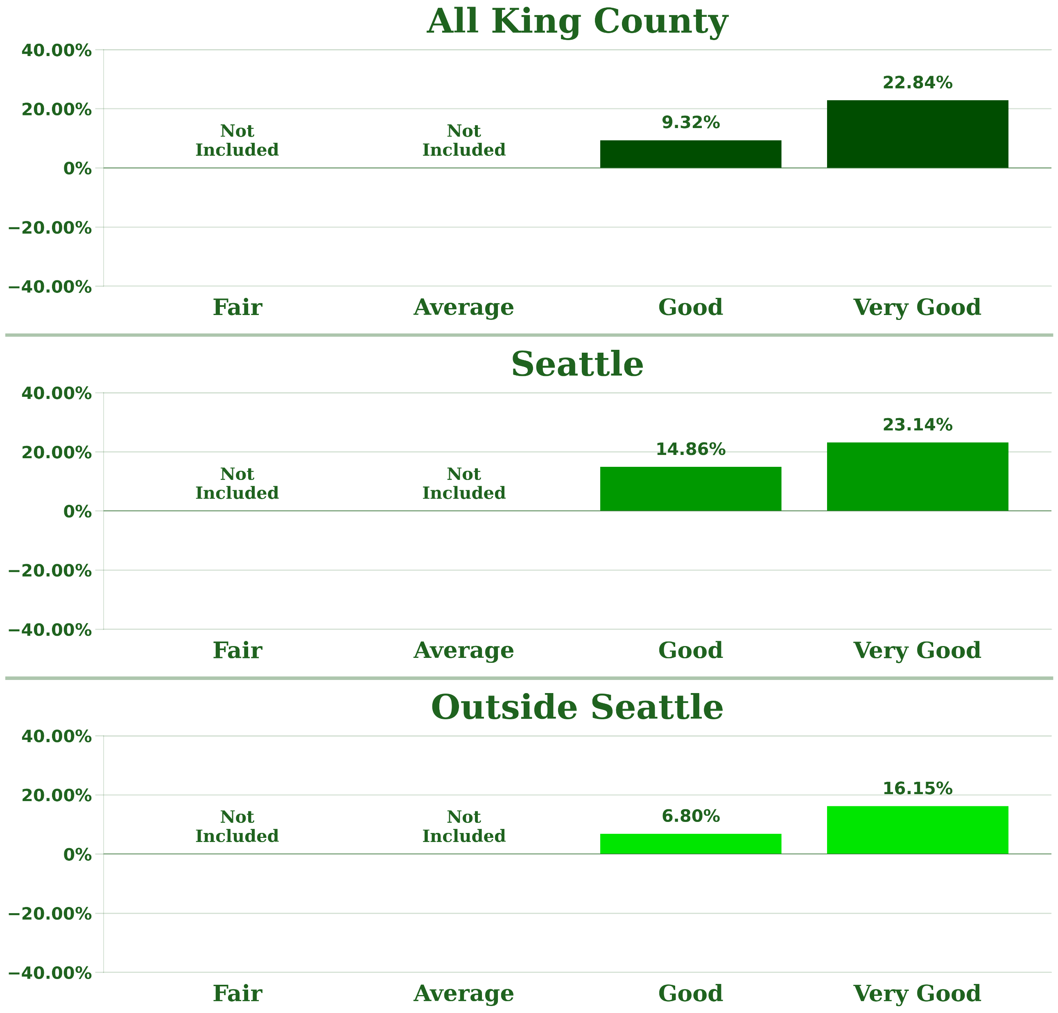
Condition

Slide 12
Recommendation
Picture Databases
Grade
8 – Good
9 – Better
10 – Very Good
11 – Excellent
12 – Luxury
13 – Mansion
Condition
4 – Good
5 – Very Good

Slide 13
Sales Price Calculator

Slide 14
Sales Price Calculator
Start Over
Choose a model.
All King County
Seattle
Outside Seattle
Click below to enter the original square footage.
Click below to enter a square footage increase.
1500 sqft
Start
500 sqft
$388,548.39
Grade
New
Good
Condition
$886,241.71
Better
Good
Very Good
Change
Very Good
Excellent
$497,693.32
Luxury

Slide 15
Future Investigations
Picture Databases
  Grade, View, and Condition Features
King County Records
  Multiple years
  Commercial property
  Separate models for each city / ZIP code
  Identify changes over time
  Identify areas with high potential
  Identify the important features for each area
Interactive Maps for each City / ZIP Code
  Zoning Districts
  Heatmap of an Area’s Potential

Slide 16



Thank You
GMail
devin.sarnataro@gmail.com
LinkedIn
www.linkedin.com/in/devin-sarnataro-0b639b148
My Analysis
https://github.com/sarnadpy32/king_county_development

