Slide 1



Single-Cell RNA-Seq Data Analysis
SupBioTech M2 · Paris · October 18–19, 2026
Sergio Sarnataro, PhD · Head of the Data Analysis group, Spatial-Cell-ID · ENS de Lyon
Notes:
Introductory lecture at the start of day 1. 14 hours in total over two days; this lecture gives the context and the concepts, the rest is hands-on with scanpy.

Slide 2




Who am I?
2016
2016–20
2020–22
2022–
MSc in Theoretical Physics
PhD in Computational Biology
NGS Data Scientist
Research Engineer in Bioinformatics
University of Naples (Italy)
IGBMC Strasbourg (France)
TIGEM Naples (Italy)
ENS de Lyon (France)
2
Notes:
Keep this short (1 minute). Background: theoretical physics, then computational biology and NGS data analysis.

Slide 3
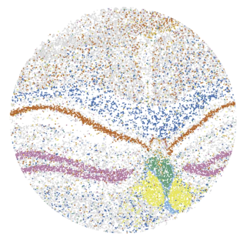

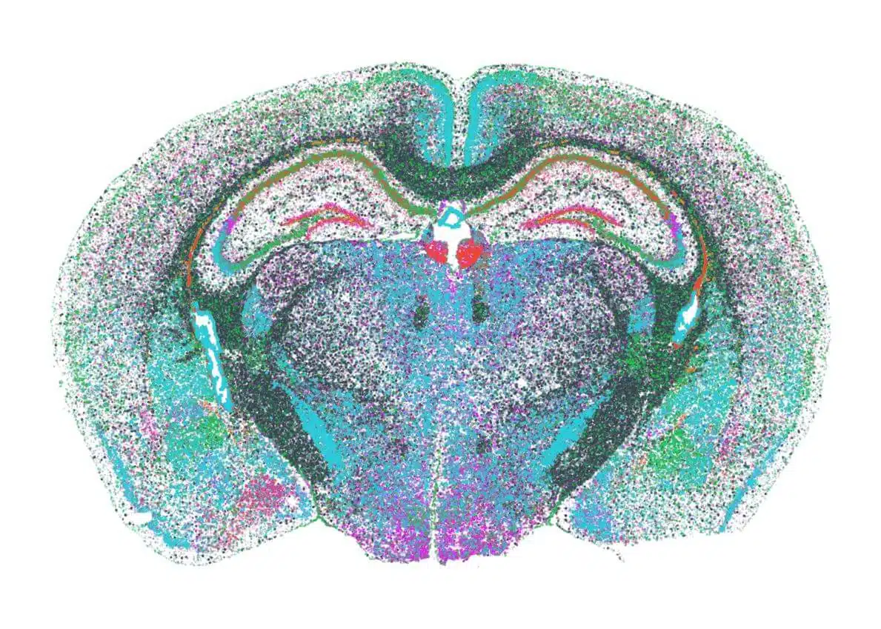
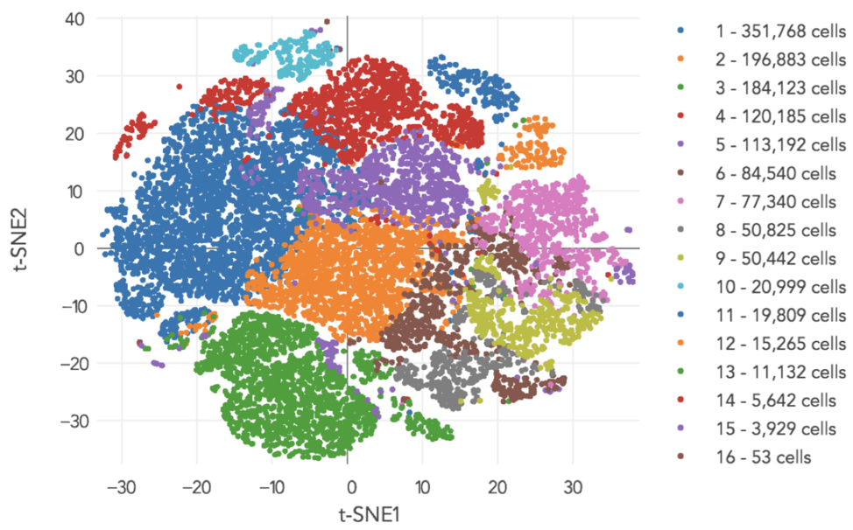
Data Analysis hub at Spatial-Cell-ID (ENS de Lyon)
New national spatial transcriptomics and single-cell RNA-Seq facility led by the École Normale Supérieure de Lyon.
Goal: studying cellular identity and its spatial heterogeneity, through very recent developments in spatial transcriptomics.
SLIDE-SEQ
MERFISH
SC-RNASEQ
DATA ANALYSIS
3
Notes:
One slide on the platform. The Data Analysis hub is where this course material comes from.

Slide 4
The course: 14 hours over two days
This lecture
Day 1 · Practical
Day 2 · Practical
Concepts and context
From counts to clusters
From clusters to biology
Why single-cell?
Our case study: human skin wound healing
From tissue to count matrix
The analysis workflow, step by step
Tools and set-up
Loading 10x matrices and quality control
Filtering, normalisation, highly variable genes
PCA, neighbours, UMAP, Leiden clustering
Batch effects and integration
Marker genes and cell-type annotation
Comparing with the authors' annotation
Differences across Skin, Wound1, Wound7, Wound30
Trajectories of keratinocytes
4
Notes:
Programme is a proposal: the exact split between days can be adjusted. Every practical uses the same dataset as the case study.

Slide 5
1
Why single-cell RNA-seq?
From bulk averages to the identity of every cell
5

Slide 6
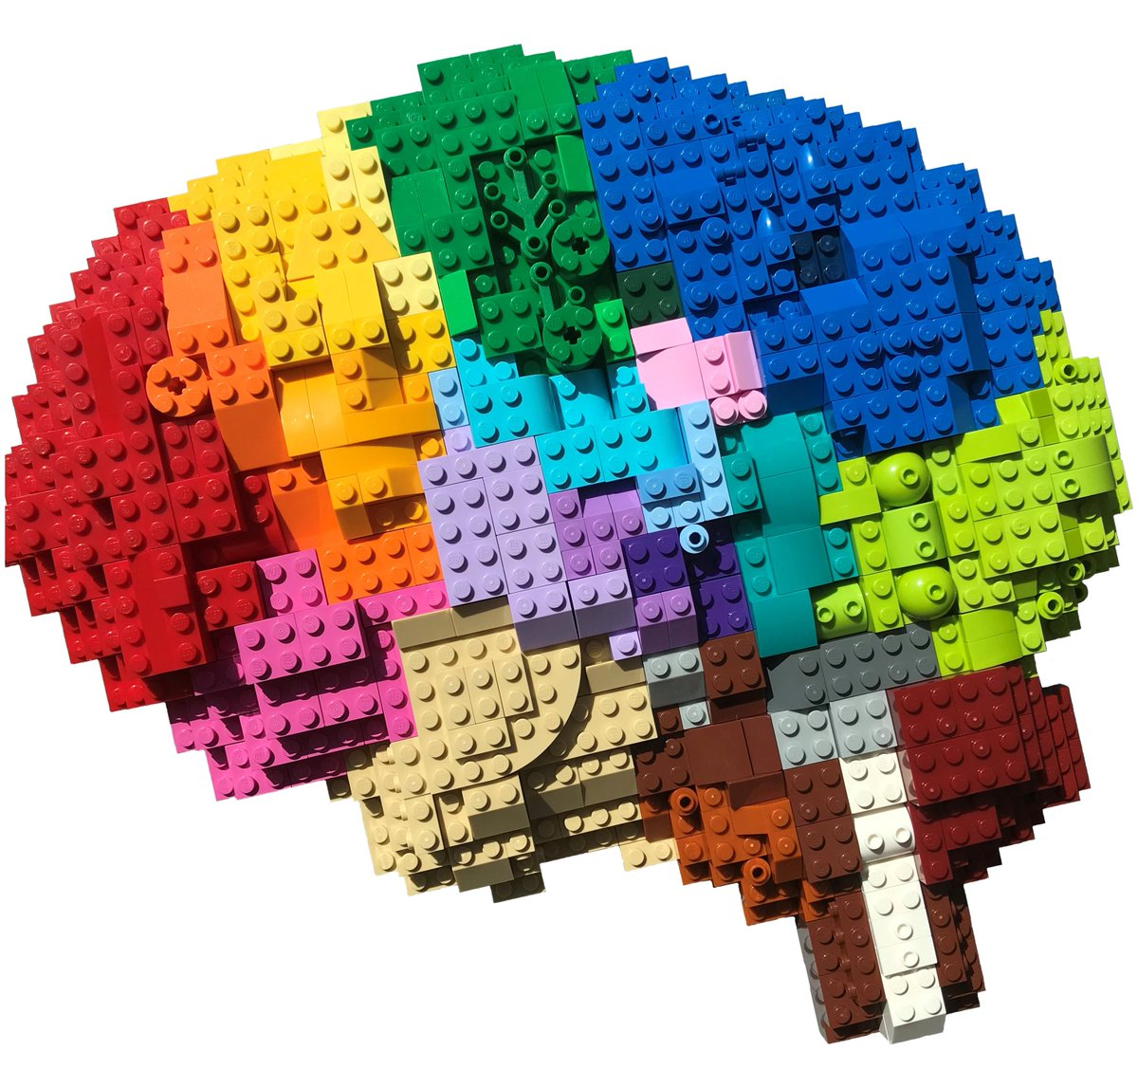
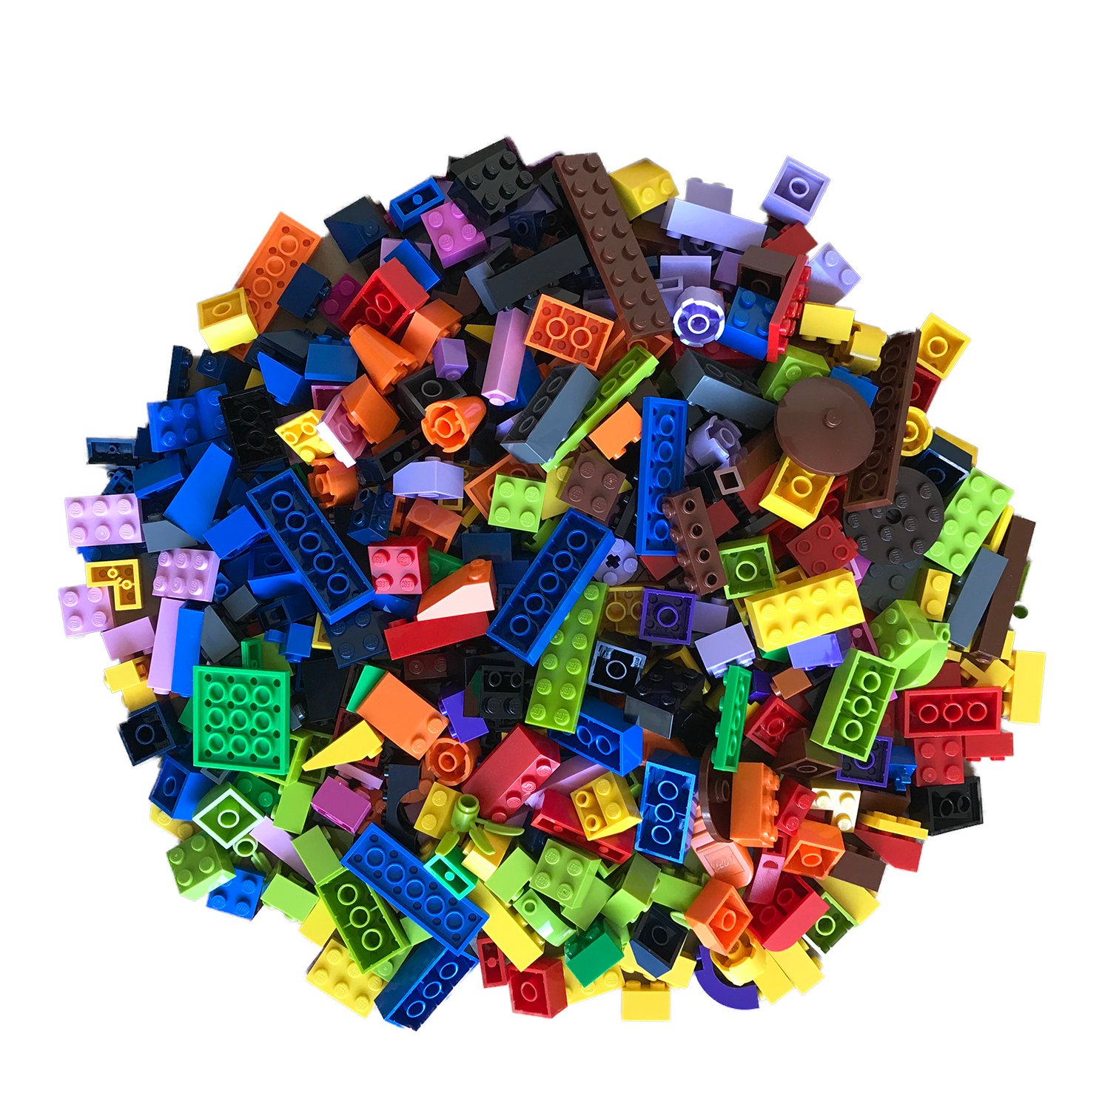

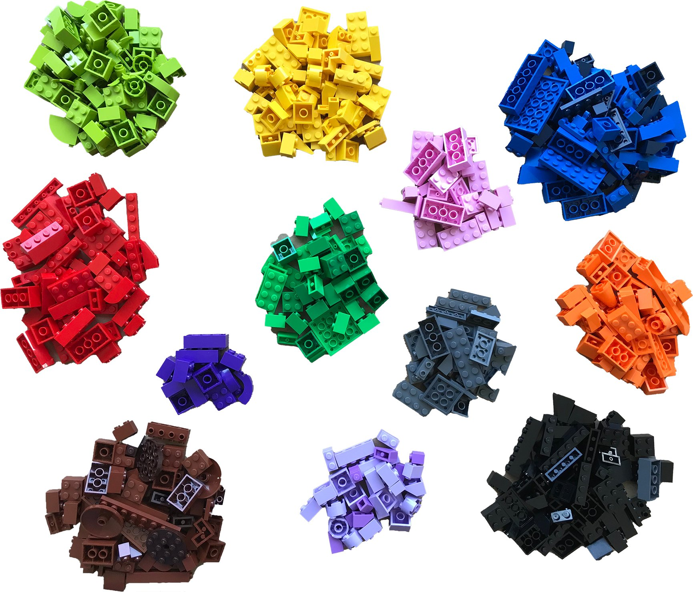
Adding new dimensions to transcriptomics
Original organ
Bulk RNA-seq
Single-cell RNA-seq
Spatial transcriptomics
Many cell types, organised in space
Everything is mixed: one averaged profile
Cells are separated: one profile per cell
Cell types and where they are
Why it matters: an average can hide the story. A change in bulk expression can mean fewer cells, more cells, or a different cell state, and bulk cannot tell them apart.
6
Notes:
The LEGO analogy: an organ is a structure of different bricks. Bulk grinds it into a pile, single-cell sorts the bricks, spatial keeps the structure.

Slide 7
What single-cell resolution gives us, and what it costs
Goals
Challenges
Explore which cell types are present in a tissue
Identify unknown or rare cell types and states
Find genes differentially expressed in a particular cell type, or even in a subpopulation of it
Large volume of data: tens of thousands of cells × tens of thousands of genes
Low sequencing depth per cell: most measurements are zero
Biological and technical variability across cells and samples
Our question: which cells enter a human skin wound, when, and what do they express as healing proceeds?
7
Notes:
Goals on the left, challenges on the right; the challenges are what the analysis workflow is designed to handle. The red bar introduces the running example.

Slide 8
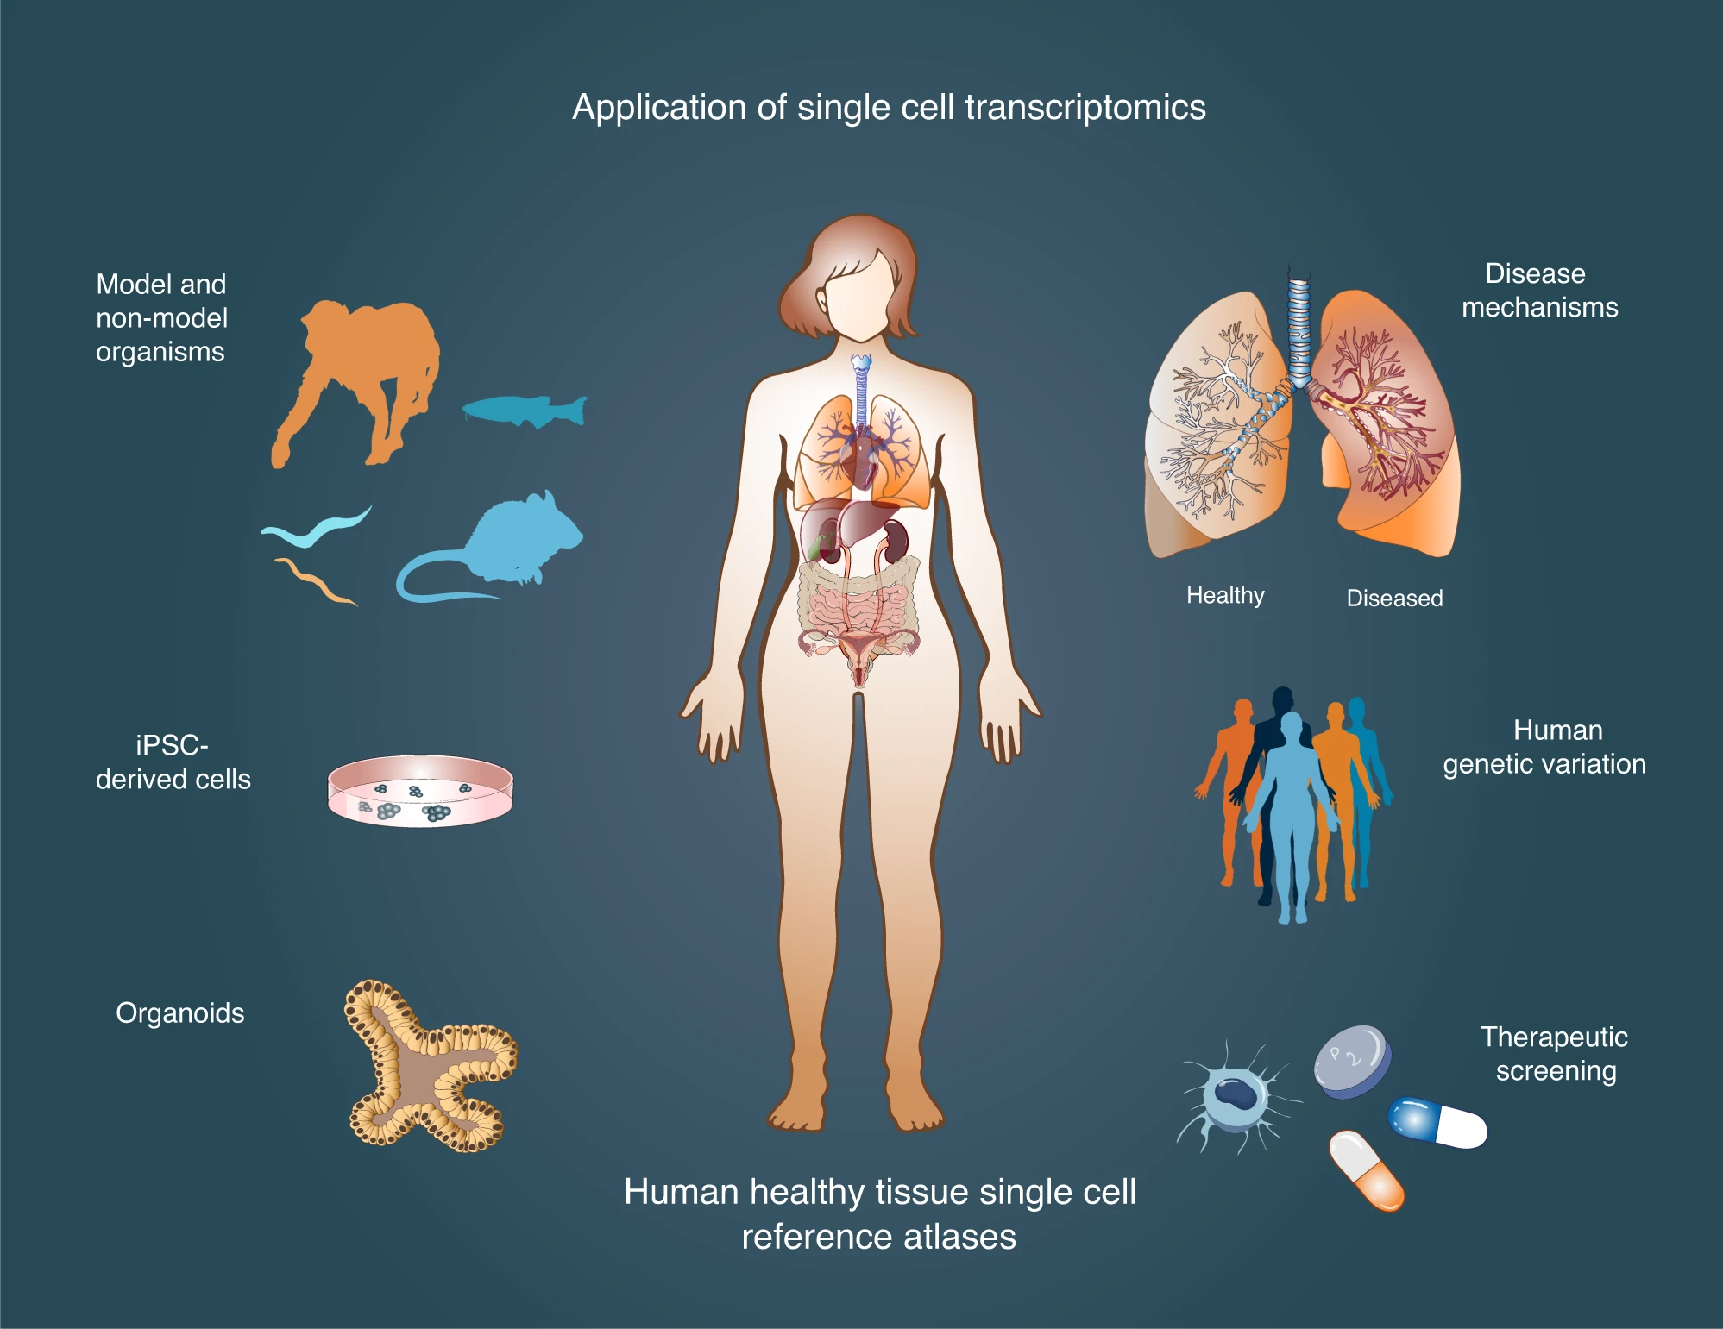
Application examples
Example 1 · A cancer of unknown primary
Subpopulations of cells migrating from the primary tumour to the metastasis
Example 2 · Our case study
Clustering reveals states such as migrating keratinocytes at the wound edge, which a bulk average cannot resolve
Figure: Aldridge & Teichmann, Nat Commun 11:4307 (2020). Wound-healing example: Liu et al., Cell Stem Cell 32:479 (2025).
8
Notes:
Example 1 is from my own work. Example 2 anticipates the case study: the migrating keratinocytes are a state, not a new tissue.

Slide 9
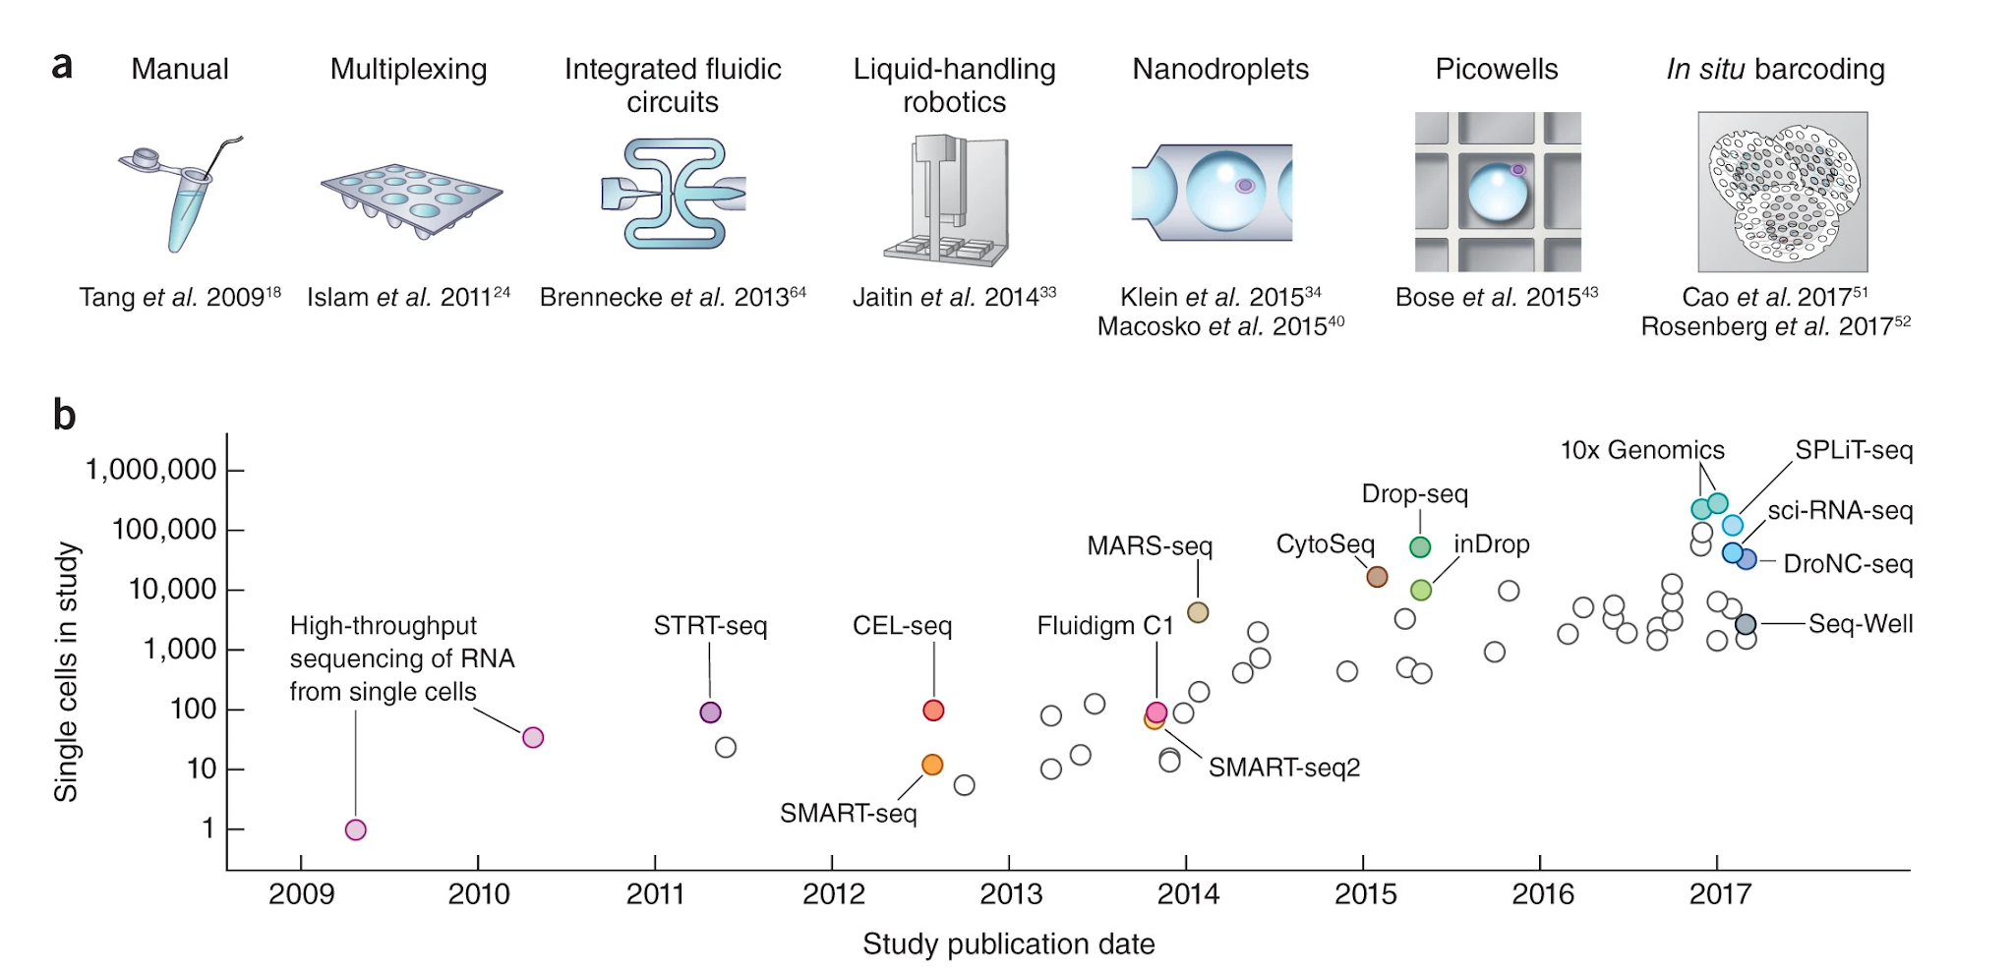
Single-cell technologies scale exponentially
Svensson, Vento-Tormo & Teichmann, Nat Protoc 13:599–604 (2018).
9
Notes:
Number of cells per study grew exponentially in the past decade (top: technologies, bottom: cells per study on a log scale).

Slide 10
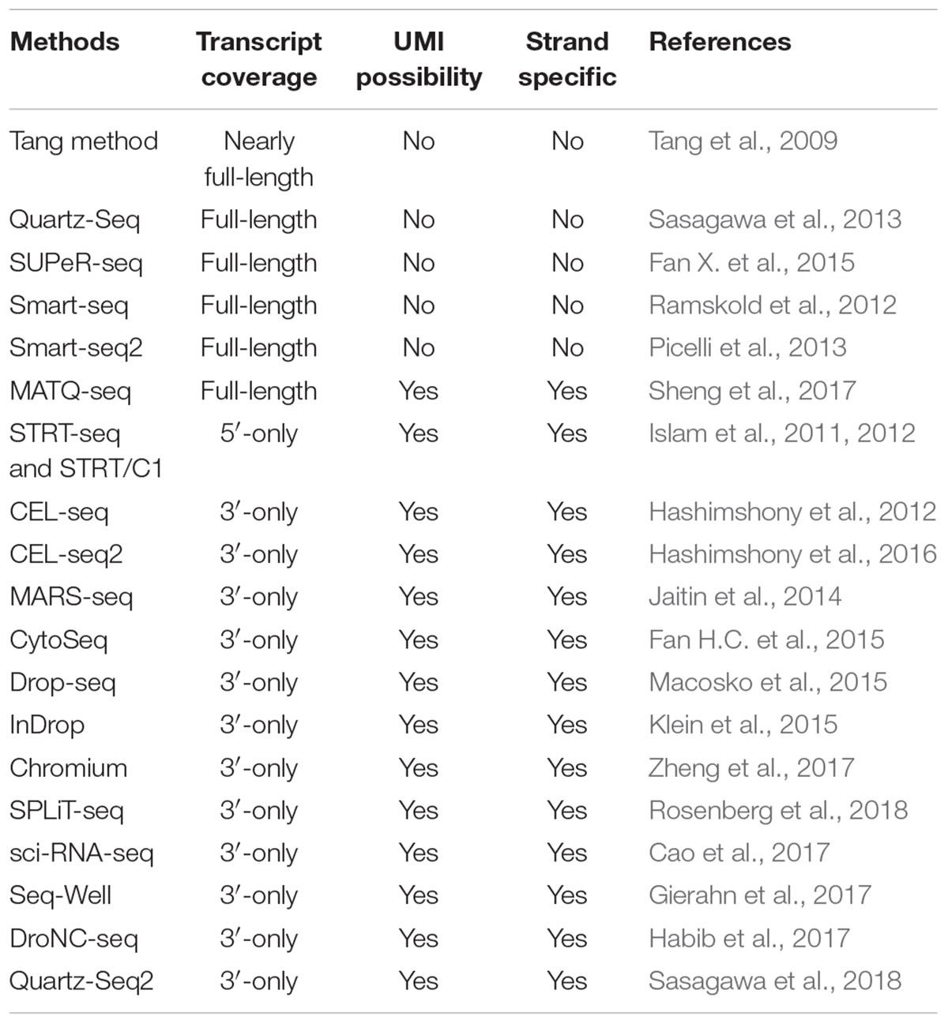
Many protocols, one focus: droplets and 3′ tags
Plate-based, full-length
Smart-seq2 and relatives: deep coverage of each transcript, but few cells
Droplet-based, 3′-tag
Drop-seq, Chromium: thousands of cells, UMIs, shallow depth per cell
Our focus: 10x Genomics Chromium 3′, the technology used in our case study.
Table: Chen, Ning & Shi, Front Genet 10:317 (2019).
10
Notes:
The table lists methods with transcript coverage, UMI availability and strand specificity. Trade-off: depth per cell vs number of cells.

Slide 11
2
Our case study: human skin wound healing
The paper, the biology and the data behind the practicals
11

Slide 12
Wound healing: three overlapping phases
Skin
Day 0 · Intact skin
Wound1
Day 1 · Inflammation
Wound7
Day 7 · Proliferation
Wound30
Day 30 · Remodelling
Baseline epidermis and dermis
The reference for every comparison
Neutrophils and pro-inflammatory macrophages arrive
Keratinocytes at the wound edge start to migrate
Proliferating keratinocytes and fibroblasts
Re-epithelialisation, granulation tissue, new capillaries
Mesenchymal fibroblasts dominate the wound bed
Extracellular matrix remodelling and scar formation
Why it matters: failed re-epithelialisation is a hallmark of chronic wounds such as venous ulcers and diabetic foot ulcers, which affect millions of people every year.
Liu et al., Cell Stem Cell 32:479–498 (2025).
12
Notes:
Colour code introduced here (grey, red, orange, navy for Skin, Wound1, Wound7, Wound30) is reused in every chart of the deck.

Slide 13
Study design: the same individuals, four time points
Healthy volunteers: 4-mm full-thickness wounds on the upper buttock
6-mm biopsies of the wound edge at day 1, 7 and 30, plus intact skin
Each donor is their own control over time
scRNA-seq: 3 donors × 4 time points = 12 samples
Chromium Next GEM 3′ v3.1, Illumina NovaSeq 6000, about 50,000 read pairs per cell
Data: GEO accession GSE241132
Cells | Skin | Wound1 | Wound7 | Wound30 | Total
PWH26 | 4,242 | 4,709 | 4,483 | 3,408 | 16,842
PWH27 | 3,265 | 6,491 | 6,518 | 5,953 | 22,227
PWH28 | 4,083 | 4,578 | 5,358 | 5,735 | 19,754
Total | 11,590 | 15,778 | 16,359 | 15,096 | 58,823
Highlighted: PWH27, the donor we analyse in the practicals (22,227 cells).
A parallel Visium spatial dataset exists for the same study, but it is not part of this course.
Liu et al. 2025 (STAR Methods). Cell counts computed from the GSE241132 cell metadata (cells retained by the authors).
13
Notes:
Numbers in the table come from GSE241132_cell_metadata.txt (58,823 cells). Total matches the paper.

Slide 14
What is in the data? Composition changes with healing
58,823
cells after QC and doublet removal
12
samples: 3 donors × 4 time points
27 → 9
clusters grouped into main cell types
Donor PWH27, authors' annotation. Keratinocytes rise to 69% at Wound1; fibroblasts grow to 35% by Wound30. 'Other': endothelial, hair follicle, mast, melanocyte, pericyte/smooth muscle, Schwann.
Computed from GSE241132 cell metadata (columns Condition, newMainCellTypes); clusters and main types from Liu et al. 2025.
14
Notes:
Real numbers from the metadata of donor PWH27 (22,227 cells). The paper groups clusters into 9 main cell types; the metadata file lists hair follicle as a tenth group.

Slide 15
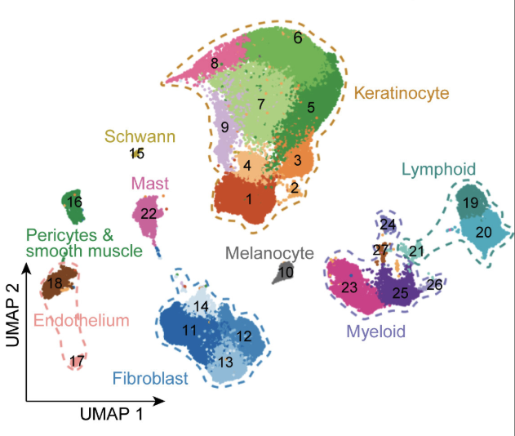
The roadmap: a UMAP of 58,823 cells
How to read it
Each dot is one cell
Nearby cells have similar expression
27 clusters, coloured by 9 main cell types
Keratinocytes and fibroblasts are the largest groups
Figure: Liu et al., Cell Stem Cell 32:479–498 (2025), CC BY 4.0.
15
Notes:
Insert Figure 1B (and 1C) from Liu et al. 2025, open access CC BY 4.0. Cite the figure on the slide.

Slide 16
What the paper found
1
Migrating keratinocytes at the wound edge
2
A relay race between cell types
Basal and spinous migrating clusters (Bas-mig, Spi-mig) peak at Wound1. They express KRT6A, MMPs, HBEGF; FOSL1 emerges as a key driver of migration.
Pro-inflammatory macrophages (CXCL1, EREG) support migration in the inflammatory phase; proliferating fibroblasts (HGF, FGF2, TGFB1) take over at day 7.
3
Fibroblast states shift over time
4
Chronic wounds fail differently
Proliferating fibroblasts appear at Wound7; mesenchymal fibroblasts (POSTN+) dominate the wound bed at Wound30.
Venous and diabetic foot ulcers lack migrating keratinocytes and show weaker inflammatory responses than acute wounds.
Liu et al., Cell Stem Cell 32:479–498 (2025). In the practical we look for these populations ourselves.
16
Notes:
Four take-aways. Point 1 and 3 can be reproduced from the data in the practical; 2 and 4 need extra tools or data and are discussed at the end.

Slide 17
3
From tissue to count matrix
Dissociation, droplets, reads and counts
17

Slide 18
Tissue dissociation: the first source of bias
1
2
3
4
5
Dispase II, 4 °C overnight: separate epidermis from dermis
Epidermis: trypsin/EDTA. Dermis: whole-skin dissociation kit
Mix equal amounts of epidermal and dermal cells
Remove red blood cells and dead cells
Load on the Chromium controller
Why it matters
An example from the paper
Cell types do not survive dissociation equally
The composition of the data is not the composition of the tissue
Neutrophils have low RNA content and high RNase levels
The standard pipeline missed them; the authors recovered them from the unfiltered matrices
Liu et al., Cell Stem Cell 32:479–498 (2025), STAR Methods.
18
Notes:
Protocol as described in the STAR Methods. The take-home: every step before the sequencer shapes what you can see afterwards.

Slide 19
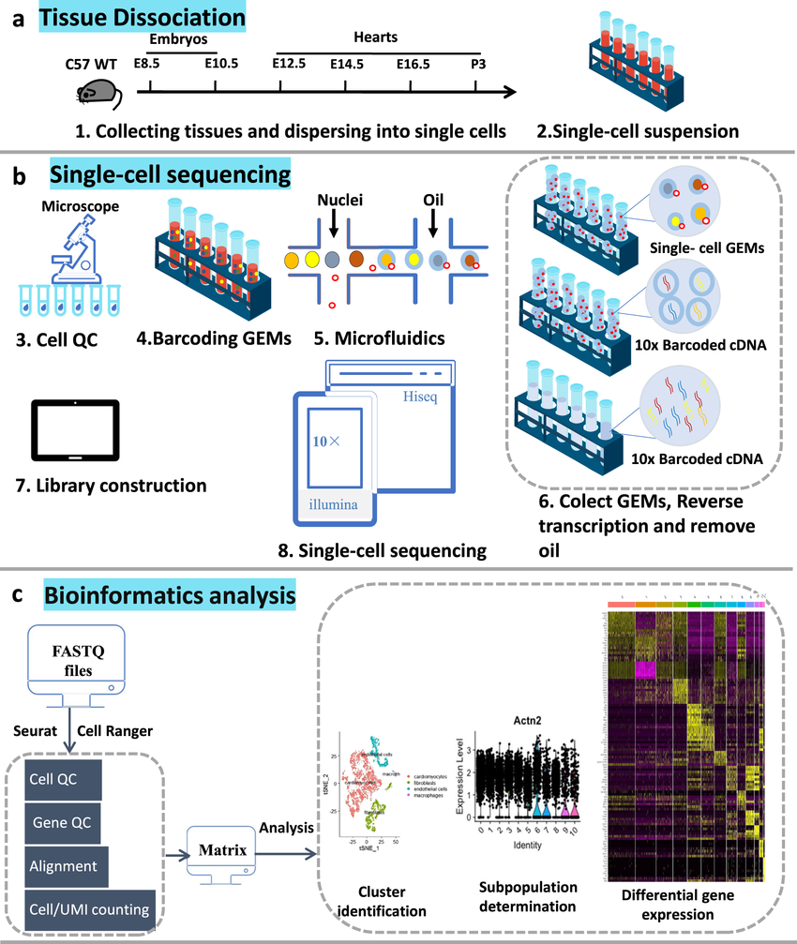
10x Genomics Chromium workflow
1
Droplets
Single cells, barcoded gel beads and oil form Gel Beads-in-Emulsion (GEMs); each GEM carries a unique cell barcode.
2
Barcoded cDNA
Inside each GEM the cell is lysed and mRNA is reverse-transcribed; every cDNA gets the cell barcode and a UMI.
3
Amplification
GEMs are broken, cDNA is pooled and amplified by PCR.
4
Sequencing
Libraries are prepared and sequenced on Illumina platforms.
Figure: Ren et al., Sci Data (2023), as cited in the 2025 lecture: reference to be verified.
19
Notes:
TODO: verify the Ren et al. 2023 reference (could not be confirmed online).

Slide 20
Structure of the sequencing reads
Read 1
Cell barcode
UMI
28 bp
Read 2
cDNA: 3′ end of the transcript
about 90 bp
Index read
i7
8 bp
Cell barcode
UMI
cDNA
Sample index
Which cell (droplet) did this molecule come from?
Which original mRNA molecule? Lets us collapse PCR duplicates.
Which gene? Mapped to the reference genome.
Which library? Demultiplexes pooled samples.
Chromium Next GEM 3′ v3.1 layout (16-bp barcode + 12-bp UMI). Schematic, not to scale for read 2.
20
Notes:
Read 1: 28 bp = 16 bp cell barcode + 12 bp UMI. Read 2: cDNA from the 3' end of the transcript. The old figure showed the v2 layout (26 bp); the paper used v3.1.

Slide 21
Why UMIs matter: counting molecules, not reads
ACTB · cell 3
AGTTGTA
AGTTGTA
AGTTGTA
3 reads → 1 molecule
count = 1
ARL1 · cell 4
ACTTGTG
ACTTGTG
4 reads → 2 molecules
count = 2
ARL1 · cell 4
TTCGTCT
TTCGTCT
Without UMIs
With UMIs
PCR amplifies molecules unevenly
Read counts reflect amplification bias as much as expression
Reads with the same barcode, UMI and gene are one molecule
The count matrix holds UMI counts per cell and gene
Schematic; UMI sequences are illustrative.
21
Notes:
Each coloured chip is a read; chips with the same UMI in the same cell and gene collapse into a single molecule.

Slide 22
Output of sequencing: FASTQ files
@SRR1234567.1
ACGTACGTACGTACGTACGTACGTACGTACGT
+
!''*((((***+))%%%++)(%%%%).1***-
Line 1 read identifier, starts with @
Line 2 nucleotide sequence
Line 3 separator, starts with +
Line 4 quality scores, one ASCII character per base
Phred quality score: Q = −10 · log₁₀(P)
P is the probability that the base call is wrong
Q = 30: 1 error in 1,000 calls (99.9% accuracy)
Q = 20: 1 error in 100 calls (99% accuracy)
22
Notes:
FASTQ = text file, 4 lines per read. In single-cell, R1 contains barcode and UMI, R2 the cDNA.

Slide 23
From reads to a count matrix
FASTQ files
Barcode and UMI processing
Alignment to the reference genome
UMI counting per cell and gene
Cell calling
CellRanger
Open-source alternatives
10x Genomics, commercial and widely used, very simple
Used in the paper: v5.0.1, GRCh38 with GENCODE v38
STARsolo, alevin-fry, kallisto | bustools
Recommended when you want full control or reproducibility
Output: BAM files and a cells × genes count matrix. In the paper, 65,462 cells and 27,973 genes before filtering.
Liu et al., Cell Stem Cell 32:479–498 (2025), STAR Methods.
23
Notes:
In the practical we start from the count matrices deposited on GEO, so alignment is not repeated.

Slide 24
The count matrix
 | Cell 1 | Cell 2 | Cell 3 | Cell 4 | Cell 5
Gene A | 10 | 0 | 5 | 2 | 7
Gene B | 0 | 15 | 3 | 0 | 1
Gene C | 20 | 7 | 0 | 10 | 5
Gene D | 3 | 0 | 8 | 4 | 0
Gene E | 0 | 2 | 0 | 6 | 12
MTX triplet (what GEO gives us)
matrix.mtx.gz, barcodes.tsv.gz, features.tsv.gz per sample
e.g. PWH27D0_matrix.mtx.gz
HDF5 (.h5, .h5ad)
One file, hierarchical, compact and fast to read
Rows = genes (features)
Columns = cells (barcodes)
Most entries are zero: the matrix is stored as sparse
CSV / TSV
Simple, but dense: unusable for large datasets
Toy matrix for illustration. Files from GEO accession GSE241132.
24
Notes:
Sparse storage keeps only the non-zero entries as (gene, cell, value) triplets: that is the MTX format.

Slide 25
4
The analysis workflow
One concept per step, and the choice the paper made
25

Slide 26
Overview: from counts to biology
1
Quality control
2
Normalisation
3
PCA and batch correction
4
Graph, clusters, UMAP
5
Markers and annotation
6
Downstream analyses
genes, UMIs, % mito, doublets
scaling, log, variable genes
denoise, align samples
Leiden, embedding
what is each cluster?
abundance, trajectories, DE
Day 1
Day 2
Every step involves a choice. For each one we will see what the paper did and what we do in the practical.
26
Notes:
Roadmap for the next slides: one slide per step (two for QC).

Slide 27
Quality control: keep cells that are real, single and alive
1
Genes per cell
The paper's filters
Low: empty droplet or dying cell. Very high: possible doublet.
< 500 genes: removed
< 1,000 UMIs: removed
> 20% mitochondrial: removed
Mitochondrial and haemoglobin genes removed; genes seen in < 10 cells removed
2
UMI counts per cell
Low: little RNA captured, unreliable profile.
65,462
58,823
3
% mitochondrial reads
cells before QC
after QC and doublets
High: stressed or dying cell that lost cytoplasmic RNA.
Thresholds depend on the dataset and the tissue: always look at the distributions before deciding.
Liu et al., Cell Stem Cell 32:479–498 (2025), STAR Methods.
27
Notes:
Discuss why the mitochondrial threshold is meaningful in dissociated cells. Numbers: raw matrix of 65,462 cells and 27,973 genes; 58,823 cells and 25,778 genes retained.

Slide 28
Doublets: two cells, one barcode
Scrublet
Simulates doublets by averaging random pairs of cells
Scores each cell by how many simulated doublets are among its neighbours
Empty droplet
Single cell
Doublet
In the paper
A doublet looks like an odd hybrid cell: it can create fake intermediate populations.
Expected rate grows with the number of cells loaded.
Other artefacts to keep in mind: ambient RNA and dead-cell debris.
Scrublet and DoubletFinder
Removed cells called by both tools, or in clusters with mixed markers
Wolock et al., Cell Syst 8:281 (2019); McGinnis et al., Cell Syst 8:329 (2019); Liu et al. 2025.
28
Notes:
In the practical we detect doublets with Scrublet (Python-native).

Slide 29
Normalisation and variable genes
The problem: cells differ in sequencing depth. In donor PWH27 the median is 15,000 to 21,000 UMIs per cell, and individual cells vary far more.
Log-normalisation (practical)
SCTransform (paper)
Scale each cell to the same total, then take the log
x′ = log(1 + 10⁴ · x / total)
Simple, fast, the scanpy default
Regularised negative-binomial regression, per gene
Regresses out mitochondrial fraction and cell cycle
Residuals replace log counts
Highly variable genes: keep the genes that carry biological signal. The paper used the top 4,000; scanpy defaults to 2,000.
Hafemeister & Satija, Genome Biol 20:296 (2019); Liu et al. 2025. UMI medians from GSE241132 metadata.
29
Notes:
Median nCount_RNA per time point in PWH27: 19,666 (Skin), 20,713 (Wound1), 14,991 (Wound7), 16,671 (Wound30).

Slide 30
PCA and the neighbour graph
Cells × genes
about 4,000 variable genes
PCA
Cells × PCs
40 in the paper
kNN
PCA compresses the noisy gene space into a few dozen axes of variation.
How many PCs? look at the elbow plot; the paper used 40.
kNN graph: each cell is linked to its most similar cells. Clustering and UMAP both work on this graph.
Liu et al., Cell Stem Cell 32:479–498 (2025). Graph drawn for illustration.
30
Notes:
PCA is linear; the neighbour graph is the object everything downstream (Leiden, UMAP, PAGA, Milo) uses.

Slide 31
Batch effects and integration
Technical differences between samples, runs or donors can separate cells more than biology does.
Batch is not condition
In the paper, three donors give replicates for every time point, so correcting per sample is defensible.
In a single donor (our subset), each sample is one time point: correcting for sample can erase the very effect we want to study.
The authors also checked that pseudobulk samples cluster by healing stage, not by donor.
Harmony
Iteratively corrects the PCA space (used in the paper, 40 PCs)
BBKNN
Builds a batch-balanced neighbour graph
Scanorama
Stitches datasets through mutual nearest neighbours
Korsunsky et al., Nat Methods 16:1289 (2019); Polański et al., Bioinformatics 36:964 (2020); Hie et al., Nat Biotechnol 37:685 (2019); Liu et al. 2025.
31
Notes:
Key teaching point of day 1: never correct a variable that is confounded with your biological question. Use the practical to show the trade-off.

Slide 32
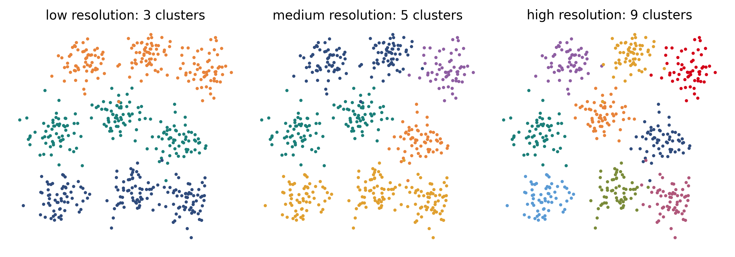
Clustering and UMAP
Leiden finds communities in the kNN graph and guarantees well-connected clusters (Louvain does not).
Resolution sets how many clusters you get. Paper: 0.8 for 27 clusters, 0.5 for subclustering.
UMAP is for visualisation: cluster sizes and distances between clusters are not quantitative.
Always ask: is this cluster stable across resolutions?
Simulated data for illustration. Traag, Waltman & van Eck, Sci Rep 9:5233 (2019); Liu et al. 2025.
32
Notes:
Same points, three resolutions. Ties in with the parameter-sensitivity exercise.

Slide 33
Marker genes and cell-type annotation
Main cell type | Markers used in the paper
Keratinocytes | KRT5 (high) or KRT10 (high)
Fibroblasts | COL1A1
Myeloid cells | LYZ, HLA-DRA
Lymphoid cells | CD3D, NKG7
Endothelial cells | PECAM1
Mast cells | TPSAB1, TPSB2
Pericytes, smooth muscle | ACTA2, MYH11
Melanocytes | TYRP1, PMEL
Schwann cells | SOX10, SOX2
How to annotate
Find the genes that distinguish each cluster
Paper: Seurat FindAllMarkers with the MAST test
Practical: scanpy rank_genes_groups (Wilcoxon)
Match markers to known biology, then compare with the authors' labels
Liu et al., Cell Stem Cell 32:479–498 (2025).
33
Notes:
Annotation combines statistics and prior knowledge. In the practical, students compare their labels with newMainCellTypes from the GEO metadata.

Slide 34
Differential abundance: who is more (or less) frequent?
Migrating keratinocytes (Bas-mig + Spi-mig), % of all cells
Reading the change
The wave of migrating keratinocytes peaks at Wound1, as in the paper
Proportions are compositional: if one population grows, others shrink
Cells are not replicates, donors are: test with sample-level replication
Milo (used in the paper) tests neighbourhoods of the kNN graph instead of fixed clusters
Computed from GSE241132 metadata (newCellTypes). Dann et al., Nat Biotechnol 40:245 (2022); Liu et al. 2025.
34
Notes:
Real numbers: migrating KC per time point, PWH27: 65/3265, 1385/6491, 604/6518, 505/5953 cells. All donors: 204, 3414, 1486, 879.

Slide 35
Trajectories: ordering cells along a process
Differentiation (all keratinocytes)
Pseudotime
Orders cells along a continuous process, from a chosen root
Paper: Monocle3, root in Bas-I; driver genes by Moran's I
Practical: diffusion pseudotime or PAGA in scanpy
Bas-I
Spi-I
Spi-II
Gra
Bas-mig
Spi-mig
Wound-specific branches (KRT6A+ cells)
Simplified from the paper: keratinocytes split into wound and non-wound cells with a Gaussian mixture model on KRT6A.
Cao et al., Nature 566:496 (2019); Wolf et al., Genome Biol 20:59 (2019); Liu et al. 2025.
35
Notes:
Two extra branches in wound cells: Bas-I to Bas-mig, and Spi-II to Spi-mig. A pseudotime is an ordering, not a clock.

Slide 36
Beyond the basics
Cell–cell communication
Gene regulatory networks
Ligand–receptor inference: MultiNicheNet, CellChat in the paper; LIANA, squidpy in Python. Found EGFR ligands and CXCL1 in migration.
pySCENIC and CellOracle: FOSL1 knock-out and overexpression simulated in silico.
RNA velocity
Spatial transcriptomics
CellRank and scVelo: direction of fibroblast trajectories from spliced and unspliced reads.
Cell2location maps the scRNA-seq cell types onto Visium spots: the companion dataset of this study.
Liu et al., Cell Stem Cell 32:479–498 (2025).
36
Notes:
Optional demos or discussion if time permits.

Slide 37
5
Tools and practicals
scanpy, AnnData and the dataset we will use
37

Slide 38

scanpy: single-cell analysis in Python
I/O
Preprocessing
read_10x_mtx, read_10x_h5, read_h5ad
filter_cells, filter_genes, normalize_total, log1p, highly_variable_genes
A scalable Python library for single-cell data analysis
Efficient for large datasets
Part of the scverse ecosystem, very well documented
Tools
Plotting
pca, neighbors, umap, leiden, rank_genes_groups, dpt, paga
umap, scatter, violin, dotplot, heatmap
Wolf, Angerer & Theis, Genome Biol 19:15 (2018). Guides: sc-best-practices.org (Heumos et al., Nat Rev Genet 24:550, 2023).
38
Notes:
scanpy has four families of functions: input/output, preprocessing, tools and plotting.

Slide 39
AnnData: the data structure behind scanpy
var
gene metadata: symbol, highly variable
Memory-efficient: sparse matrices
Data and metadata travel together
Saved as .h5ad
Shared by many tools (scanpy, squidpy, scvi-tools)
obs
cell metadata: sample, time point, n_genes, cluster
X
cells × genes
counts, normalised values
obsm
PCA and UMAP coordinates
layers
raw counts, other normalisations
uns
results, colours
Virshup et al., J Open Source Softw 9:4371 (2024).
39
Notes:
Rows of X are cells (obs), columns are genes (var).

Slide 40
The dataset for our practicals: donor PWH27
Cells per sample (22,227 in total)
Why this subset
4 samples, 22,227 cells: runs on a laptop
Same individual across the whole healing time course
Public matrices on GEO (GSE241132), one archive per sample
The authors' annotation is available to check our own labels
Cell counts from GSE241132 cell metadata.
40
Notes:
Decision: practicals use PWH27 only. Keep the full 58,823-cell dataset as context and for the paper's results.

Slide 41
From the paper's pipeline to our practical
Step | Paper (R, Seurat) | Practical (Python, scanpy)
Counts | CellRanger 5.0.1 | Provided (GEO matrices)
QC | < 500 genes, < 1,000 UMIs, > 20% mito | Same thresholds
Doublets | Scrublet + DoubletFinder | Scrublet
Normalisation | SCTransform, 4,000 HVGs | Log-normalisation, HVGs
Batch | Harmony, 40 PCs | Harmony, BBKNN, Scanorama
Clustering | Louvain, resolution 0.8 | Leiden
Markers | FindAllMarkers (MAST) | rank_genes_groups
Abundance | Milo | Proportions per time point
Trajectory | Monocle3 | Diffusion pseudotime, PAGA
Practical column: planned content, to be adjusted with the notebooks. Paper column: Liu et al., STAR Methods.
41
Notes:
Same logic, different tools. Differences are teaching opportunities: SCTransform vs log-normalisation, Louvain vs Leiden.

Slide 42
Setting up the computational environment
# create and activate the course environment
mamba env create -f environment.yml
mamba activate skinwound
# check that scanpy works
python -c "import scanpy; print(scanpy.__version__)"
In the environment
Python 3.11
scanpy, anndata, leidenalg
harmonypy, bbknn, scanorama
Data
Notebooks
Public matrices from GEO: GSE241132
Or the copy on the course server: path given by the instructor
One notebook per module
Run cells in order; restart the kernel if something looks wrong
Details in the repository README (environment.yml). Adjust if the course runs on the shared server.
42
Notes:
Replace with the actual server instructions once fixed. Also mention the environment name (skinwound) from the repository.

Slide 43
Take-home messages
1
Single-cell resolves cell types and states that bulk averages hide
2
Every step before the count matrix (dissociation, capture, depth) shapes what we can see
3
The workflow is a chain of choices: QC, normalisation, correction, resolution
4
Never correct for a variable that is confounded with the biology you study
5
Annotation and statistics need biological knowledge, and replicates that are donors, not cells
43
Notes:
Close the lecture, then move to the first notebook.

Slide 44
References (1/2)
Liu Z. et al. Spatiotemporal single-cell roadmap of human skin wound healing. Cell Stem Cell 32, 479–498 (2025). doi:10.1016/j.stem.2024.11.013
Svensson V., Vento-Tormo R., Teichmann S.A. Exponential scaling of single-cell RNA-seq in the past decade. Nat Protoc 13, 599–604 (2018).
Aldridge S., Teichmann S.A. Single cell transcriptomics comes of age. Nat Commun 11, 4307 (2020).
Chen G., Ning B., Shi T. Single-cell RNA-seq technologies and related computational data analysis. Front Genet 10, 317 (2019).
Ren et al. Scientific Data (2023). [reference to be verified]
Wolock S.L., Lopez R., Klein A.M. Scrublet. Cell Syst 8, 281–291 (2019).
McGinnis C.S., Murrow L.M., Gartner Z.J. DoubletFinder. Cell Syst 8, 329–337 (2019).
Hafemeister C., Satija R. Normalization and variance stabilization of single-cell RNA-seq data using regularized negative binomial regression. Genome Biol 20, 296 (2019).
44
Notes:
Reference formats follow the sources used on the slides.

Slide 45
References (2/2)
Korsunsky I. et al. Fast, sensitive and accurate integration of single-cell data with Harmony. Nat Methods 16, 1289–1296 (2019).
Polański K. et al. BBKNN: fast batch alignment of single cell transcriptomes. Bioinformatics 36, 964–965 (2020).
Hie B., Bryson B., Berger B. Efficient integration of heterogeneous single-cell transcriptomes using Scanorama. Nat Biotechnol 37, 685–691 (2019).
Traag V.A., Waltman L., van Eck N.J. From Louvain to Leiden: guaranteeing well-connected communities. Sci Rep 9, 5233 (2019).
Dann E. et al. Differential abundance testing on single-cell data using k-nearest neighbor graphs. Nat Biotechnol 40, 245–253 (2022).
Cao J. et al. The single-cell transcriptional landscape of mammalian organogenesis. Nature 566, 496–502 (2019).
Wolf F.A., Angerer P., Theis F.J. SCANPY: large-scale single-cell gene expression data analysis. Genome Biol 19, 15 (2018).
Wolf F.A. et al. PAGA: graph abstraction reconciles clustering with trajectory inference. Genome Biol 20, 59 (2019).
Heumos L. et al. Best practices for single-cell analysis across modalities. Nat Rev Genet 24, 550–572 (2023).
Virshup I. et al. anndata: access and store annotated data matrices. J Open Source Softw 9, 4371 (2024).
45
Notes:
Reference formats follow the sources used on the slides.

Slide 46
Thank you
To you, SupBioTech students, for your attention
Course given with the support of ENS de Lyon and the Spatial-Cell-ID Data Analysis hub
46

