Slide 1
GREENHOUSE MONITORING AND CONTROLLING SYSTEM
SENDHU VARTHANI. S (18BIT028)
SARNIKA. K (18BIT042)

Slide 2
ABSTRACT :
The main objective of this project is to understand what are the factors that affects the growth of the plant and monitors the defect and controls the plant and increase the productivity of the crop.
This constantly monitor and control environmental conditions in greenhouse to ensure it remains at preset temperature and humidity levels.

Slide 3
COMPONENTS :
ATmega8 aurdino
LCD display
4 channel 5V relay module
Sensor
9V Battery
Motor fan
Connecting wires
Cardboard

Slide 4
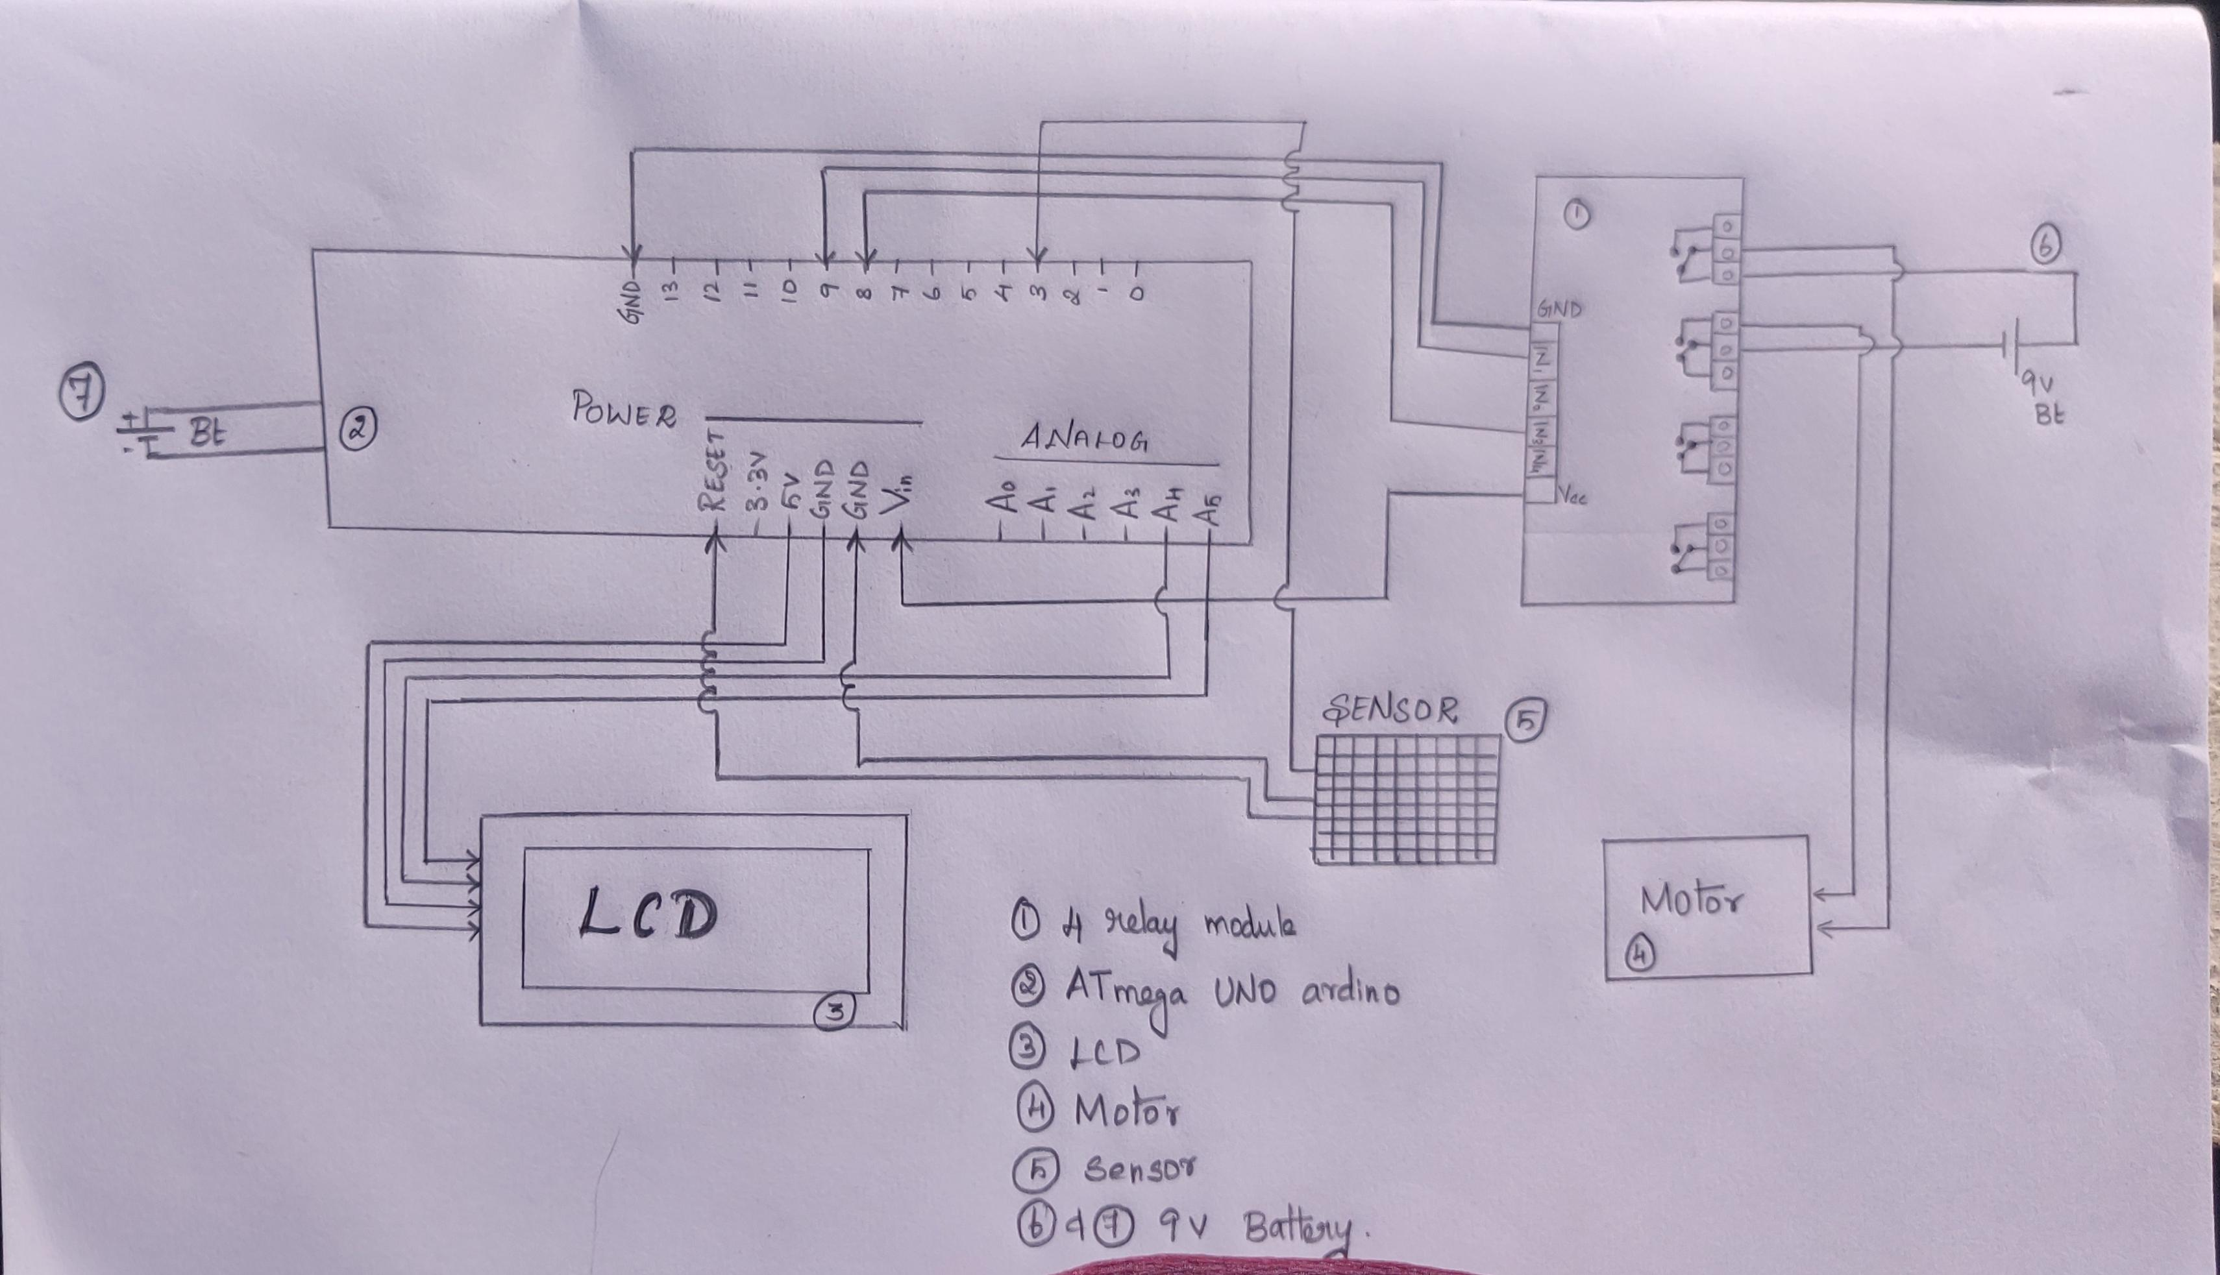
CIRCUIT DIAGRAM :

Slide 5
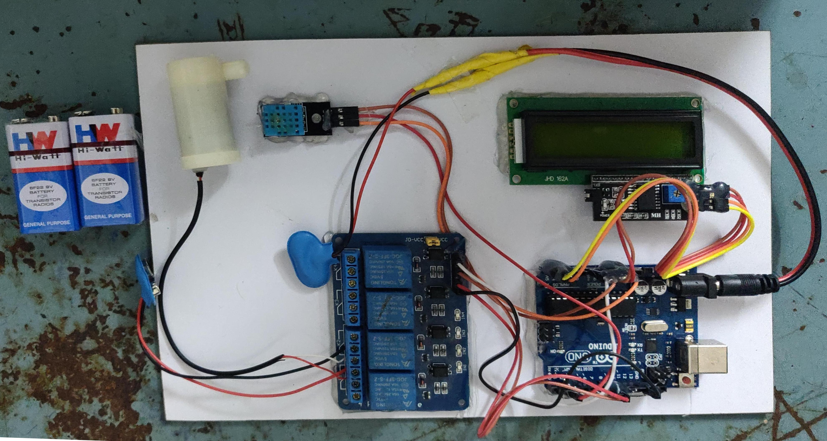
CIRCUIT DESIGN :
The design begins with the Arduino.
The input pins (GND, IN1, IN3, Vcc) of 4 relay module is connected to aurdino.
The sensor pins are connected to Arduino.
The power and analog pins of the Arduino is connected to LCD display.
Finally one battery of 9V is connected from LCD and another battery of 9V is connected from Arduino.
When batter is connected the circuit works.

Slide 6
PRINCIPLE :
The main principle is when temperature increases the FAN gets ON and when humidity increases AC gets ON. These operations are indicated through a MOTOR which acts a detector when there is unbalanced changes in temperature and humidity.

Slide 7
WORKING :
When the battery is connected, the data of the temperature and humidity is displayed in LCD screen.
When temperature increases above 35°C the FAN gets switched ON and when the humidity increases above 80°C the AC gets ON.
When both temperature and humidity is within the range they are in normal conditions.
At the increased condition of either temperature or humidity or both the motor fan gets ON indicating the changes in the range.

Slide 8
CONCLUSION :
As a conclusion, the design system allows real time measurement and data transmission from the greenhouse to intrested farmer.
To be confirmed, we hav tested our greenhouse project in different places at different climatic conditions whether it works without any error.

