Slide 1
Sorting Algorithms
Introduction

Slide 2
What is Sorting??
Sorting is the process of arranging elements in a specific order.
Typically, elements are organized in ascending or descending order.
Notes:
Sorting arranges data in an organized format, making it easier to search, retrieve, and analyze. It’s one of the most essential tasks in programming and data handling, especially for optimizing performance in various algorithms and applications.

Slide 3
Why is Sorting Important
Enhances Search Efficiency
Speeds up search operations.
Data Organization
Simplifies data management and analysis.
Foundation for Algorithms
Sorting is essential for other algorithms, like binary search.
Notes:
Sorting is crucial for efficient data handling. An organized dataset allows for faster data retrieval and enhances performance in other algorithms. It’s a fundamental step in many operations, from database management to scientific computing, making it a core skill in programming.

Slide 4
Types of Basic Sorting Algorithms
Bubble Sort
Swaps adjacent elements until the list is sorted.
Selection Sort
Finds the smallest element and places it at the beginning of the list.
Insertion Sort
Inserts each element into its correct position within a growing sorted list.
Merge Sort and Quick Sort
Efficient algorithms that use divide-and-conquer strategies.
Notes:
sorting algorithms work by comparing elements to determine their order. Bubble Sort is straightforward but less efficient, while Selection and Insertion Sorts are useful for smaller datasets. Merge Sort and Quick Sort are efficient and suitable for larger datasets, thanks to their O(n log n) performance.

Slide 5
Bubble Sort
3 | 2 | 1 | 4
How it Works:
Repeatedly steps through the list, swapping adjacent elements if they’re in the wrong order.
Pros and Cons:
Easy to understand and implement.
Less efficient with a time complexity of O(n^2).
2 | 3 | 4 | 1
2 | 3 | 1 | 4
2 | 3 | 1 | 4
2 | 1 | 3 | 4
2 | 1 | 3 | 4
1 | 2 | 3 | 4
Notes:
Bubble Sort is one of the simplest sorting algorithms. It compares each element with its neighbor and swaps them if needed, “bubbling” the largest unsorted element to the end in each pass. However, it’s slow and not ideal for large datasets due to its inefficiency.
[3, 2, 4, 1]
--- Pass 1 ---
Swapping 3 and 2
Current list: [2, 3, 4, 1]
Not swapped the value 3 and 4 continue comparing from 4
Swapping 4 and 1
Current list: [2, 3, 1, 4]
End of Pass 1: [2, 3, 1, 4]
--- Pass 2 ---
Not swapped the value 2 and 3 continue comparing from 3
Swapping 3 and 1
Current list: [2, 1, 3, 4]
End of Pass 2: [2, 1, 3, 4]
--- Pass 3 ---
Swapping 2 and 1
Current list: [1, 2, 3, 4]
End of Pass 3: [1, 2, 3, 4]
--- Pass 4 ---
End of Pass 4: [1, 2, 3, 4]
Final sorted list: [1, 2, 3, 4]
[1, 2, 3, 4]
############################Key Explanation of code####################################
Explanation of Key Parts:
n = len(list_a):
n holds the length of the list. It initially covers the entire list, but with each pass, it decreases by one, allowing us to avoid checking elements that are already in their correct positions.
sorted = False:
This variable tracks whether the list is sorted. If no swaps are made in a pass, it remains True, ending the loop. This optimizes performance by stopping early if the list is already sorted before reaching the final pass.
pass_num:
This counter is for tracking the number of passes through the list. It helps to show progress and is used in print statements for easier tracing of each pass.
for i in range(0, n - 1):
This loop iterates from the beginning of the list to the second last unsorted element (n - 1). Since the largest element of each pass moves to its correct position, we don’t need to compare it in the next pass, so we reduce n by 1 each time.
Swapping logic (if list_a[i] > list_a[i + 1]):
If the current element is greater than the next element, they are swapped, indicating that the list was not yet sorted. The sorted flag is set to False to trigger another pass.
Reducing n:
After each pass, we reduce n by 1. This is because, with each complete pass, the largest remaining unsorted element is placed in its final position at the end of the list.
Final Output:
After all passes are complete, the final sorted list is printed. This happens when no swaps are made in a pass, so the while loop exits.
4o

Slide 6
Introduction to Selection Sort
Selection Sort is a simple and intuitive sorting algorithm.
It divides the input list into two parts: a sorted part and an unsorted part.
The algorithm repeatedly selects the smallest (or largest) element from the unsorted part and moves it to the sorted part.

Slide 7
How Selection Sort Works
Start with the first element as the minimum.
Compare it with the other elements in the list.
If a smaller element is found, update the minimum.
After each pass, swap the minimum with the first unsorted element.
Repeat until the list is sorted.
Notes:
Discuss each step in detail:
The outer loop iterates through each element in the list.
The inner loop compares elements in the unsorted section to identify the minimum.
Emphasize that the algorithm builds a sorted list incrementally, which provides a clear visualization of how sorting works.

Slide 8
Sorting Transition –How it works after each Pass
First Pass
Sencond Pass
Third Pass
Fourth Pass
1 | 10 | 23 | -2
-2 | 10 | 23 | 1
-2 | 10 | 23 | 1
-2 | 1 | 23 | 10
-2 | 1 | 23 | 10
-2 | 1 | 10 | 23
-2 | 1 | 10 | 23
-2 | 1 | 10 | 23
Notes:
--- Pass 1 ---
Initial minimum value at index 0: 1
Element 10 at index 1 is not smaller than 1 (current minimum).
Current minimum after comparing index 1: 1
Element 23 at index 2 is not smaller than 1 (current minimum).
Current minimum after comparing index 2: 1
New minimum found at index 3: -2
Current minimum after comparing index 3: -2
Swapping 1 with -2
List after swap: [-2, 10, 23, 1]
Current sorted part: [-2]
Current unsorted part: [10, 23, 1]
--- Pass 2 ---
Initial minimum value at index 1: 10
Element 23 at index 2 is not smaller than 10 (current minimum).
Current minimum after comparing index 2: 10
New minimum found at index 3: 1
Current minimum after comparing index 3: 1
Swapping 10 with 1
List after swap: [-2, 1, 23, 10]
Current sorted part: [-2, 1]
Current unsorted part: [23, 10]
--- Pass 3 ---
Initial minimum value at index 2: 23
New minimum found at index 3: 10
Current minimum after comparing index 3: 10
Swapping 23 with 10
List after swap: [-2, 1, 10, 23]
Current sorted part: [-2, 1, 10]
Current unsorted part: [23]
Final sorted list: [-2, 1, 10, 23]

Slide 9
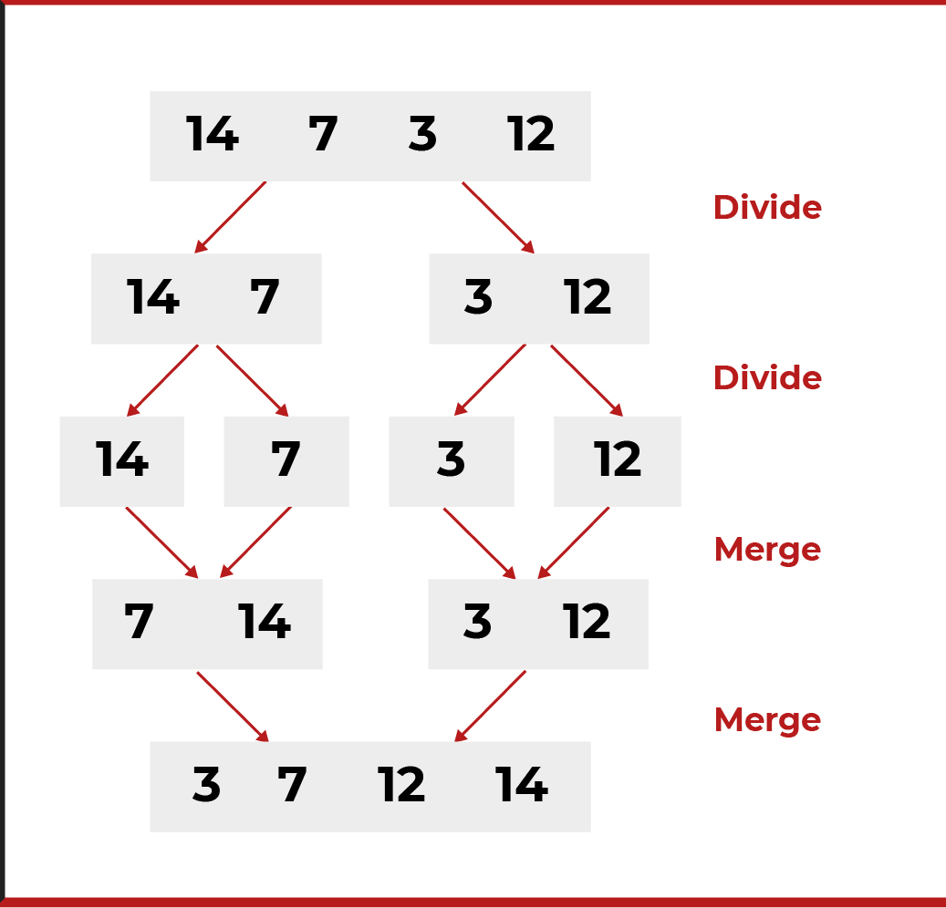
Merge Sort Algorithm
Definition: Merge Sort is a divide and conquer algorithm that divides the input array into two halves, sorts them, and then merges them back together.
Complexity:
Time Complexity: O(nlog⁡n)
Space Complexity: O(n)
Notes:
Explain that this sorting algorithm is foundational in computer science, particularly useful for its efficiency with large datasets. Mention that the focus will be on understanding how it works through visualizations and examples.

Slide 10
Steps of Merge Sort
Divide: Split the array into two halves.
Conquer: Recursively sort both halves.
Combine: Merge the sorted halves to produce the sorted array
Notes:
Walk through the three main steps of Merge Sort:
Divide: Explain how the algorithm splits the array until each subarray contains a single element.
Conquer: Discuss the recursive aspect, where each half is sorted. Reinforce the idea that a single element is inherently sorted.
Combine: Explain how merging happens. This is where the sorted halves are combined into a single sorted array. The merging process involves comparisons and is a crucial part of the algorithm’s efficiency.
For Inpurt ([38, 27, 43, 3, 9, 82, 10]
# merge_sort([38, 27, 43, 3, 9, 82, 10])
# / \
# merge_sort([38, 27, 43]) merge_sort([3, 9, 82, 10])
# / \ / \
# merge_sort([38]) merge_sort([27, 43]) merge_sort([3, 9]) merge_sort([82, 10])
# / \ / \ / \
# merge_sort([27]) merge_sort([43]) merge_sort([3]) merge_sort([9]) merge_sort([82]) merge_sort([10])
# \ / \ / \ /
# [27, 43] (merge) [3, 9] (merge) [82, 10] (merge)
# \ / \
# [27, 38, 43] (merge) [3, 9, 82, 10] (merge)
# \ /
# [3, 9, 10, 27, 38, 43, 82] (final merge)

Slide 11
Comparison between Sorting Algorithms
Sorting Algorithm | Advantages | Disadvantages
Bubble Sort | - Simple to understand and implement. | - Inefficient for large datasets (O(n2)).
 | - Stable sort (maintains relative order of equal elements). | - Performs many redundant comparisons.
 | - In-place sorting (requires little extra memory). | - Generally slower than other algorithms.
Selection Sort | - Simple and easy to understand. | - Inefficient for large datasets (O(n2)).
 | - Performs well on small lists. | - Not stable by default (can be made stable with modifications).
 | - Requires little additional memory (in-place sort). | - Does not adapt to the existing order of the data.
Merge Sort | - Efficient for large datasets (O(nlog⁡n)). | - Requires additional memory for merging (not in-place).
 | - Stable sort (maintains relative order of equal elements). | - More complex to implement than Bubble and Selection Sort.
 | - Good performance on linked lists. | - Can be slower than in-place algorithms for small datasets due to overhead.
Notes:
Bubble Sort:
Advantages:
Simplicity: Its implementation is straightforward, making it a good choice for educational purposes.
Stability: It maintains the order of equal elements, which can be important in certain scenarios.
In-Place Sorting: Requires minimal extra memory, making it suitable for environments with limited space.
Disadvantages:
Inefficiency: The quadratic time complexity (O(n2)) makes it impractical for large datasets.
Redundant Comparisons: Even when the list is already sorted, it continues to check each pair, leading to unnecessary operations.
Slow: Generally slower than other algorithms like Selection Sort and Merge Sort.
Selection Sort:
Advantages:
Simplicity: Similar to Bubble Sort, it’s easy to understand and implement.
Performance on Small Lists: Performs reasonably well on small datasets, making it suitable for certain applications.
Memory Efficiency: Operates in-place, requiring very little additional memory.
Disadvantages:
Inefficiency for Large Datasets: Like Bubble Sort, it has a time complexity of O(n2), making it unsuitable for large lists.
Not Stable: The default implementation is not stable, which can be a drawback in situations where the order of equal elements matters.
Lack of Adaptivity: It does not take advantage of existing order in the dataset, leading to unnecessary comparisons.
Merge Sort:
Advantages:
Efficiency: With a time complexity of O(nlog⁡n), it is much more efficient for large datasets compared to Bubble and Selection Sort.
Stability: It is a stable sort, which is useful when the relative order of equal elements needs to be preserved.
Linked Lists: Performs well on linked lists, as it does not require random access to elements.
Disadvantages:
Memory Usage: Requires additional memory for merging, which can be a limitation in environments with restricted memory.
Complexity: More complex to implement than Bubble and Selection Sort, which can be a disadvantage in some educational contexts.
Overhead for Small Datasets: For smaller datasets, the overhead of the merging process can make it slower than simpler algorithms.
This table can help in understanding the strengths and weaknesses of each sorting algorithm and assist in selecting the appropriate one based on specific needs and constraints.

Slide 12
Time Complexity Comparison
Sorting Algorithm | Best Case | Average Case | Worst Case | Space Complexity
Bubble Sort | O(n | O(n2) | O(n2) | O(1)
Selection Sort | O(n2) | O(n2) | O(n2) | O(1)
Merge Sort | O(nlog⁡n) | O(nlog⁡n) | O(nlog⁡n) | O(n)
Notes:
Bubble Sort:
Best Case: O(n)O(n)O(n) - Occurs when the list is already sorted. In this case, the algorithm makes a single pass through the list without any swaps.
Average Case: O(n2)O(n^2)O(n2) - This reflects the typical scenario where the elements are in random order, leading to nested iterations through the list.
Worst Case: O(n2)O(n^2)O(n2) - Occurs when the list is sorted in reverse order, requiring the maximum number of comparisons and swaps.
Space Complexity: O(1)O(1)O(1) - The algorithm sorts in place, requiring only a constant amount of additional memory.
Selection Sort:
Best Case: O(n2)O(n^2)O(n2) - Even if the list is already sorted, the algorithm still performs all comparisons to find the minimum value for each position.
Average Case: O(n2)O(n^2)O(n2) - Similar to the best case, it has to go through nested iterations regardless of the initial arrangement of the elements.
Worst Case: O(n2)O(n^2)O(n2) - This also remains the same as the average case since the performance does not improve in any situation.
Space Complexity: O(1)O(1)O(1) - Like Bubble Sort, it is an in-place sorting algorithm requiring only a fixed amount of additional memory.
Merge Sort:
Best Case: O(nlog⁡n)O(n \log n)O(nlogn) - This is the case for any initial arrangement of elements because the algorithm consistently divides the list and merges them back in sorted order.
Average Case: O(nlog⁡n)O(n \log n)O(nlogn) - The complexity remains the same as the best case due to the divide-and-conquer approach.
Worst Case: O(nlog⁡n)O(n \log n)O(nlogn) - Similarly, it performs consistently across all scenarios due to its stable dividing and merging strategy.
Space Complexity: O(n)O(n)O(n) - Merge Sort requires additional memory for temporary arrays used during the merging process.

