Slide 1
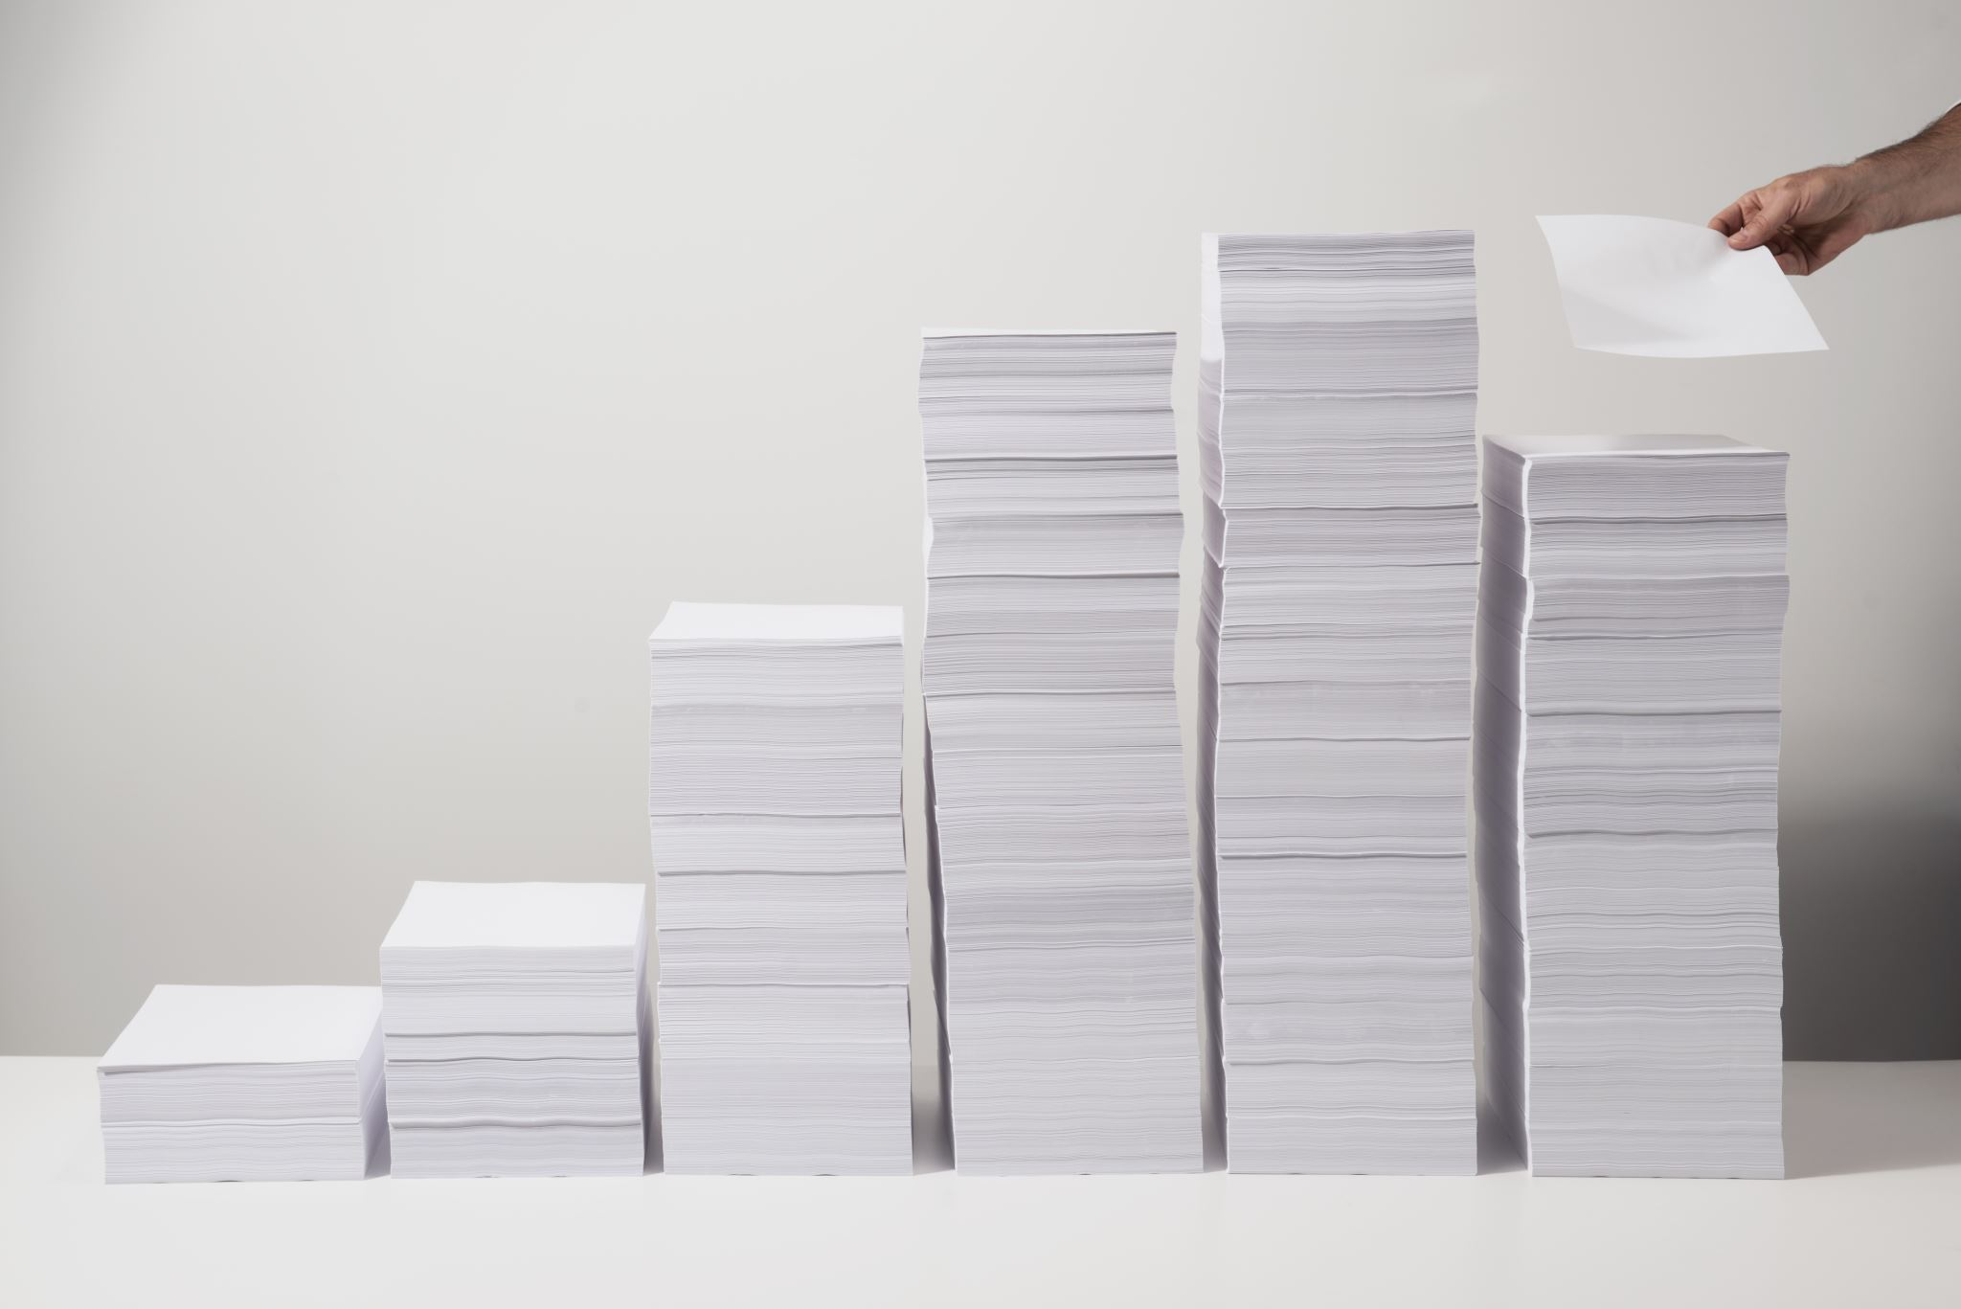
Stack
Notes:
May I begin by saying that the Stack is remarkable DS! One of my favourites in fact. This is part 1 out of 3 in the stack videos, part 2 will consist of looking at the stack implementation and part 3 some source code for how a Stack is implemented using a linked list.

Slide 2
Outline
Discussion about Stacks
What is a Stack?
When and where is a Stack used?
Complexity Analysis
Stack usage examples
Implementation details
Pushing elements on stack
Popping elements from stack
Code Implementation
Notes:
Here are the topics I will be covering in this video as well as the others.
First we will answer the question what is a stack and where is it used. Then we will see some really really cool examples of problems stacks can be used to solve including some basic syntax checking and the Tower of Hanoi. Afterwards we will briefly look at how stacks are implemented internally and the time complexities associated with each of the stack’s operations. Lastly we will look at some source code I have written which implements the stack ADT

Slide 3
Discussion

Slide 4

What is a Stack?
A stack is a one-ended linear data structure which models a real world stack by having two primary operations, namely push and pop.
Data
Data
Push
Pop
Top
Data
Data
Data
Notes:
Slide Title: What is a Stack?
Definition:
A stack is a linear data structure that organizes data in a specific order.
LIFO Principle:
Stacks operate on the Last In, First Out (LIFO) principle.
The last element added to the stack is the first one to be removed.
Basic Structure:
Visualize it as a vertical stack of plates:
The plate on top is the first one to be removed.
Operations:
Push: Add an item to the top of the stack.
Pop: Remove the top item from the stack.
Peek: View the top item without removing it.
isEmpty: Check if the stack is empty.
Dynamic Size:
Stacks can grow and shrink dynamically as items are added or removed.
Restricted Access:
Elements can only be accessed from the top, enforcing a strict access pattern.
Real-World Analogy:
Think of a stack like a stack of books: you can only take the top book off, and you can only add a new book to the top.
Common Use Cases:
Function call management in programming.
Evaluating expressions (e.g., postfix notation).
Implementing undo features in applications.

Slide 5
What is a Stack?
Instructions
pop()
push(‘Onion’)
push(‘Celery’)
push(‘Watermelon’)
pop()
pop()
push(‘Lettuce’)
Apple
Potato
Cabbage
Garlic
Notes:
In this example we have a list of instructions that are about to be performed on the stack on the right hand side. Let’s have a walk through and see what happens.

Slide 6

What is a Stack?
Instructions
pop()
push(‘Onion’)
push(‘Celery’)
push(‘Watermelon’)
pop()
pop()
push(‘Lettuce’)
Apple
Potato
Cabbage
Garlic
Notes:
The first instruction says pop, so we remove the top element of the stack.

Slide 7
What is a Stack?
Instructions
pop()
push(‘Onion’)
push(‘Celery’)
push(‘Watermelon’)
pop()
pop()
push(‘Lettuce’)
Apple
Potato
Cabbage
Garlic

Slide 8
What is a Stack?
Instructions
pop()
push(‘Onion’)
push(‘Celery’)
push(‘Watermelon’)
pop()
pop()
push(‘Lettuce’)
Potato
Cabbage
Garlic

Slide 9
What is a Stack?
Instructions
pop()
push(‘Onion’)
push(‘Celery’)
push(‘Watermelon’)
pop()
pop()
push(‘Lettuce’)
Onion
Potato
Cabbage
Garlic
Notes:
Then the next instruction says to push onion on the stack, so we add onion to the top of the stack.

Slide 10
What is a Stack?
Instructions
pop()
push(‘Onion’)
push(‘Celery’)
push(‘Watermelon’)
pop()
pop()
push(‘Lettuce’)
Onion
Potato
Cabbage
Garlic

Slide 11
What is a Stack?
Instructions
Celery
pop()
push(‘Onion’)
push(‘Celery’)
push(‘Watermelon’)
pop()
pop()
push(‘Lettuce’)
Onion
Potato
Cabbage
Garlic
Notes:
The next instruction we push celery onto the Stack.

Slide 12
What is a Stack?
Instructions
pop()
push(‘Onion’)
push(‘Celery’)
push(‘Watermelon’)
pop()
pop()
push(‘Lettuce’)
Celery
Onion
Potato
Cabbage
Garlic

Slide 13
What is a Stack?
Instructions
Watermelon
pop()
push(‘Onion’)
push(‘Celery’)
push(‘Watermelon’)
pop()
pop()
push(‘Lettuce’)
Celery
Onion
Potato
Cabbage
Garlic
Notes:
Next is Watermelon which we put on top of celery which is at the top of the stack.

Slide 14
What is a Stack?
Instructions
Watermelon
pop()
push(‘Onion’)
push(‘Celery’)
push(‘Watermelon’)
pop()
pop()
push(‘Lettuce’)
Celery
Onion
Potato
Cabbage
Garlic

Slide 15
What is a Stack?
Instructions
Watermelon
pop()
push(‘Onion’)
push(‘Celery’)
push(‘Watermelon’)
pop()
pop()
push(‘Lettuce’)
Celery
Onion
Potato
Cabbage
Garlic
Notes:
The next operation says pop, so we remove the element at the top of the stack, this is watermelon which we just added.

Slide 16
What is a Stack?
Instructions
Watermelon
pop()
push(‘Onion’)
push(‘Celery’)
push(‘Watermelon’)
pop()
pop()
push(‘Lettuce’)
Celery
Onion
Potato
Cabbage
Garlic
Notes:
The next operation says pop so we remove the element at the top of the stack, this is watermelon which we just added.

Slide 17
What is a Stack?
Instructions
pop()
push(‘Onion’)
push(‘Celery’)
push(‘Watermelon’)
pop()
pop()
push(‘Lettuce’)
Celery
Onion
Potato
Cabbage
Garlic

Slide 18
What is a Stack?
Instructions
pop()
push(‘Onion’)
push(‘Celery’)
push(‘Watermelon’)
pop()
pop()
push(‘Lettuce’)
Celery
Onion
Potato
Cabbage
Garlic
Notes:
The next operation is also pop, so we remove the element at the top of the stack this time being celery.

Slide 19
What is a Stack?
Instructions
Celery
pop()
push(‘Onion’)
push(‘Celery’)
push(‘Watermelon’)
pop()
pop()
push(‘Lettuce’)
Onion
Potato
Cabbage
Garlic

Slide 20
What is a Stack?
Instructions
pop()
push(‘Onion’)
push(‘Celery’)
push(‘Watermelon’)
pop()
pop()
push(‘Lettuce’)
Onion
Potato
Cabbage
Garlic

Slide 21
What is a Stack?
Instructions
Lettuce
pop()
push(‘Onion’)
push(‘Celery’)
push(‘Watermelon’)
pop()
pop()
push(‘Lettuce’)
Onion
Potato
Cabbage
Garlic
Notes:
The last operation is to push lettuce on the stack, so we add lettuce to the top of the stack.

Slide 22
What is a Stack?
Instructions
pop()
push(‘Onion’)
push(‘Celery’)
push(‘Watermelon’)
pop()
pop()
push(‘Lettuce’)
Lettuce
Onion
Potato
Cabbage
Garlic

Slide 23
When and where is a Stack used?
Used by undo mechanisms in text editors.
Used in compiler syntax checking for matching brackets and braces.
Can be used to model a pile of books or plates.
Used behind the scenes to support recursion by keeping track of previous function calls.
Can be used to do a Depth First Search (DFS) on a graph.
Notes:
So now that we understand the basics of how a stack works, where does it get used? Stacks are surprisingly everywhere. They are used in text editors to undo text you’ve written in browsers to navigate backwards and forwards.
They are used in compilers to make sure that you have the correct number of matching braces and in the right order.
Stacks can be used to model real world books, plates, and even games like the tower of hanoi.
Stacks are also used behind the scenes to support recursion by keeping track of previous function calls. When a function returns it pops the current stack frame off the stack and rewinds to the next function that called it in the stack, it’s rather remarkable that we use stacks all the time in programming and never even notice it.
Something else you can use stacks for is to perform a depth first search on a graph. A depth first search can be done by manually maintaining your own stack or by using recursion, well guess what both use stacks as we just discussed.

Slide 24
Complexity
Analysis

Slide 25
Complexity
Pushing | O(1)
Popping | O(1)
Peeking | O(1)
Searching | O(n)
Size | O(1)
Notes:
The following complexity table assumes you implemented a Stack using a linked list.
Pushing takes constant time because we have a reference to the top of the stack at all times, same argument goes for popping and peeking.
Searching however still take linear time. The element we’re searching for isn’t necessarily at the top of the stack, it could be at the very bottom, meaning we have to search all the elements in the stack until we find it.
Getting the size of the stack is a constant time operation because we are able to maintain a counter of the number of elements in the stack at all times. When a push operation happens we add +1 to the counter and if a pop operation happens add -1 to the counter, simple.

Slide 26
Example - Brackets
Problem: Given a string made up of the following brackets: ()[]{}, determine whether the brackets properly match.
[{}]
Valid
(()())
Valid
{]
Invalid
[()]))()
Invalid
[]{}({})
Valid
Notes:
Let’s look at an example of when stacks can be useful.
Read the problem.
Before I give you the solution, try and use a stack and solve this problem yourself.

