Slide 1

Feed Forward Neural Network Raj Sarode / 002762015 / Data Science Engineering Methods and Tools

Slide 2
Problem Statement
Implement a simple feed-forward neural network model for the loan dataset and then evaluate the performance on a 80/20 split. Exclude irrelevant columns and perform one-hot encoding and normalization of each column, if needed.

Slide 3

Feed Forward Neural Network
Neurons - Feed forward neural networks consist of artificial neurons that take inputs and produce outputs through a series of weighted connections.
Training - The model is trained with gradient descent, which adjusts the weights and biases to minimize the error between predicted and actual values.
Generalization - The goal is to achieve good generalization to unseen data, avoiding overfitting by using regularization, dropout, and early stopping.

Slide 4
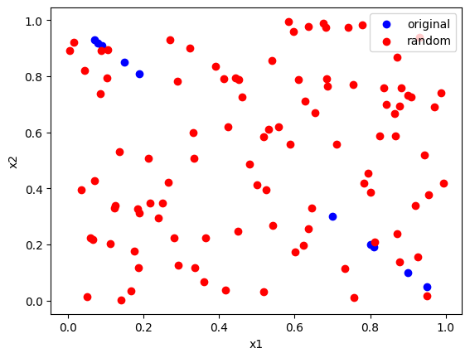
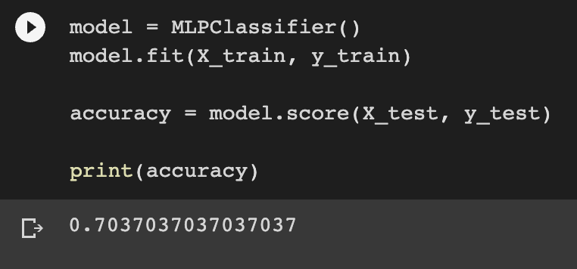
Results

