Slide 1

RAJ SARODE
002762015
Data science engineering methods and tools
Convolution Neural networks

Slide 2
Problem Statement & Approach
Problem Statement: Predicting the median value of owner-occupied homes in the Boston Housing Dataset.
Approach:
Import necessary libraries
Load the Cipher10 dataset
Split the dataset into 90/10 split
Used ”relu” as my activation function.
Compared the accuracies of 3 CNN models by their accuracies.
Activation function: Relu, Sigmoid
Outcome:
After changing the dropout values and simultaneously increasing the batch size, received a greater accuracy compared to consecutive previous models.

Slide 3
CNN – Cifar10 Dataset
Cifar-10 is a standard computer vision dataset used for image recognition. It is a subset of the 80 million tiny images dataset and consists of 60,000 32×32 color images containing one of 10 object classes, with 6000 images per class. There are 50000 training images and 10000 test images.
The 10 object classes that are present in this dataset are airplanes, automobiles, birds, cats, deers, dogs, frogs, horses, ships, and trucks. All these classes are mutually exclusive and there is no overlap between automobiles and trucks.
To complete the model, you will feed the last output tensor from the convolutional base (of shape (4, 4, 64)) into one or more Dense layers to perform classification. Dense layers take vectors as input (which are 1D), while the current output is a 3D tensor.
I’ve flattened (or unroll) the 3D output to 1D, then add one or more Dense layers on top. CIFAR has 10 output classes, so you use a final Dense layer with 10 outputs.

Slide 4
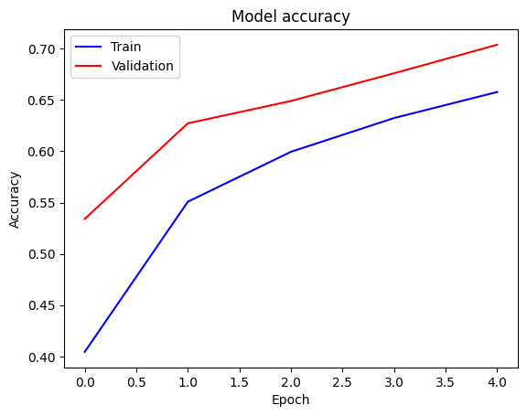
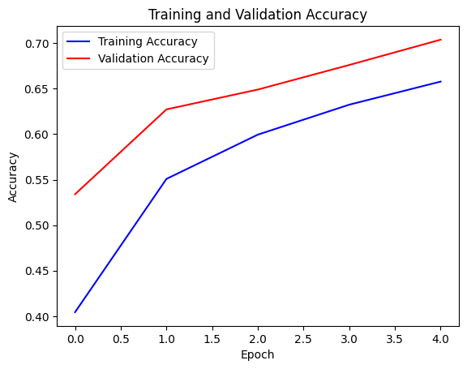
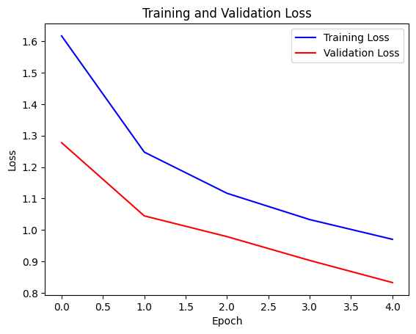
CNN Model - 1
Activation Function – Relu, Softmax Dropout Value – 0.25, 0.5 Batch Size – 64 Epochs – 8 , Test Accuracy – 0.76, Test Loss – 0.68 Here as we can see that a comparison between training and validation loss is plotted:

Slide 5
CNN Model - 2
Activation Function – Relu, Softmax Dropout Value – 0.5 Batch Size – 64 Epochs – 5 , Test Accuracy – 0.70, Test Loss – 0.85 Here as we can see that a comparison between training and validation loss is plotted:

Slide 6
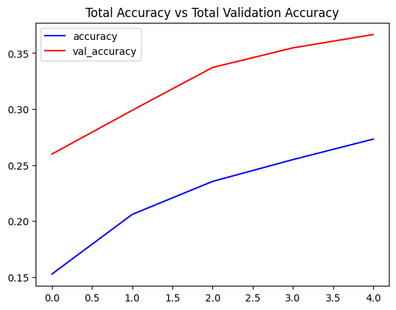
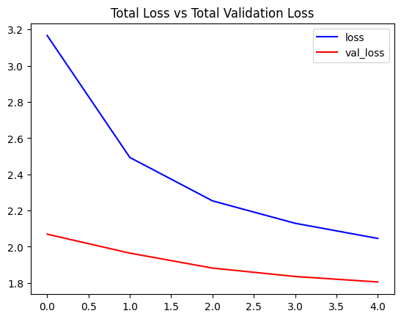
CNN Model - 3
Activation Function – Relu, Softmax Dropout Values – 0.5, 0.25 Batch Size – 128 Epochs – 30 , Accuracy – 0.78 Added 2 Conv2D layers followed by Batch Normalization Layer Here as we can see that a comparison between training and validation loss is plotted: 1. Total Accuracy vs Total Validation Accuracy 2. Total Loss vs Validation Loss

