Slide 1
- RAJ SARODE - 002762015
HIERARCHIAL AND K-MEANS
CLUSTERING

Slide 2
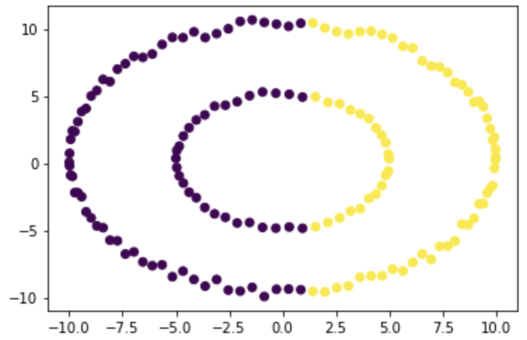
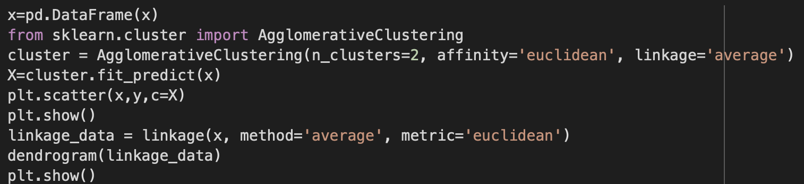
HIERARCHIAL CLUSTERING
Hierarchical clustering is one of the popular and easy to understand clustering technique. This clustering technique is divided into two types:
Agglomerative
Divisive
1. Agglomerative:
In this technique, initially each data point is considered as an individual cluster. At each iteration, the similar clusters merge with other clusters until one cluster or K clusters are formed.

Slide 3
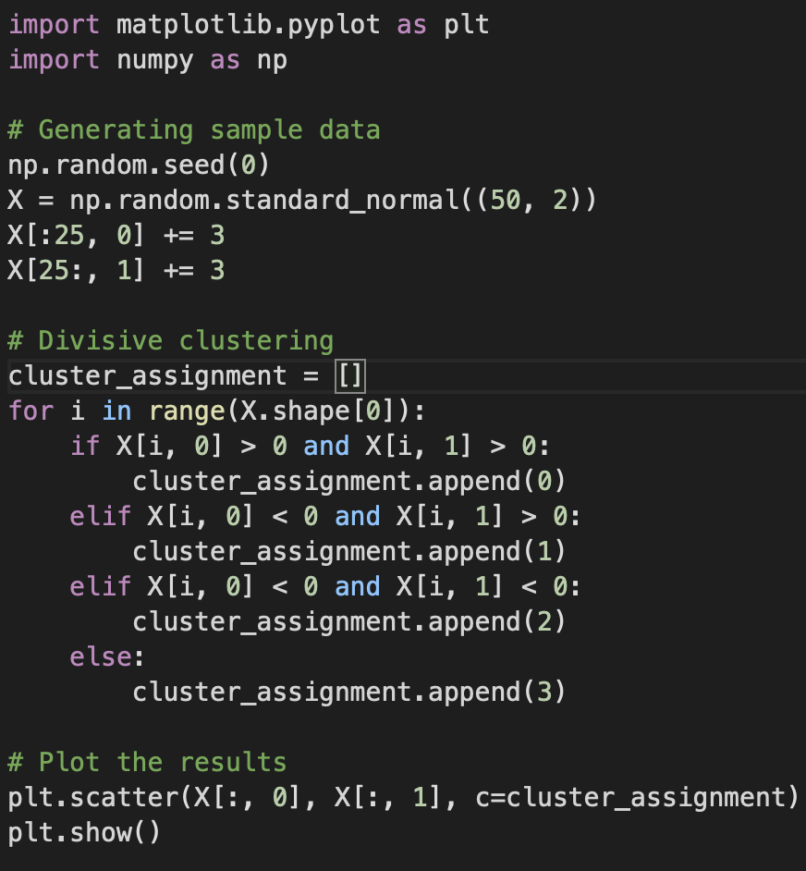
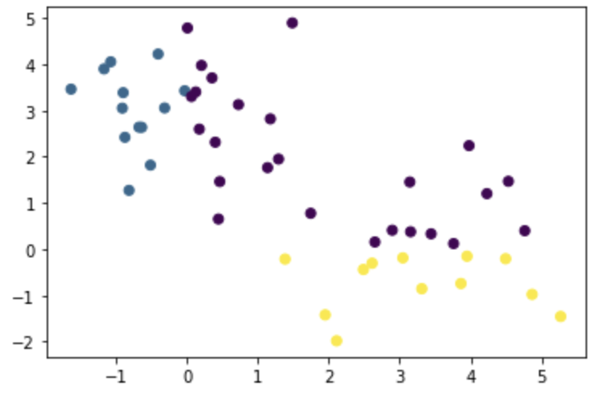
2. Disisive Clustering:
Divisive Hierarchical clustering is exactly the opposite of the Agglomerative Hierarchical clustering. In Divisive Hierarchical clustering, we consider all the data points as a single cluster and in each iteration, we separate the data points from the cluster which are not similar. Each data point which is separated is considered as an individual cluster. In the end, we’ll be left with n clusters.

Slide 4
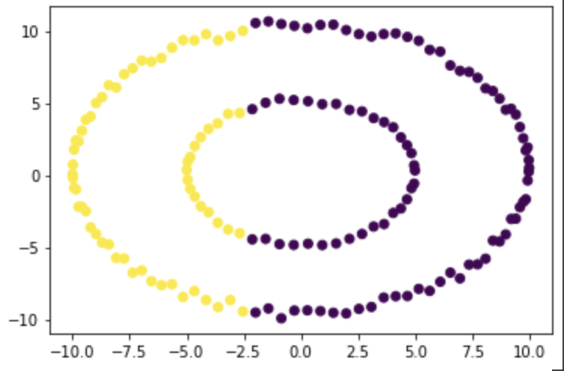
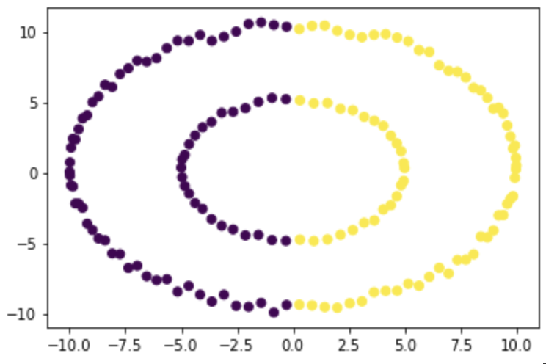
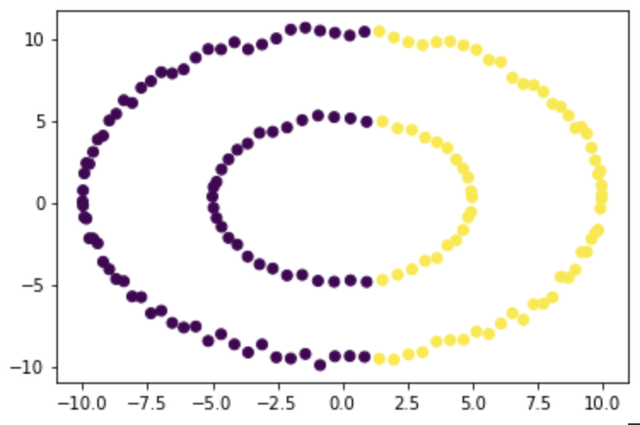
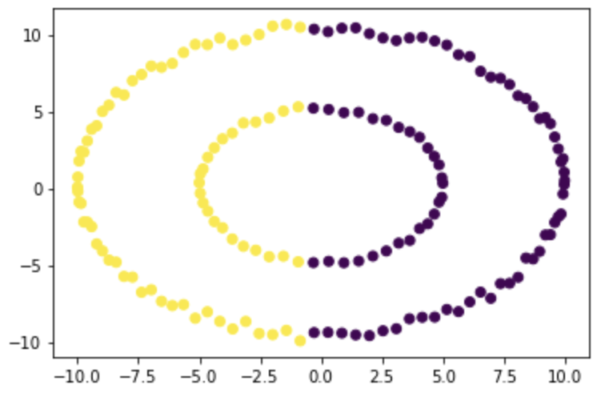
Ward Linkage
Single Linkage
Average Linkage
Complete Linkage

Slide 5
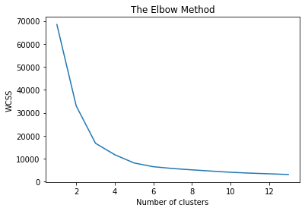
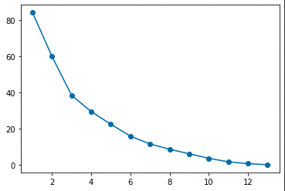
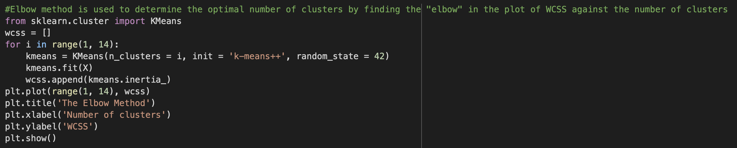
K-Means Clustering:
K-means clustering is a simple unsupervised learning algorithm that is used to solve clustering problems. It follows a simple procedure of classifying a given data set into a number of clusters, defined by the letter "k," which is fixed beforehand.
Elbow Method in K-Means Clustering:
The elbow method is a graphical representation of finding the optimal ‘K’ in a K-means clustering. It works by finding WCSS (Within-Cluster Sum of Square) i.e. the sum of the square distance between points in a cluster and the cluster centroid.
The elbow graph shows WCSS values(on the y-axis) corresponding to the different values of K(on the x-axis). When we see an elbow shape in the graph, we pick the K-value where the elbow gets created. We can call this point the Elbow point.

Slide 6
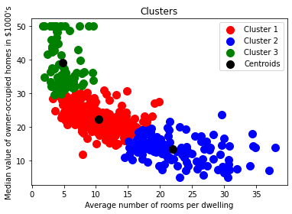
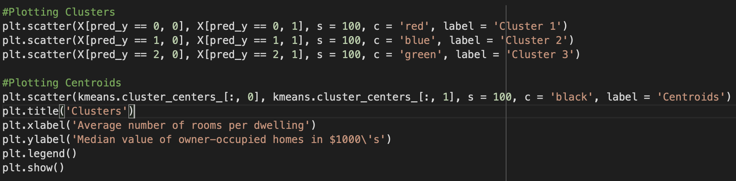
Scatter Plot

Slide 7
THANK YOU

