Slide 1
McDonald's Nutrition: A Diagnostic Analysis
Diagnostic analysis of the fast-food dataset
Prepared by: Sauravi Sarode
Batch / Team: PTID-CDA-SEP-26-11277
Date: 10-10-2026
Notes:
Introduce yourself and the project. I analysed McDonald's from the fast food nutrition dataset and built a Power BI dashboard to explain why its numbers look the way they do.

Slide 2
The project at a glance
512
8
57
records in the dataset
restaurant chains
McDonald's menu items
Goal: explain why McDonald's calories, sodium and protein look the way they do, and recommend improvements.
Limitation: the dataset has no price column, so nutrition measures replace average price.
Notes:
The dataset has 515 records across 8 chains. McDonald's has 57 items. The brief mentions average price, but there is no price column, so I used nutrition measures instead.

Slide 3
Cleaning the data
1
Removed useless columns
2
Removed duplicates
satish (empty), age (all zeros) and salad (all "Other")
1 duplicate rows, leaving 511 records
3
Fixed missing values
4
Created new columns
Replaced "NA" with null and set numeric data types
Calorie Category, Is Salad and Protein per 100 Cal
Notes:
Four cleaning steps. I also found that inch marks in item names broke the CSV, so three rows were lost. Connecting directly to MySQL solved that.

Slide 4
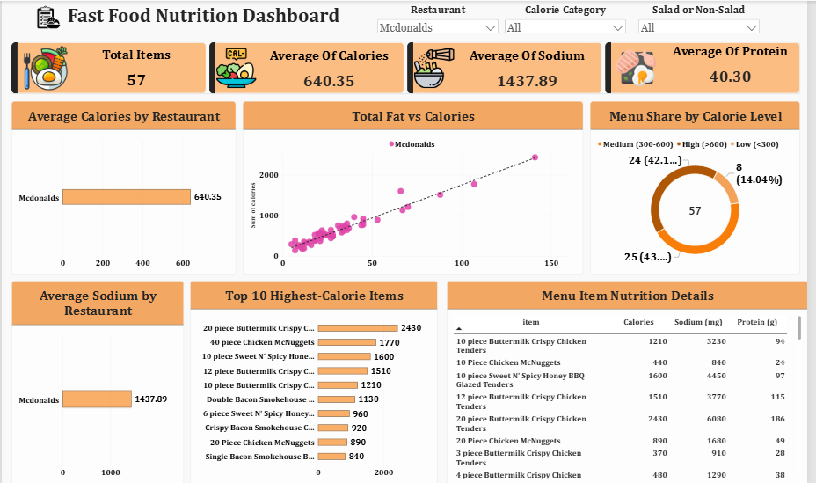
The dashboard
Notes:
Walk through the dashboard: KPI cards, the charts and the three slicers. Click the restaurant slicer and the calorie category slicer to show everything updating together.

Slide 5
Big portions drive calories
140 to 2,430
calories per item
Why
Multi-piece sharing portions, breaded and fried.
Meaning
Single items are far lower: Hamburger 250, Cheeseburger 300.
Notes:
Calories range from 140 to 2,430. The top five are all large chicken portions. They are shared items listed as one, which pulls the average up to 640.

Slide 6
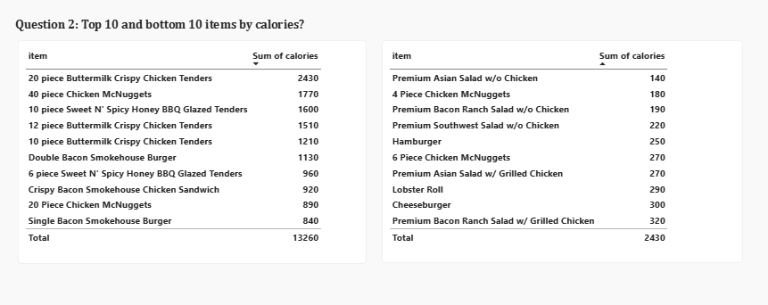
Top 10 and bottom 10 items by calories

Slide 7
Sodium runs very high
19 of 57
items above 1,500 mg
Why
Breading, sauces, cheese and processed meat add salt.
Meaning
Six items exceed 2,300 mg, the daily limit. Saturated fat peaks at 27 g in the Double Bacon Smokehouse Burger.
Notes:
The same fried chicken items lead on sodium. The 20 piece tenders have 6,080 mg, more than double the commonly cited daily limit. For saturated fat, multi-patty burgers lead, with the Double Bacon Smokehouse Burger at 27 grams.

Slide 8
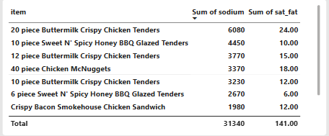
Top 10 items by sodium

Slide 9
Best protein per calorie
13.13
g protein per 100 calories
Why
Grilled chicken is lean protein, with no breading or frying.
Meaning
The Bacon Ranch Salad gives 42 g protein for 320 calories.
Notes:
This ratio shows the best nutritional value. Grilled chicken salads and sandwiches lead because they give a lot of protein for few calories.

Slide 10
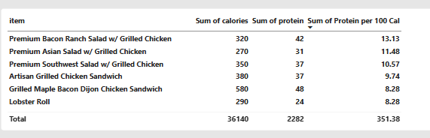
Most protein for the fewest calories

Slide 11
Salads vs other items
Salads (9 items)
Non-salads (48 items)
332
698
calories on average
calories on average
Sodium: 824 mg Protein: 26 g
Sodium: 1,553 mg Protein: 43 g
Why: salads replace buns, fries, fried coatings and cheese with vegetables, so calories and sodium are roughly halved. Protein is lower because there is less meat.
Notes:
Salads average 332 calories against 698 for other items, and sodium is about half. Protein is also lower because there is less meat.

Slide 12
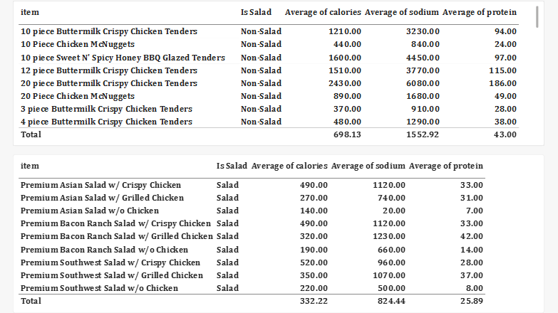
Salads vs other items

Slide 13
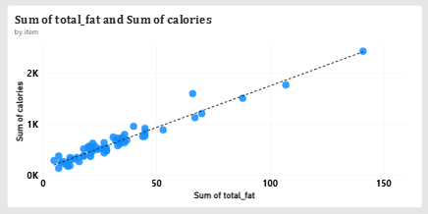
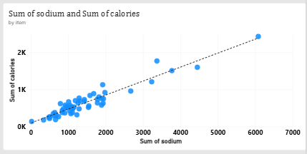
Fat drives calories
0.97
correlation: calories and fat
0.95
calories and sodium
Why: fat has 9 calories per gram versus 4 for carbs and protein. Meat-heavy items bring fat, salt and protein together.
Notes:
Both scatter charts rise tightly along the trend line. Correlation of calories with fat is about 0.97 and with sodium about 0.95. This shows a relationship, not proof of cause.

Slide 14
Diagnostic summary
Finding | Why it happens
Calories up to 2,430 | Multi-piece fried items listed as one item
High sodium | Breading, sauces, cheese and processed meat; 19 of 57 items above 1,500 mg
High saturated fat | Double patties, bacon and cheese, up to 27 g
Salads are lighter | Vegetables replace buns, fries and coatings: 332 vs 698 calories
Calories follow fat | 9 calories per gram of fat versus 4 for carbs and protein
Notes:
Summarise the five main findings and the reason behind each.

Slide 15
Recommendations
Separate sharing portions
Add sodium warnings
1
2
Show sharing items apart from single servings
Flag items above 1,500 mg
Promote grilled options
Add lighter items
3
4
Best protein per calorie
Only 8 of 57 items are under 300 calories
Cut fat in multi-patty burgers
Collect price and sales data
5
6
Lowers calories and saturated fat
Link nutrition to what customers buy
Notes:
Six recommendations, each tied to a finding. The last one is about data: price and sales data would let us link nutrition to real customer choices.

Slide 16
Conclusion
McDonald's ranges from a 140-calorie salad to a 2,430-calorie sharing platter. The extremes come from large, fried, breaded portions, while salads and grilled chicken are the lightest, highest-value choices. Better labelling and more light options would help customers choose well.
Thank you.
Notes:
Close with the main takeaway and mention the limitation: no price or sales data. Then thank the audience.

